Slide 1
All Through The Night
Words: | Welsh Folk Song, Translated
Music: | Old Welsh Air (c. 1794)
4/4
G/G- DO
Verses: 2
Lead - | DO
Alto - | SOL
Tenor - | DO
Bass - | DO
PDHymns.com

Slide 2
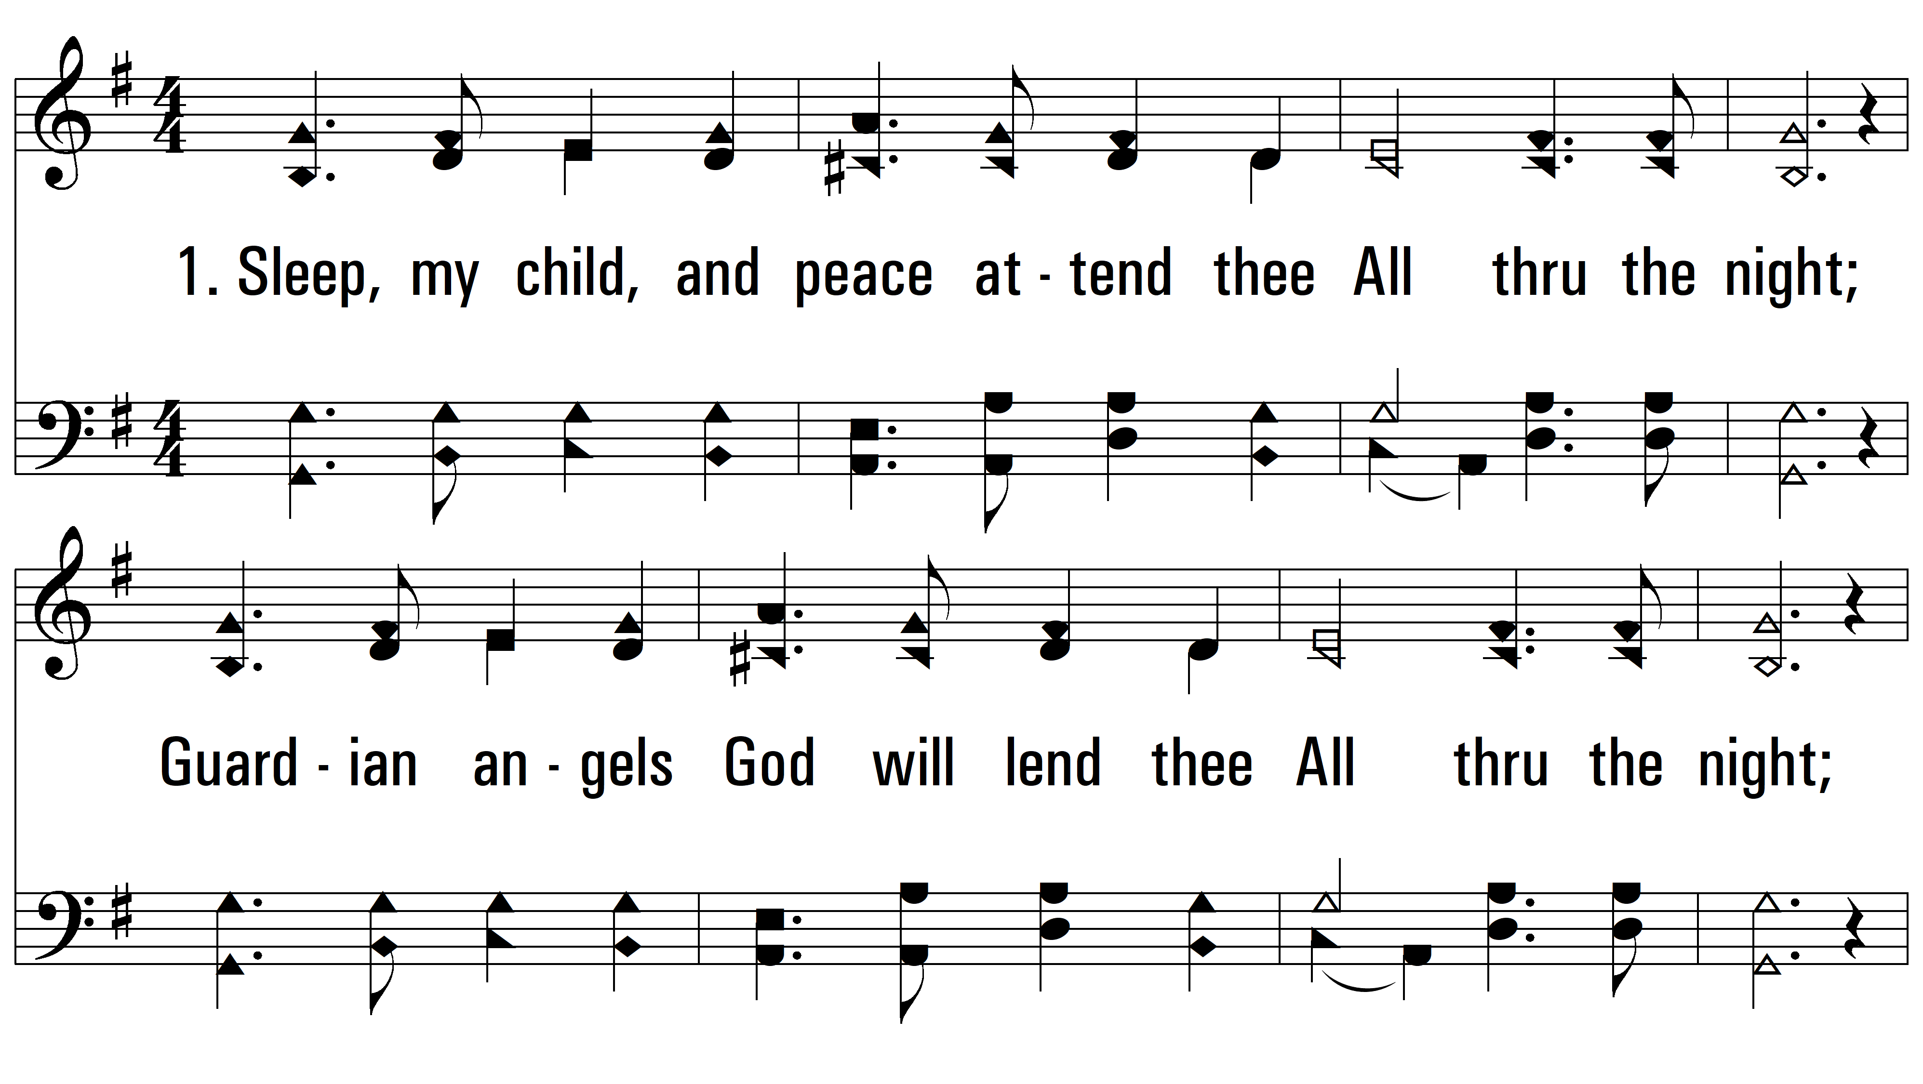
vs. 1 ~ All Through The Night

Slide 3
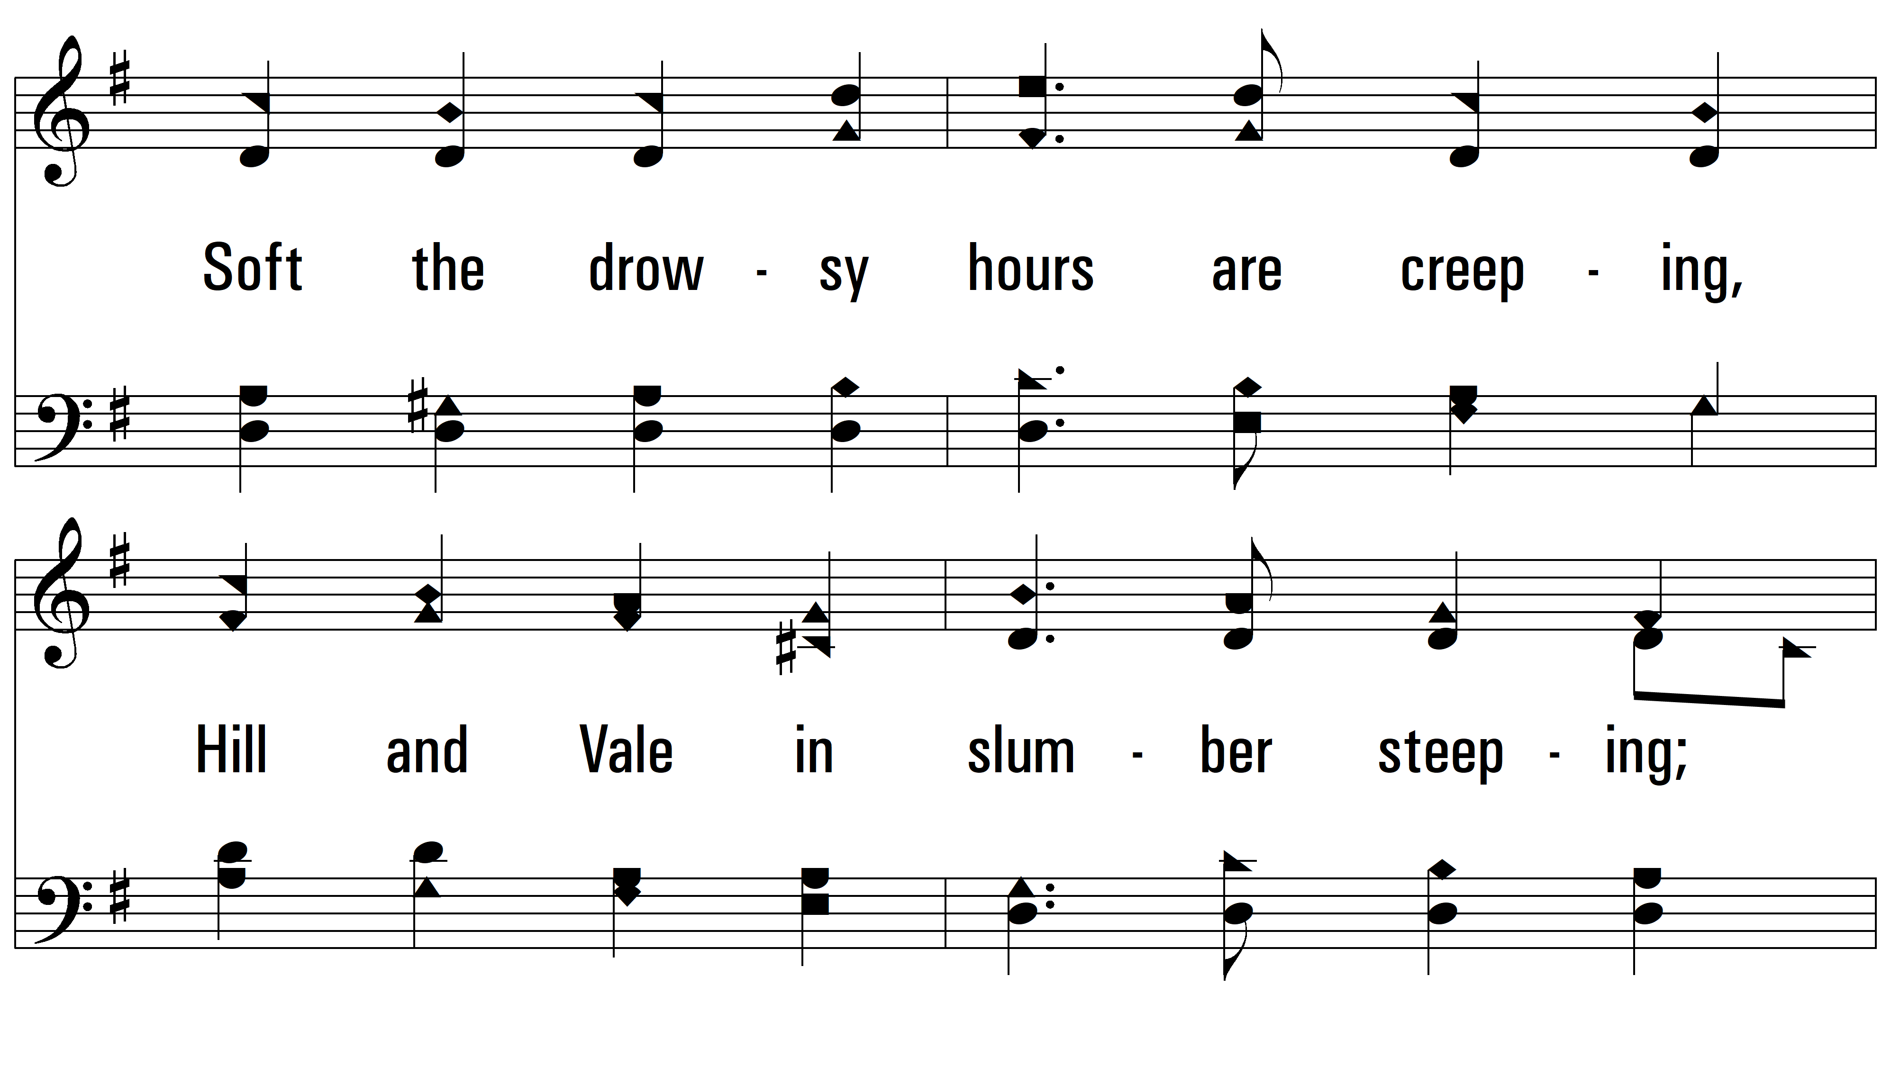
vs. 1

Slide 4
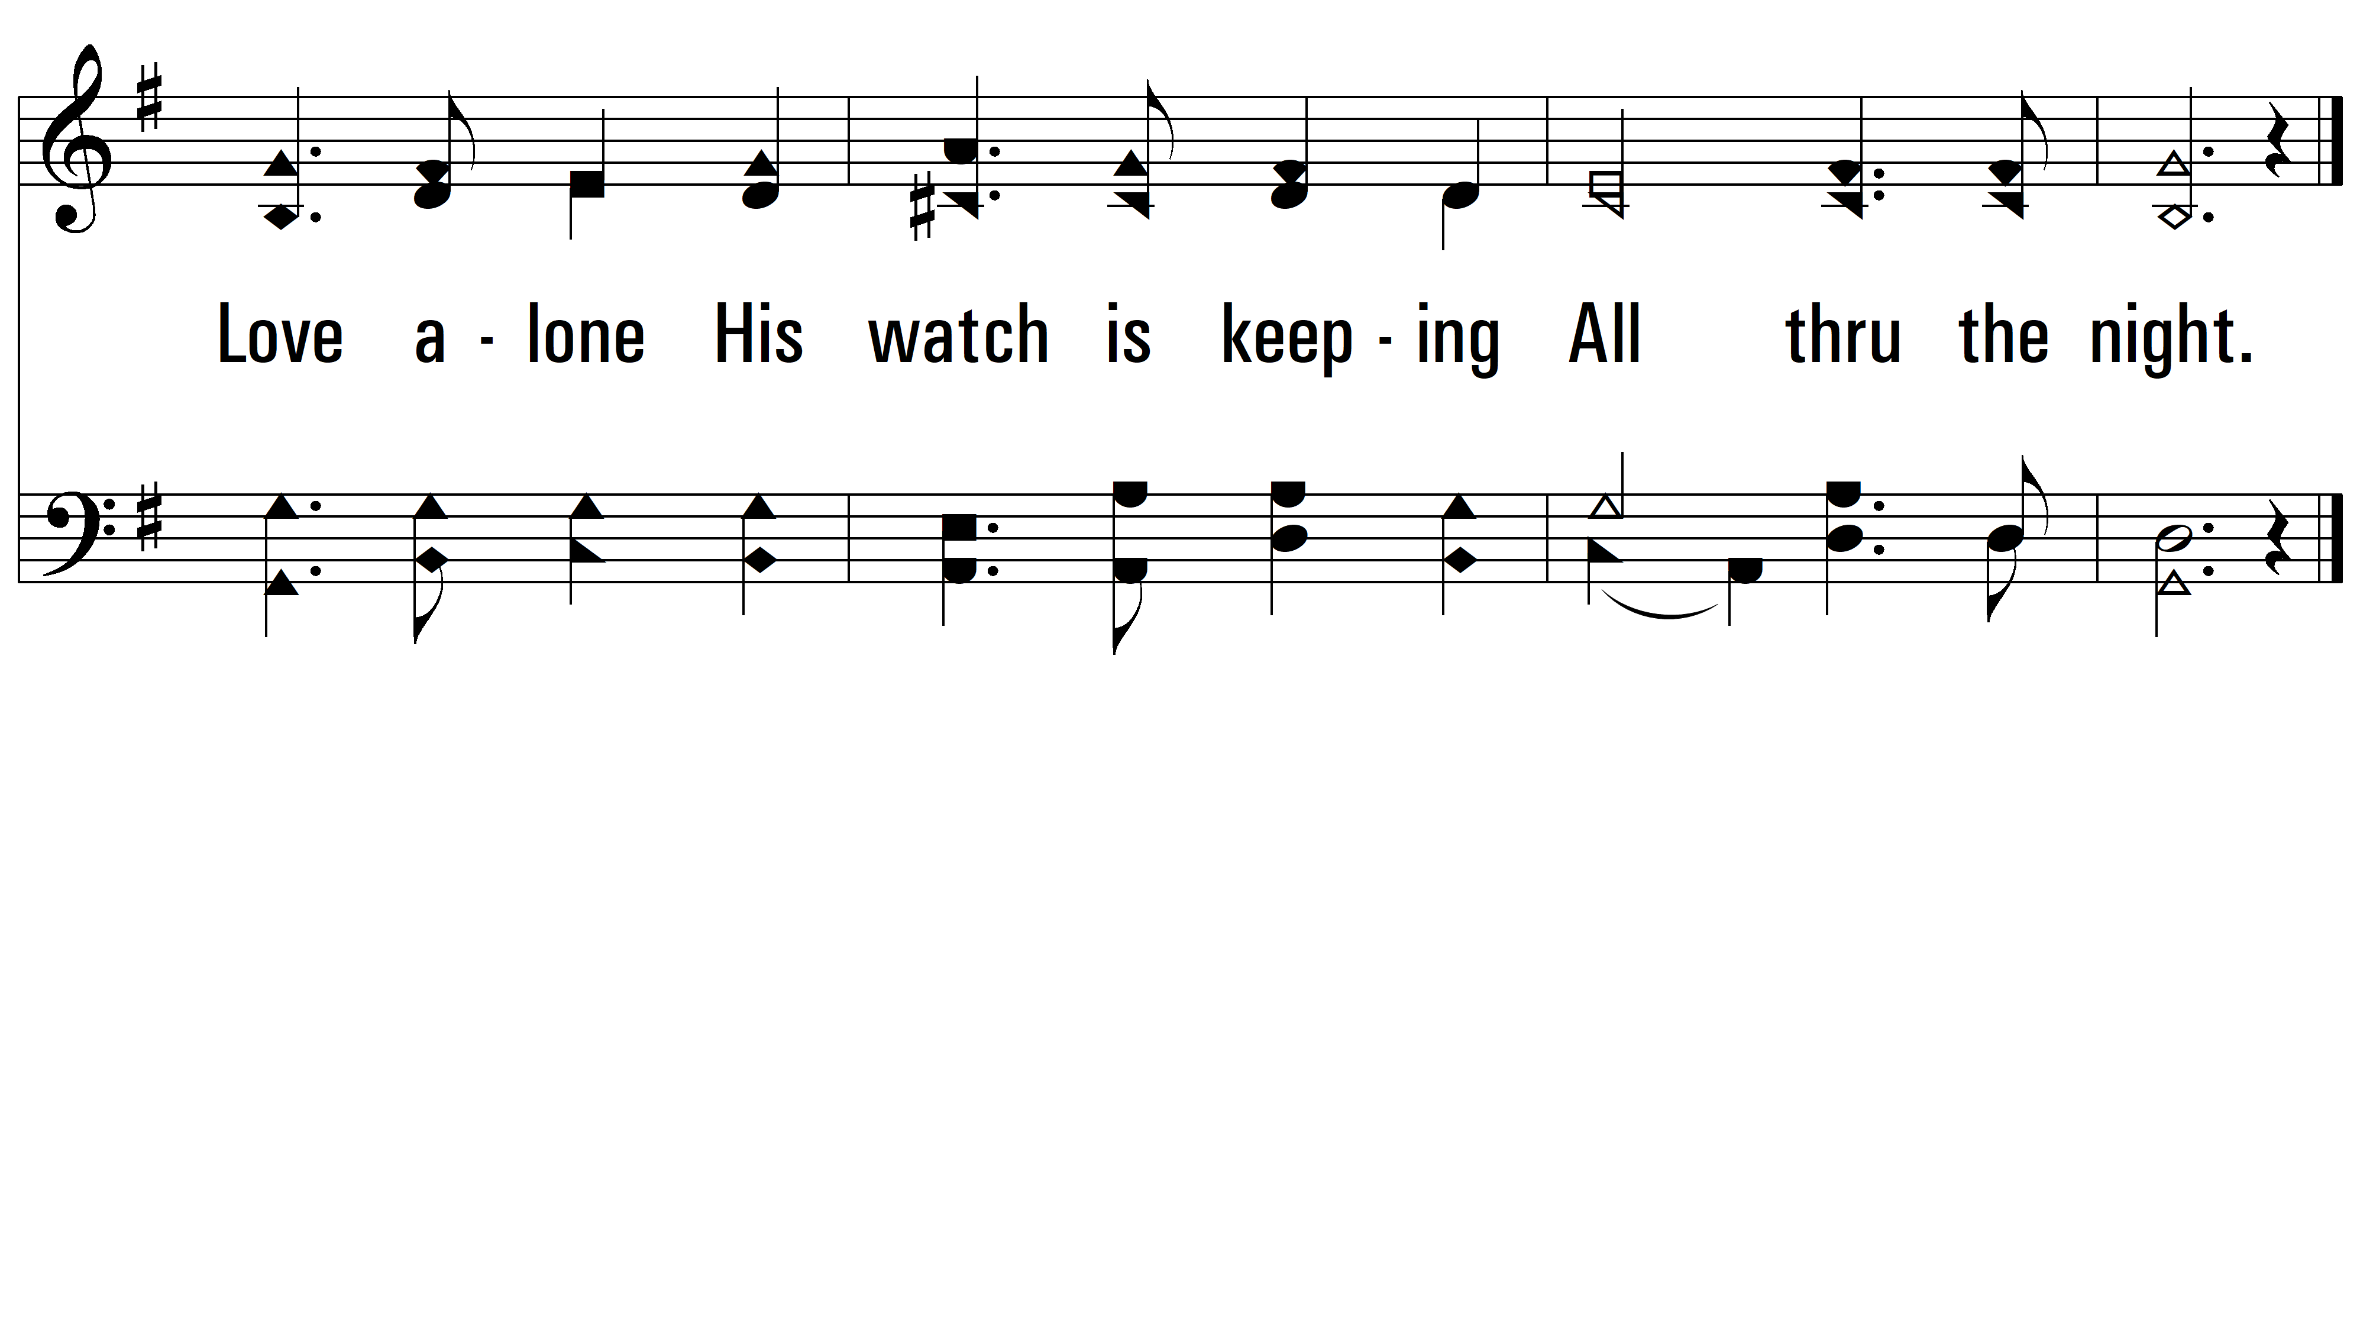
vs. 1

Slide 5
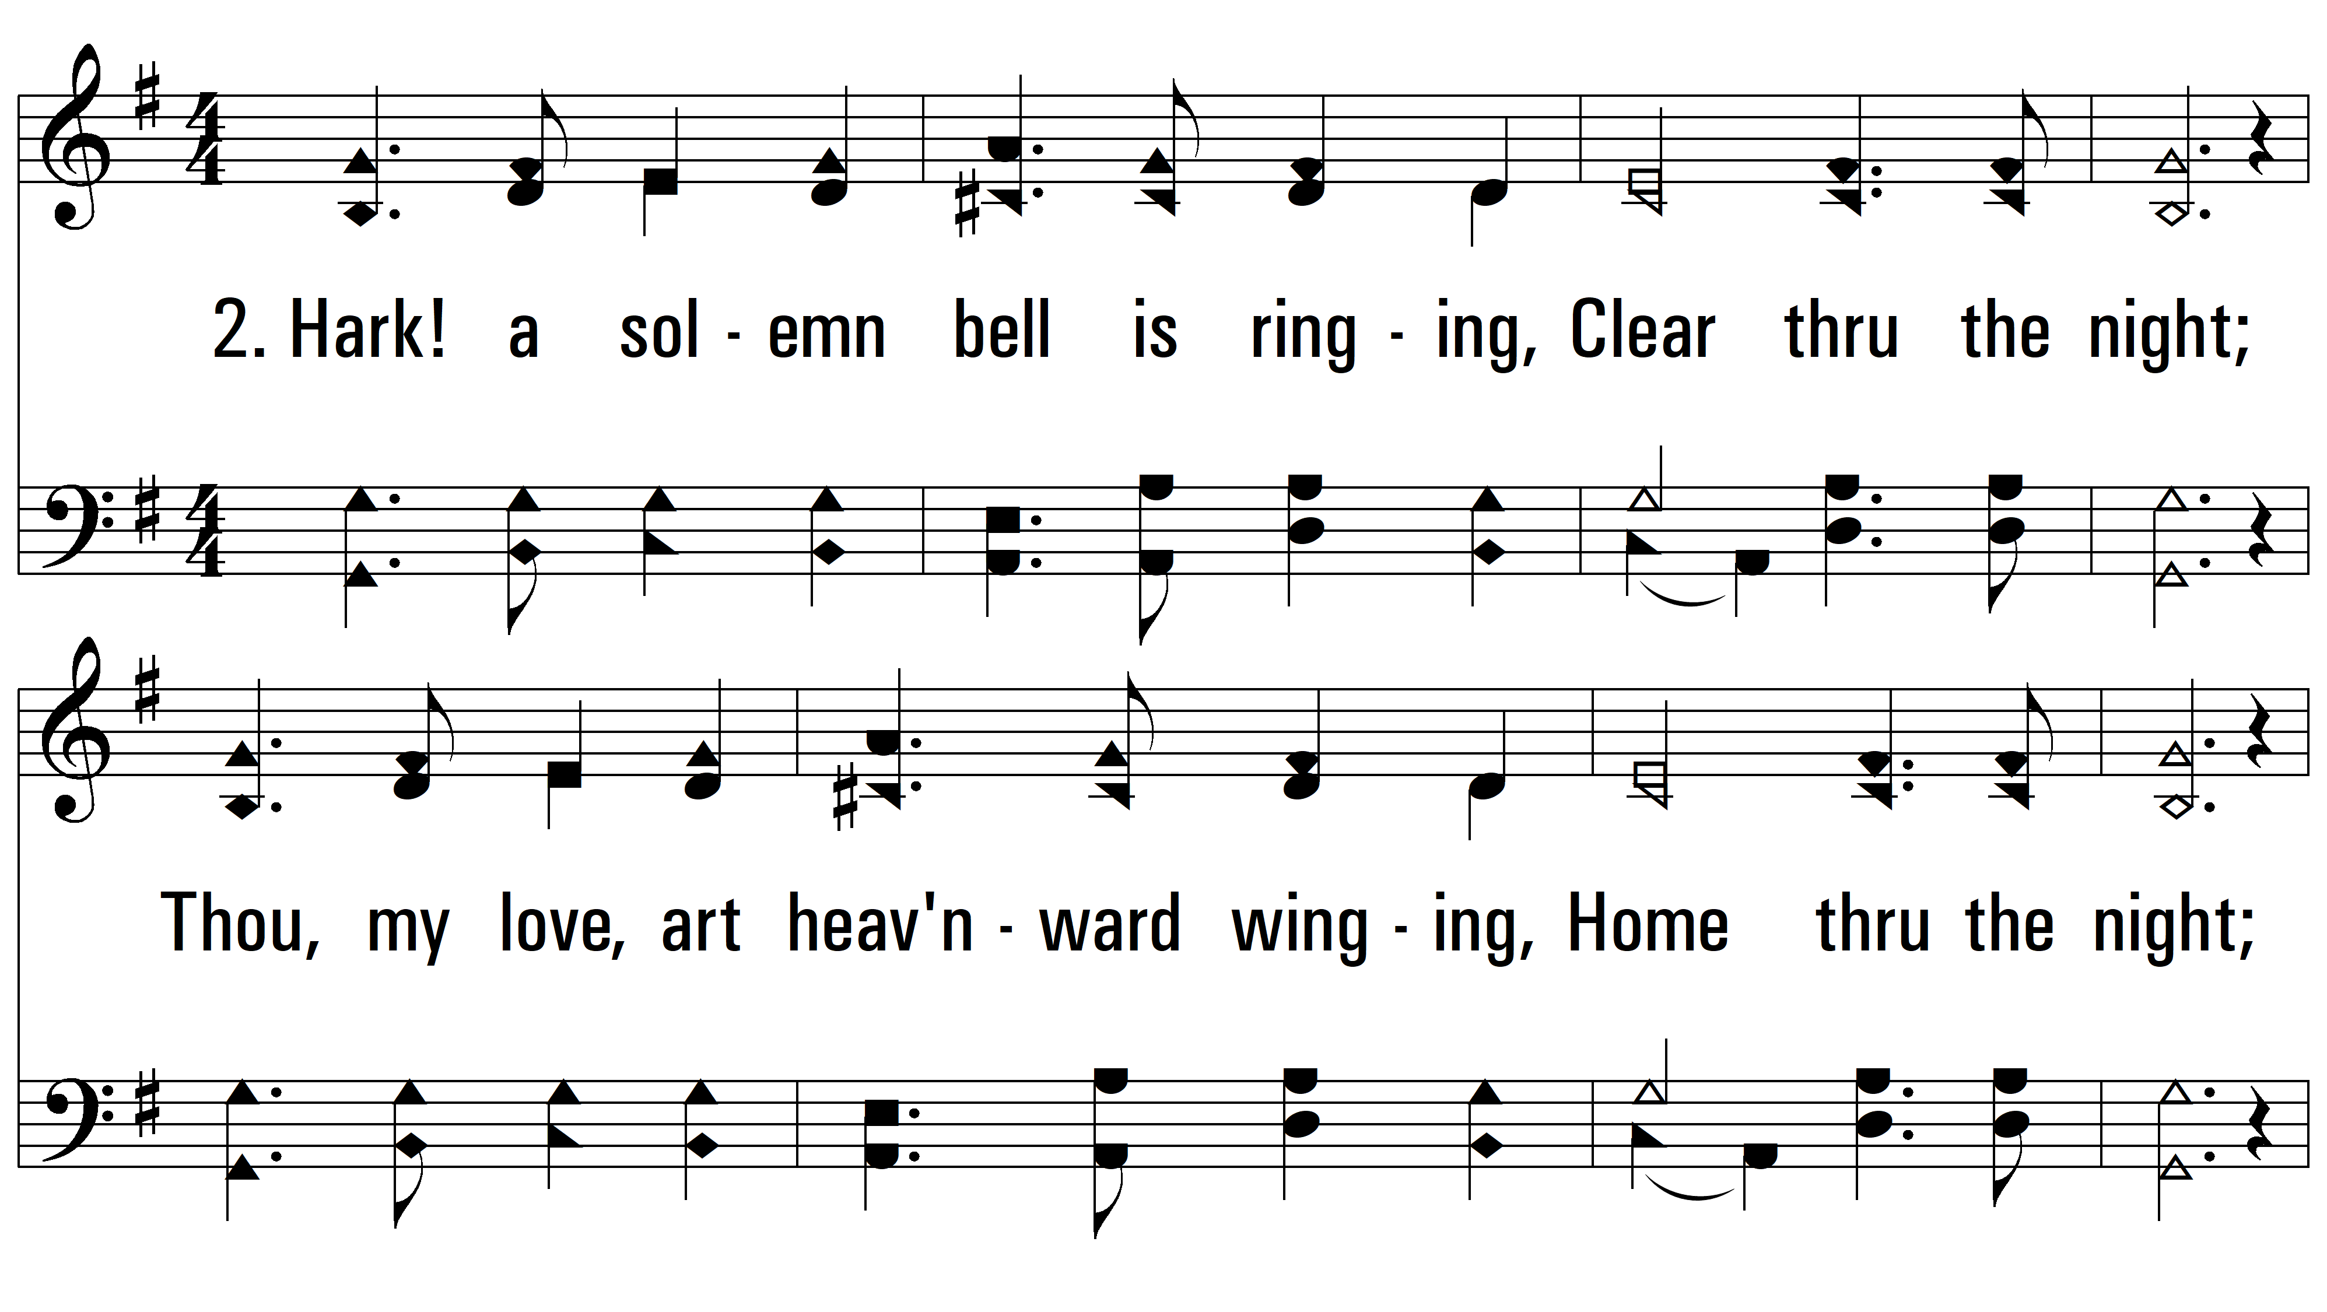
vs. 2 ~ All Through The Night

Slide 6
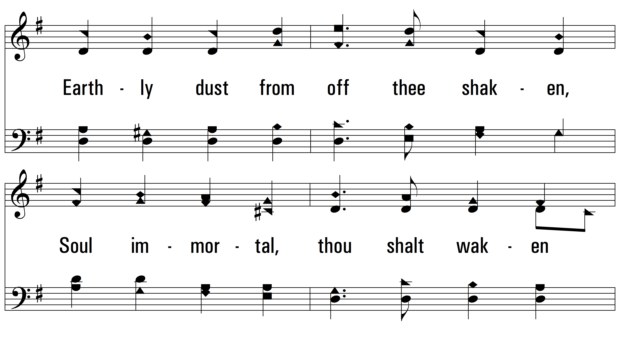
vs. 2

Slide 7
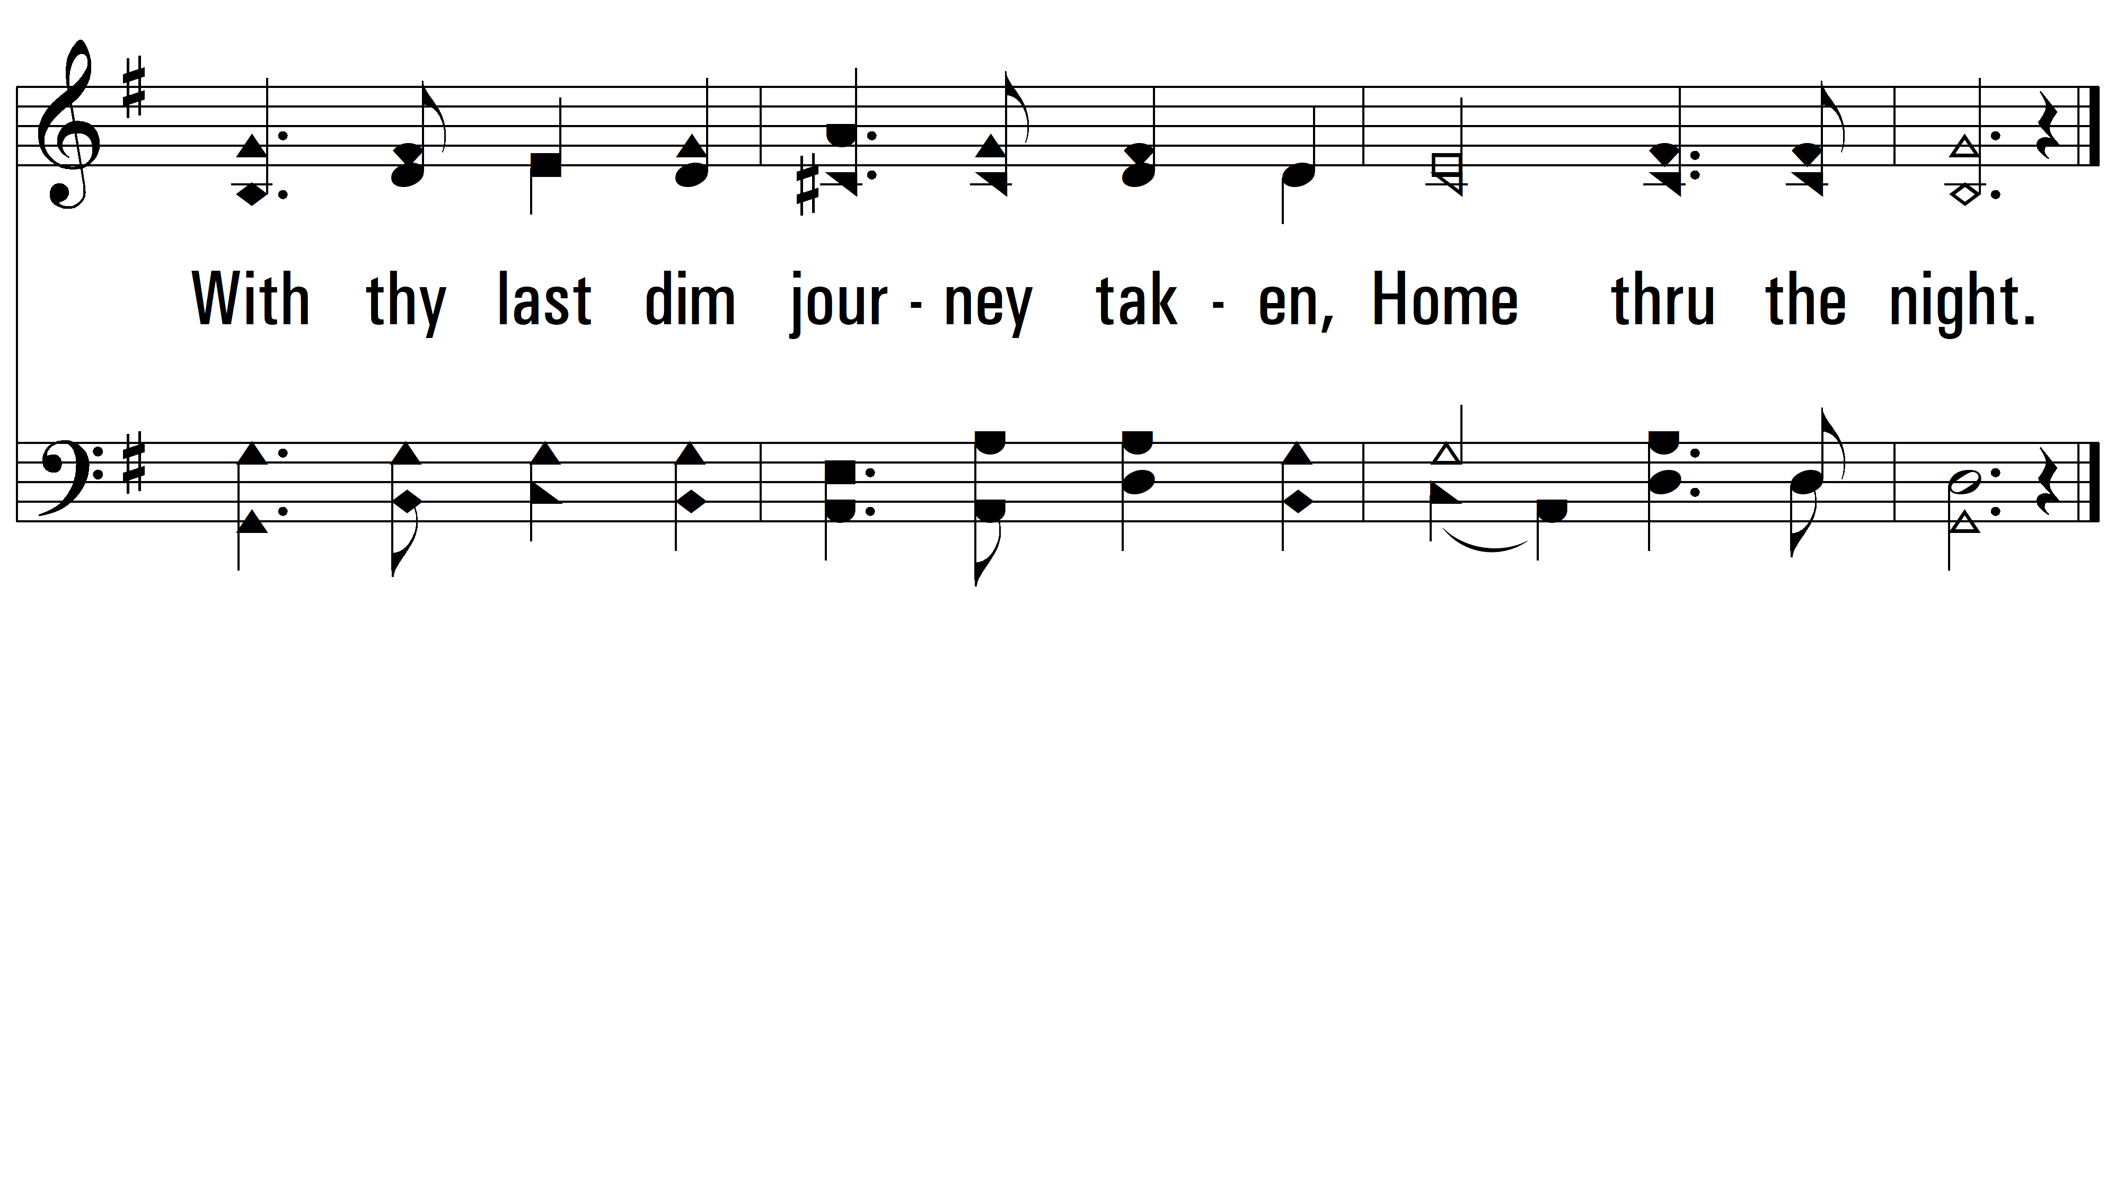
vs. 2
PDHymns.com
END

