Slide 1
All To Jesus I Surrender
(I Surrender All)
Words: | . W. Van De Venter (1896)
Music: | W. S. Weeden (1896)
4/4
D/F# - MI
Verses: 5/Chorus
Lead - | MI
Alto - | DO
Tenor - | SOL
Bass - | DO
PDHymns.com

Slide 2
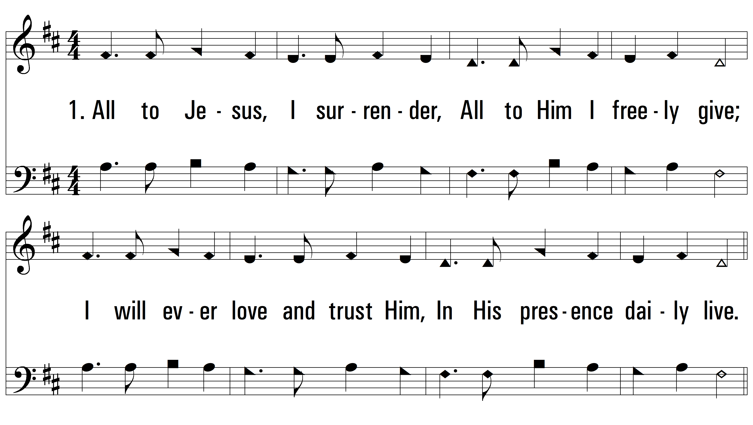
vs. 1 ~ All To Jesus I Surrender

Slide 3
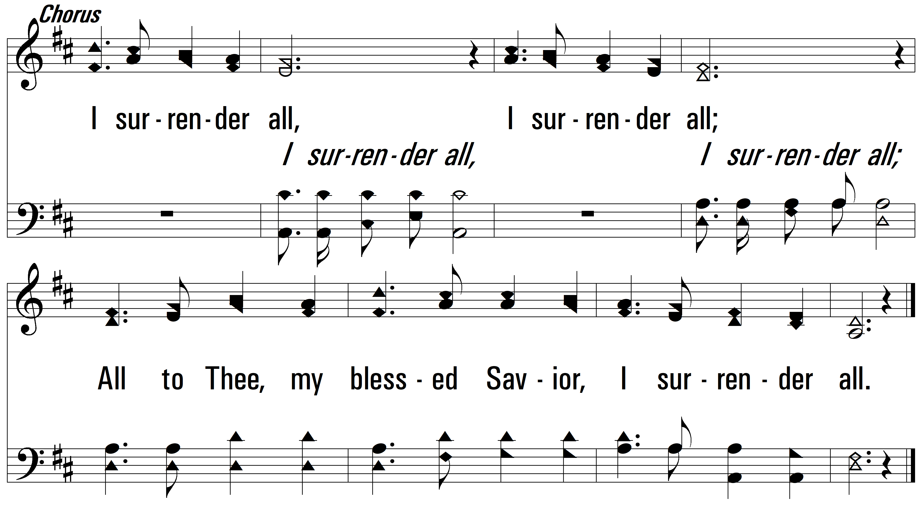
vs. 1

Slide 4
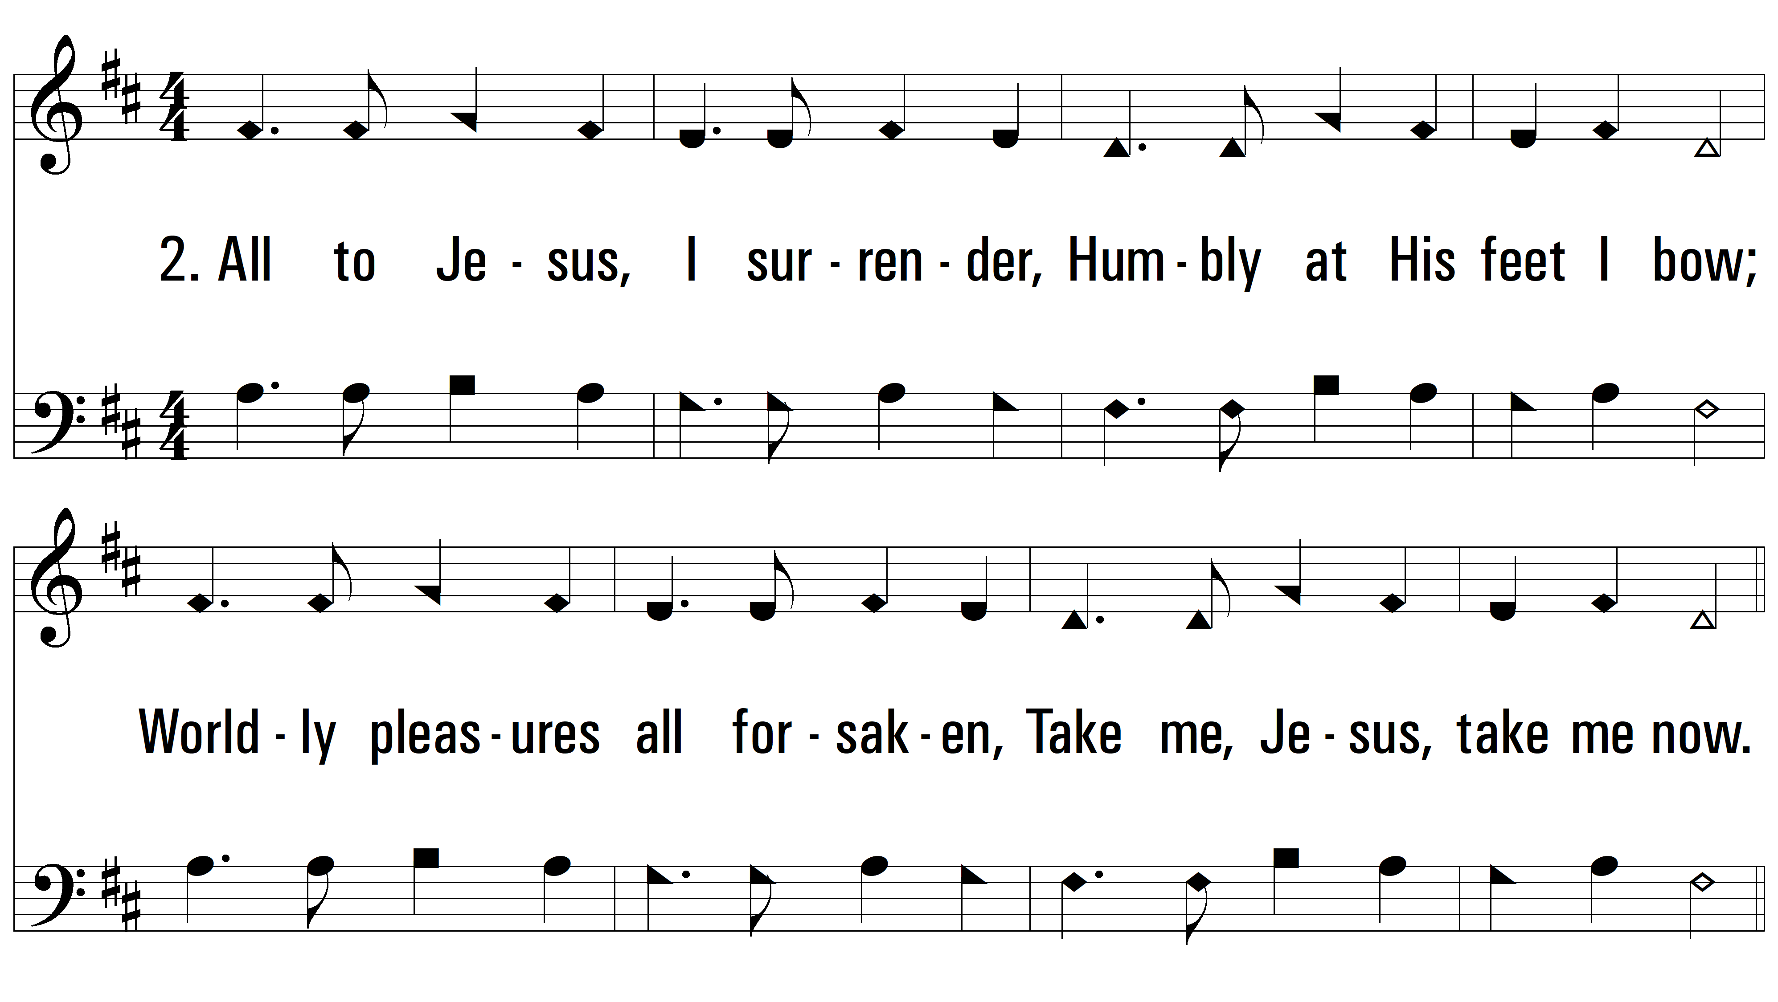
vs. 2 ~ All To Jesus I Surrender

Slide 5
vs. 2

Slide 6
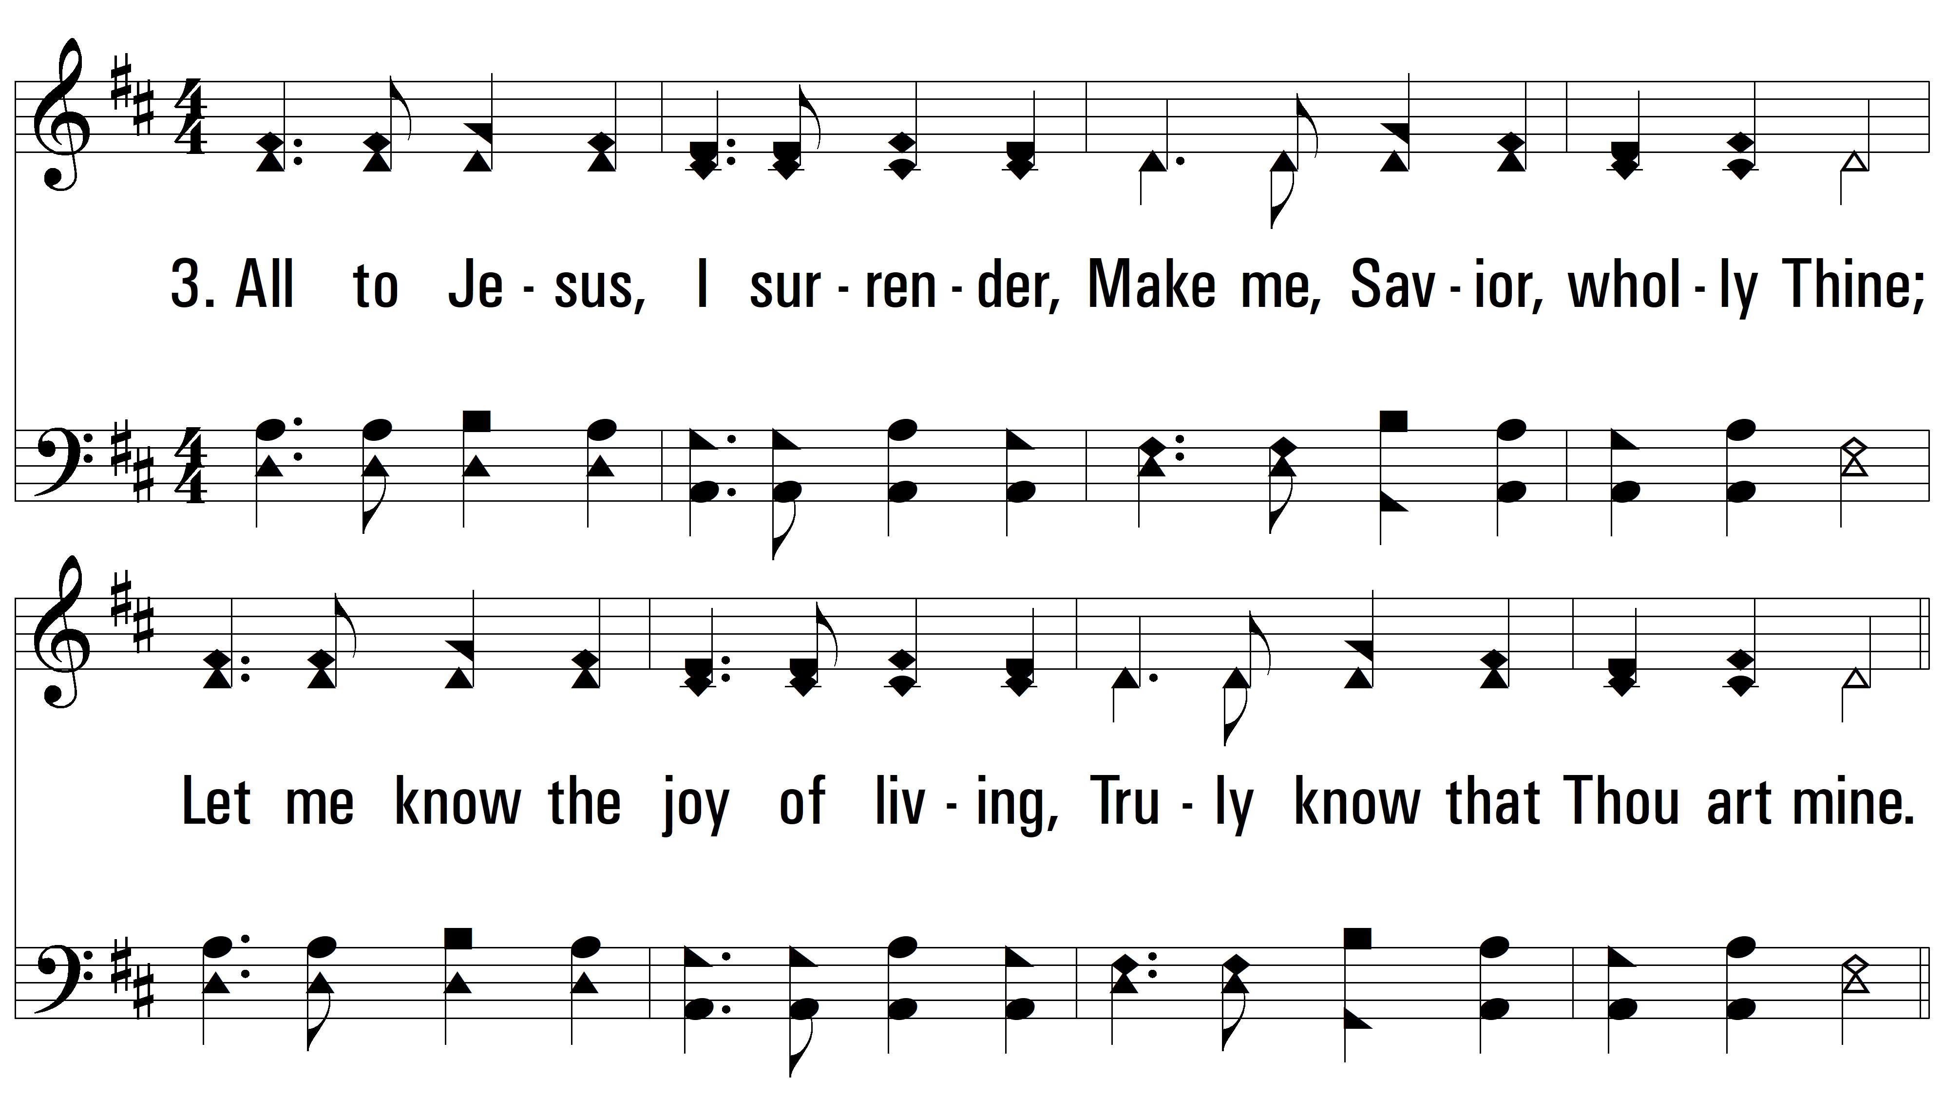
vs. 3 ~ All To Jesus I Surrender

Slide 7
vs. 3

Slide 8
vs. 4 ~ All To Jesus I Surrender

Slide 9
vs. 4

Slide 10
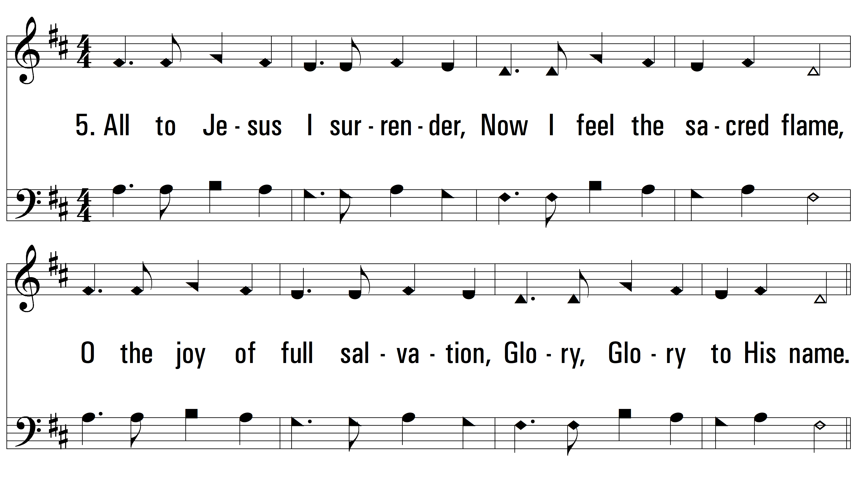
vs. 5 ~ All To Jesus I Surrender

Slide 11
vs. 5
PDHymns.com
END

