Slide 1
Alleluia! Sing To Jesus
HYFRYDOL
8.7.8.7.D
Words: | William C. Dix (1867)
Music: | Rowland H. Prichard (1831)
3/4
G/G - DO
Verses: 3
Lead - | DO
Alto - | SOL
Tenor - | MI
Bass - | DO
PDHymns.com

Slide 2
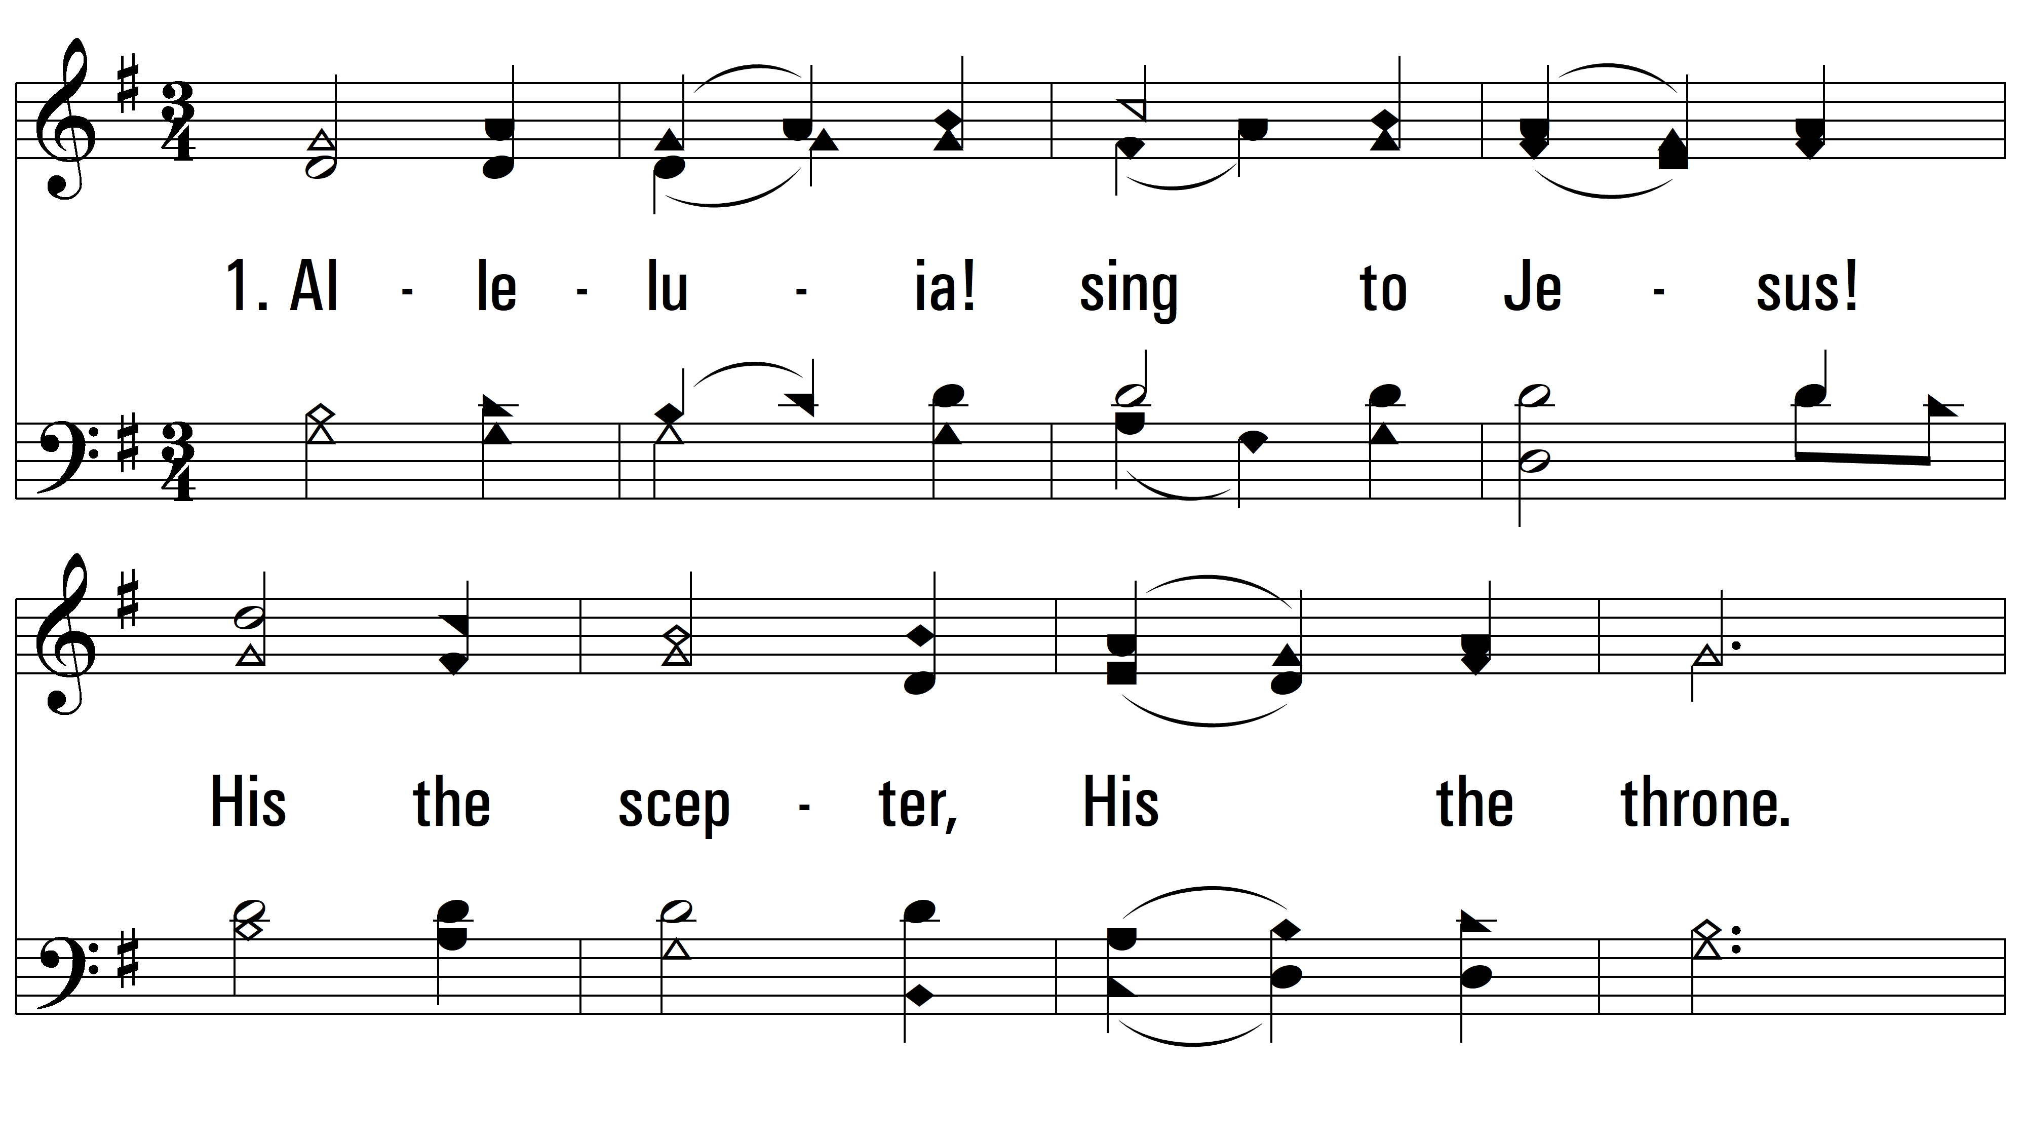
vs. 1 ~ Alleluia! Sing To Jesus

Slide 3
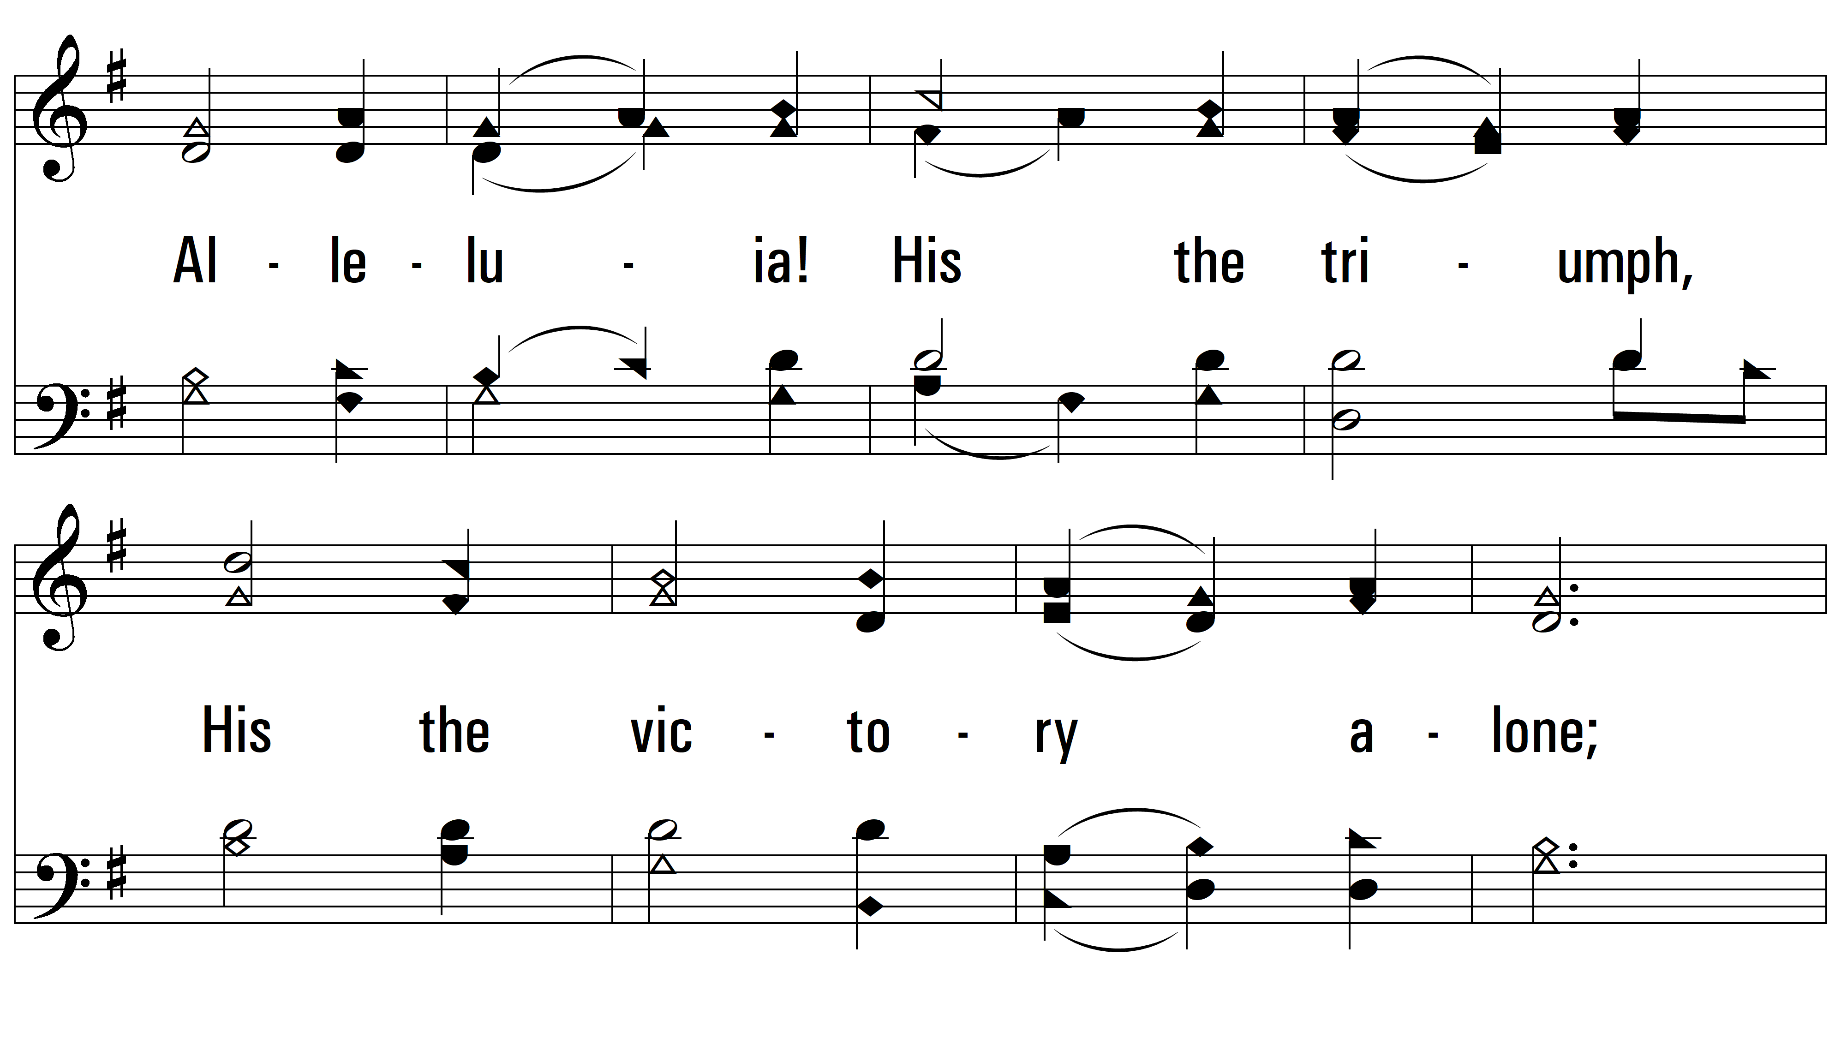
vs. 1

Slide 4
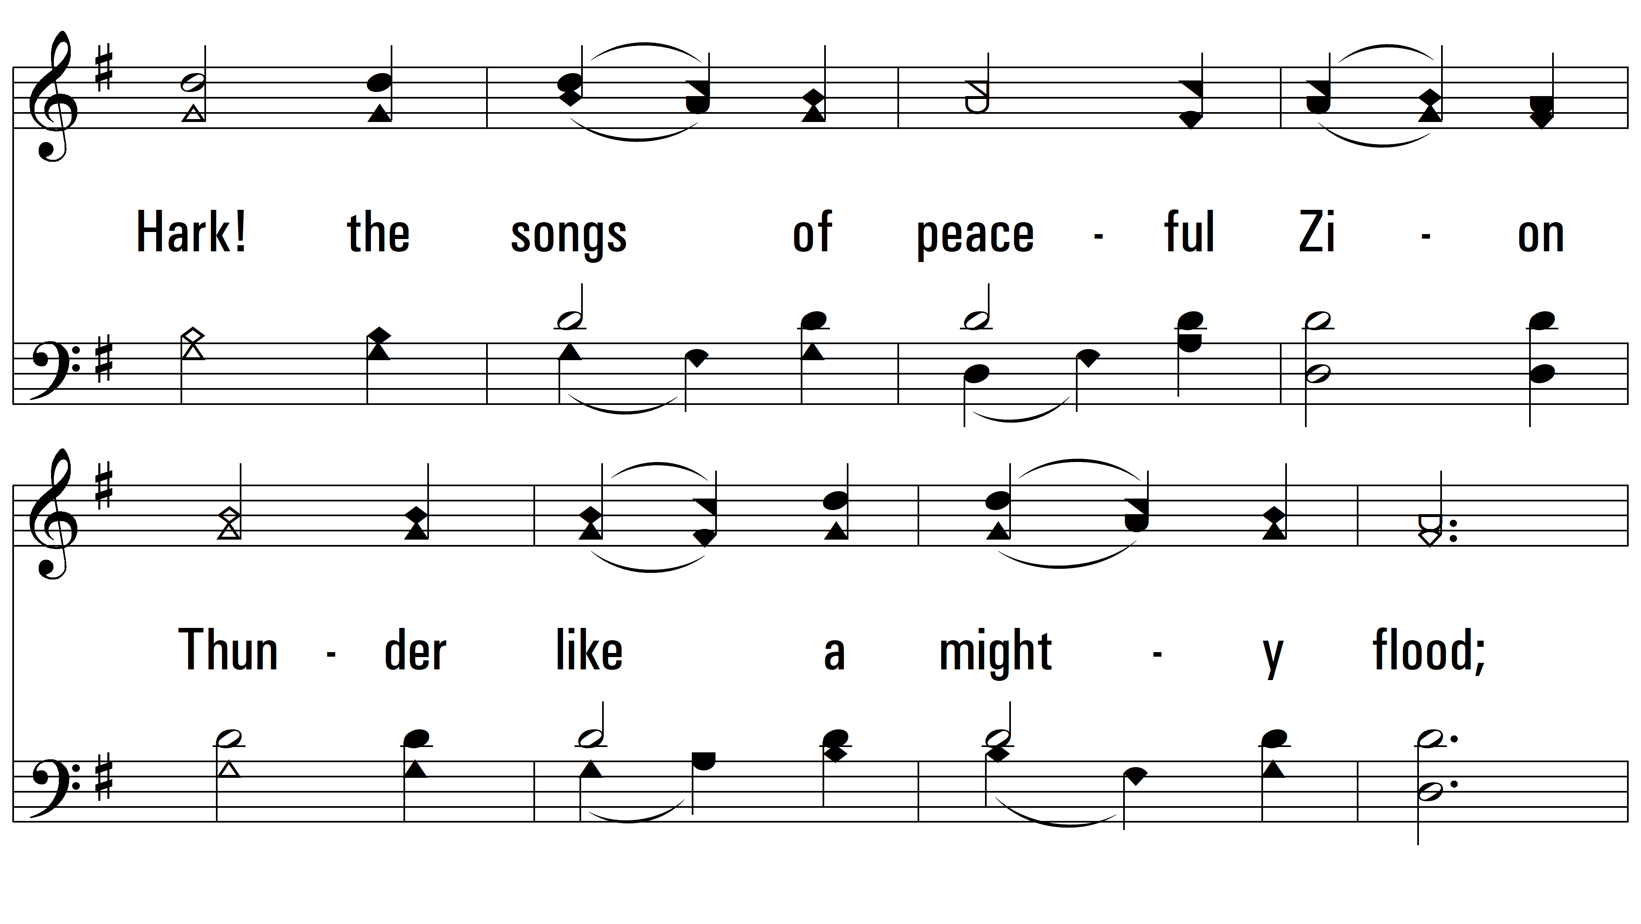
vs. 1

Slide 5
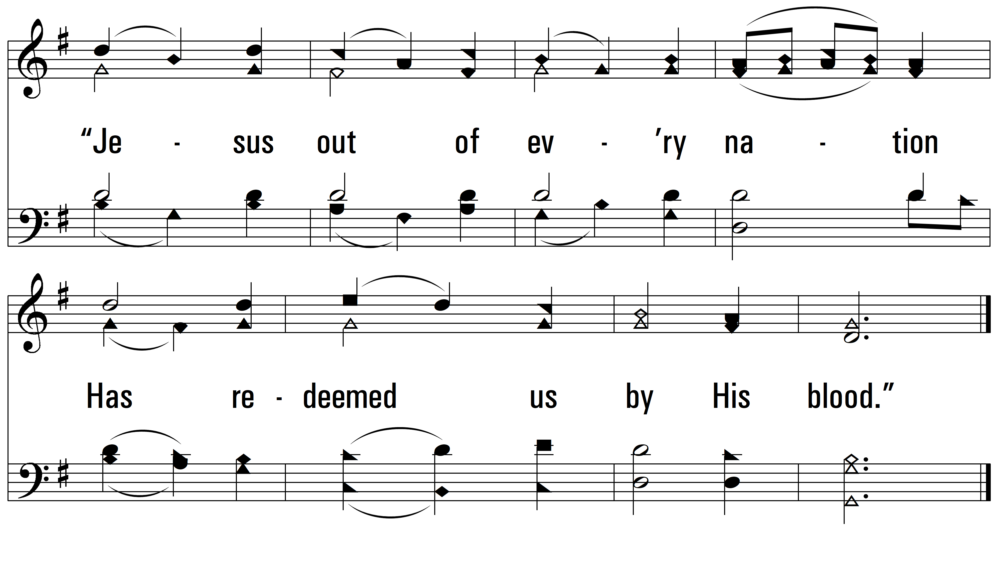
vs. 1

Slide 6
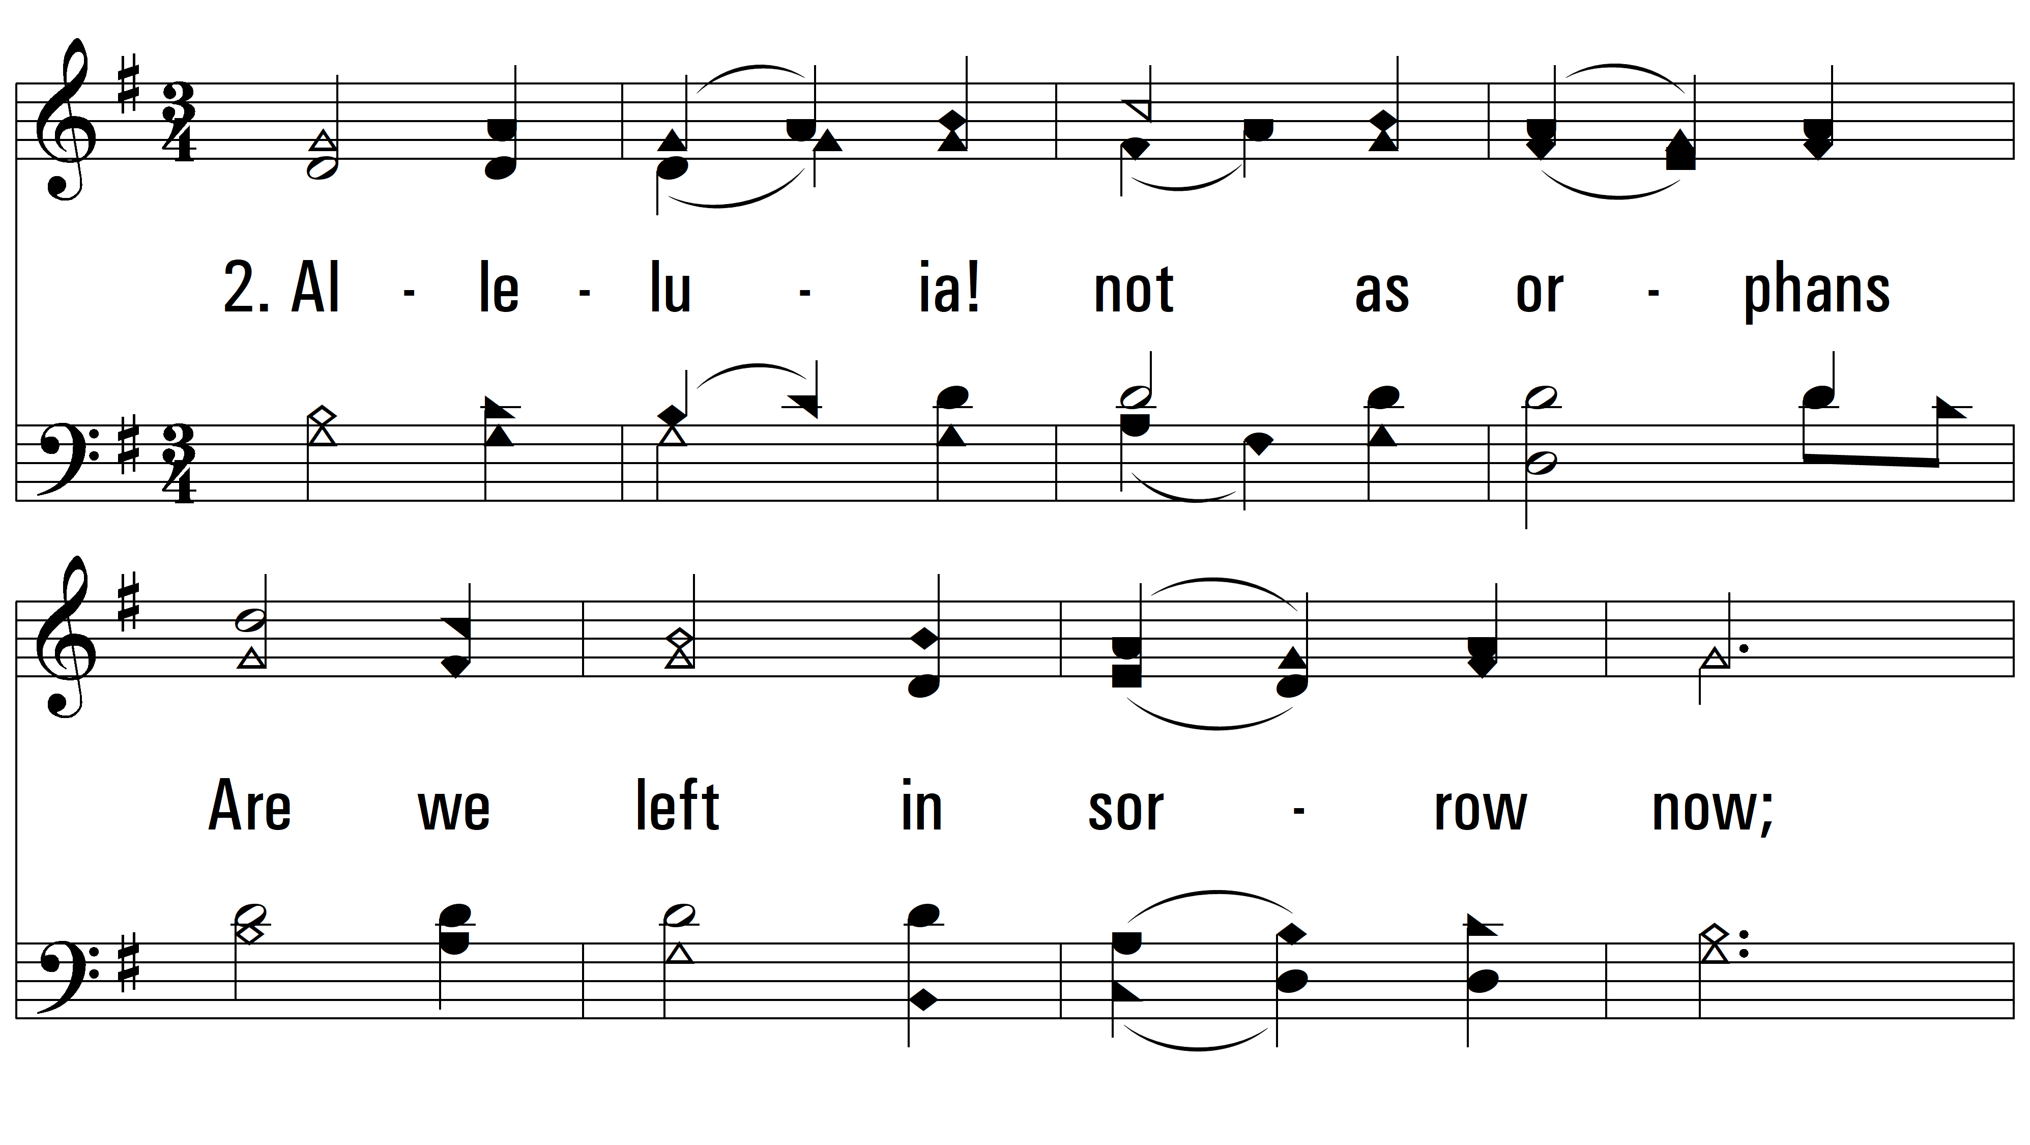
vs. 2 ~ Alleluia! Sing To Jesus

Slide 7
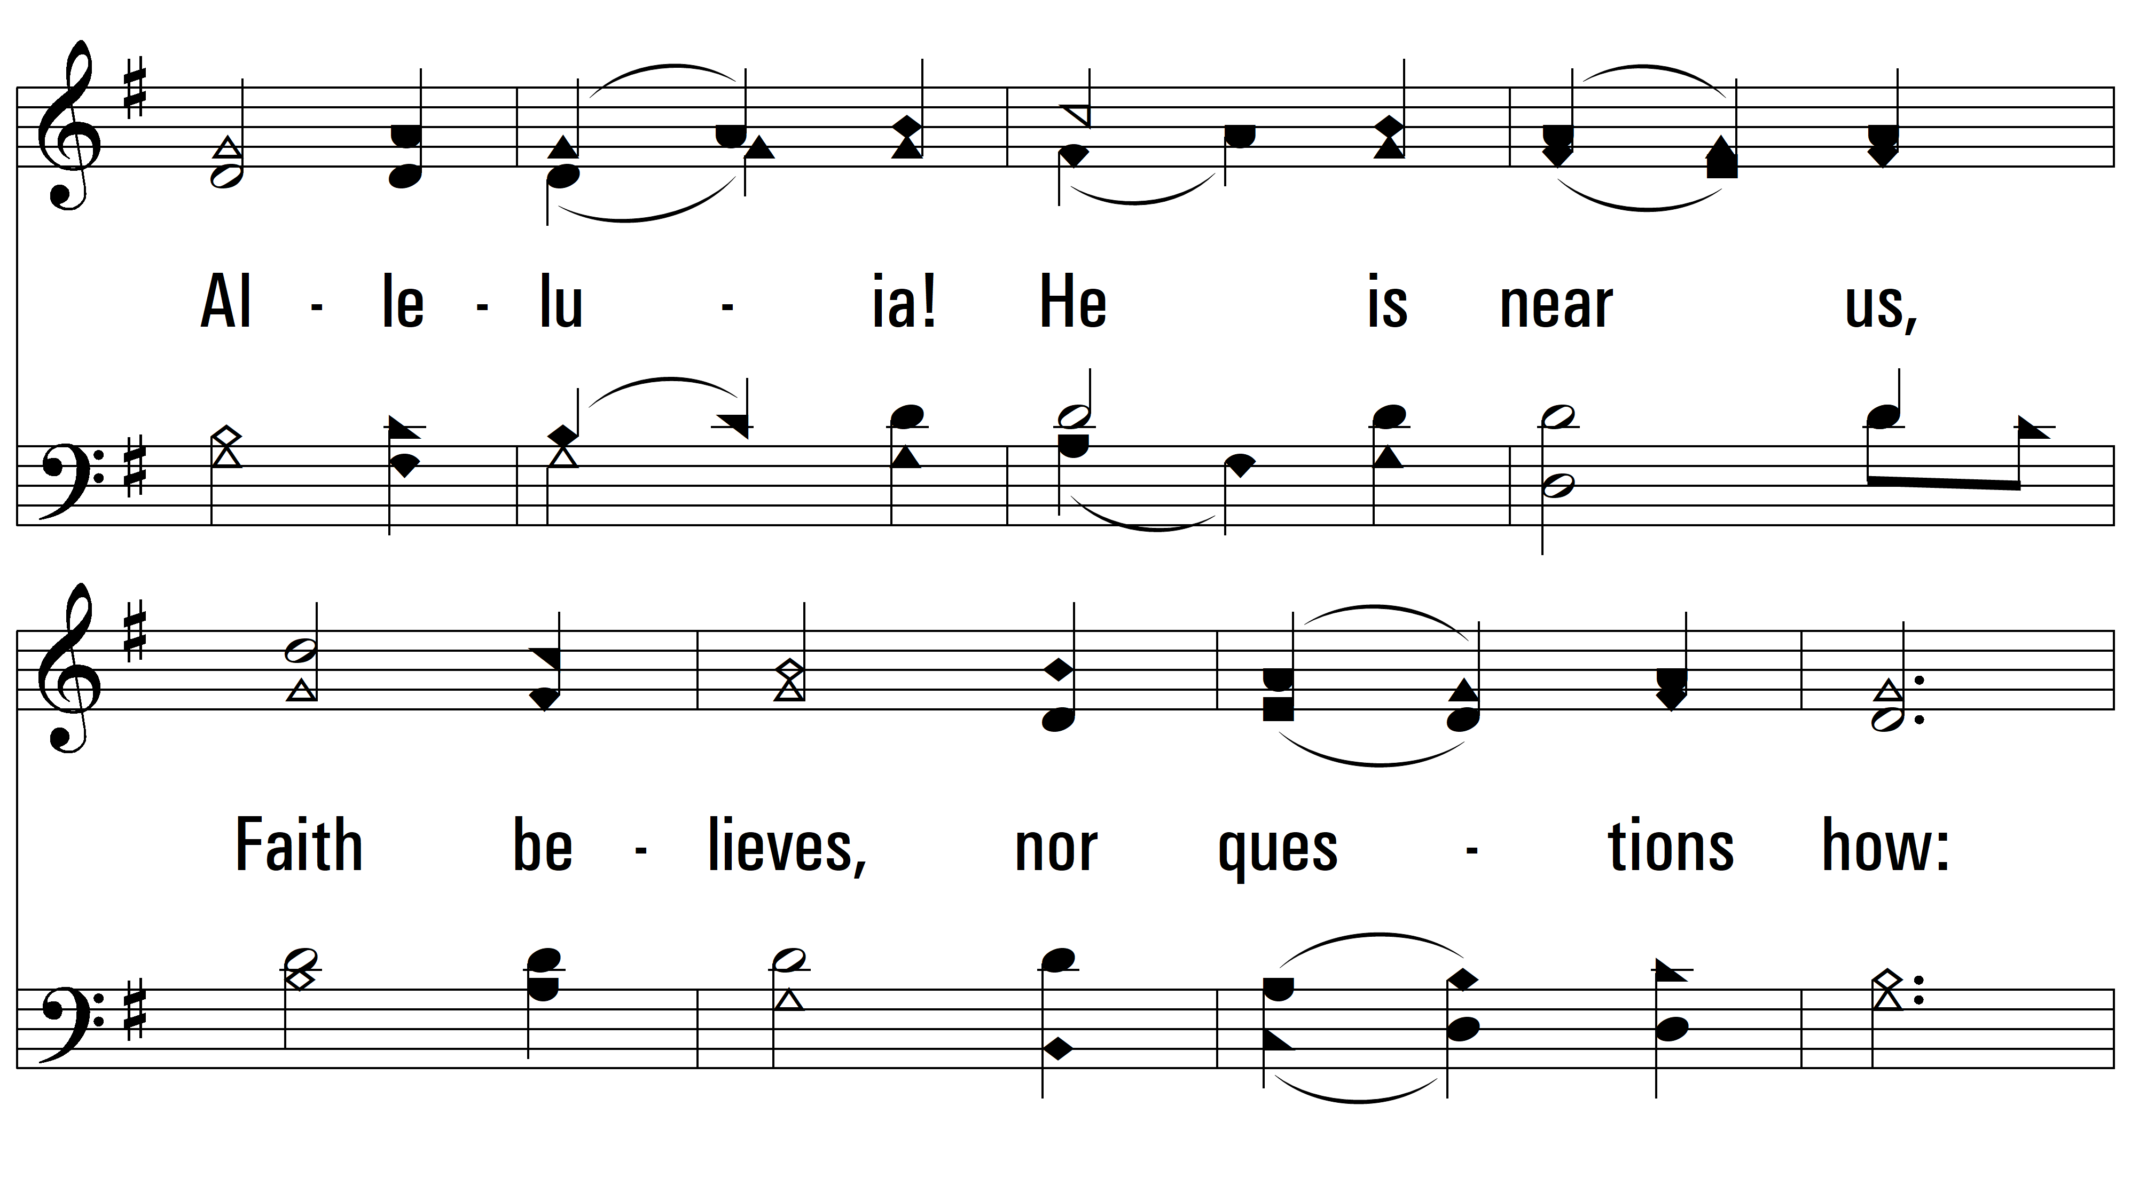
vs. 2

Slide 8
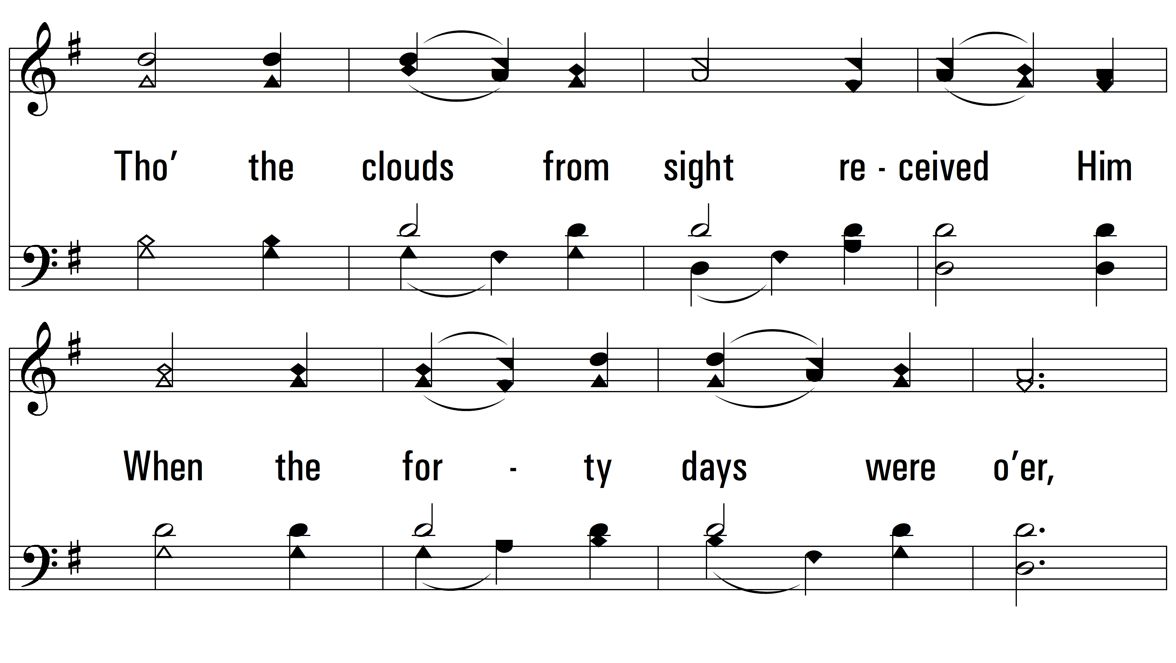
vs. 2

Slide 9
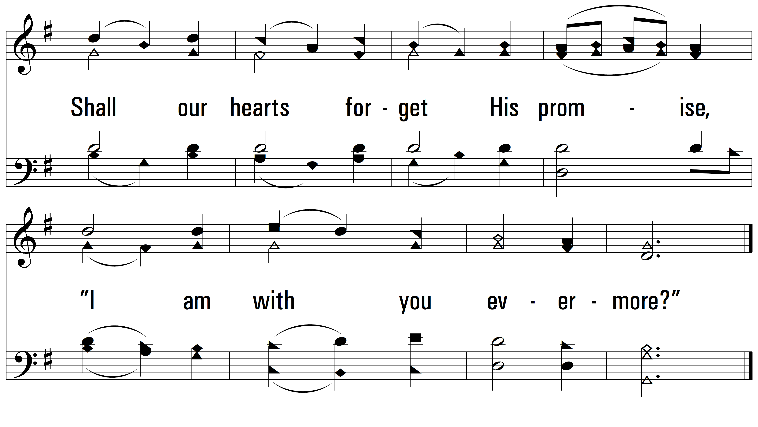
vs. 2

Slide 10
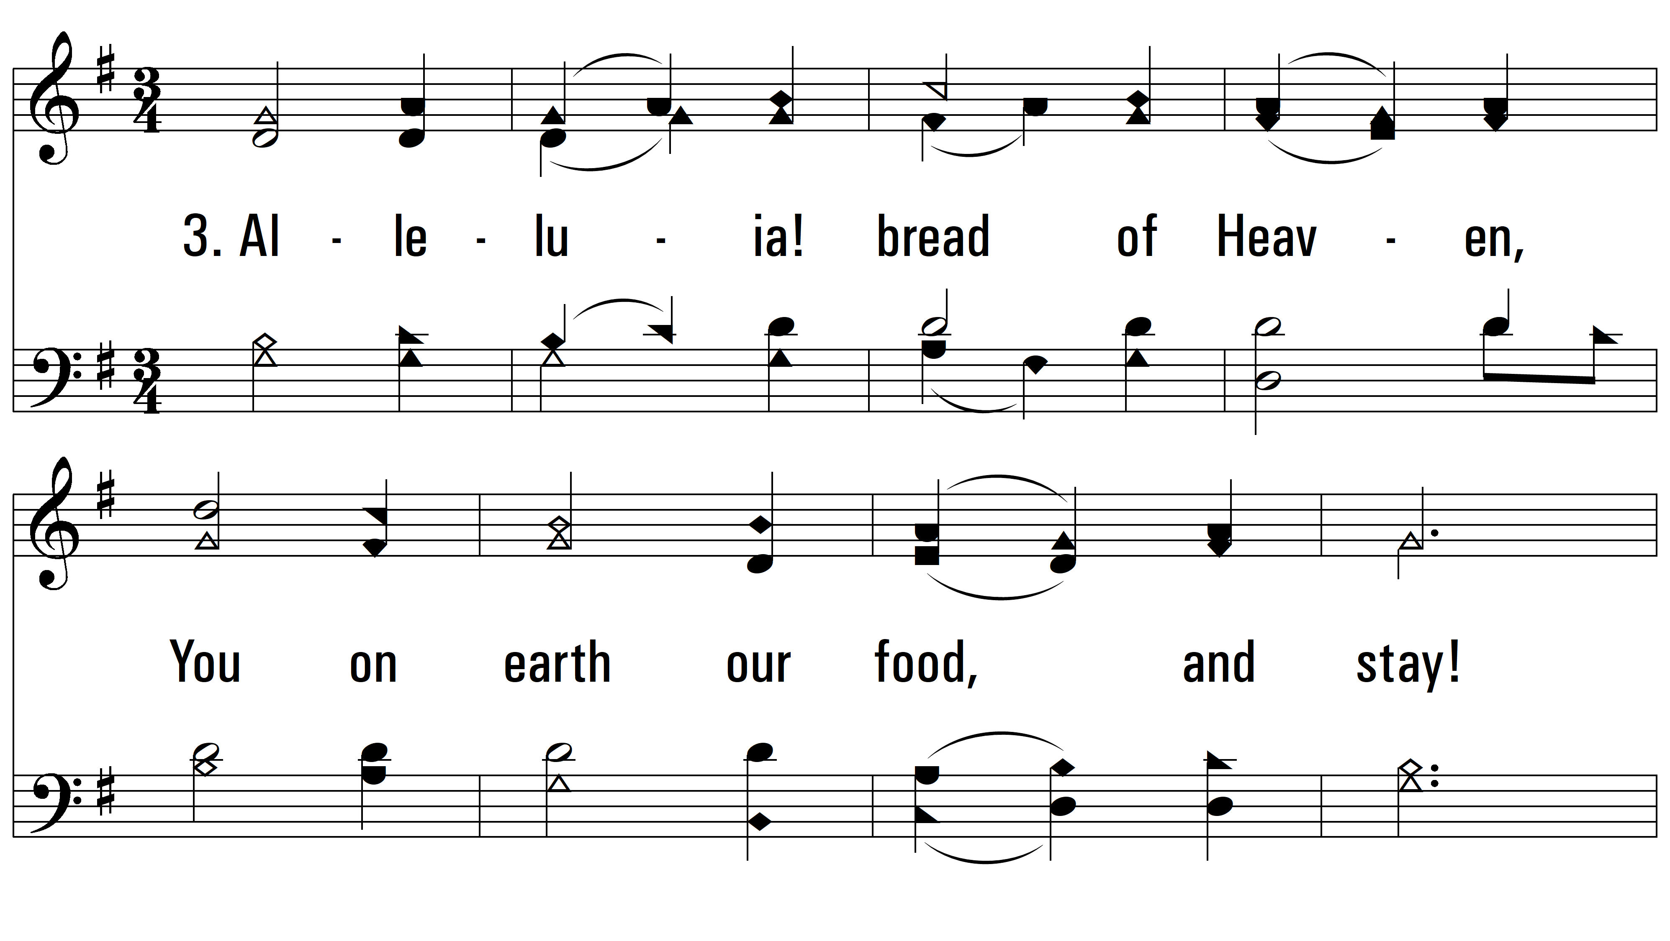
vs. 3 ~ Alleluia! Sing To Jesus

Slide 11
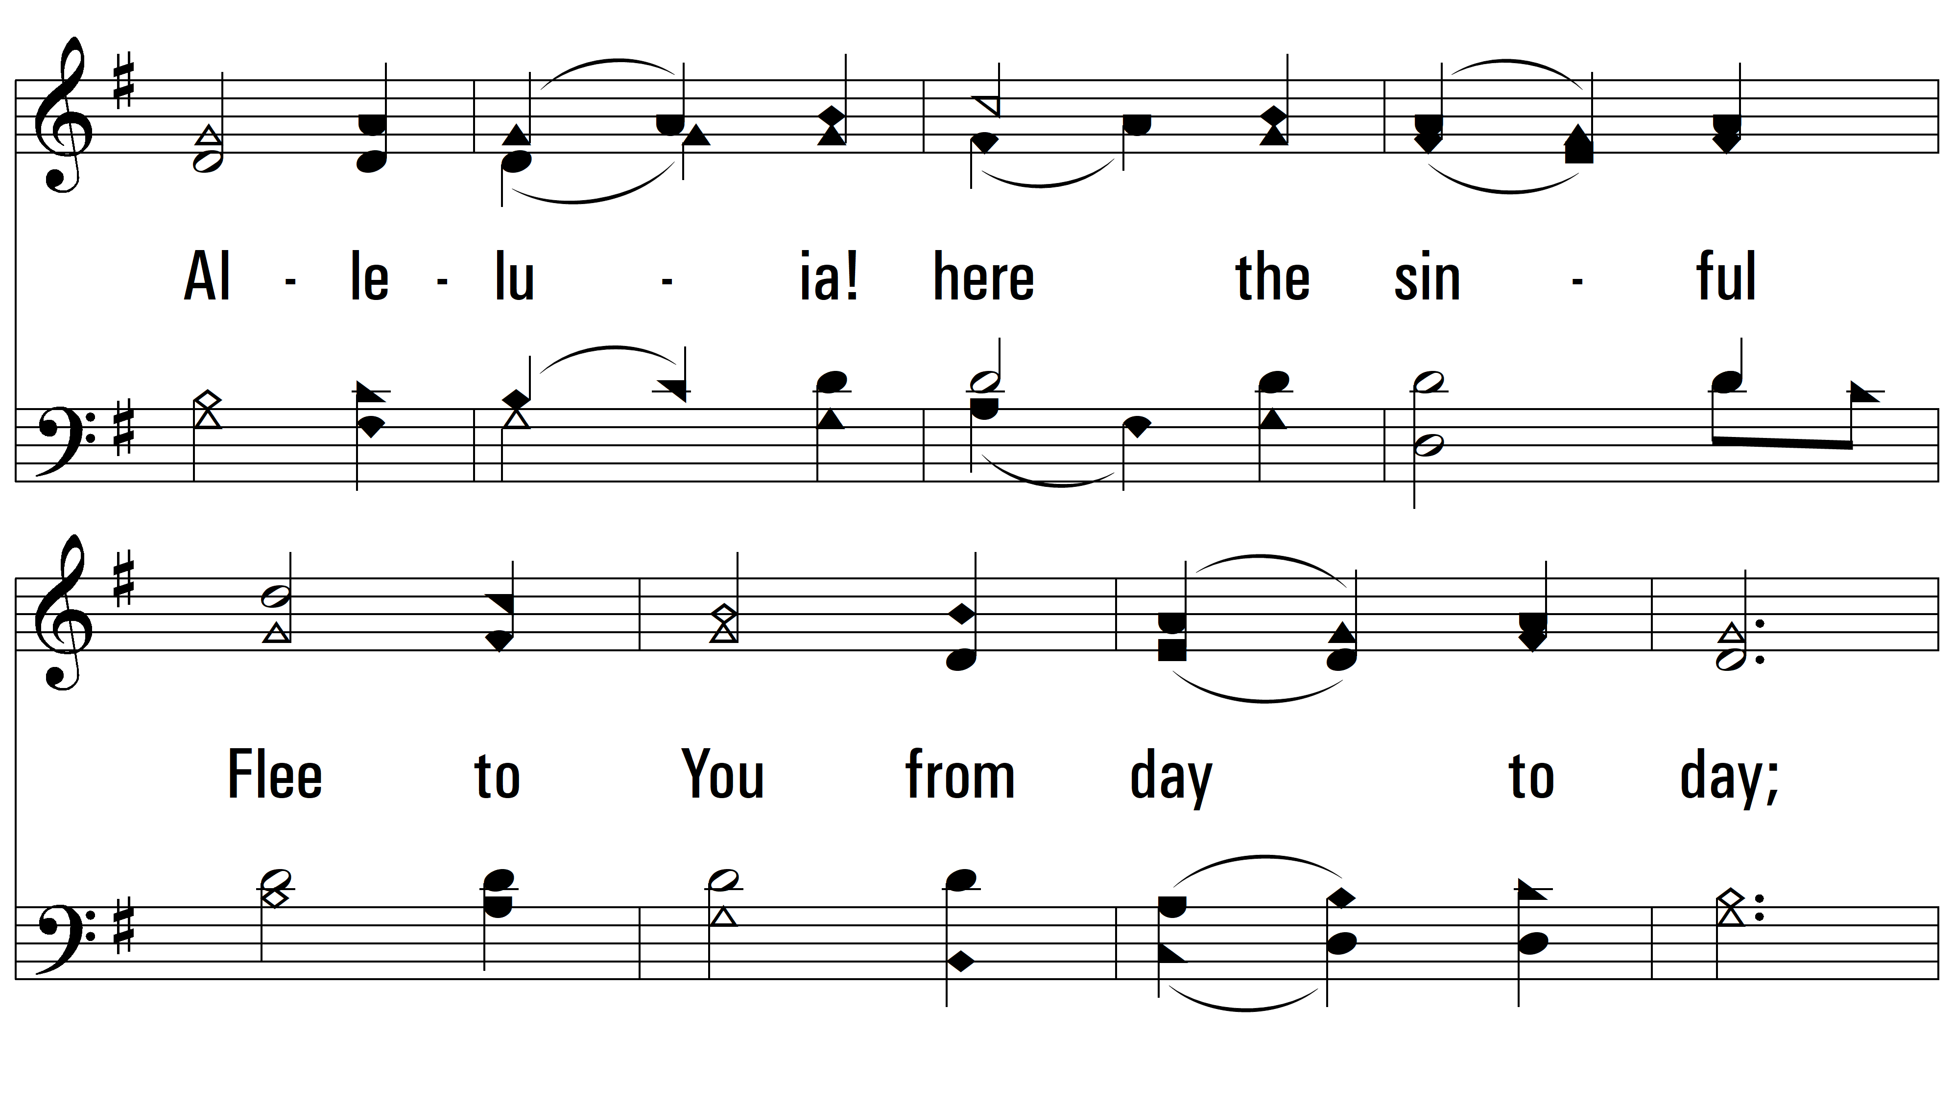
vs. 3

Slide 12
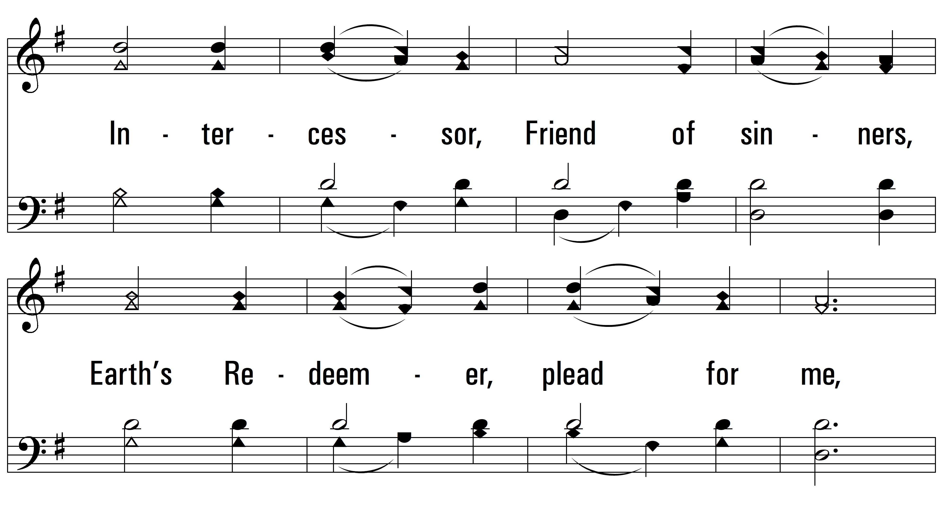
vs. 3

Slide 13
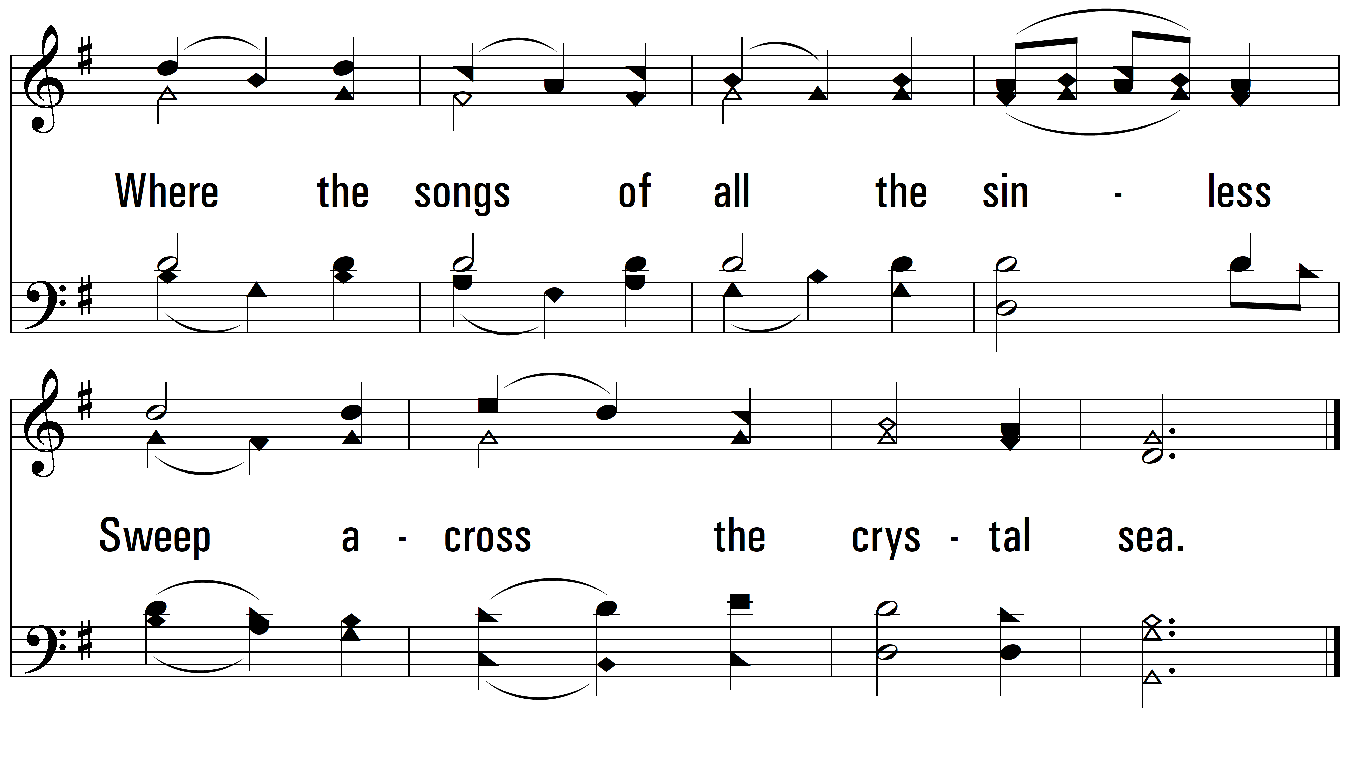
vs. 3
PDHymns.com
END

