Slide 1
Anywhere Is Home
Words: | J. M. Henson
Music: | Homer F. Morris
4/4
A^{b}/E^{b} - SOL
Verses: 3/Chorus
Lead - | SOL
Alto - | SOL
Tenor - | MI
Bass - | DO
PDHymns.com

Slide 2
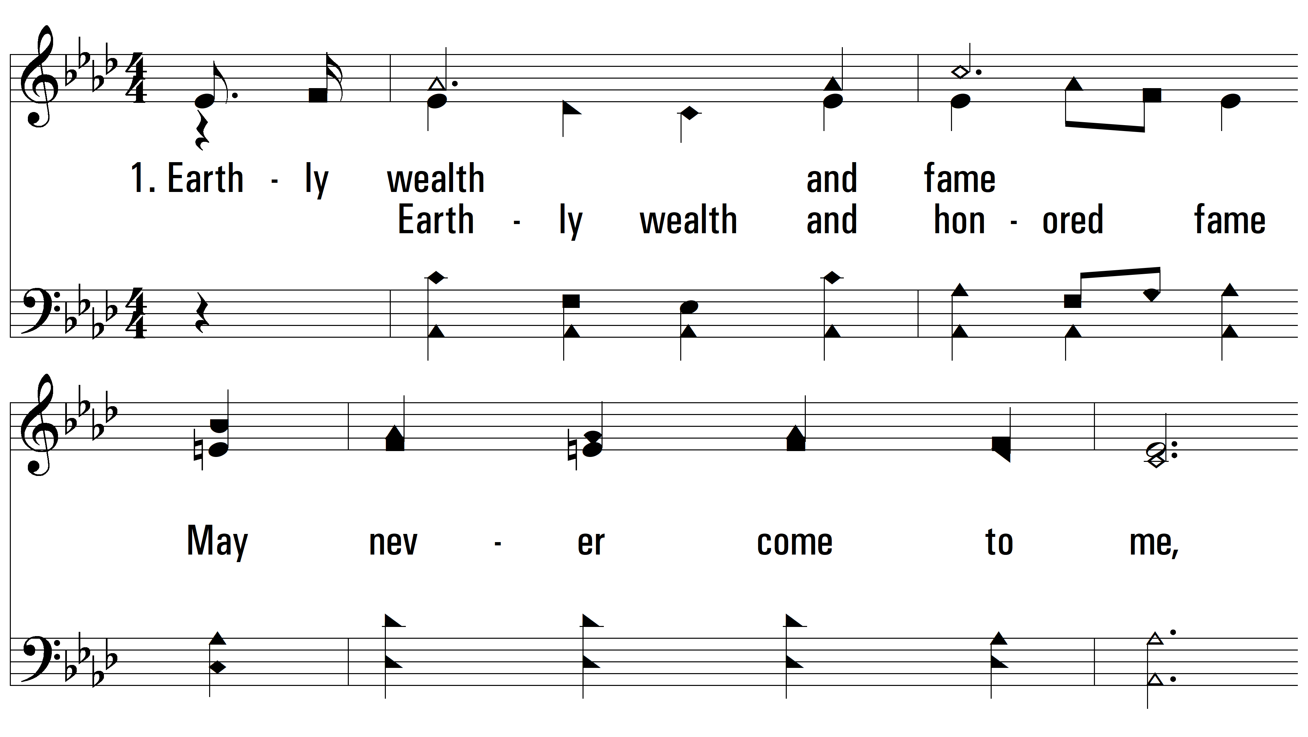
vs. 1 ~ Anywhere Is Home

Slide 3
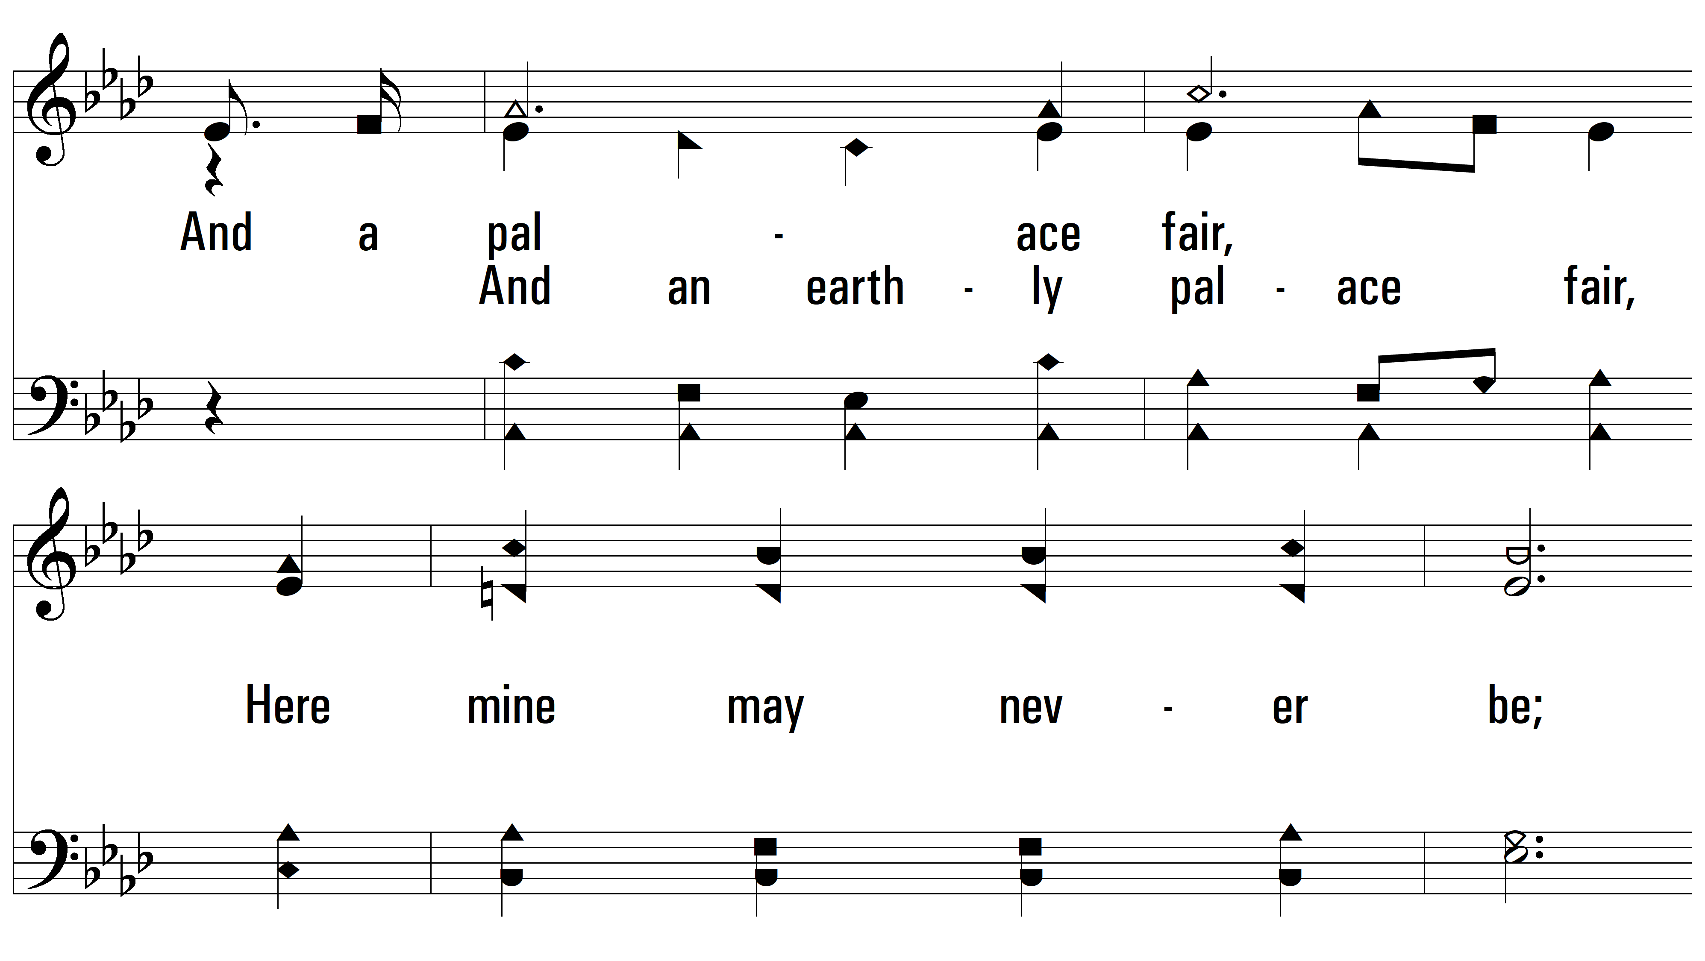
vs. 1

Slide 4
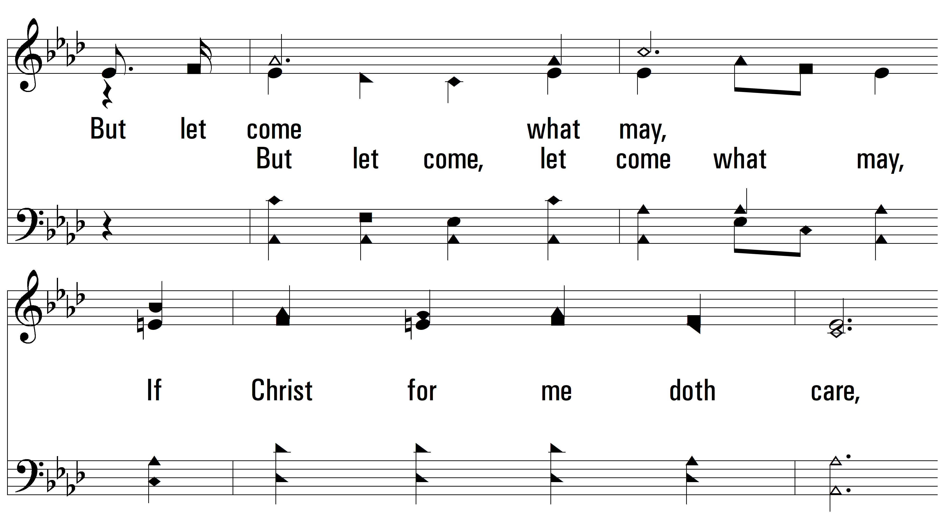
vs. 1

Slide 5
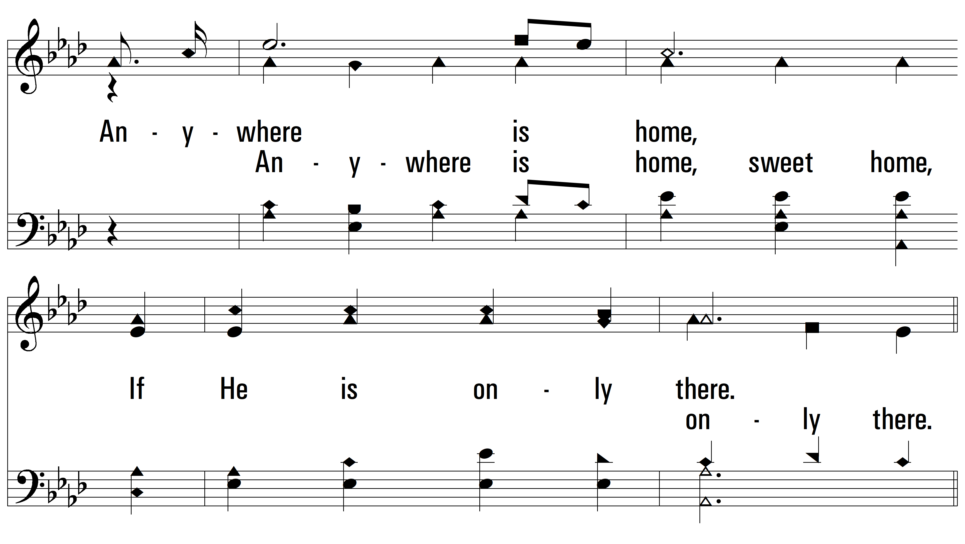
vs. 1

Slide 6
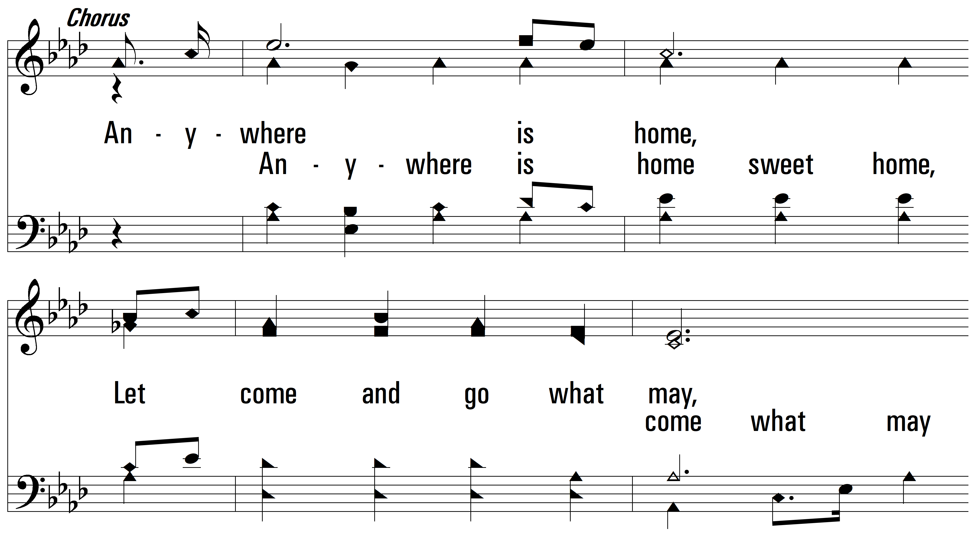
vs. 1

Slide 7
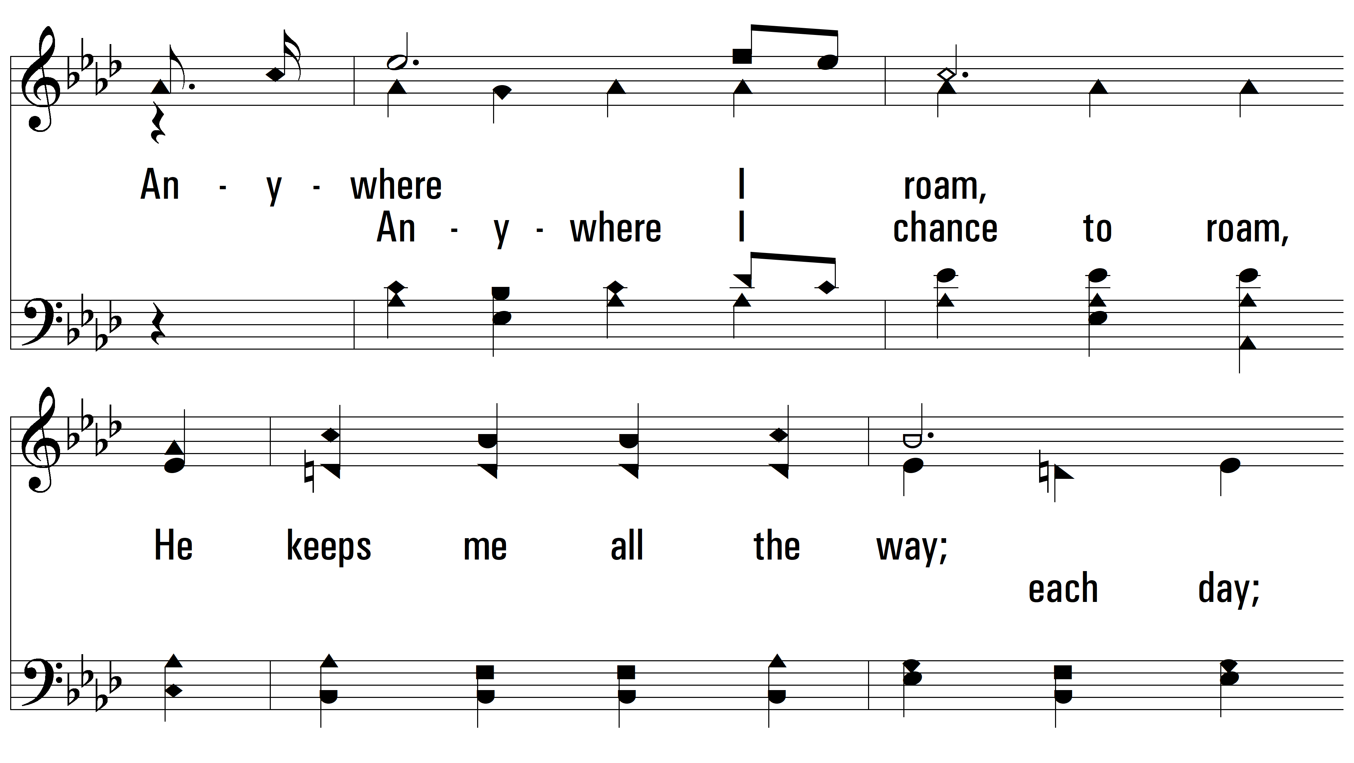
vs. 1

Slide 8
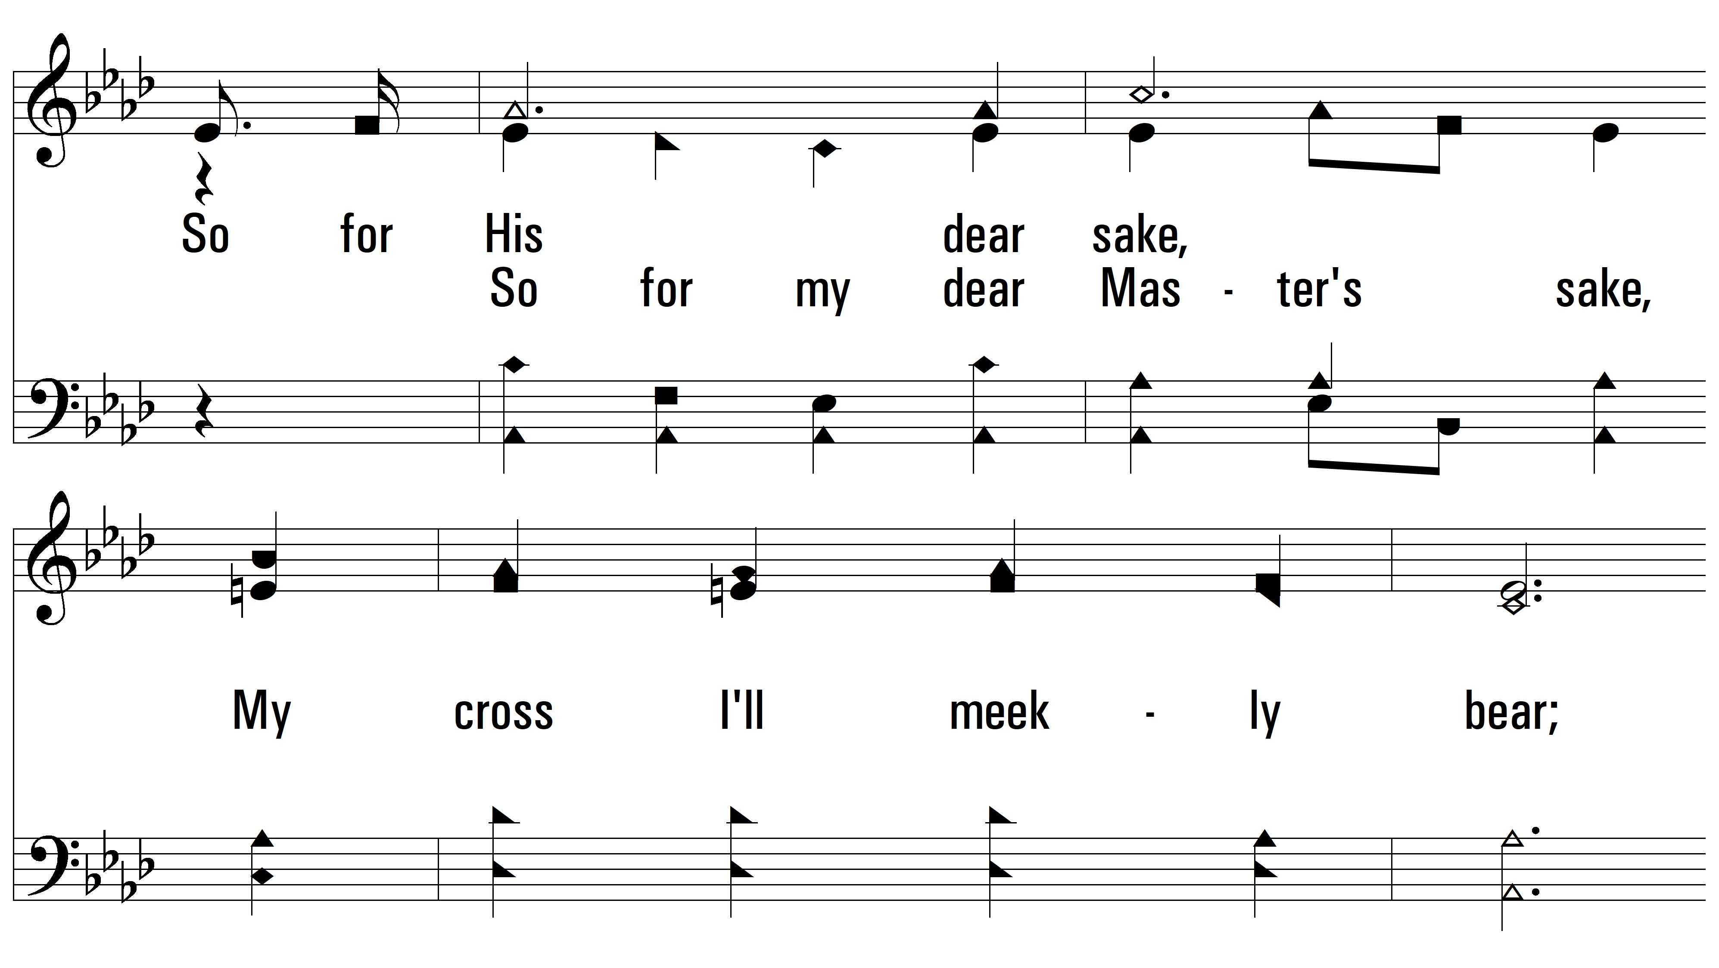
vs. 1

Slide 9
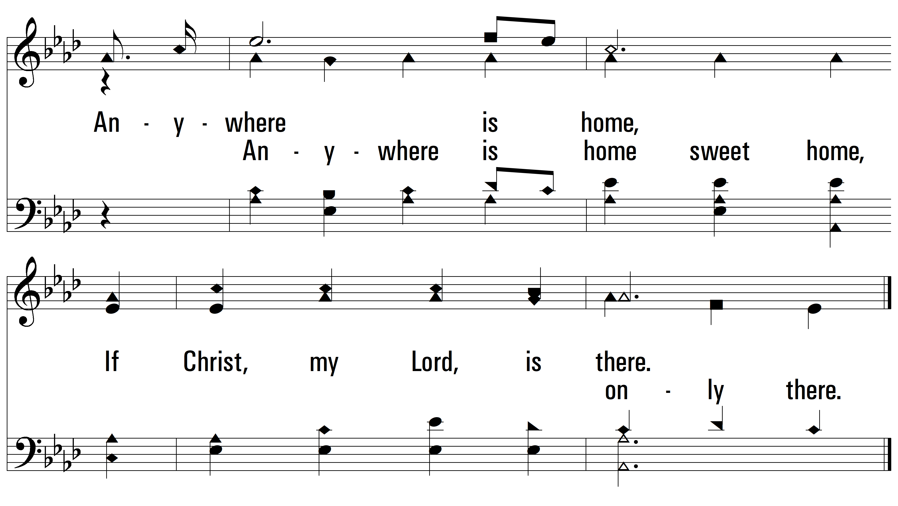
vs. 1

Slide 10
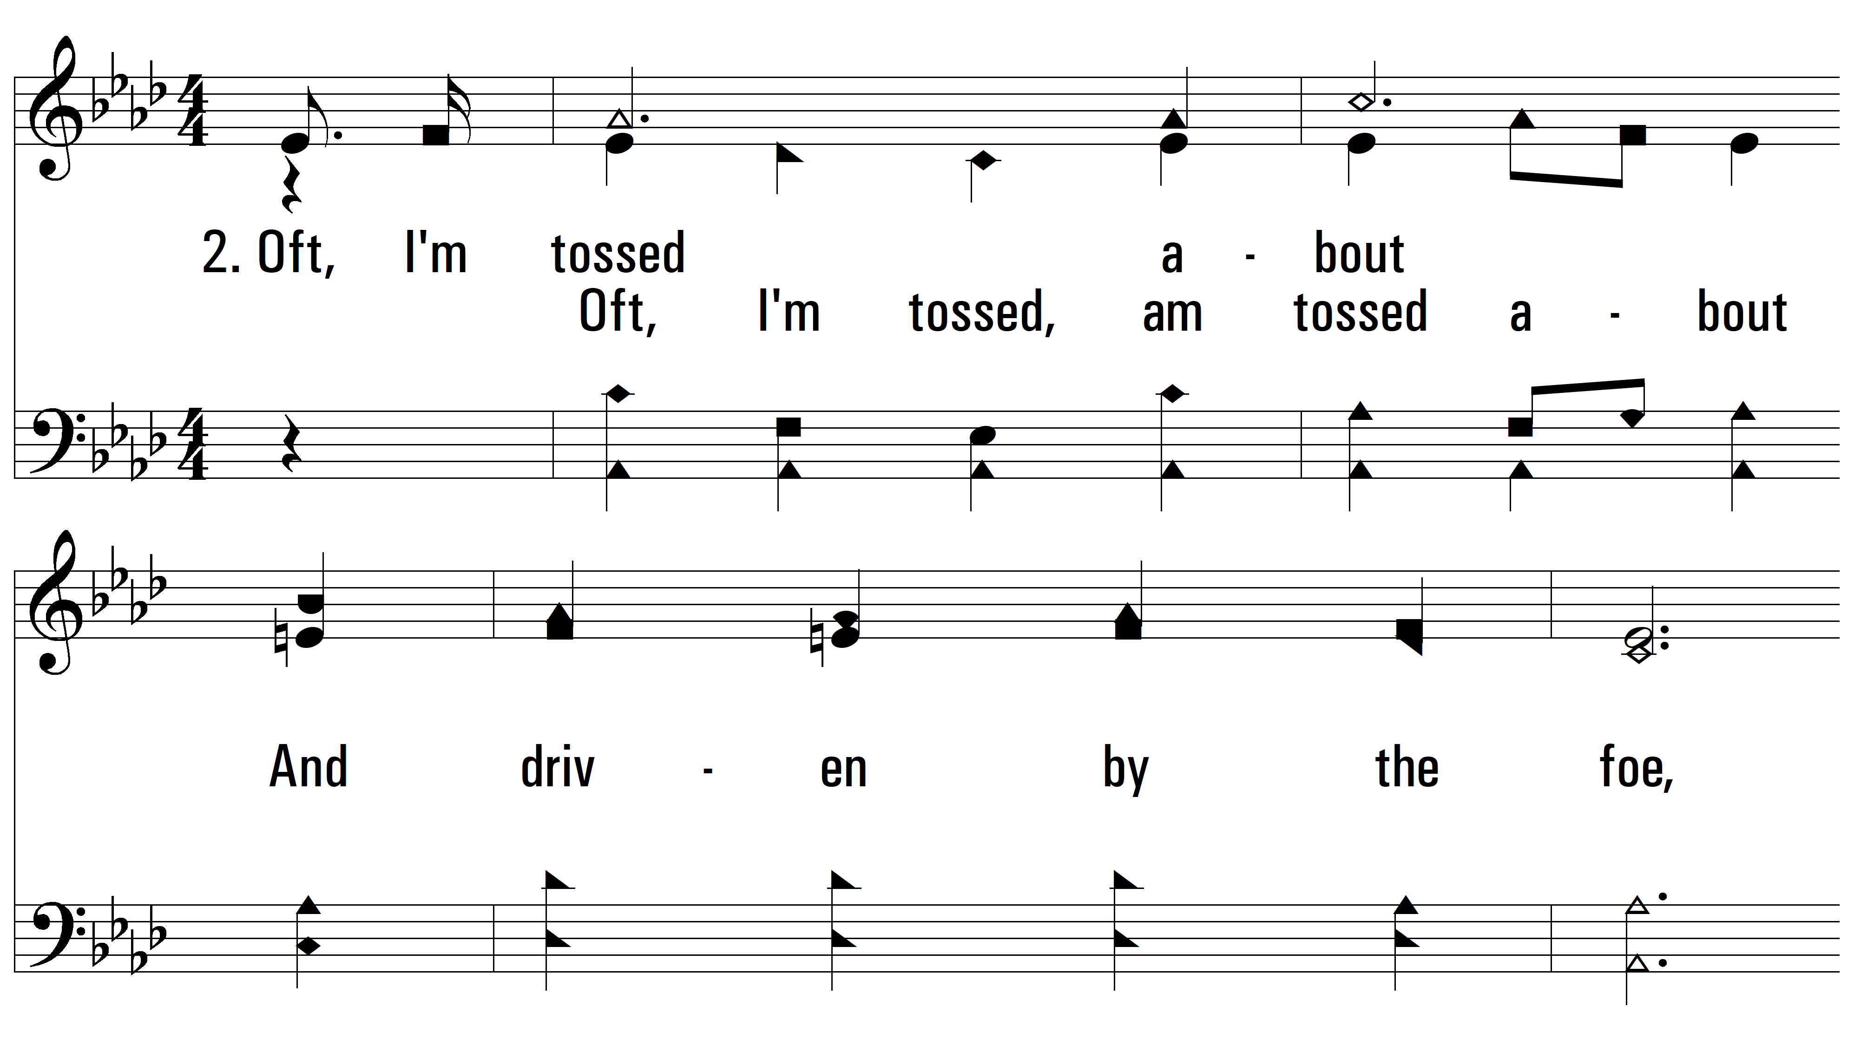
vs. 2 ~ Anywhere Is Home

Slide 11
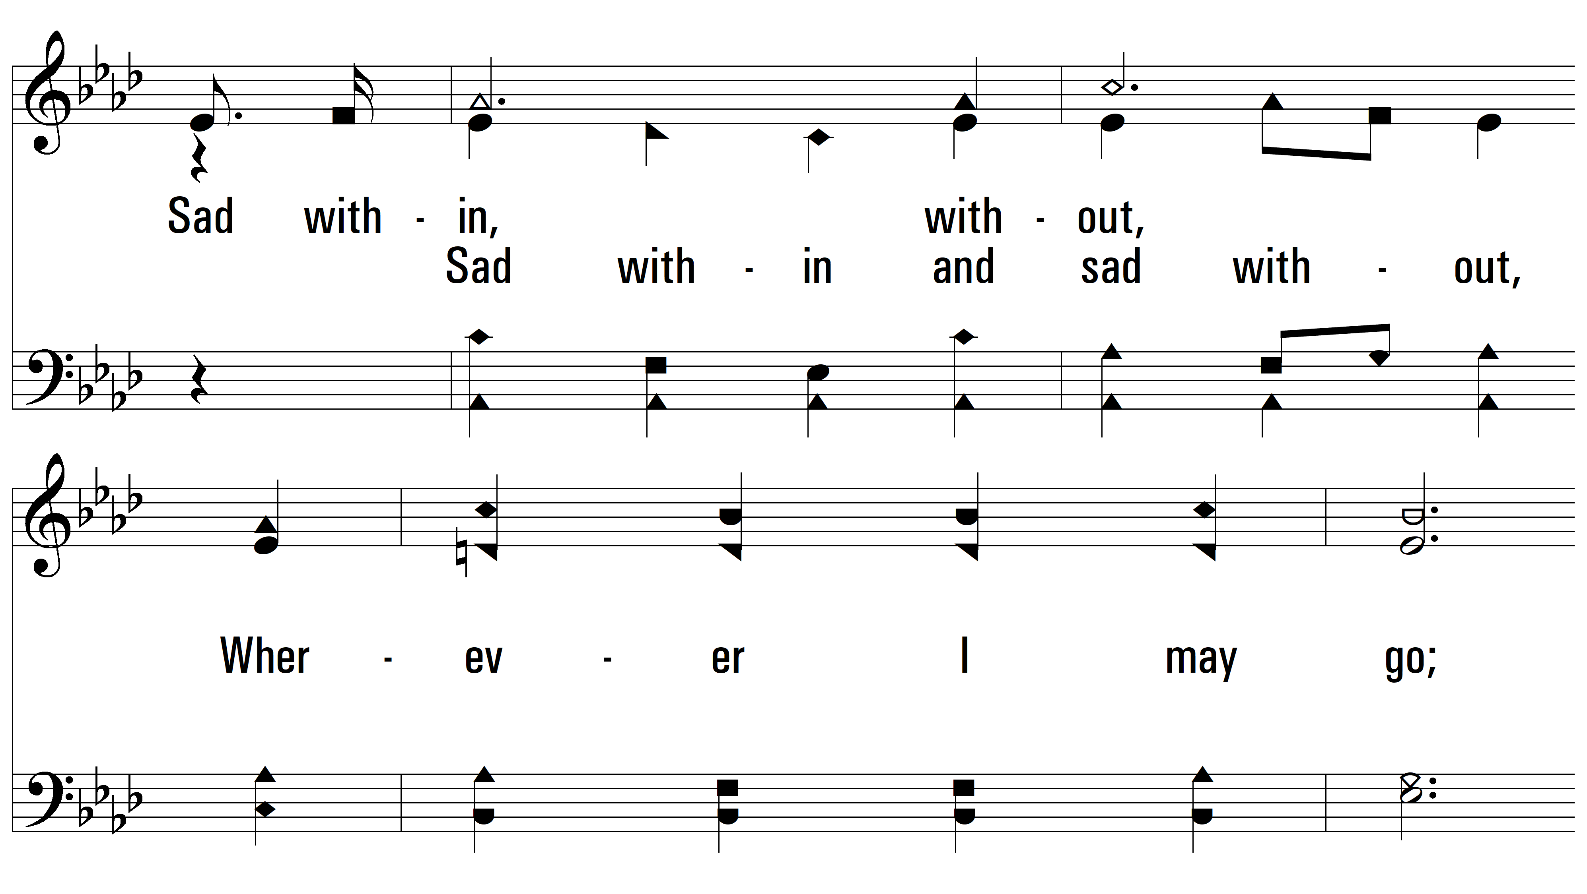
vs. 2

Slide 12
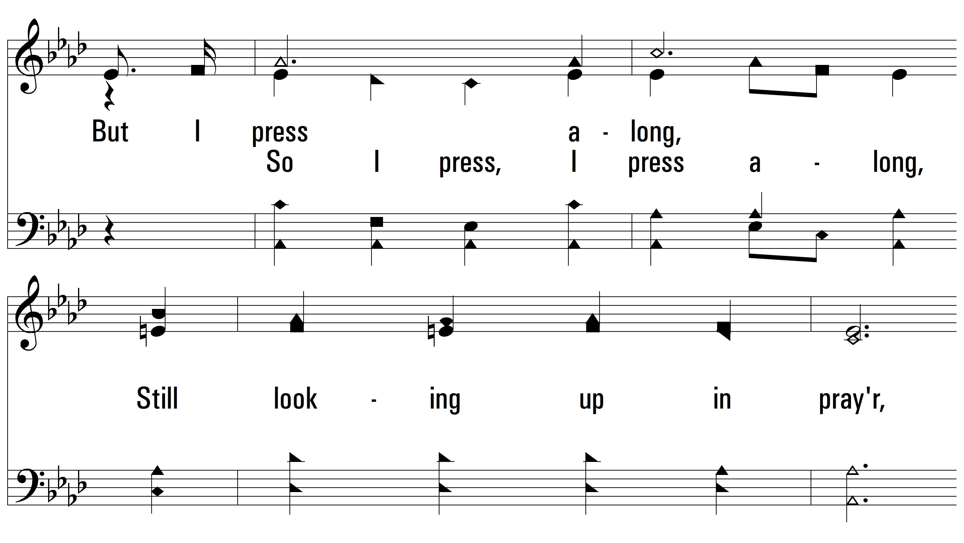
vs. 2

Slide 13
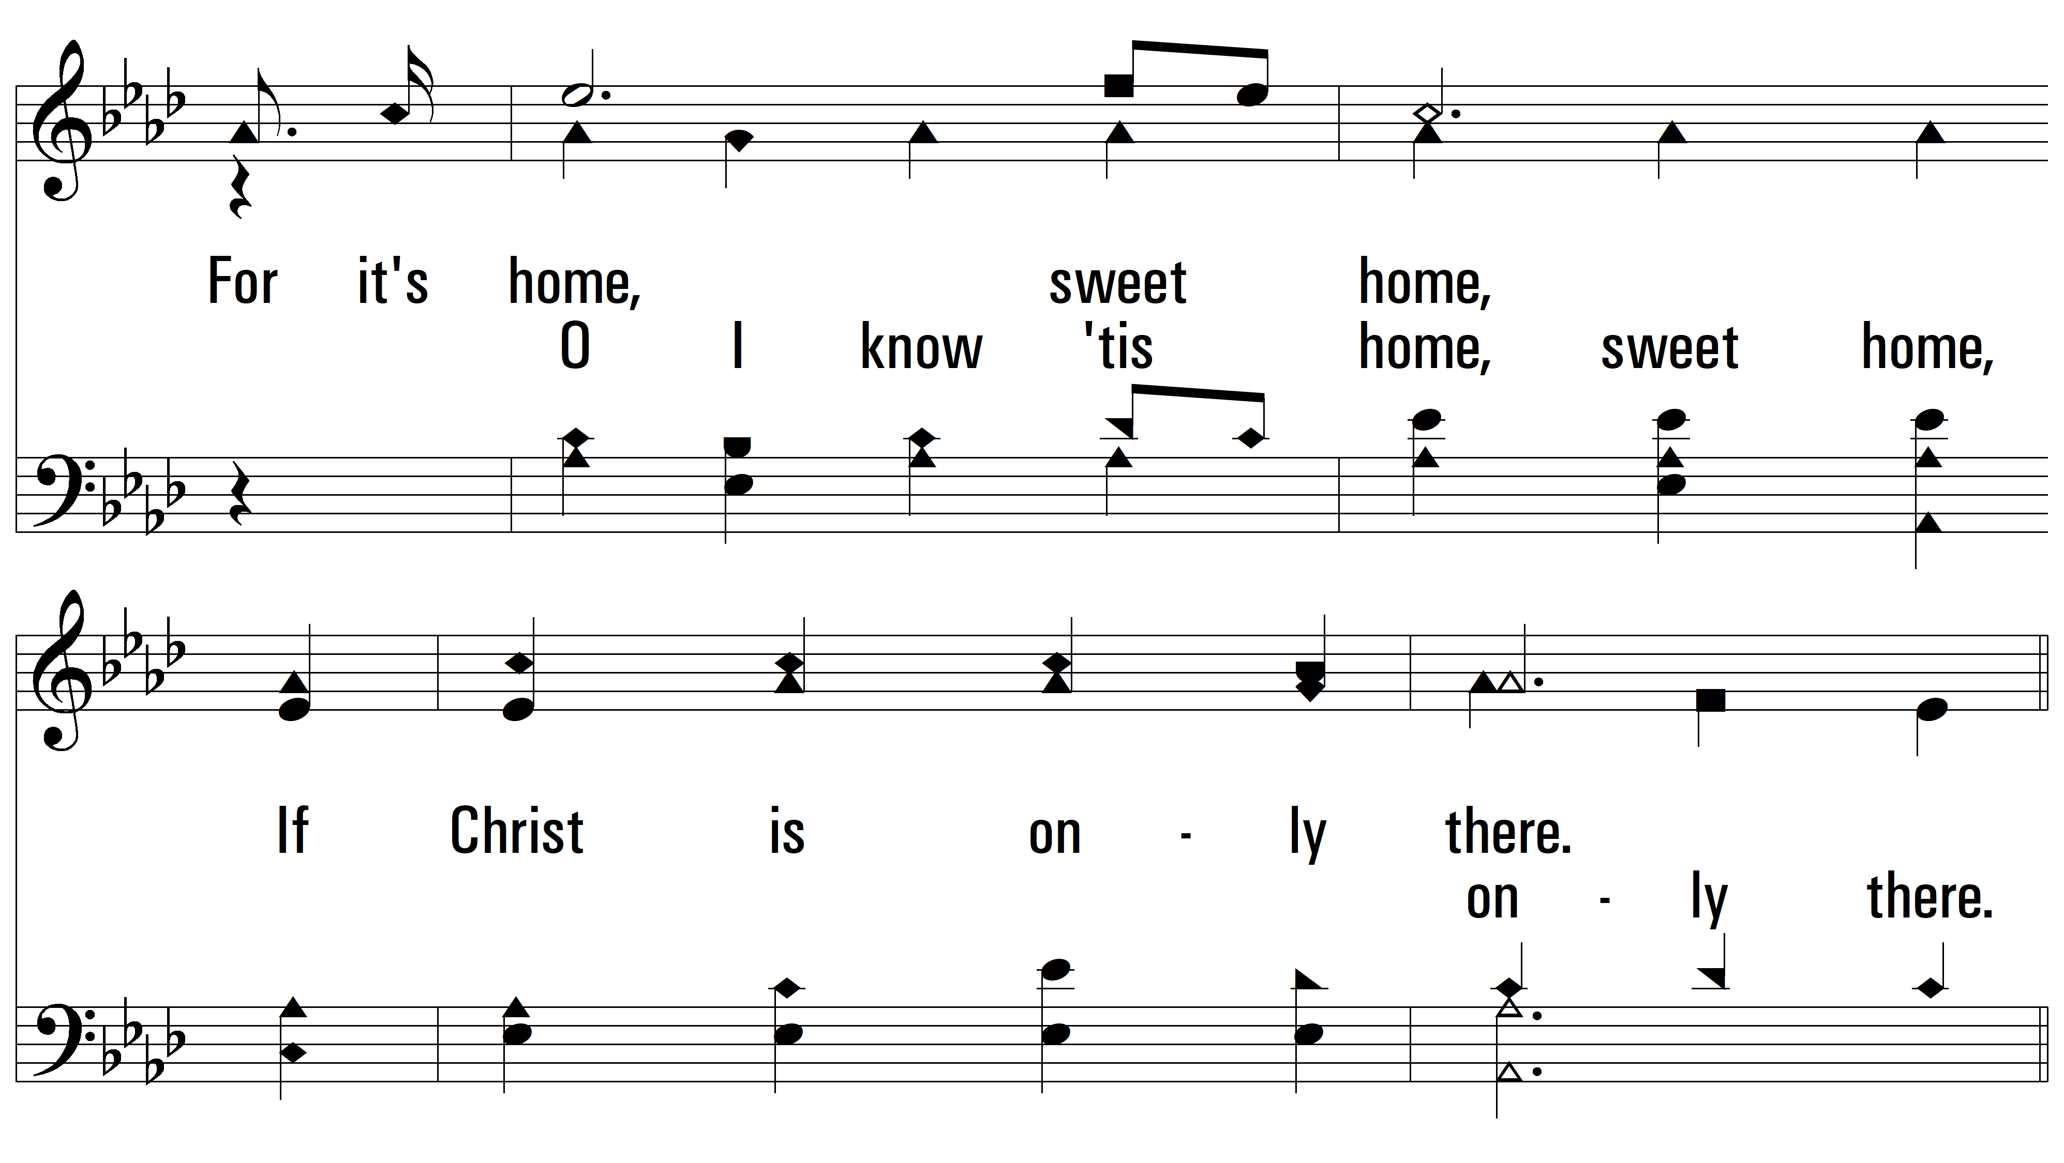
vs. 2

Slide 14
vs. 2

Slide 15
vs. 2

Slide 16
vs. 2

Slide 17
vs. 2

Slide 18
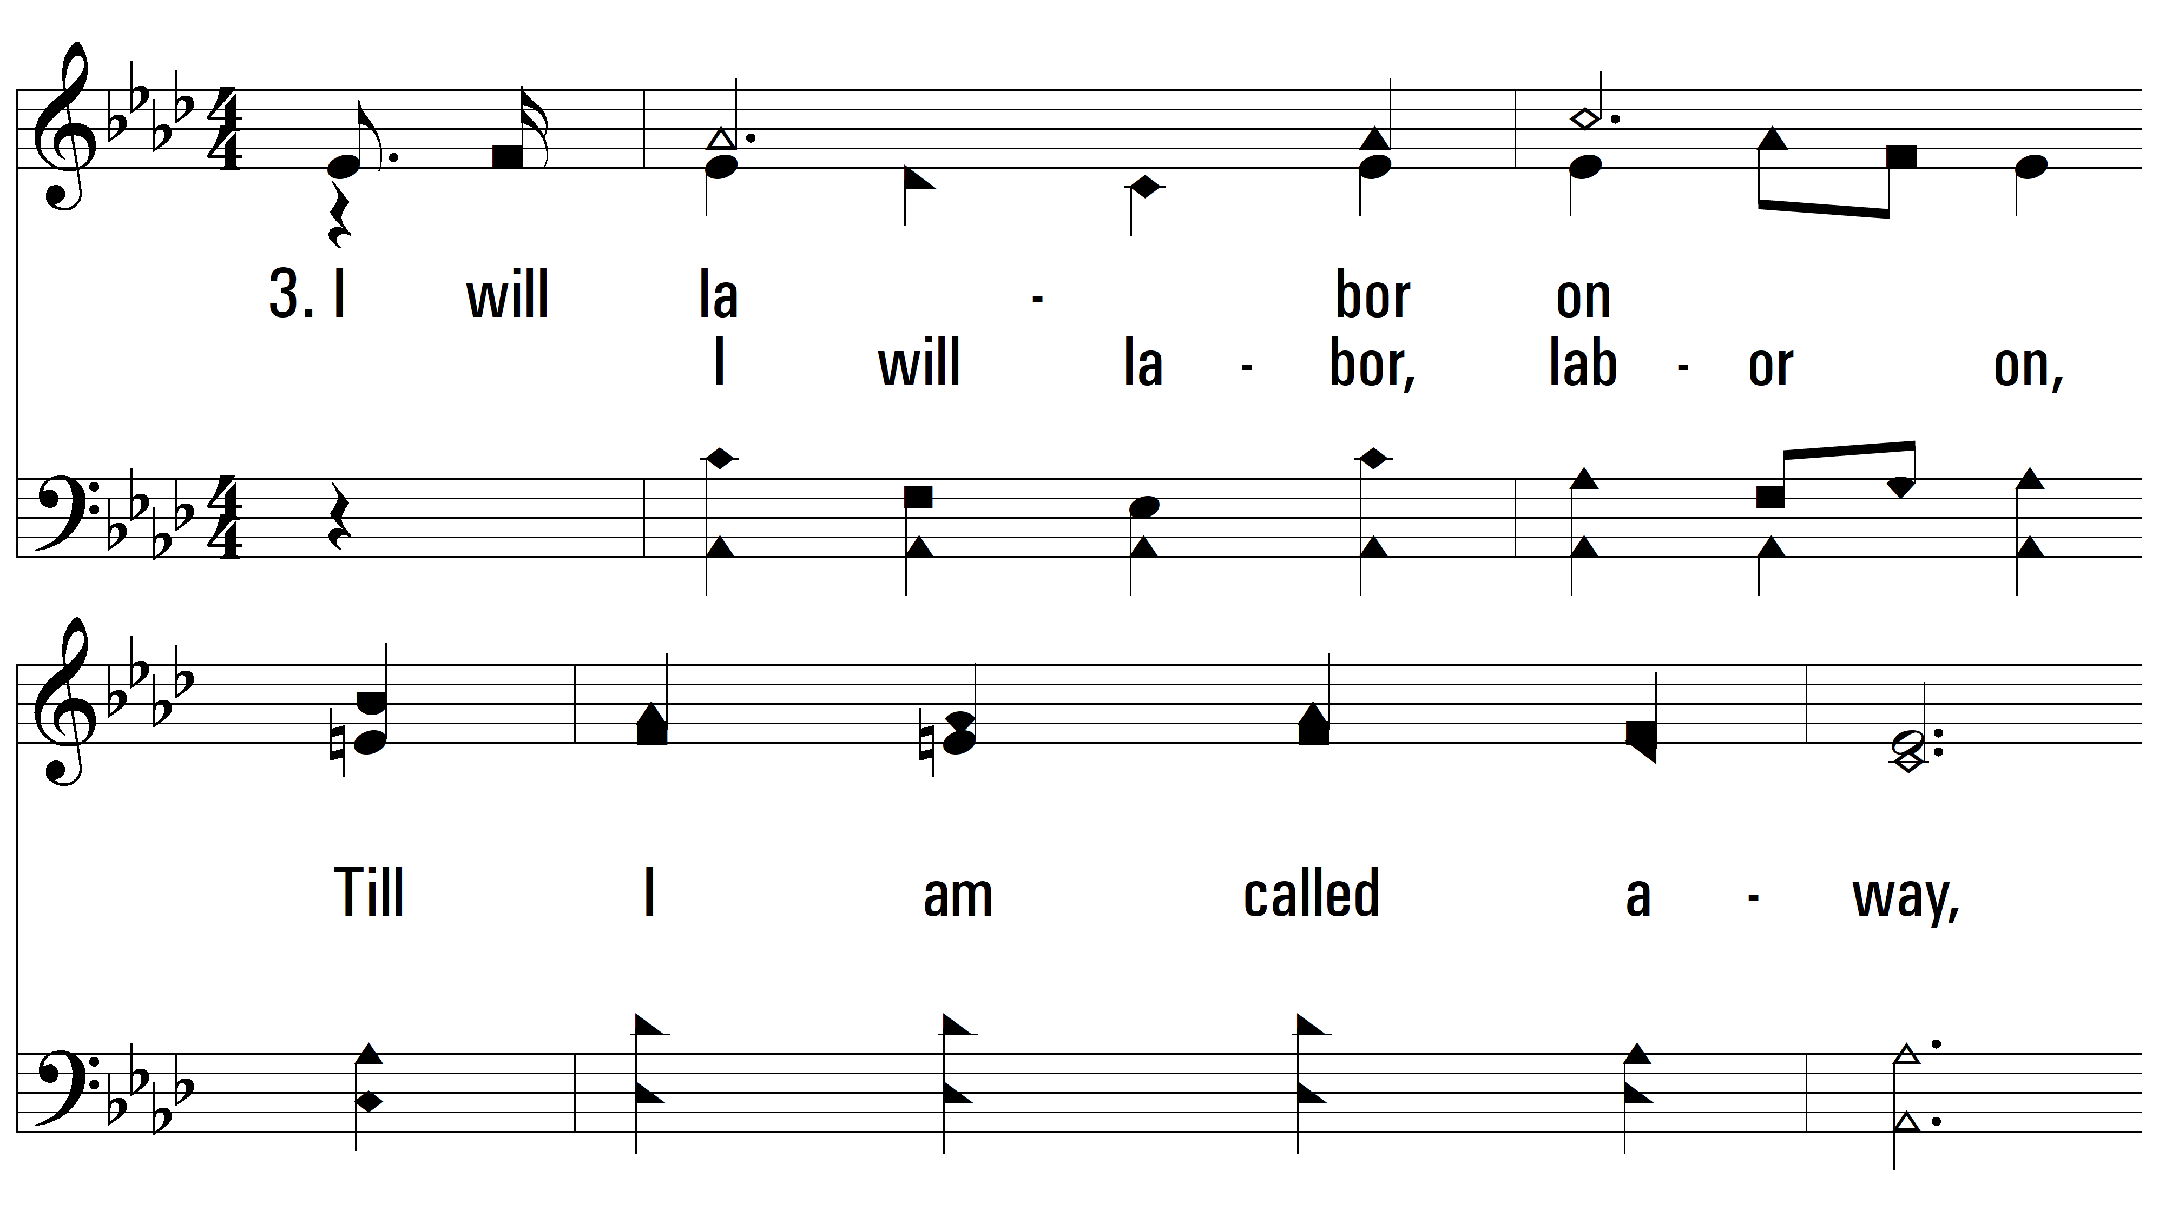
vs. 3 ~ Anywhere Is Home

Slide 19
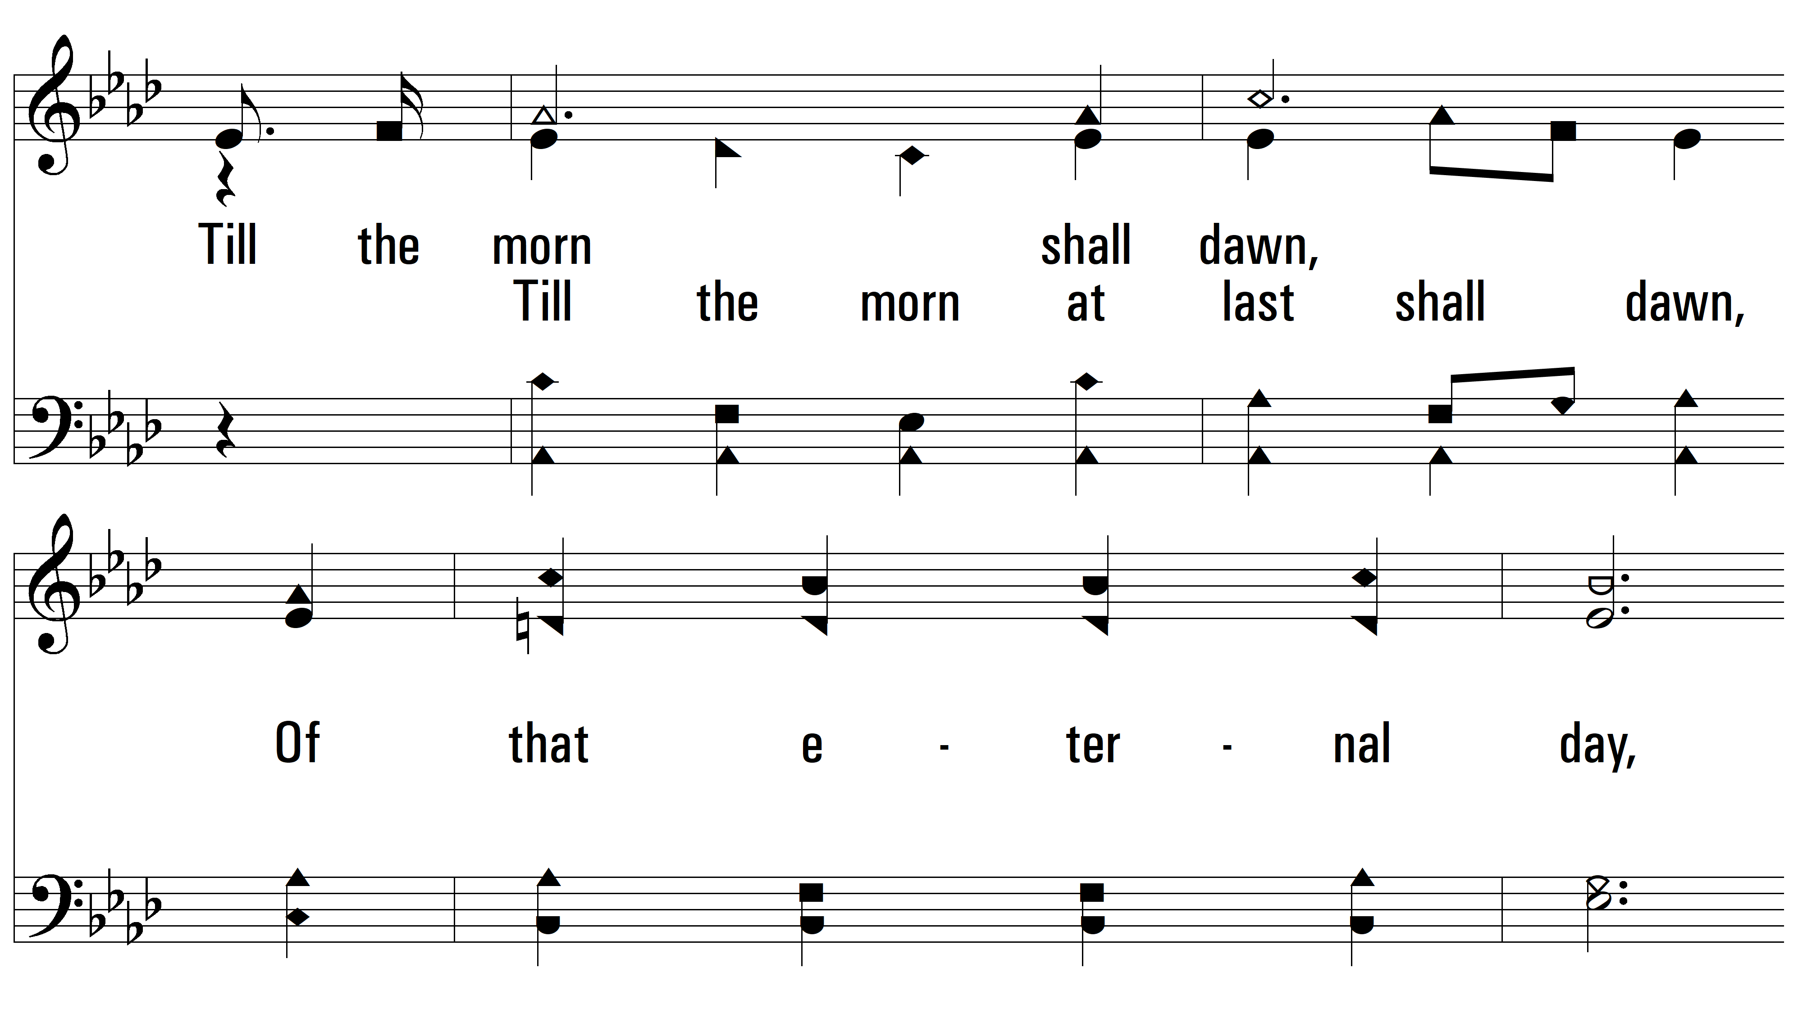
vs. 3

Slide 20
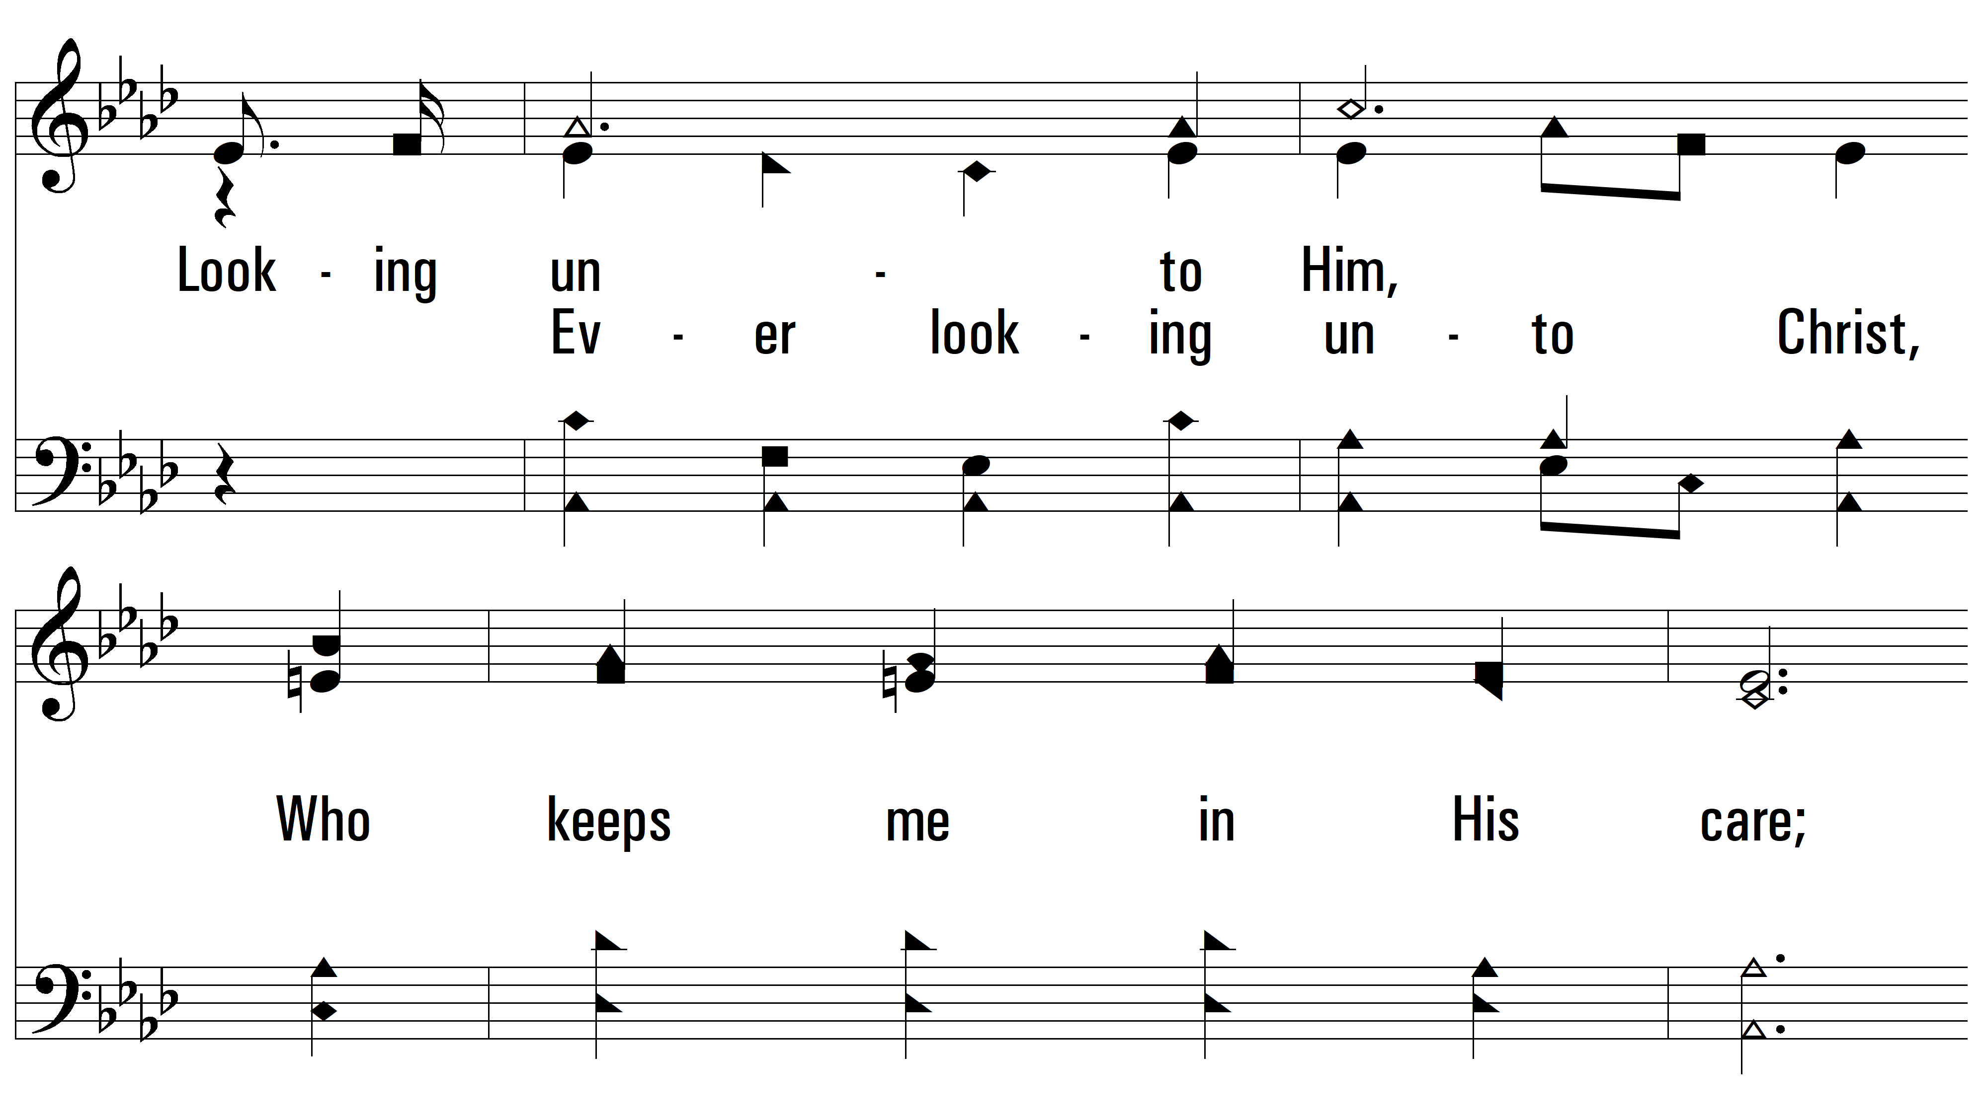
vs. 3

Slide 21
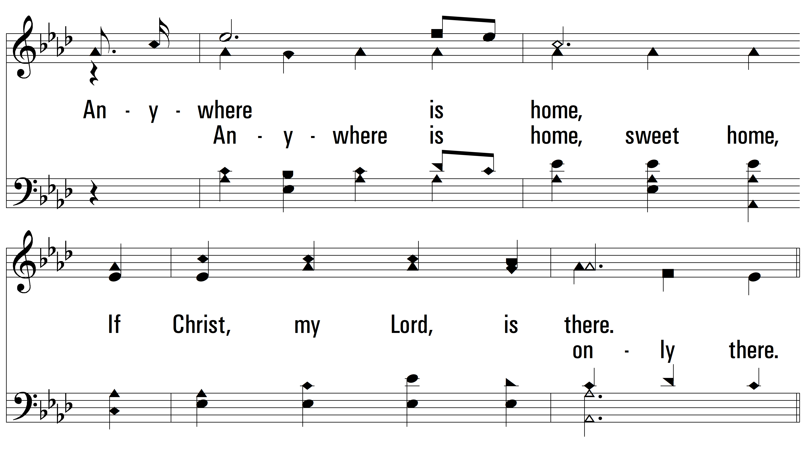
vs. 3

Slide 22
vs. 3

Slide 23
vs. 3

Slide 24
vs. 3

Slide 25
vs. 3

