Slide 1
Art Thou Weary?
STEPHANOS
8.5.8.3
Words: | Stephen the Sabaite; Tr. John Mason Neale (1862)
Music: | Henry W. Baker (1868); Har. by William H. Monk (1868)
4/4
G/B - MI
Verses: 3
Lead - | MI
Alto - | SOL
Tenor - | DO
Bass - | DO
PDHymns.com

Slide 2
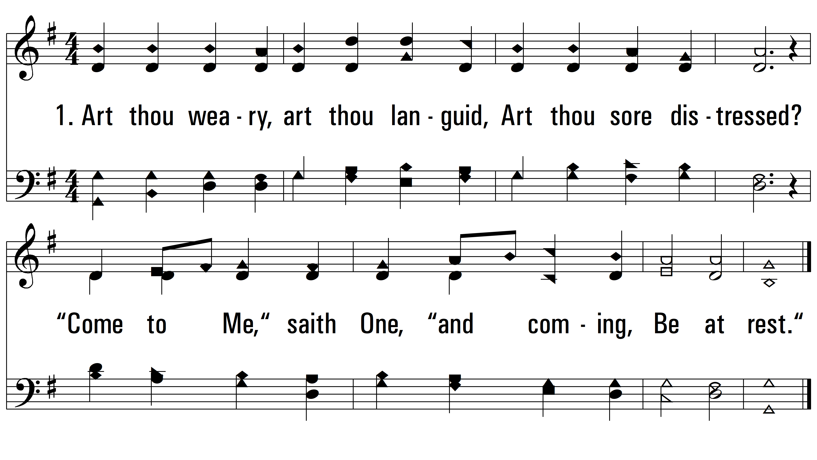
vs. 1 ~ Art Thou Weary?

Slide 3
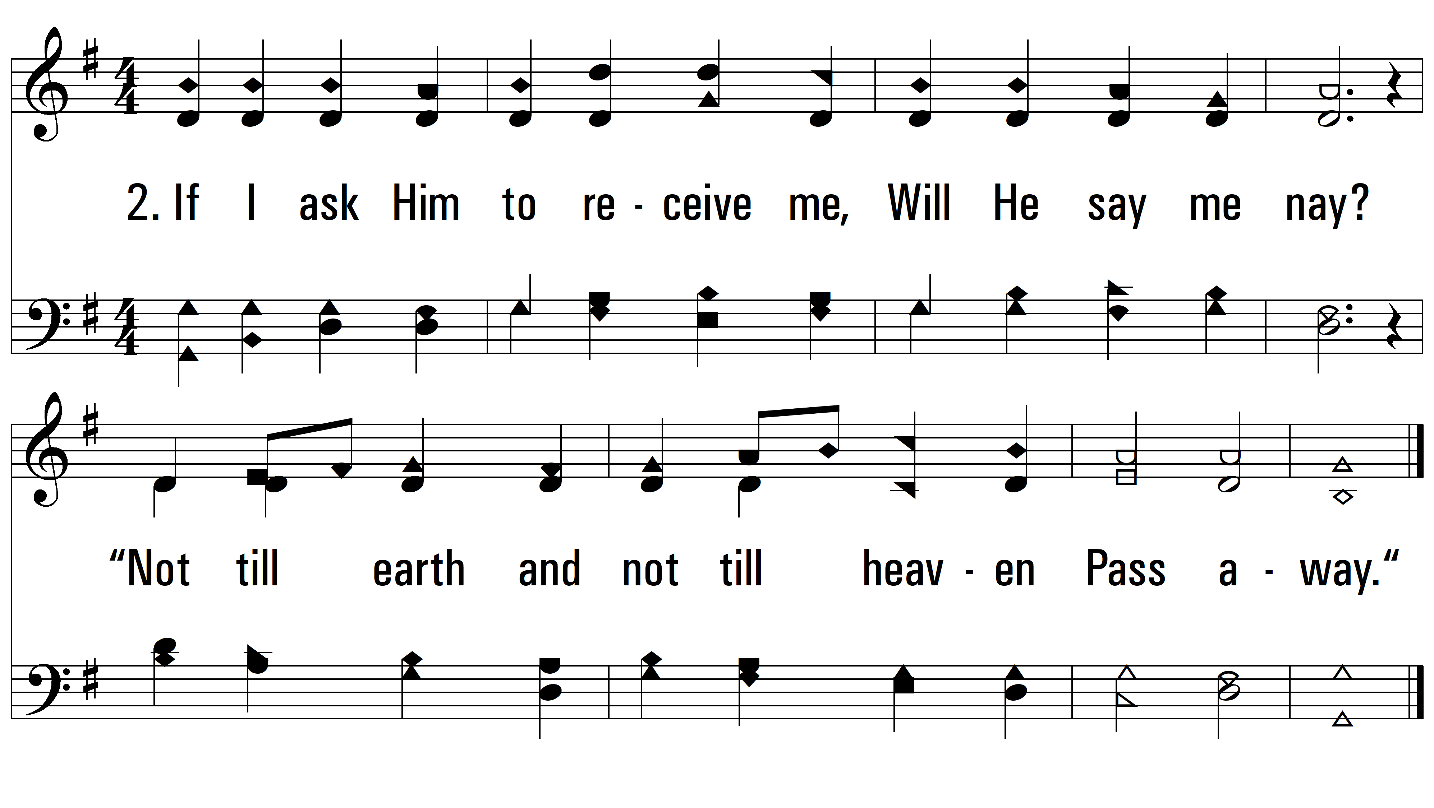
vs. 2 ~ Art Thou Weary?

Slide 4
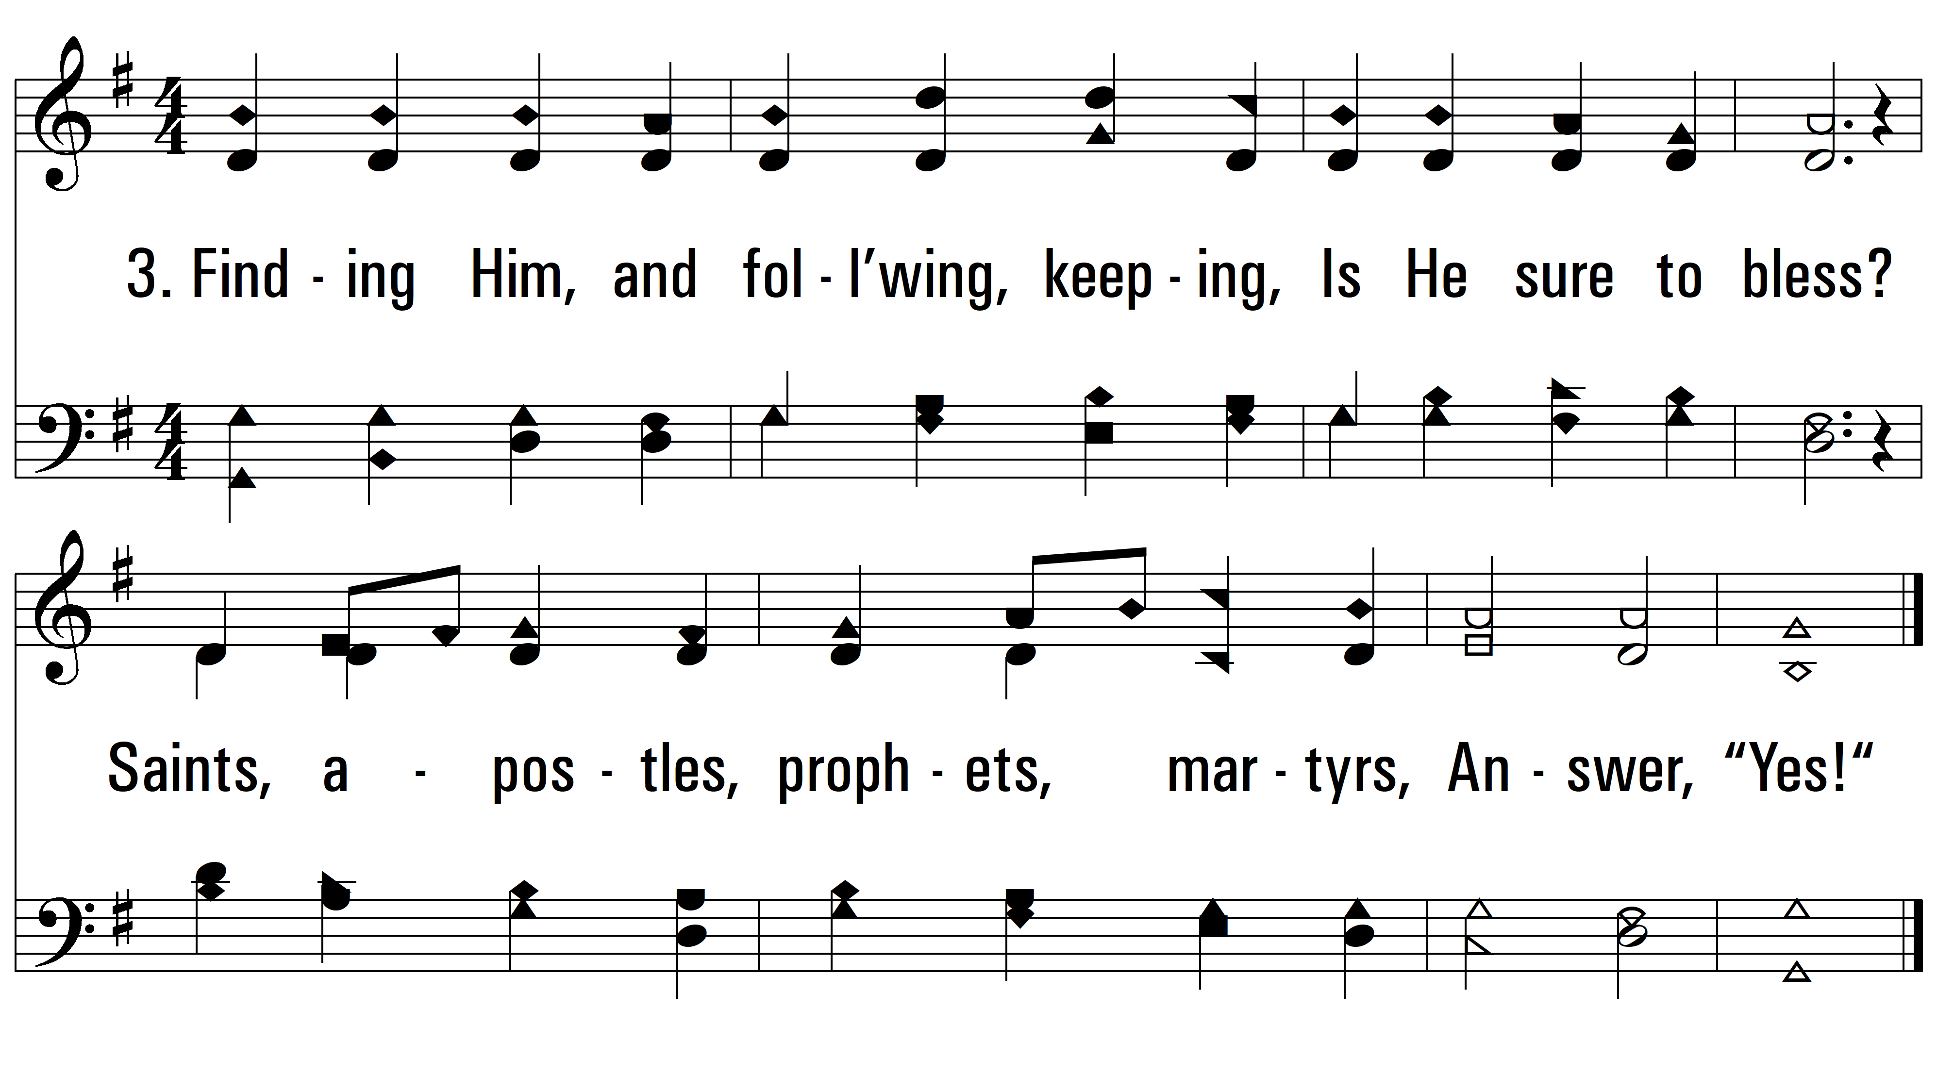
vs. 3 ~ Art Thou Weary?
PDHymns.com
END

