Slide 1
Child Of The King
Words: | Hattie E. Buell (1877)
Music: | John B. Sumner (1877)
3/4
E/G - MI
Verses: 4/Chorus
Lead - | MI
Alto - | DO
Tenor - | SOL
Bass - | DO
PDHymns.com

Slide 2
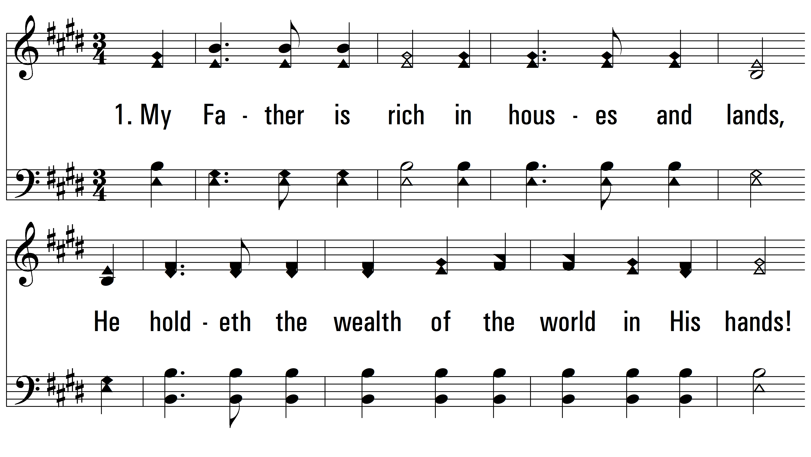
vs. 1 ~ Child Of The King
PDHymns.com
END

Slide 3
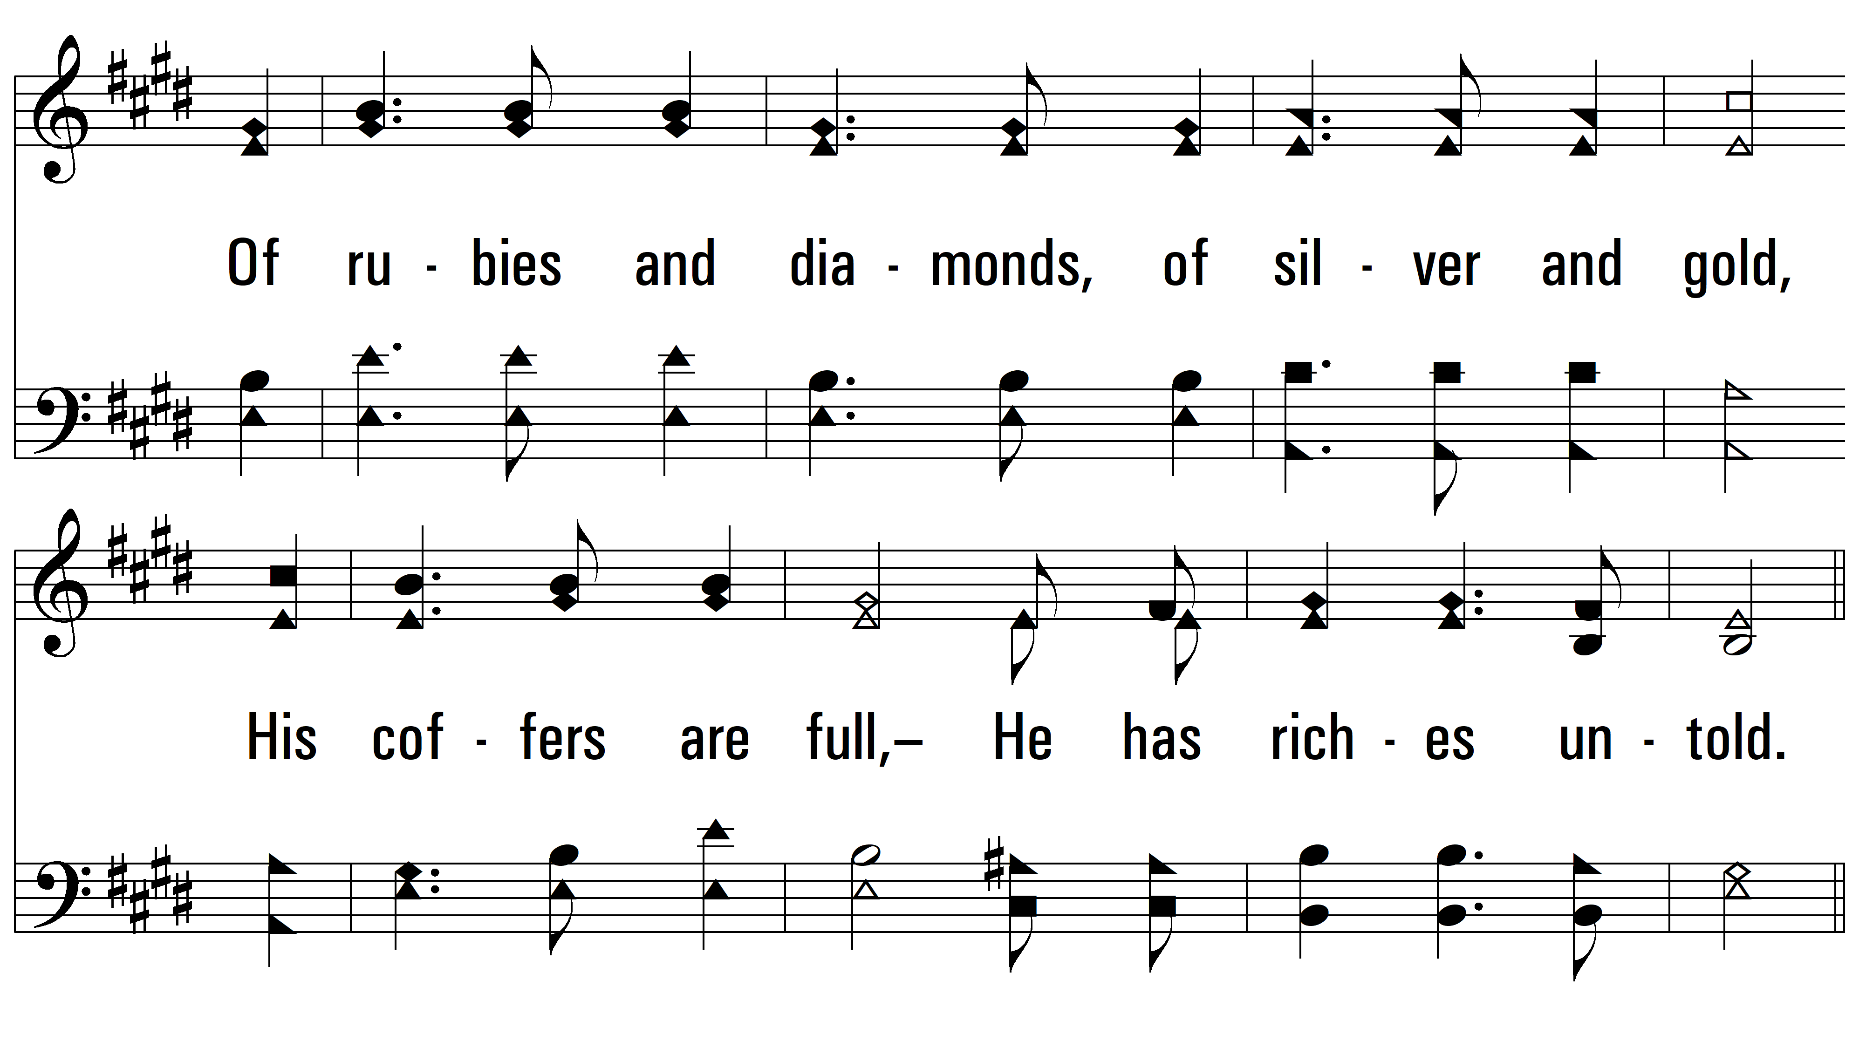
vs. 1

Slide 4
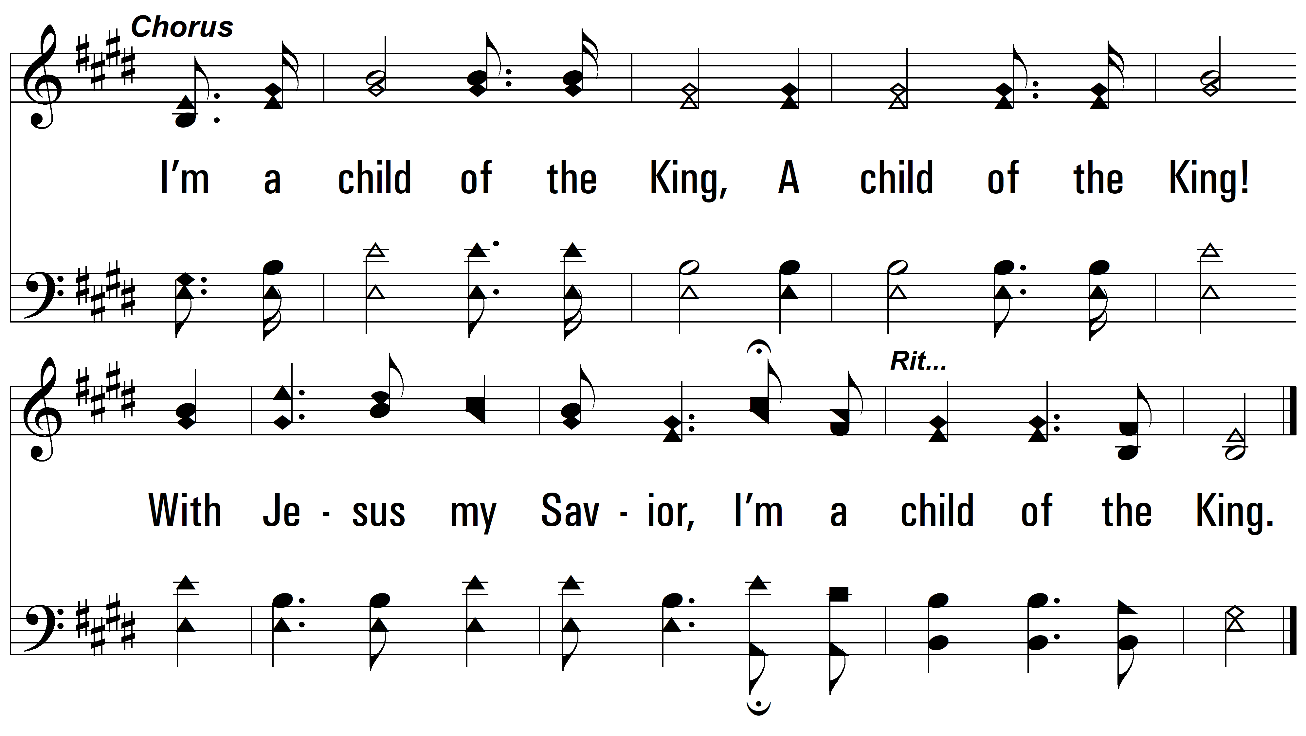
vs. 1

Slide 5
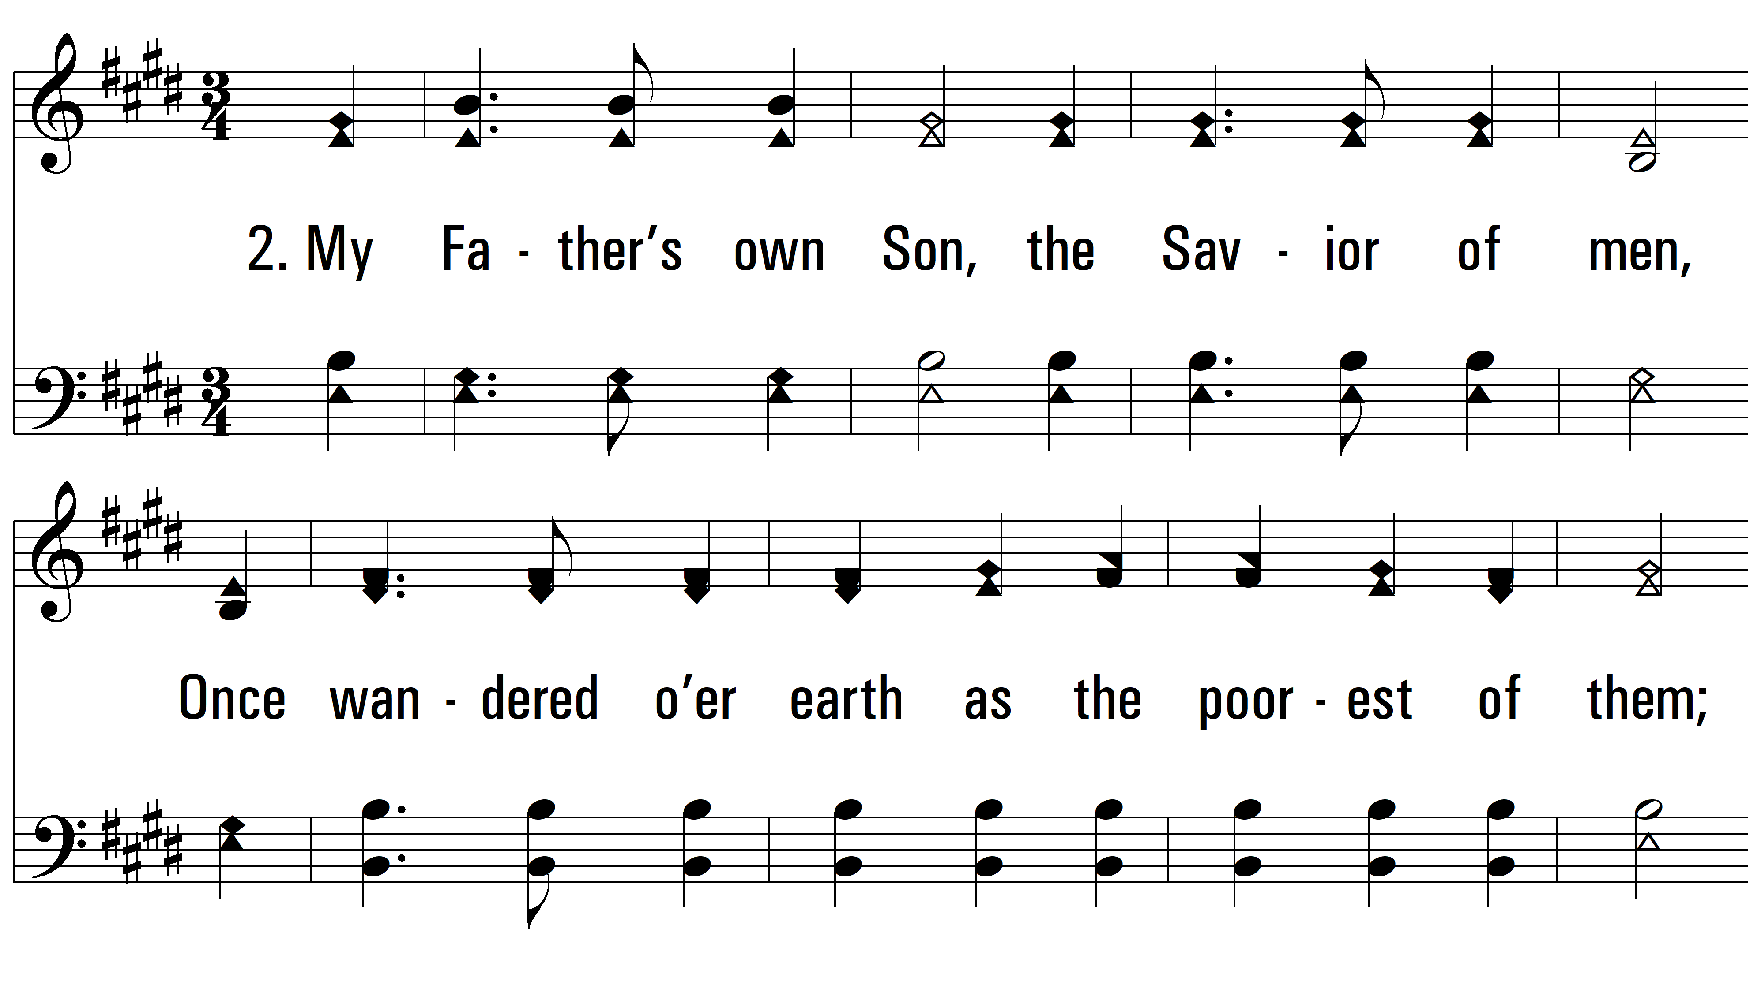
vs. 2 ~ Child Of The King

Slide 6
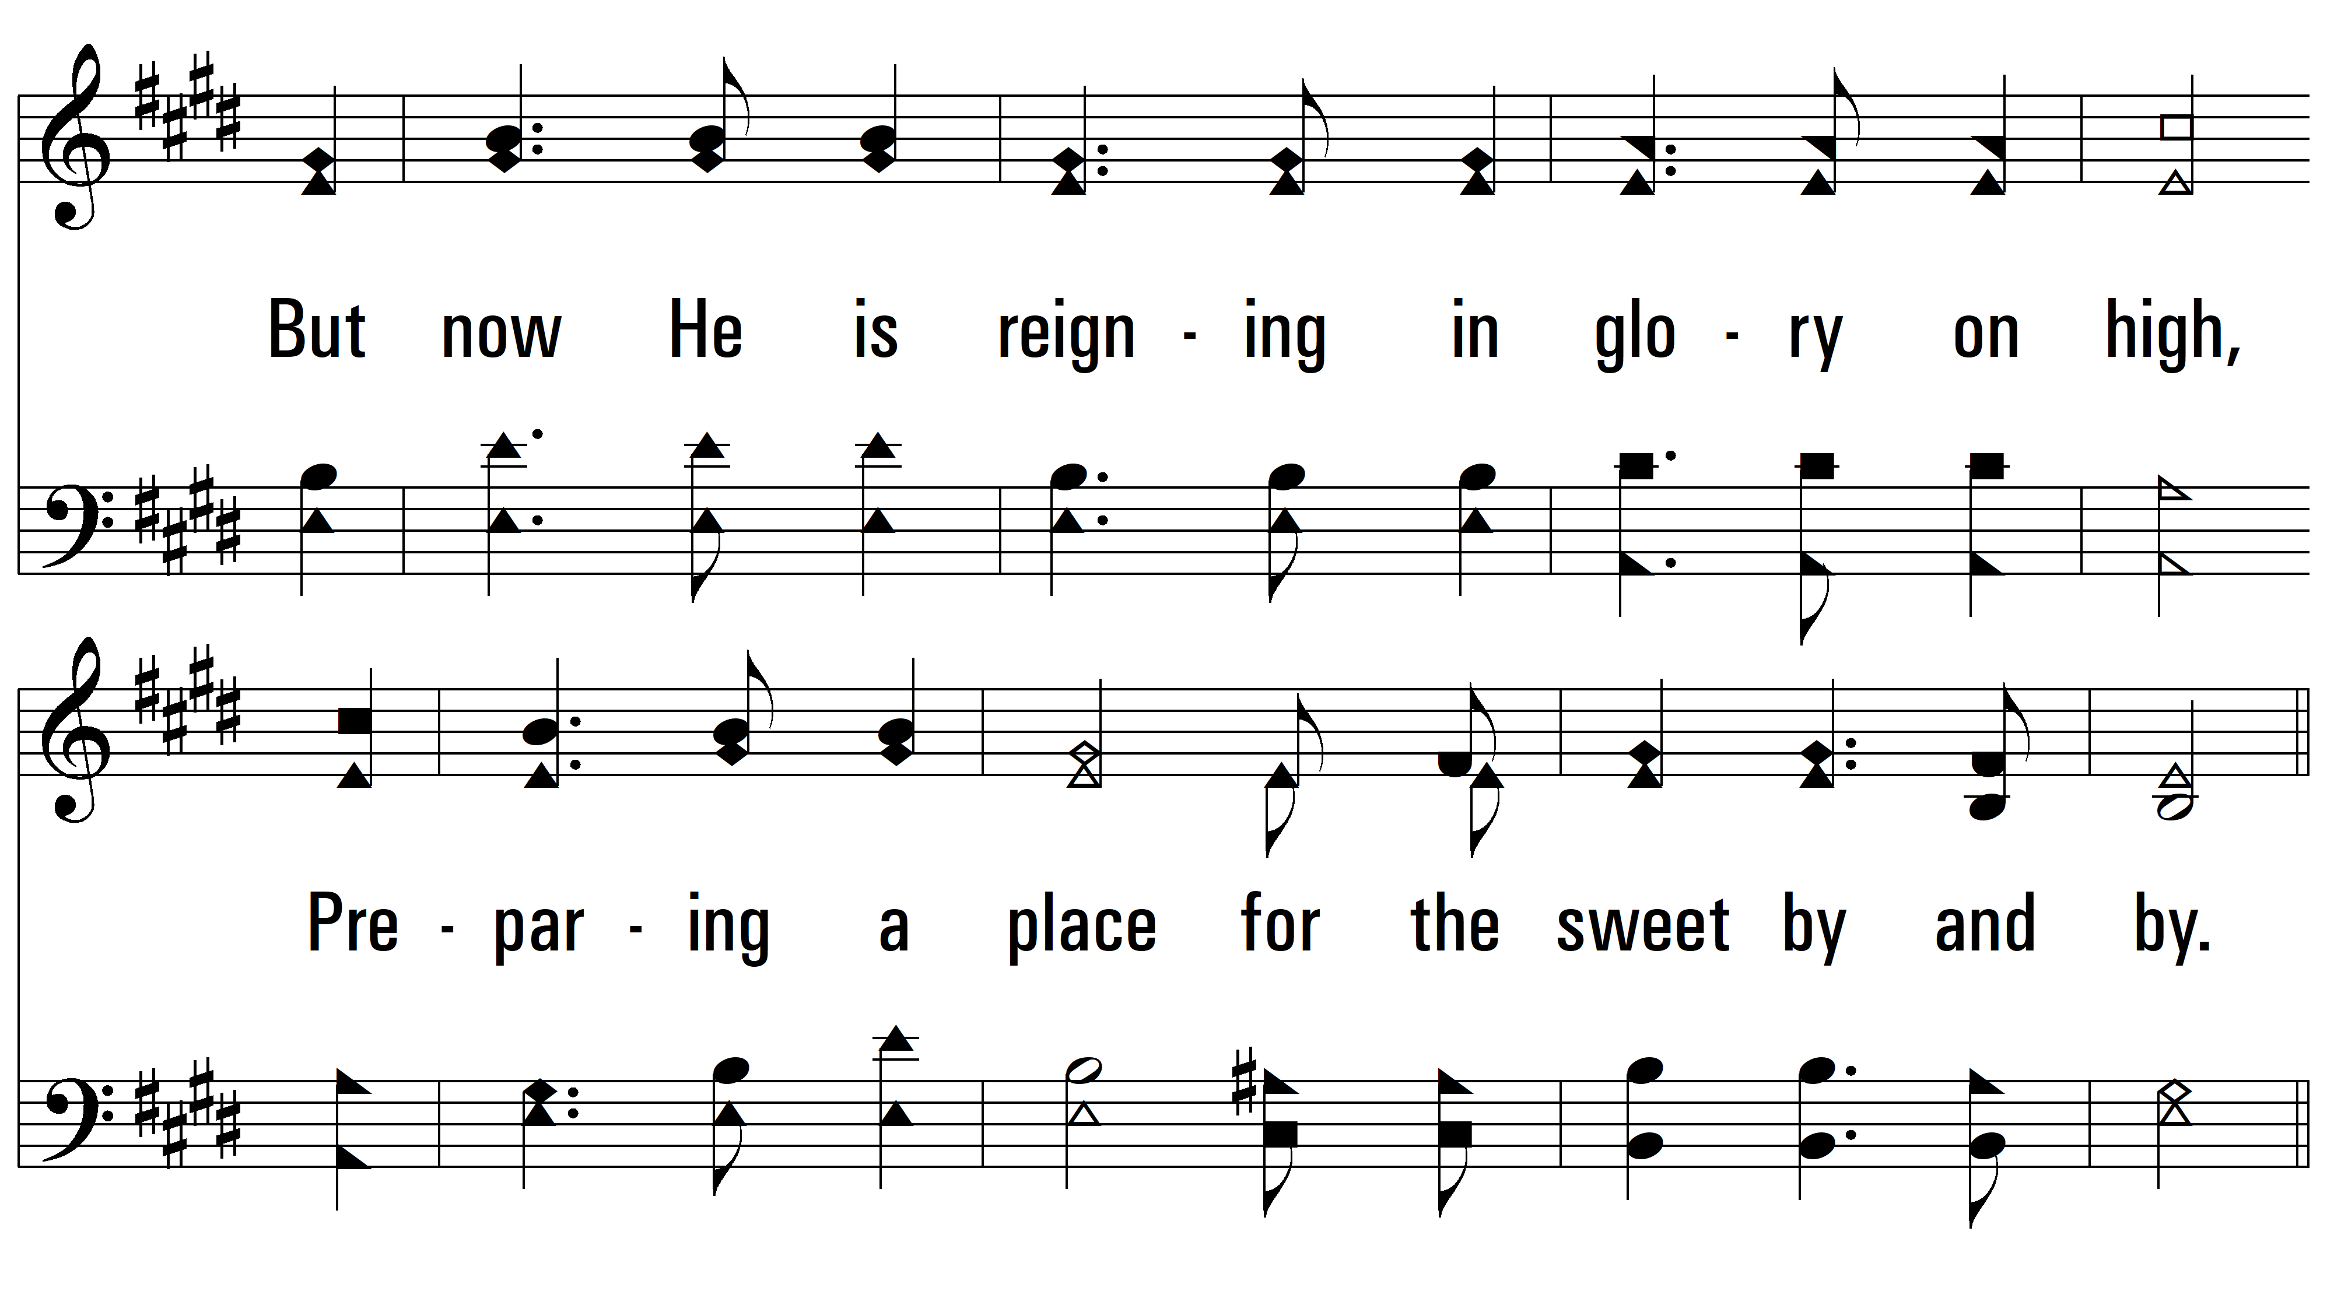
vs. 2

Slide 7
vs. 2

Slide 8
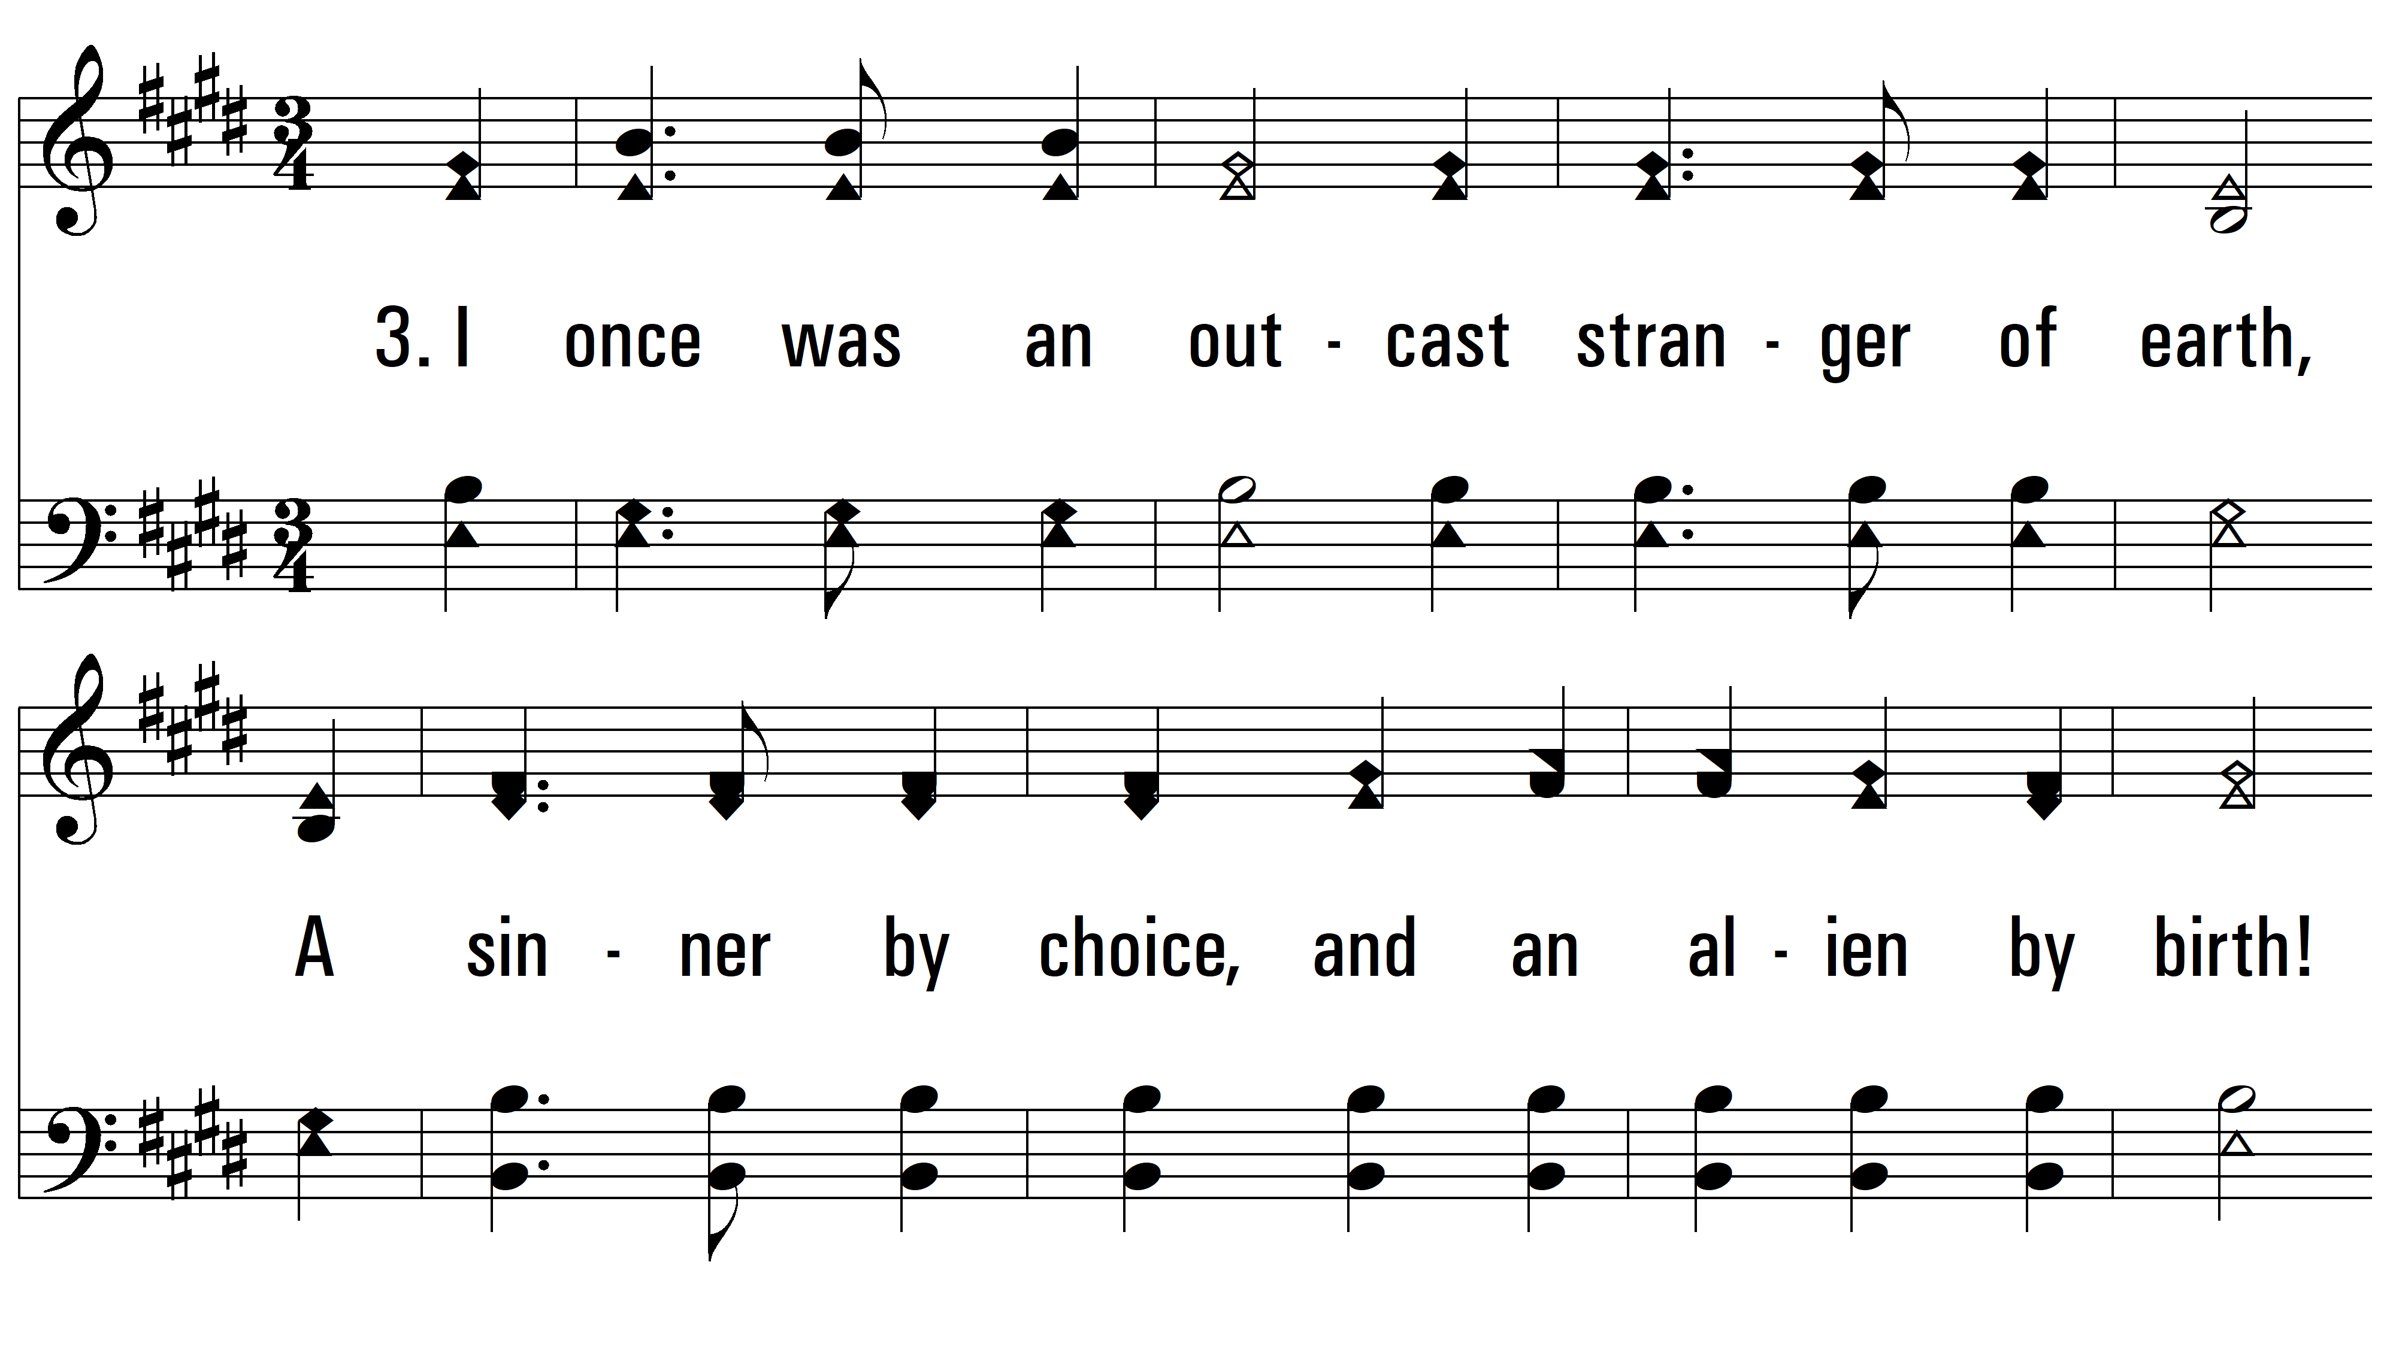
vs. 3 ~ Child Of The King

Slide 9
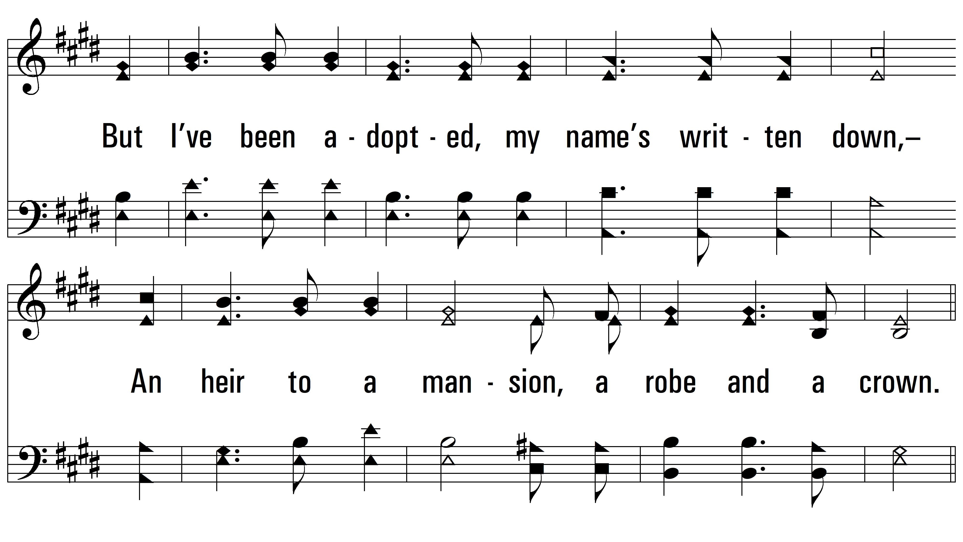
vs. 3

Slide 10
vs. 3

Slide 11
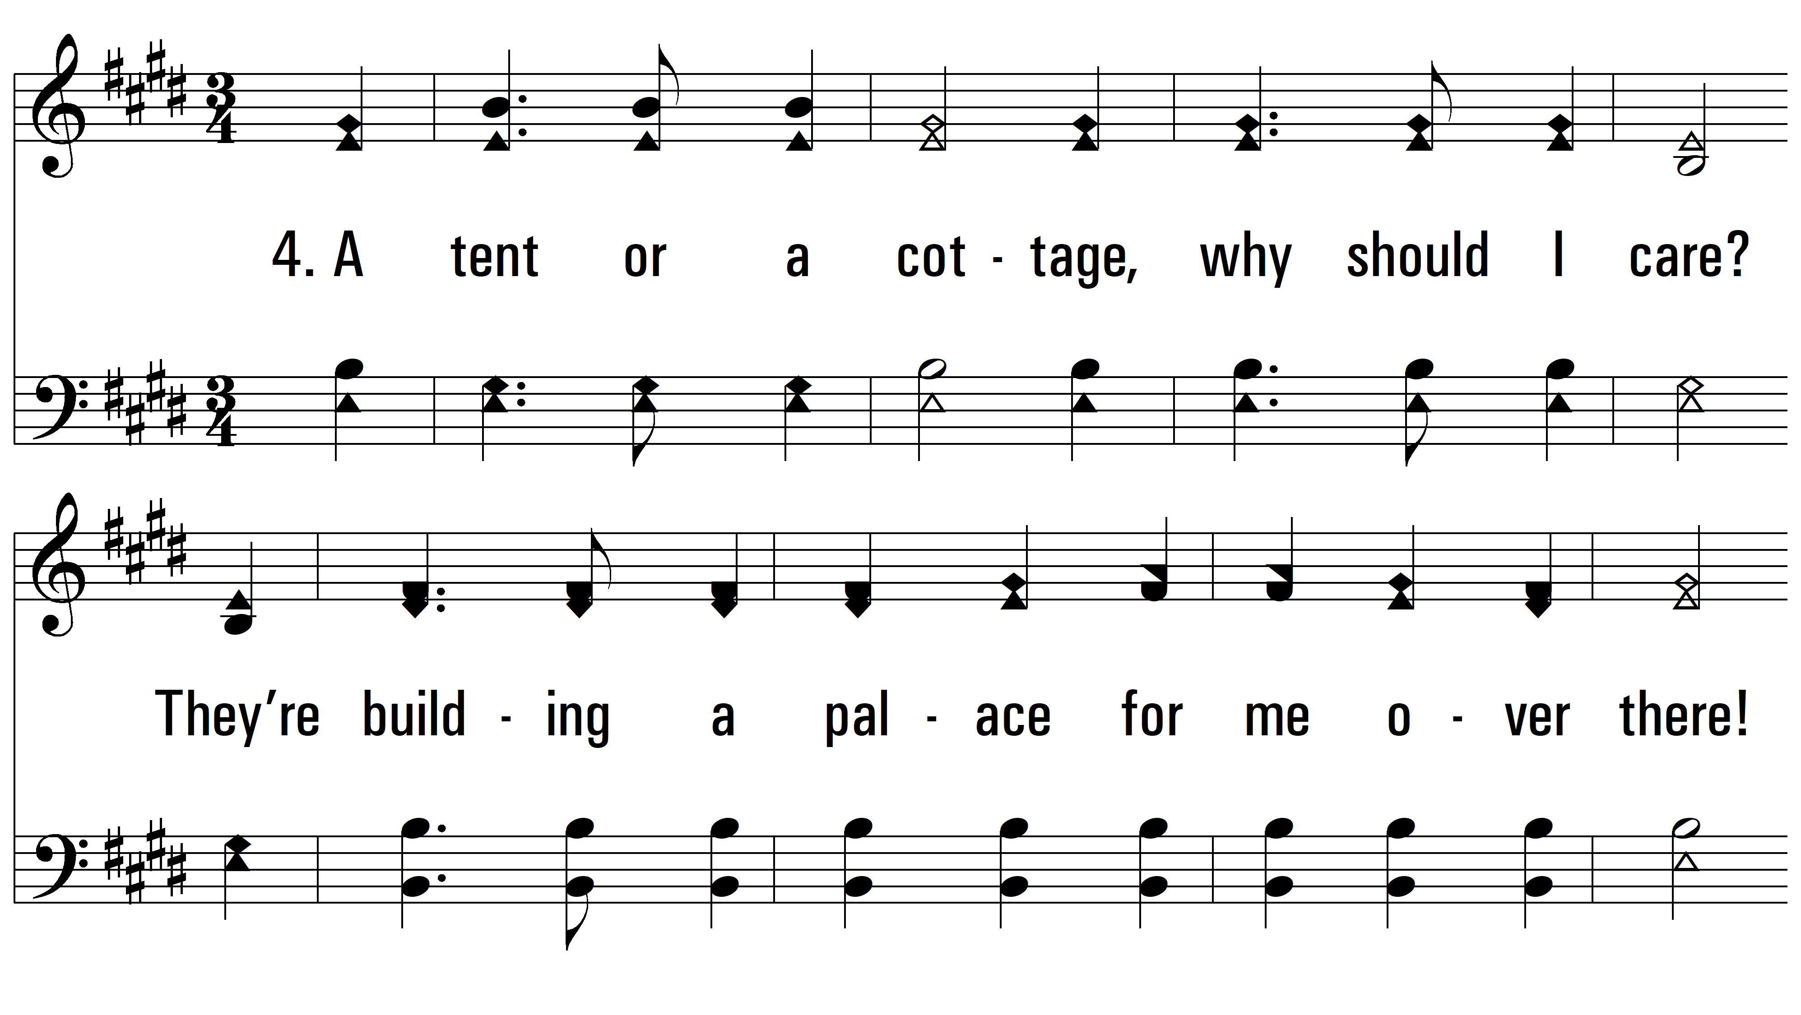
vs. 4 ~ Child Of The King

Slide 12
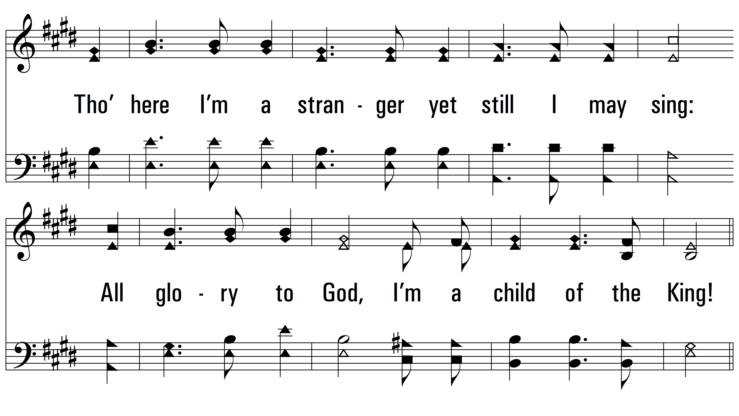
vs. 4

Slide 13
vs. 4
PDHymns.com
END

