Slide 1
Closer To Thee
TAYLOR
8.8.6.6.6.4
Words: | Austin Taylor (1911)
Music: | Austin Taylor (1911)
6/8
B^{b}/F - SOL
Verses: 3
Lead - | SOL
Alto - | MI
Tenor - | DO
Bass - | DO
PDHymns.com

Slide 2
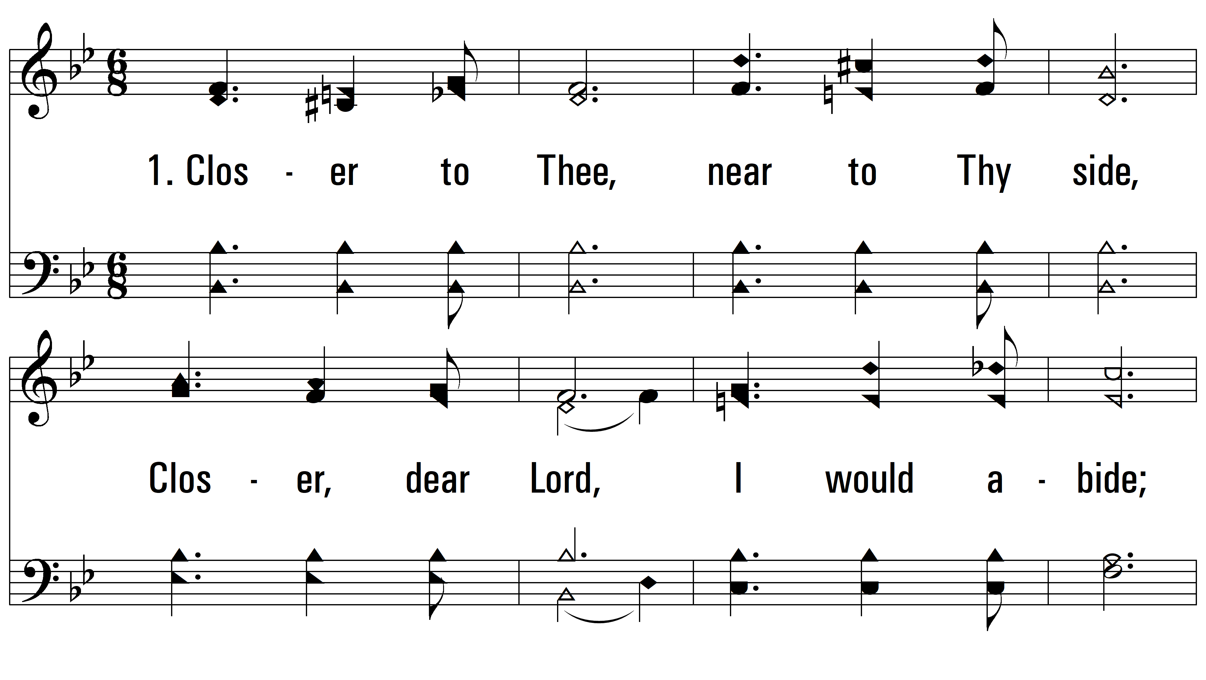
vs. 1 ~ Closer To Thee

Slide 3
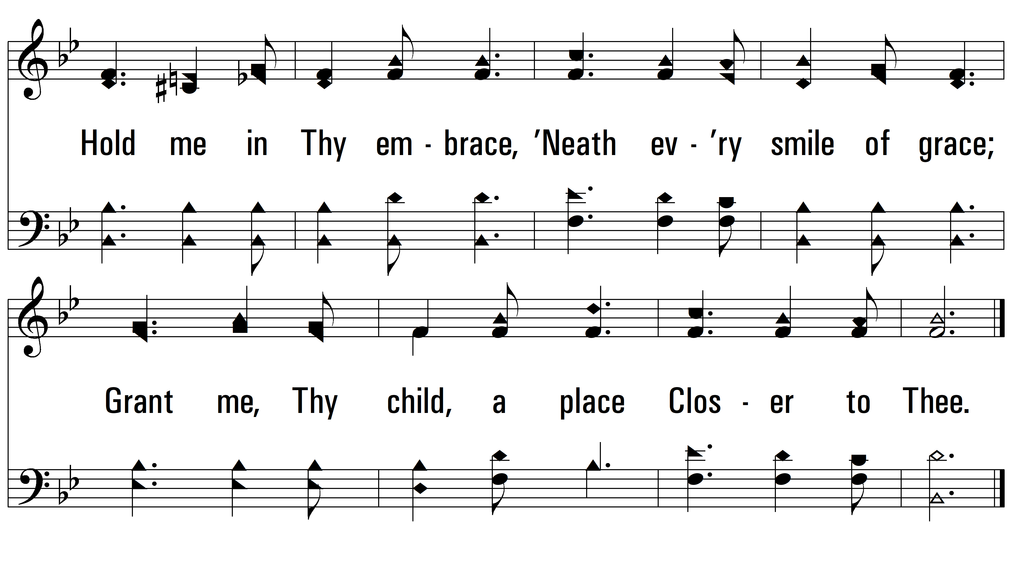
vs. 1

Slide 4
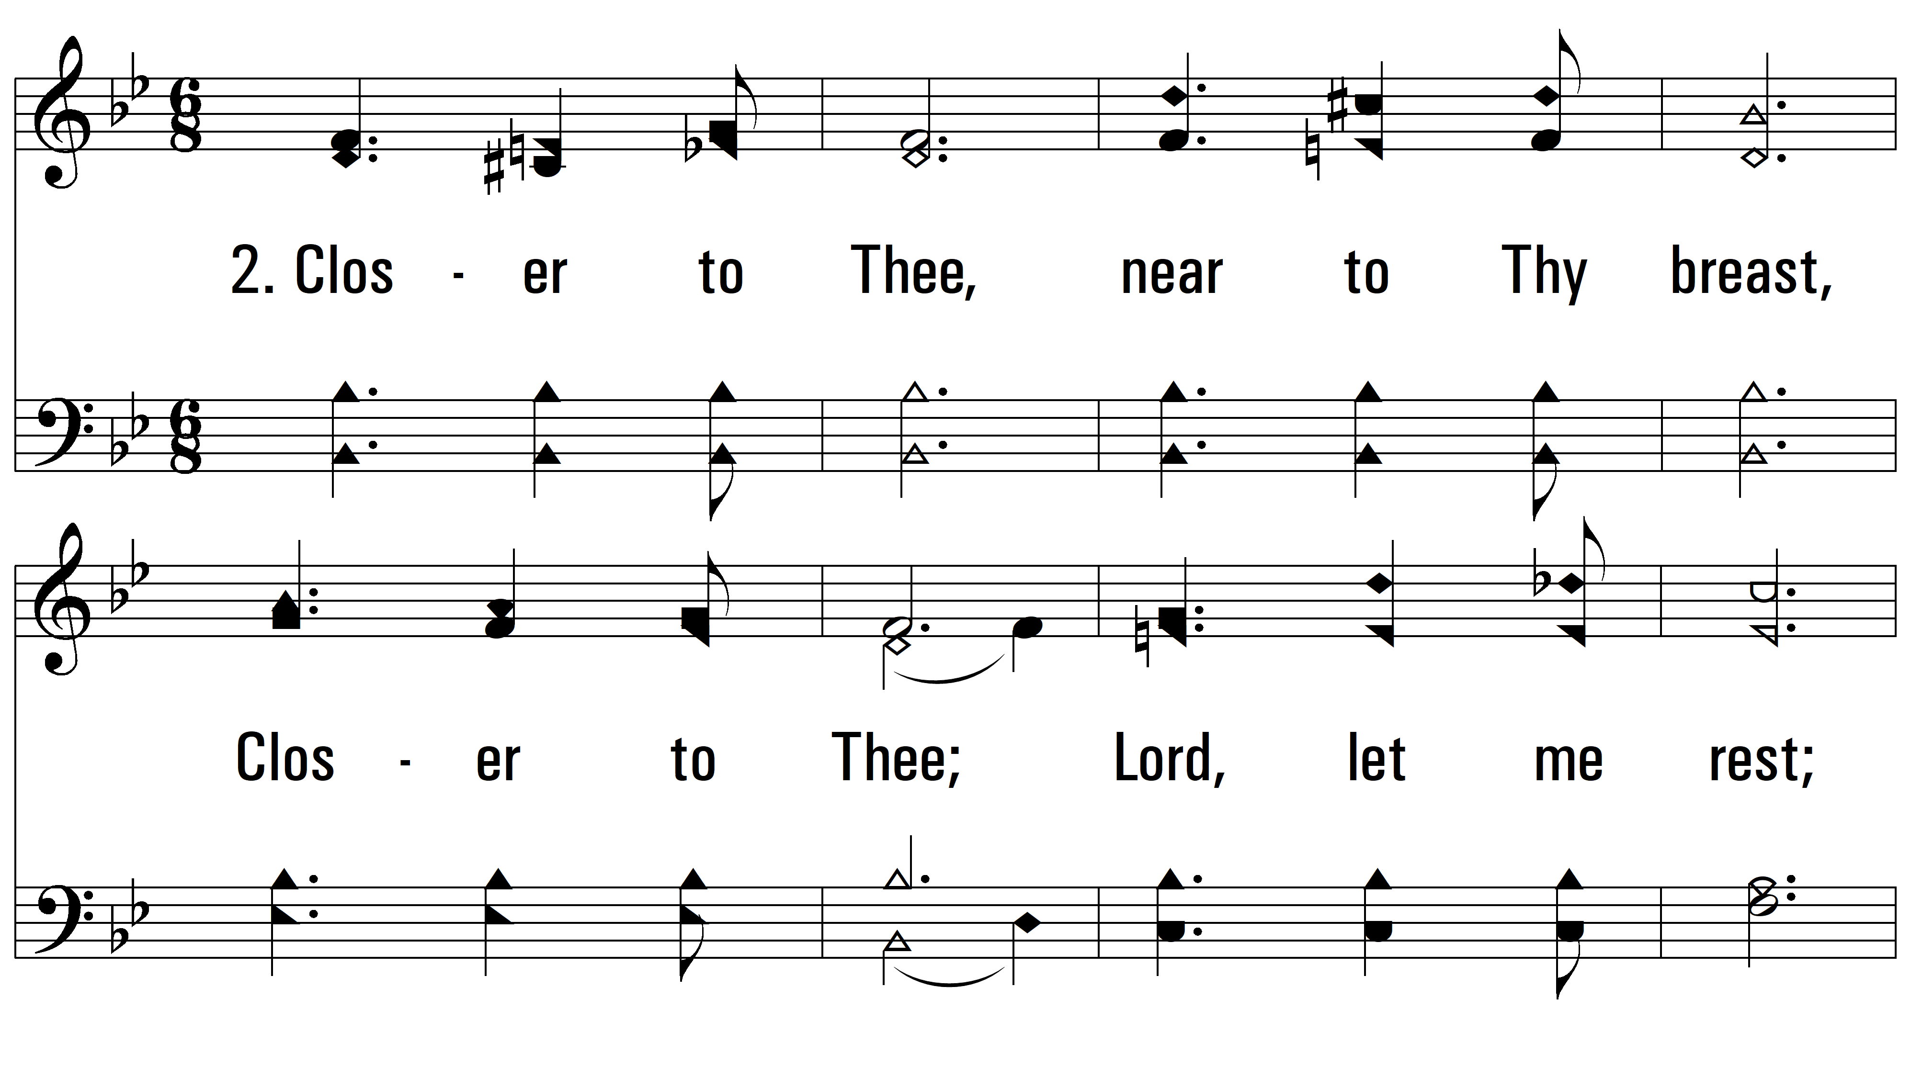
vs. 2 ~ Closer To Thee

Slide 5
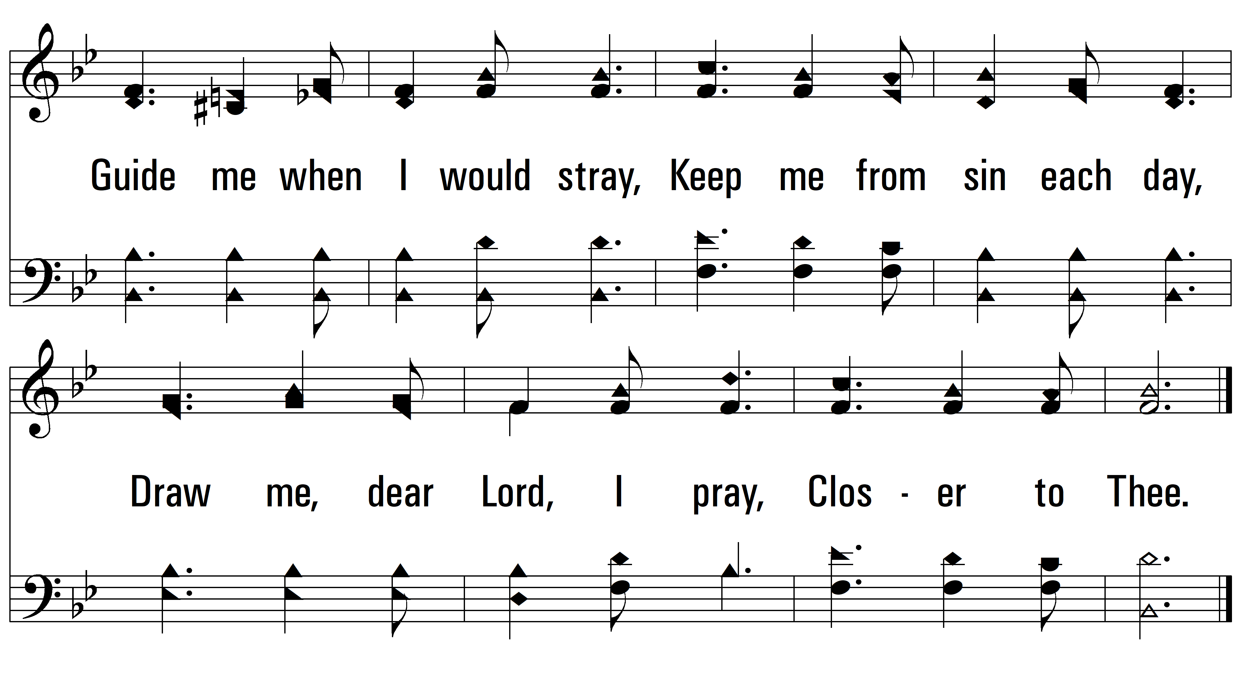
vs. 2

Slide 6
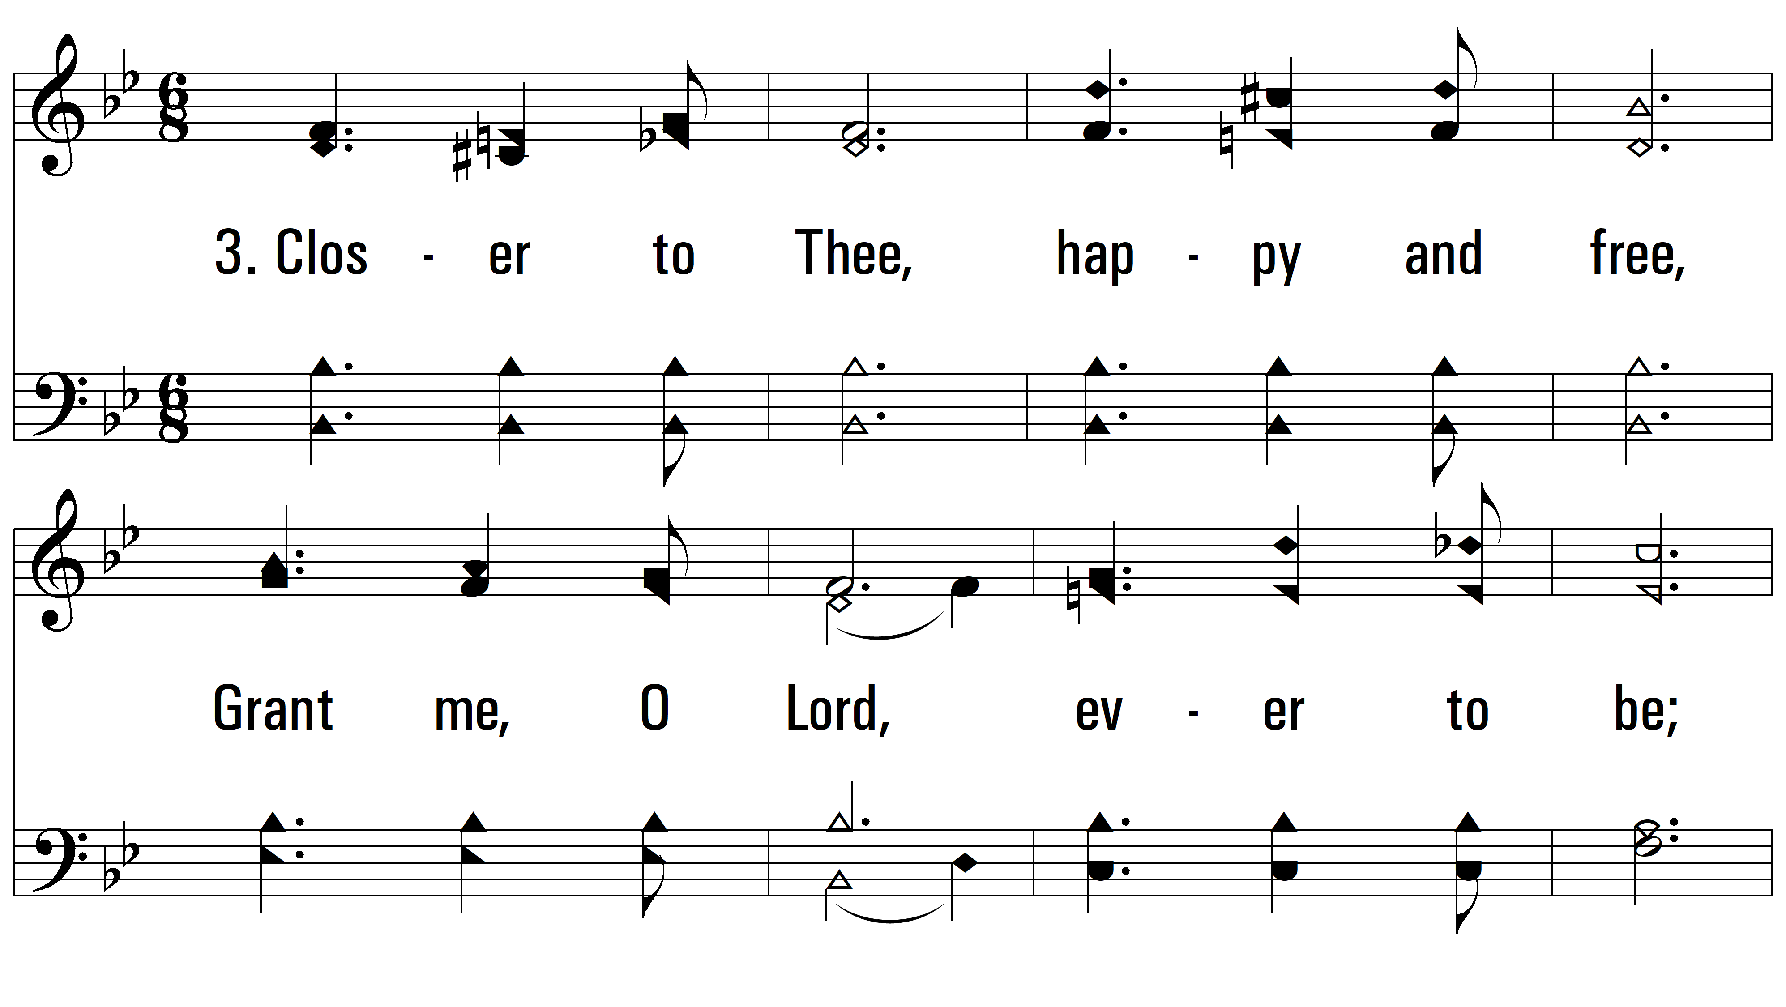
vs. 3 ~ Closer To Thee

Slide 7
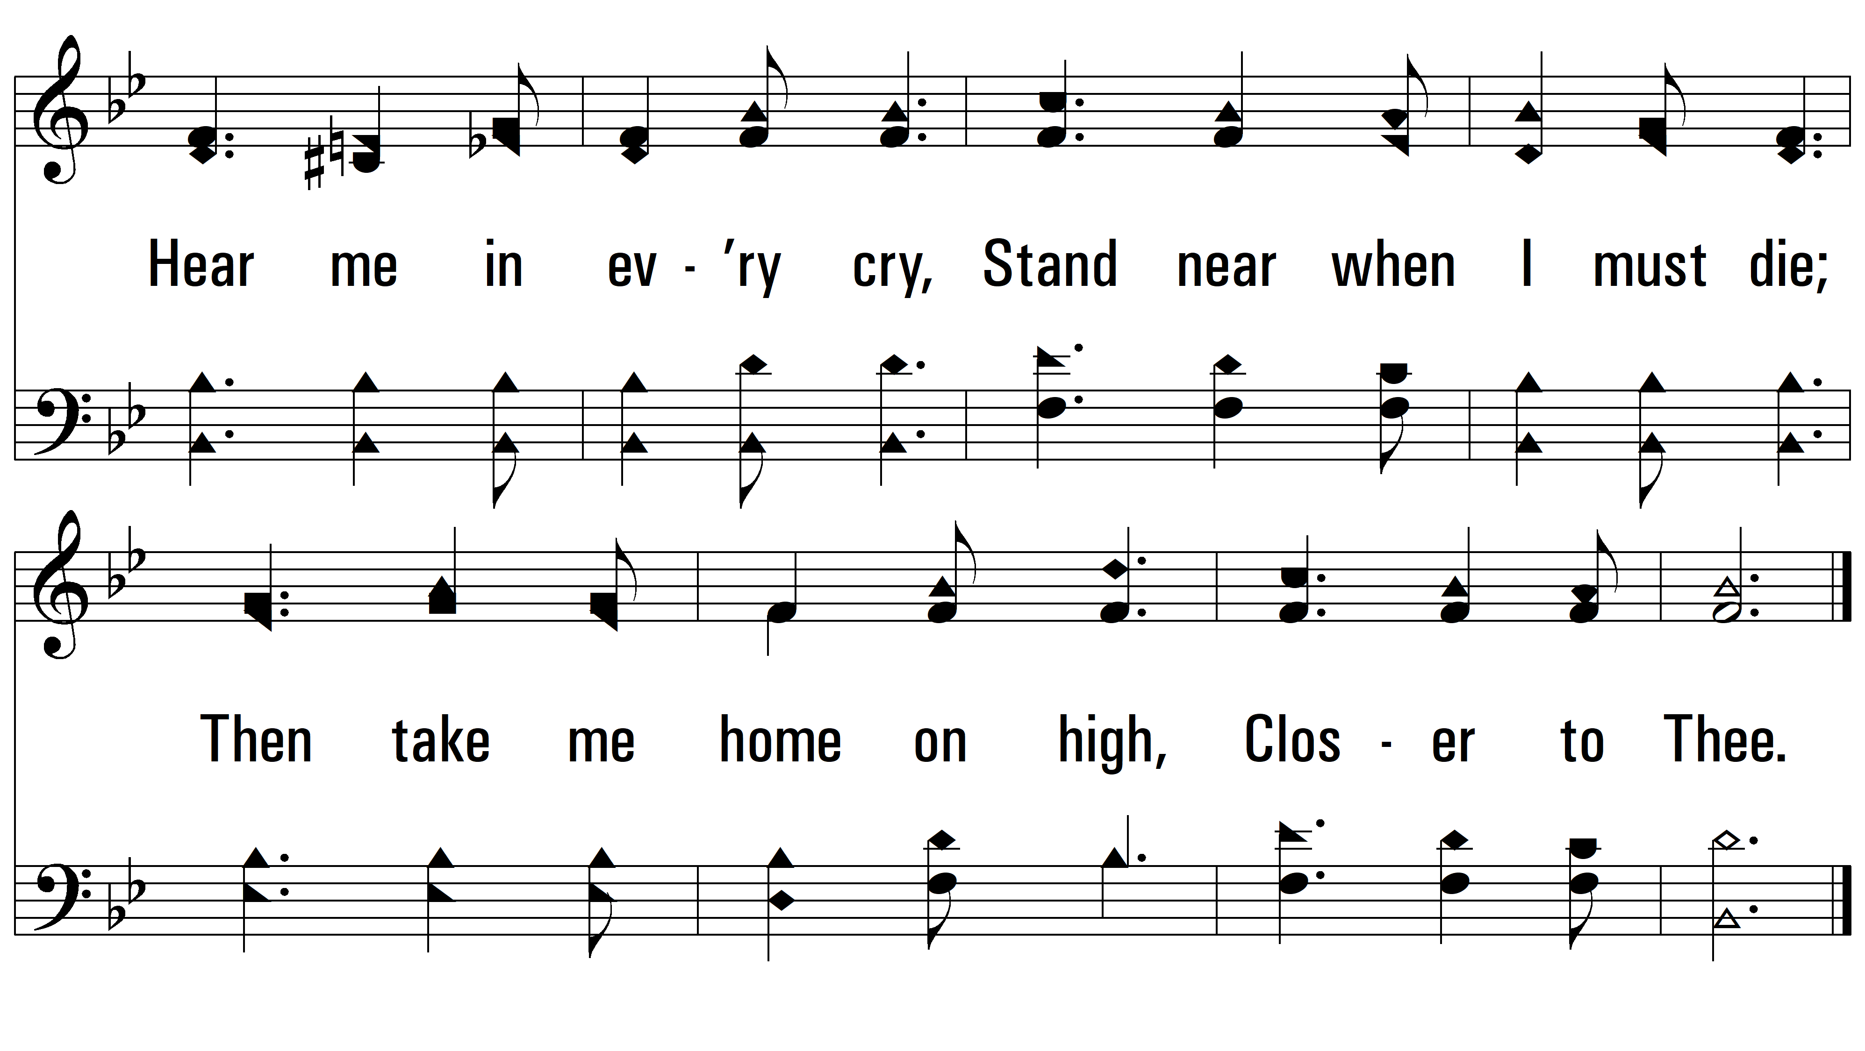
vs. 3
PDHymns.com
END

