Slide 1
God Moves In A Mysterious Way
DUNDEE
CM
Words: | William Cowper (1774)
Music: | Hart’s Psalms Of David (1615)
2/4
E^{b}/E^{b} - DO
Verses: 5
Lead - | DO
Alto - | SOL
Tenor - | MI
Bass - | DO
PDHymns.com

Slide 2
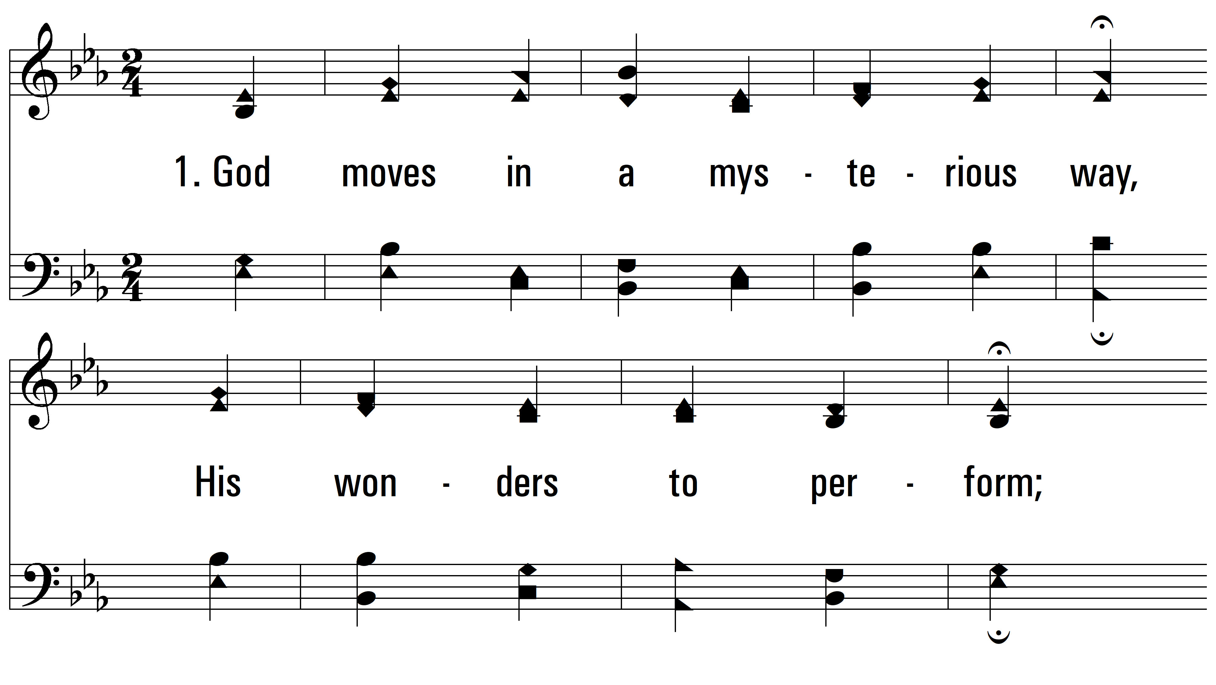
vs. 1 ~ God Moves In A Mysterious Way

Slide 3
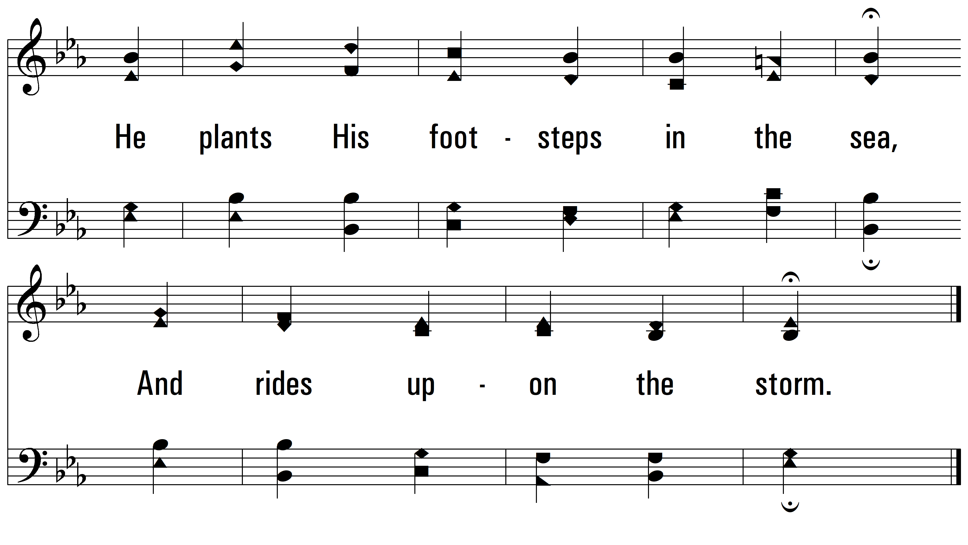
vs. 1

Slide 4
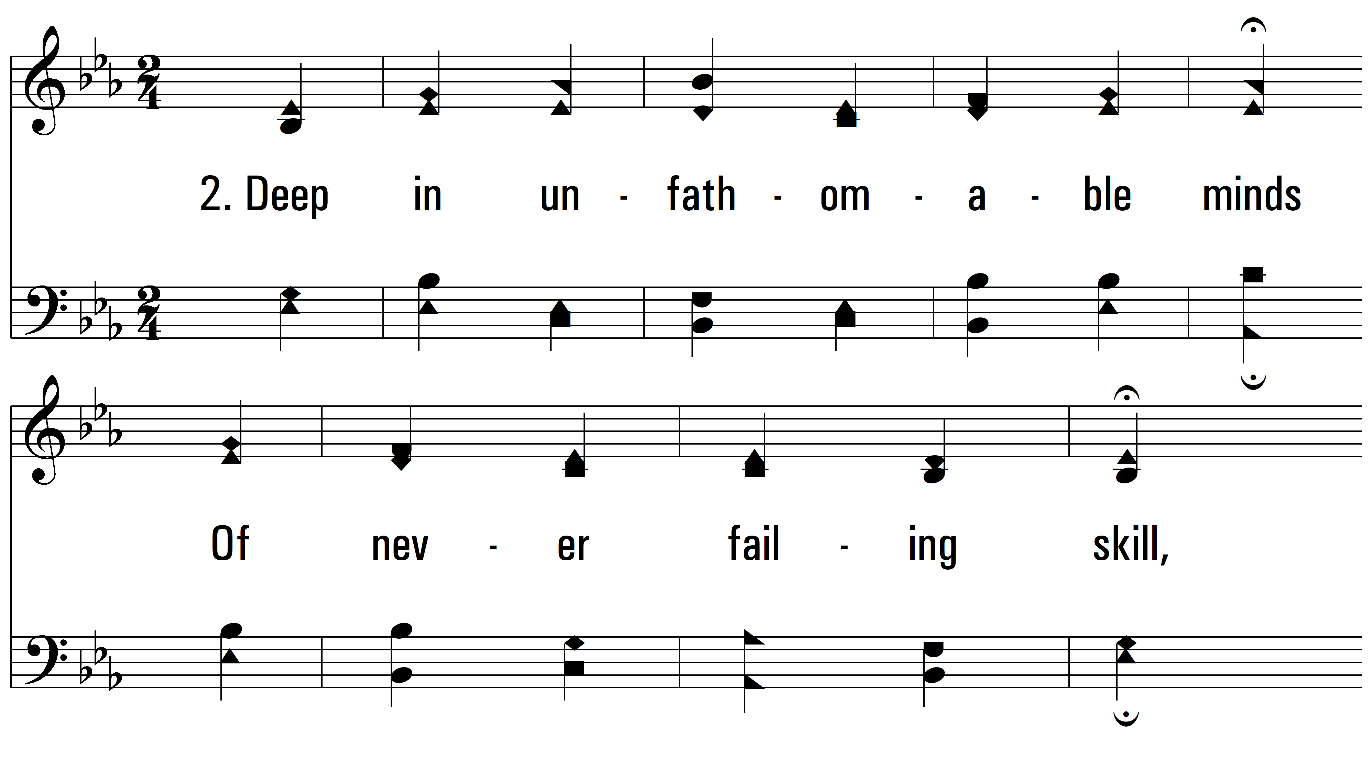
vs. 2 ~ God Moves In A Mysterious Way

Slide 5
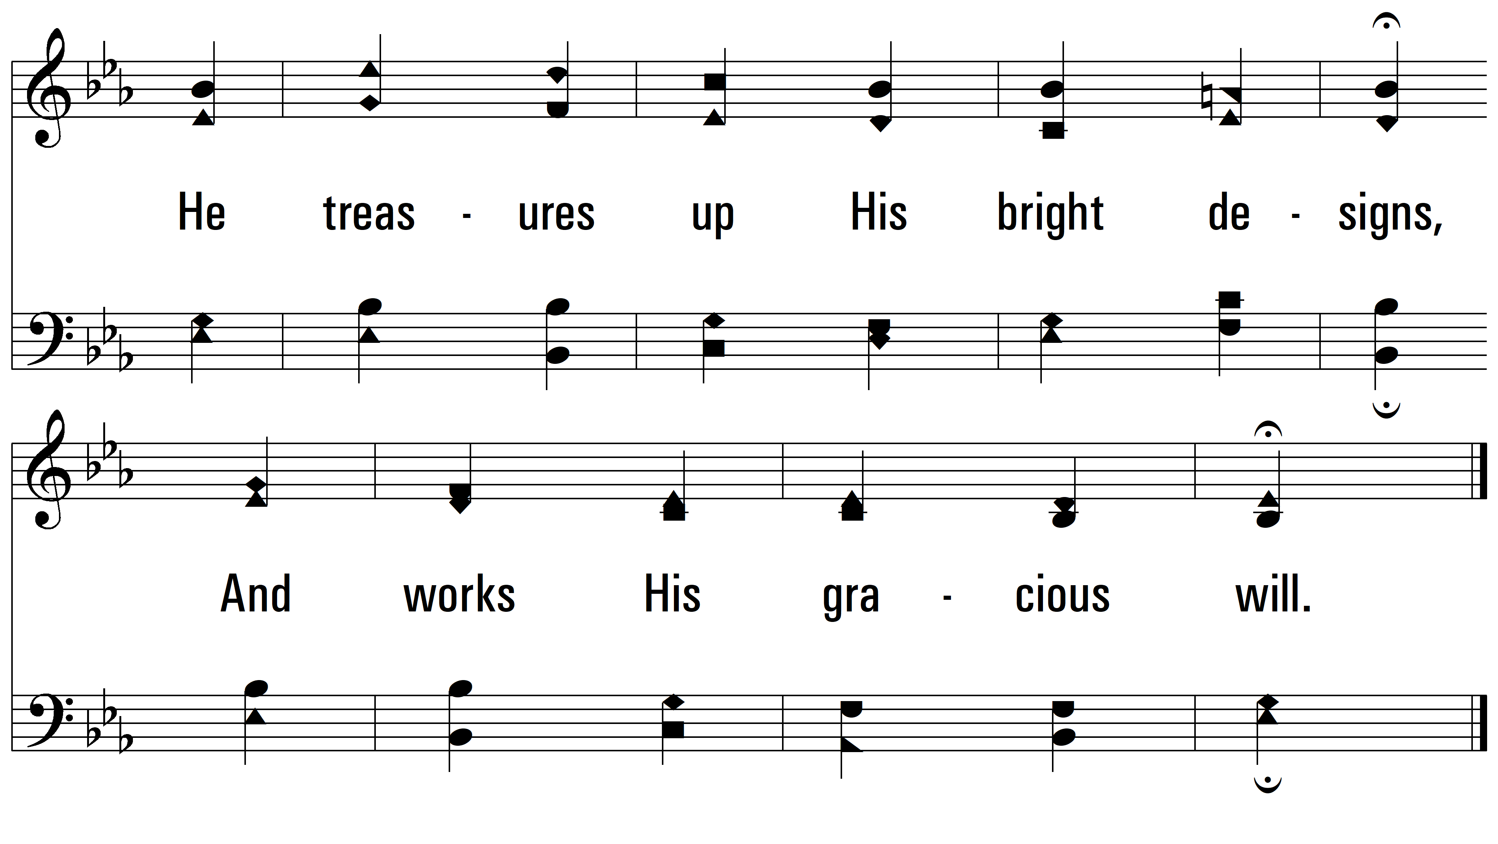
vs. 2

Slide 6
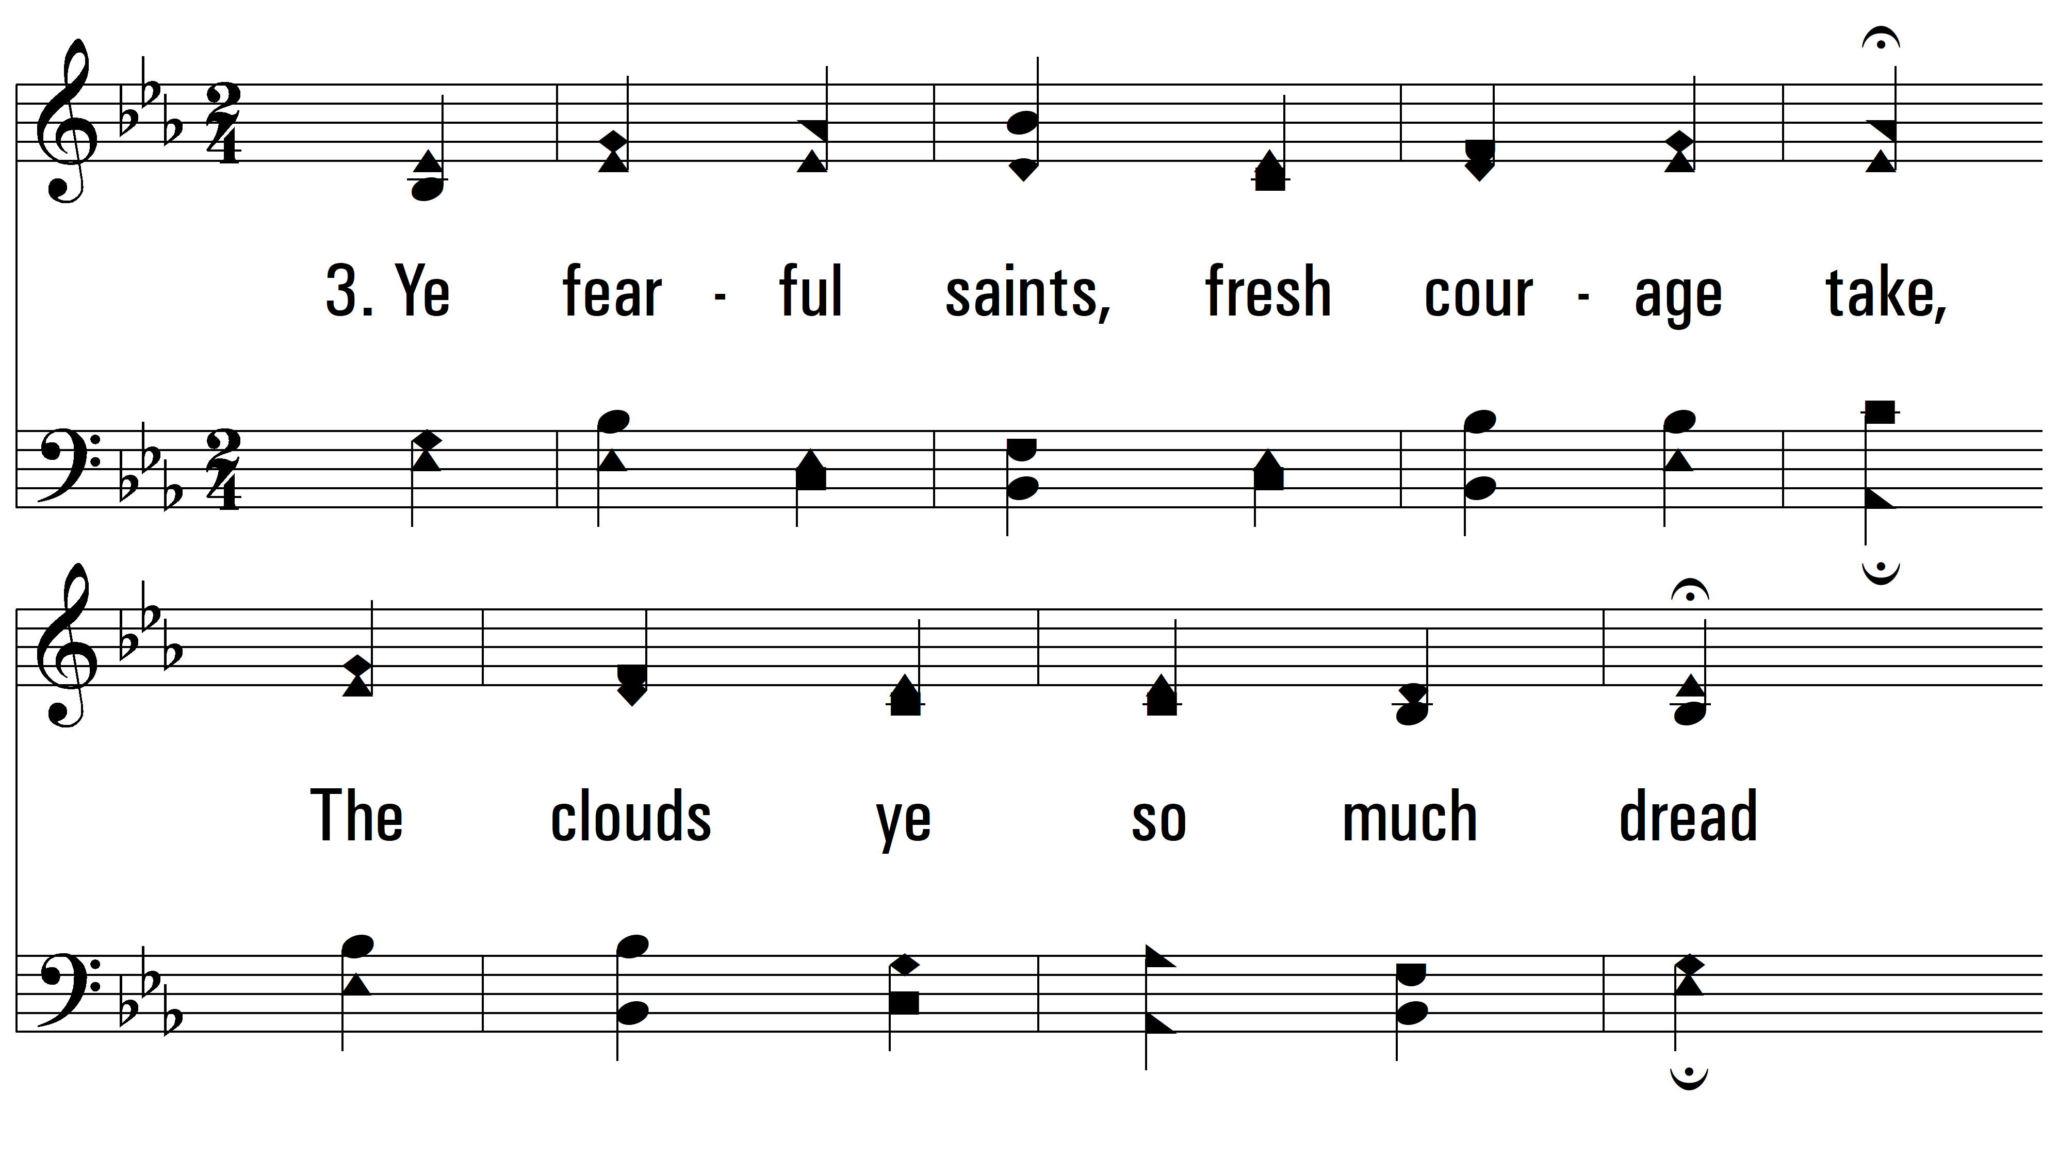
vs. 3 ~ God Moves In A Mysterious Way

Slide 7
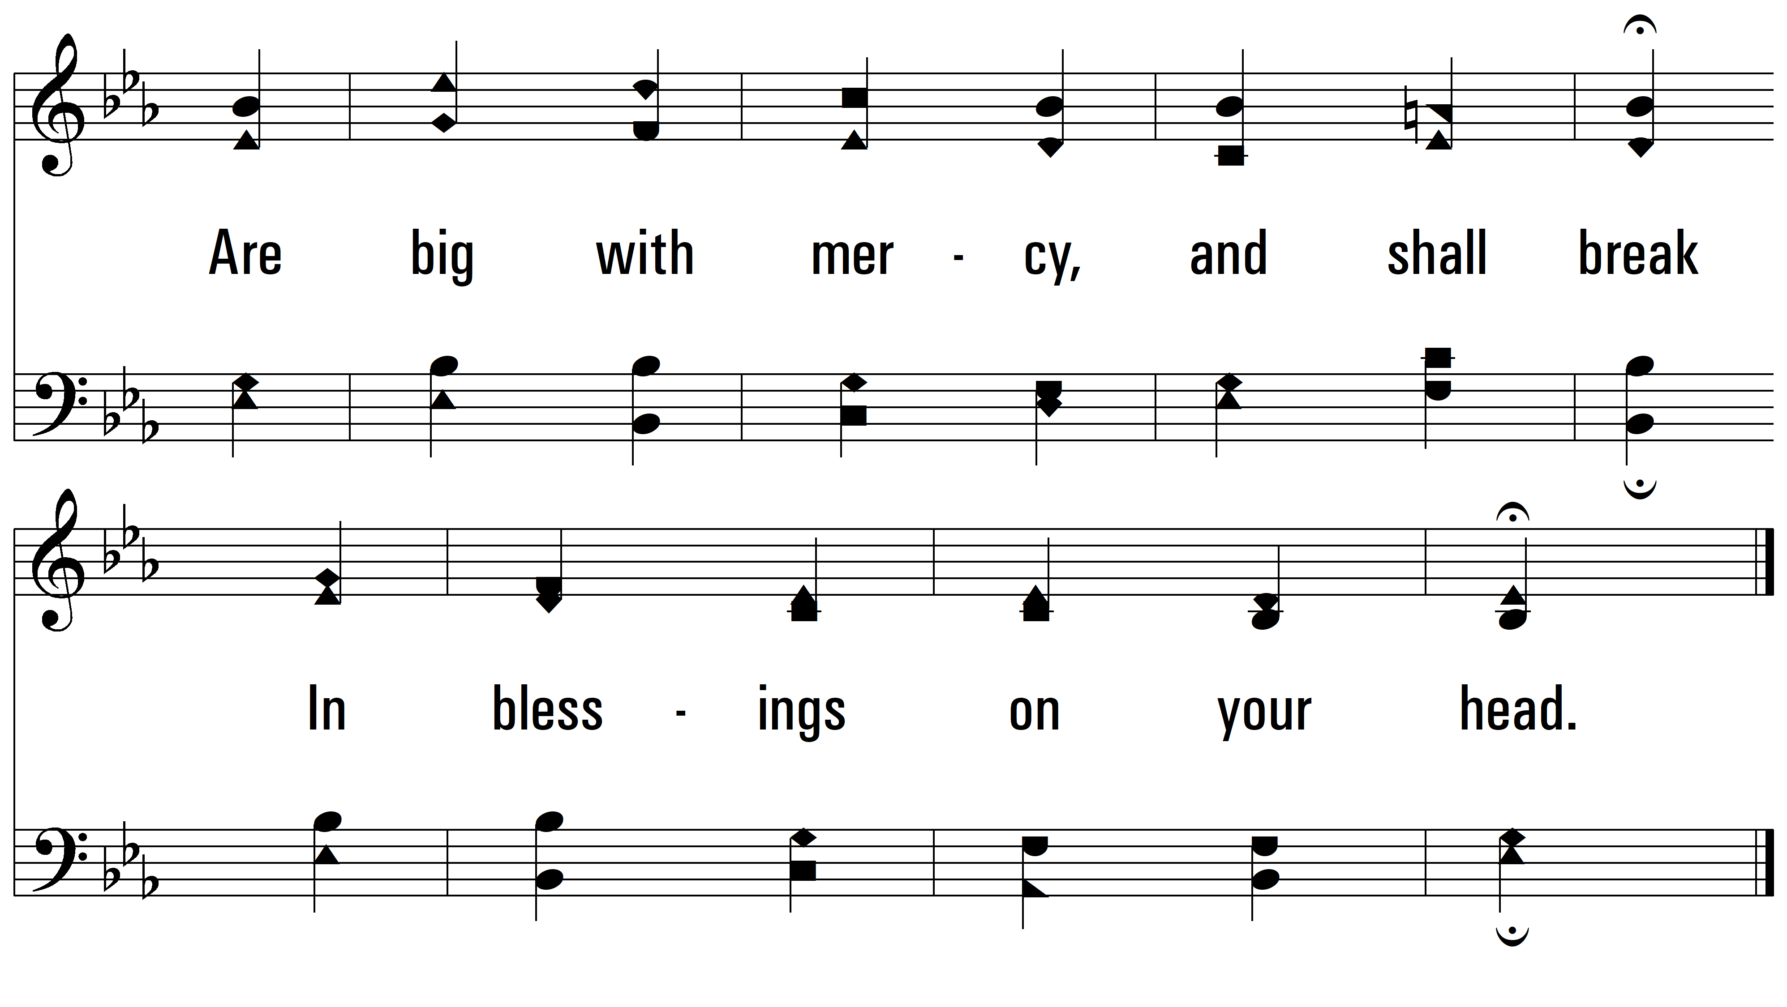
vs. 3

Slide 8
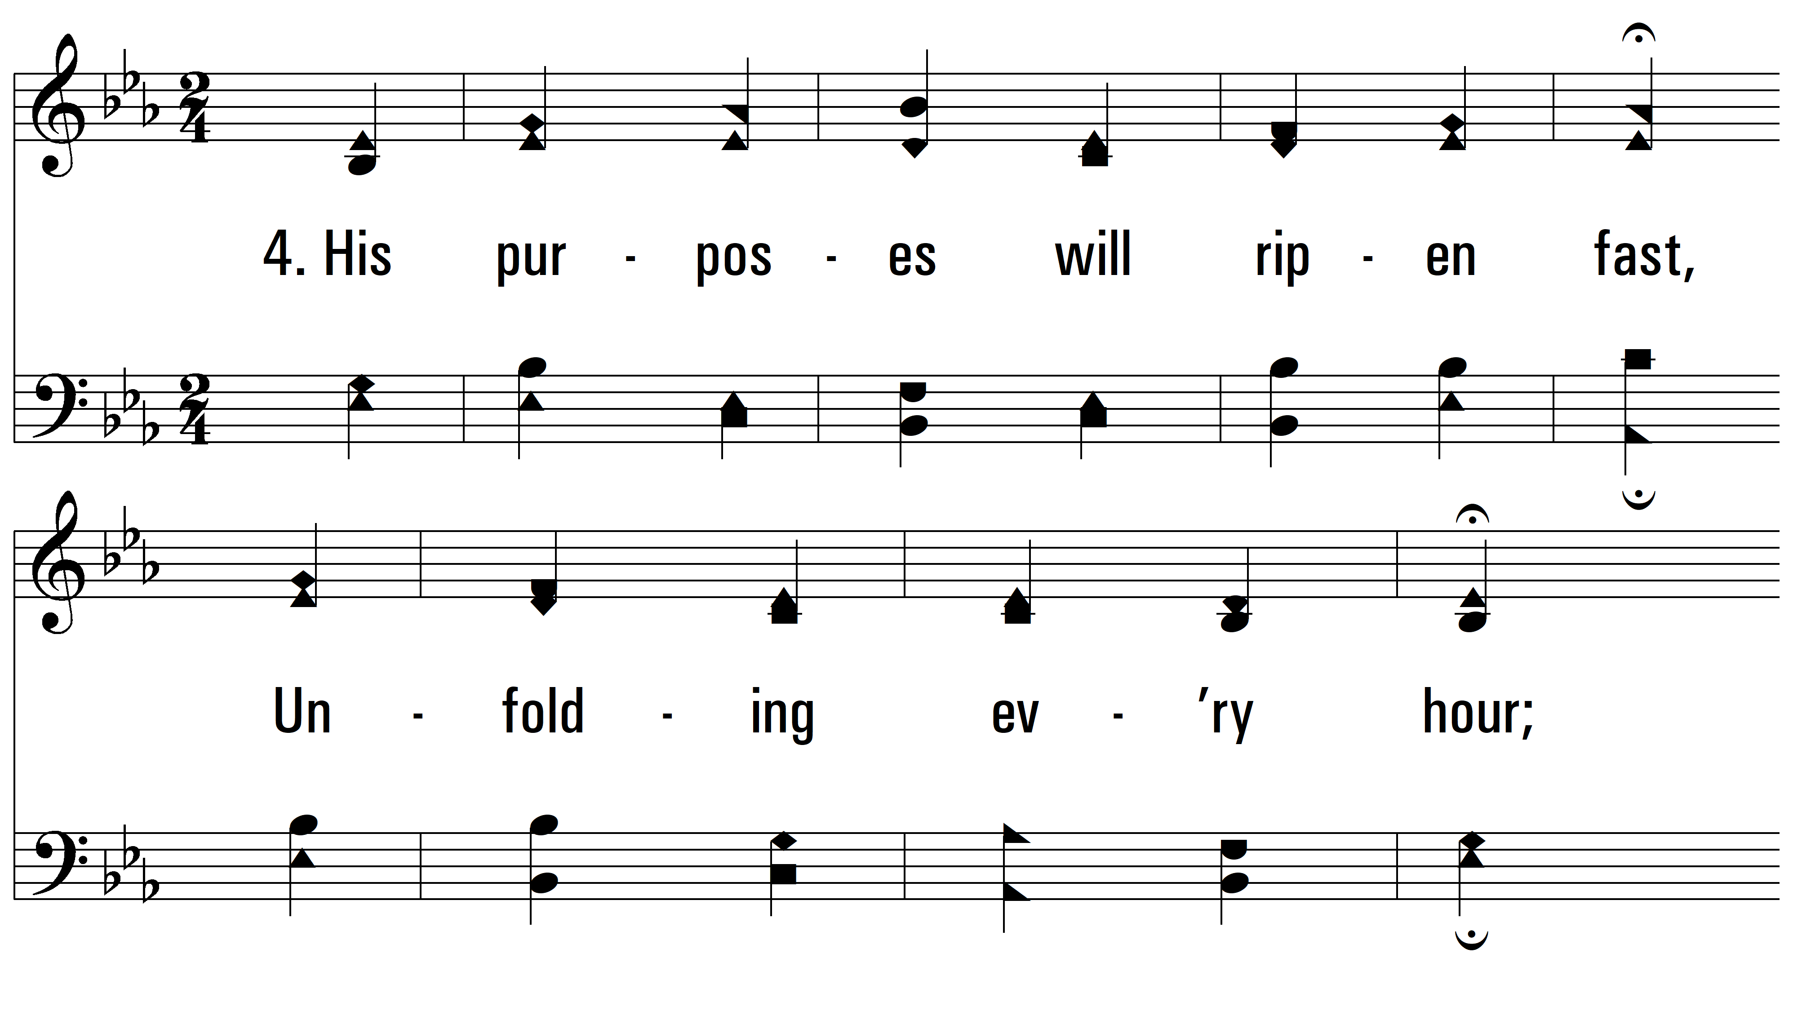
vs. 4 ~ God Moves In A Mysterious Way

Slide 9
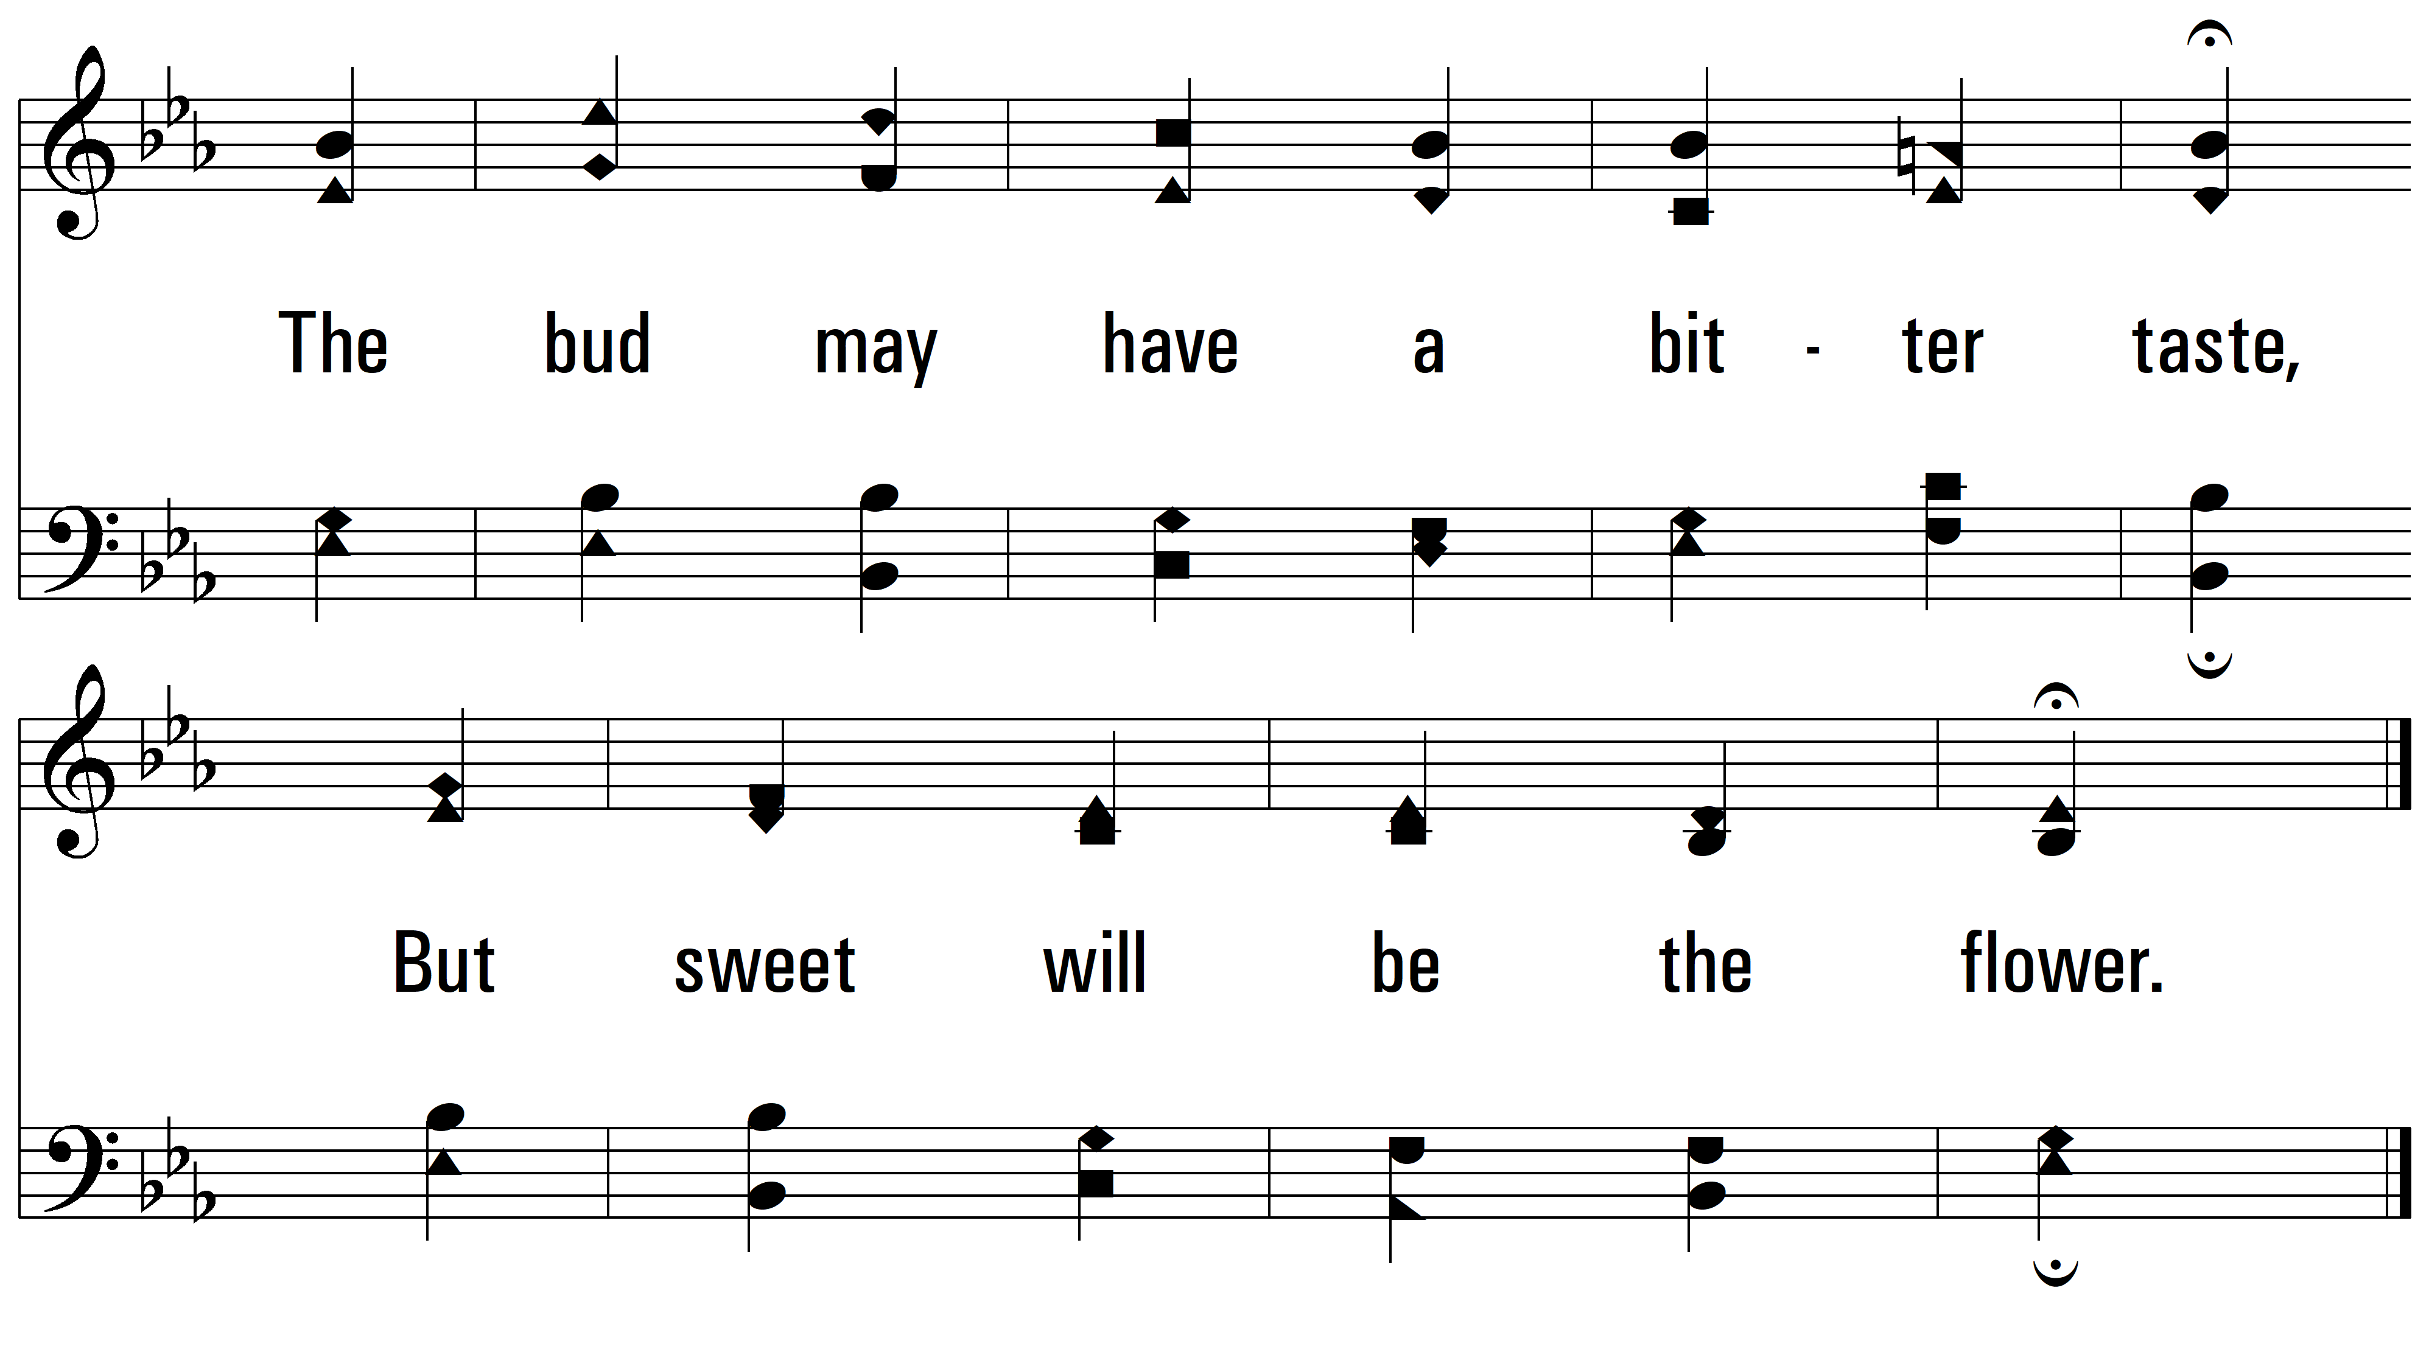
vs. 1

Slide 10
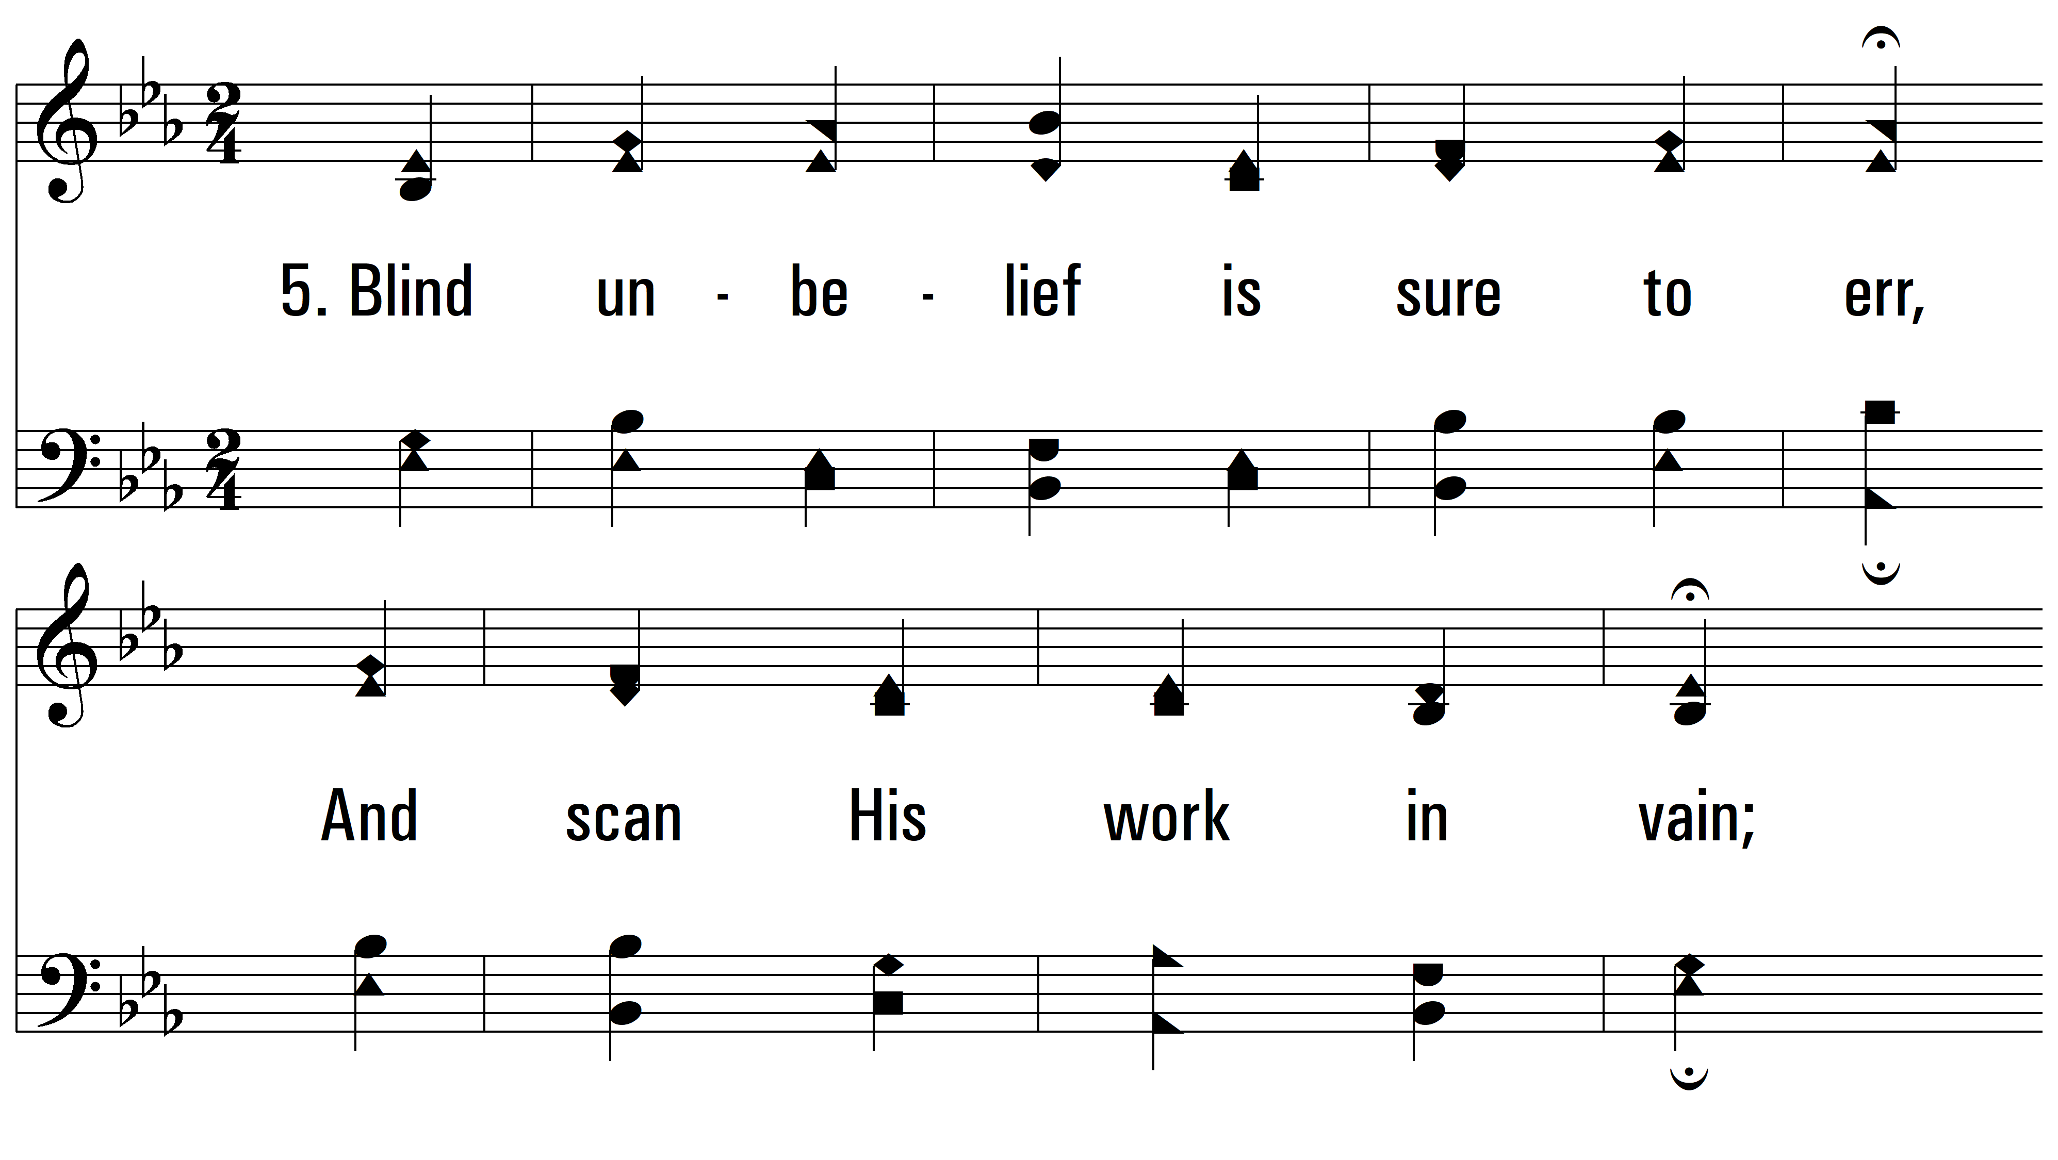
vs. 5 ~ God Moves In A Mysterious Way

Slide 11
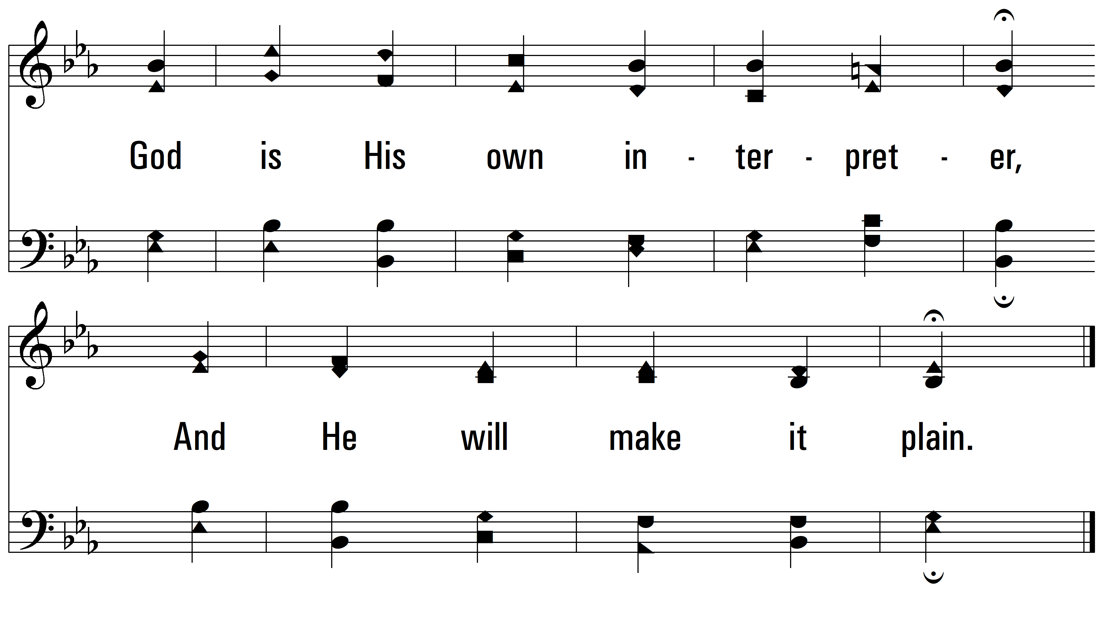
vs. 5
PDHymns.com
END

