Slide 1
He Is Able To Deliver Thee
Words: | W. A. Ogden (1887)
Music: | W. A. Ogden (1887)
4/4
B^{b}/F - SOL
Verses: 3/Chorus
Lead - | SOL
Alto - | MI
Tenor - | DO
Bass - | DO
PDHymns.com

Slide 2
vs. 1 ~ He Is Able To Deliver Thee

Slide 3
vs. 1

Slide 4
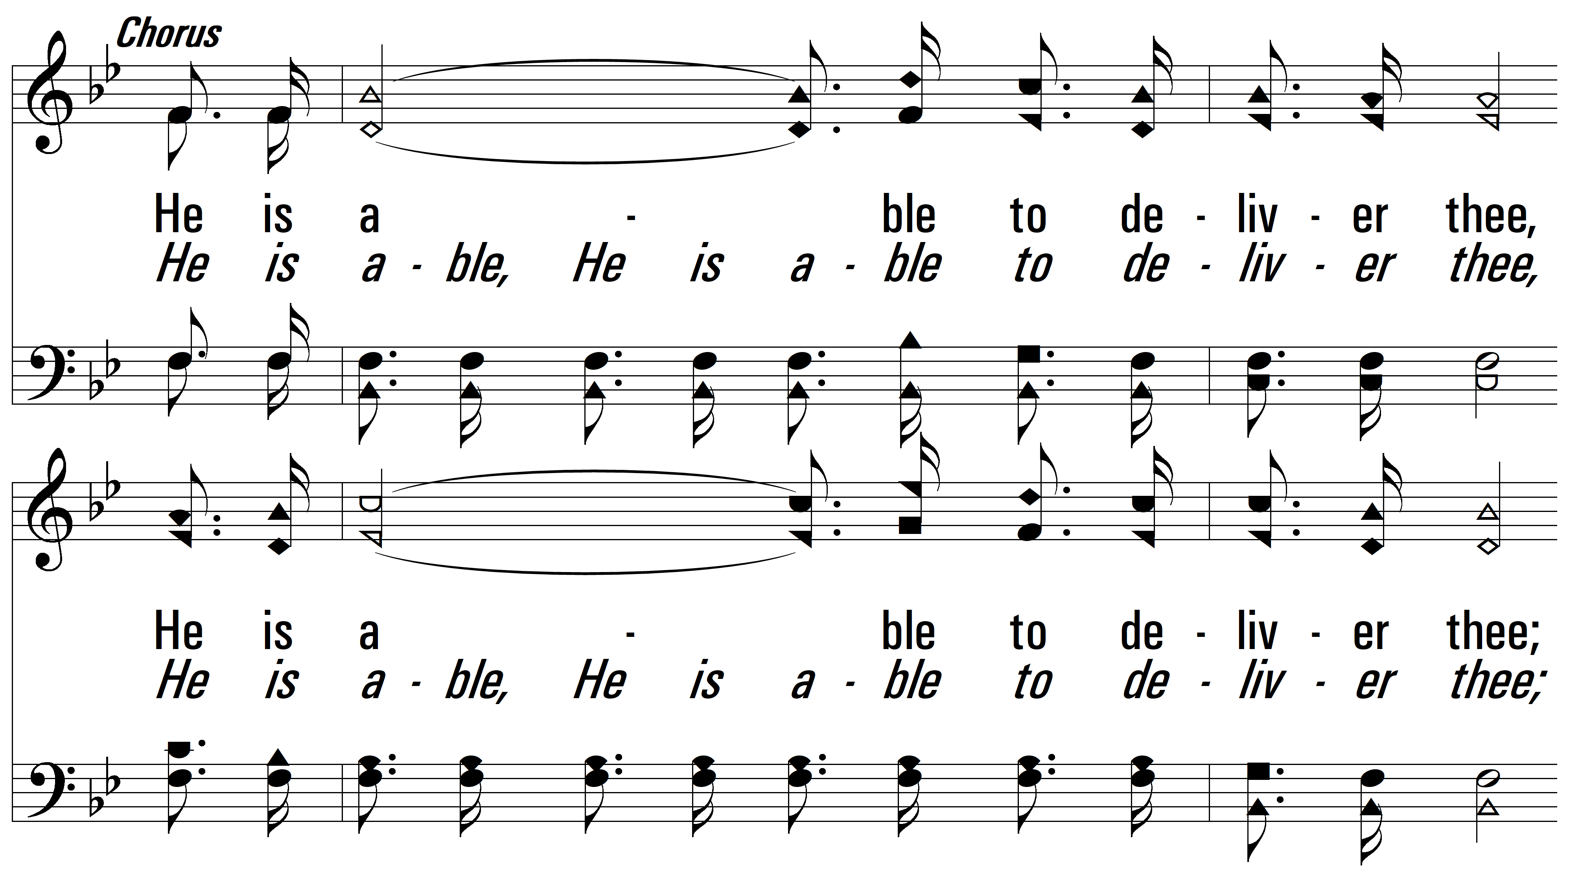
vs. 1

Slide 5
vs. 1

Slide 6
vs. 2 ~ He Is Able To Deliver Thee

Slide 7
vs. 2

Slide 8
vs. 2

Slide 9
vs. 2

Slide 10
vs. 3 ~ He Is Able To Deliver Thee

Slide 11
vs. 3

Slide 12
vs. 3

Slide 13
vs. 3
PDHymns.com
END

