Slide 1
He Is Lord
Words: | Based On Philippians 2:11, st. 2 by Alton Howard
Music: | American Folk Melody
4/4
E/E - TI
Verses: 2
Lead - | TI
Alto - | SOL
Tenor - | RE
Bass - | SOL
PDHymns.com

Slide 2
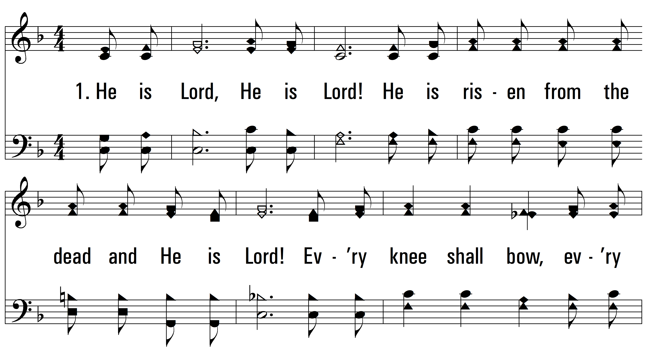
vs. 1 ~ He Is Lord

Slide 3
vs. 1

Slide 4
vs. 2 ~ He Is Lord

Slide 5
vs. 2
PDHymns.com
END

