Slide 1
He’s Calling You
Words: | Arr. by T. S. Cobb
Music: | J. M. Greer, Arr by T. S. Cobb
2/4
A^{b}/E^{b} - SOL
Verses: 3/Chorus
Lead - | SOL
Alto - | MI
Tenor - | DO
Bass - | DO
PDHymns.com

Slide 2
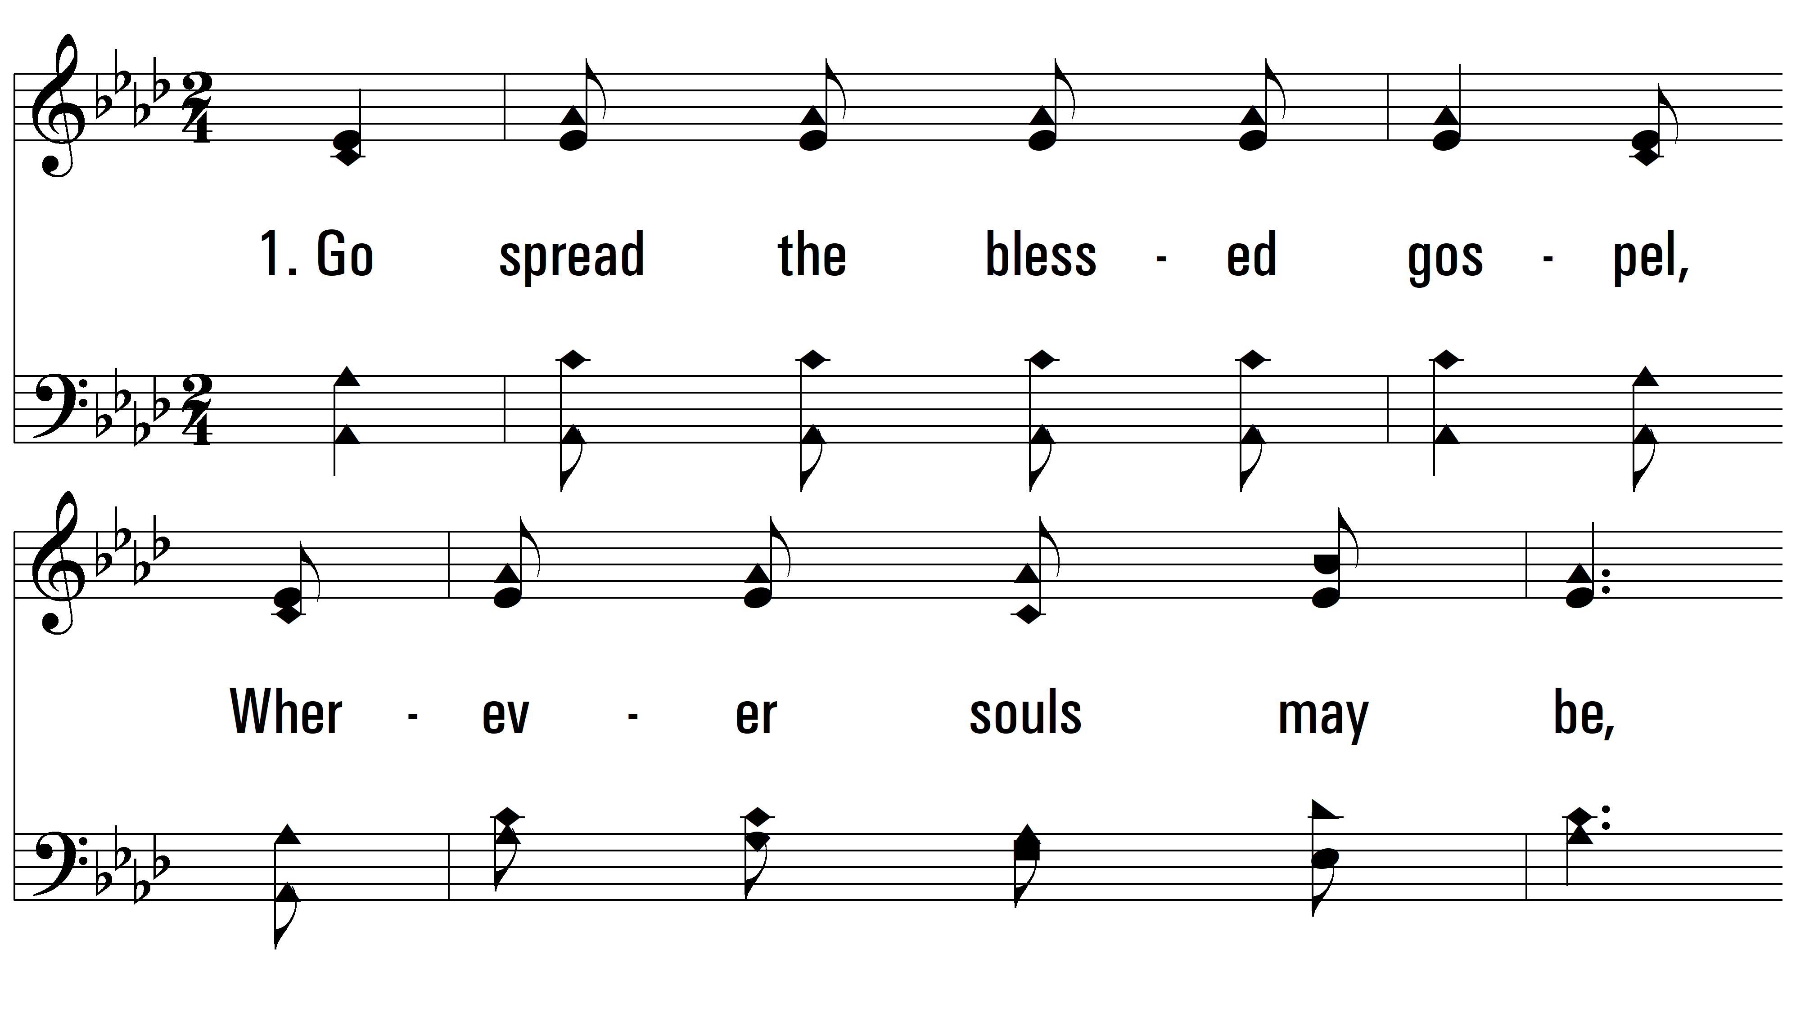
vs. 1 ~ He’s Calling You

Slide 3
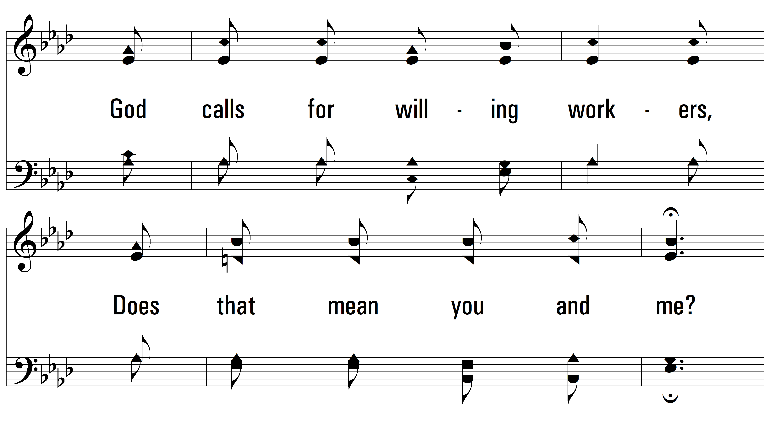
vs. 1

Slide 4
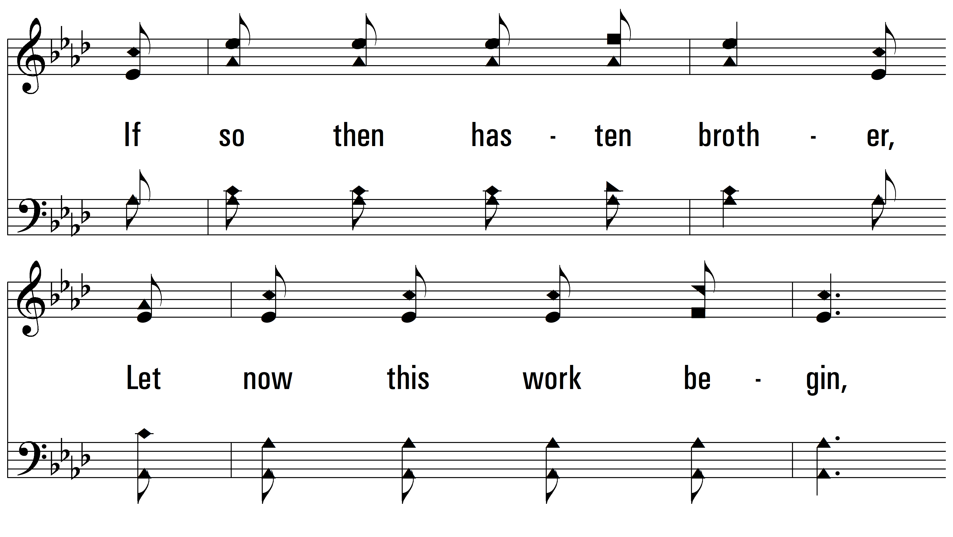
vs. 1

Slide 5
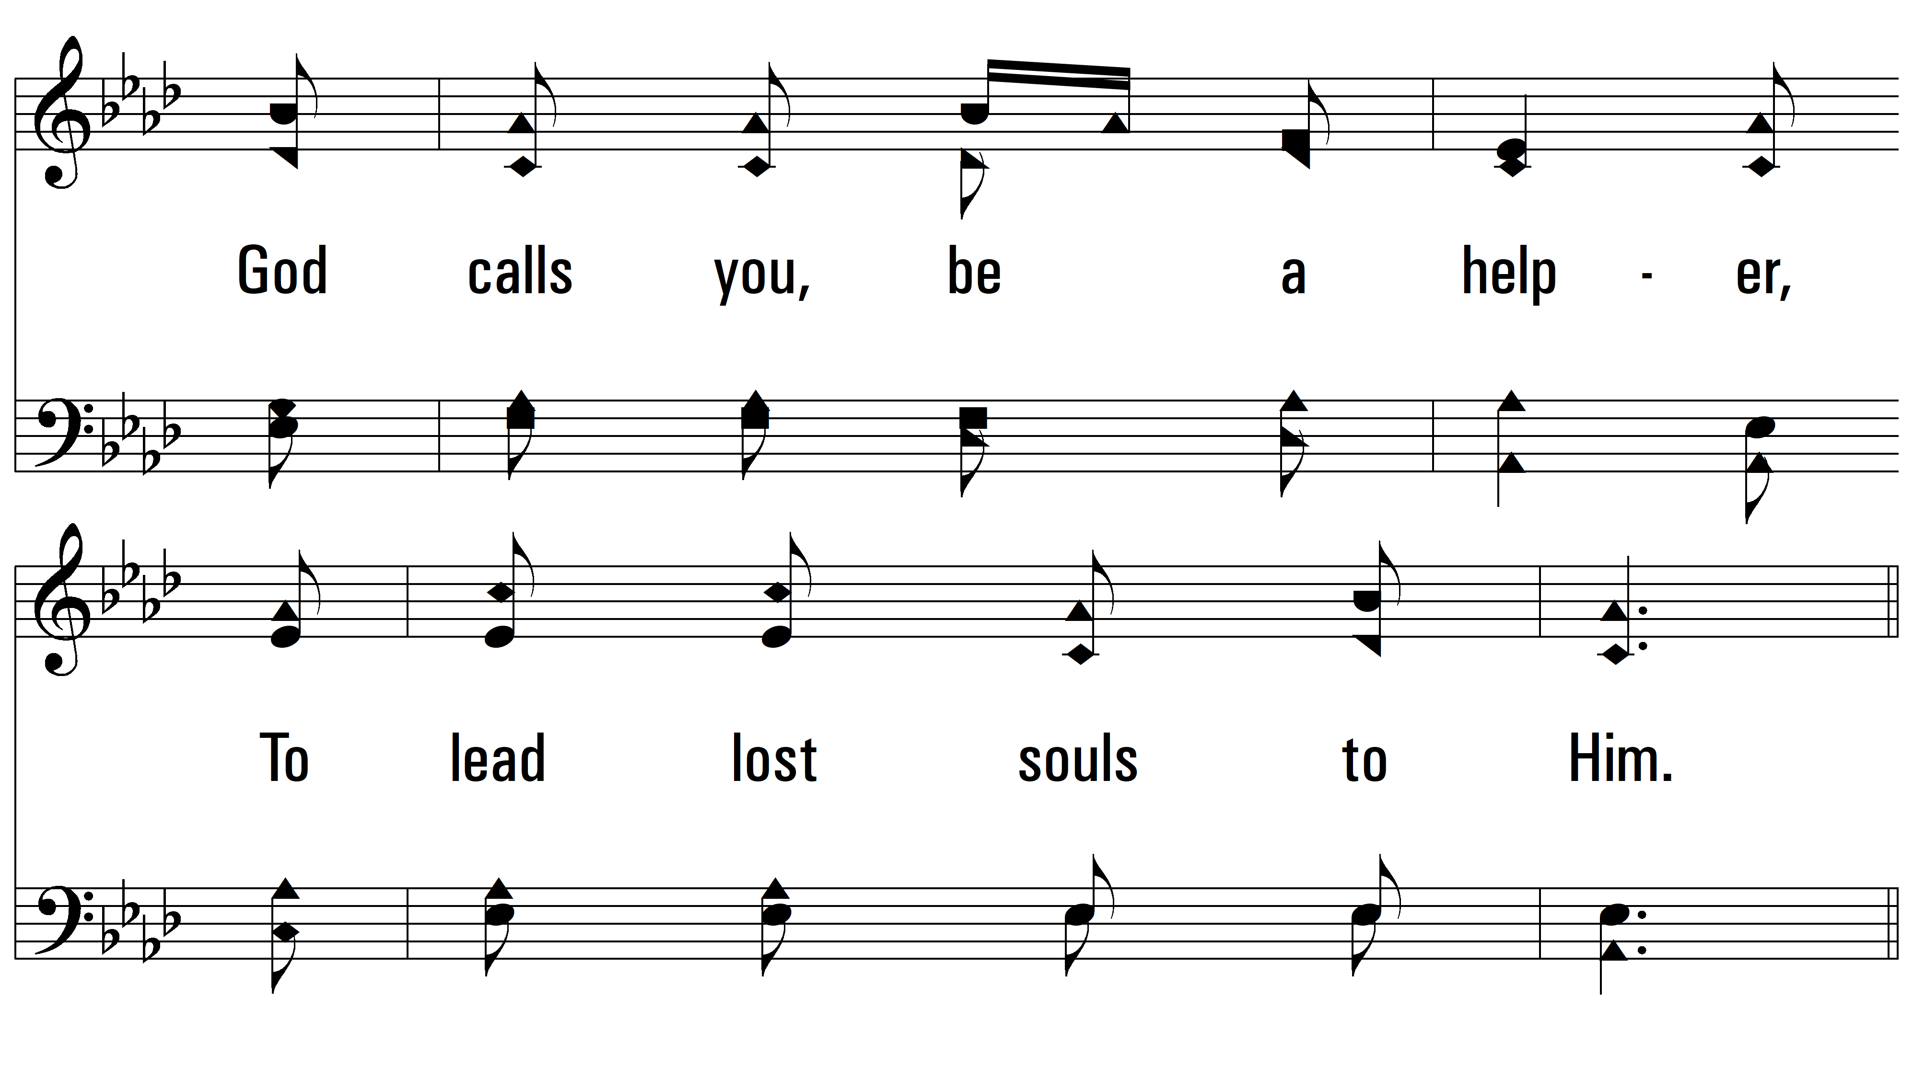
vs. 1

Slide 6
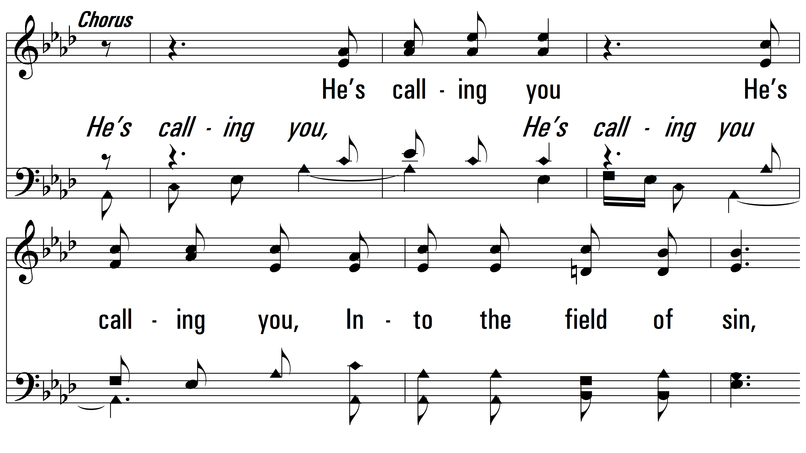
vs. 1

Slide 7
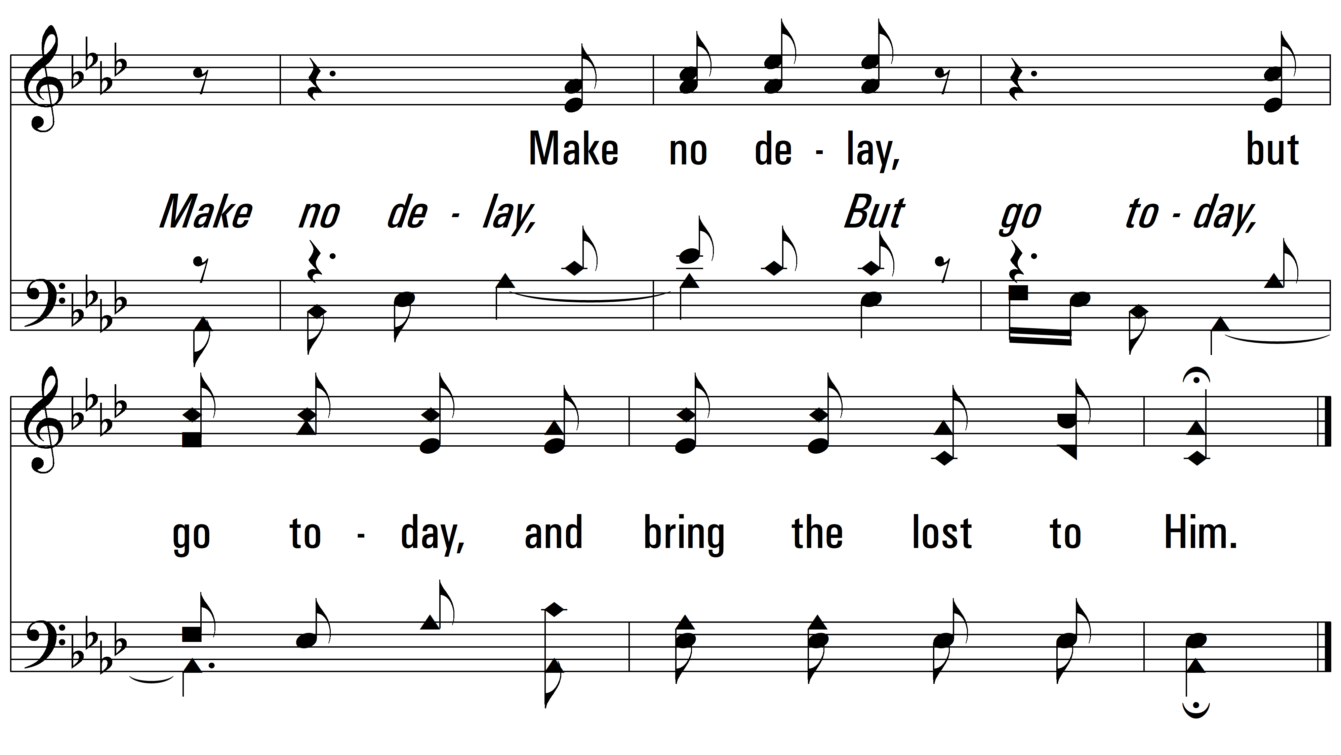
vs. 1

Slide 8
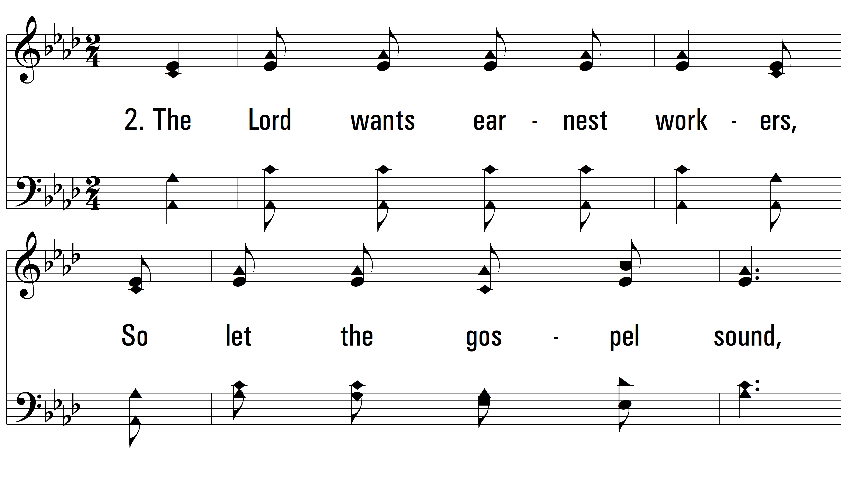
vs. 2 ~ He’s Calling You

Slide 9
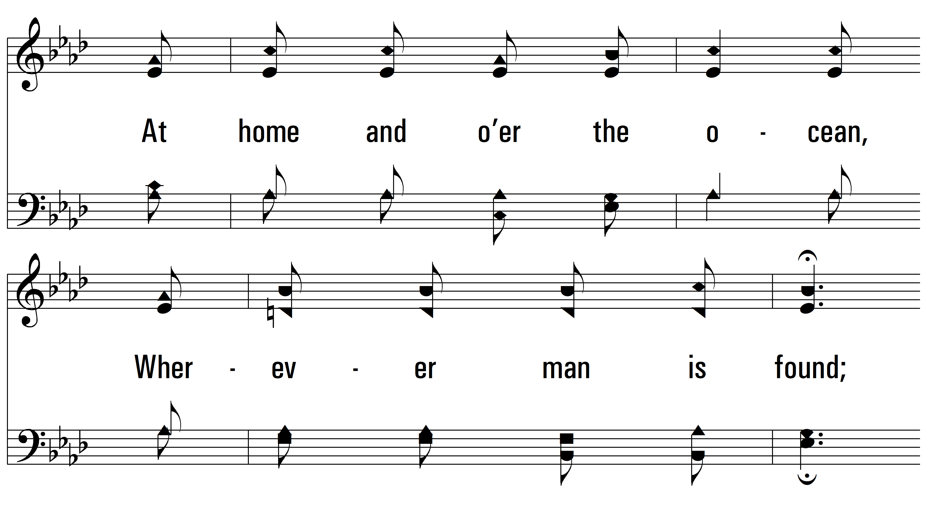
vs. 2

Slide 10
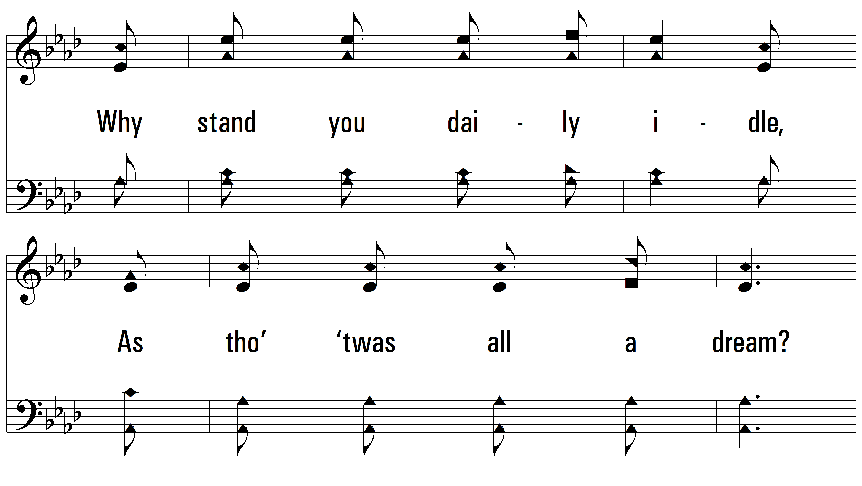
vs. 2

Slide 11
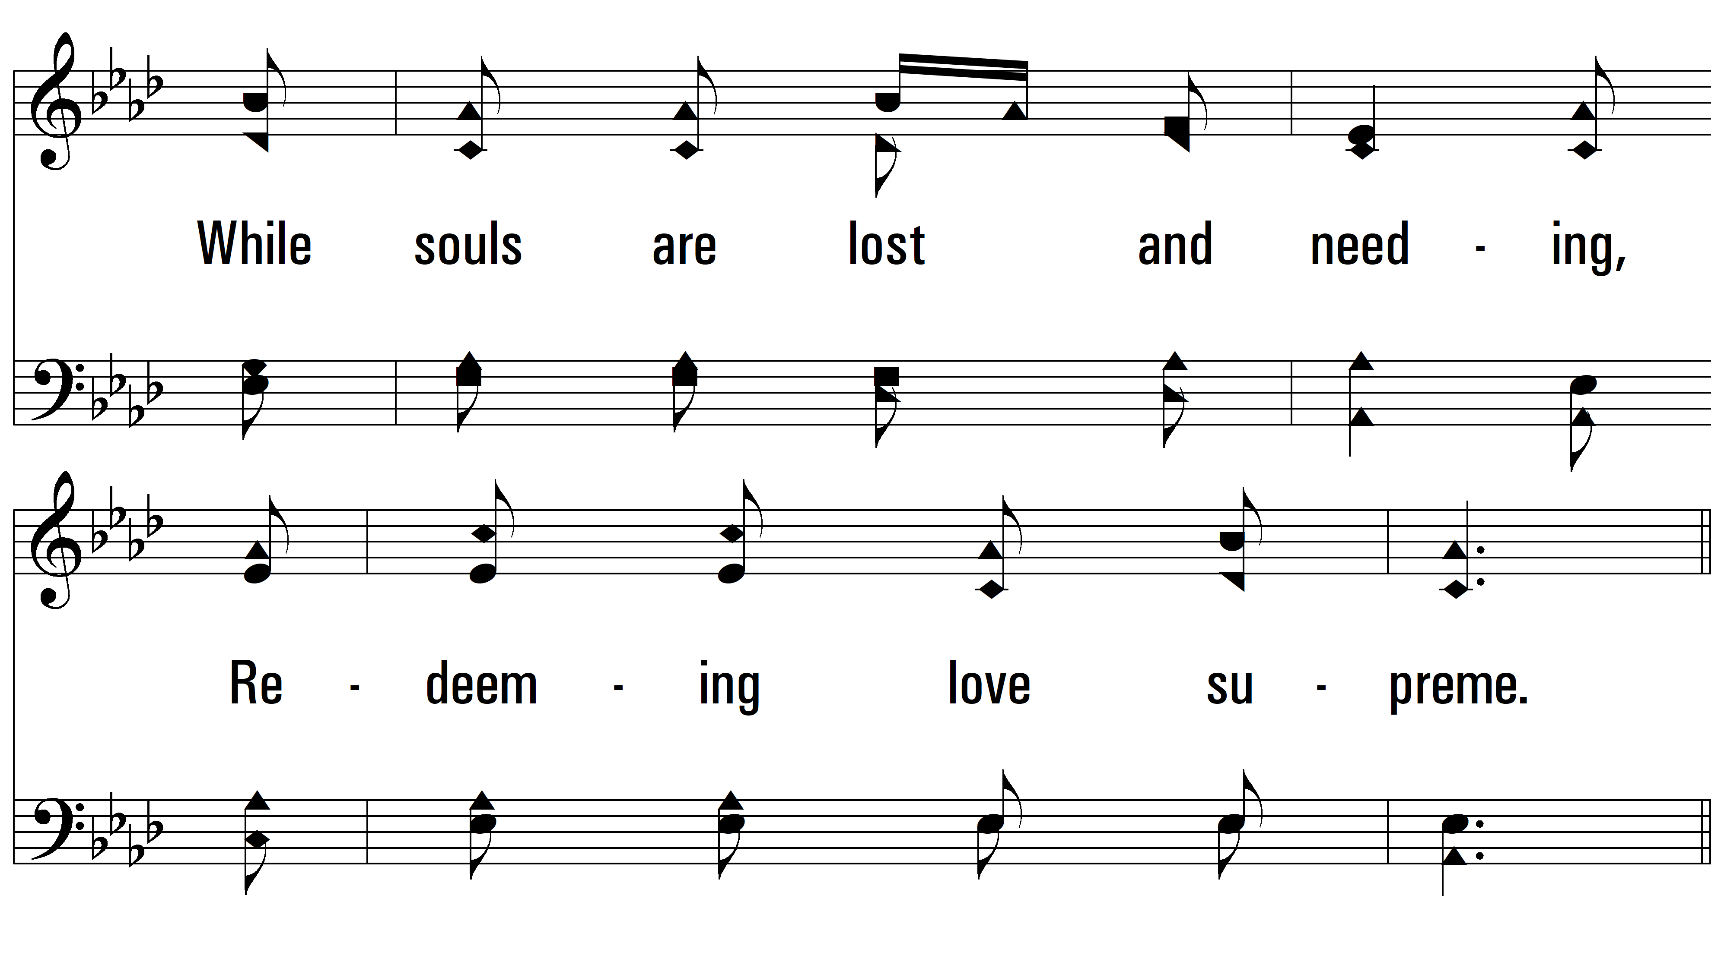
vs. 2

Slide 12
vs. 2

Slide 13
vs. 2

Slide 14
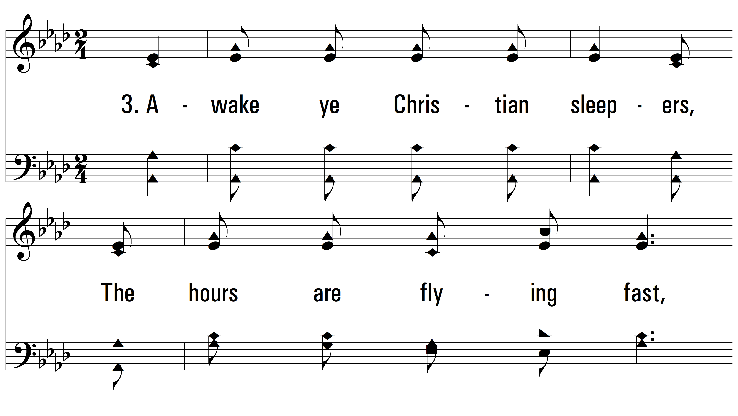
vs. 3 ~ He’s Calling You

Slide 15
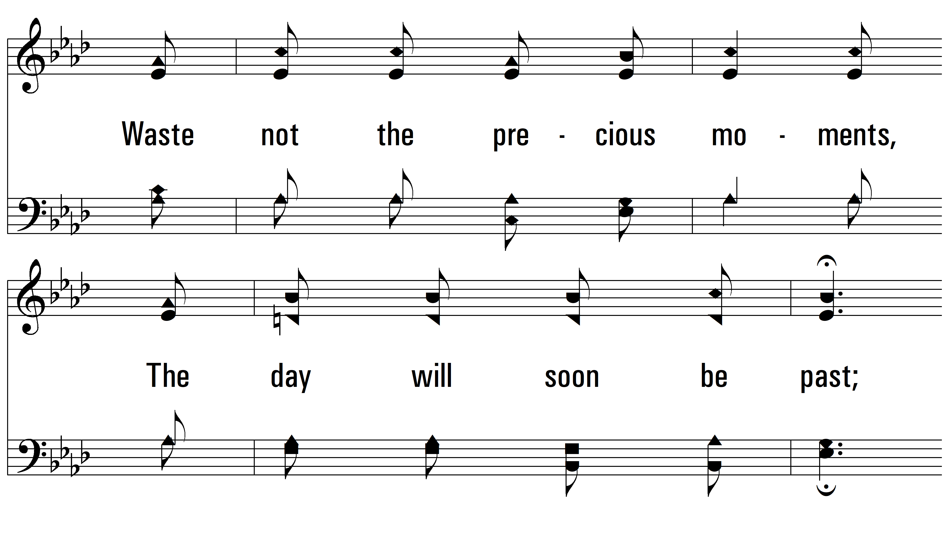
vs. 3

Slide 16
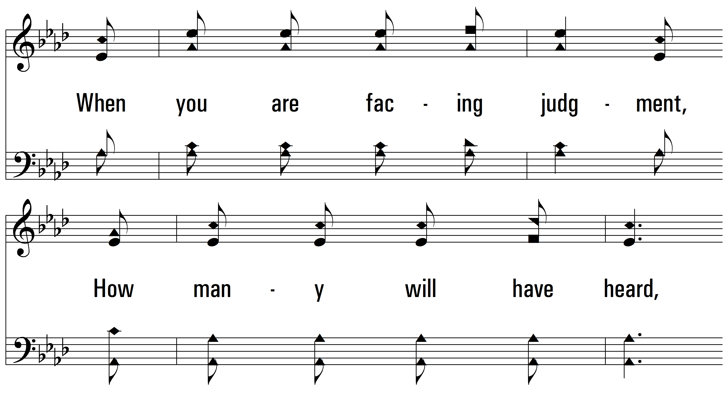
vs. 3

Slide 17
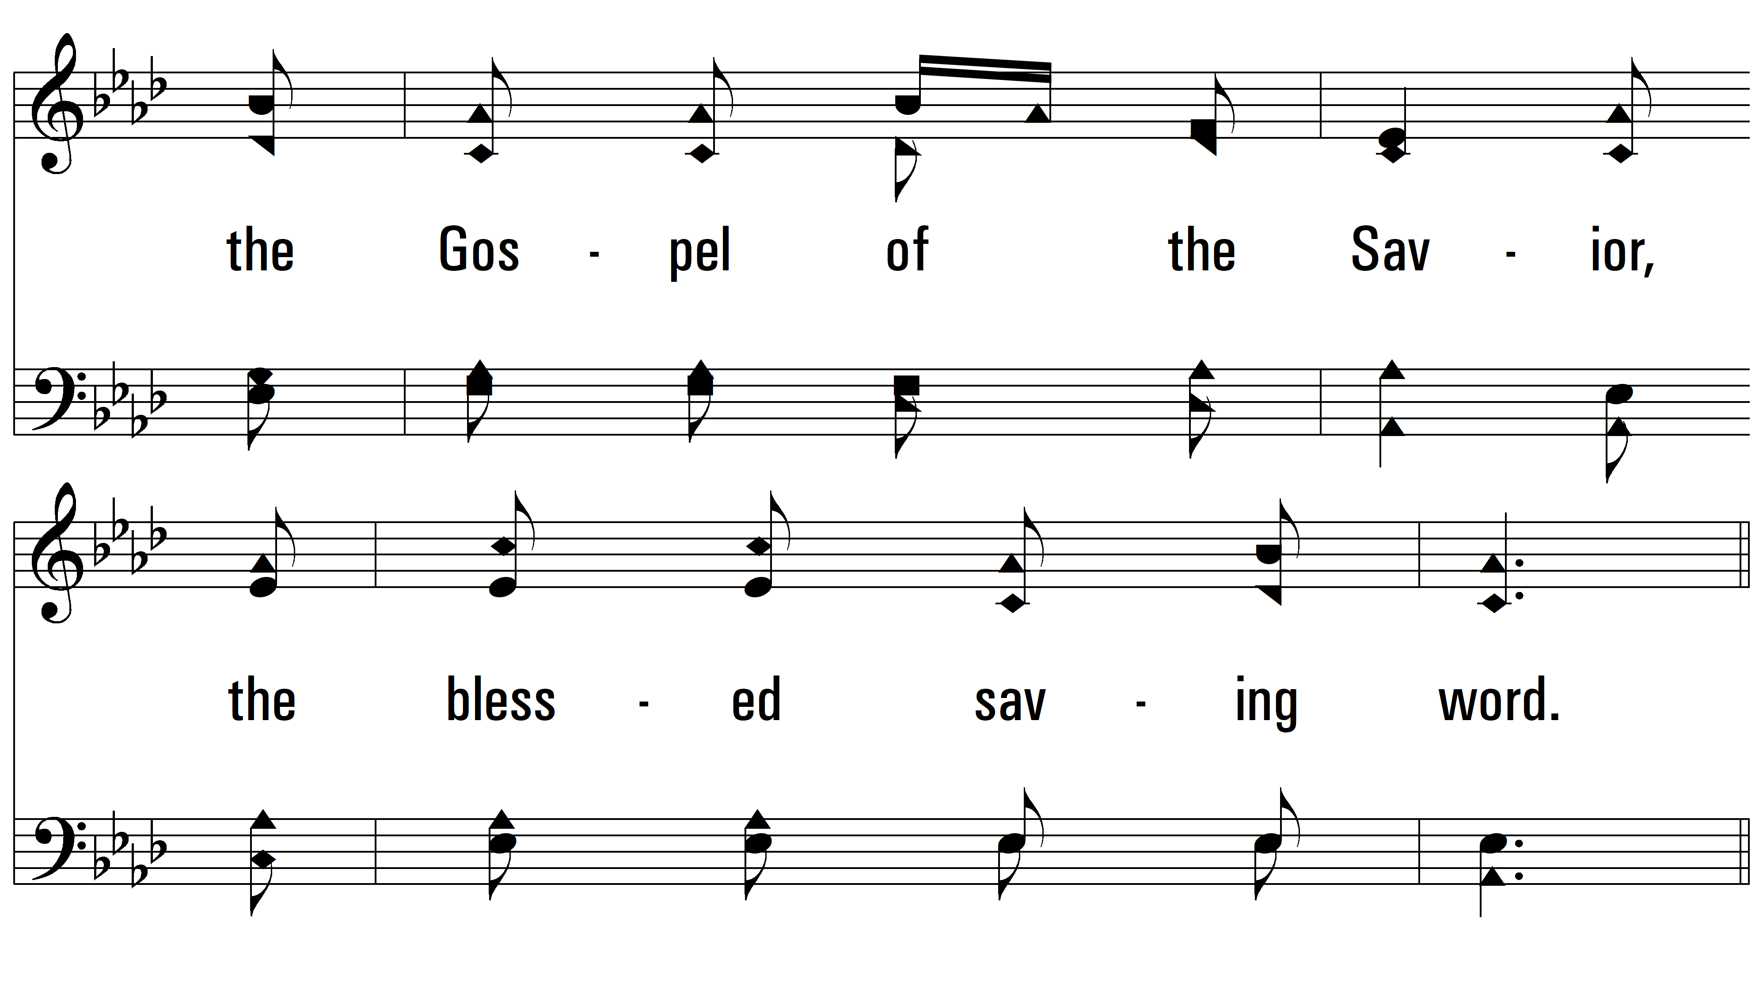
vs. 3

Slide 18
vs. 3

Slide 19
vs. 3
PDHymns.com
END

