Slide 1
Hiding In Thee
Words: | William O. Cuching (1876)
Music: | Ira D. Sankey (1877)
4/4
F/C - SOL
Verses: 3/Chorus
Lead - | SOL
Alto - | DO
Tenor - | MI
Bass - | DO
PDHymns.com

Slide 2
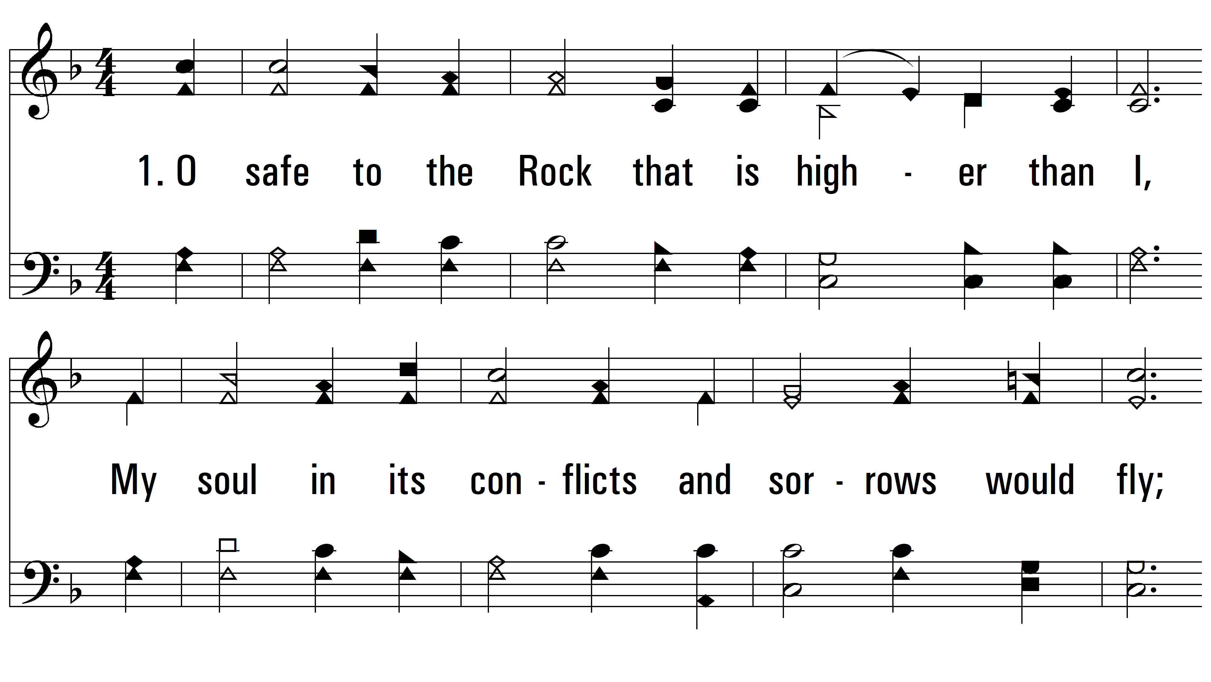
vs. 1 ~ Hiding In Thee

Slide 3
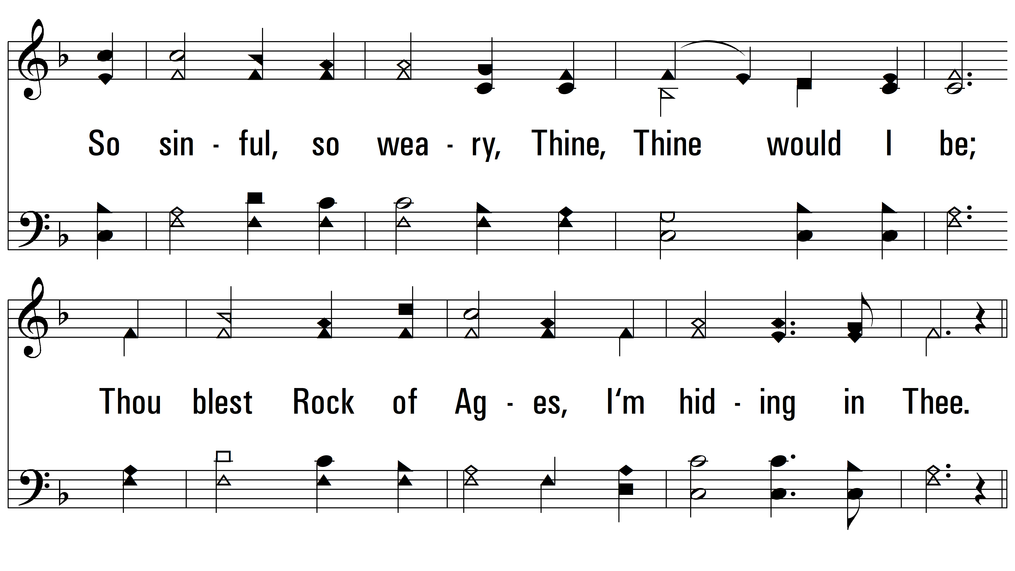
vs. 1

Slide 4
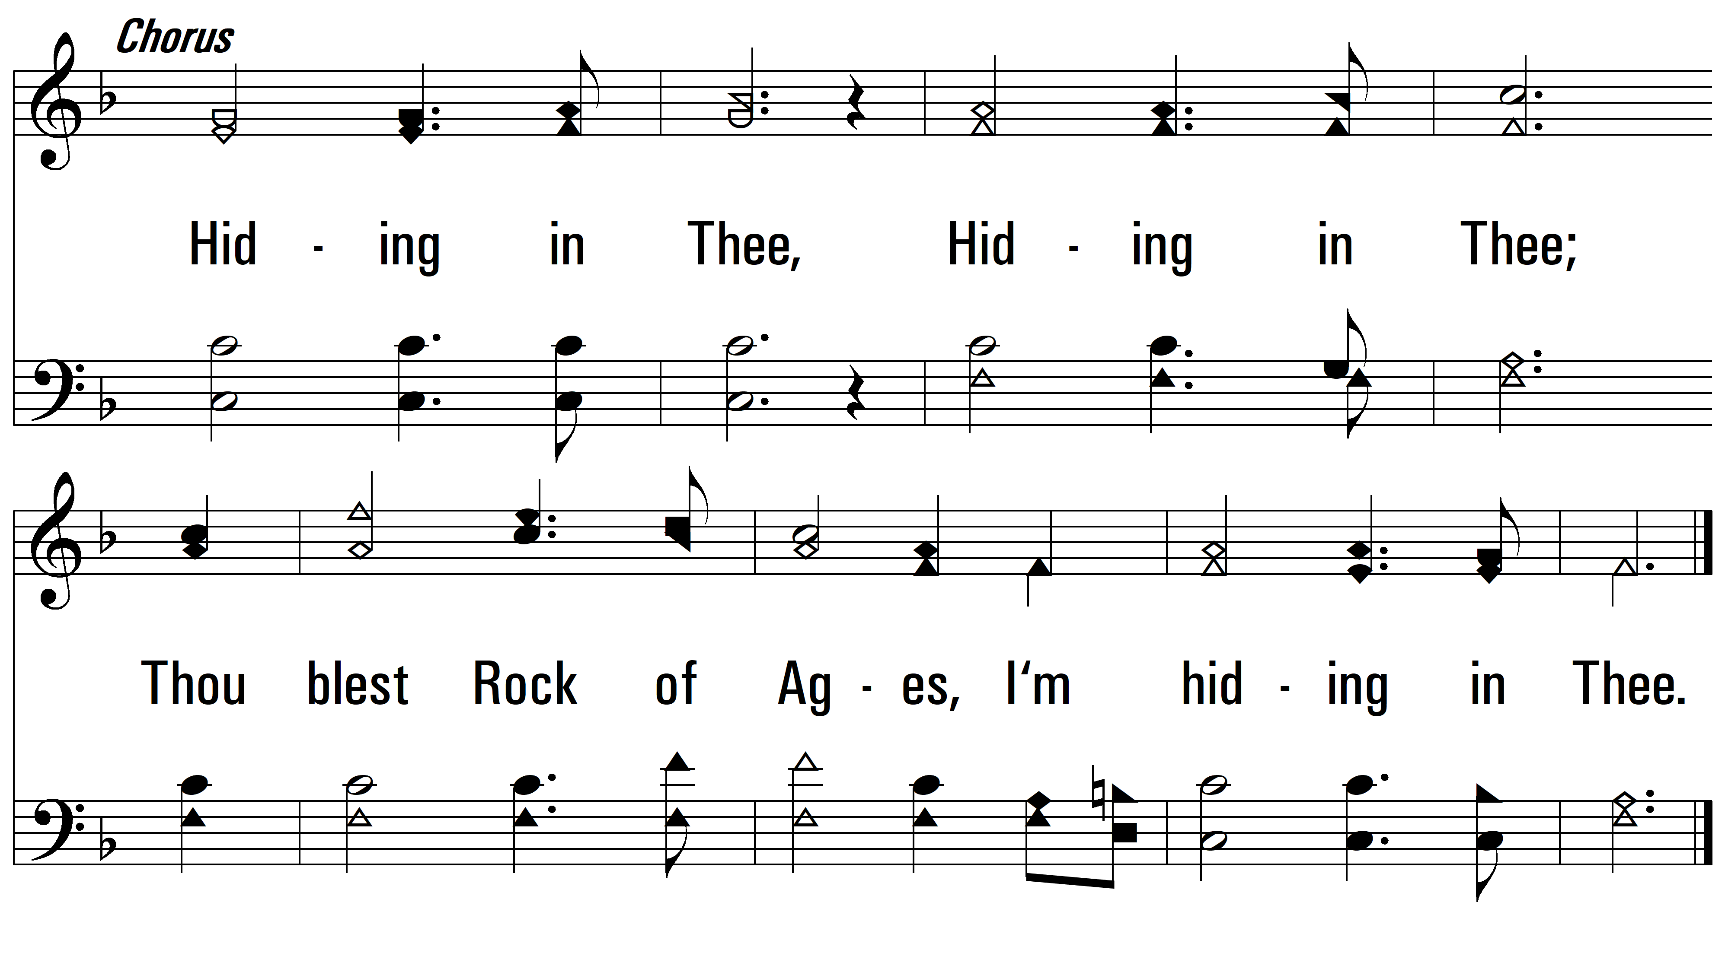
vs. 1

Slide 5
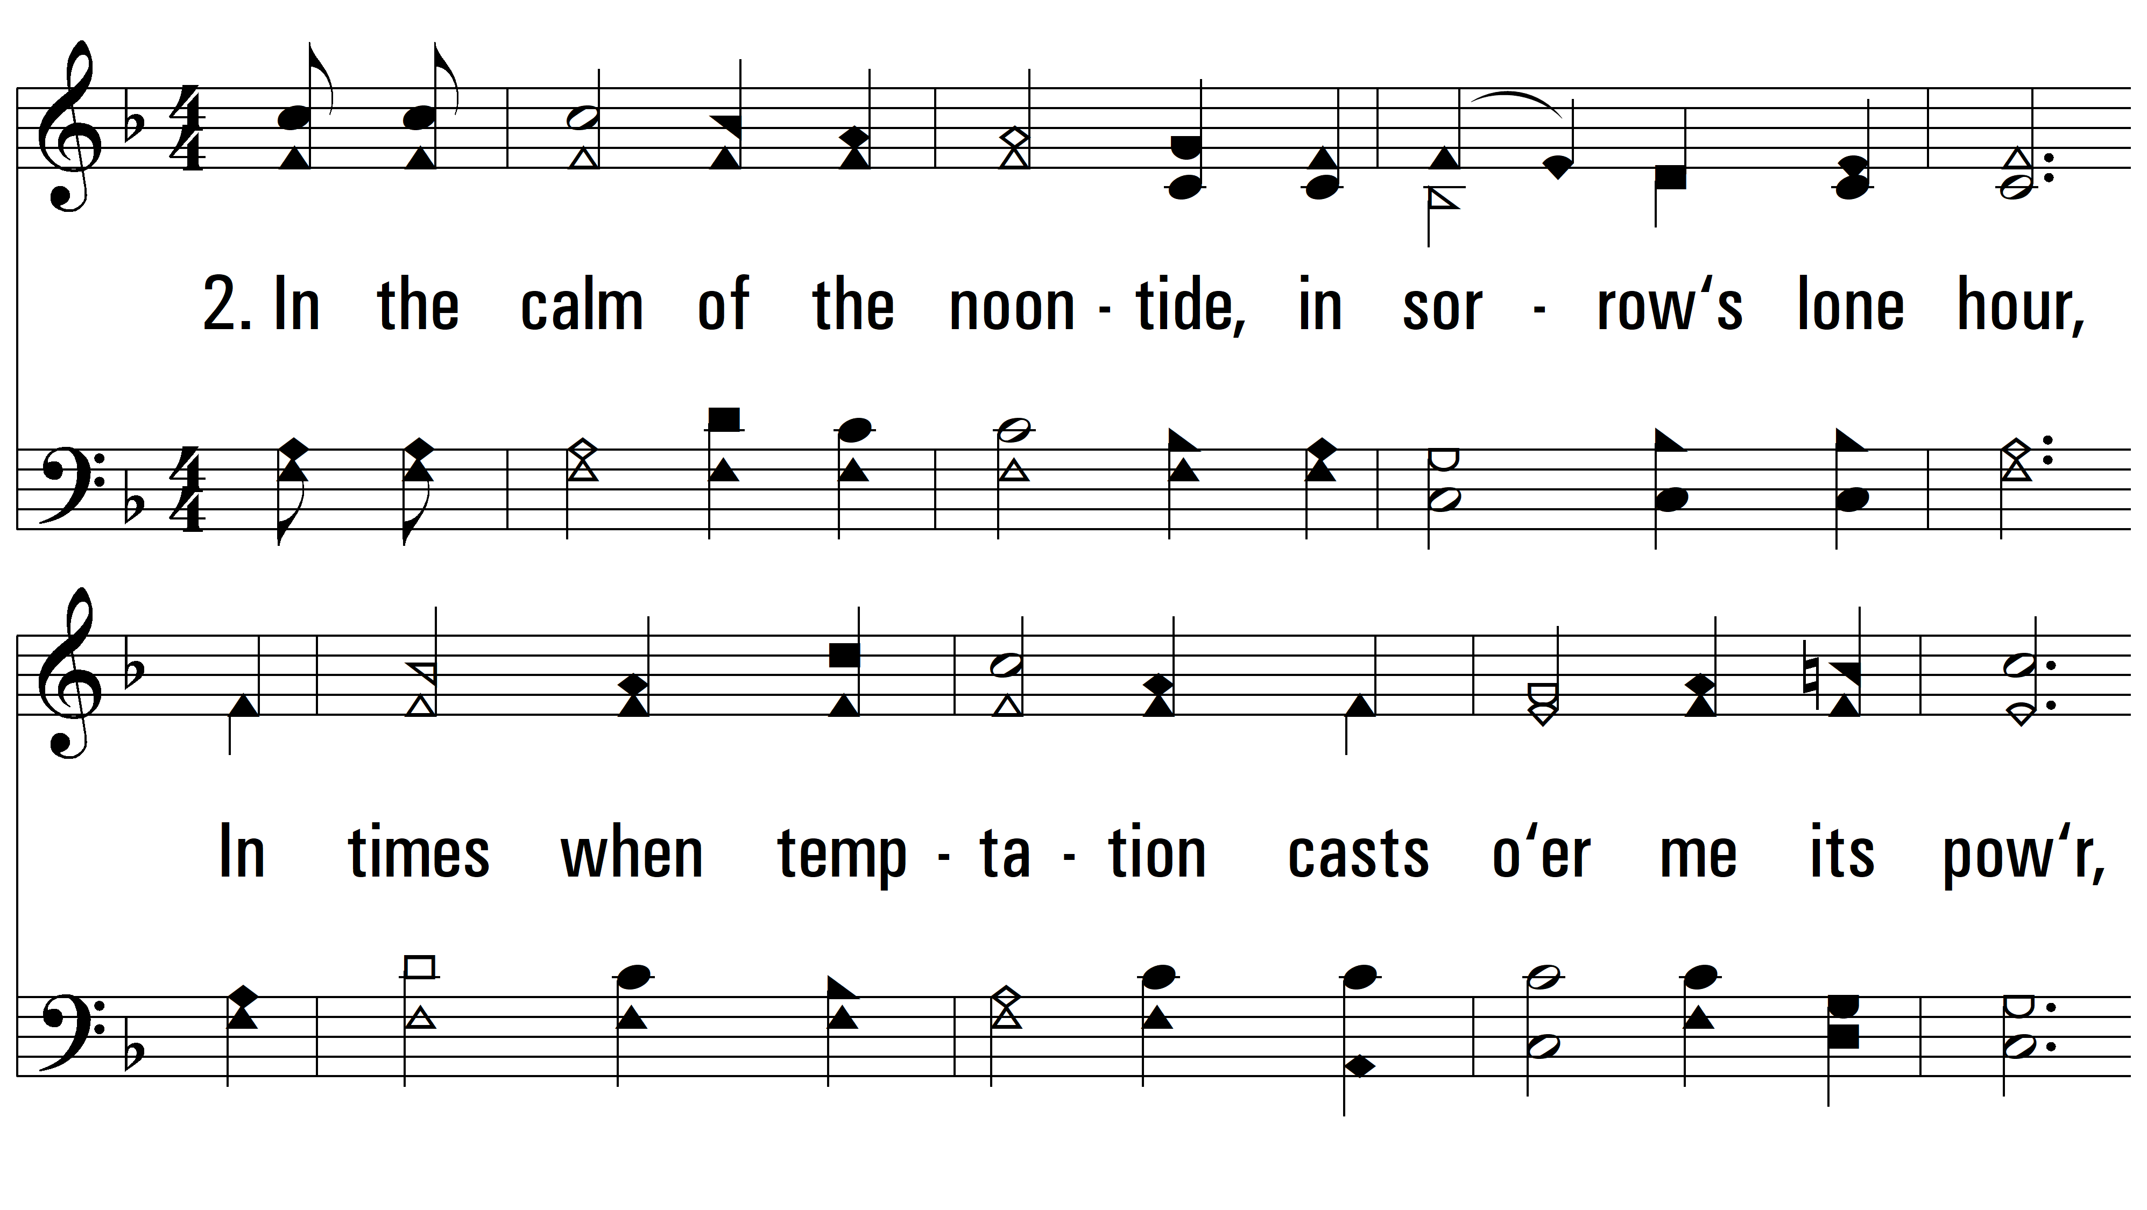
vs. 2 ~ Hiding In Thee

Slide 6
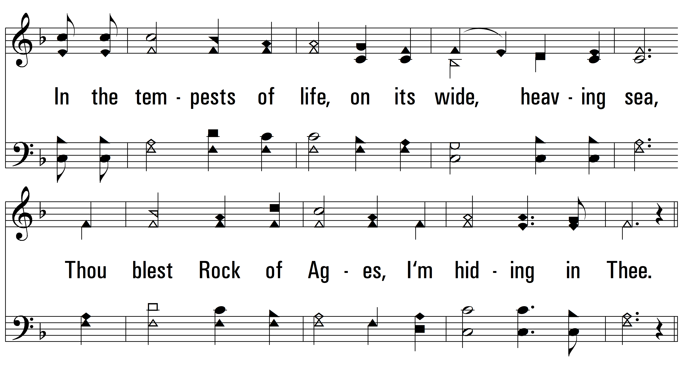
vs. 2

Slide 7
vs. 2

Slide 8
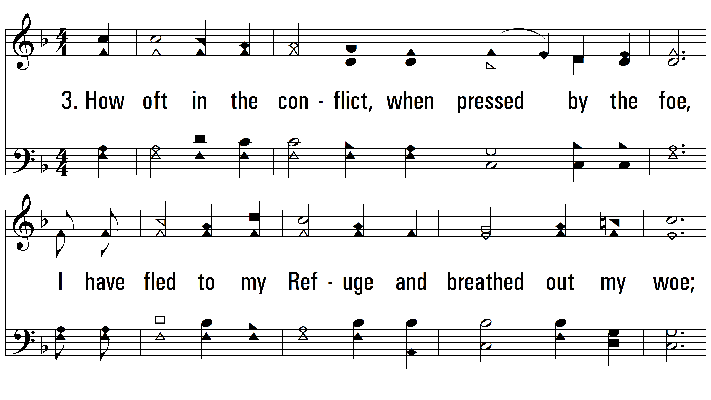
vs. 3 ~ Hiding In Thee

Slide 9
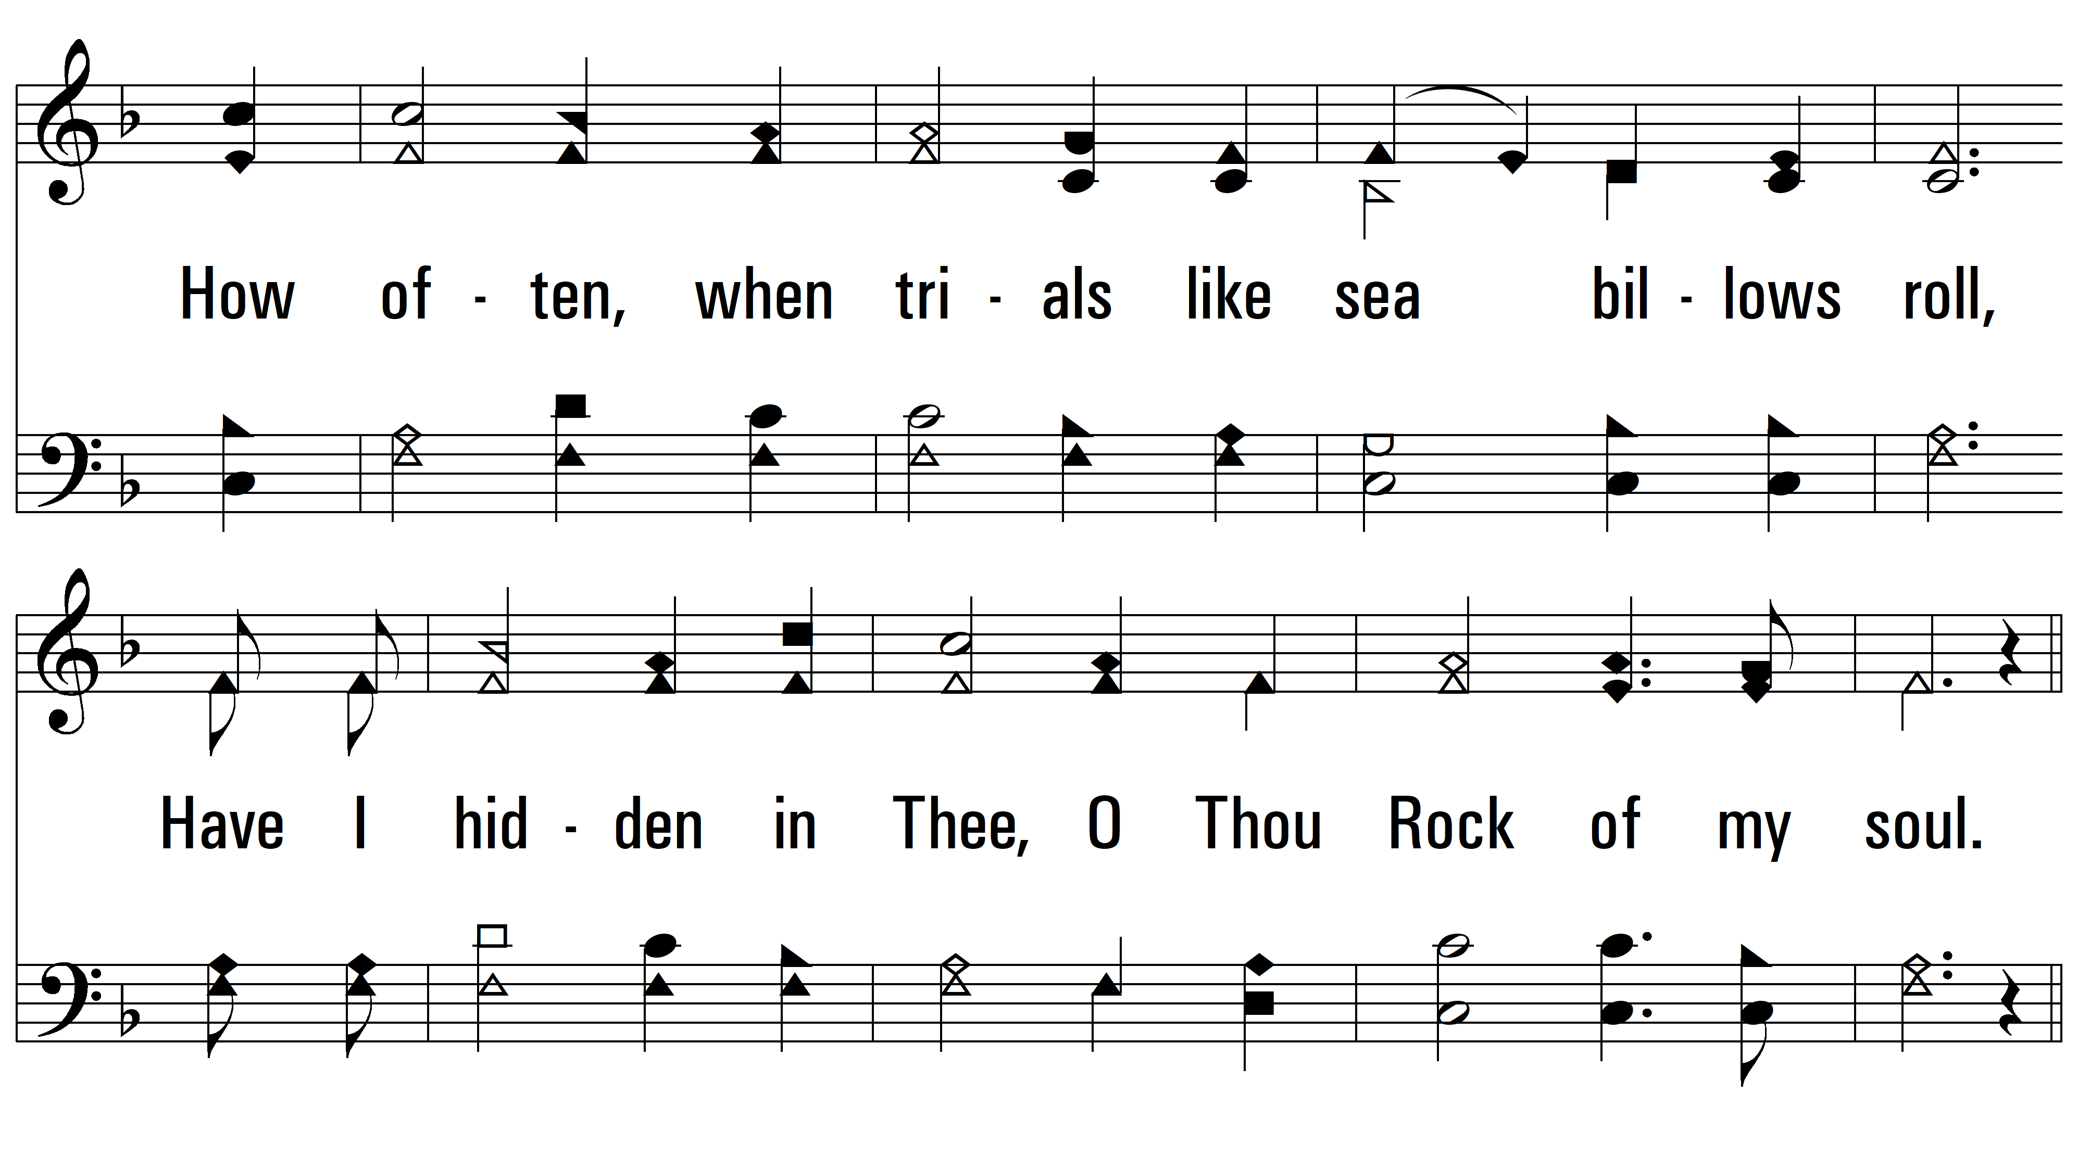
vs. 3

Slide 10
vs. 3
PDHymns.com
END

