Slide 1
Holy Bible, Book Divine
ALETTA
7.7.7.7
Words: | John Burton (1803)
Music: | William B. Bradbury (1858)
3/4
E/G# - MI
Verses: 4
Lead - | MI
Alto - | DO
Tenor - | SOL
Bass - | DO
PDHymns.com

Slide 2
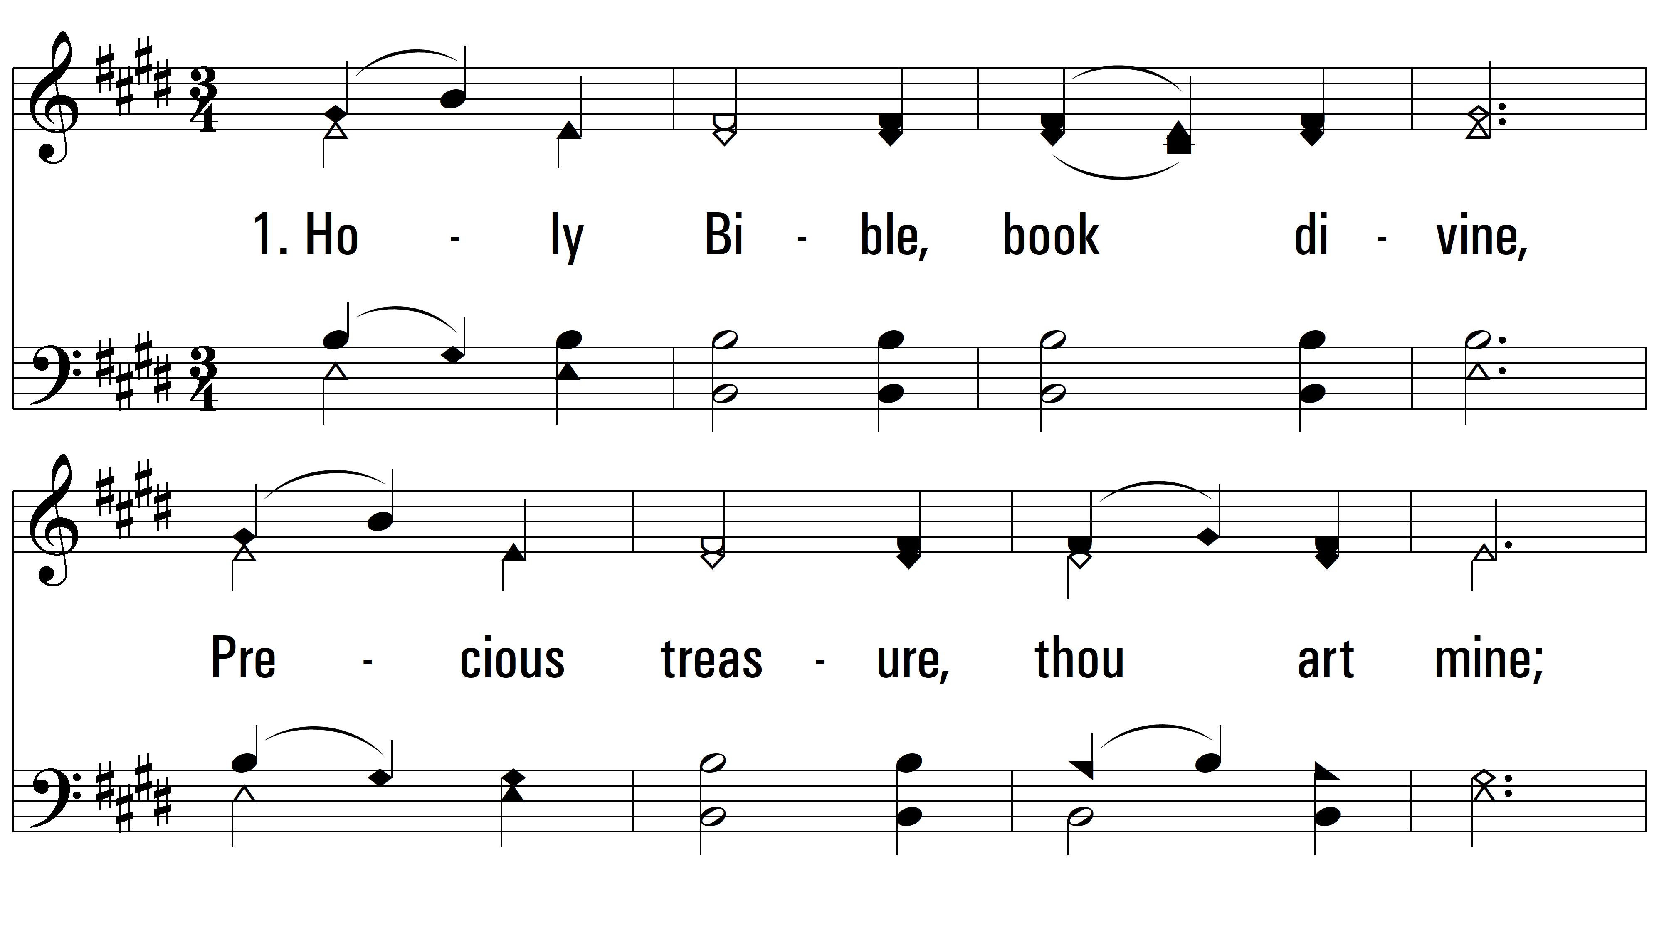
vs. 1 ~ Holy Bible, Book Divine

Slide 3
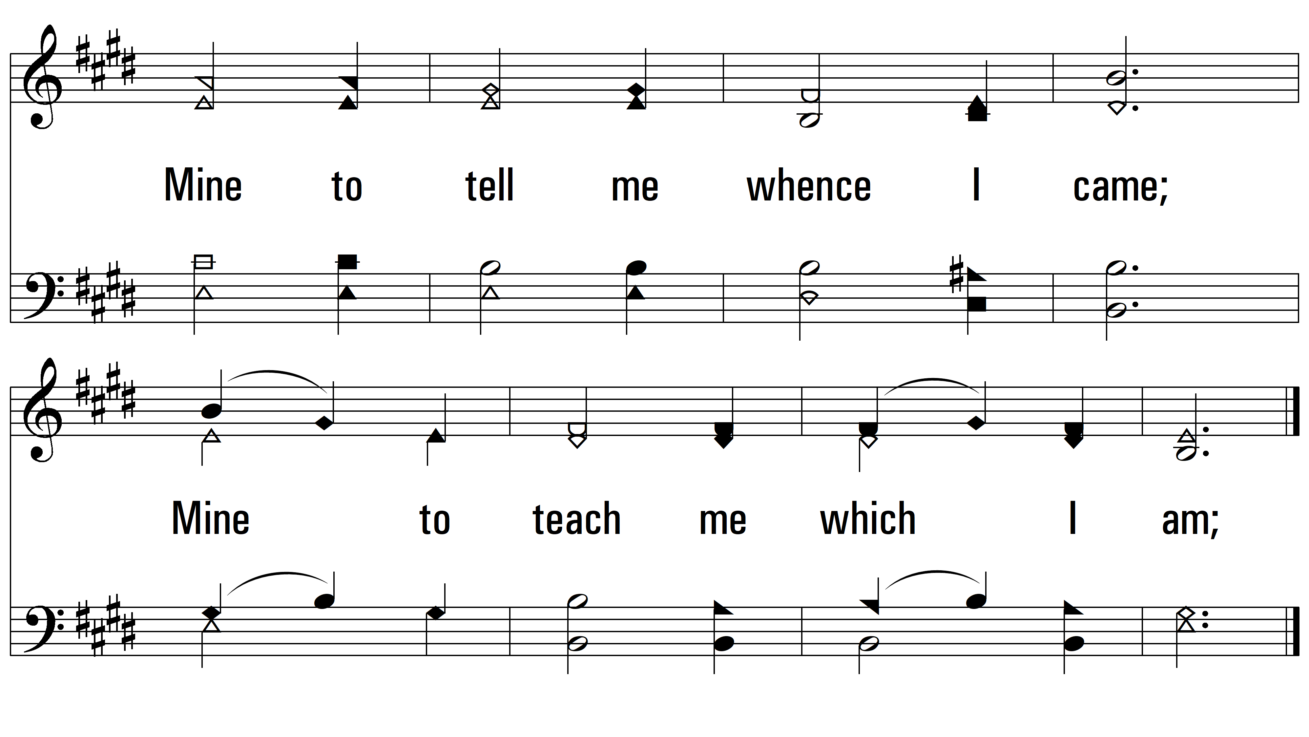
vs. 1

Slide 4
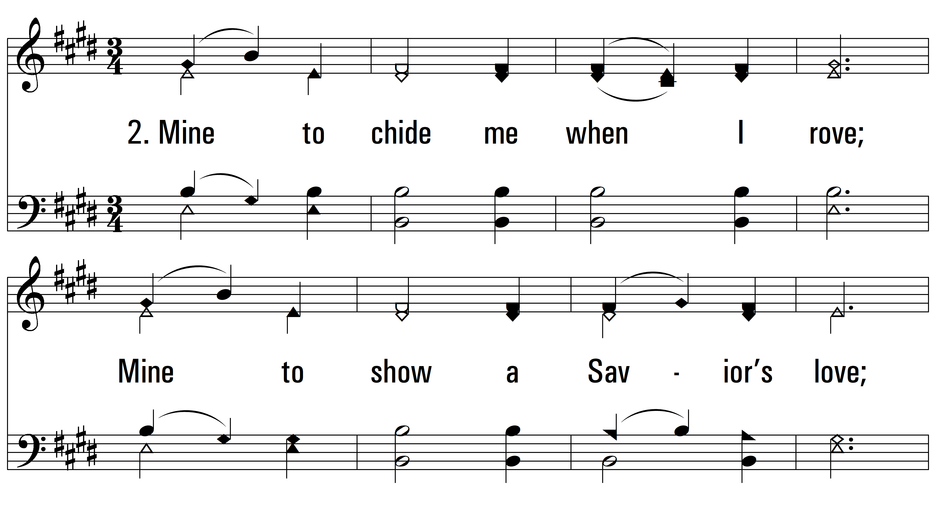
vs. 2 ~ Holy Bible, Book Divine

Slide 5
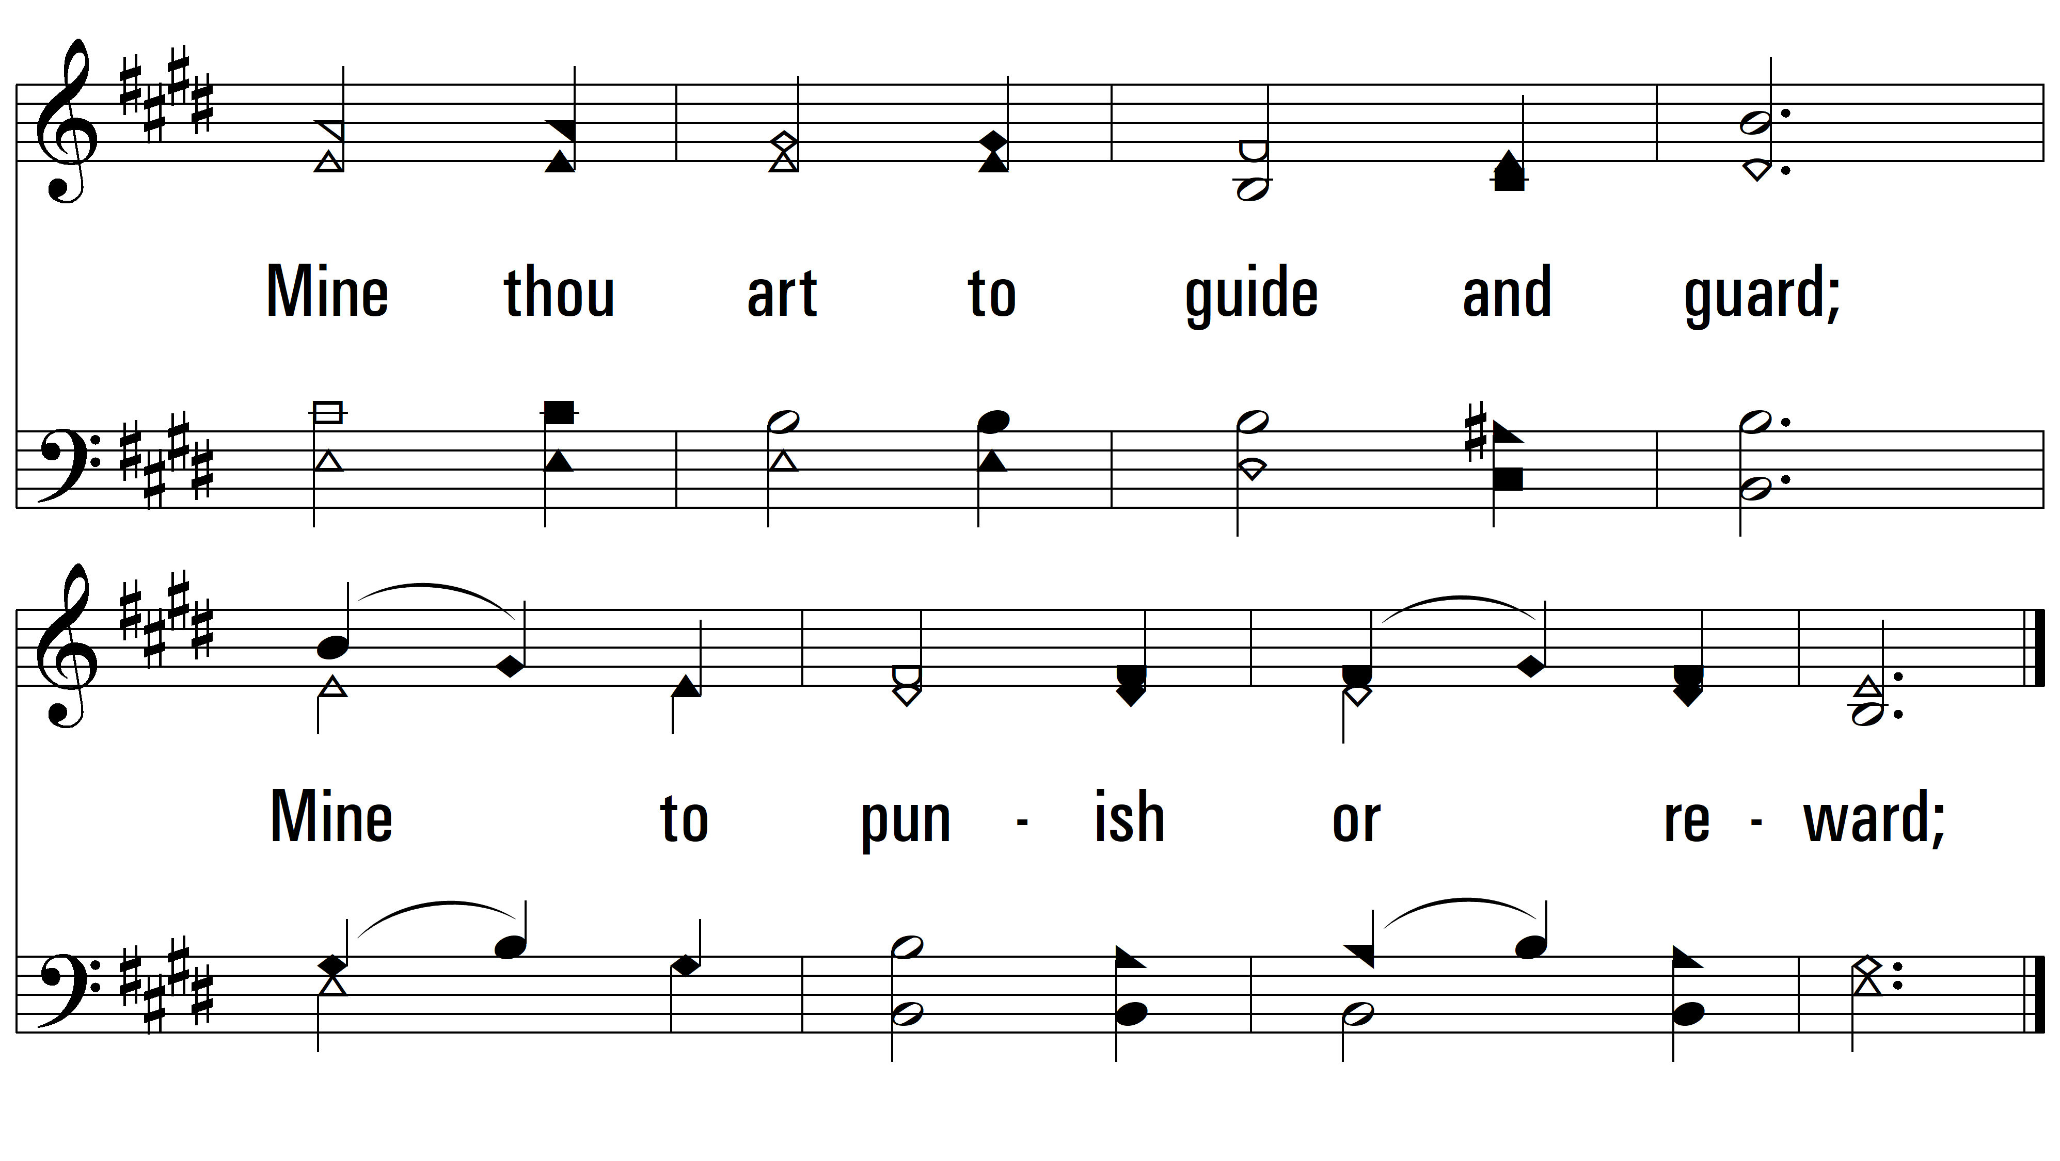
vs. 2

Slide 6
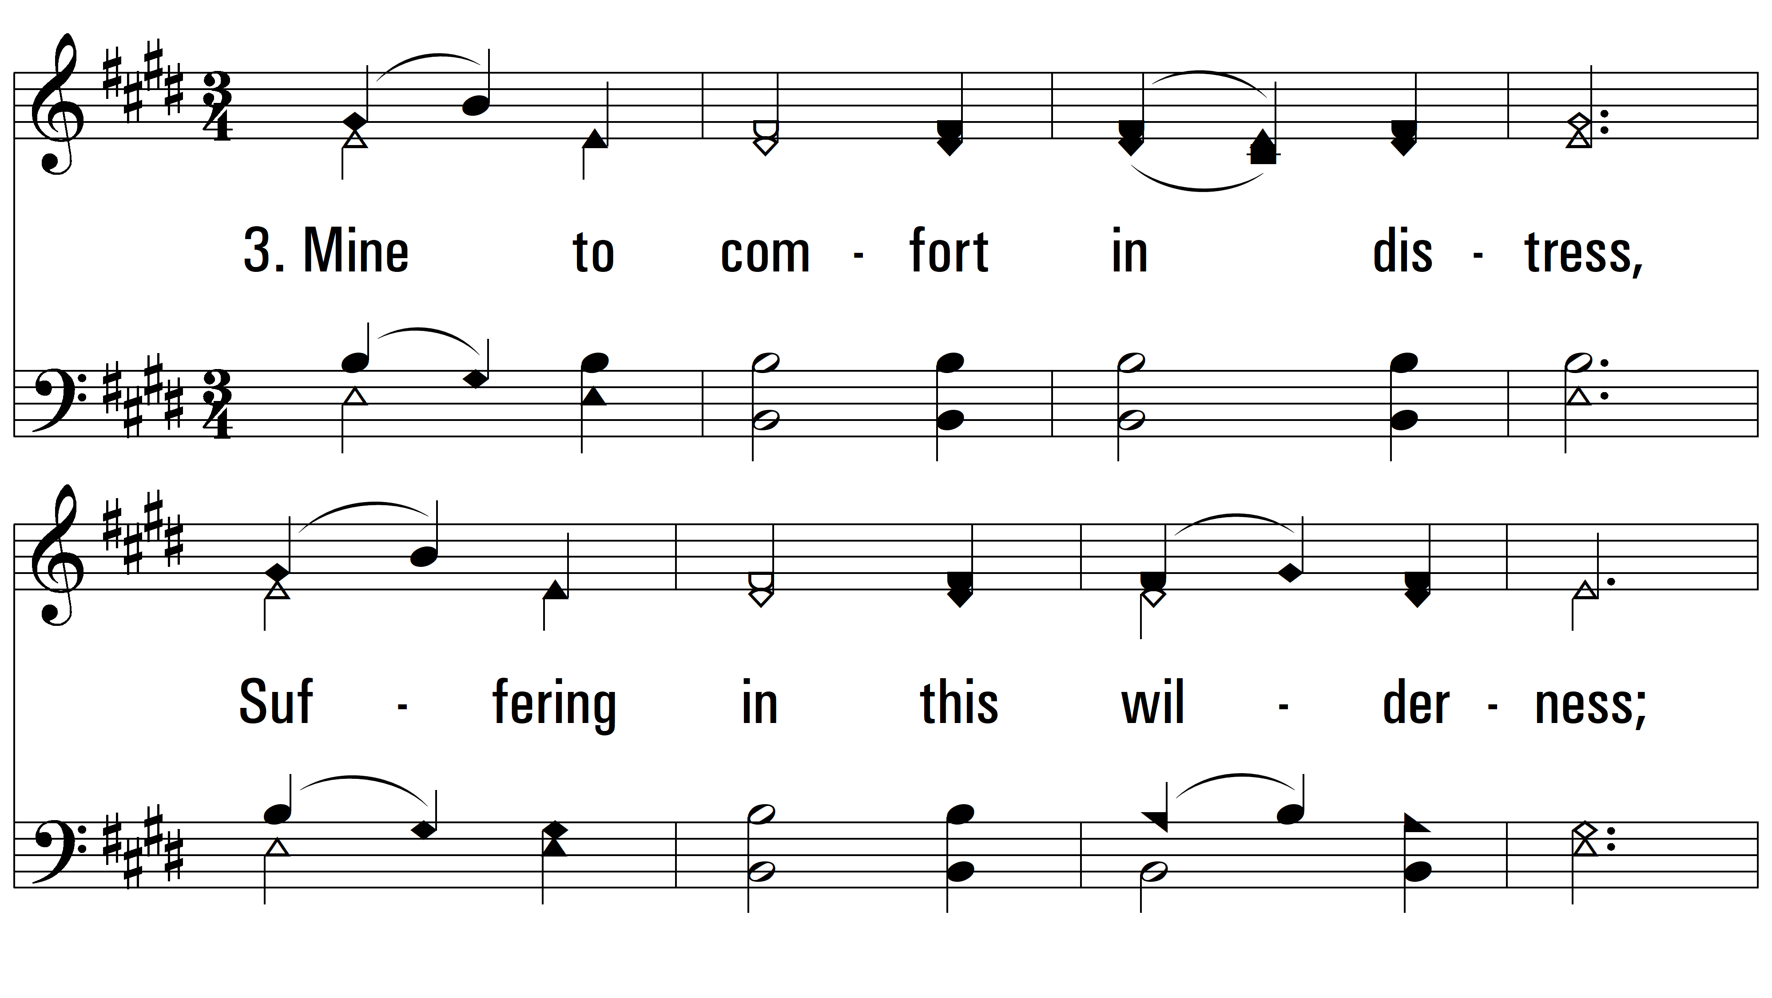
vs. 3 ~ Holy Bible, Book Divine

Slide 7
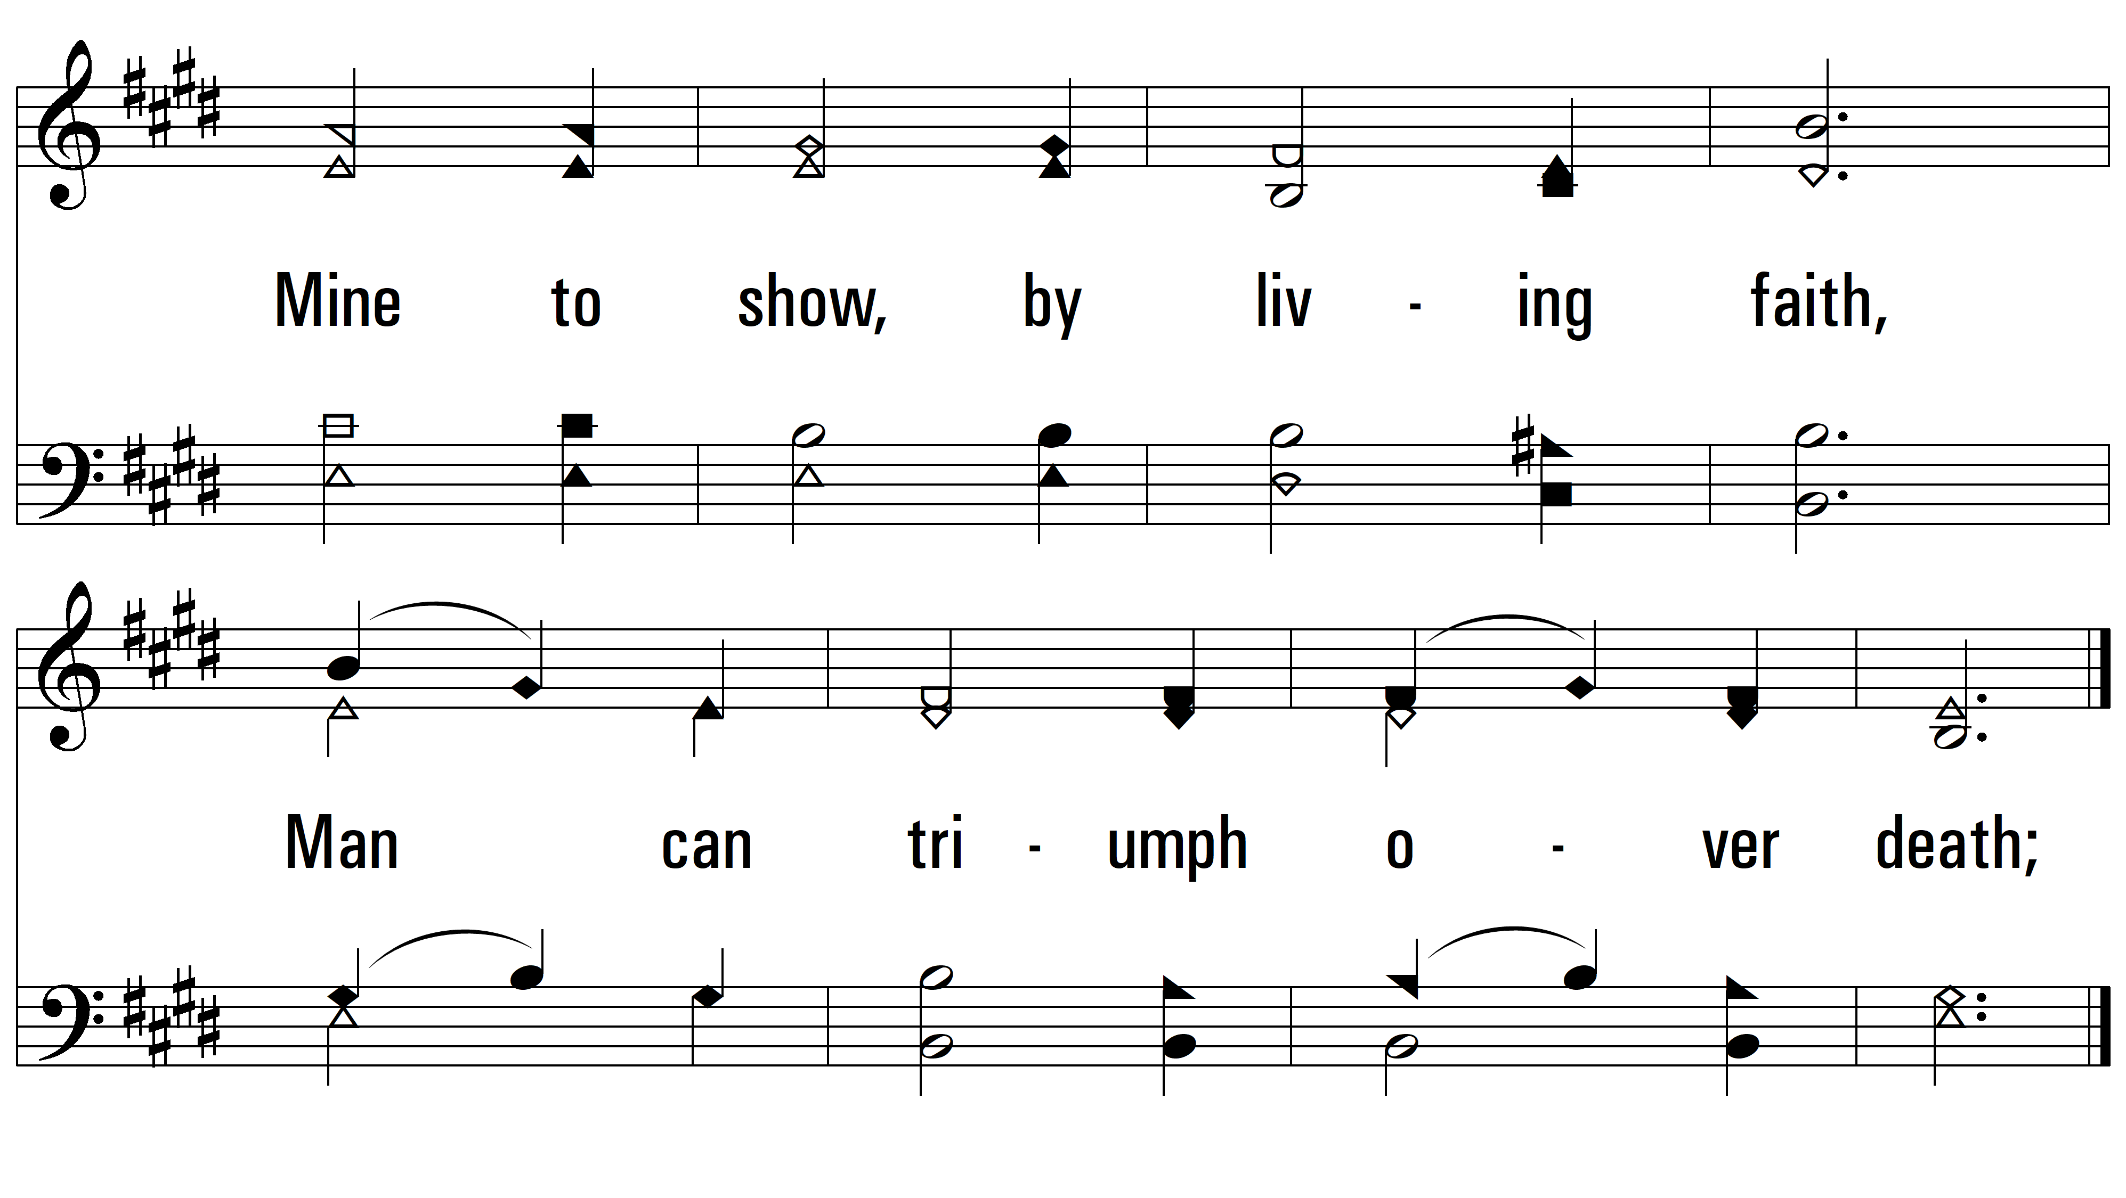
vs. 3

Slide 8
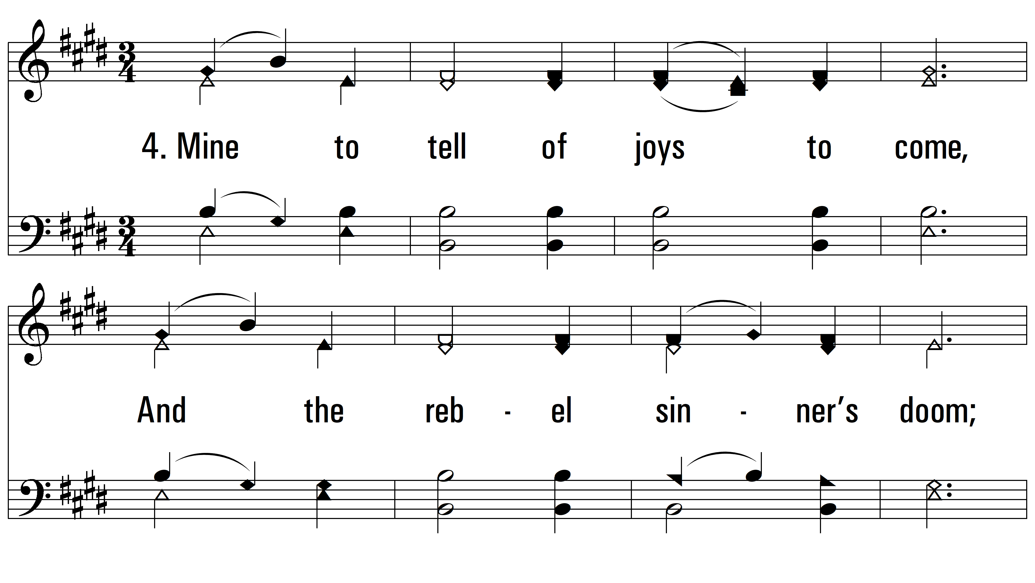
vs. 4 ~ Holy Bible, Book Divine

Slide 9
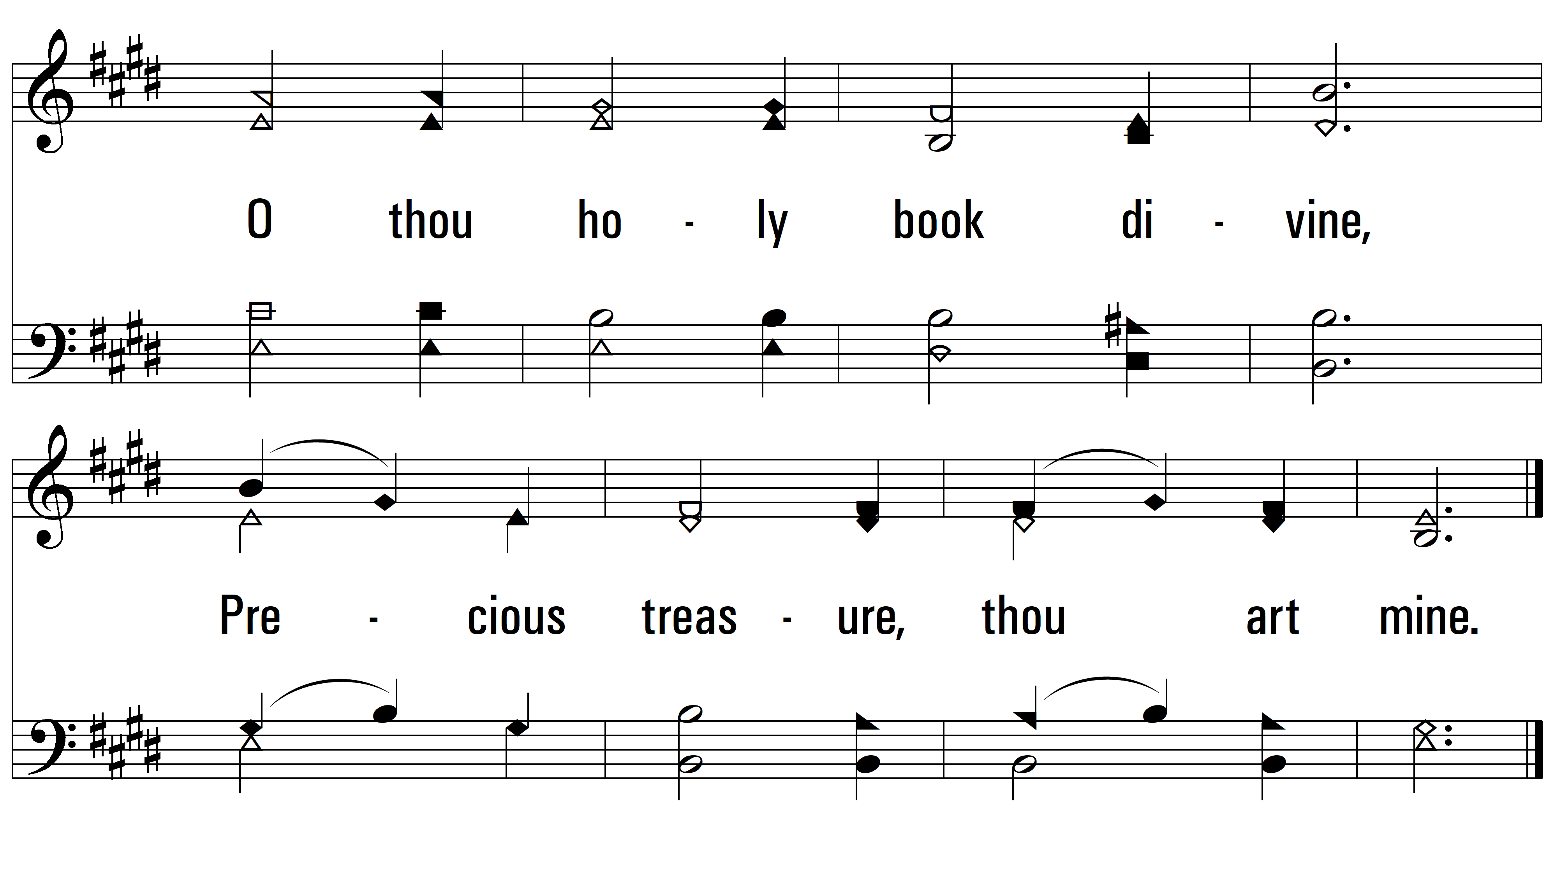
vs. 4
PDHymns.com
END

