Slide 2
How Shall The Young Secure Their Hearts?
CROYDON
CM
Words: | Isaac Watts (1719)
Music: | Attr. to Ludwig van Beethoven
4/4
E/B - SOL
Verses: 3
Lead - | SOL
Alto - | MI
Tenor - | SOL
Bass - | DO
PDHymns.com

Slide 3
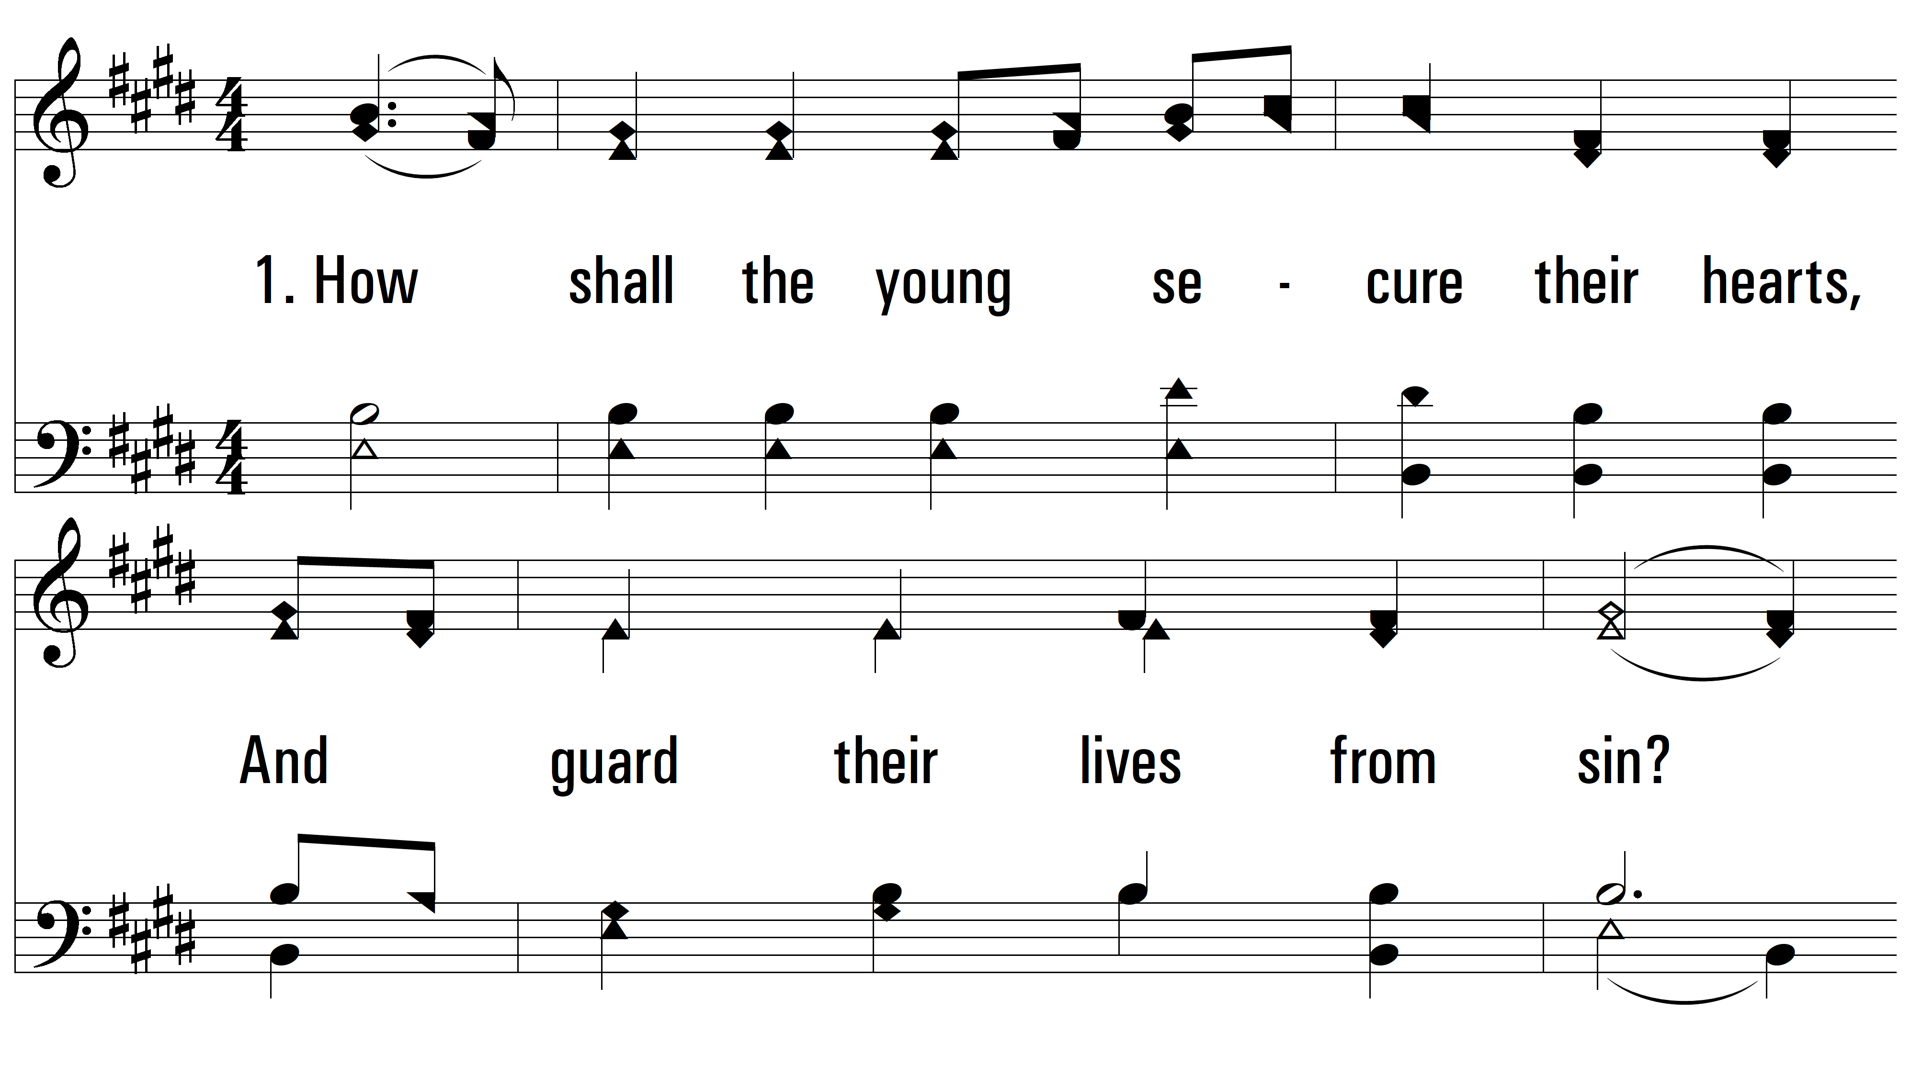
vs. 1 ~ How Shall The Young Secure Their Hearts

Slide 4
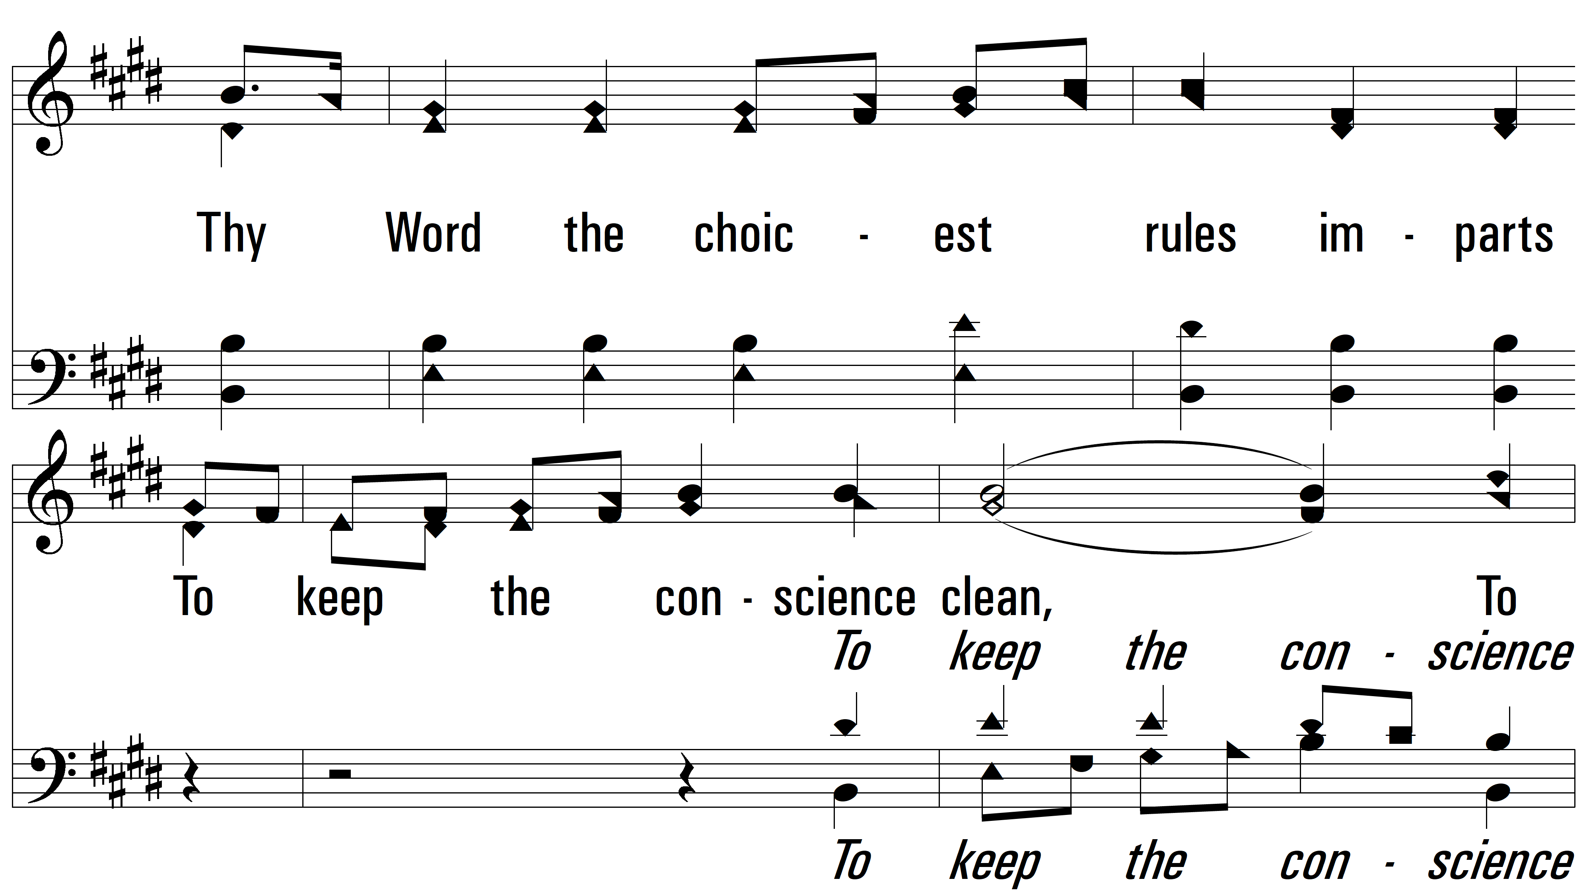
vs. 1

Slide 5
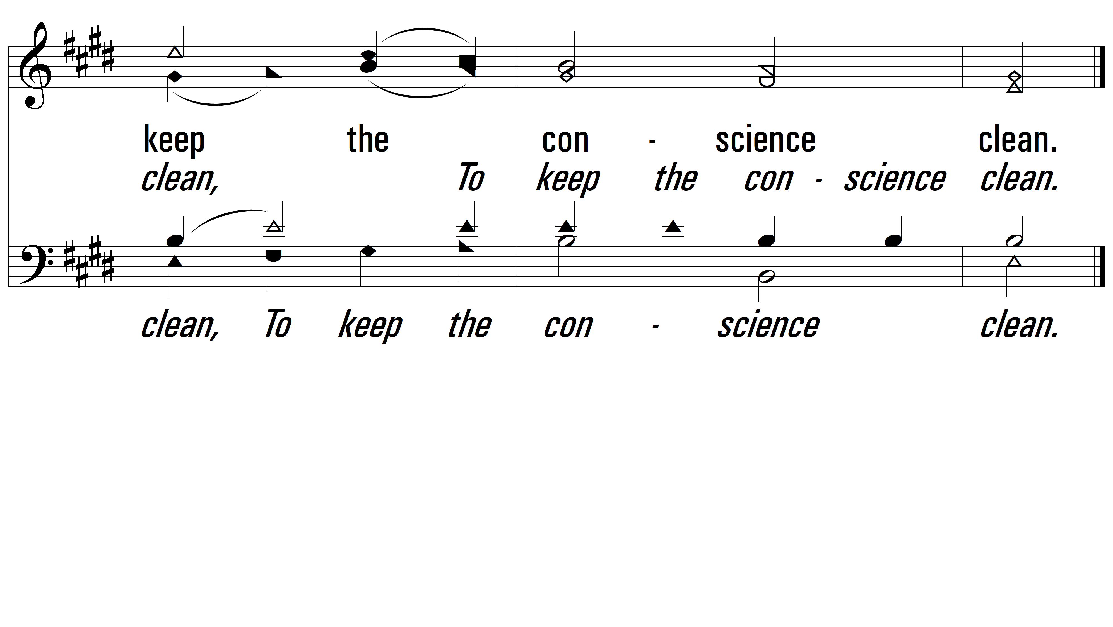
vs. 1

Slide 6
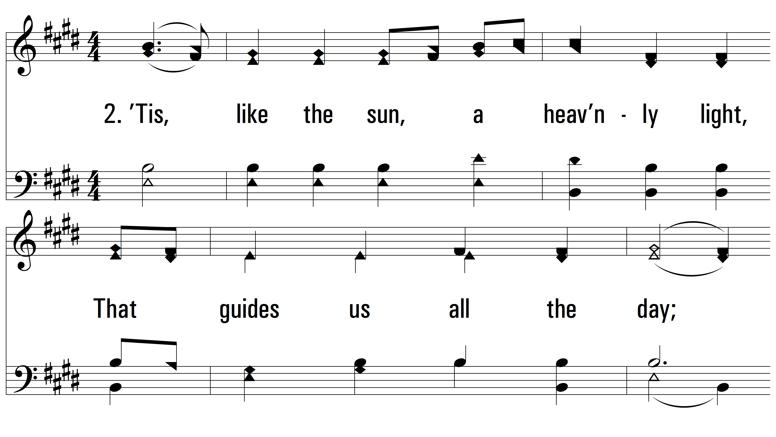
vs. 2 ~ How Shall The Young Secure Their Hearts

Slide 7
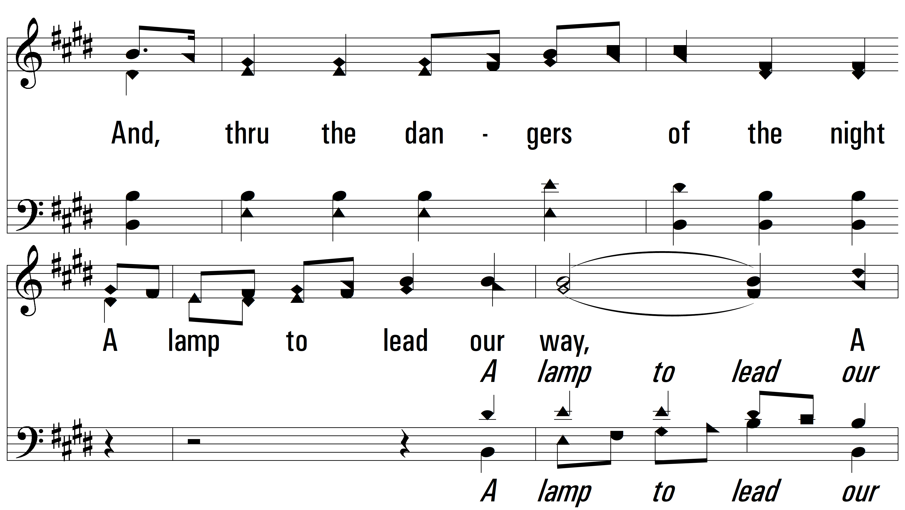
vs. 2

Slide 8
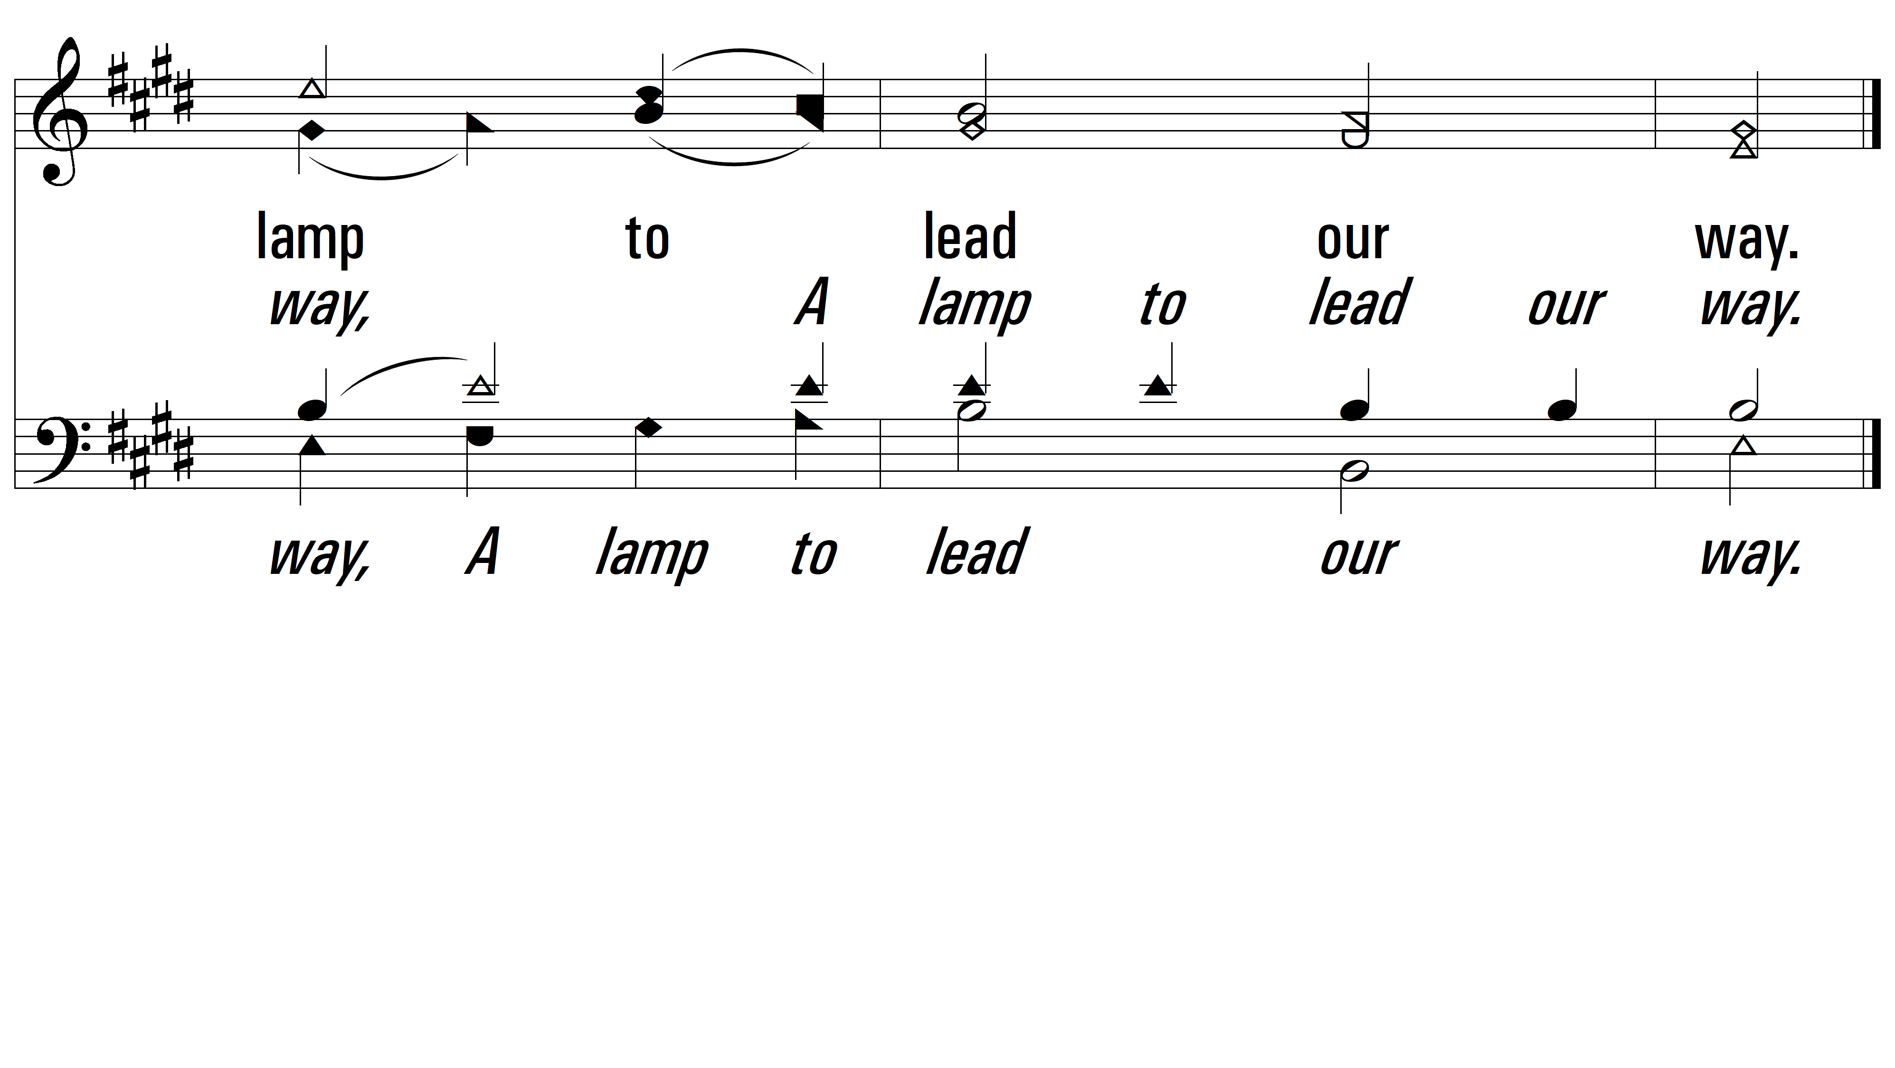
vs. 2

Slide 9
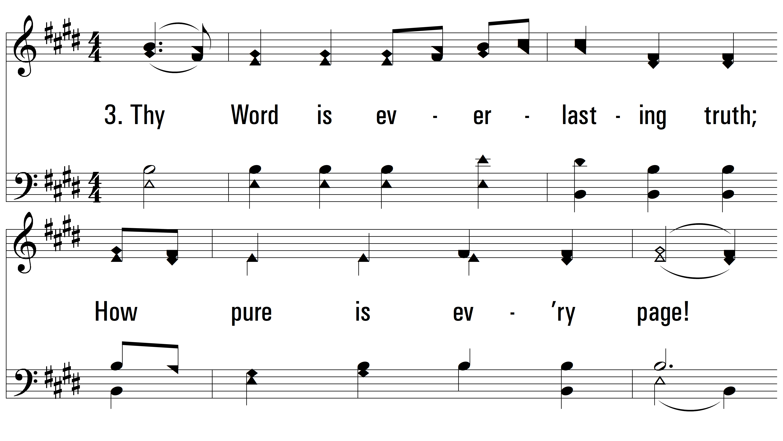
vs. 3 ~ How Shall The Young Secure Their Hearts

Slide 10
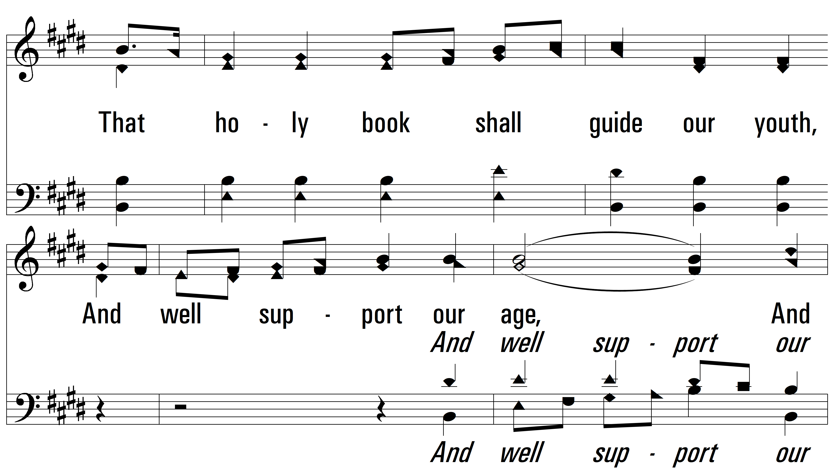
vs. 3

Slide 11
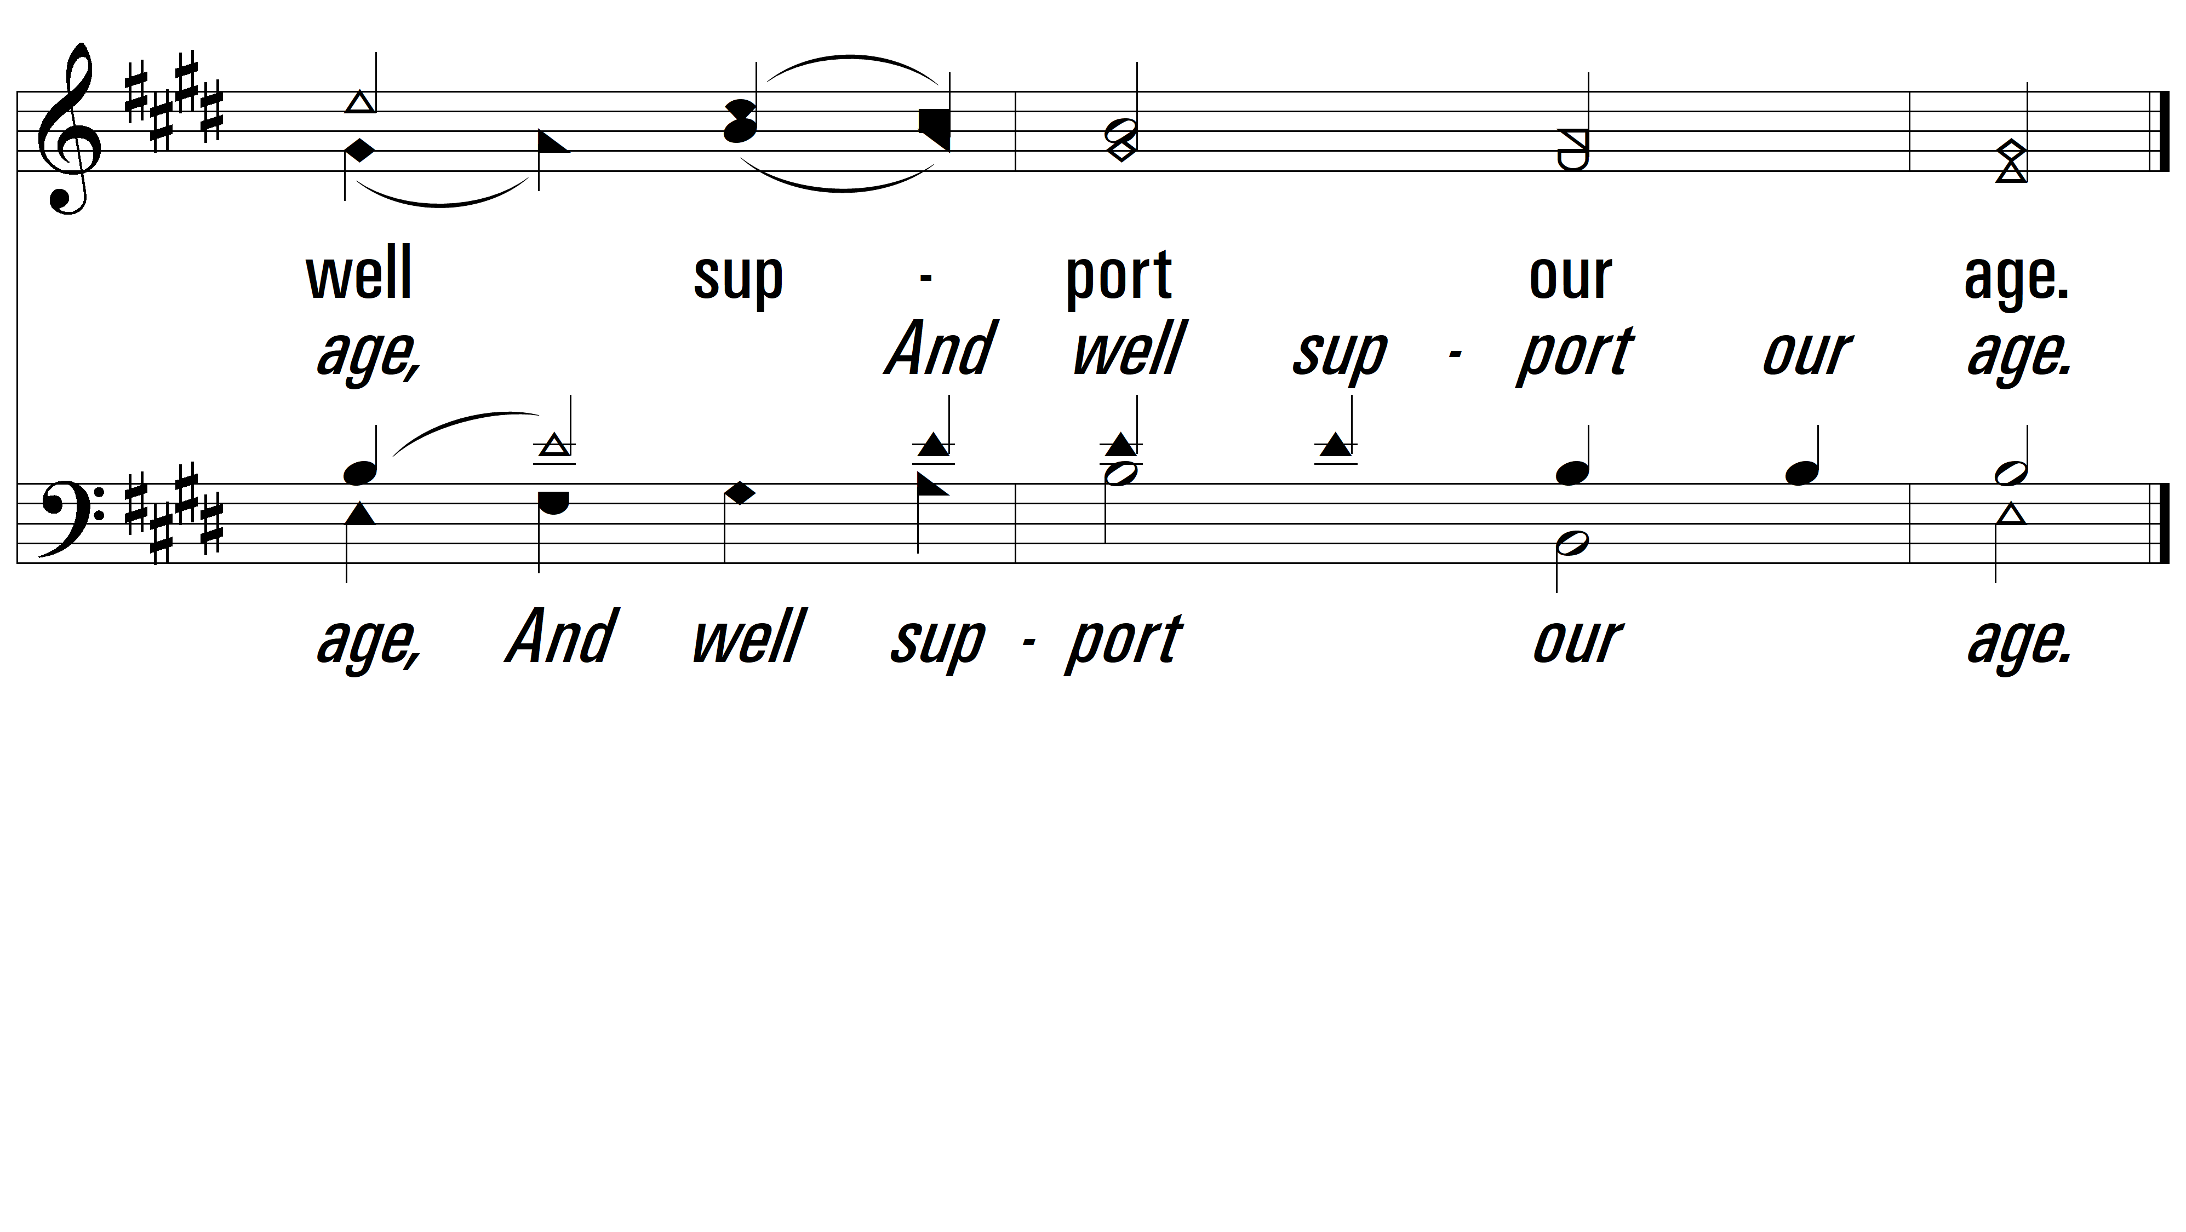
vs. 3
PDHymns.com
END

