Slide 1
I Am A Poor Wayfaring Stranger
(Poor Wayfaring Stranger)
Words: | Bever’s Christian Songster (1858), Vs. 2&3 Taylor’s Revival Hymns & Plantation Melodies (1882)
Music: | Tillman’s Revival (1891)
4/4
Dm (F)/D - LA
Verses: 3
Lead - | LA
Alto - | LA
Tenor - | LA
Bass - | LA
PDHymns.com

Slide 2
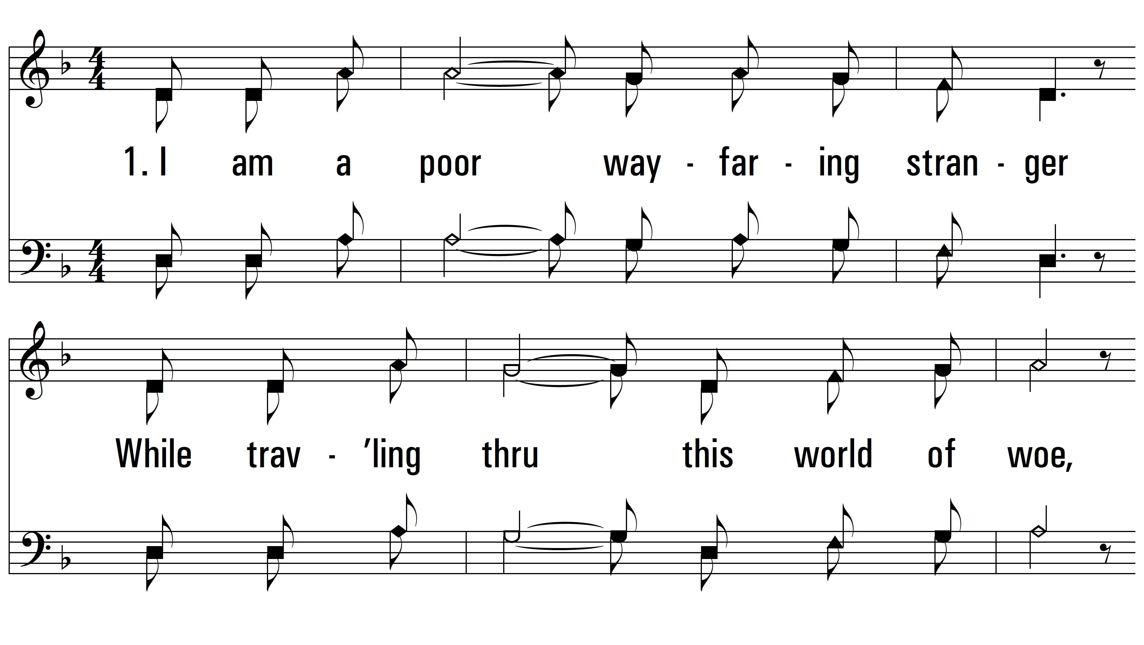
vs. 1 ~ I Am A Poor Wayfaring Stranger

Slide 3
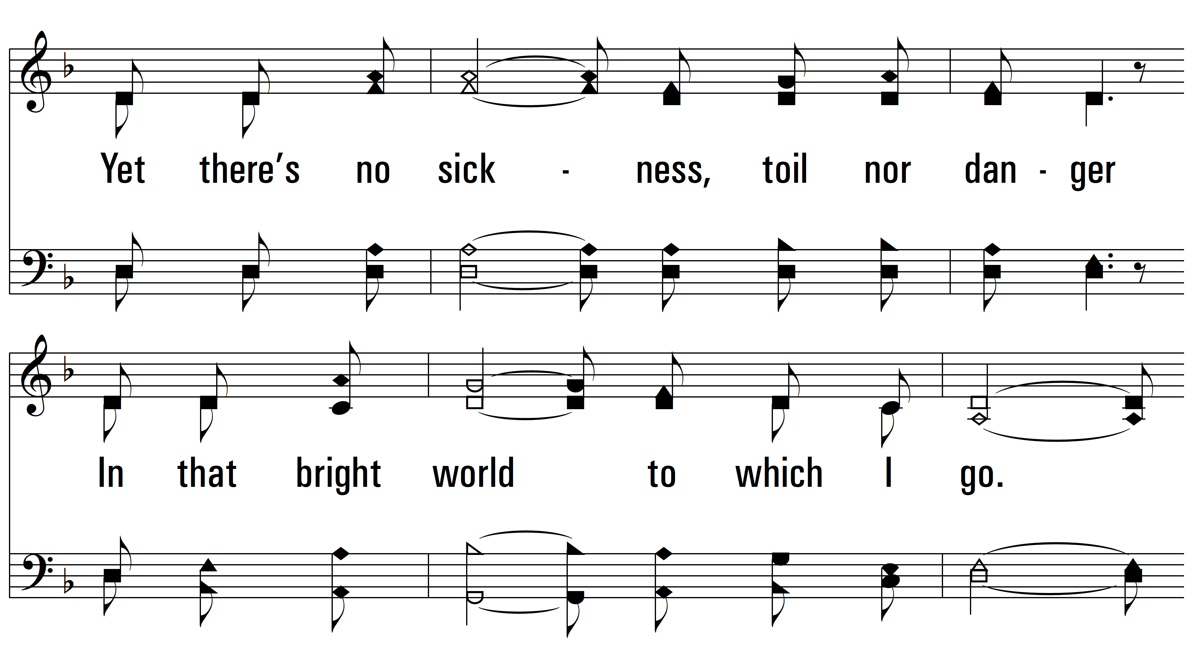
vs. 1

Slide 4
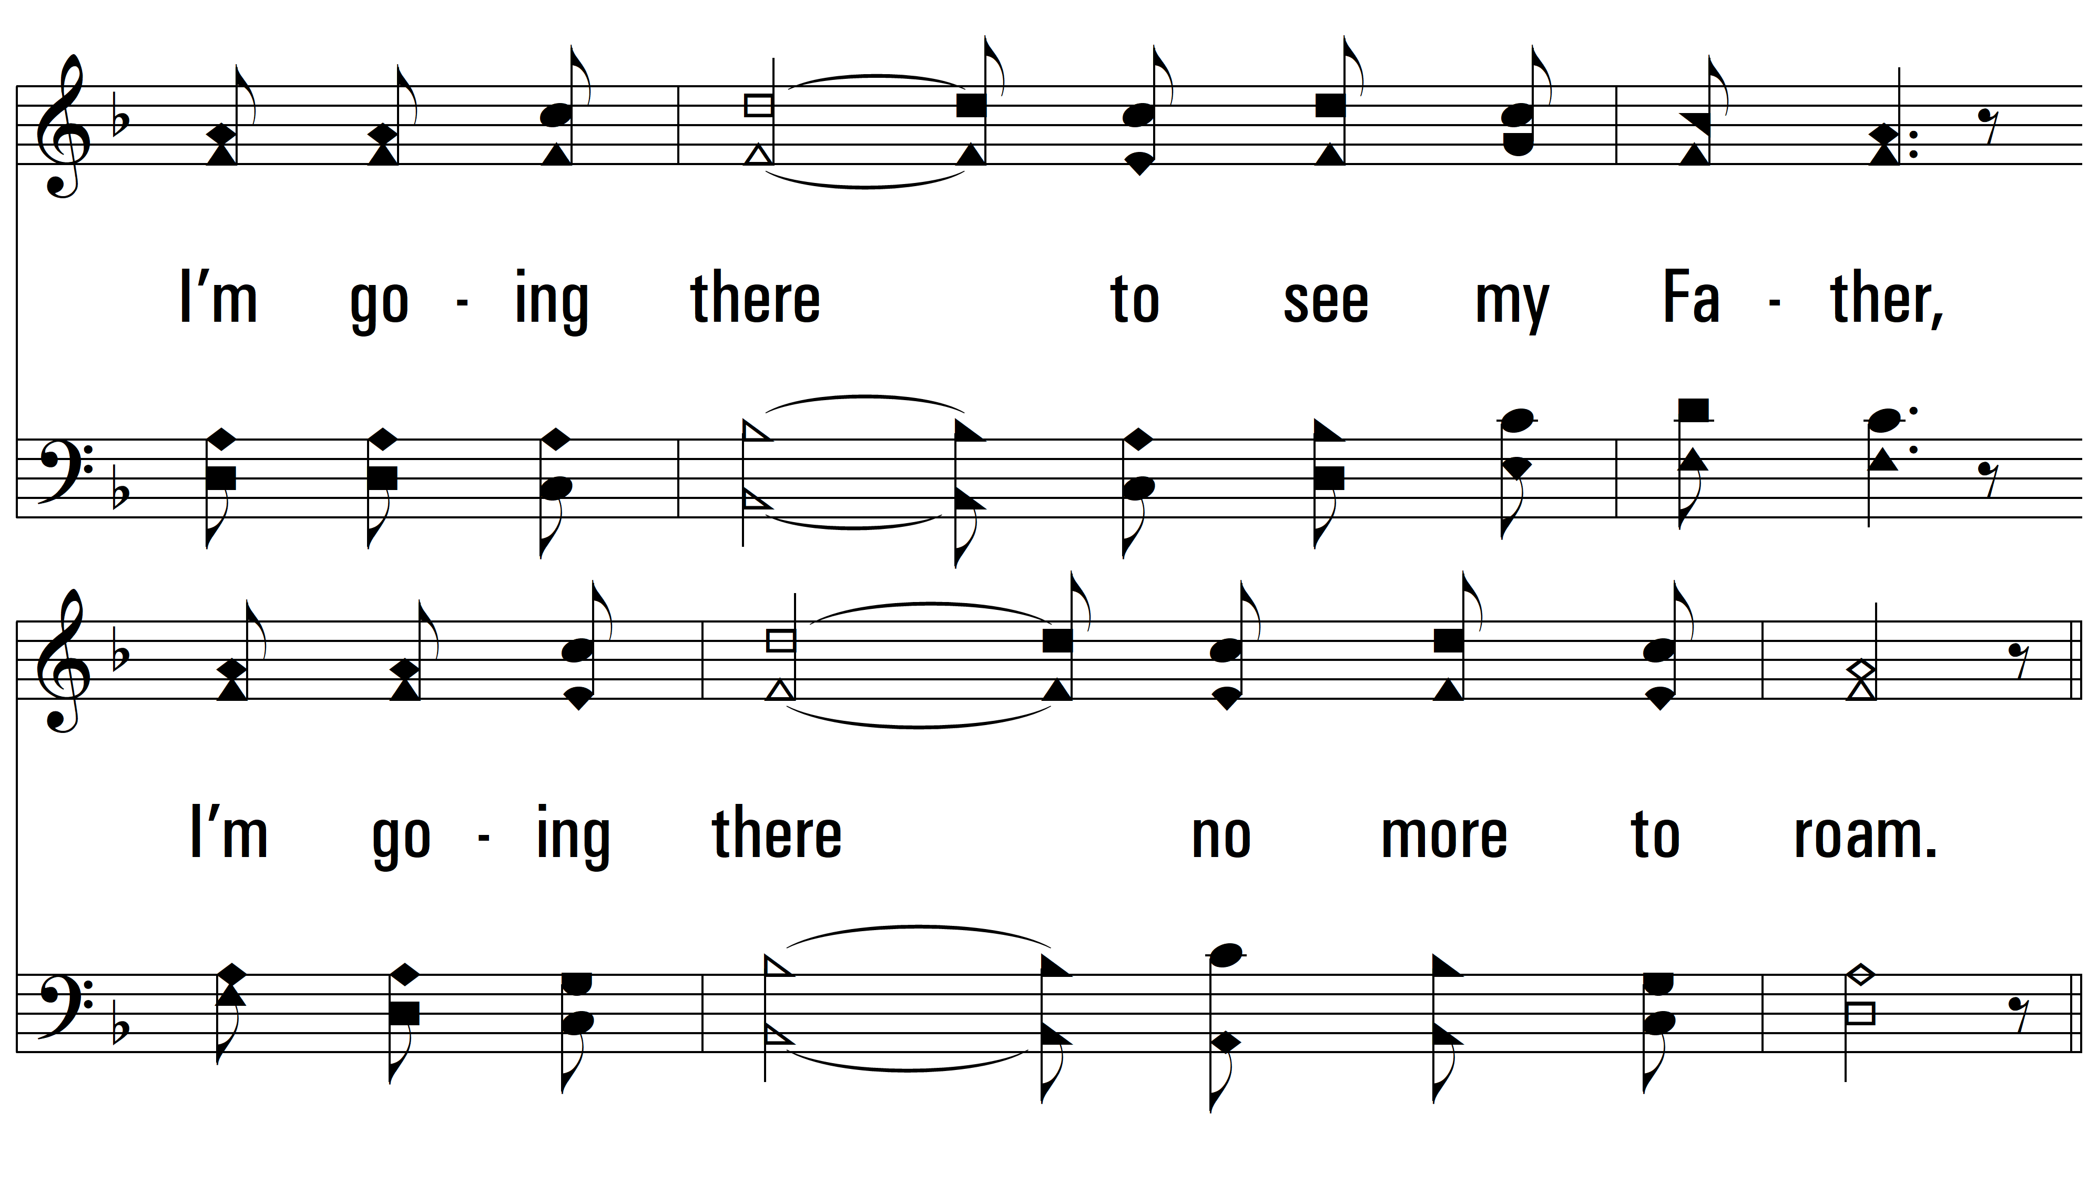
vs. 1

Slide 5
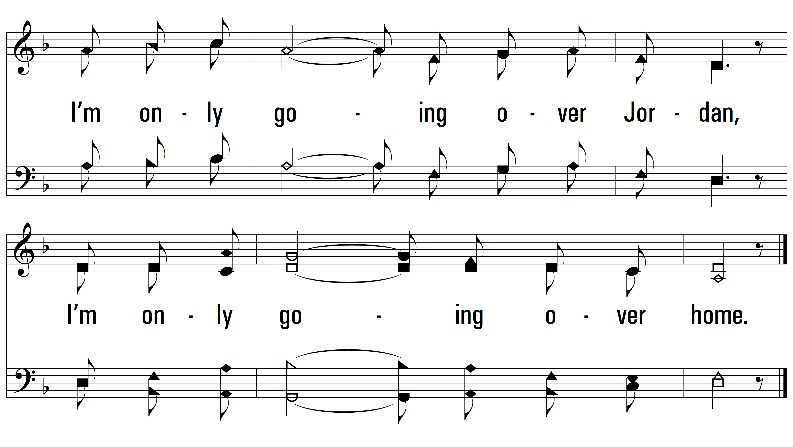
vs. 1

Slide 6
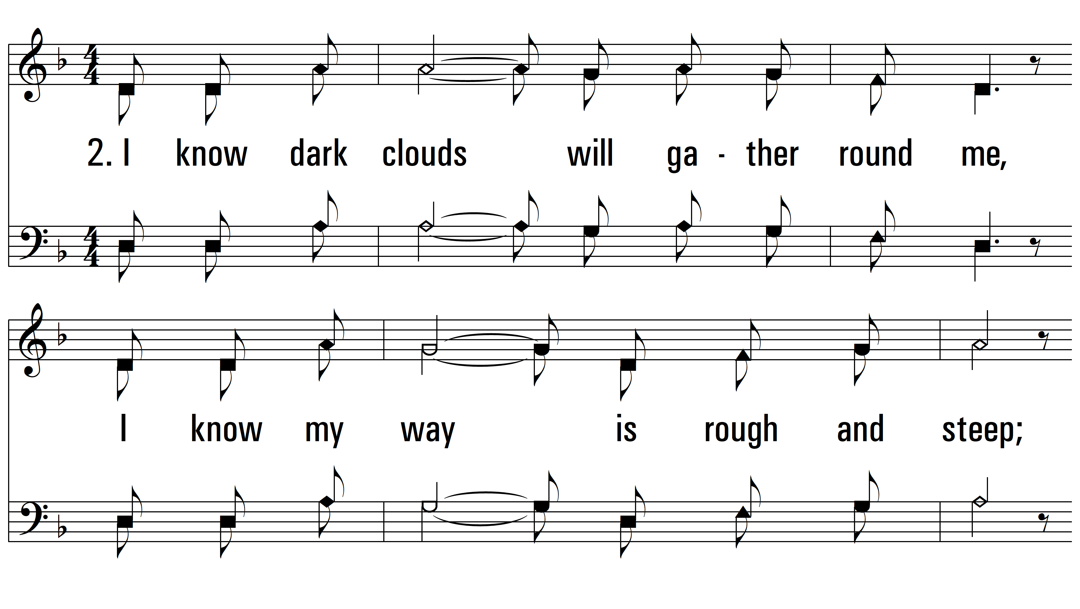
vs. 2 ~ I Am A Poor Wayfaring Stranger

Slide 7
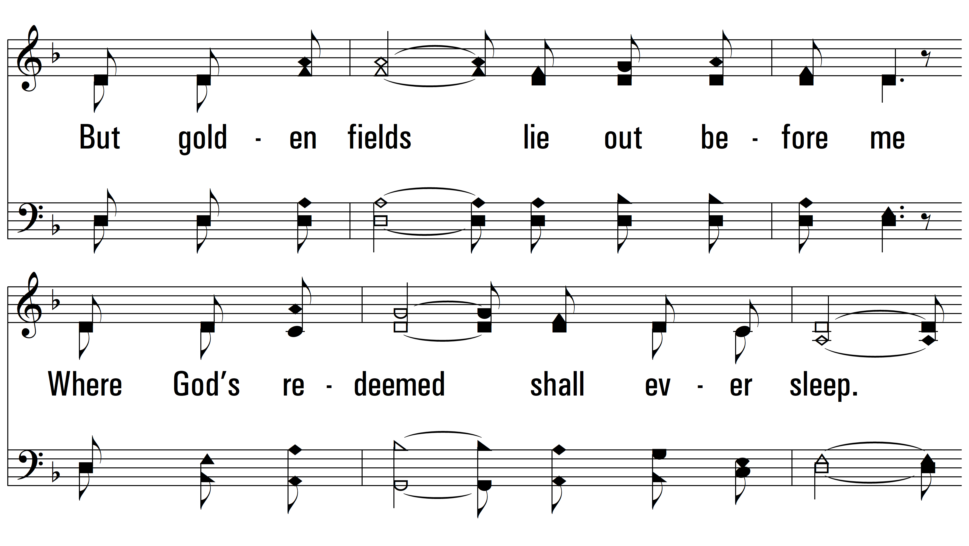
vs. 2

Slide 8
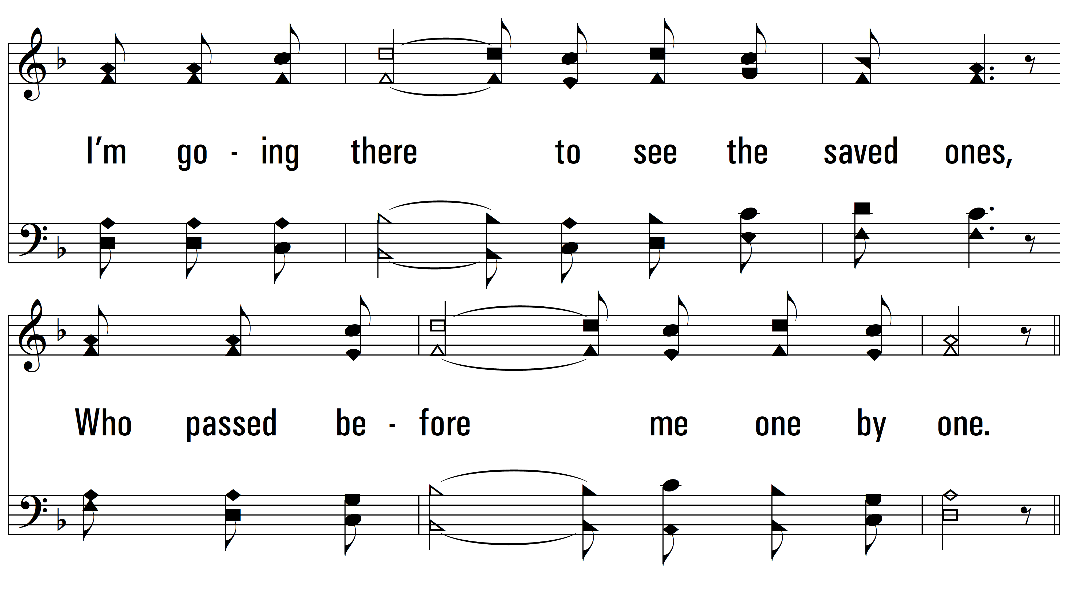
vs. 2

Slide 9
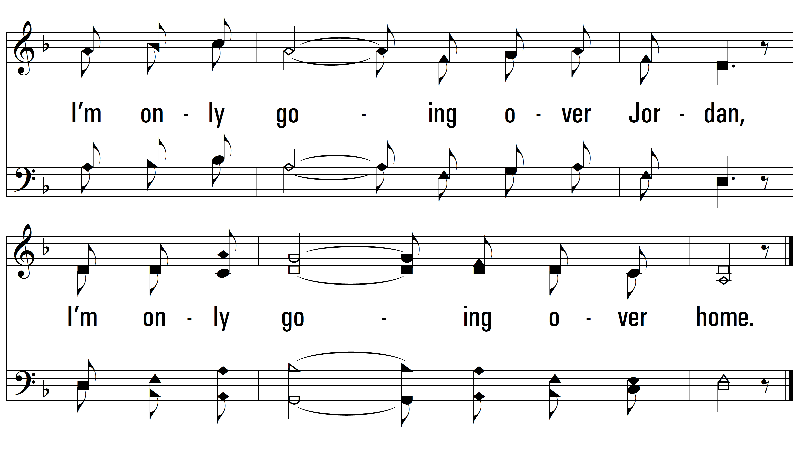
vs. 2

Slide 10
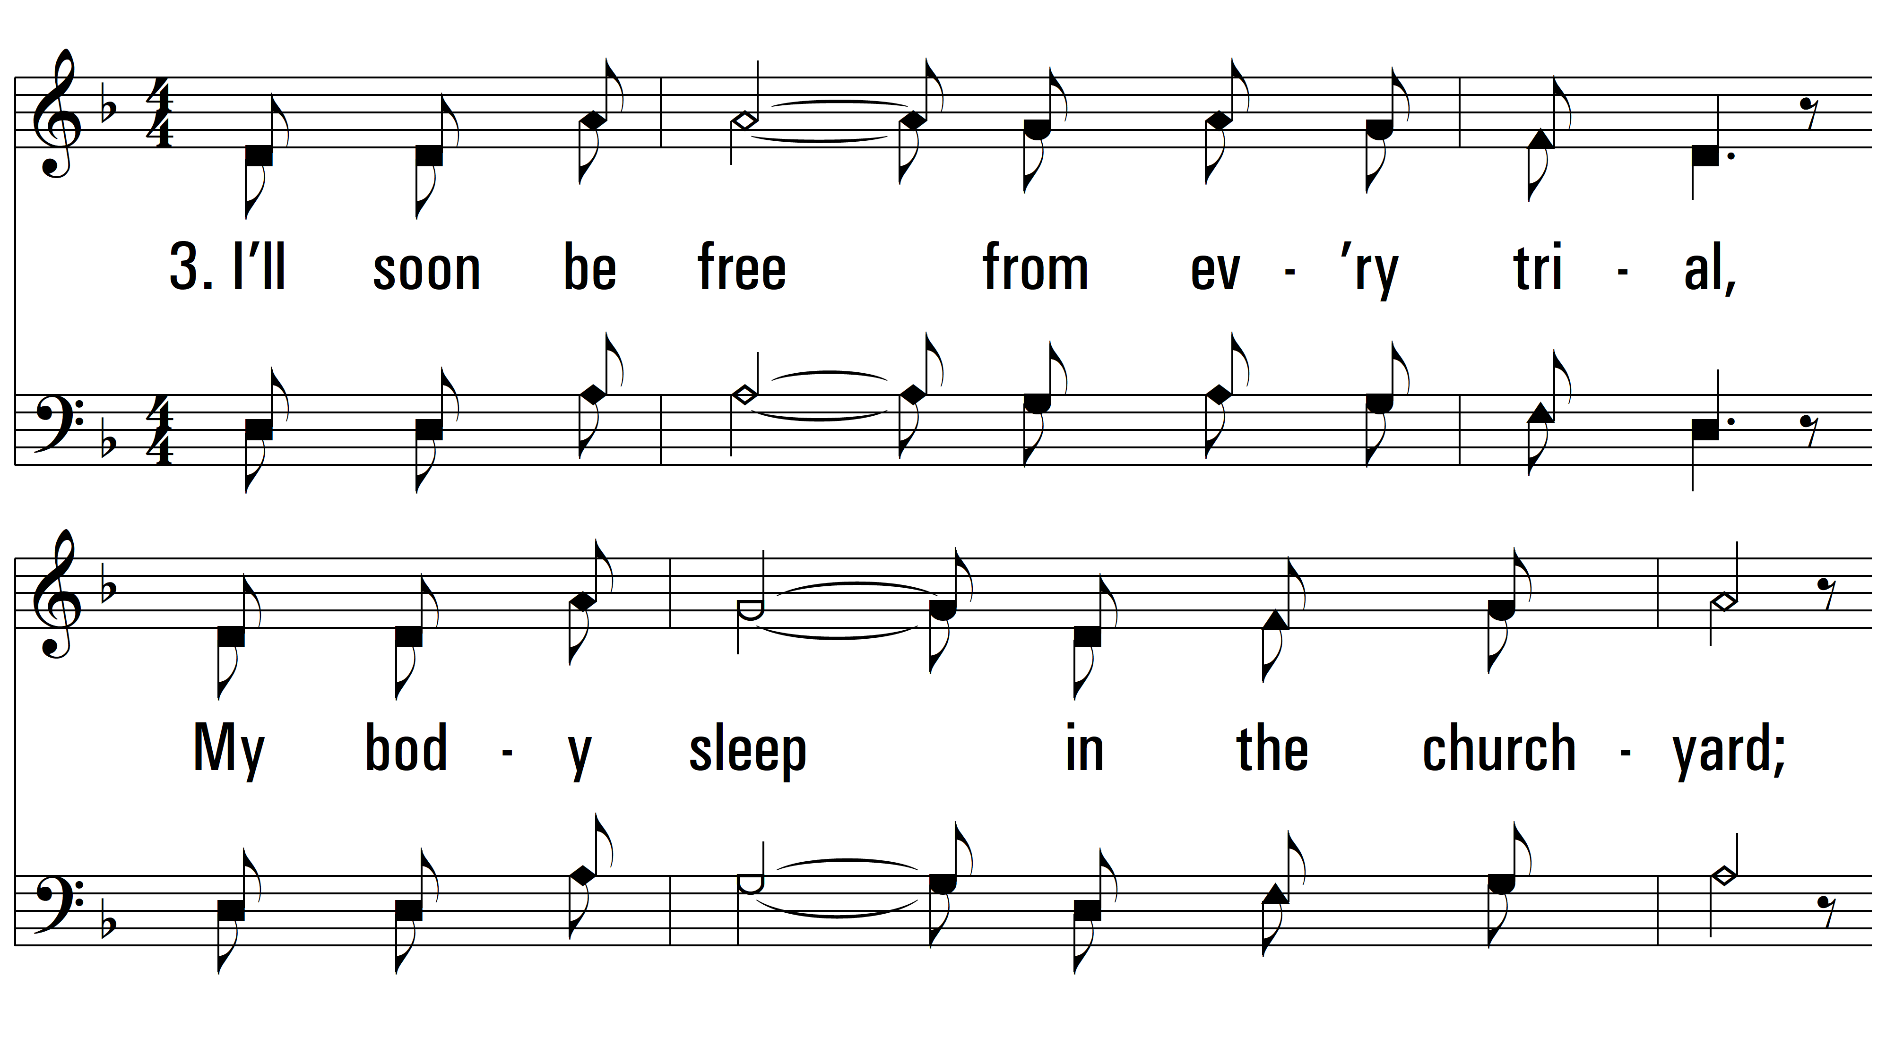
vs. 3 ~ I Am A Poor Wayfaring Stranger

Slide 11
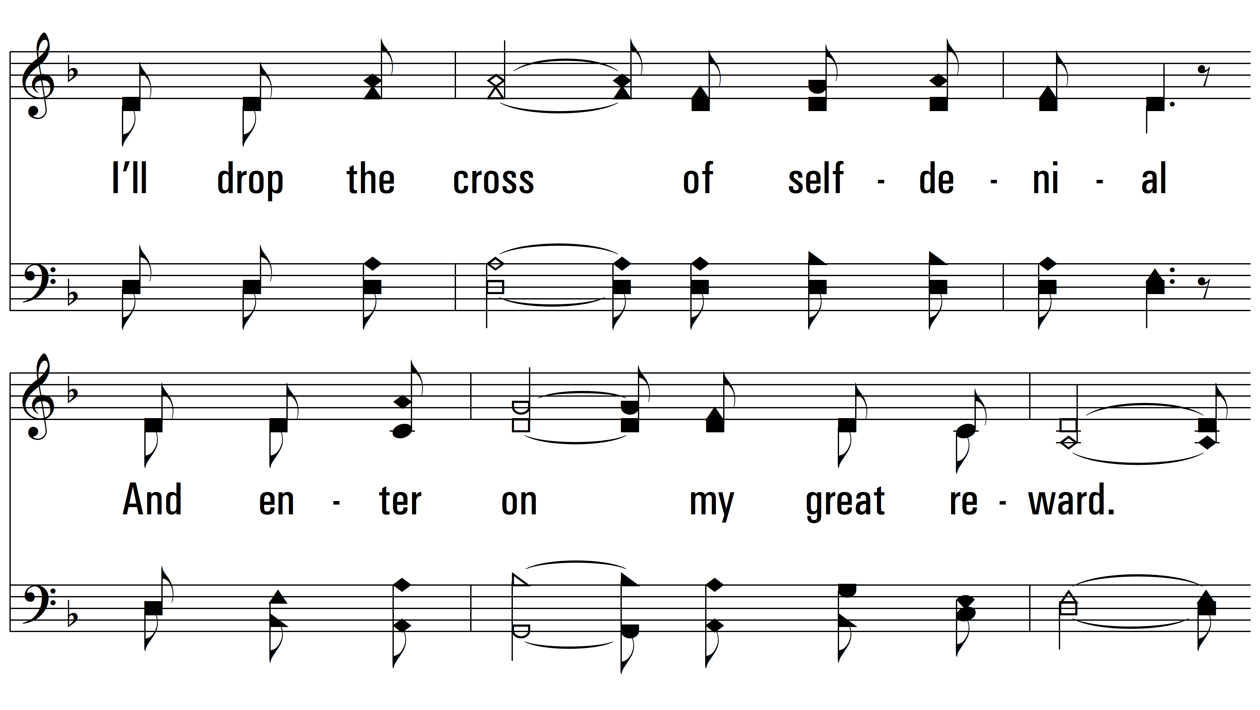
vs. 3

Slide 12
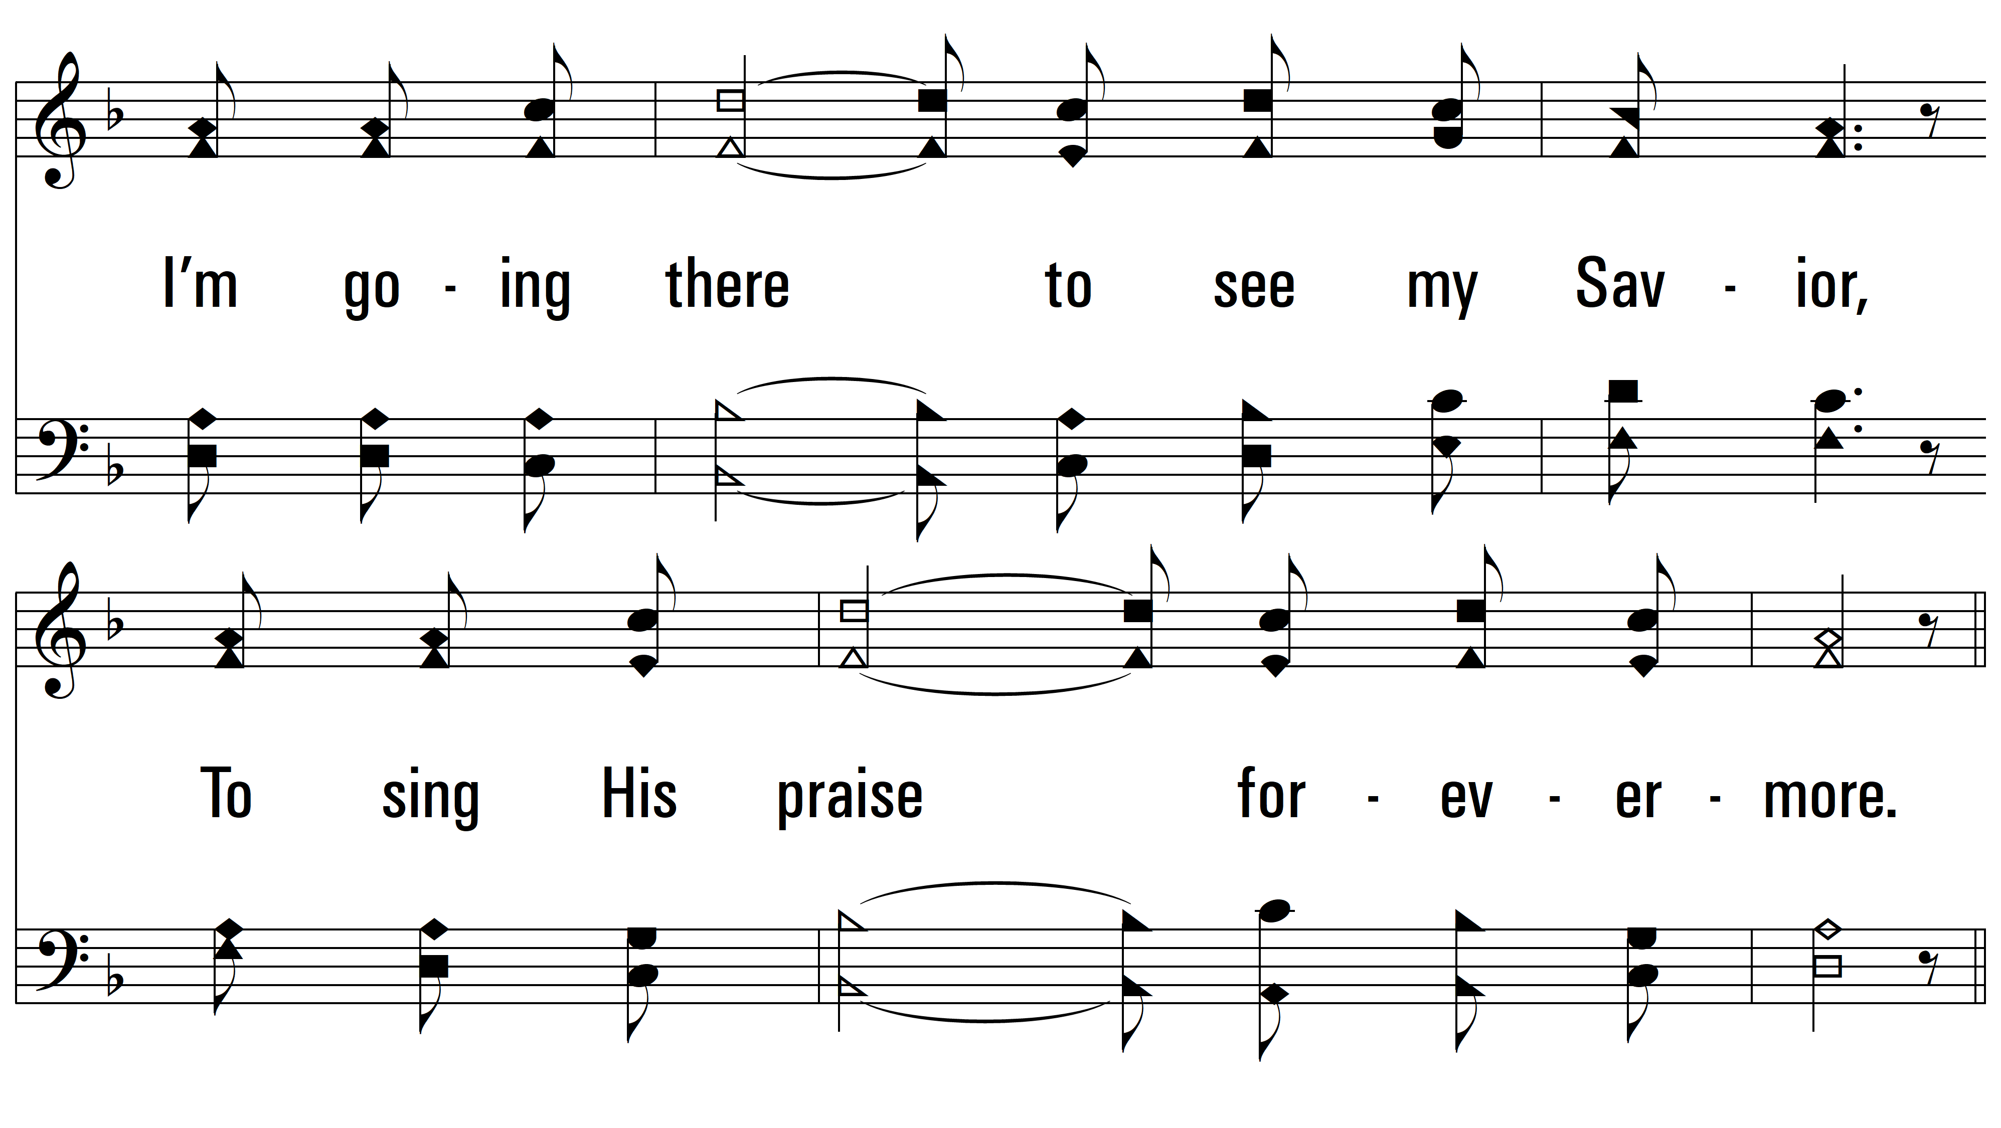
vs. 3

Slide 13
vs. 3
PDHymns.com
END

