Slide 1
I Am The Vine
Words: | Knowles Shaw (1877)
Music: | Knowles Shaw (1877)
9/8
D/D - DO
Verses: 3/Chorus
Lead - | DO
Alto - | DO
Tenor - | MI
Bass - | DO
PDHymns.com

Slide 2
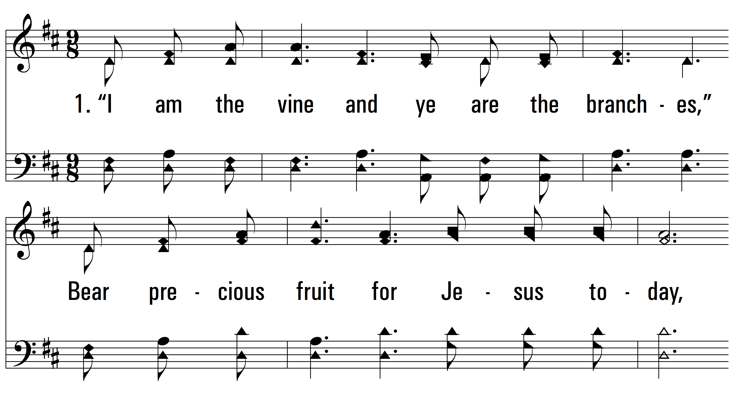
vs. 1 ~ I Am The Vine

Slide 3
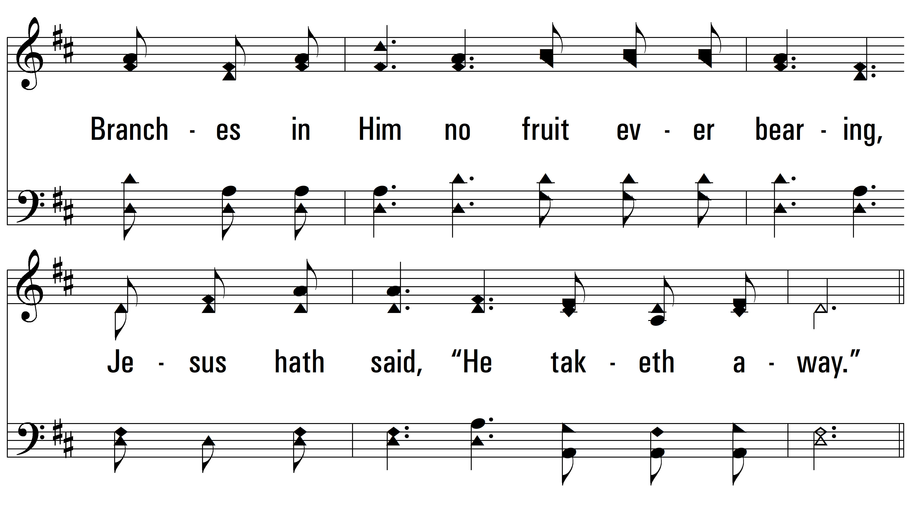
vs. 1

Slide 4
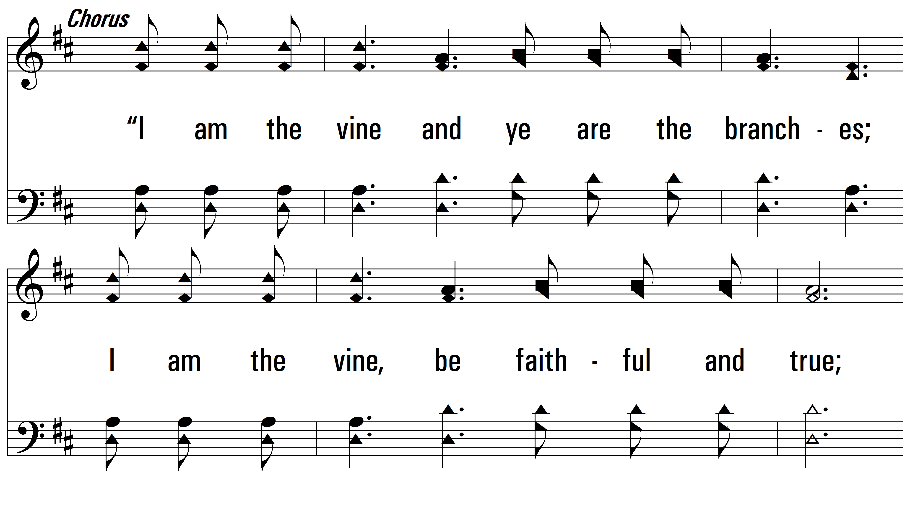
vs. 1

Slide 5
vs. 1

Slide 6
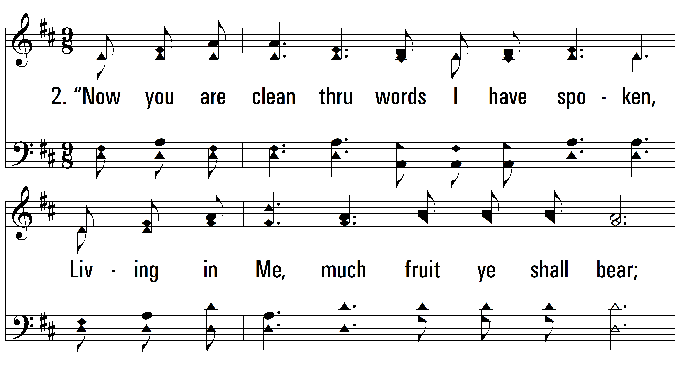
vs. 2 ~ I Am The Vine

Slide 7
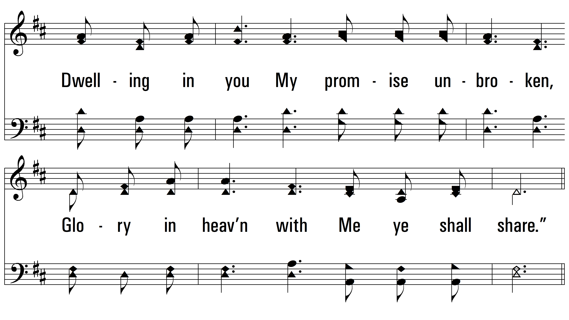
vs. 2

Slide 8
vs. 2

Slide 9
vs. 2

Slide 10
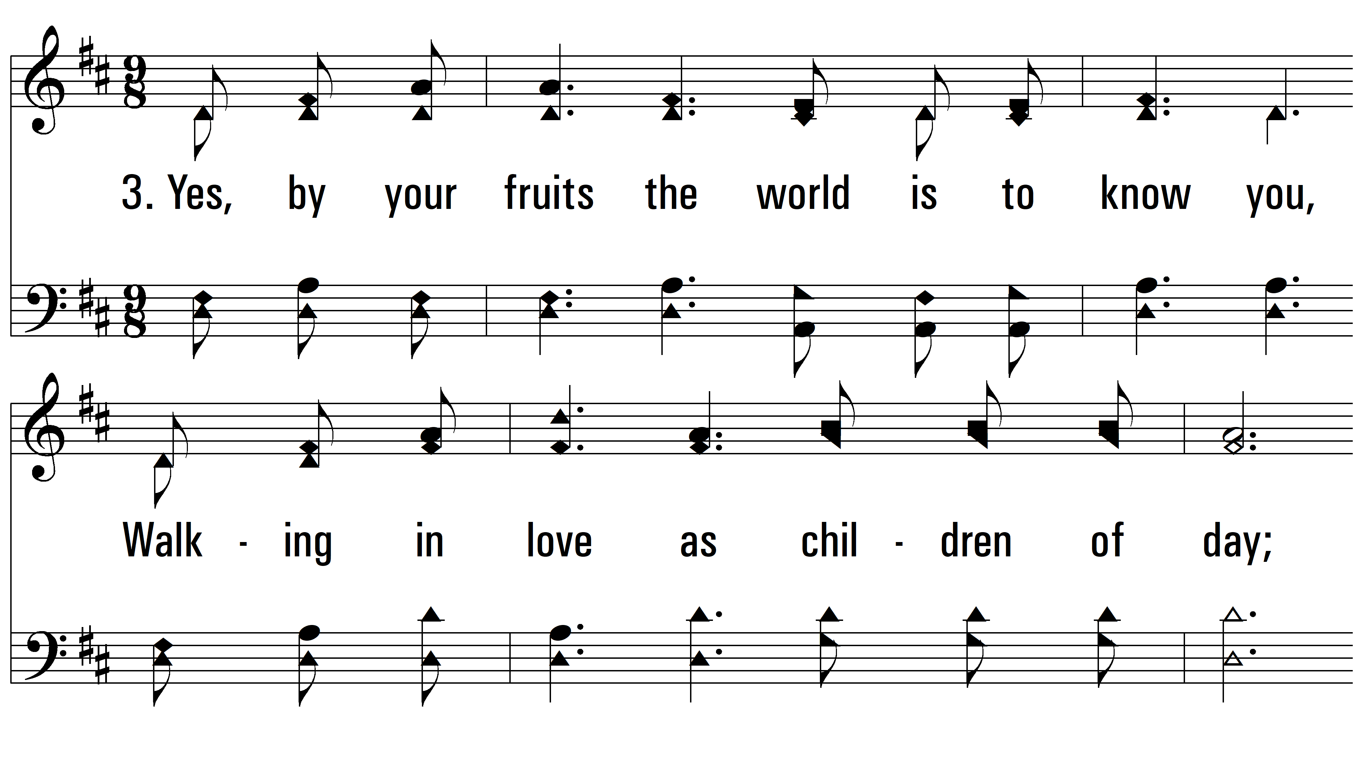
vs. 3 ~ I Am The Vine

Slide 11
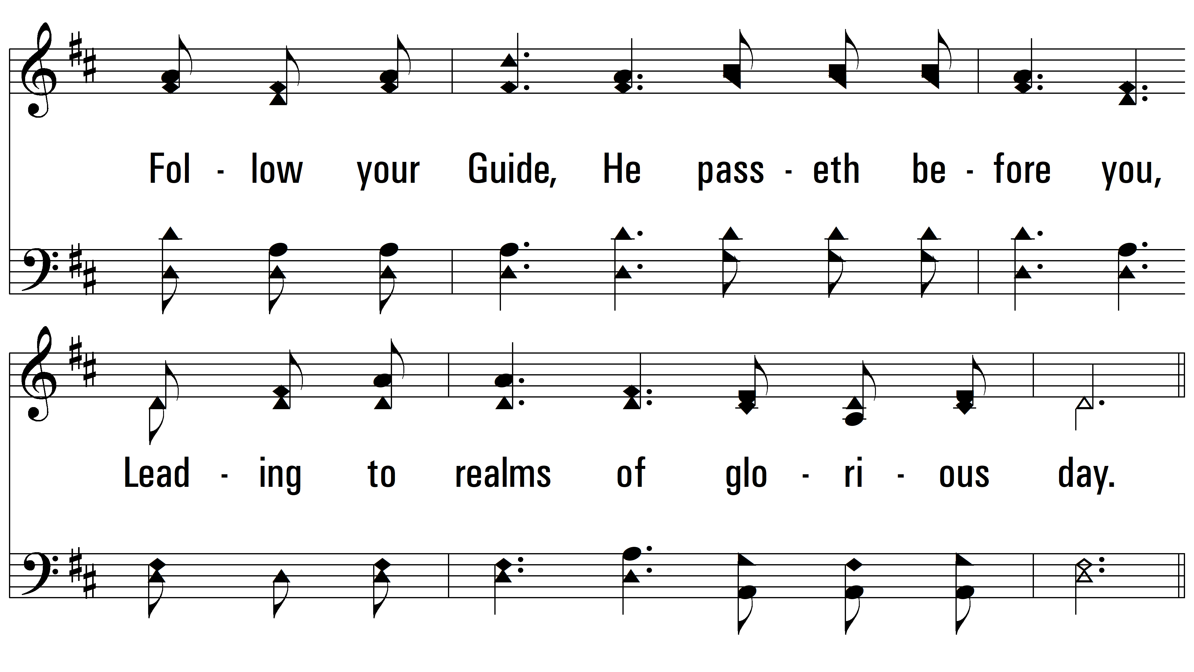
vs. 3

Slide 12
vs. 3

Slide 13
vs. 3
PDHymns.com
END

