Slide 1
I Know The Lord Will Find A Way
Words: | American Fold Hymn
Music: | American Folk Melody
3/4
F/C - SOL
Verses: 3
Lead - | SOL
Alto - | SOL
Tenor - | DO
Bass - | DO
PDHymns.com

Slide 2
vs. 1 ~ I Know The Lord Will Find A Way

Slide 3
vs. 1

Slide 4
vs. 2 ~ I Know The Lord Will Find A Way

Slide 5
vs. 2

Slide 6
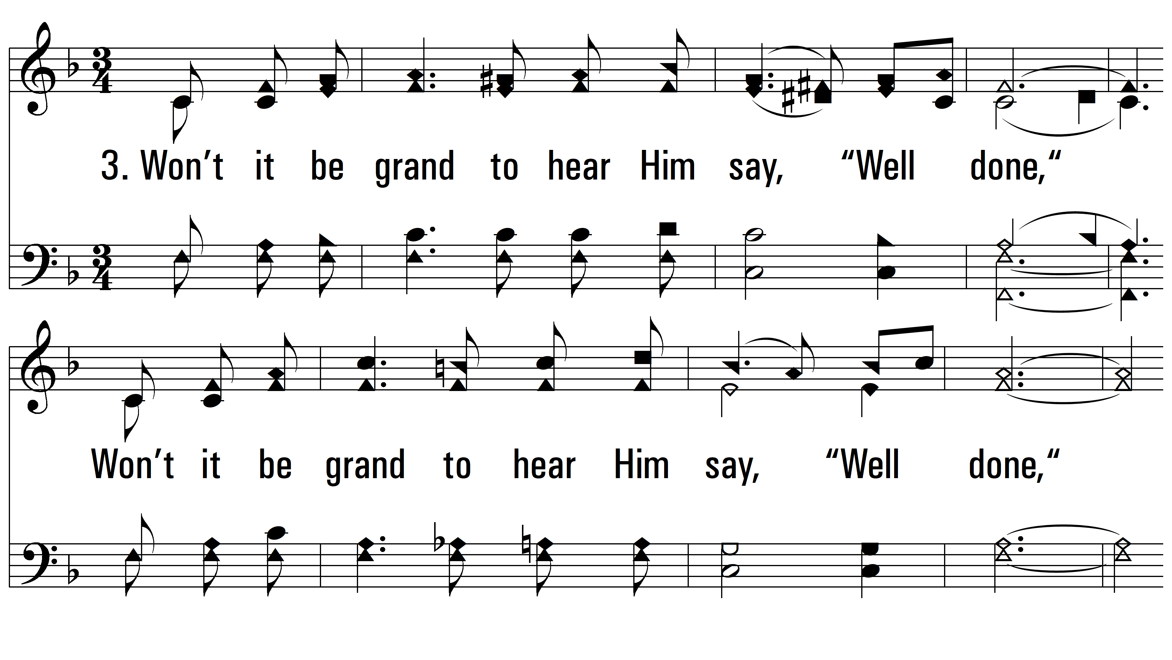
vs. 3 ~ I Know The Lord Will Find A Way

Slide 7
vs. 3
PDHymns.com
END

