Slide 1
I Need Thee Every Hour
Words: | Annie S. Hawks (1872)
Music: | Robert Lowry (1872)
3/4
A^{b}/A^{b} - DO
Verses: 5/Chorus
Lead - | DO
Alto - | MI
Tenor - | SOL
Bass - | DO
PDHymns.com

Slide 2
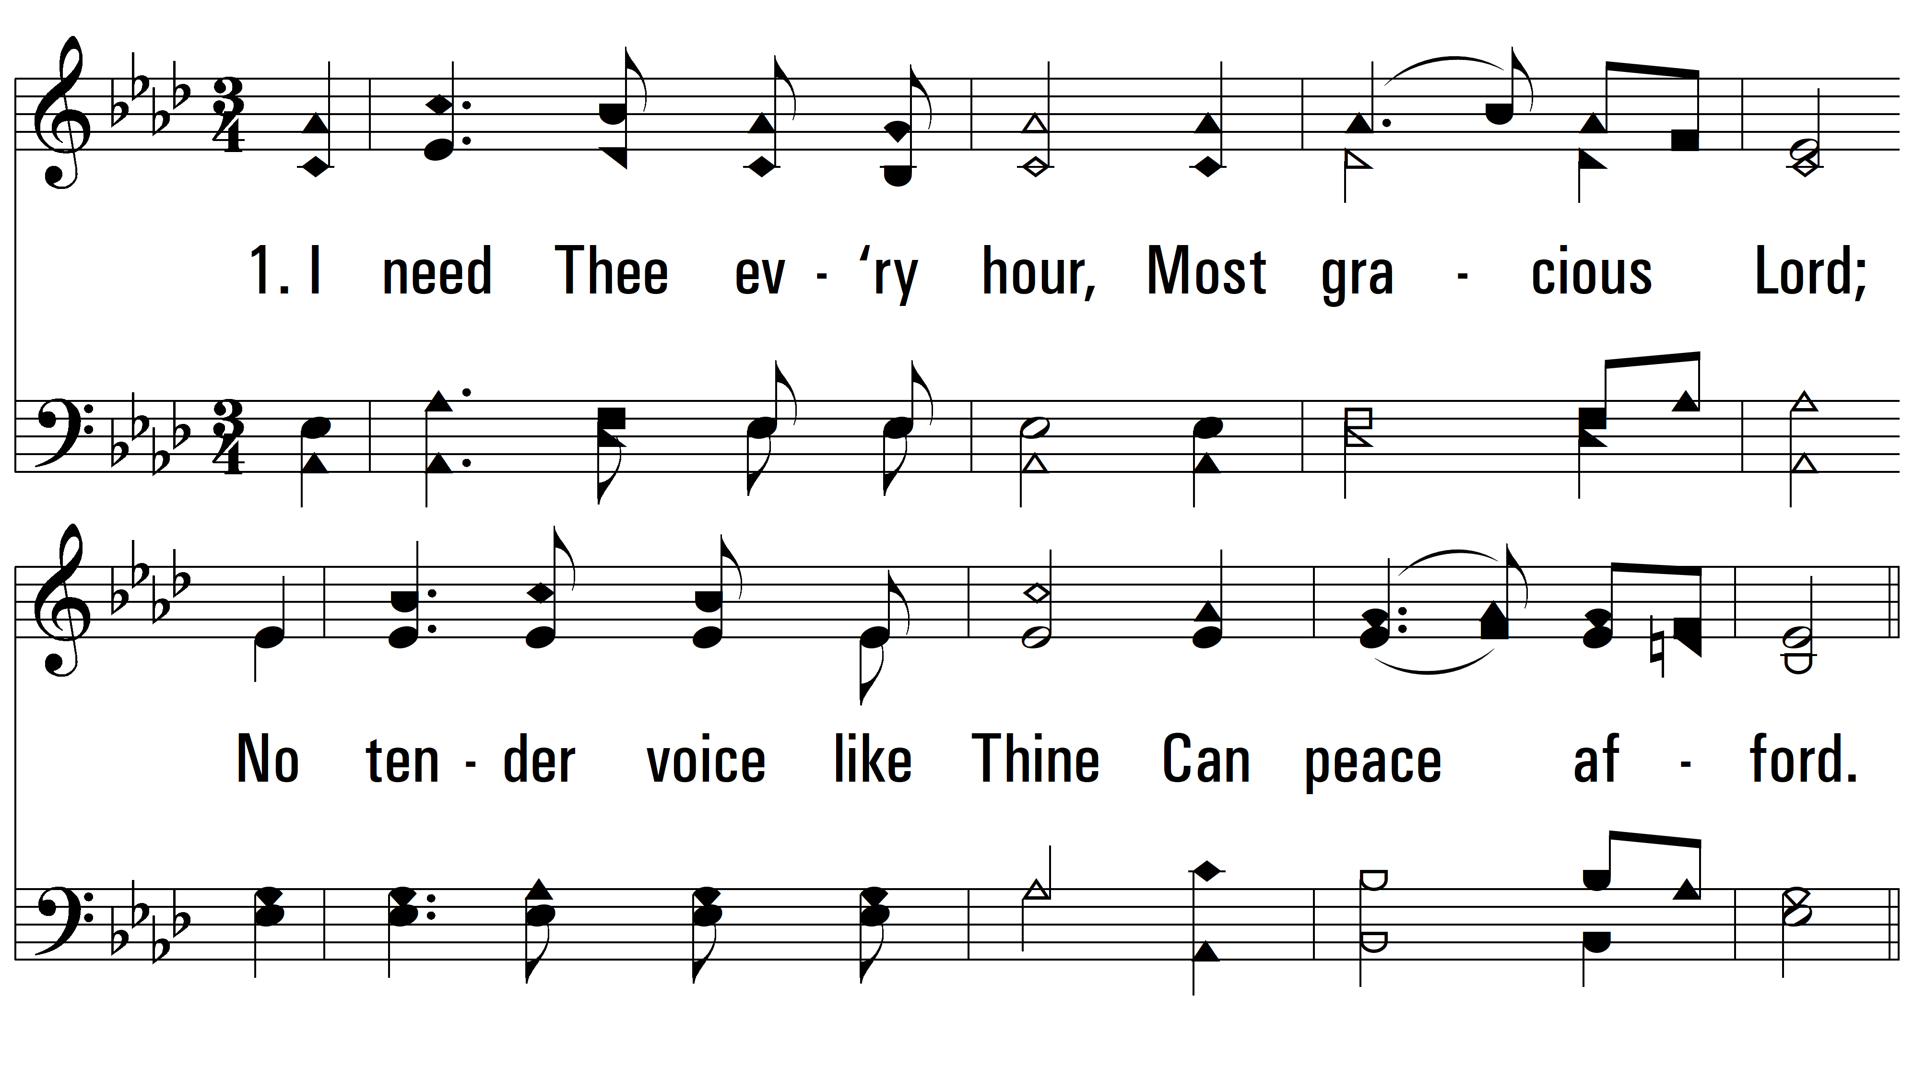
vs. 1 ~ I Need Thee Every Hour

Slide 3
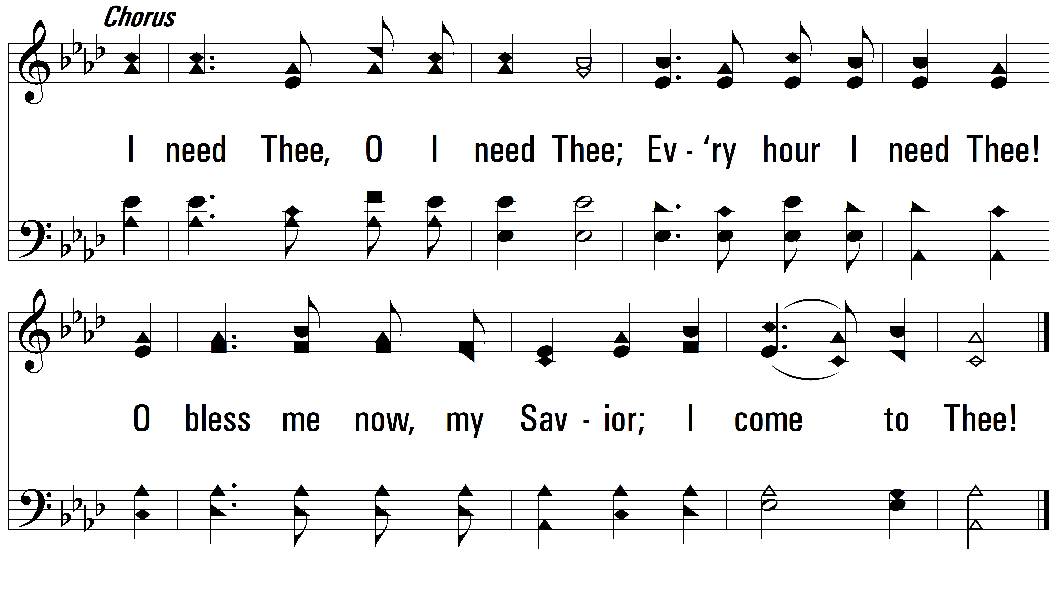
vs. 1

Slide 4
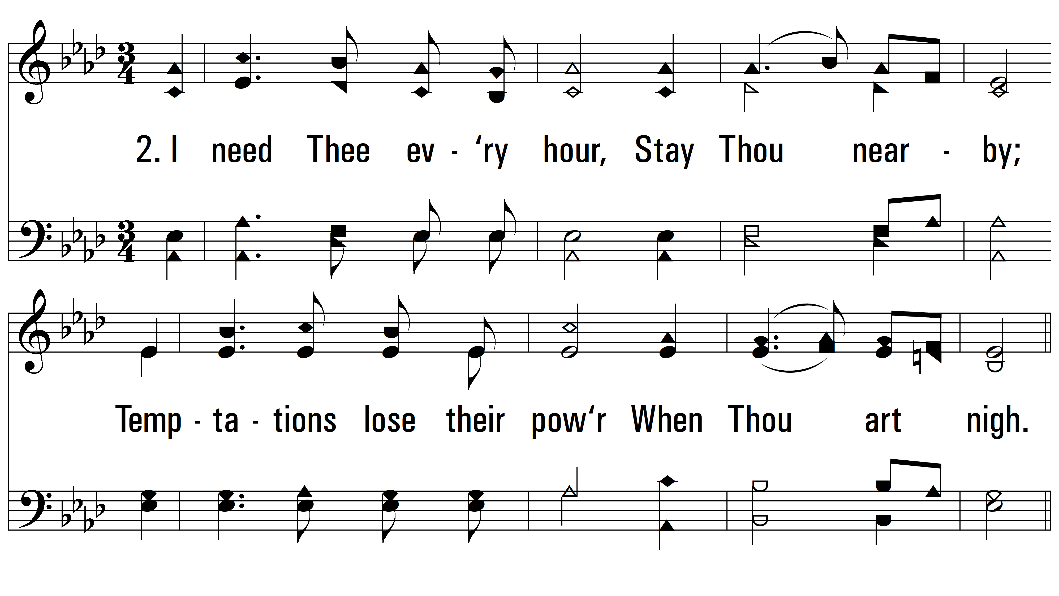
vs. 2 ~ I Need Thee Every Hour

Slide 5
vs. 2

Slide 6
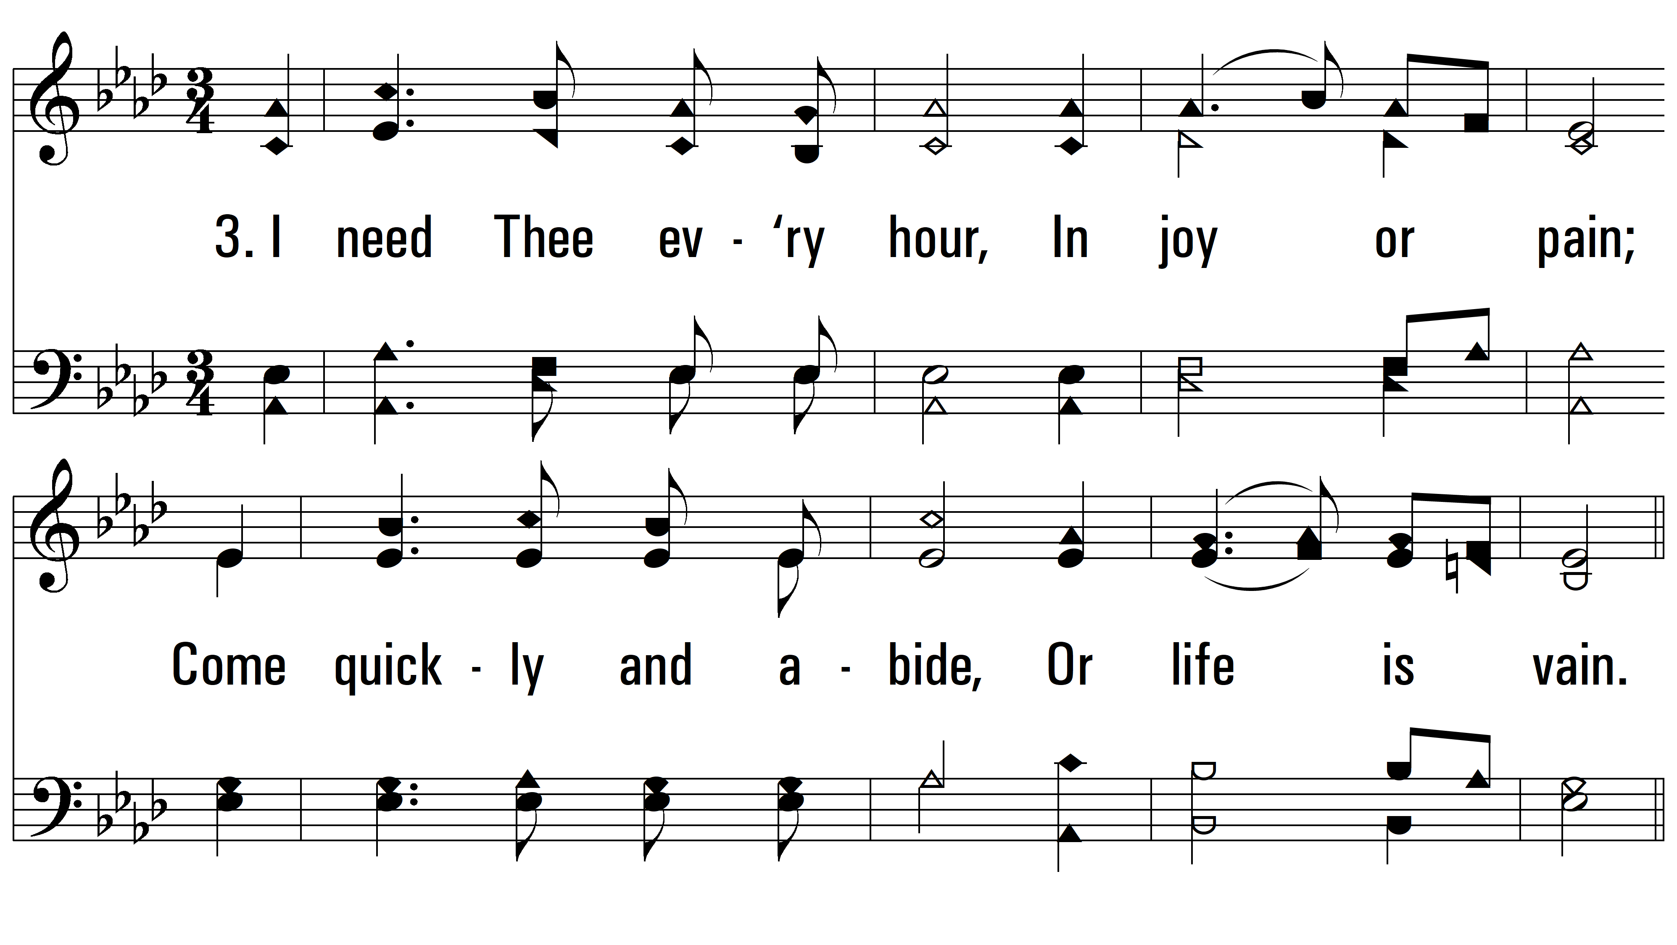
vs. 3 ~ I Need Thee Every Hour

Slide 7
vs. 3

Slide 8
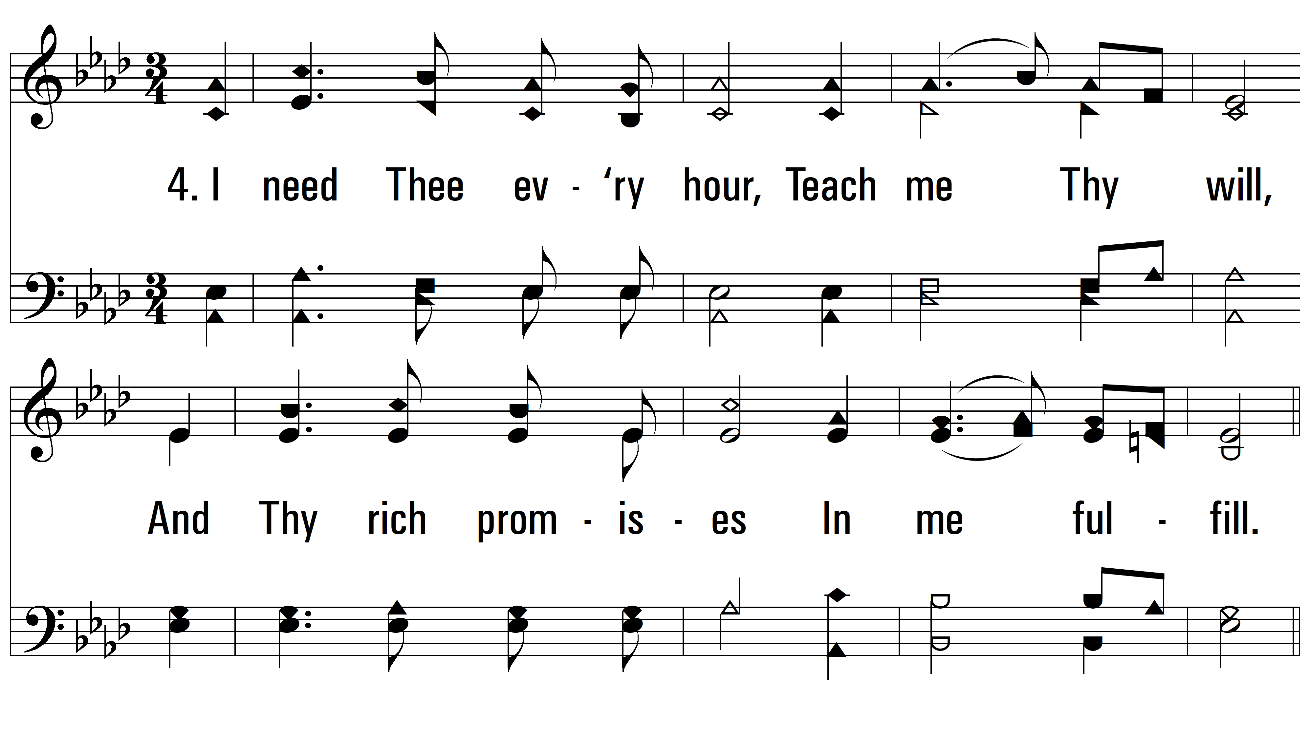
vs. 4 ~ I Need Thee Every Hour

Slide 9
vs. 4

Slide 10
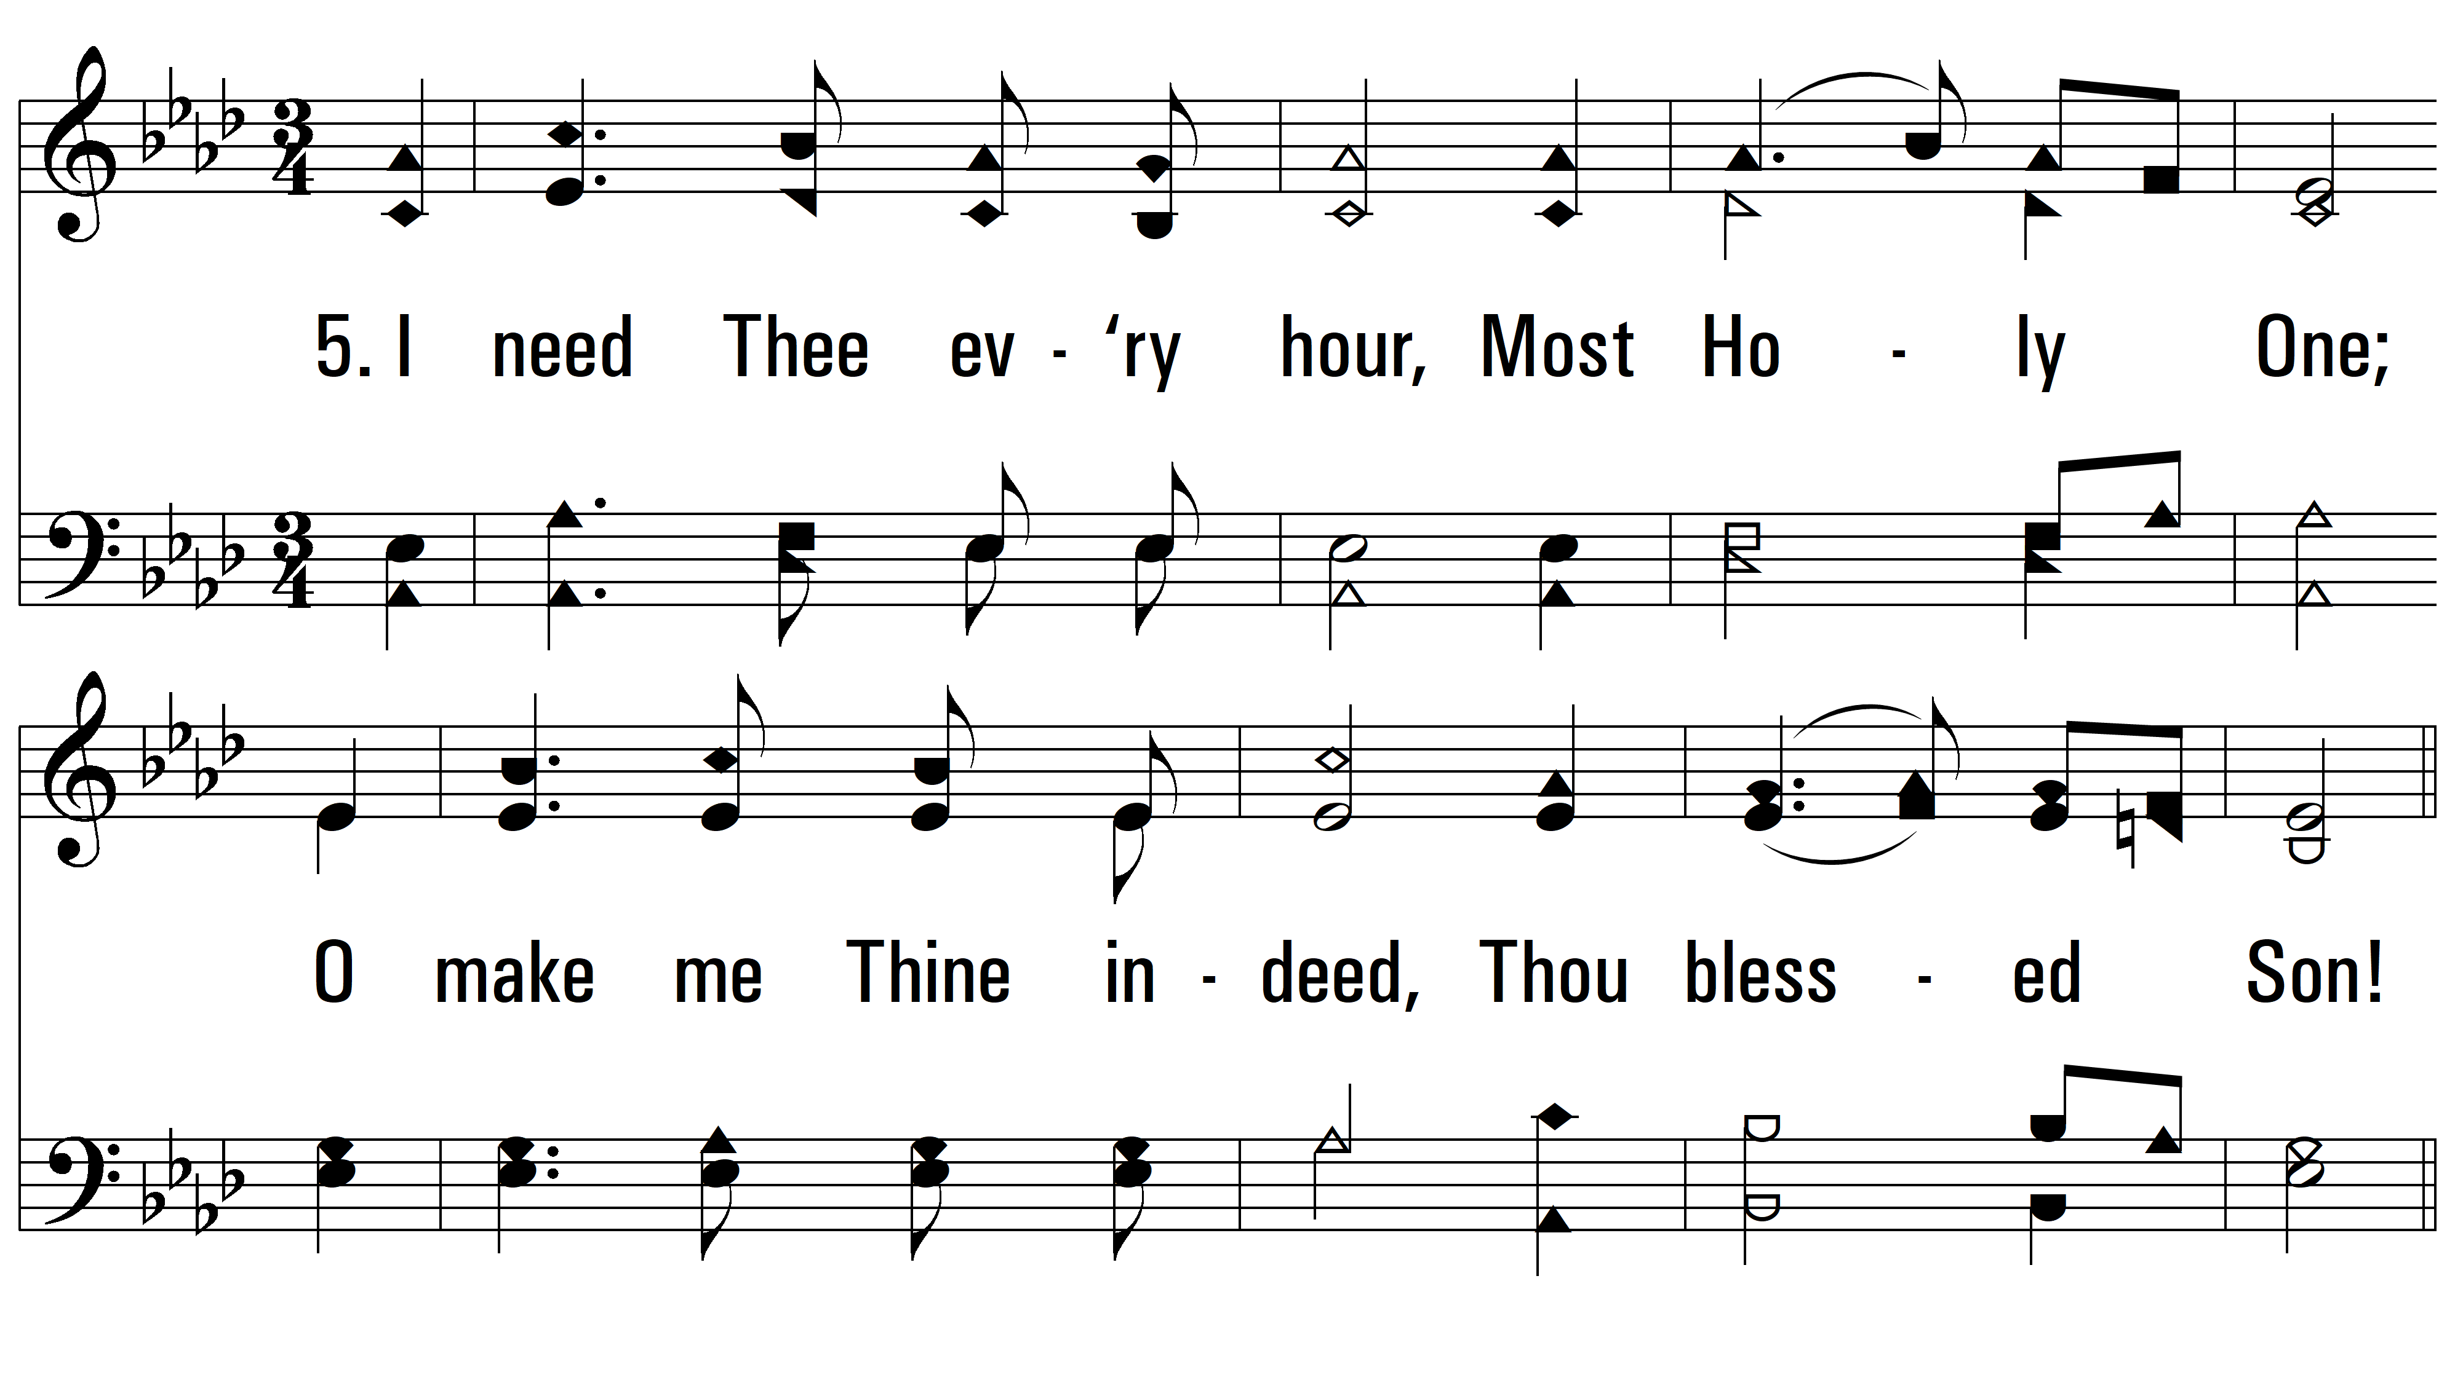
vs. 5 ~ I Need Thee Every Hour

Slide 11
vs. 5
PDHymns.com
END

