Slide 1
I Will Sing Of The Mercies Of The Lord
Words: | Psalm 89:1
Music: | James H. Filmore
4/4
D/D - DO
Verses: 1
Lead - | DO
Alto - | DO
Tenor - | MI
Bass - | DO
PDHymns.com

Slide 2
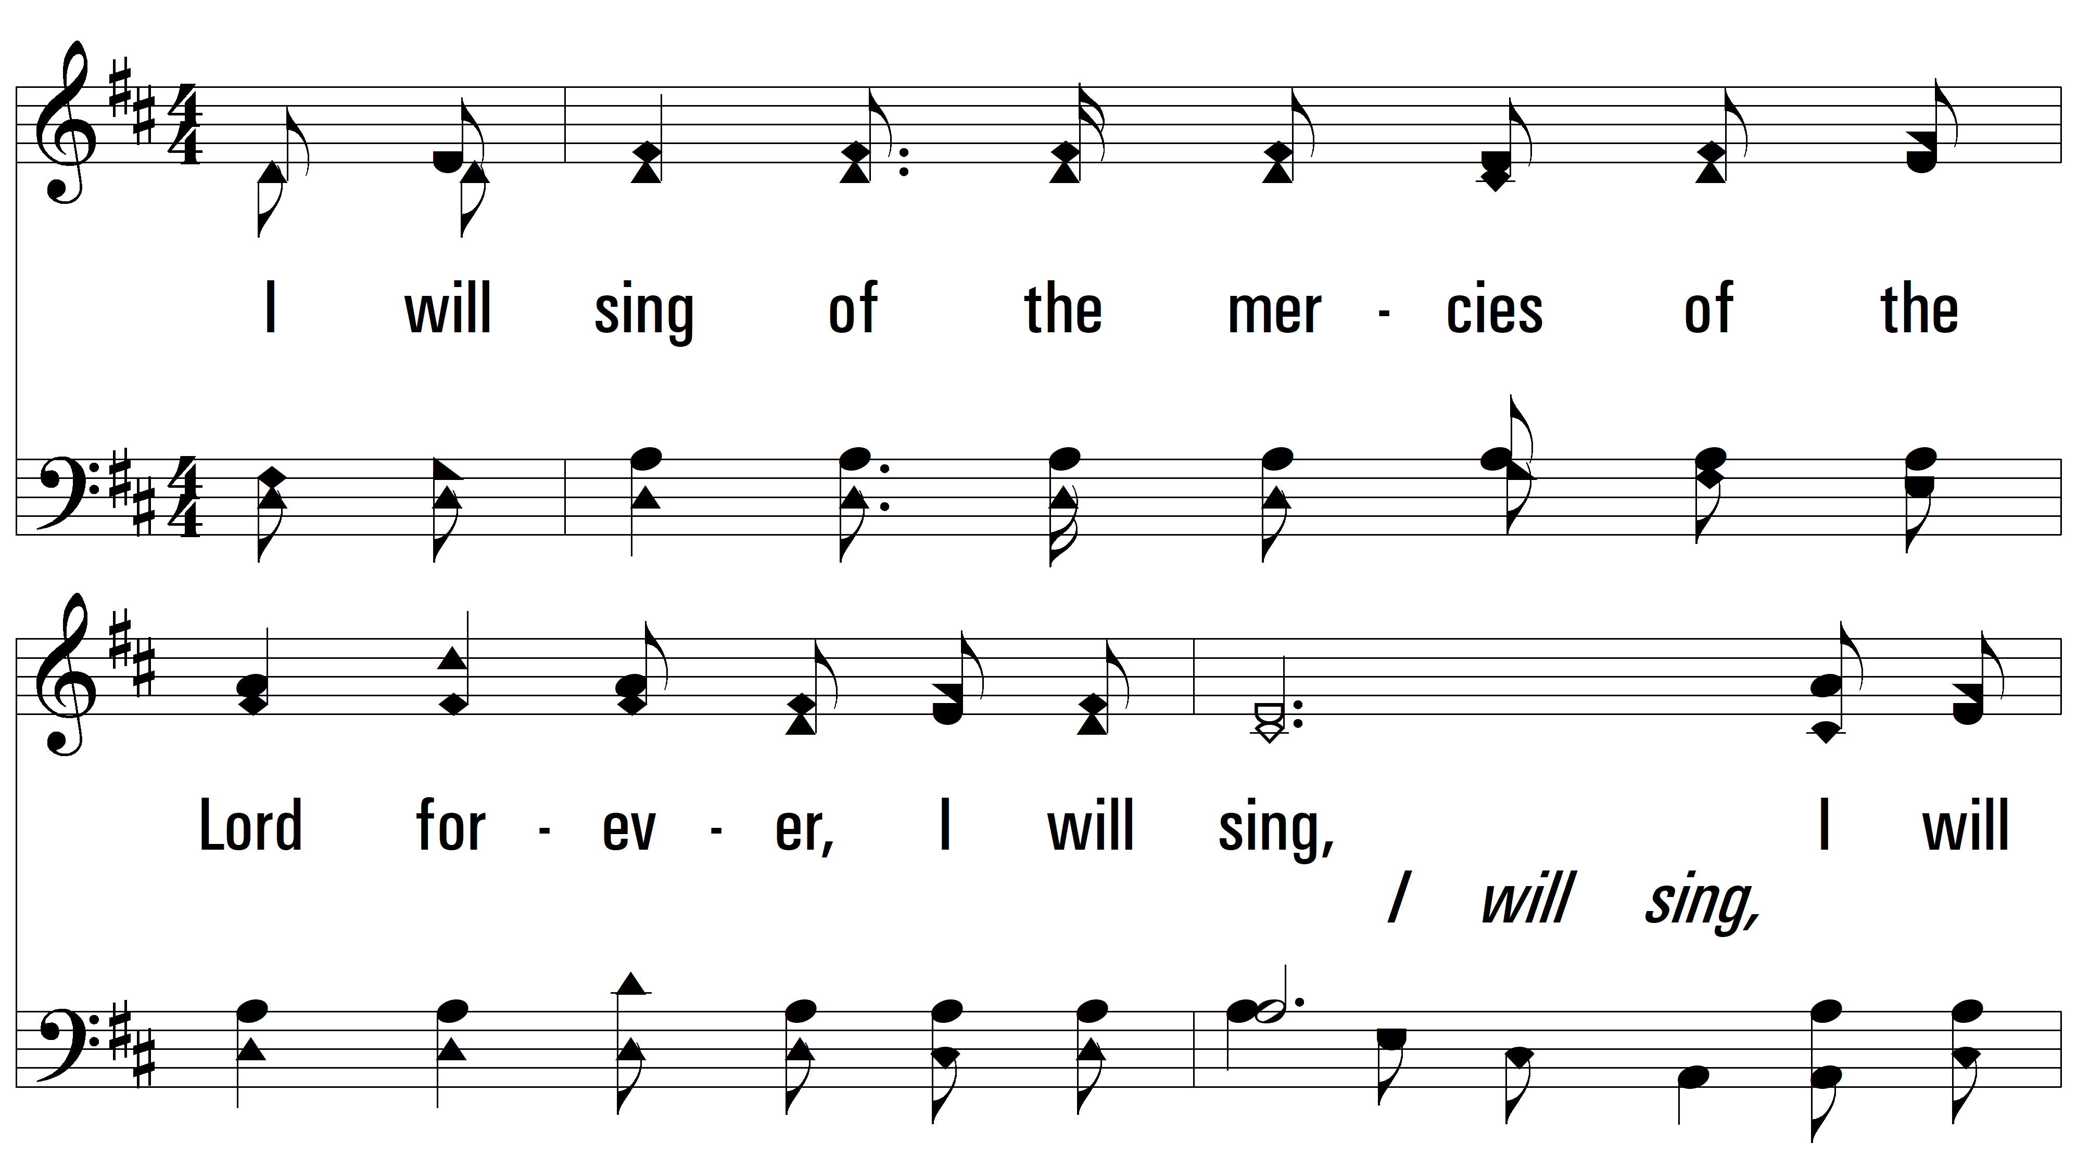
vs. 1 ~ I Will Sing Of The Mercies Of The Lord
vs. 1

Slide 3
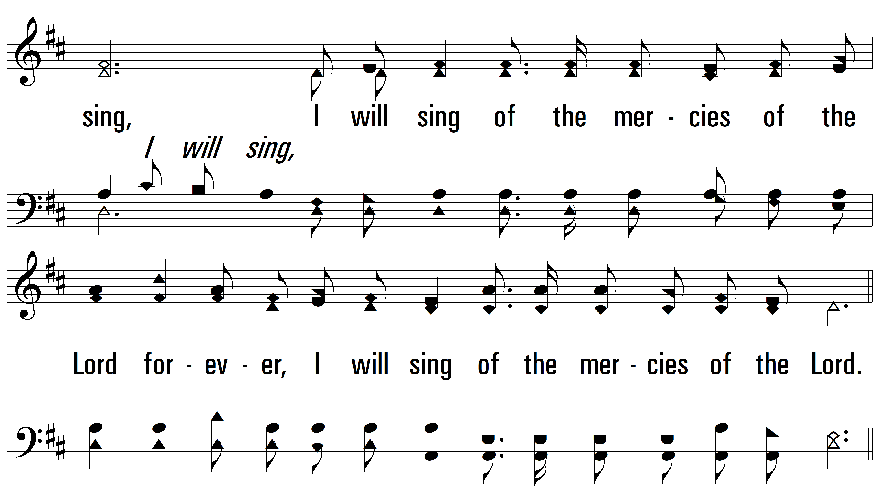
vs. 1

Slide 4
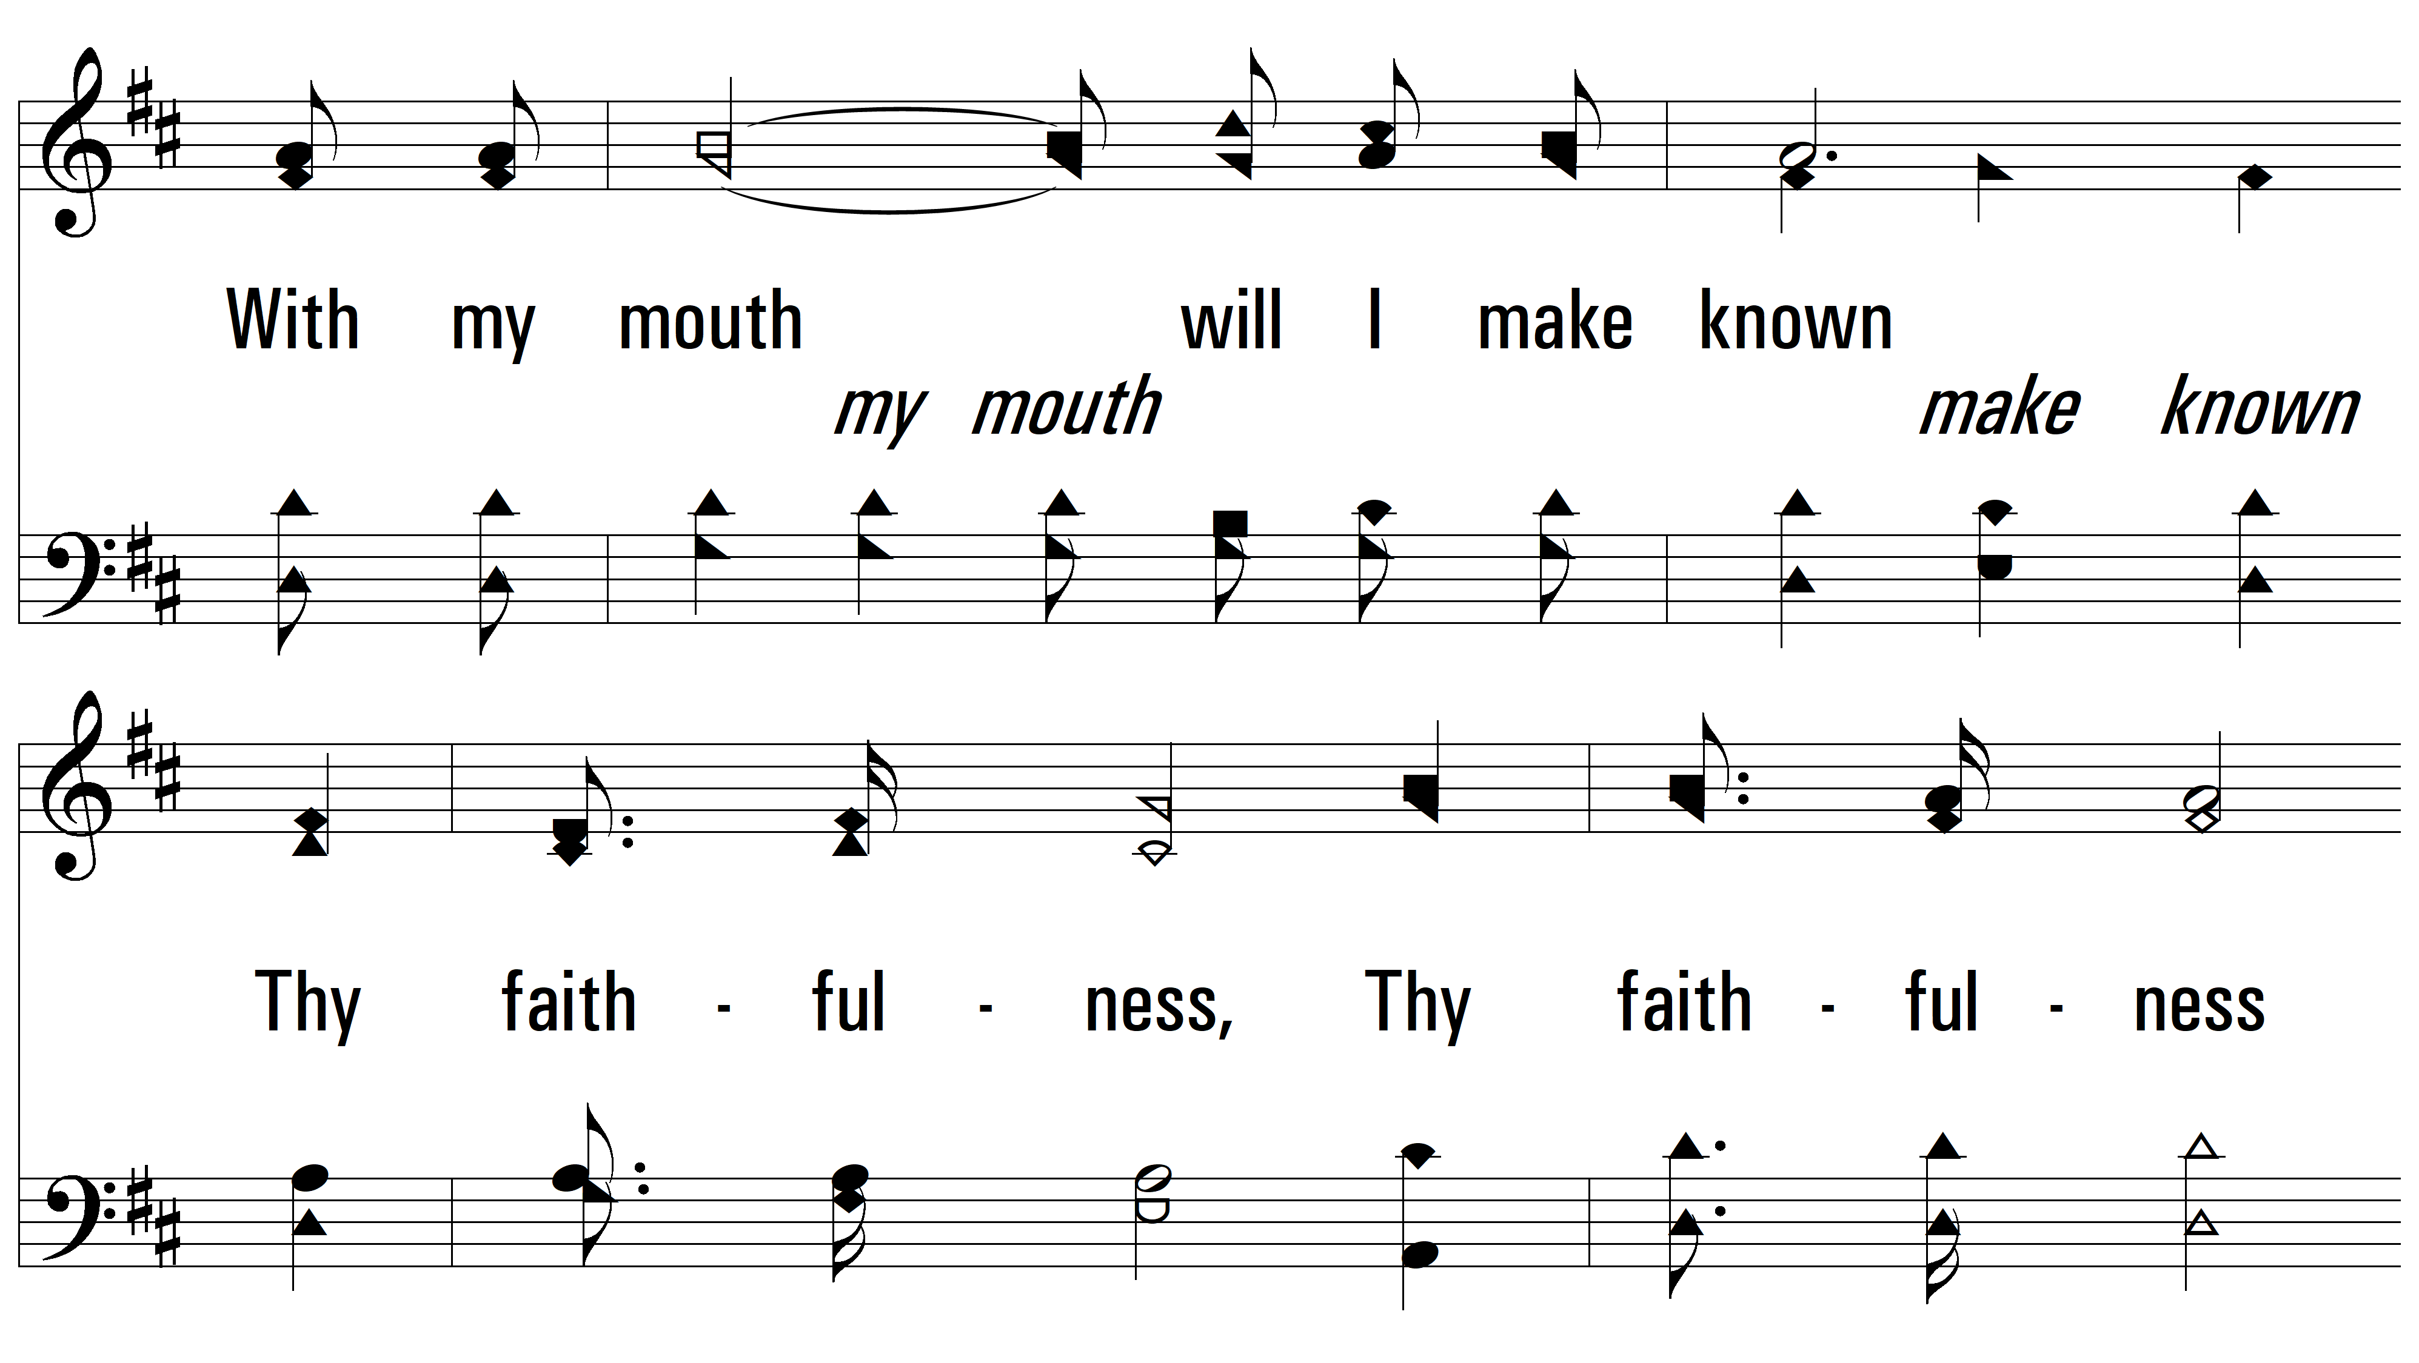
vs. 1

Slide 5
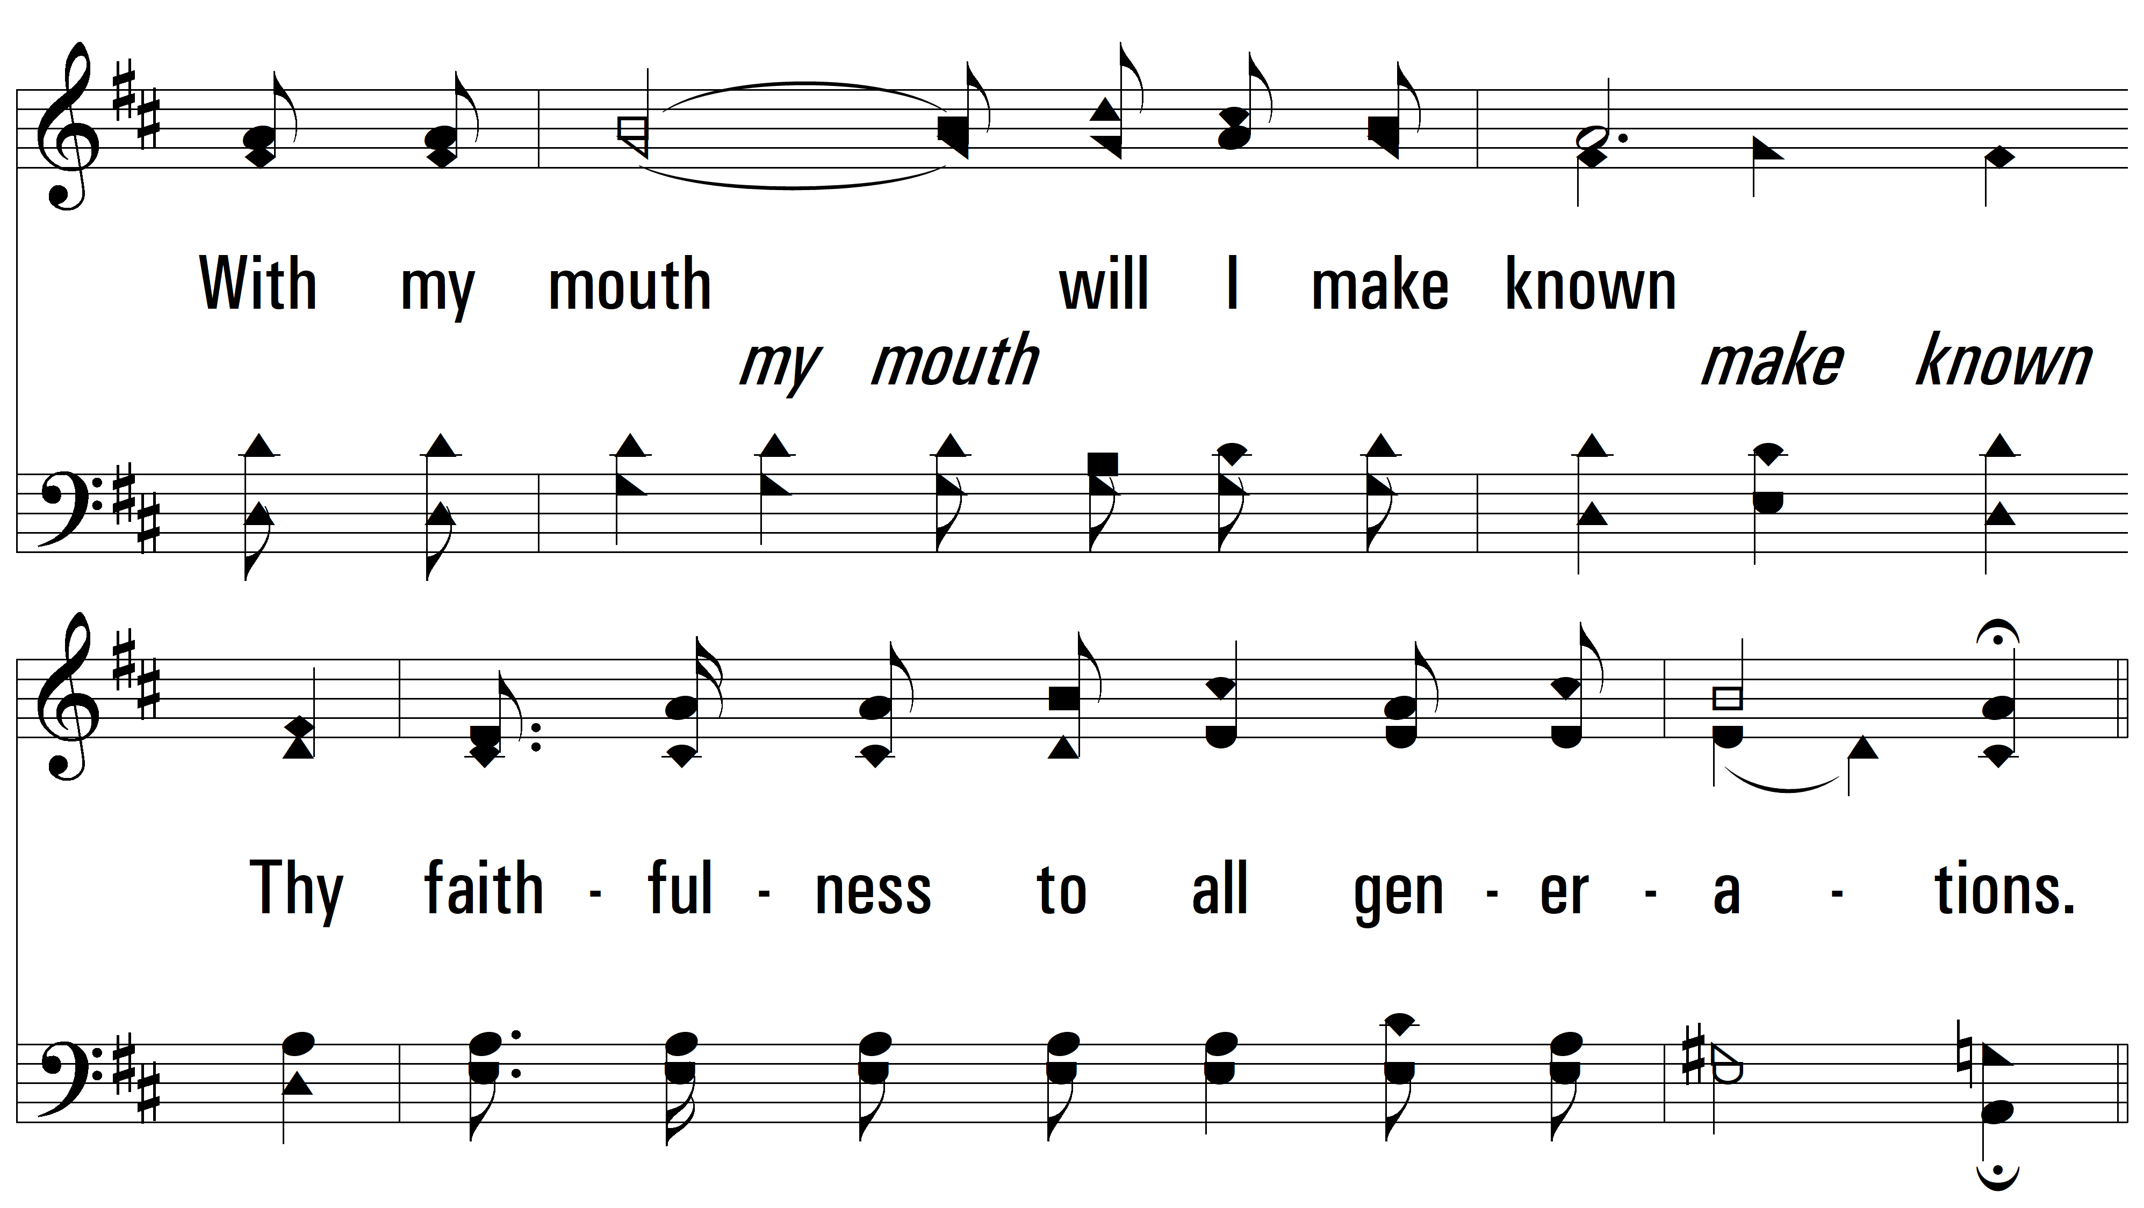
vs. 1

Slide 6
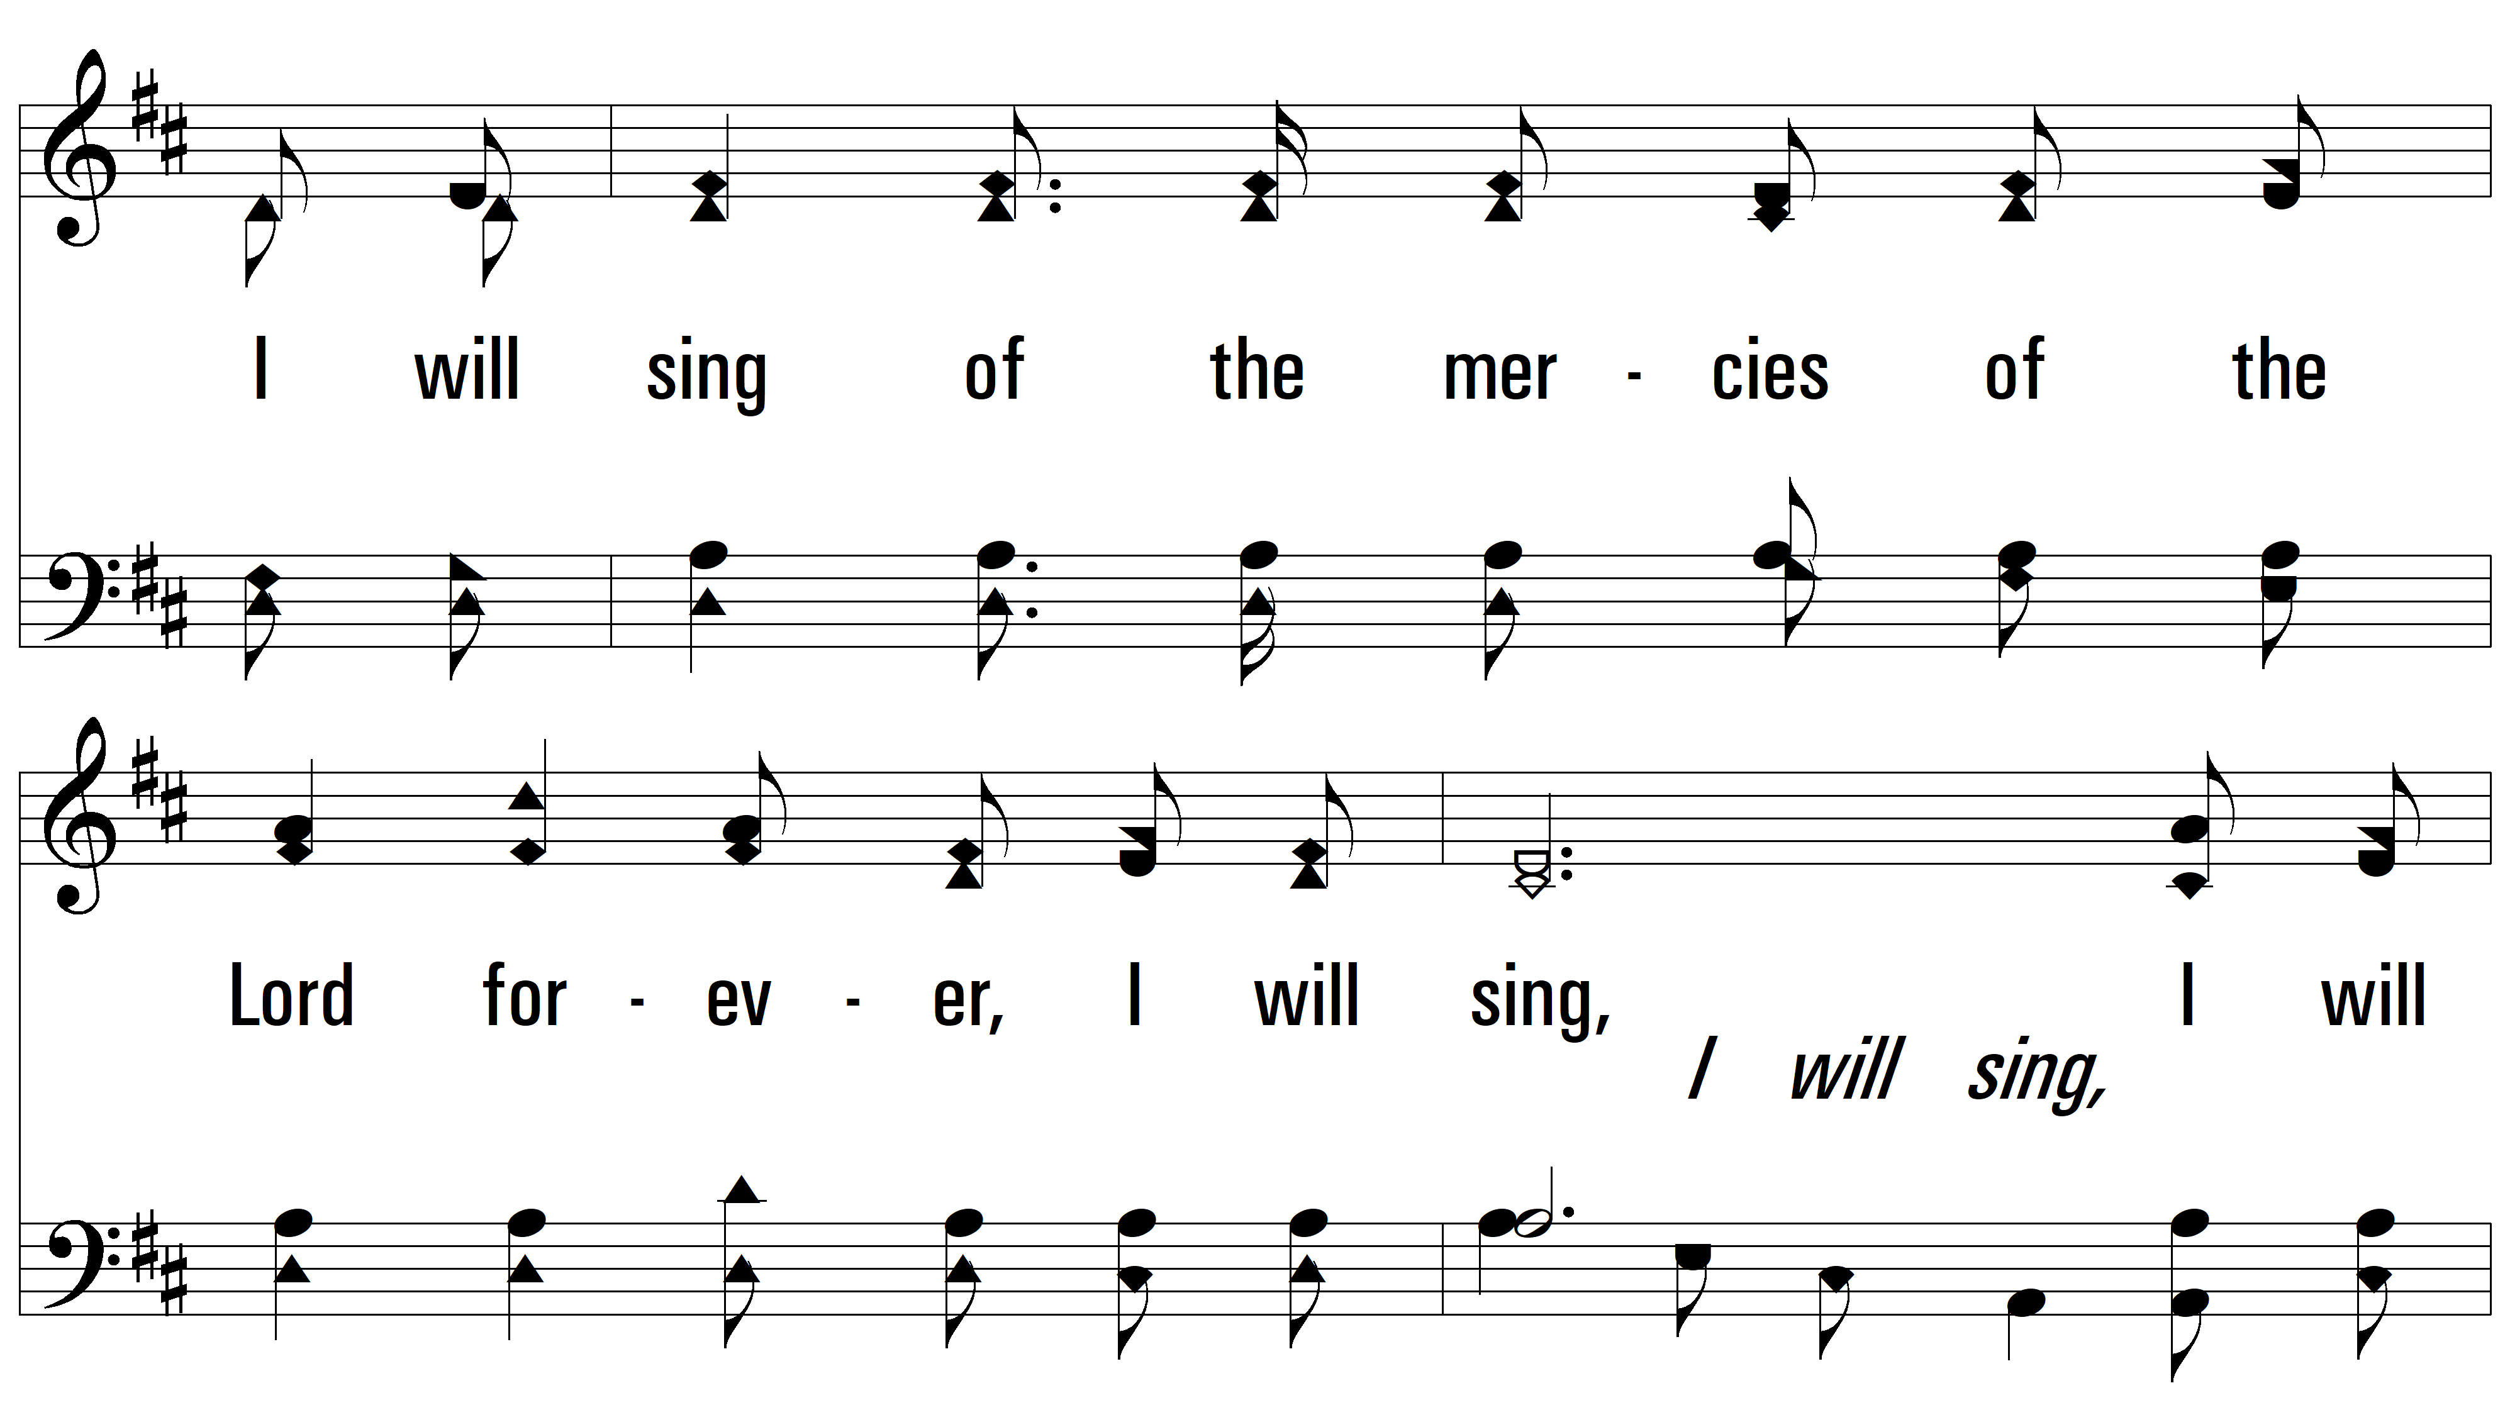
vs. 1

Slide 7
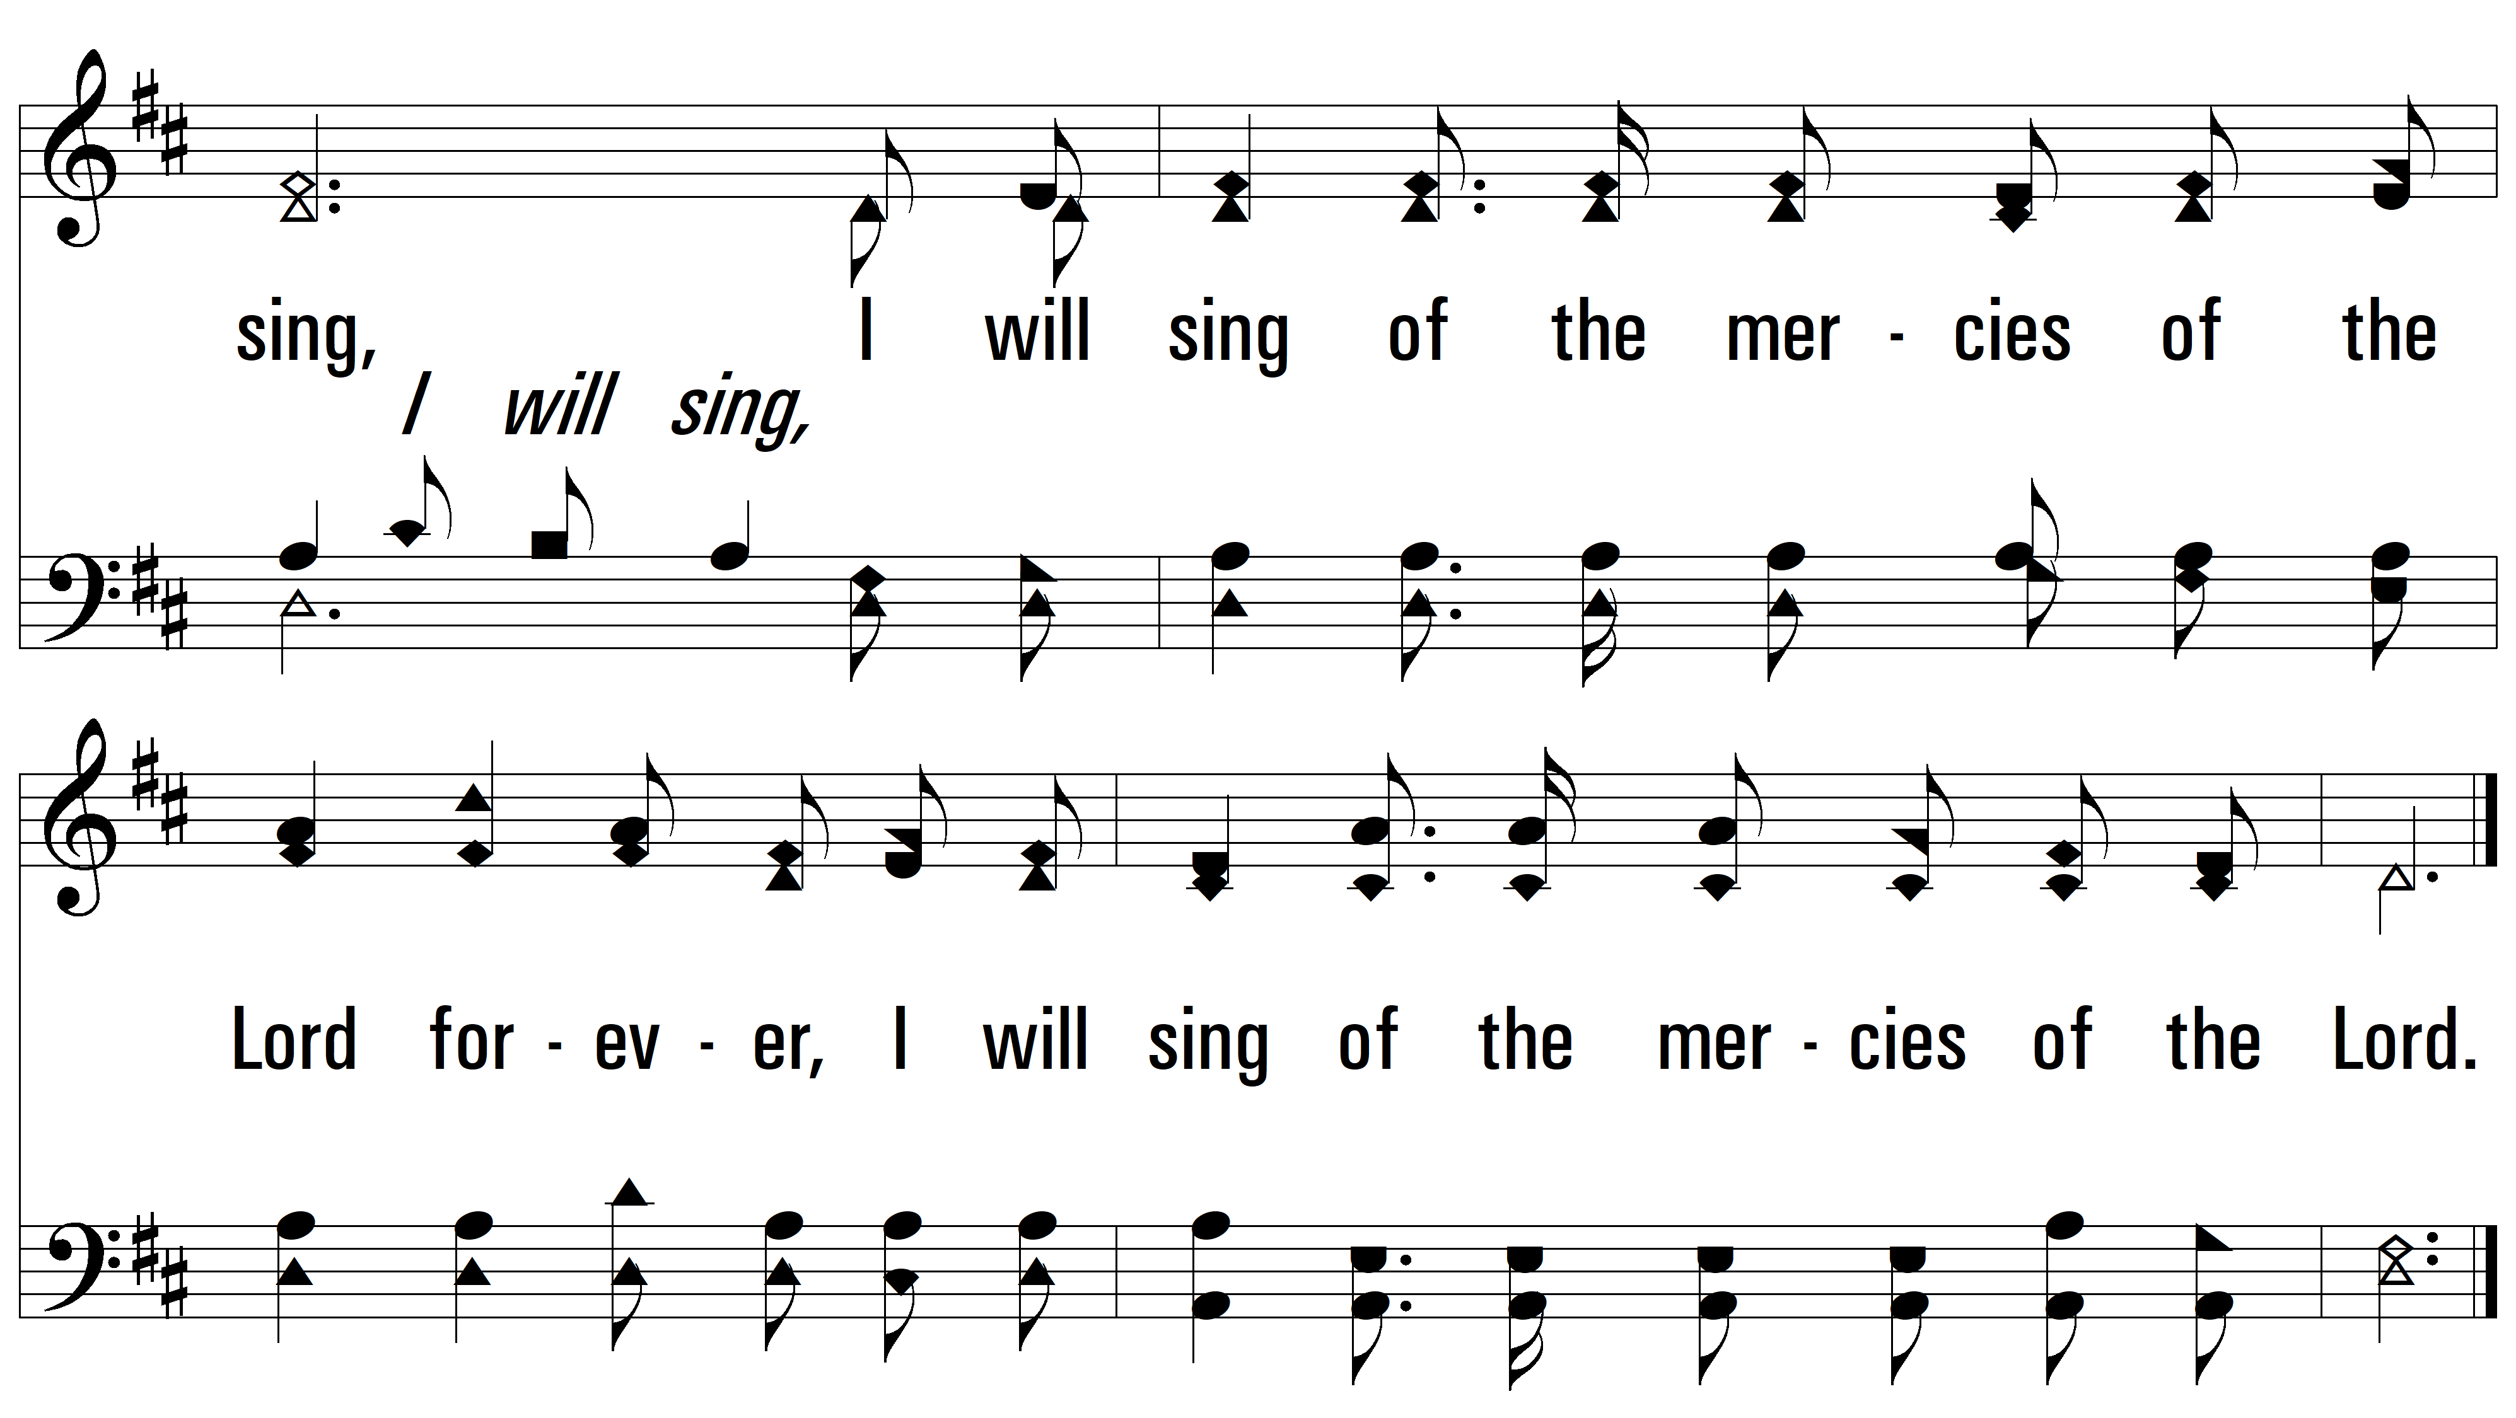
vs. 1
PDHymns.com
END

