Slide 1
Into The Heart Of Jesus
(Deeper And Deeper)
Words: | Oswald J. Smith (1915)
Music: | Oswald J. Smith (1915)
6/4
D/F# - MI
Verses: 4
Lead - | MI
Alto - | DO
Tenor - | SOL
Bass - | DO
PDHymns.com

Slide 2
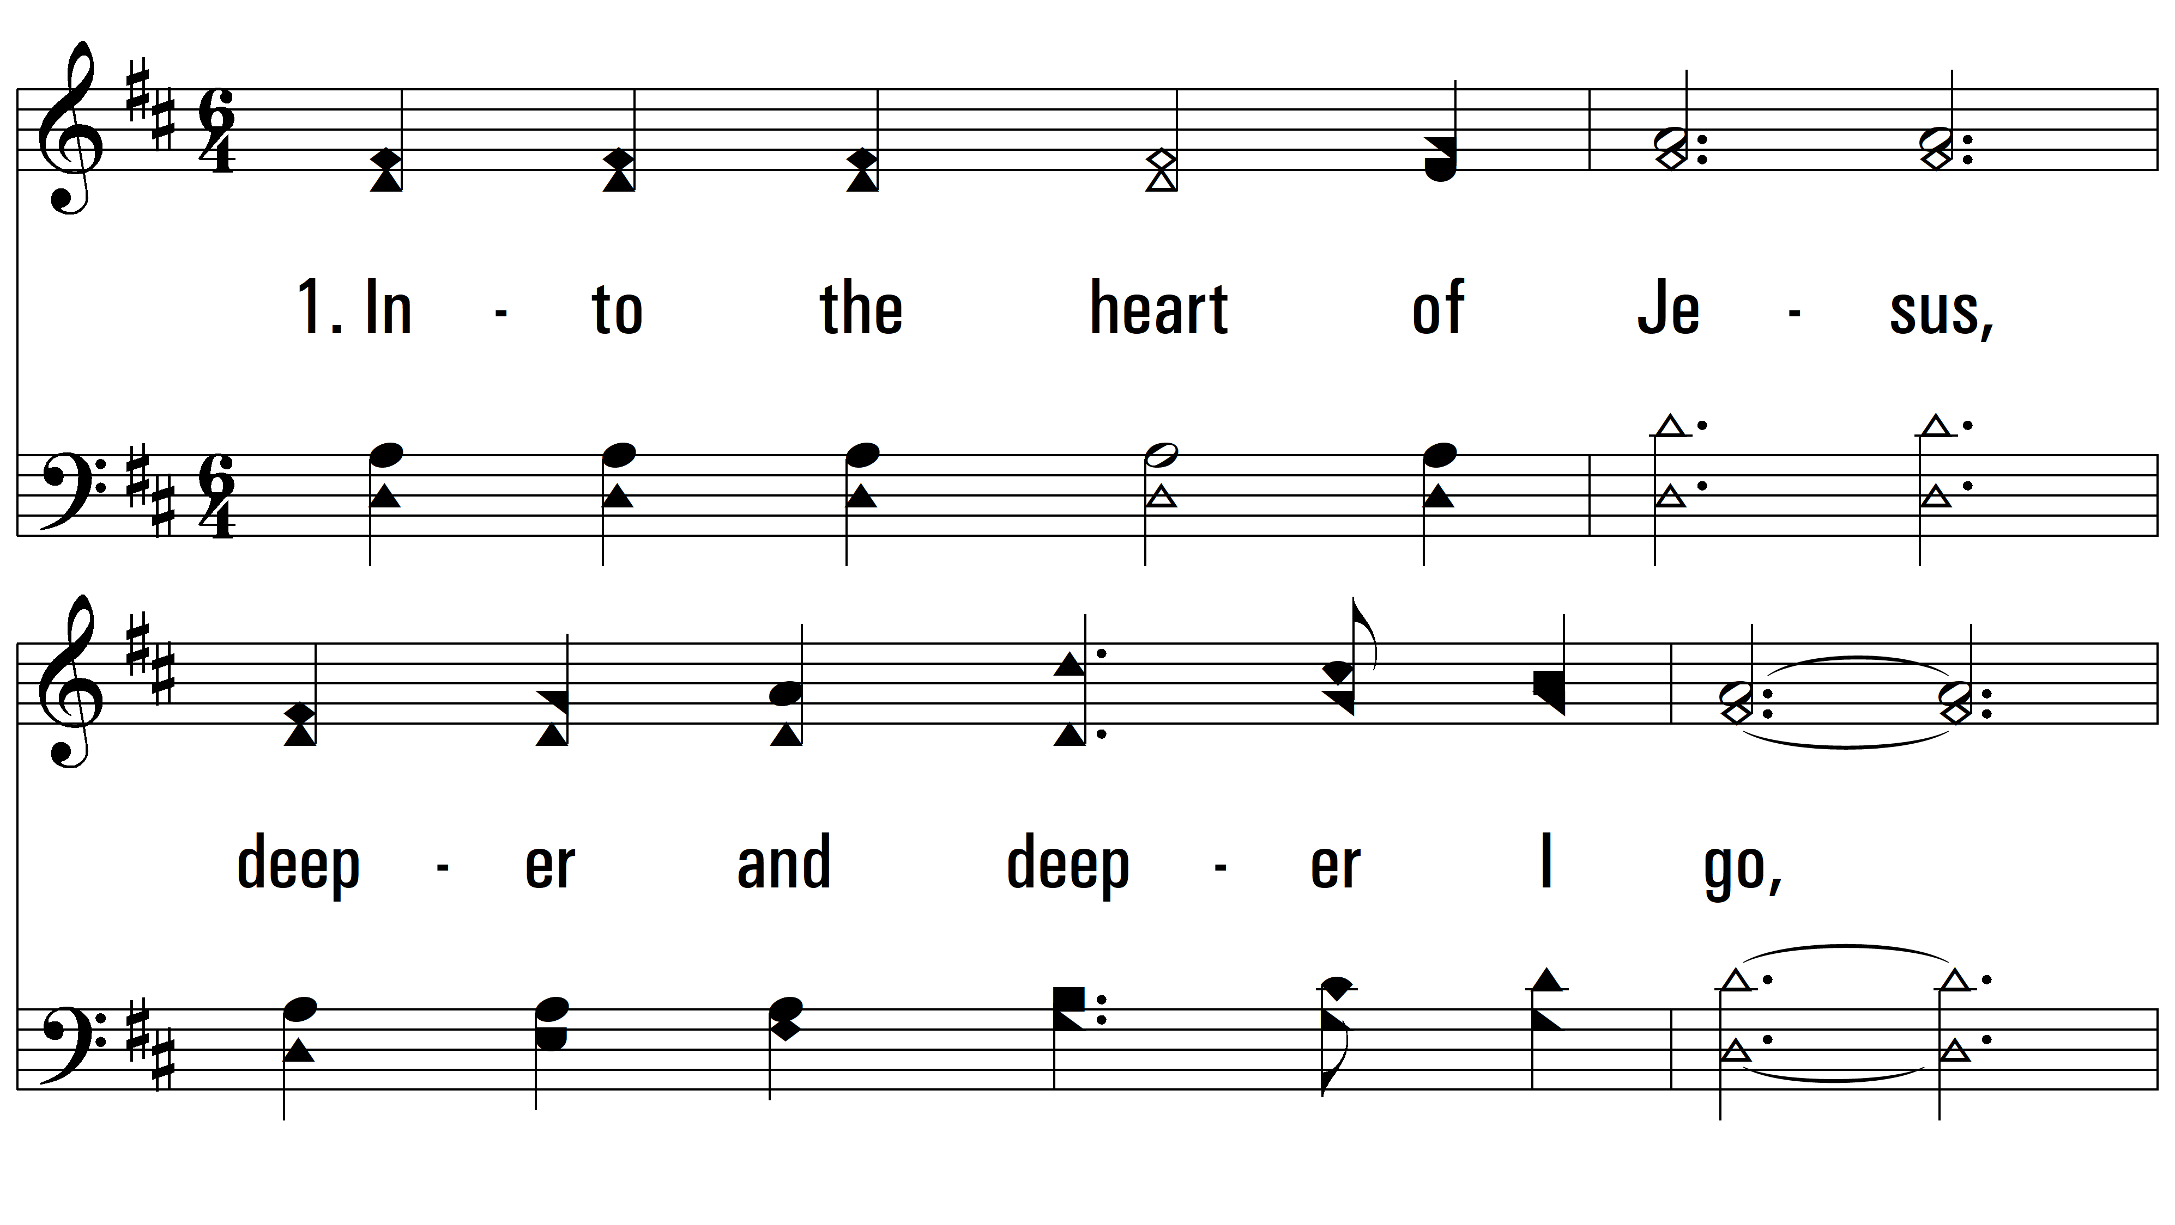
vs. 1 ~ Into The Heart Of Jesus

Slide 3
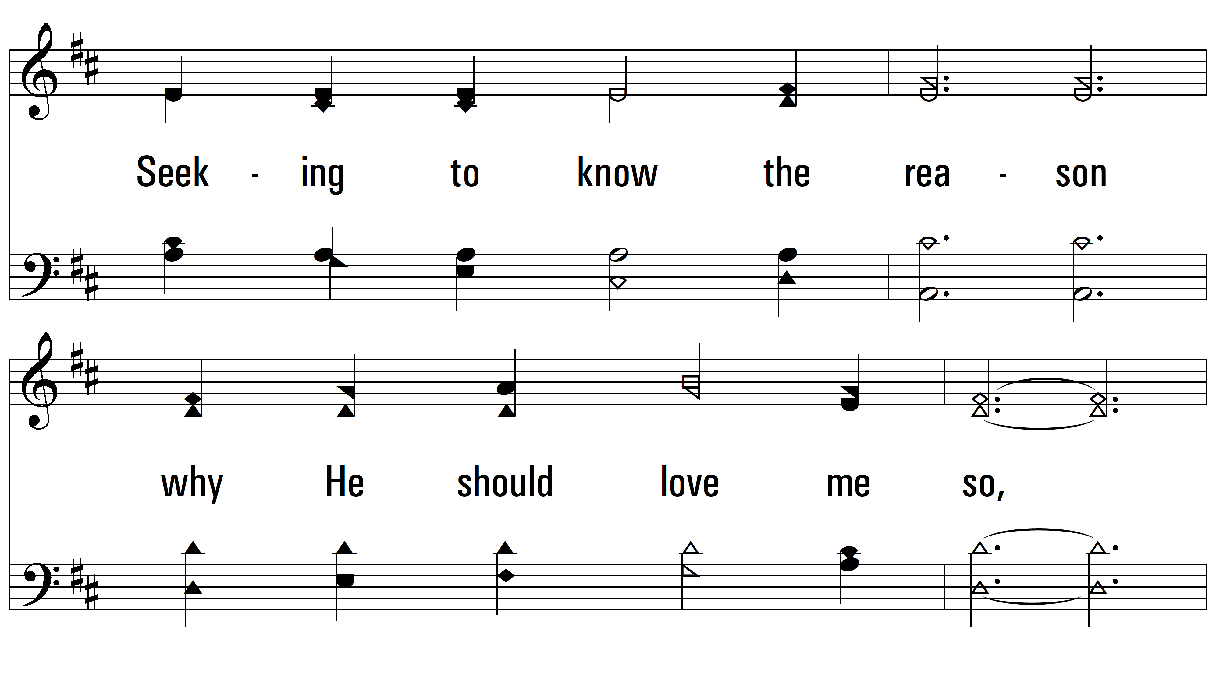
vs. 1

Slide 4
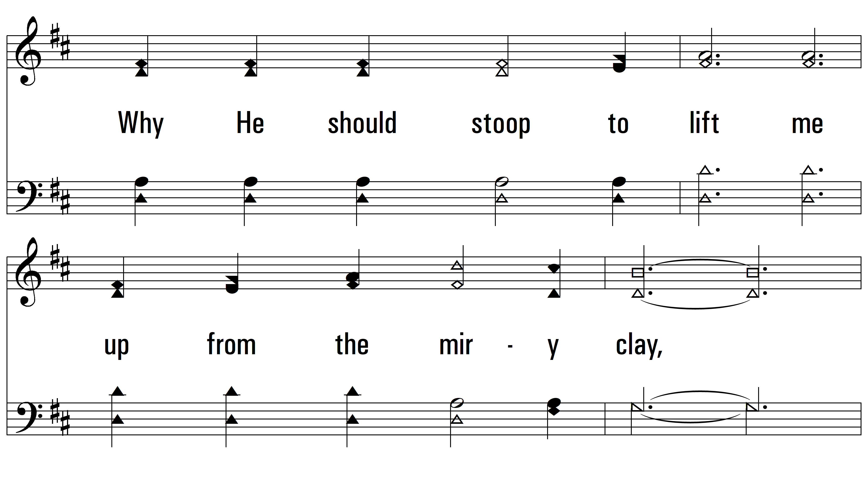
vs. 1

Slide 5
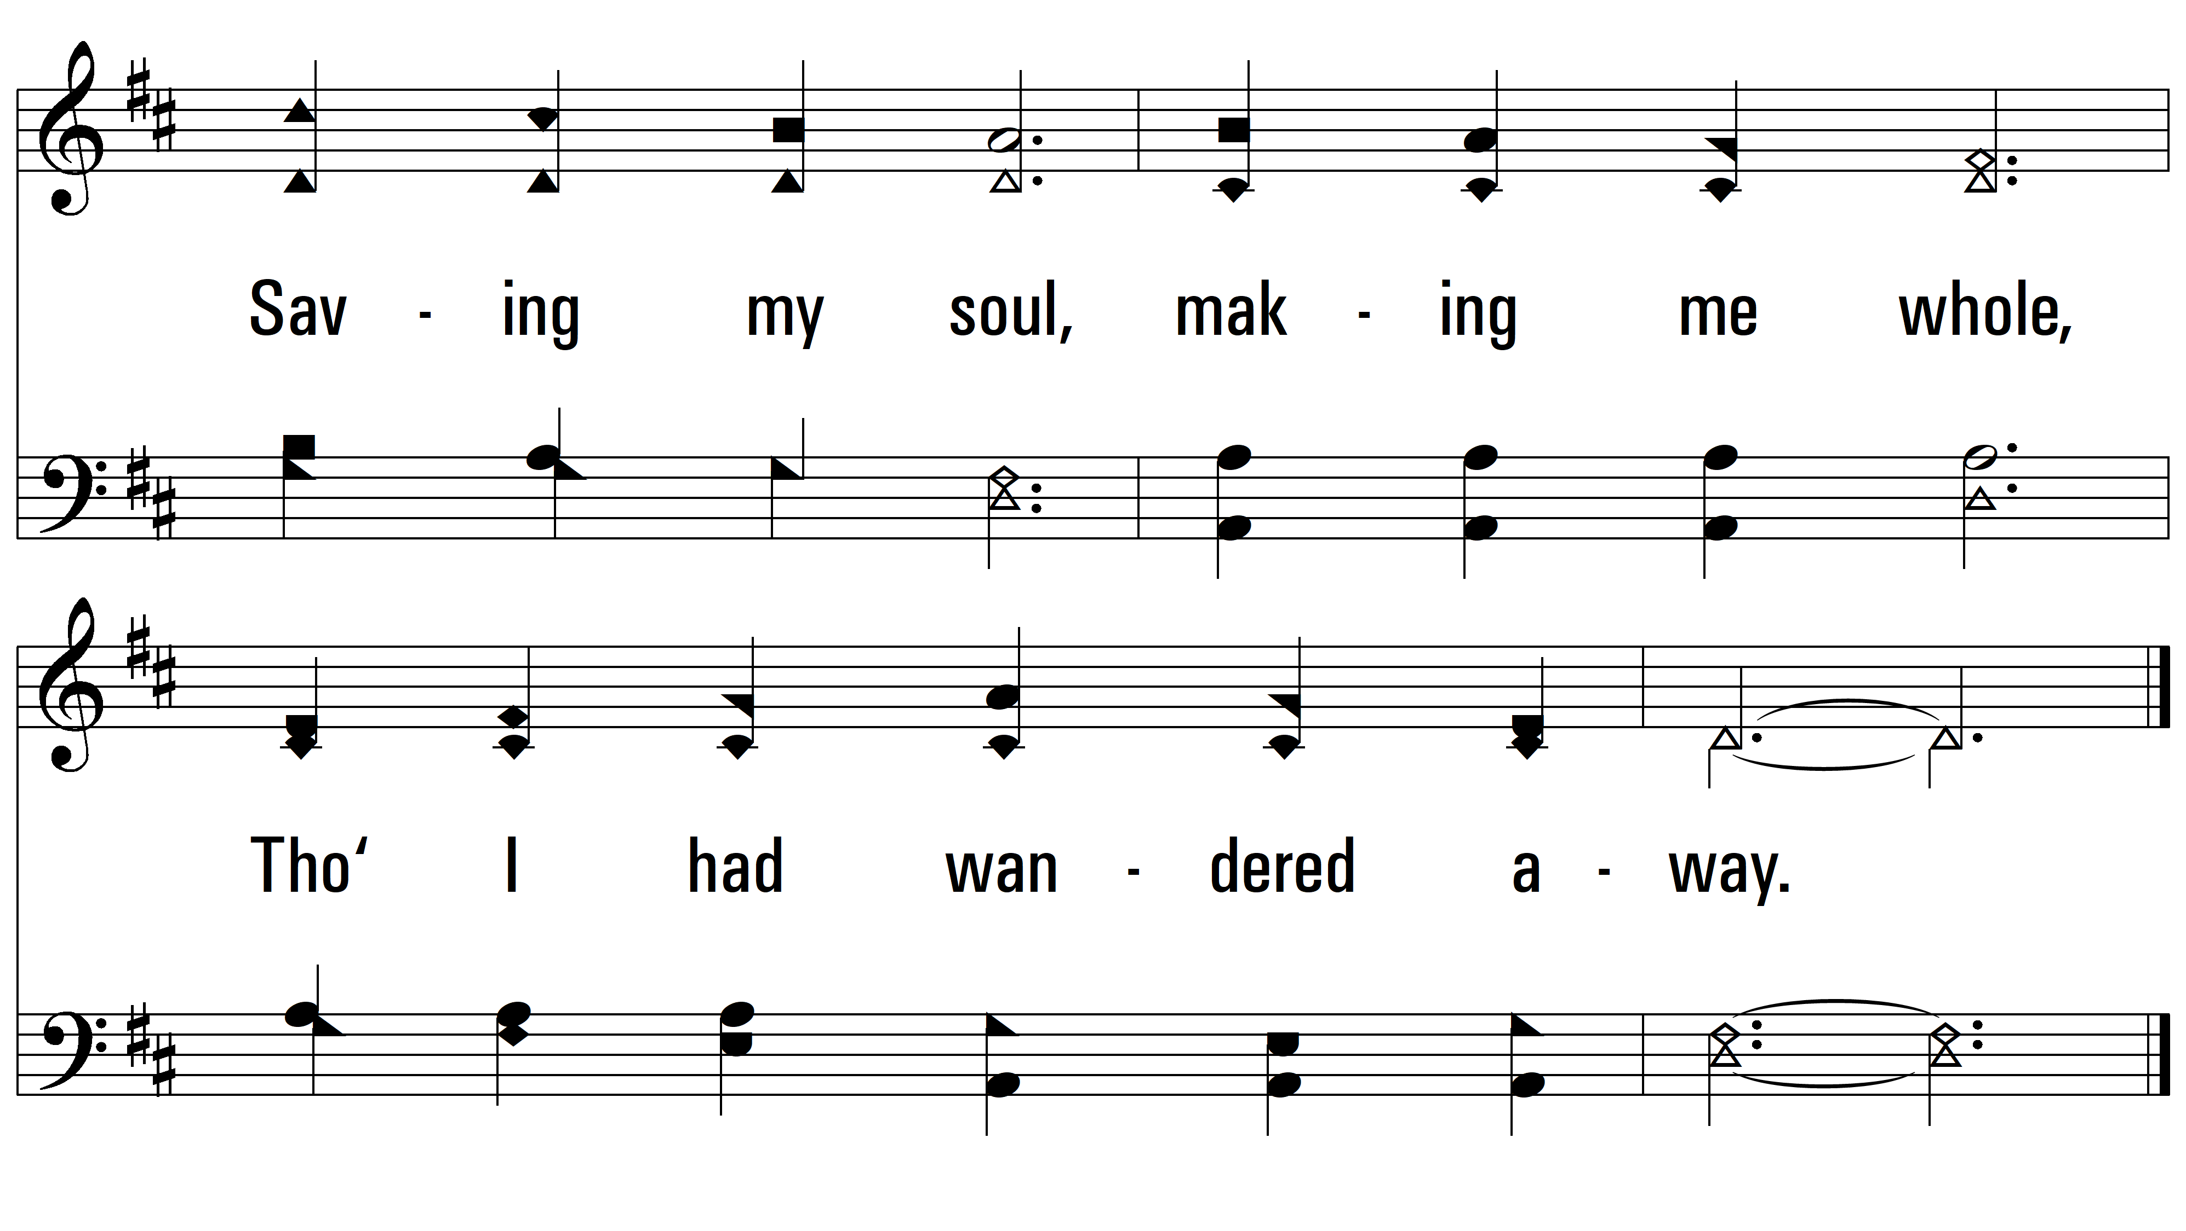
vs. 1

Slide 6
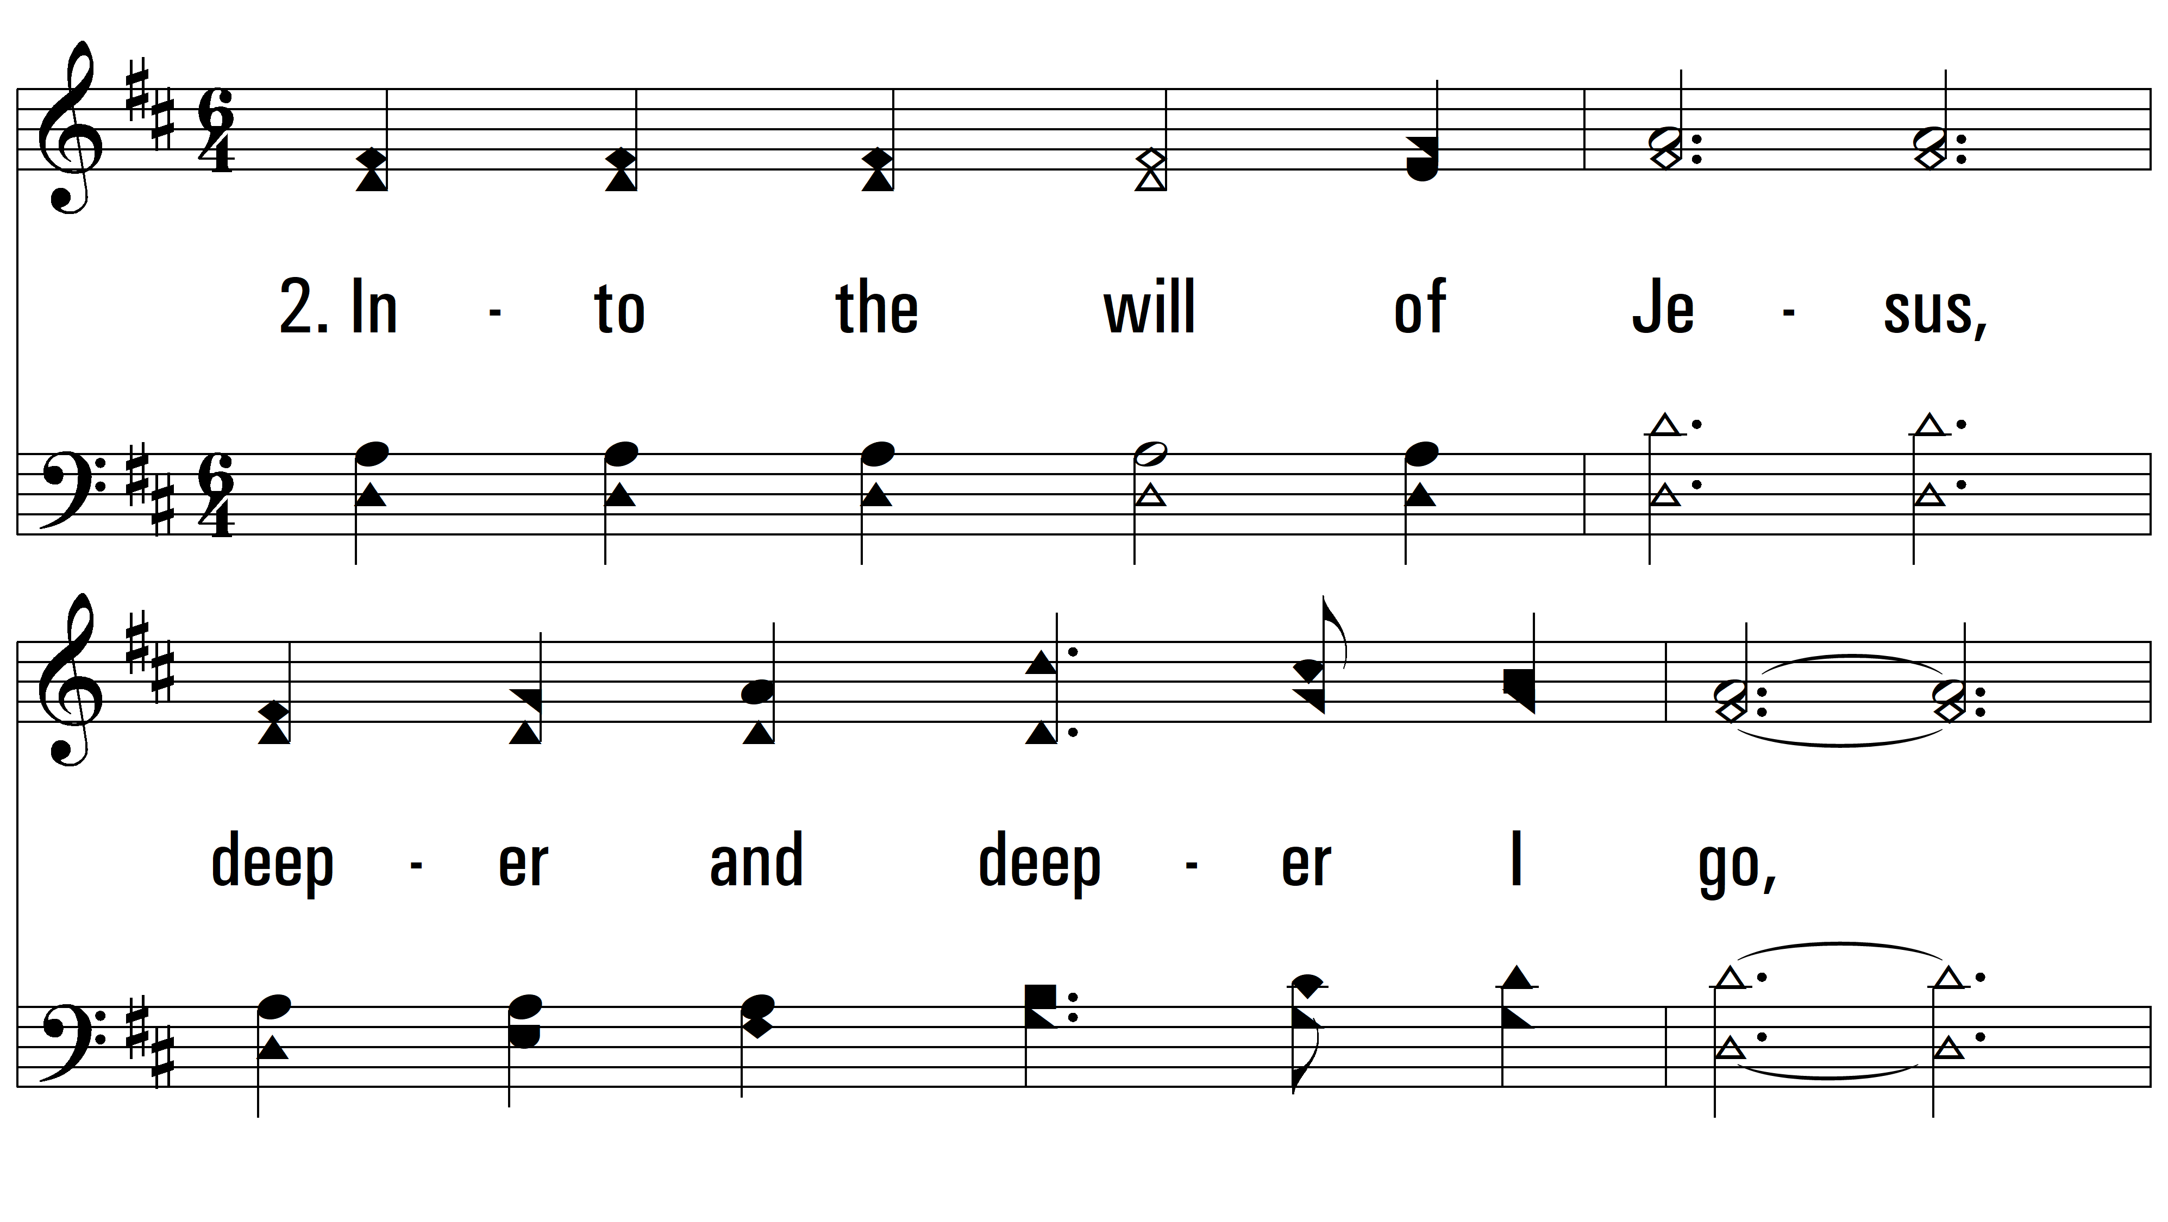
vs. 2 ~ Into The Heart Of Jesus

Slide 7
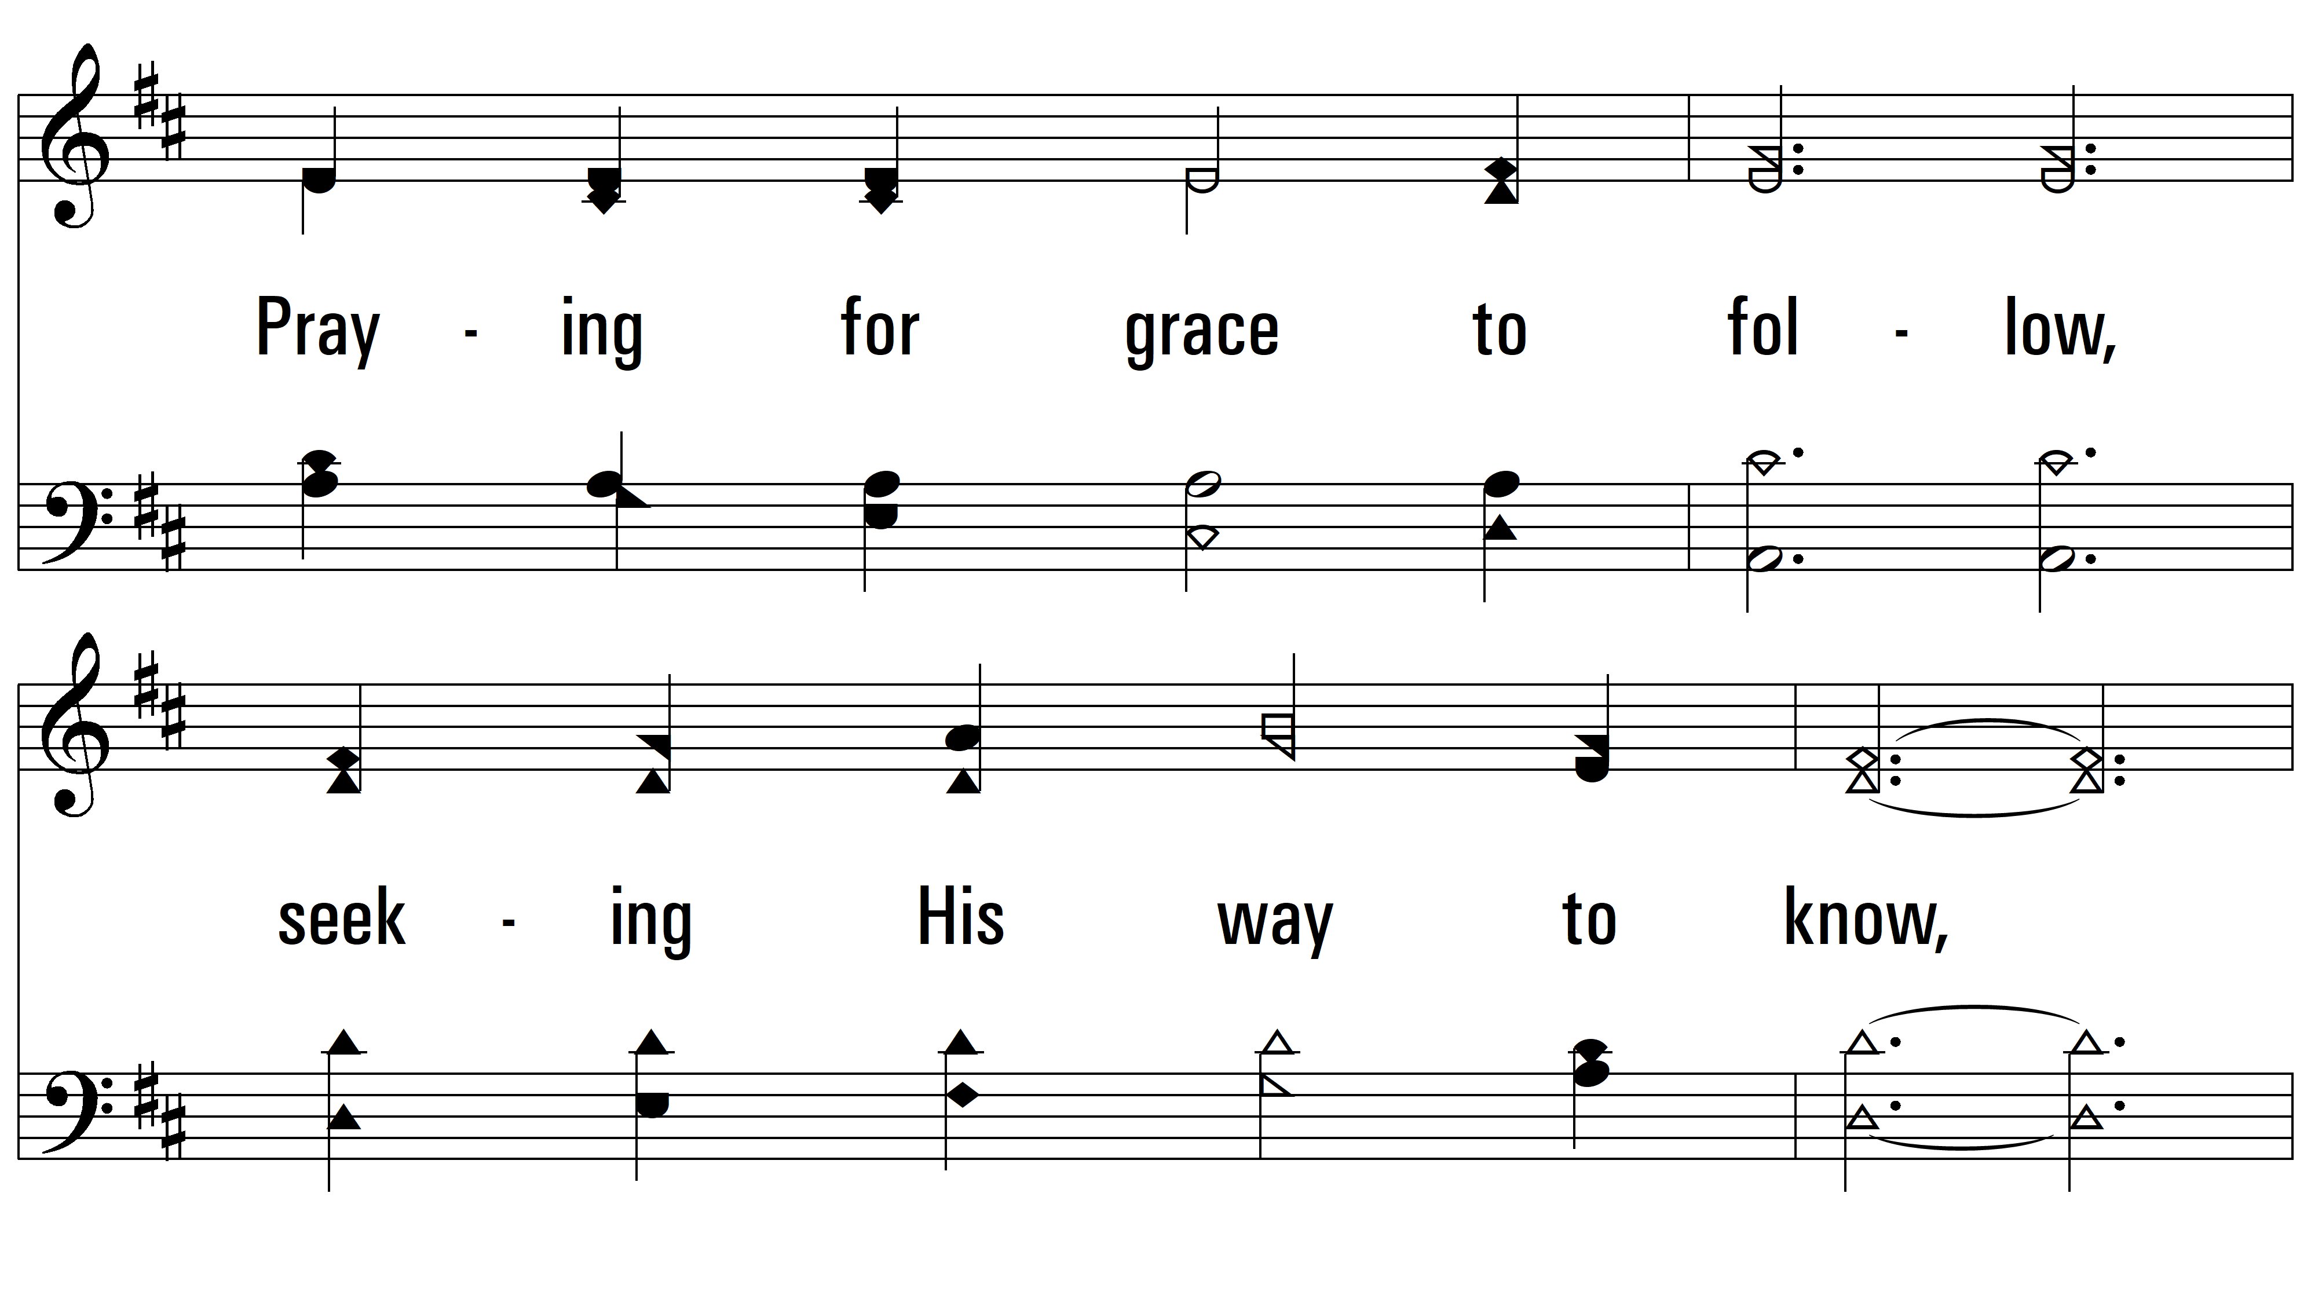
vs. 2

Slide 8
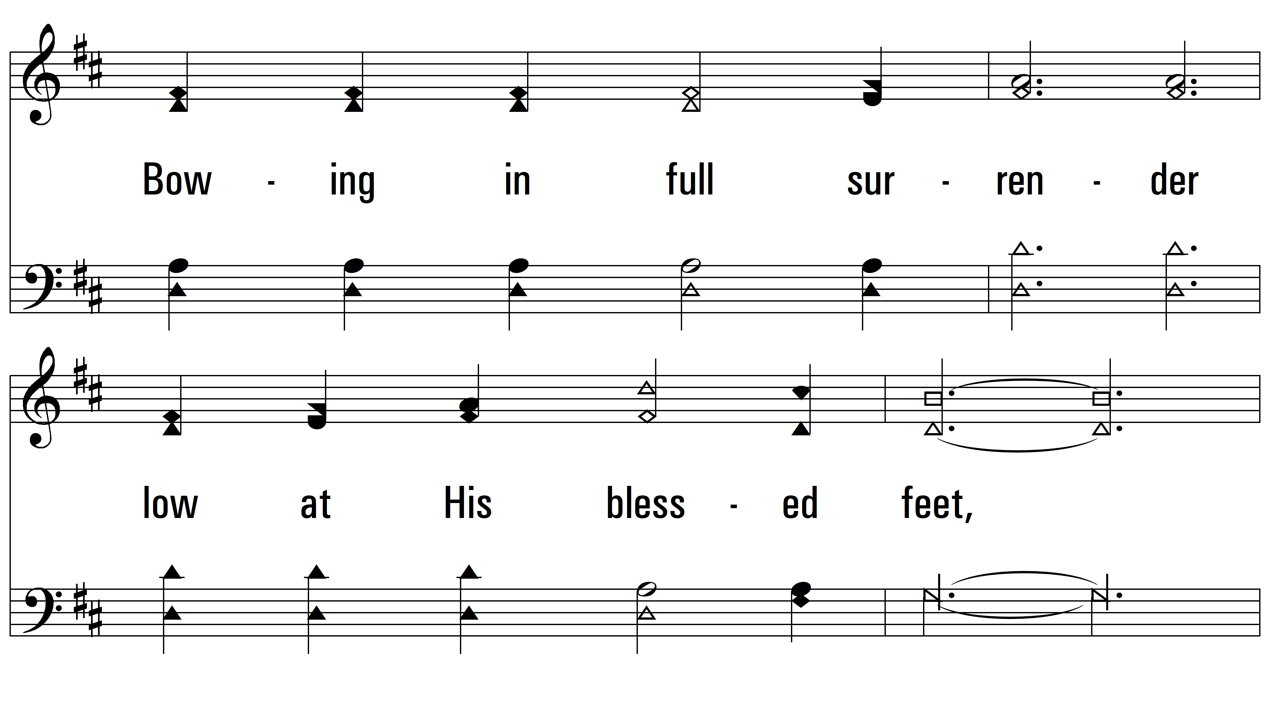
vs. 2

Slide 9
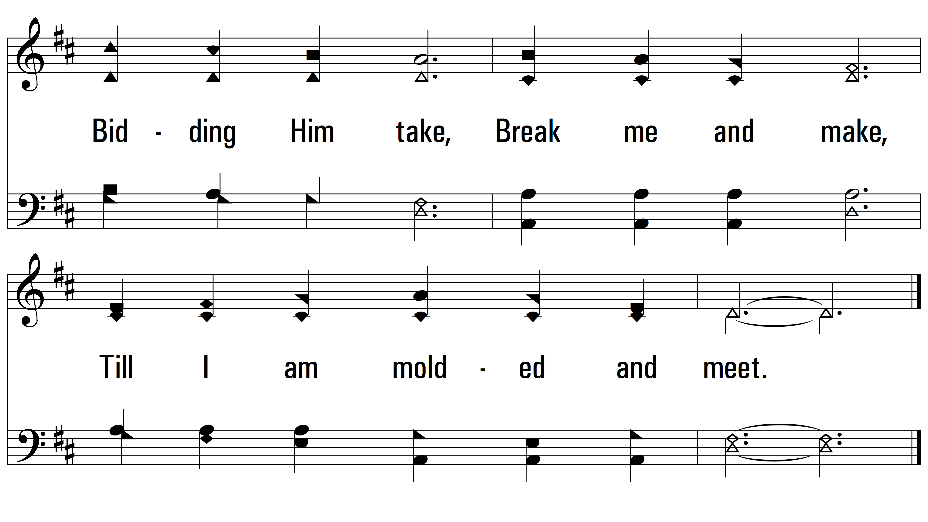
vs. 2

Slide 10
vs. 3 ~ Into The Heart Of Jesus

Slide 11
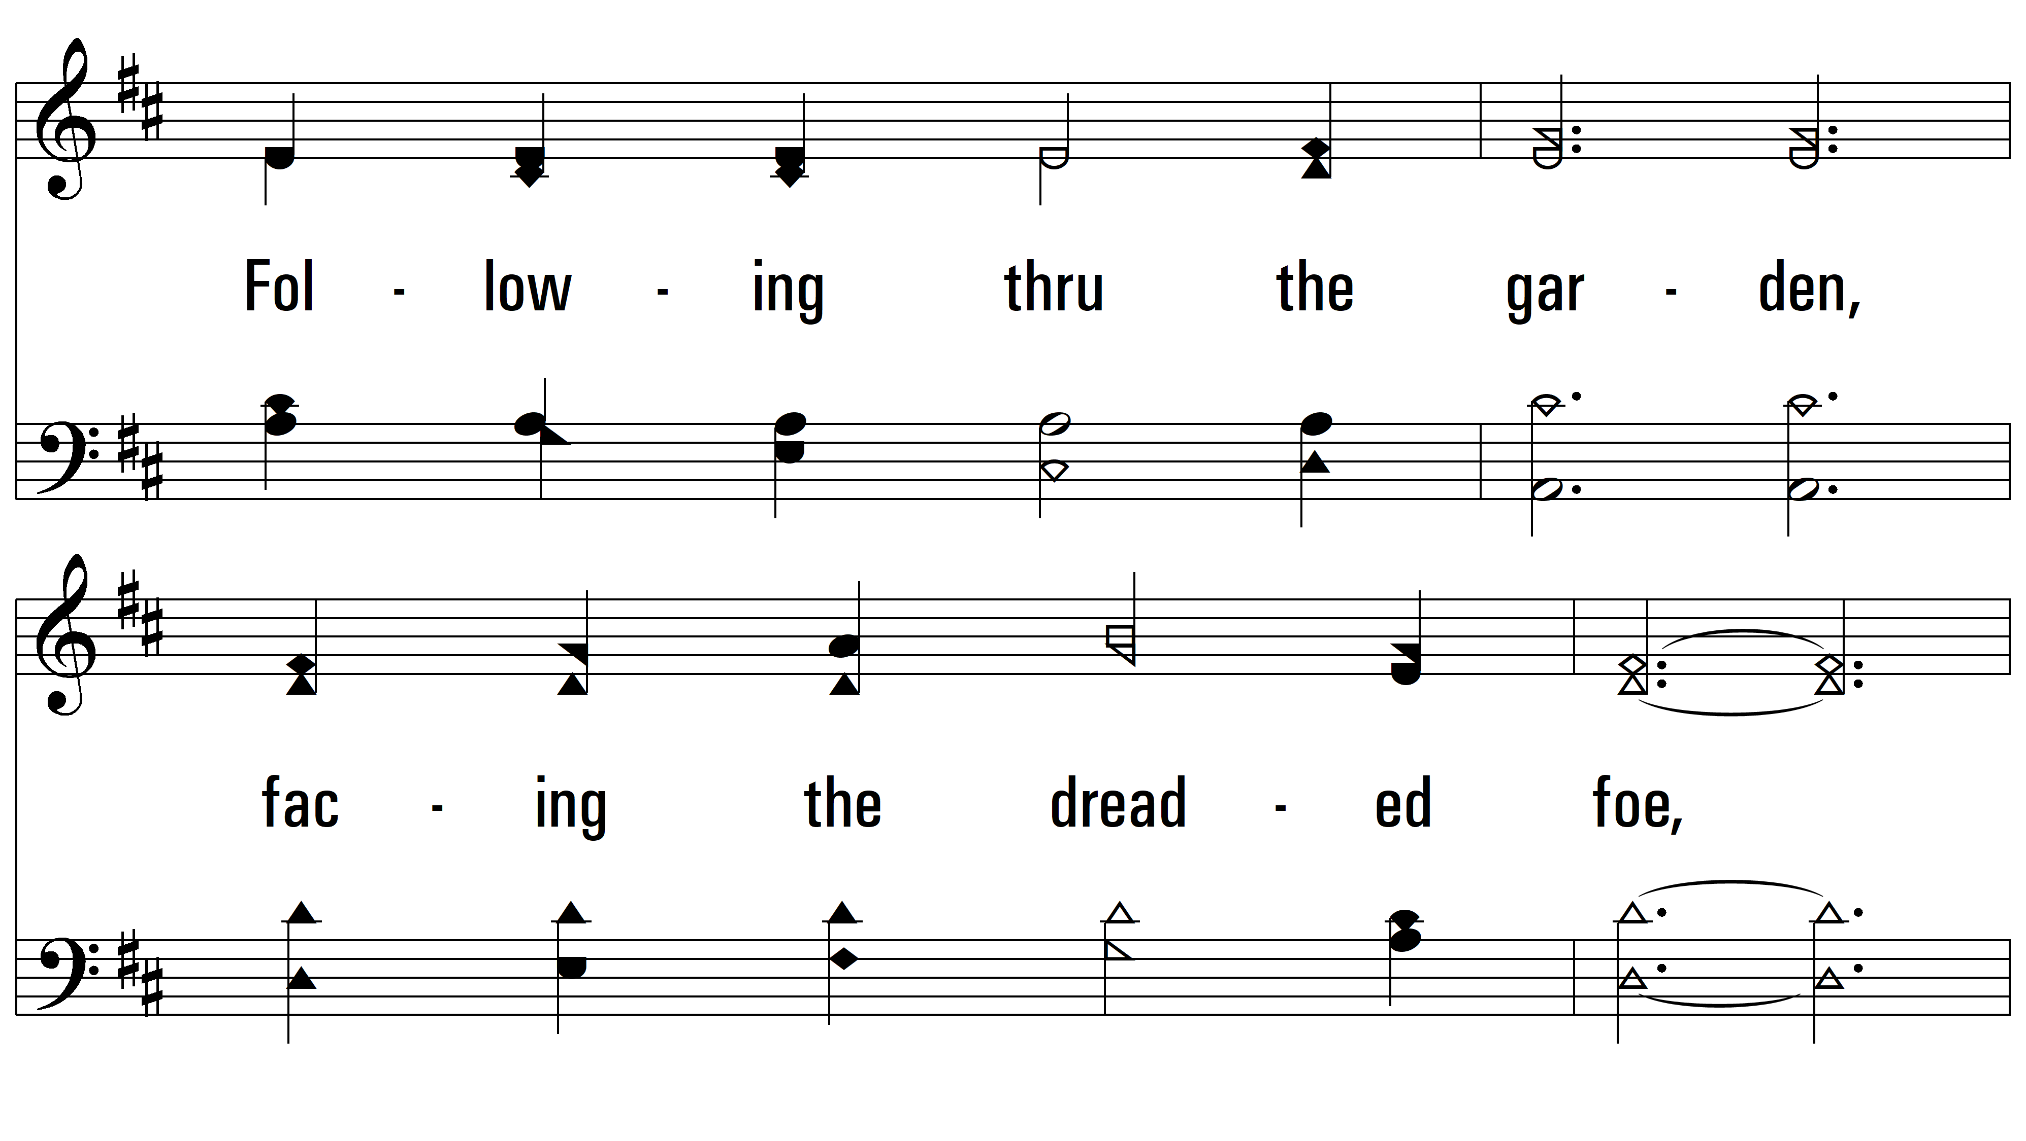
vs. 3

Slide 12
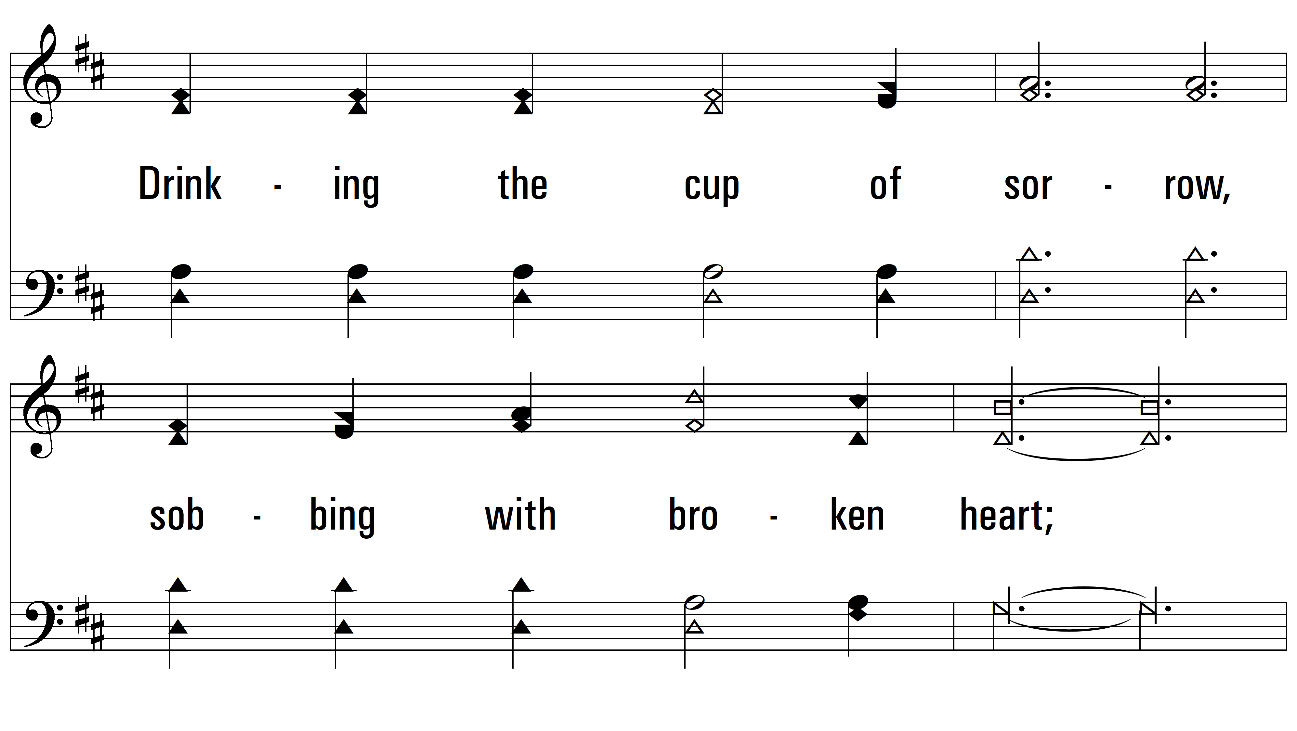
vs. 3

Slide 13
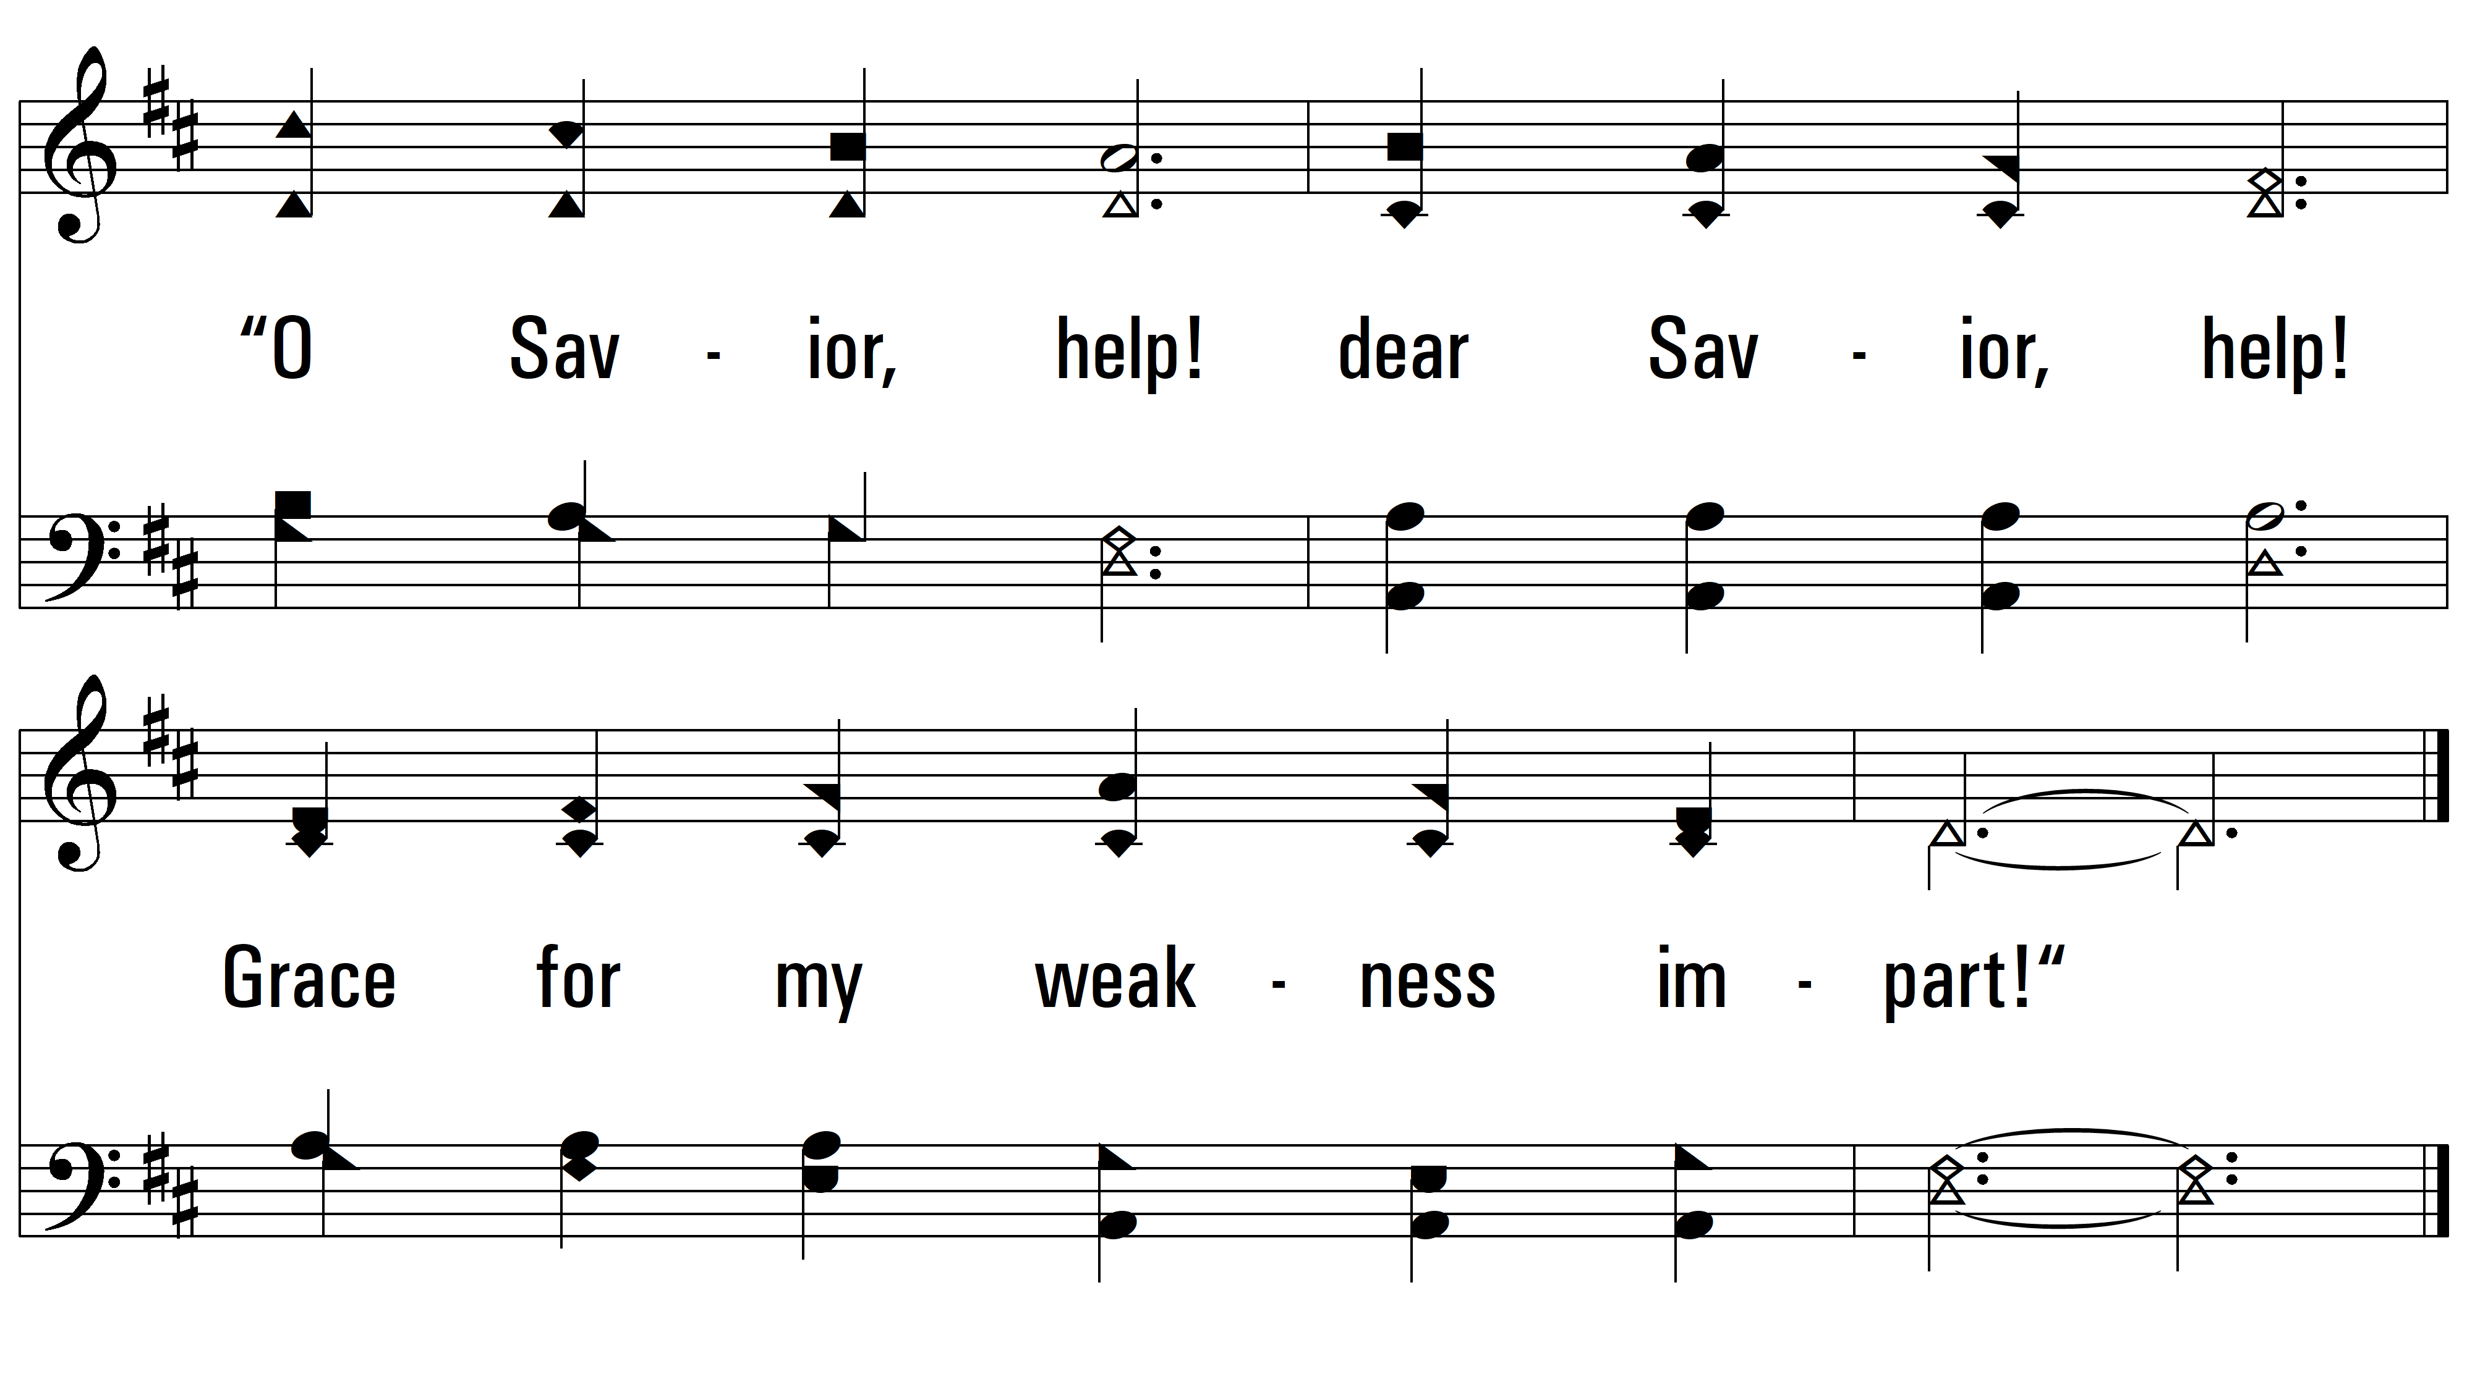
vs. 3

Slide 14
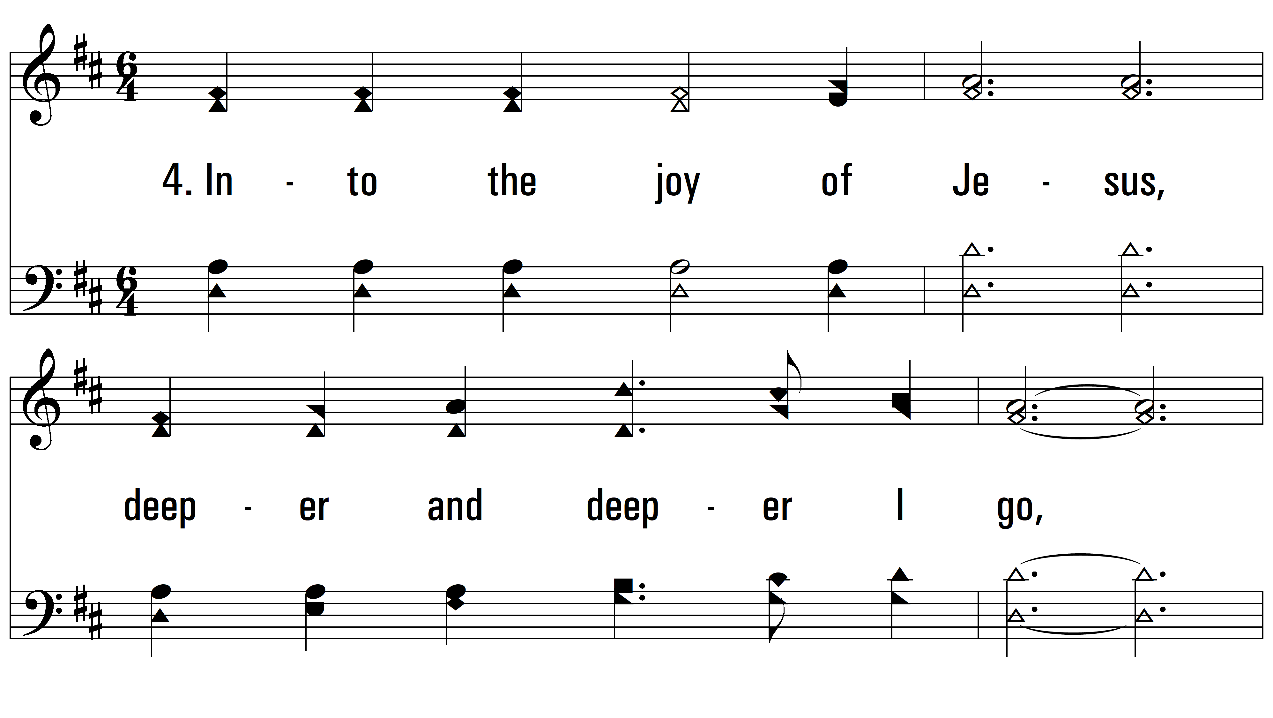
vs. 4 ~ Into The Heart Of Jesus

Slide 15
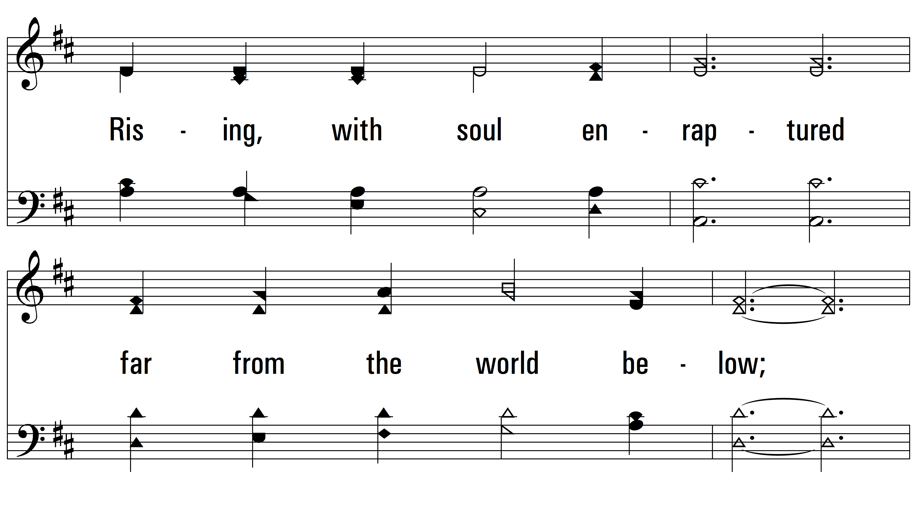
vs. 4

Slide 16
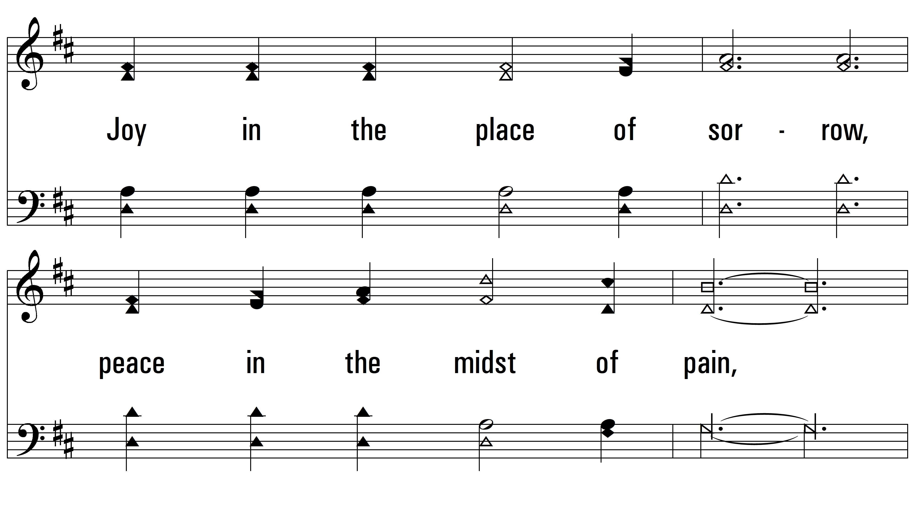
vs. 4

Slide 17
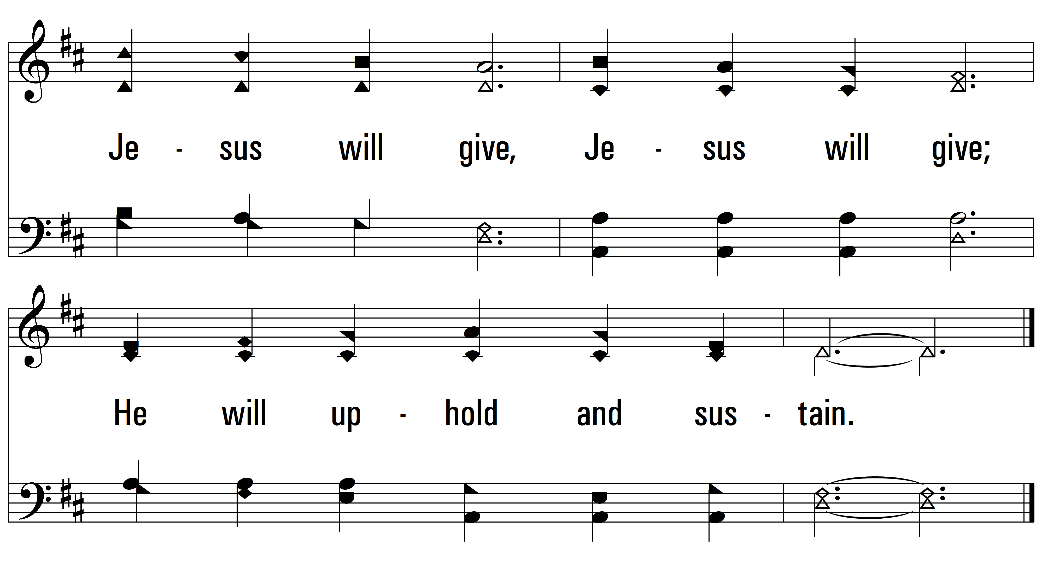
vs. 4
PDHymns.com
END

