Slide 1
Jesus, Lover Of My Soul
REFUGE
7.7.7.7.D
Words: | Charles Wesley (1738)
Music: | J. P. Holbrook (1862)
3/4
D/F# - MI
Verses: 4
Lead - | MI
Alto - | MI
Tenor - | SOL
Bass - | SOL
PDHymns.com

Slide 2
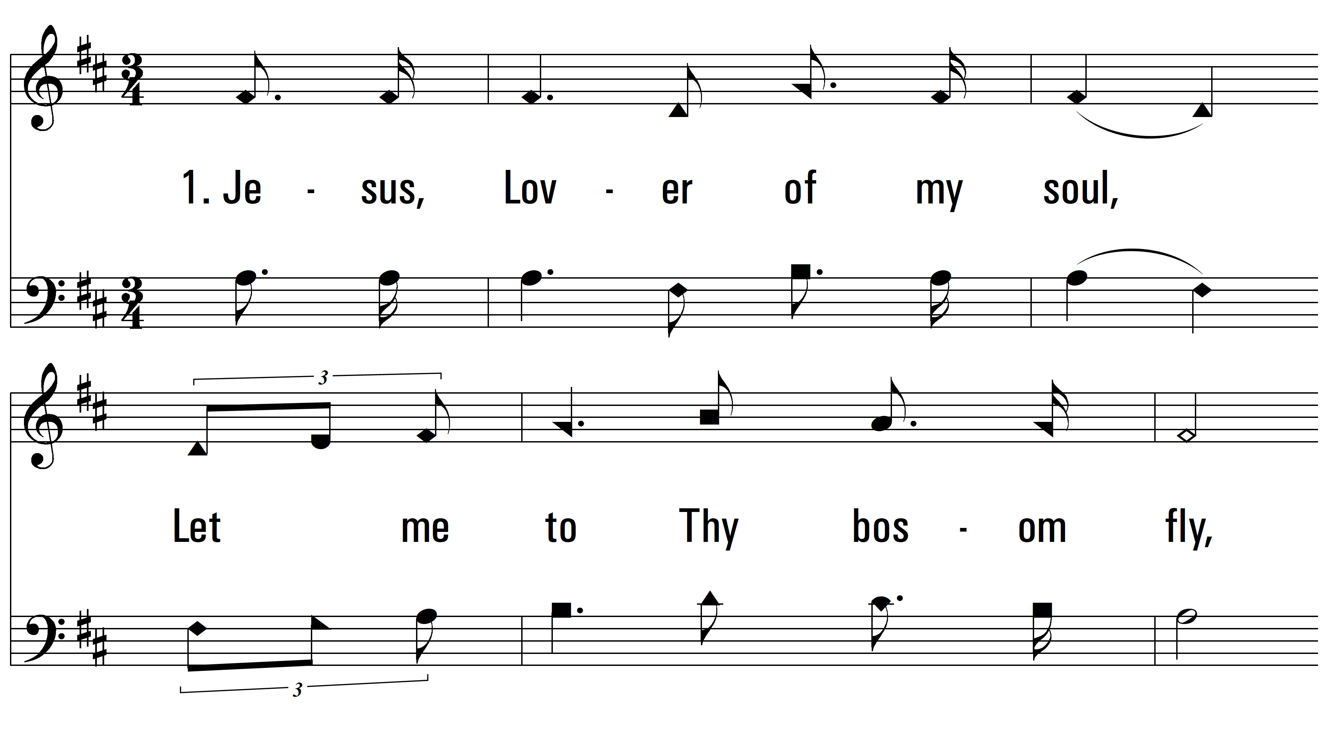
vs. 1 ~ Jesus, Lover Of My Soul

Slide 3
vs. 1

Slide 4
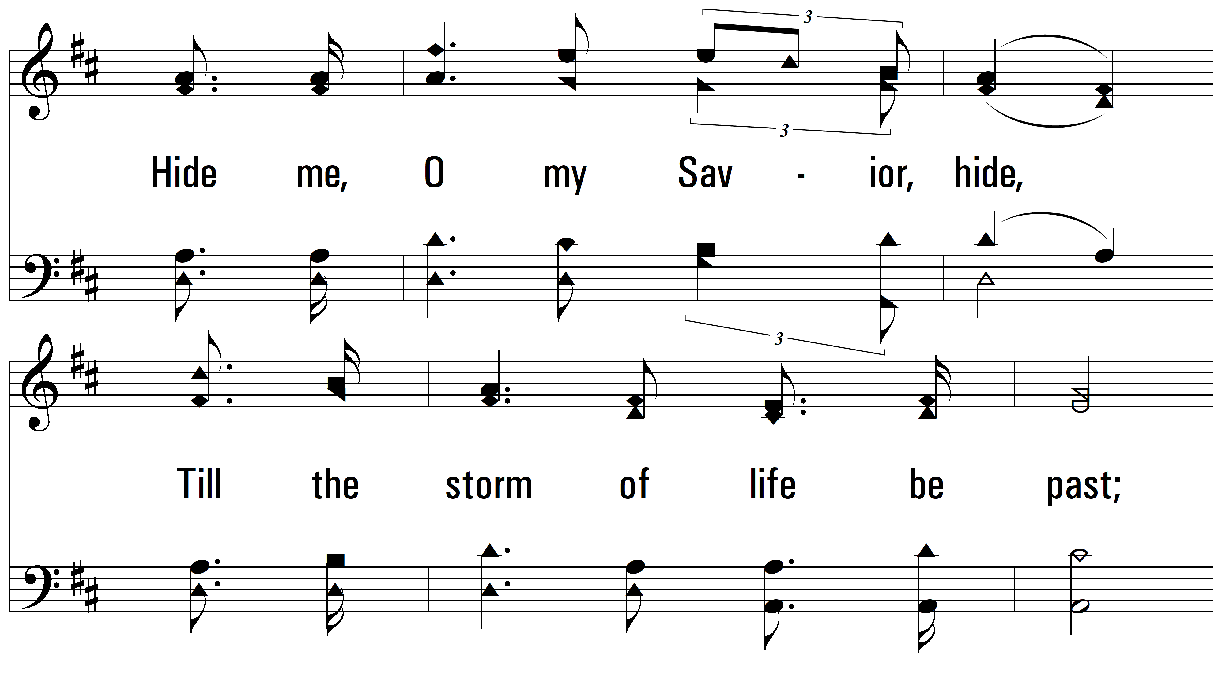
vs. 1

Slide 5
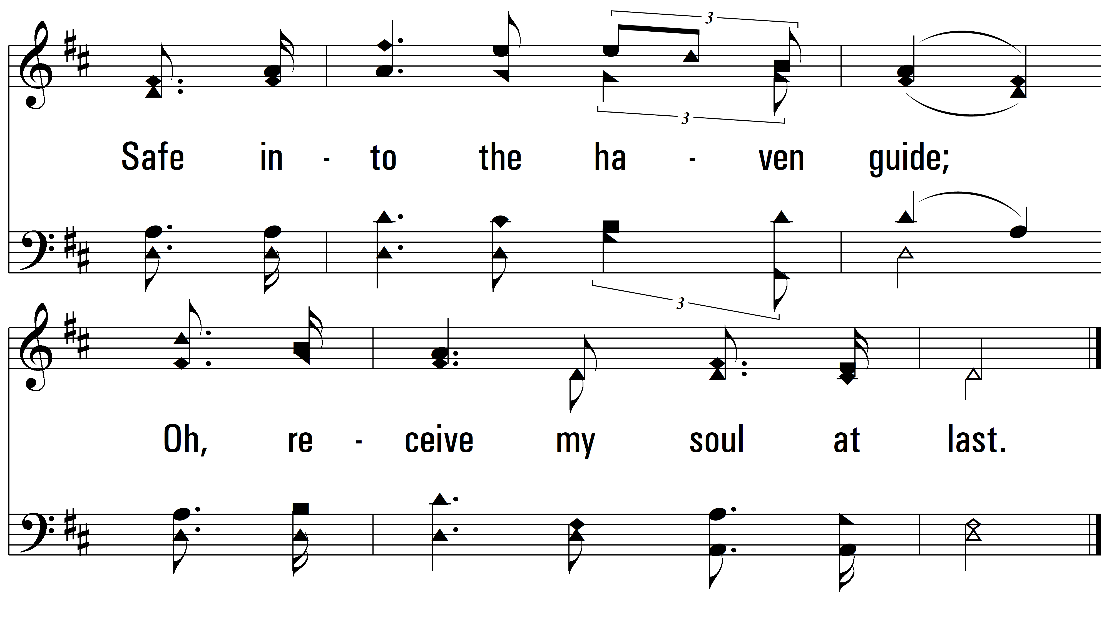
vs. 1

Slide 6
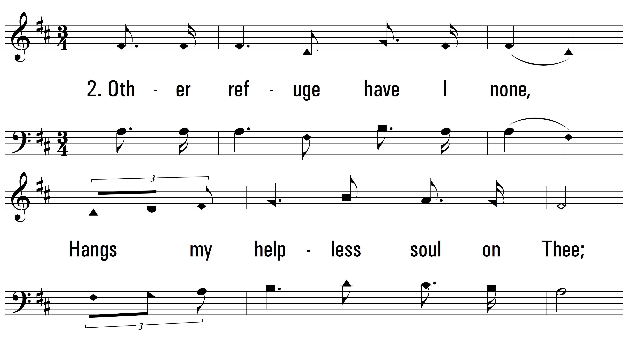
vs. 2 ~ Jesus, Lover Of My Soul

Slide 7
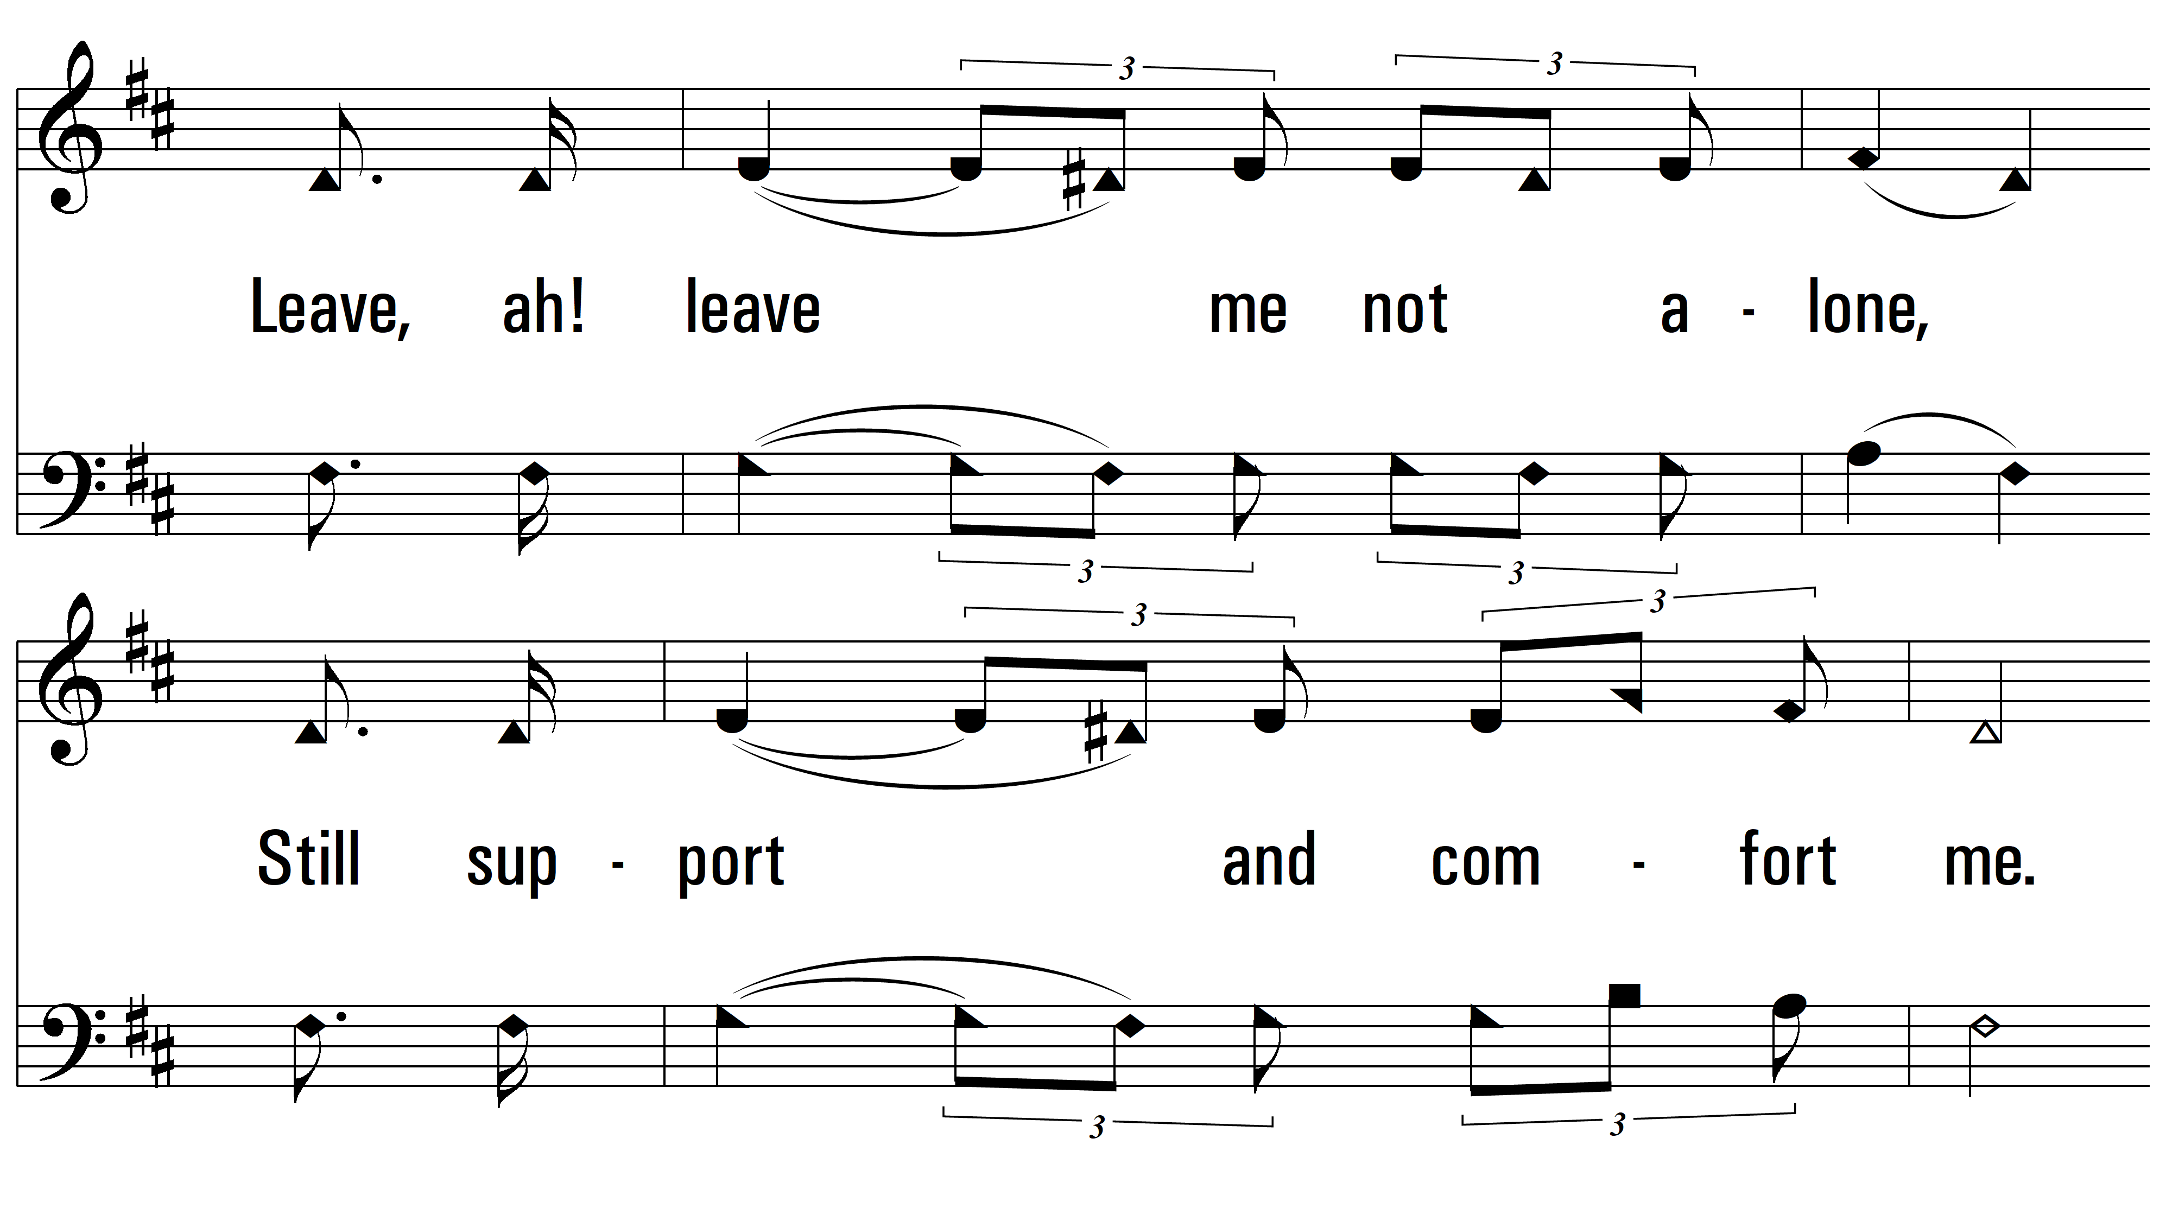
vs. 2

Slide 8
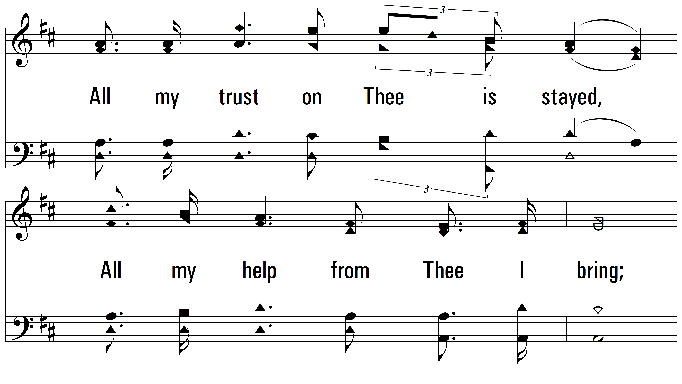
vs. 2

Slide 9
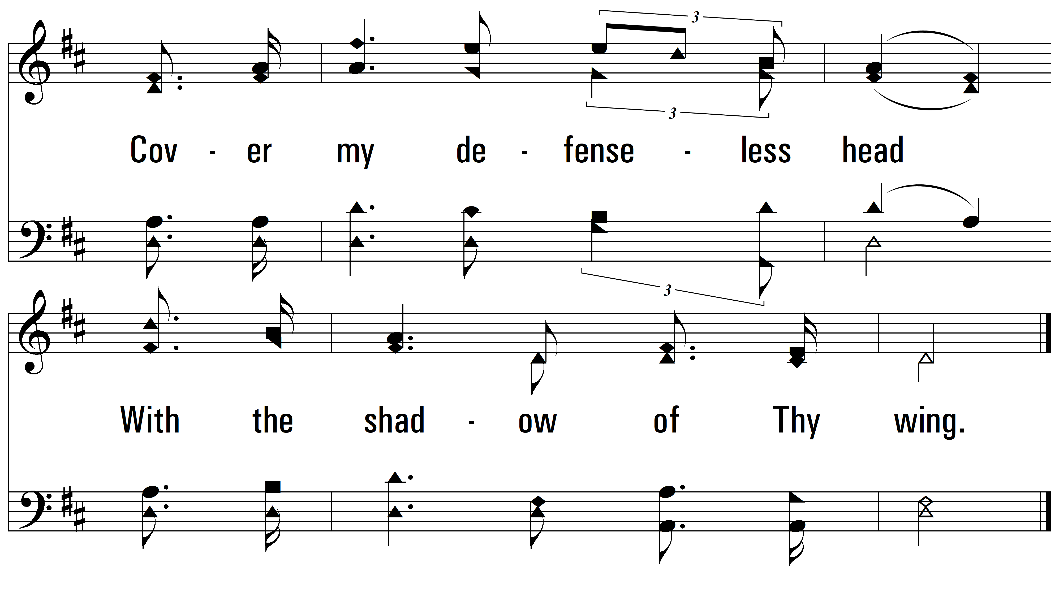
vs. 2

Slide 10
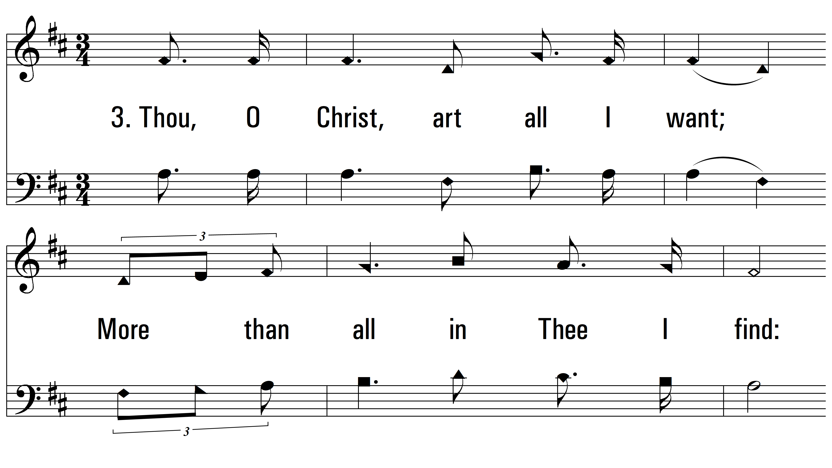
vs. 3 ~ Jesus, Lover Of My Soul

Slide 11
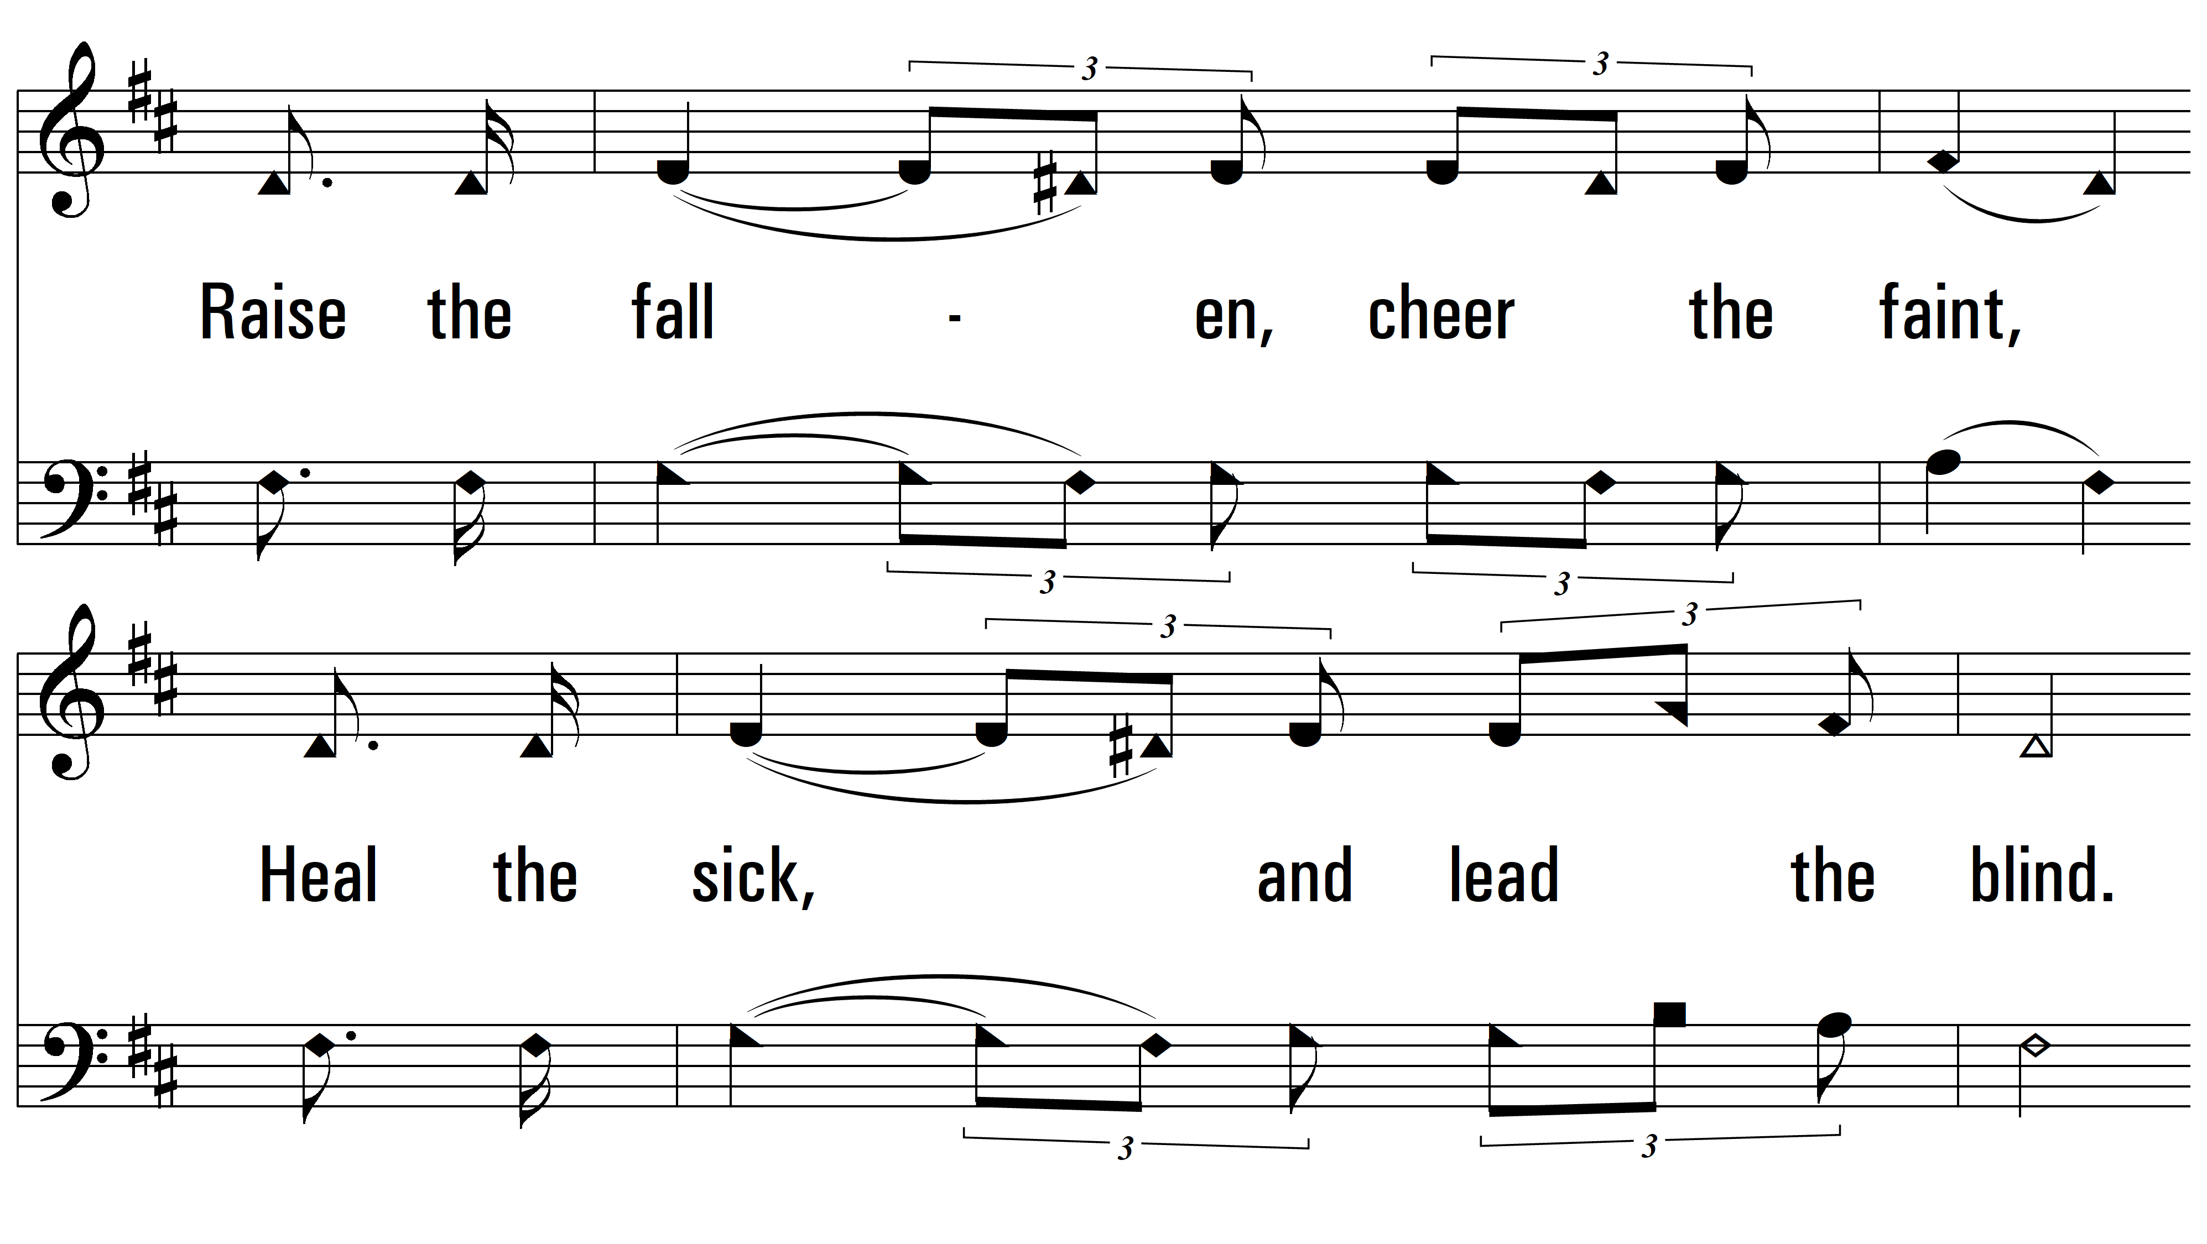
vs. 3

Slide 12
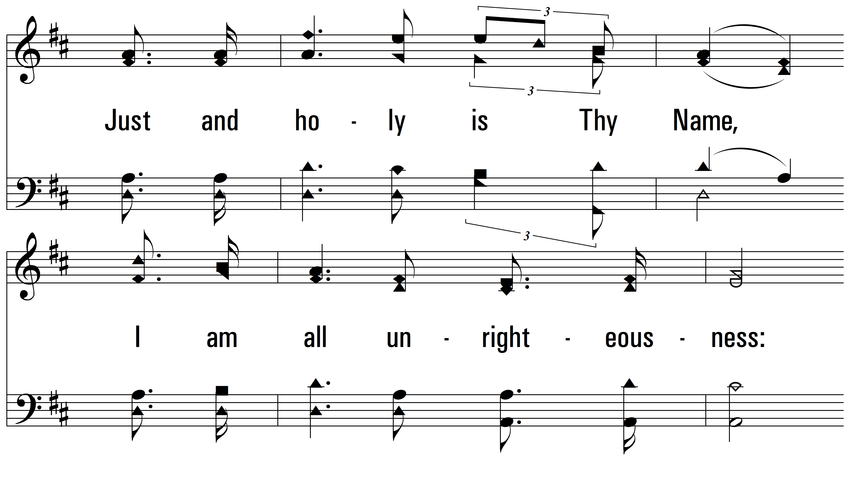
vs. 3

Slide 13
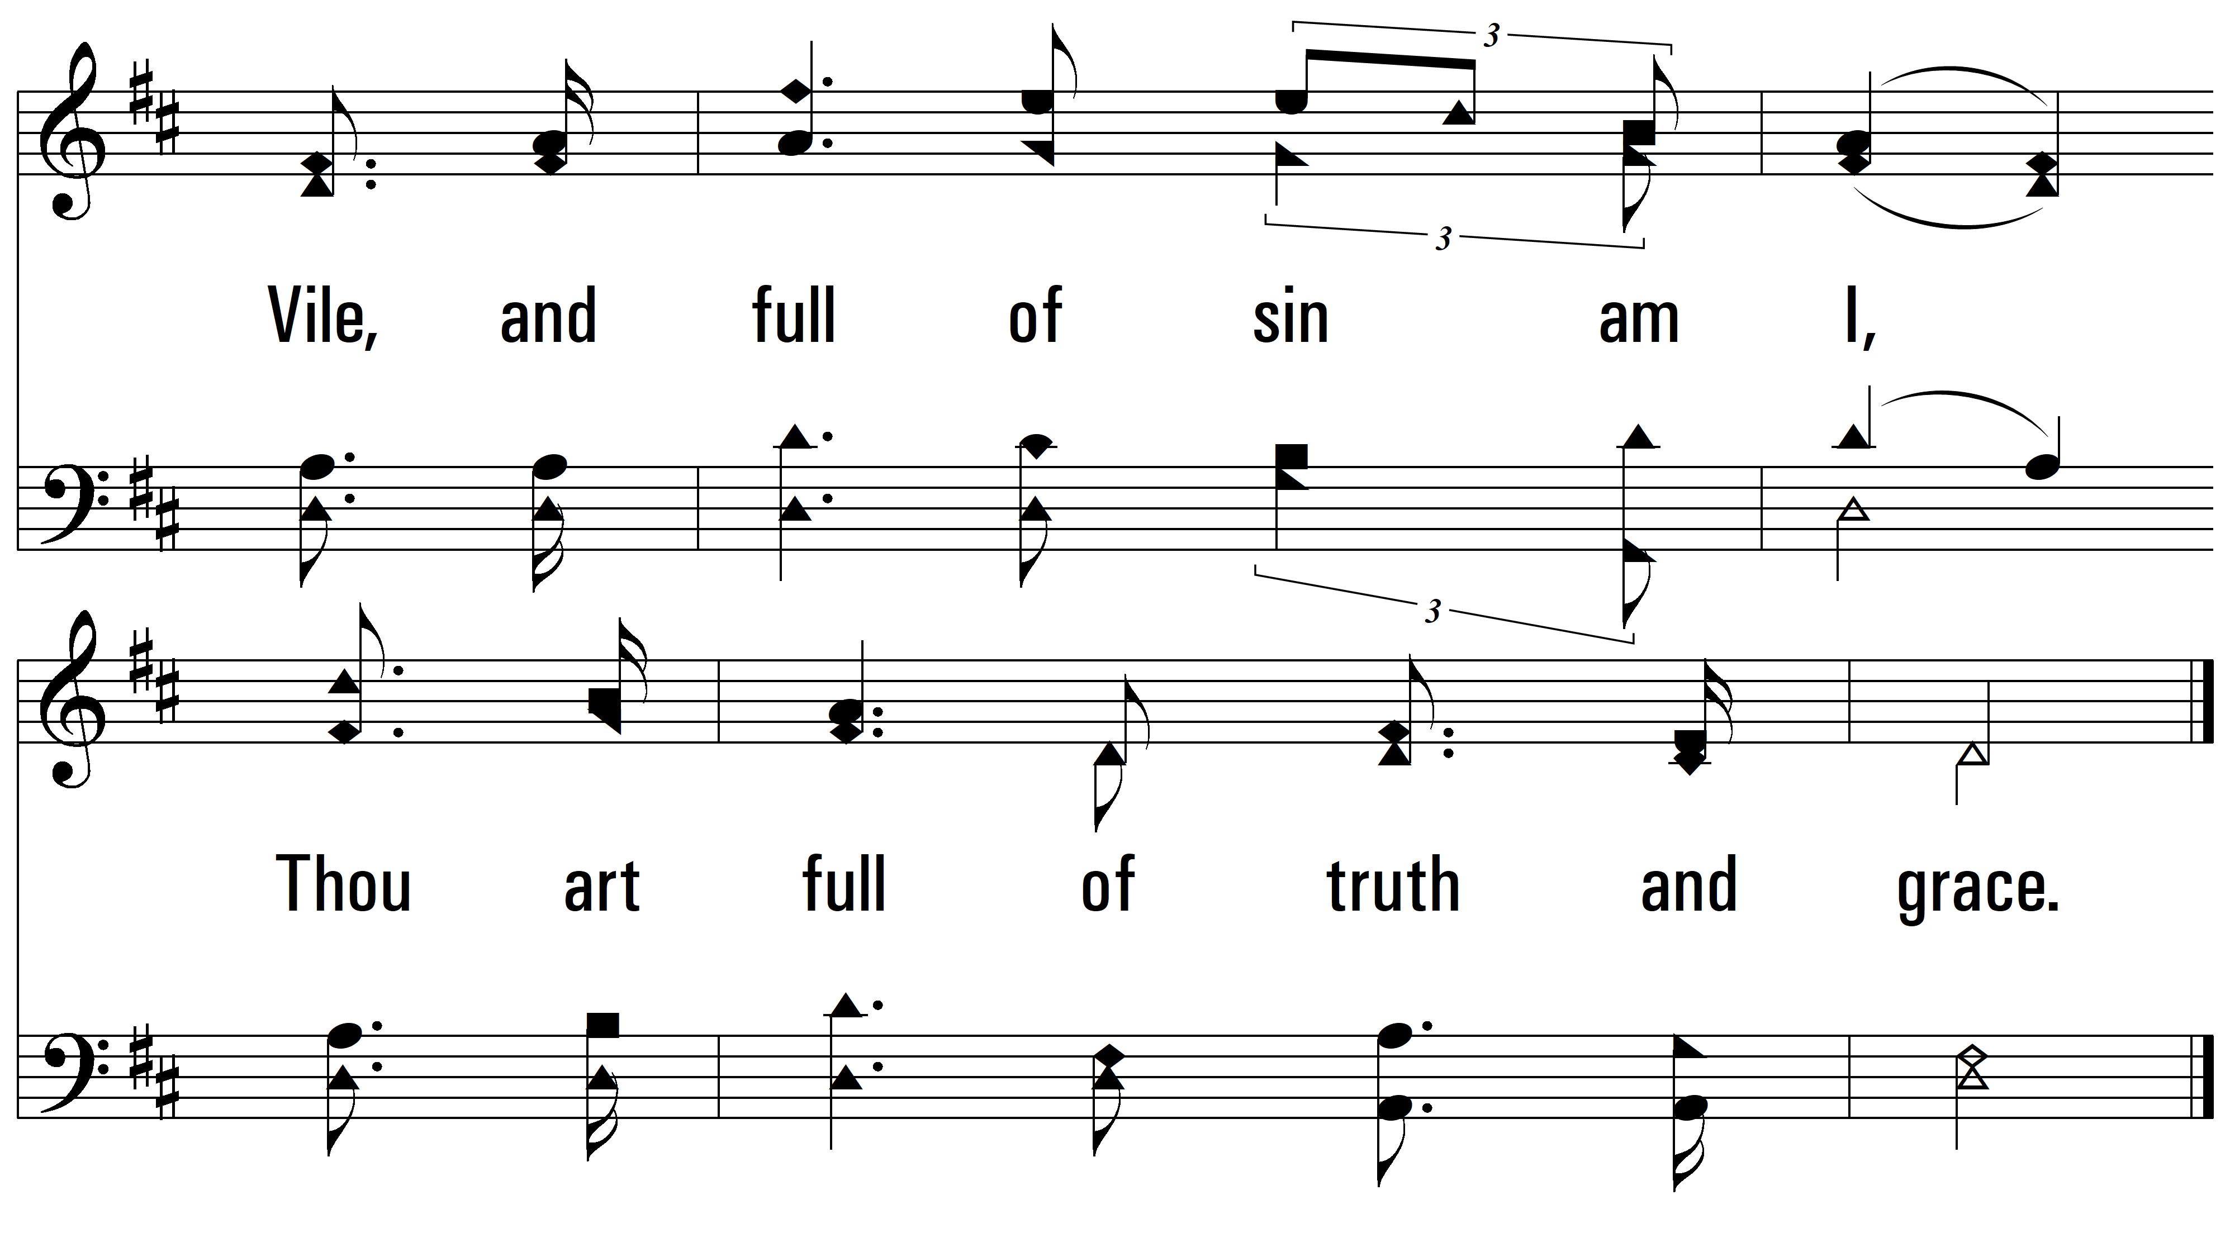
vs. 3

Slide 14
vs. 4 ~ Jesus, Lover Of My Soul

Slide 15
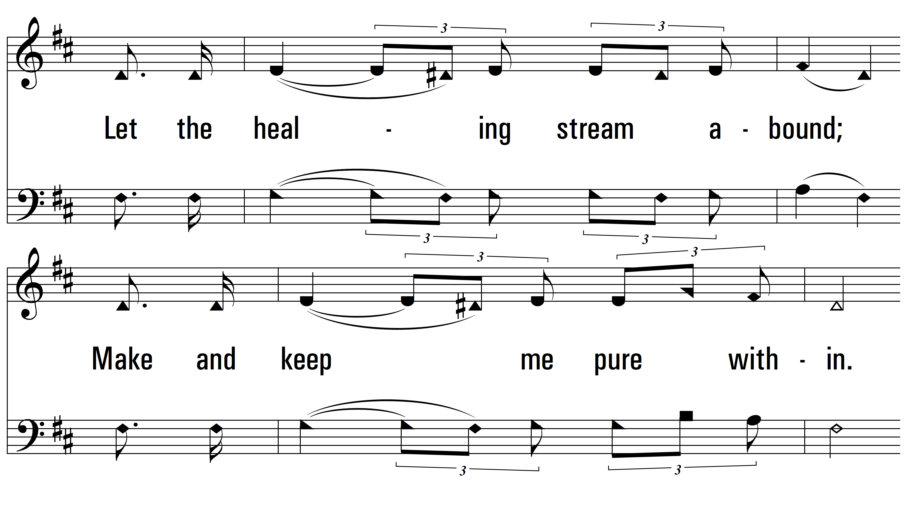
vs. 4

Slide 16
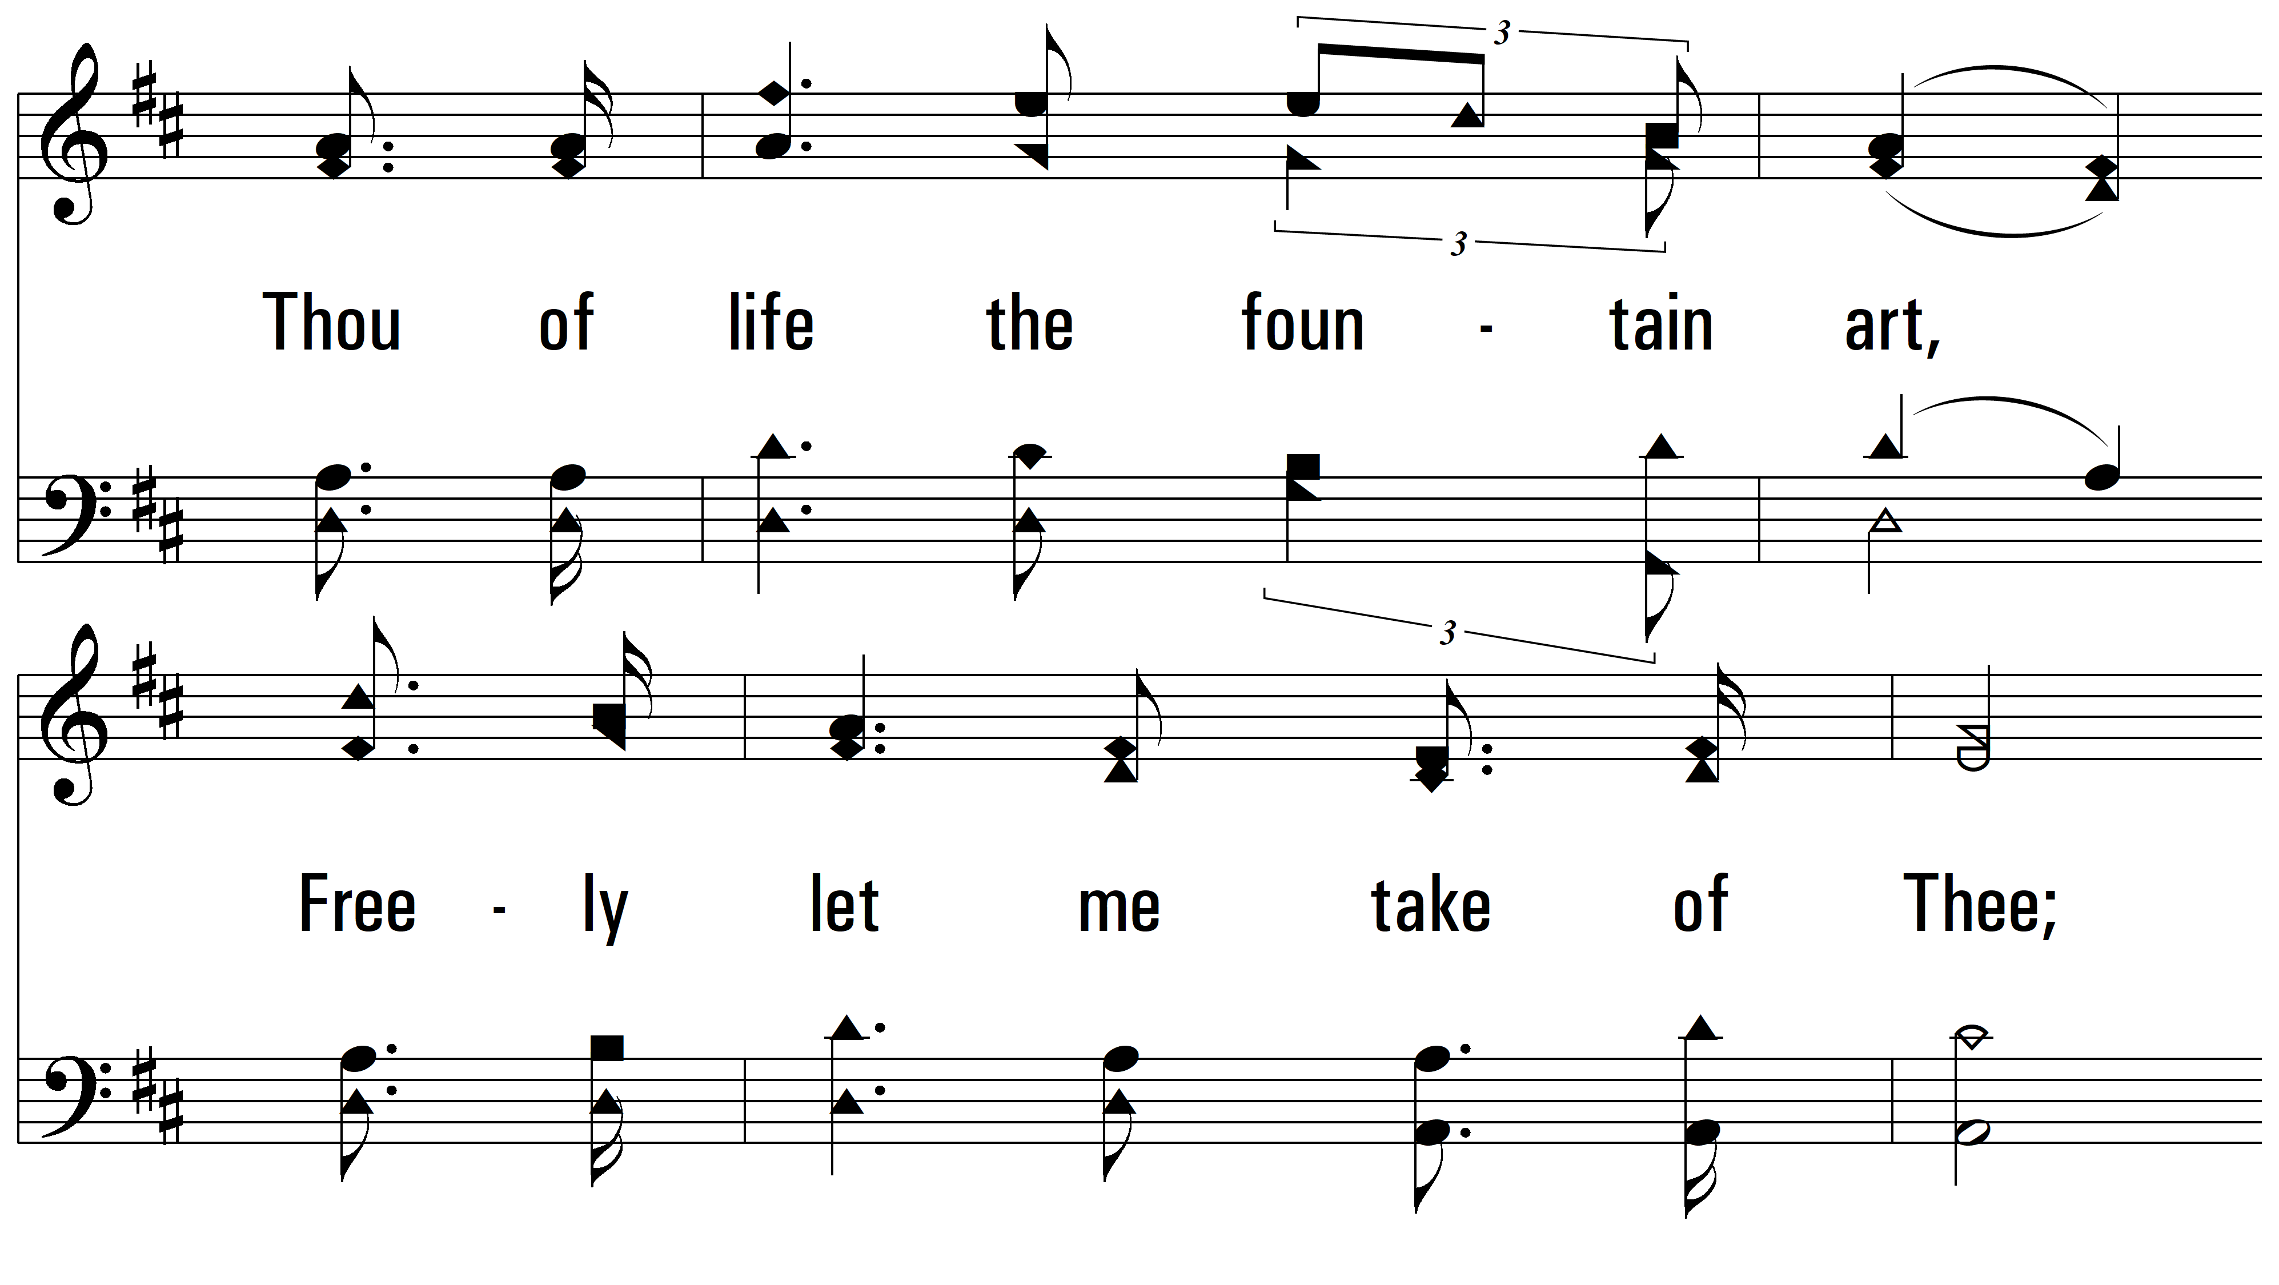
vs. 4

Slide 17
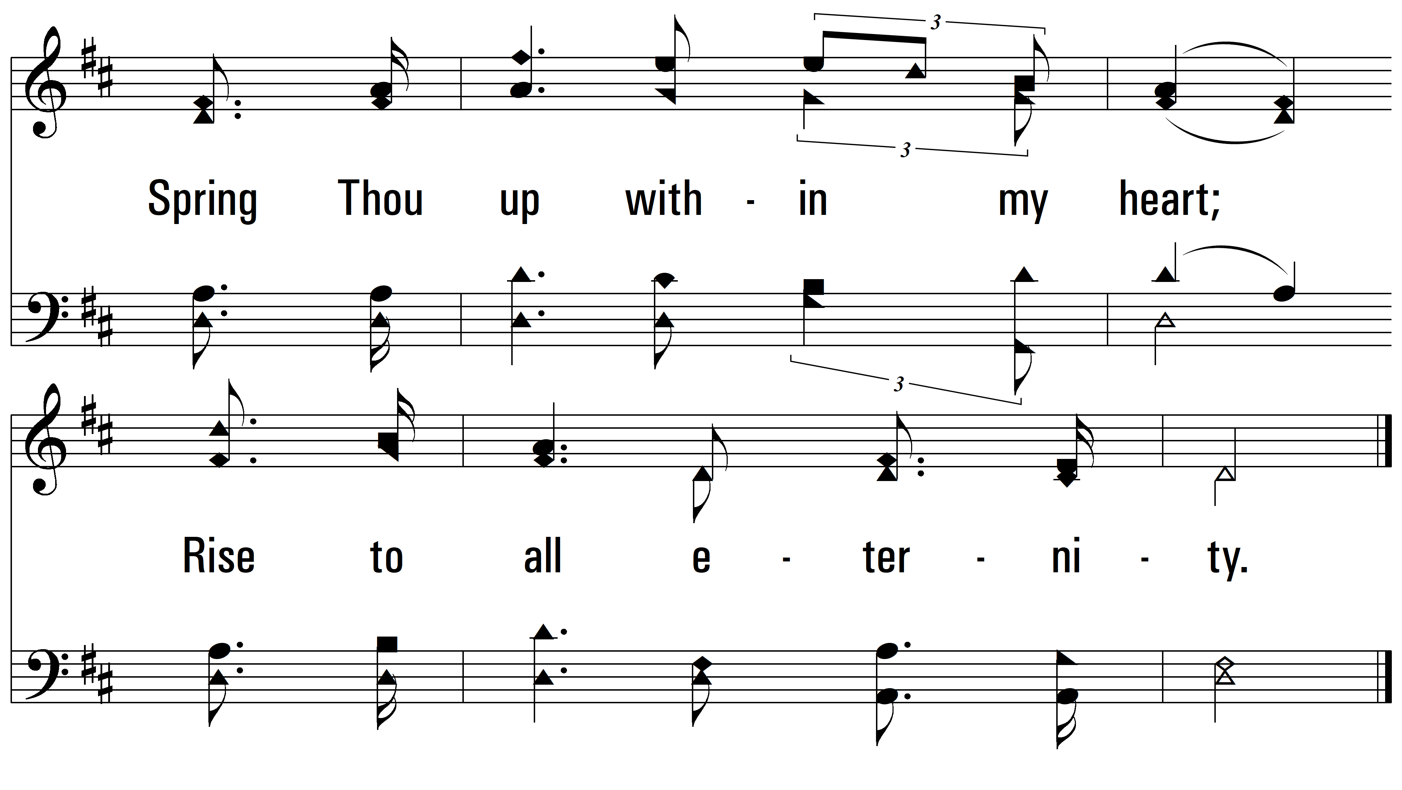
vs. 4
PDHymns.com
END

