Slide 1
Kneel At The Cross
Words: | Charles E. Moody (1924)
Music: | Charles E. Moody (1924)
4/4
B^{b}/F - SOL
Verses: 3/Chorus
Lead - | SOL
Alto - | MI
Tenor - | DO
Bass - | DO
PDHymns.com

Slide 2
vs. 1 ~ Kneel At The Cross

Slide 3
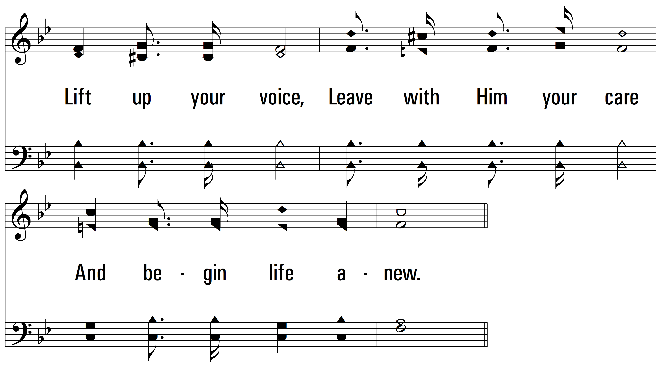
vs. 1

Slide 4
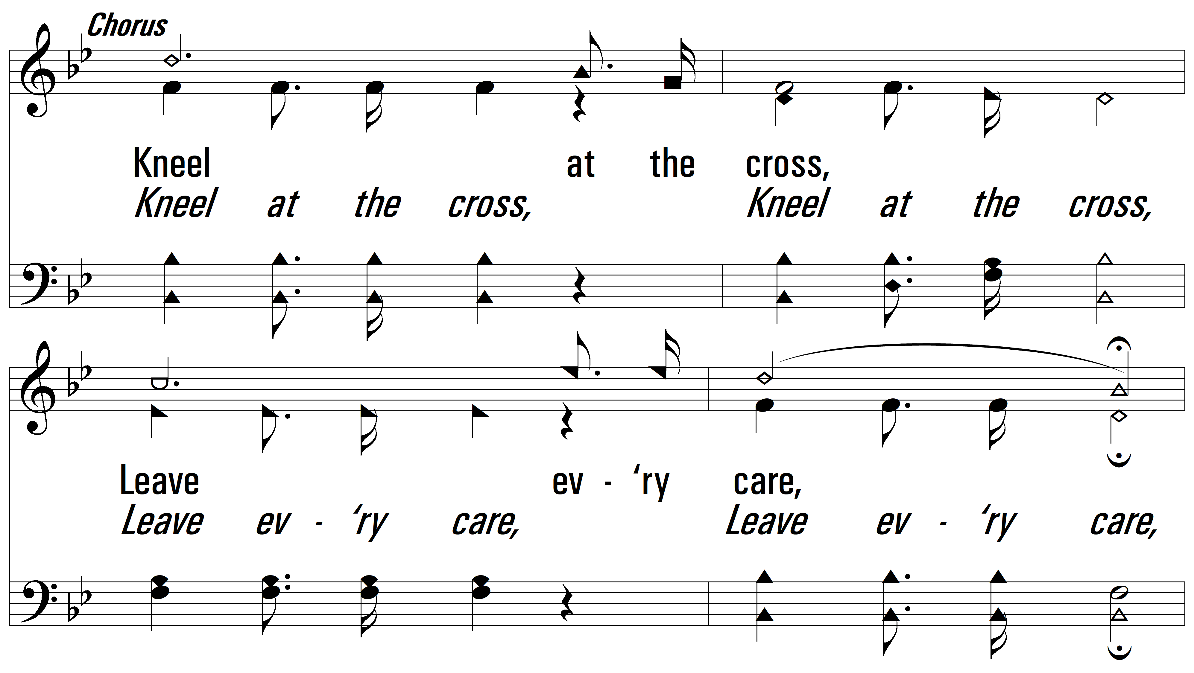
vs. 1

Slide 5
vs. 1

Slide 6
vs. 2 ~ Kneel At The Cross

Slide 7
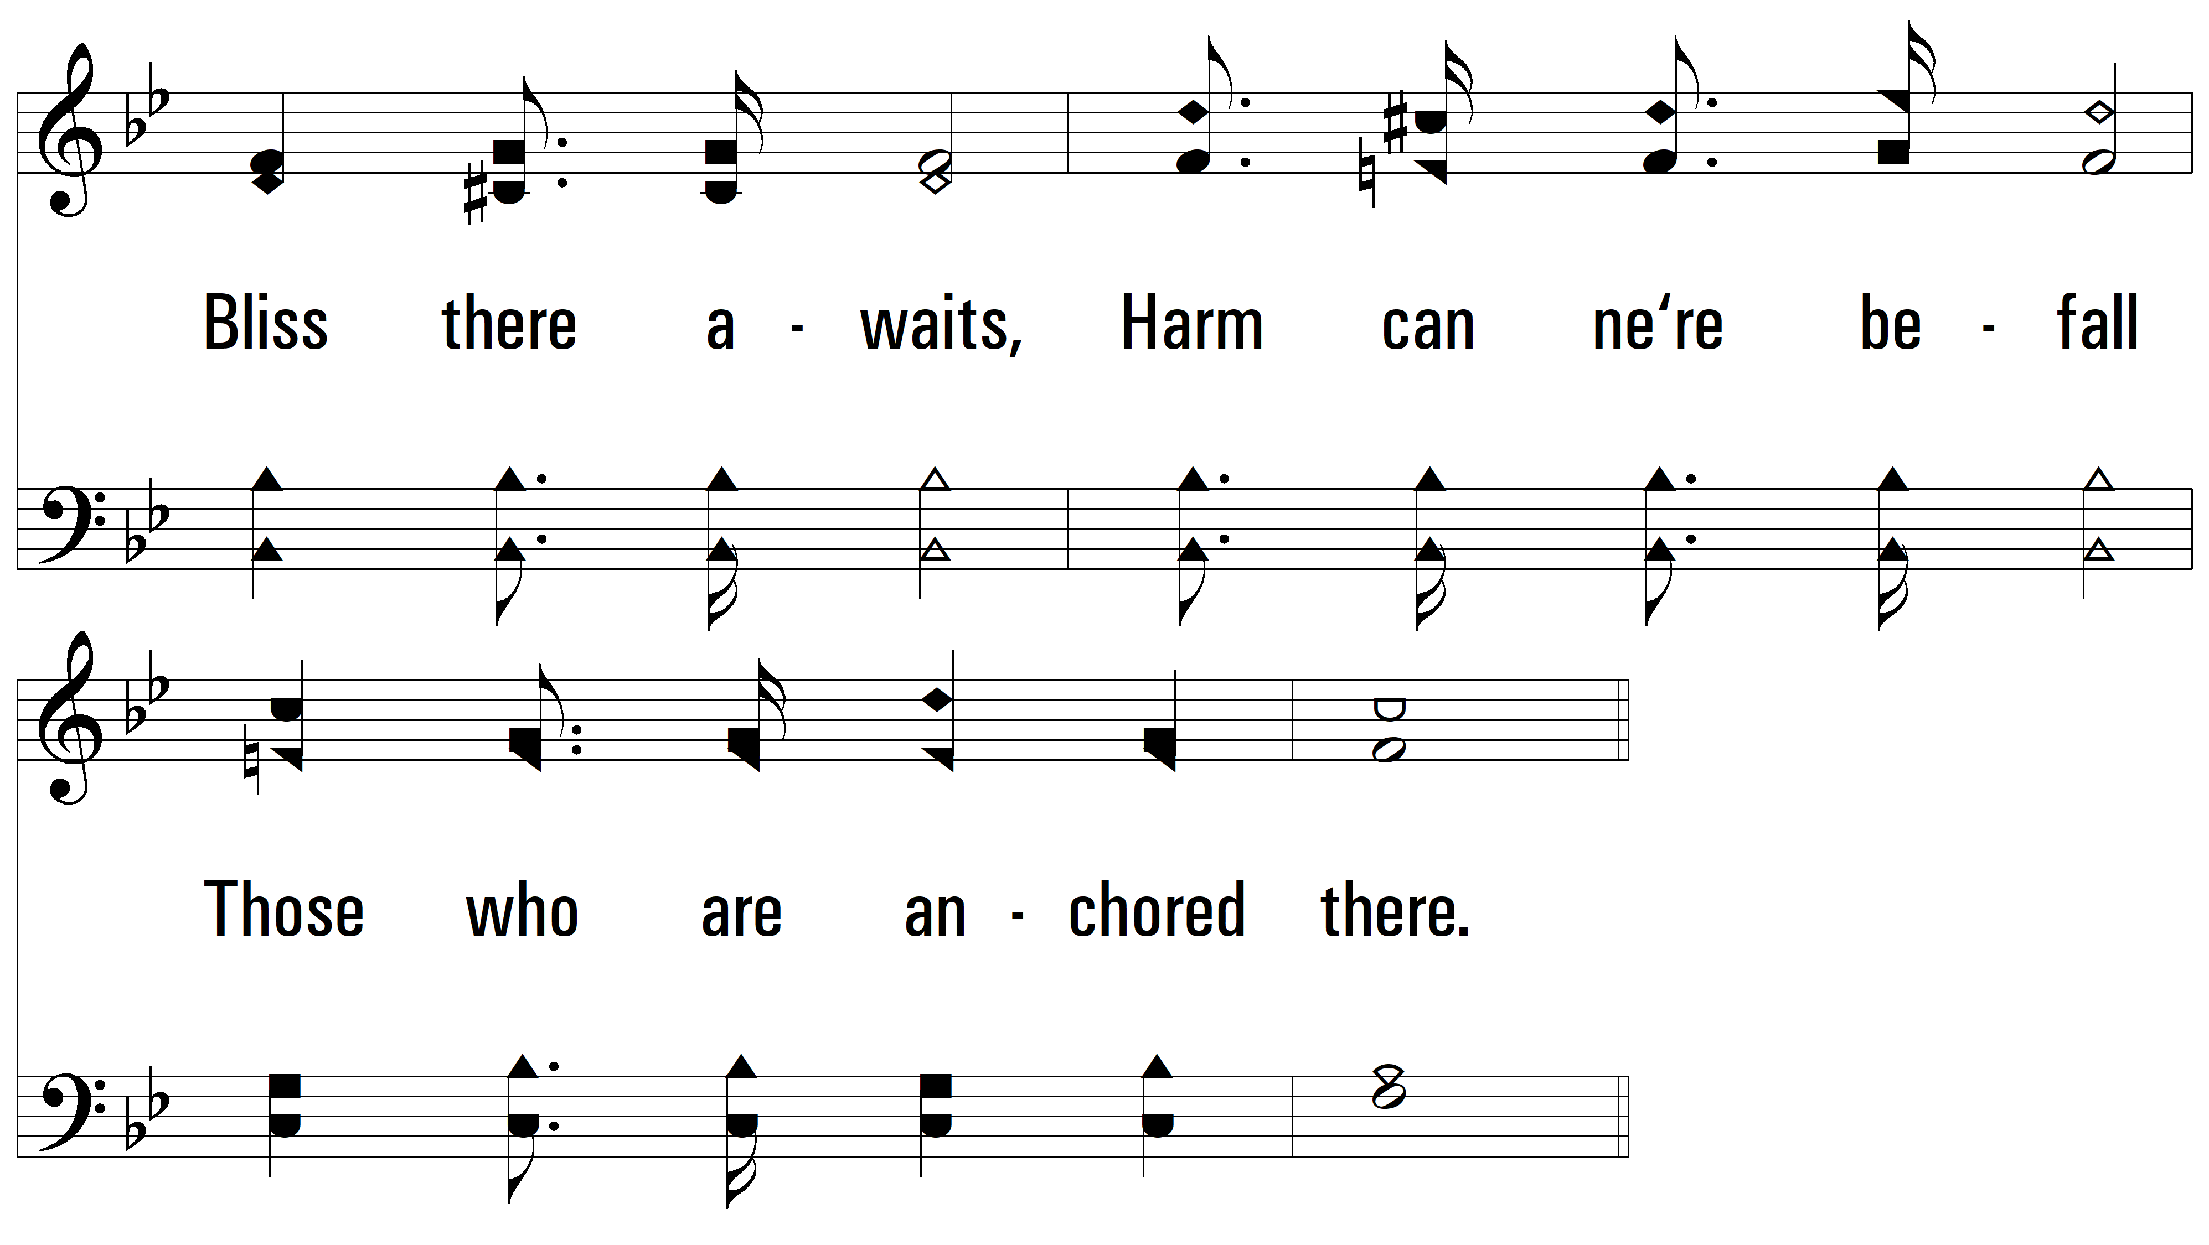
vs. 2

Slide 8
vs. 2

Slide 9
vs. 2

Slide 10
vs. 3 ~ Kneel At The Cross

Slide 11
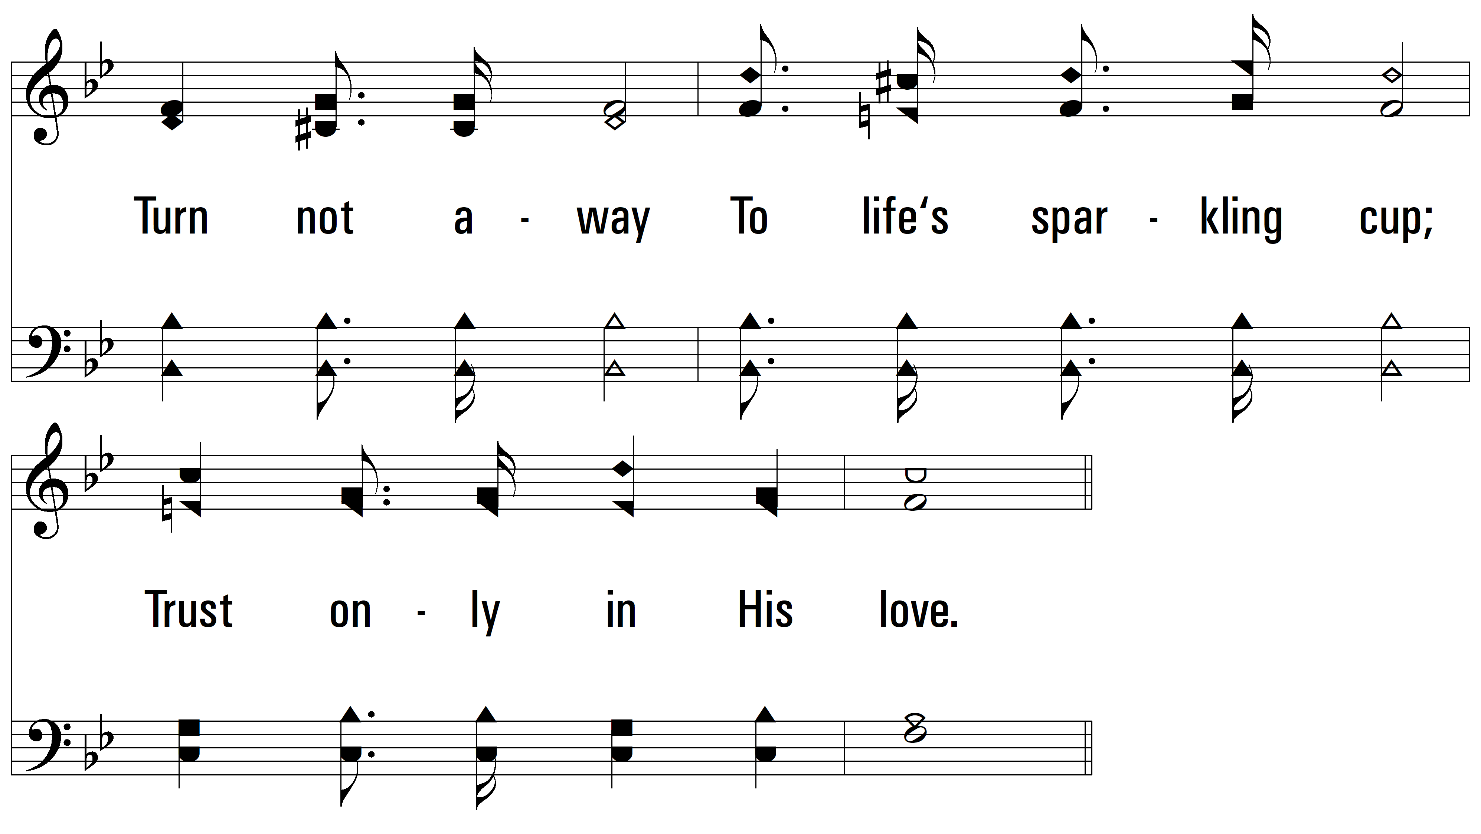
vs. 3

Slide 12
vs. 3

Slide 13
vs. 3
PDHymns.com
END

