Slide 1
Let Every Heart Rejoice And Sing
Words: | Henry S. Washburne (1842)
Music: | George J. Webb (1848)
4/4
F/F - DO
Verses: 2/Chorus
Lead - | DO
Alto - | SOL
Tenor - | MI
Bass - | DO
PDHymns.com

Slide 2
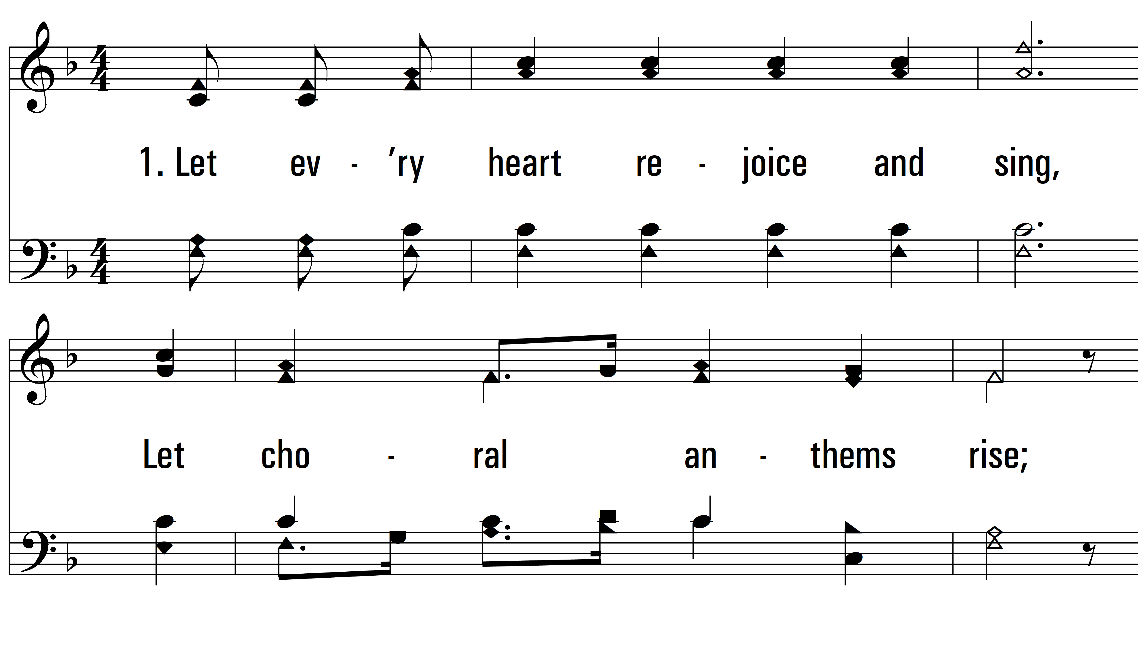
vs. 1 ~ Let Every Heart Rejoice And Sing

Slide 3
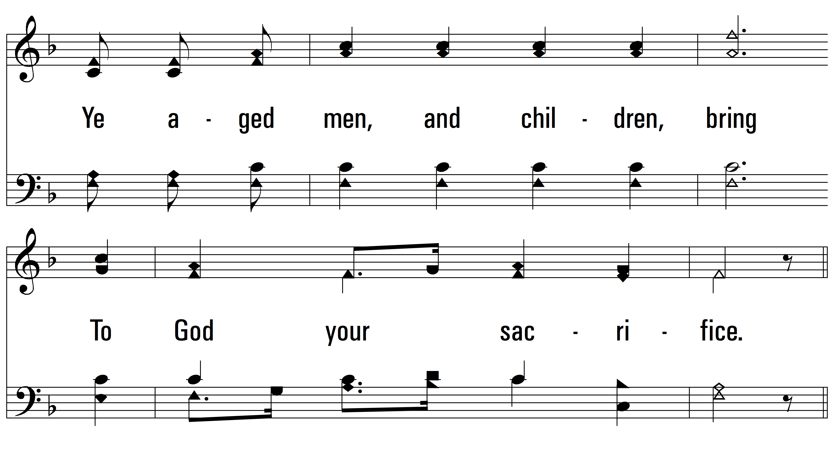
vs. 1

Slide 4
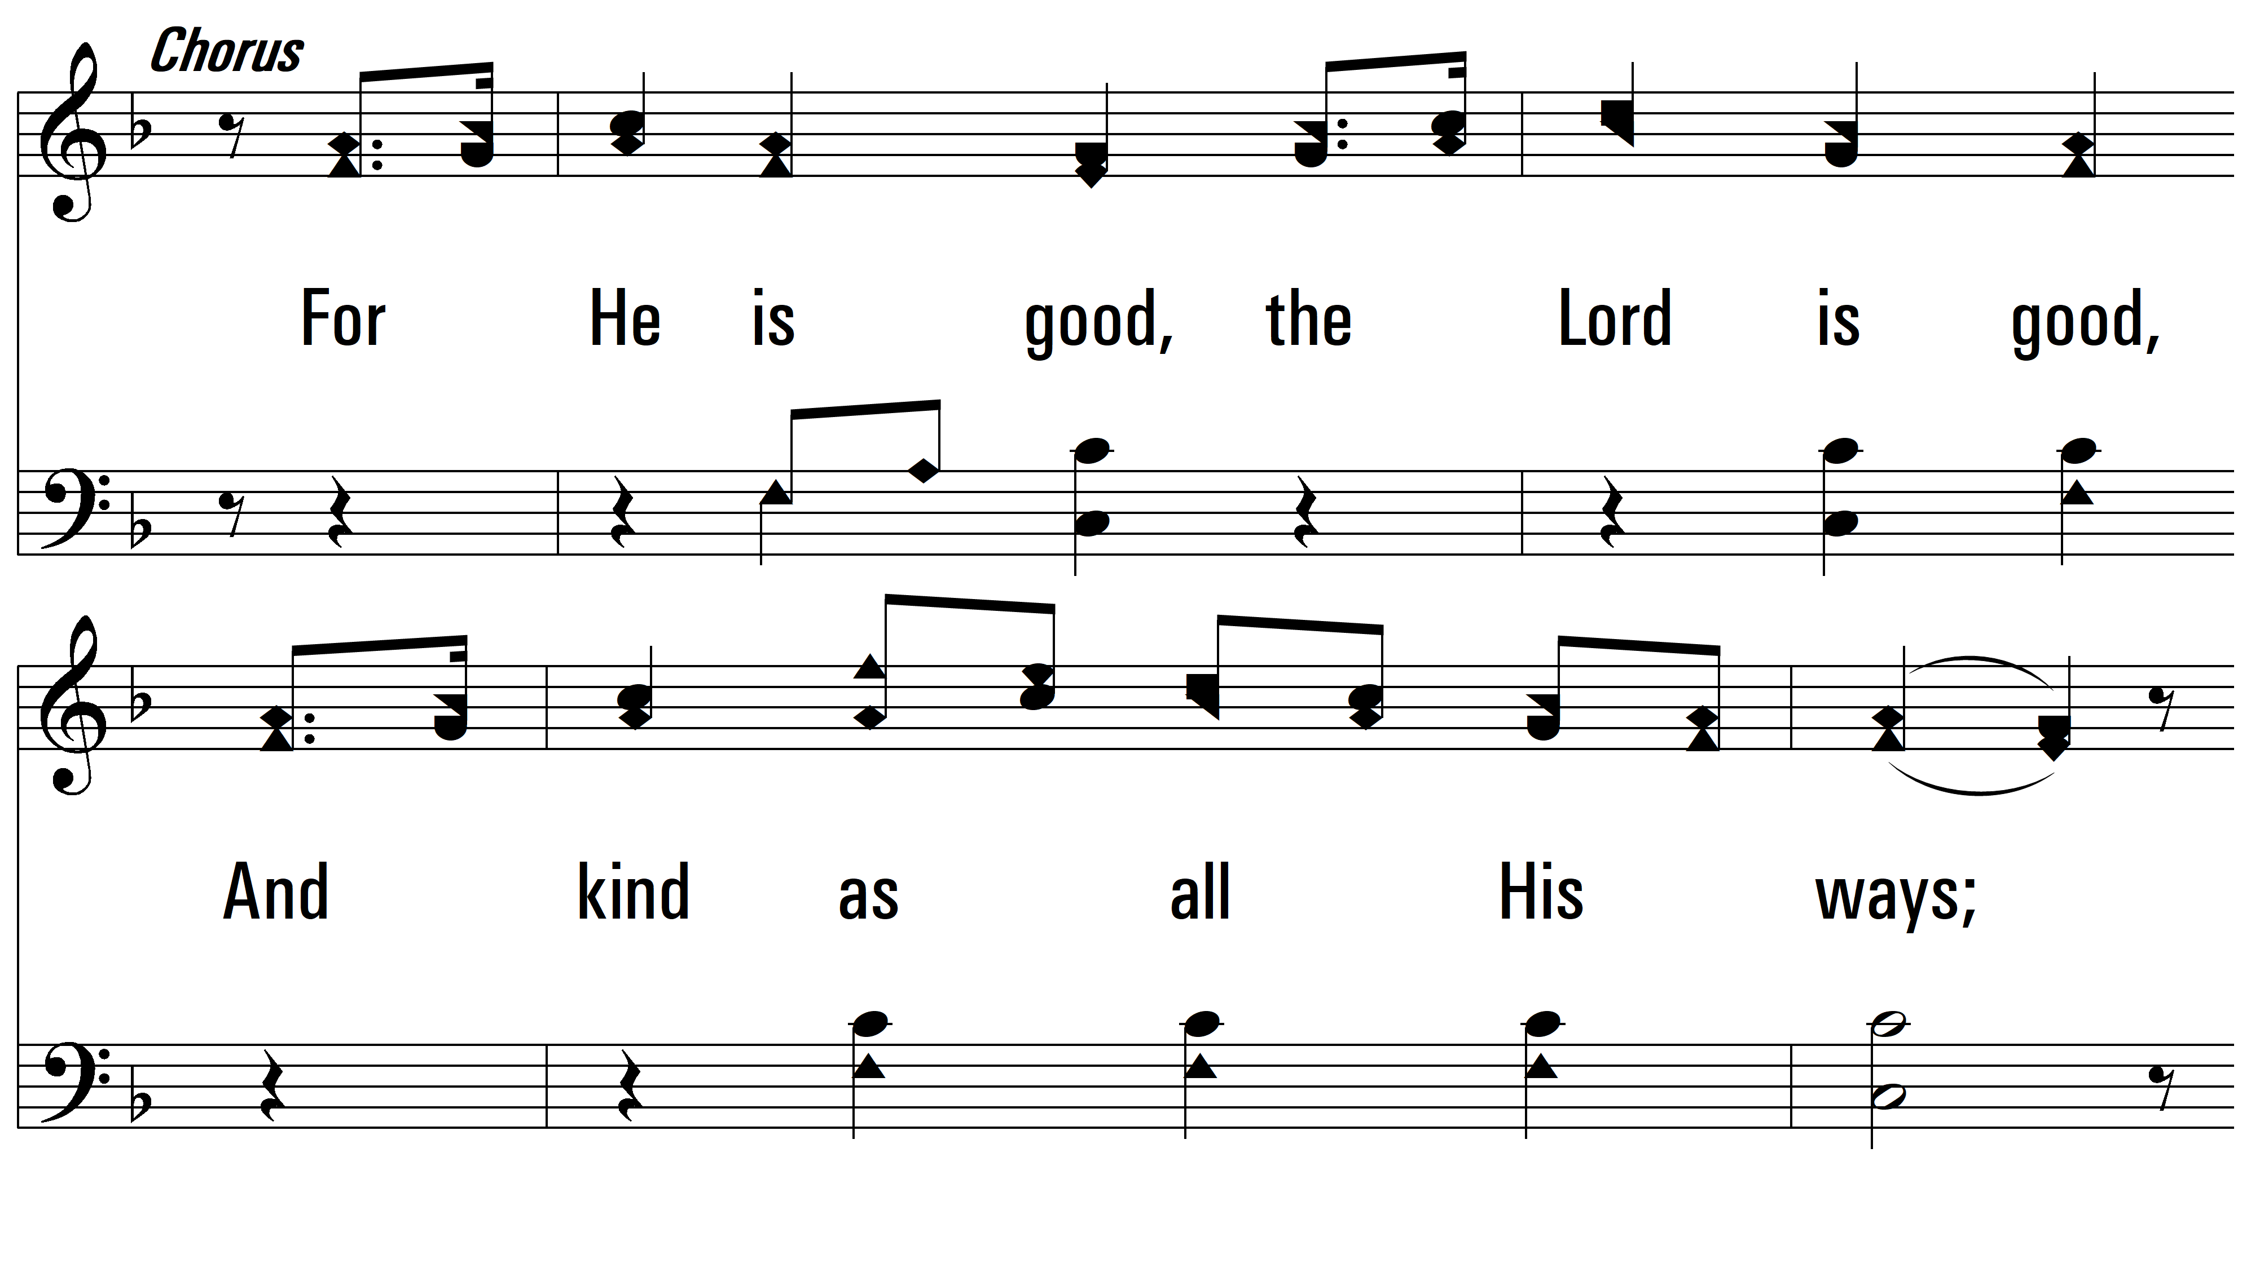
vs. 1

Slide 5
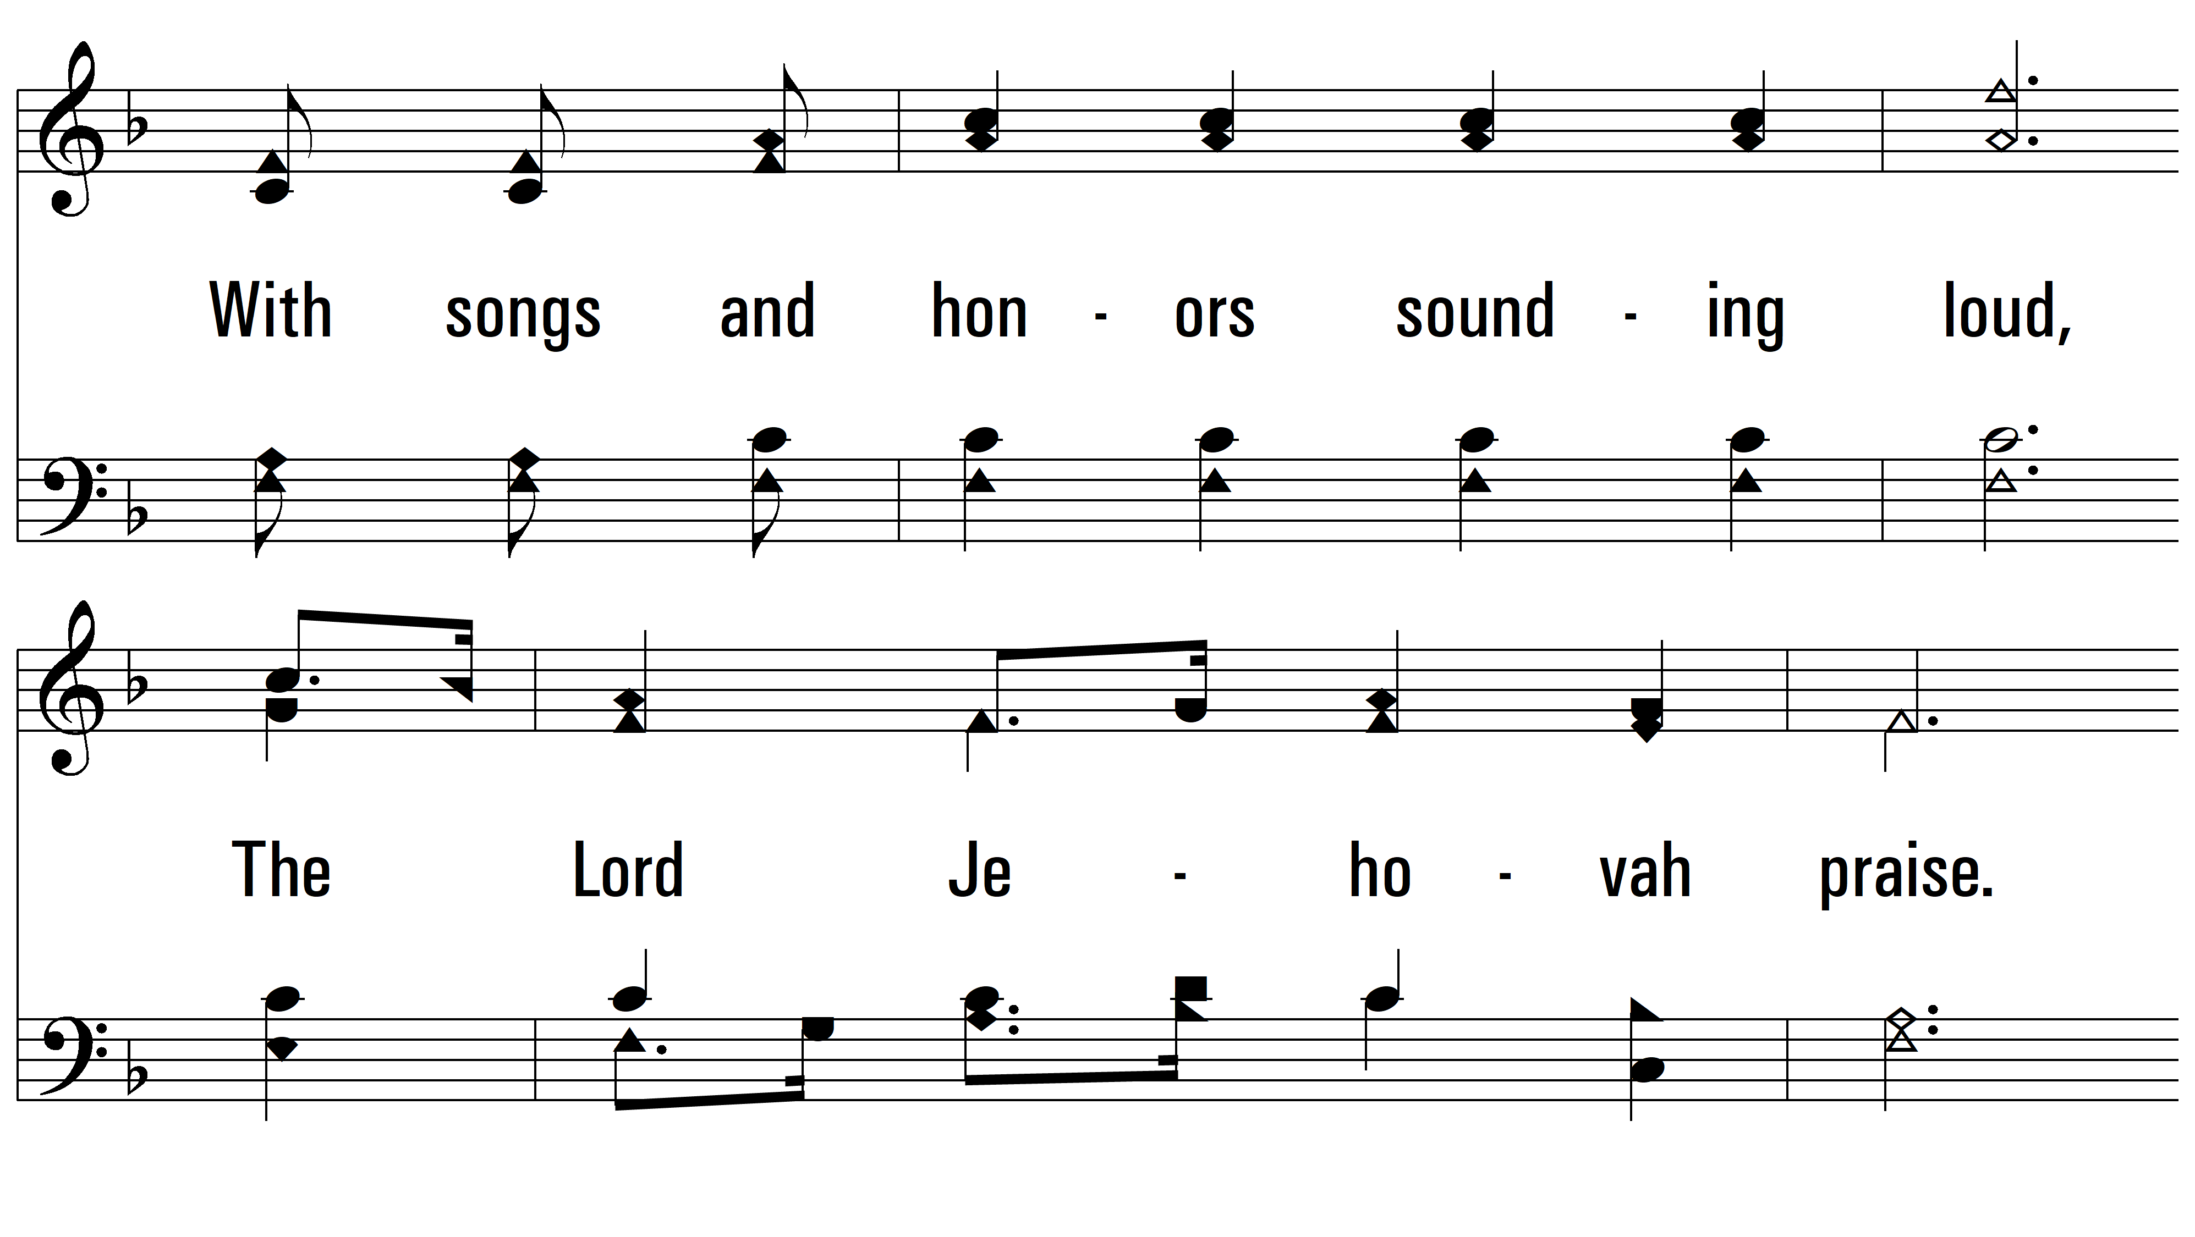
vs. 1

Slide 6
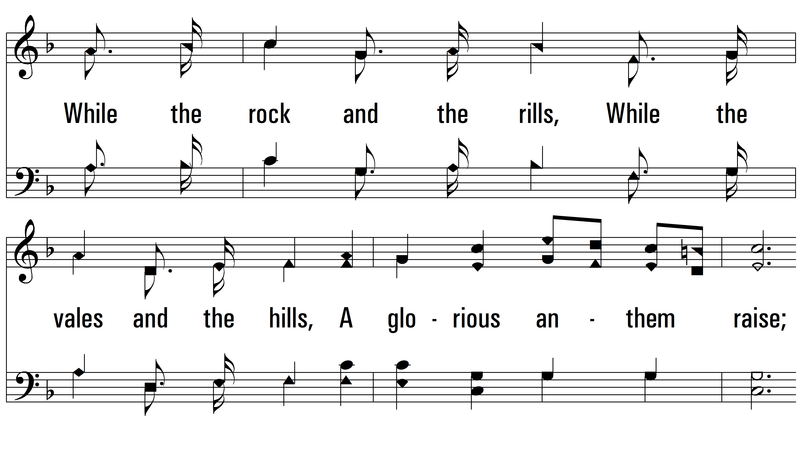
vs. 1

Slide 7
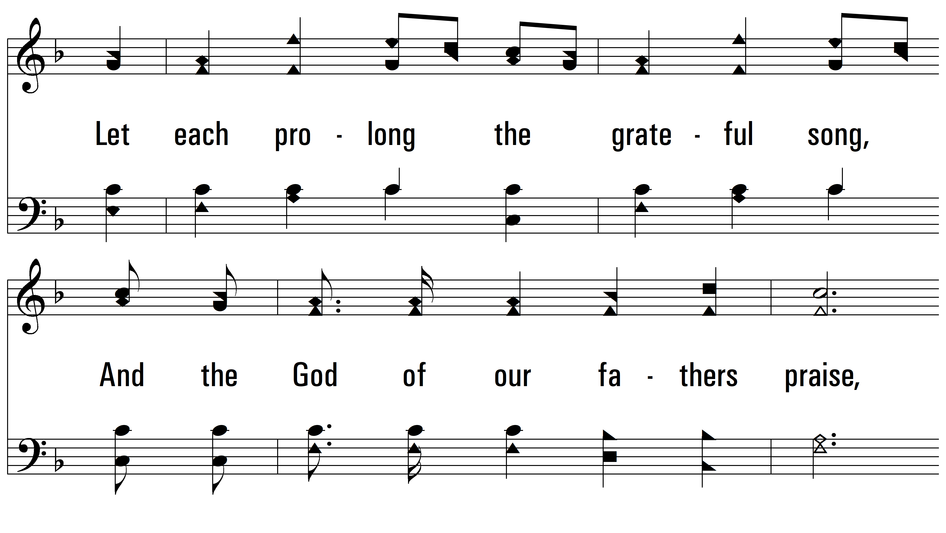
vs. 1

Slide 8
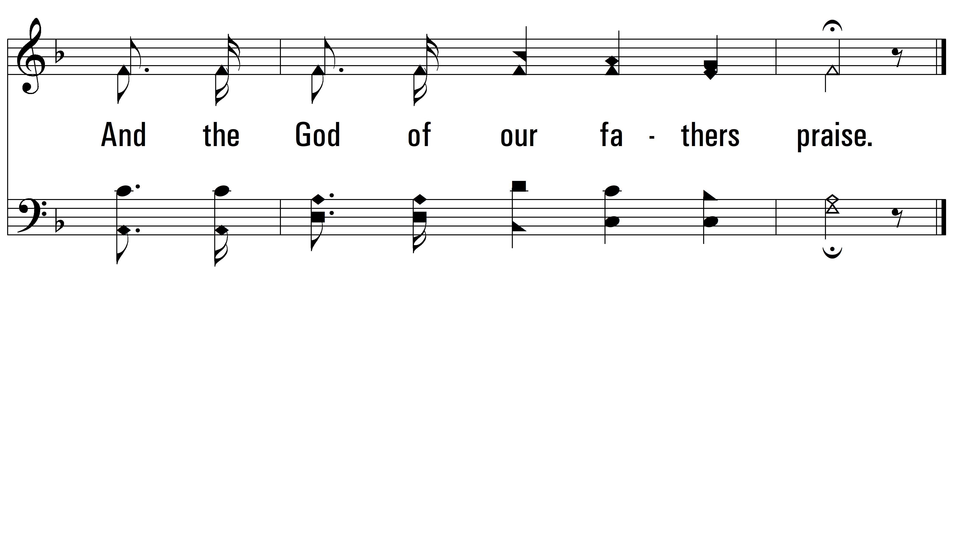
vs. 1

Slide 9
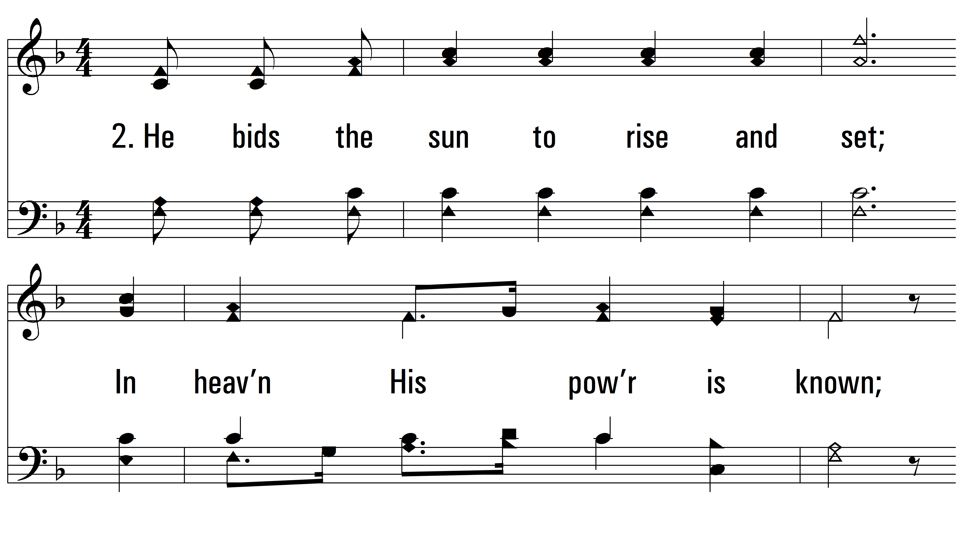
vs. 2 ~ Let Every Heart Rejoice And Sing

Slide 10
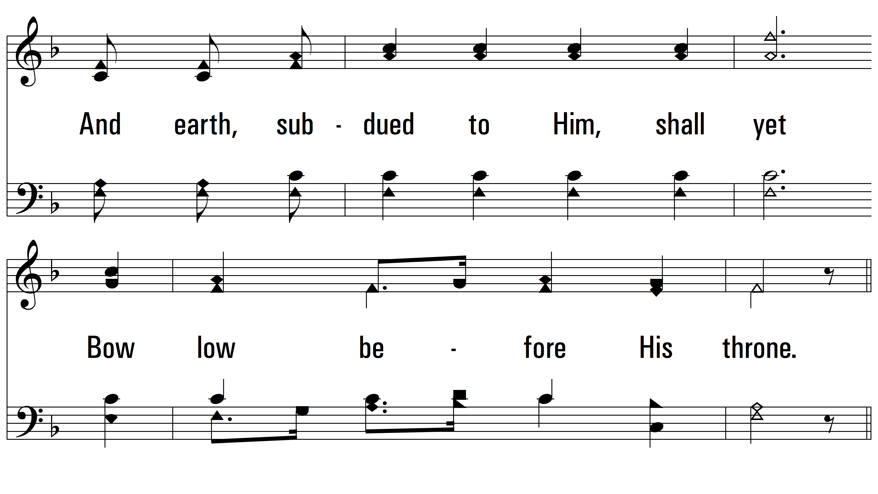
vs. 2

Slide 11
vs. 2

Slide 12
vs. 2

Slide 13
vs. 2

Slide 14
vs. 2

Slide 15
vs. 2
PDHymns.com
END

