Slide 1
Let Him Have His Way With Thee
(His Way With Thee)
Words: | Cyrus S. Nusbaum (1898)
Music: | Cyrus S. Nusbaum (1898)
4/4
G/D - SOL
Verses: 3/Chorus
Lead - | SOL
Alto - | SOL
Tenor - | MI
Bass - | DO
PDHymns.com

Slide 2
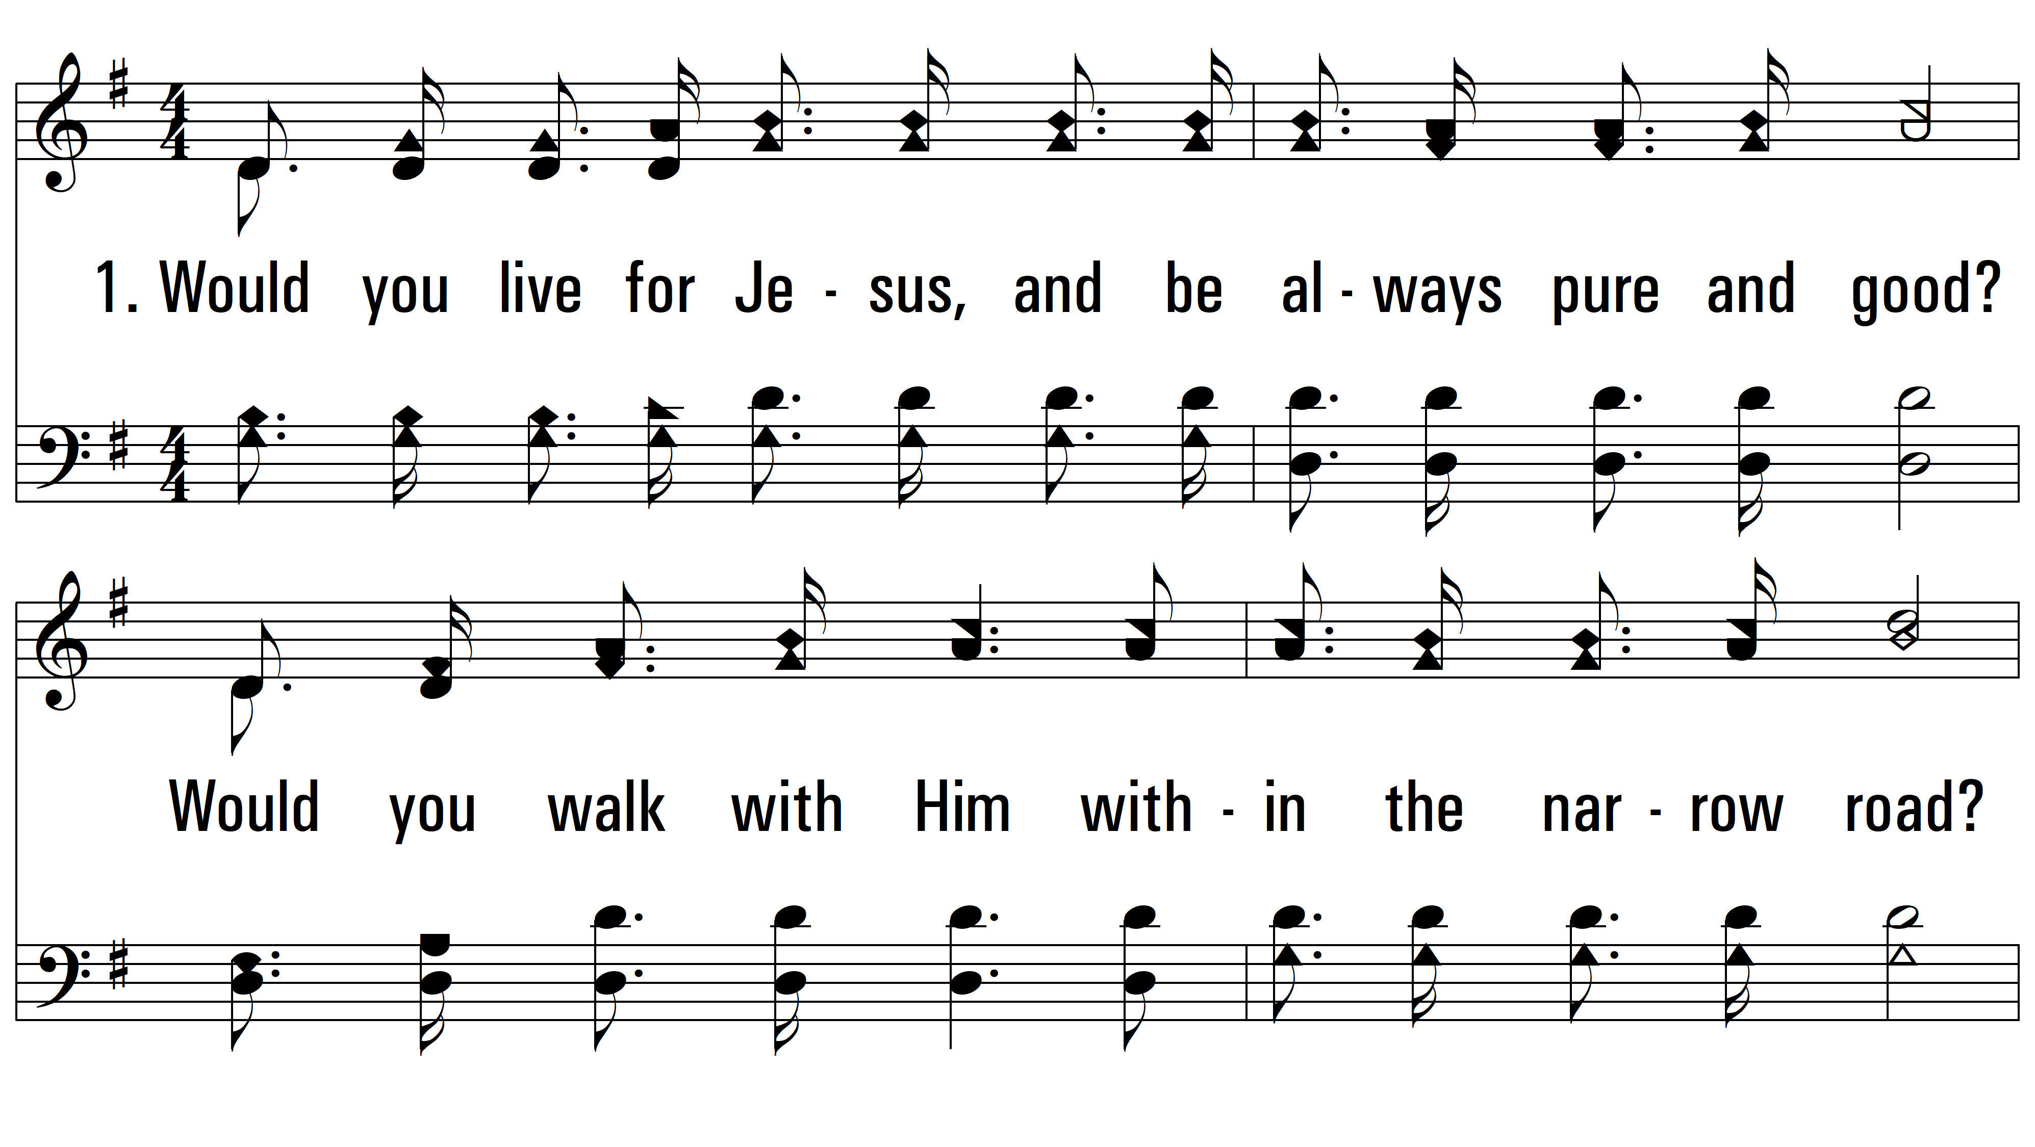
vs. 1 ~ Let Him Have His Way With Thee

Slide 3
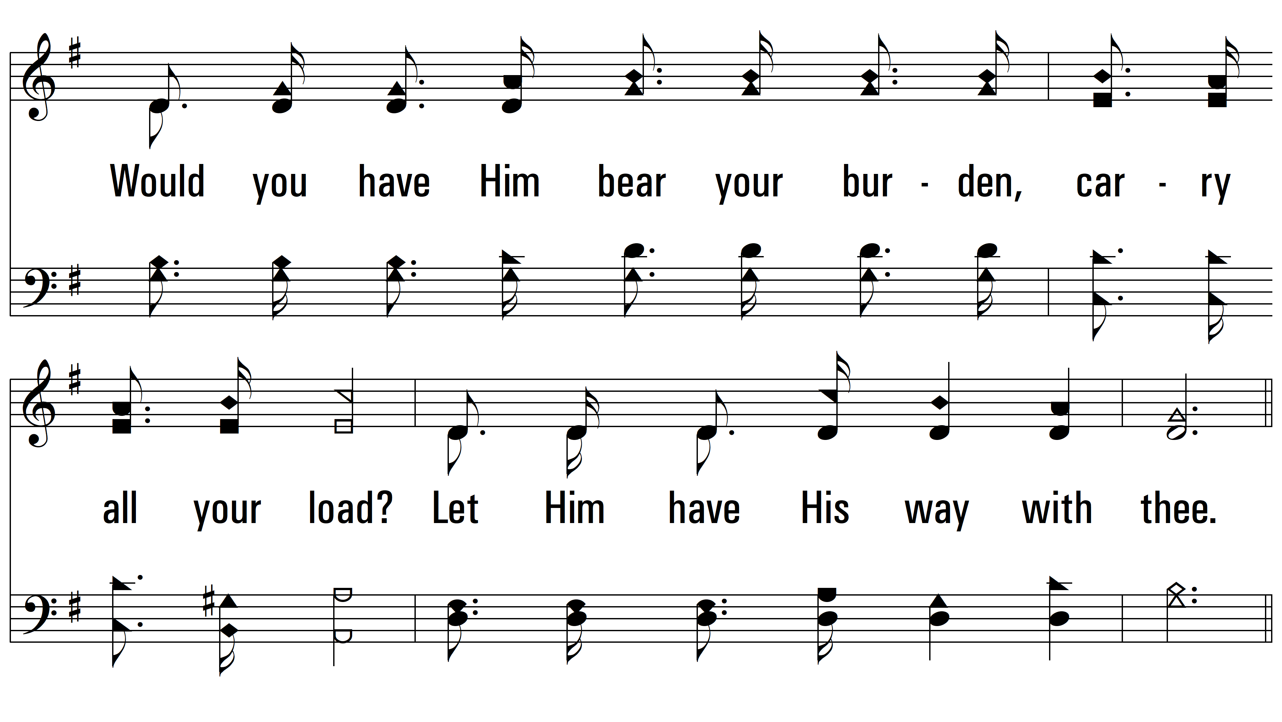
vs. 1

Slide 4
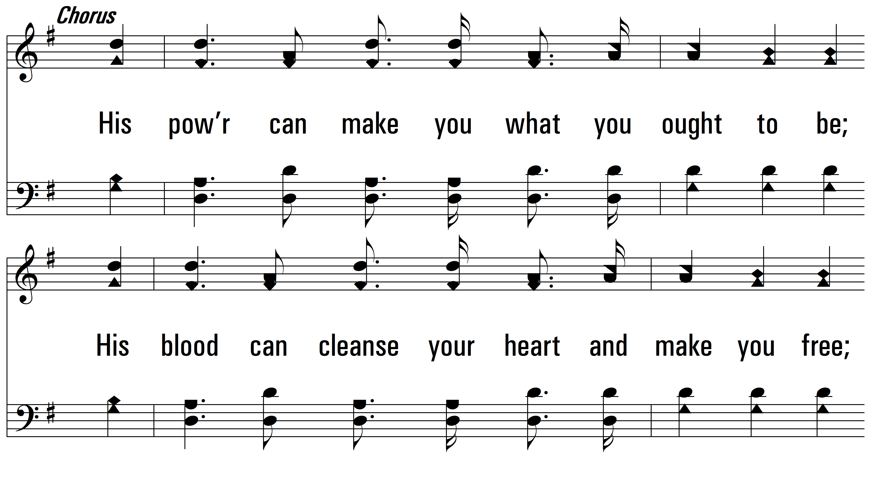
vs. 1

Slide 5
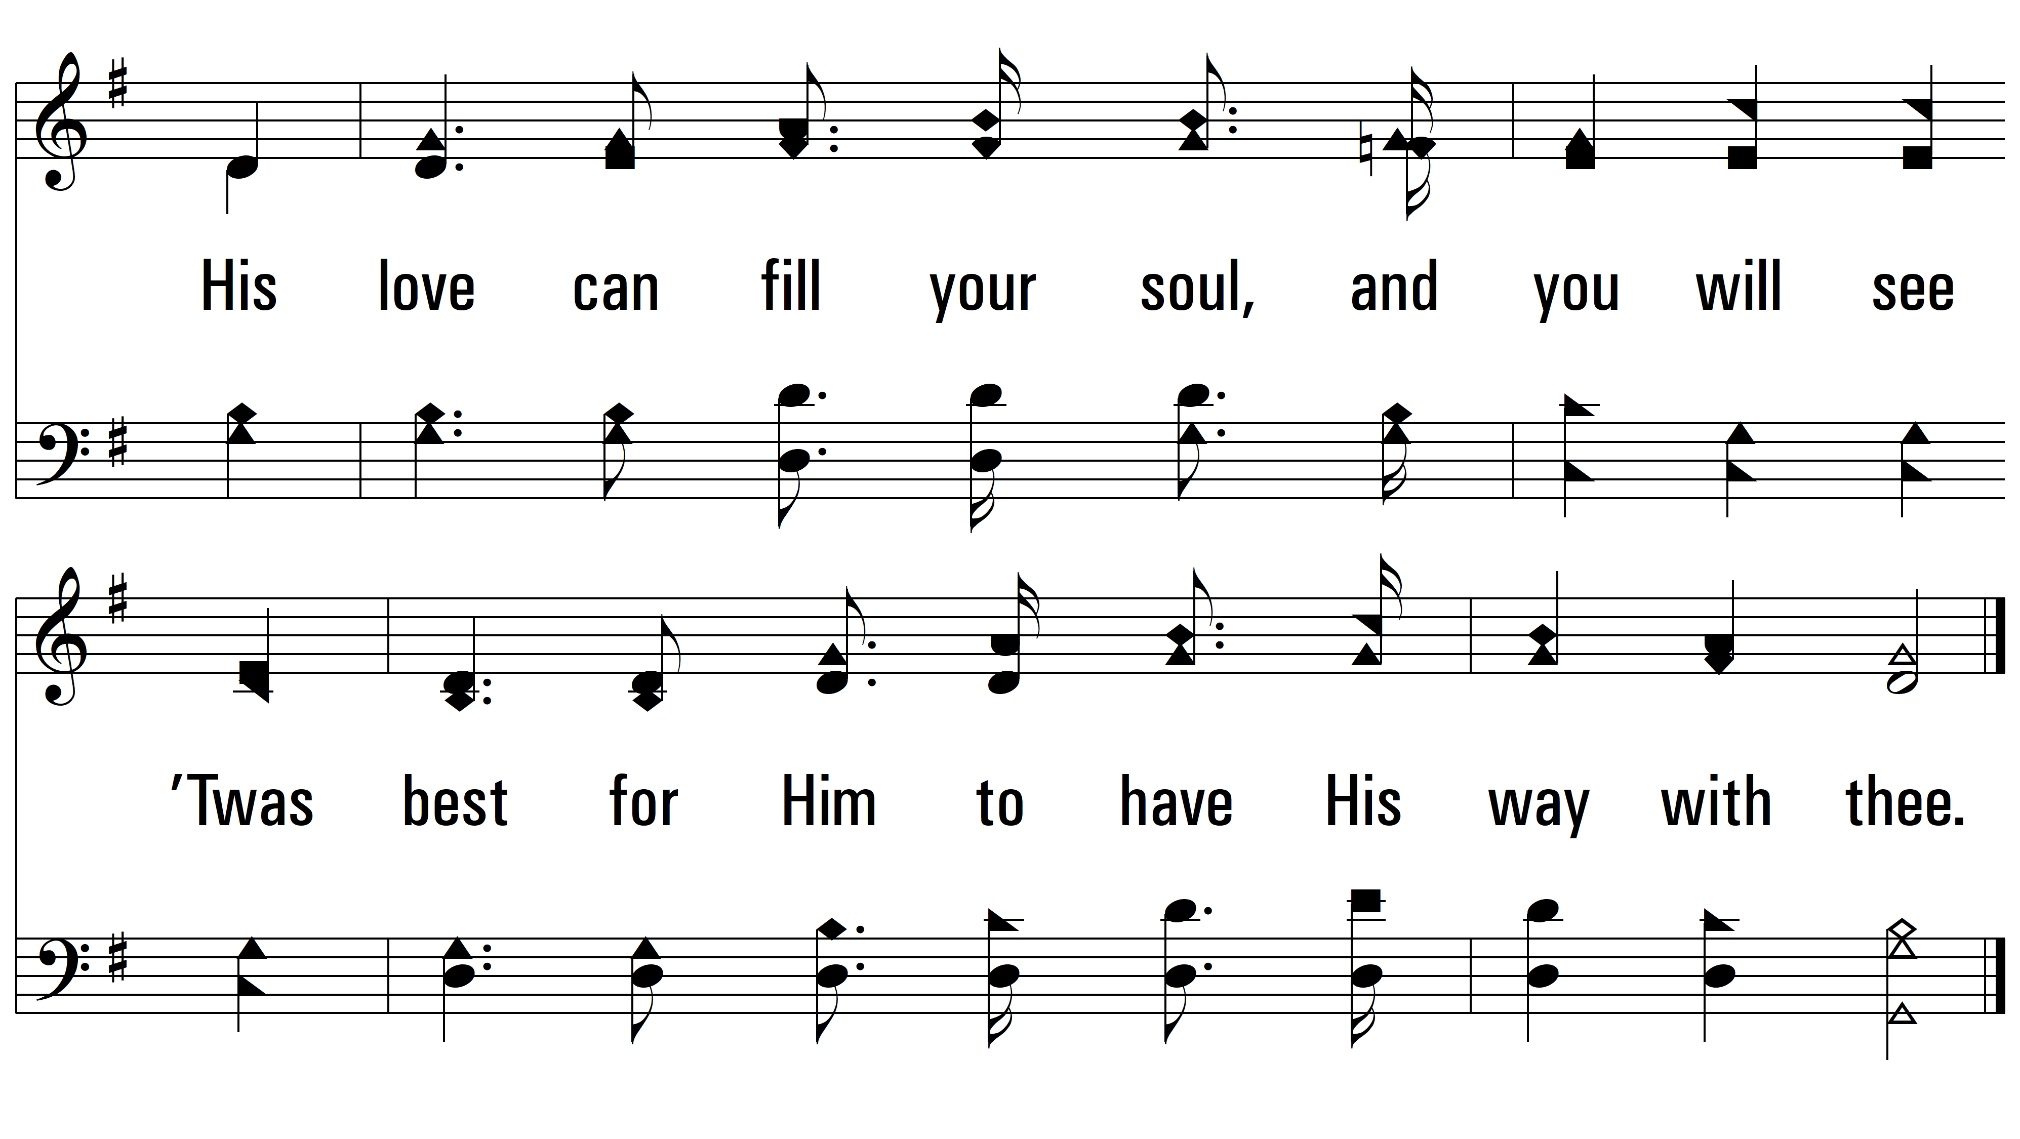
vs. 1

Slide 6
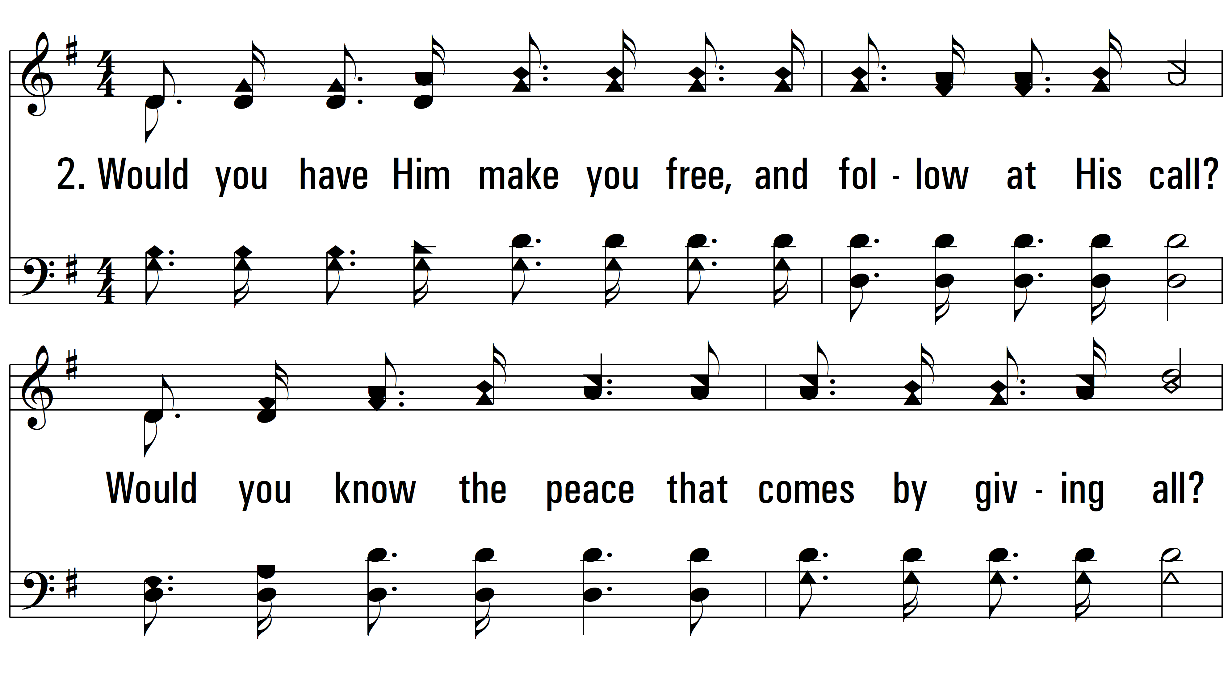
vs. 2 ~ Let Him Have His Way With Thee

Slide 7
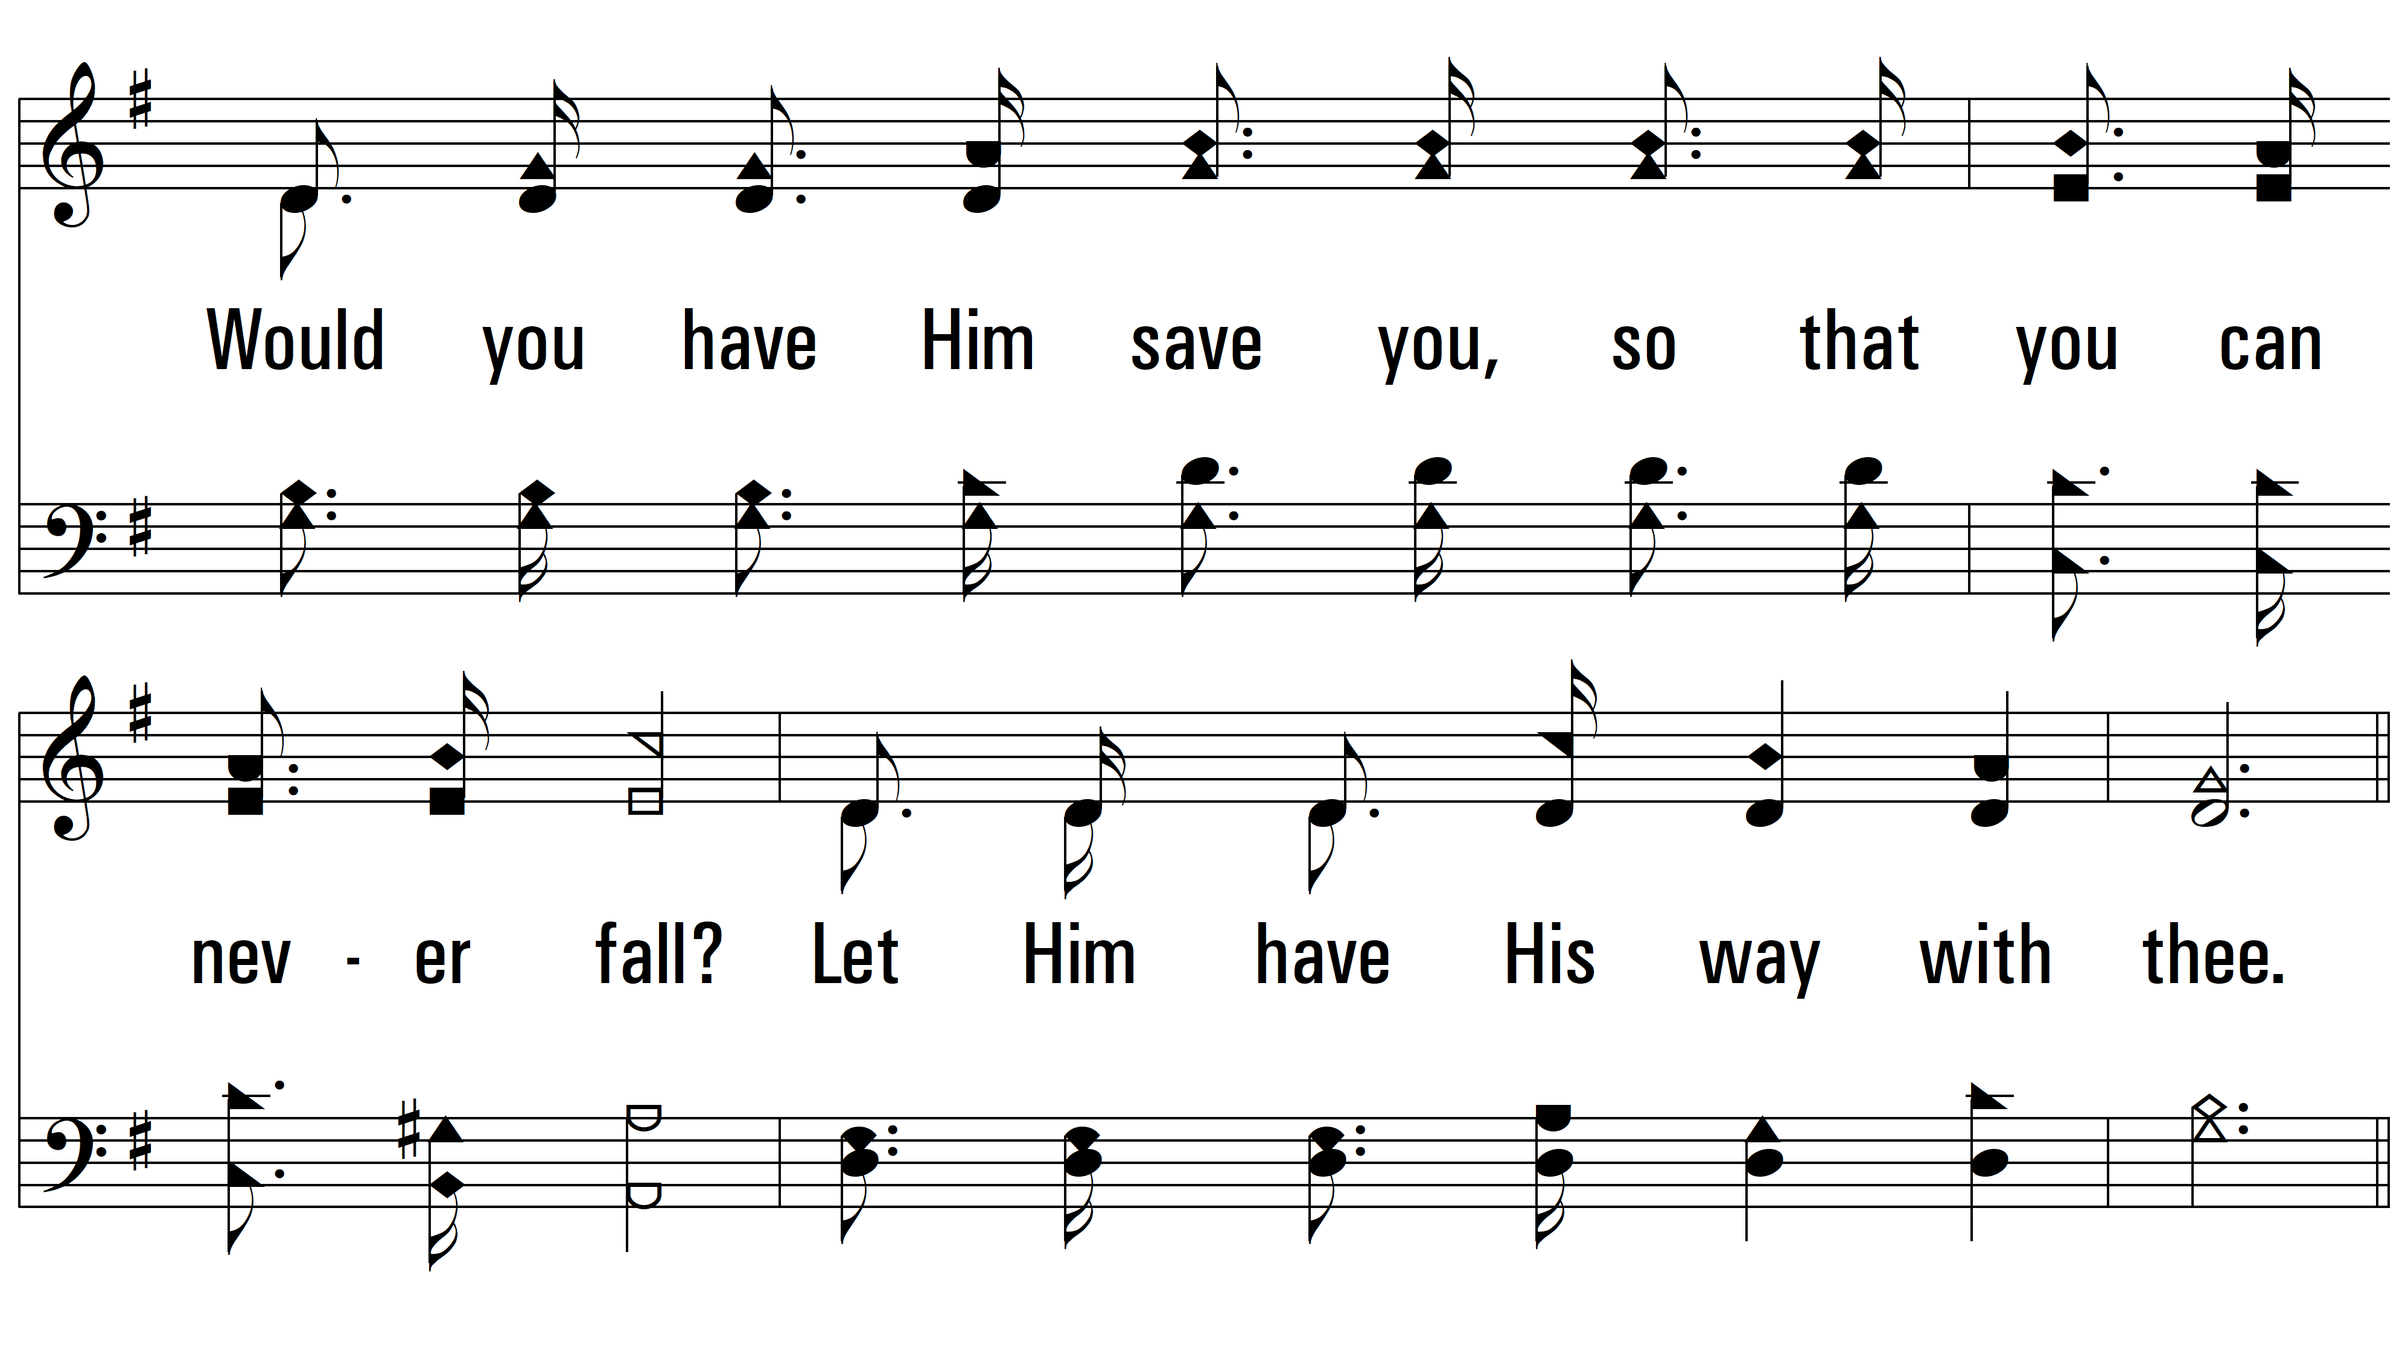
vs. 2

Slide 8
vs. 2

Slide 9
vs. 2

Slide 10
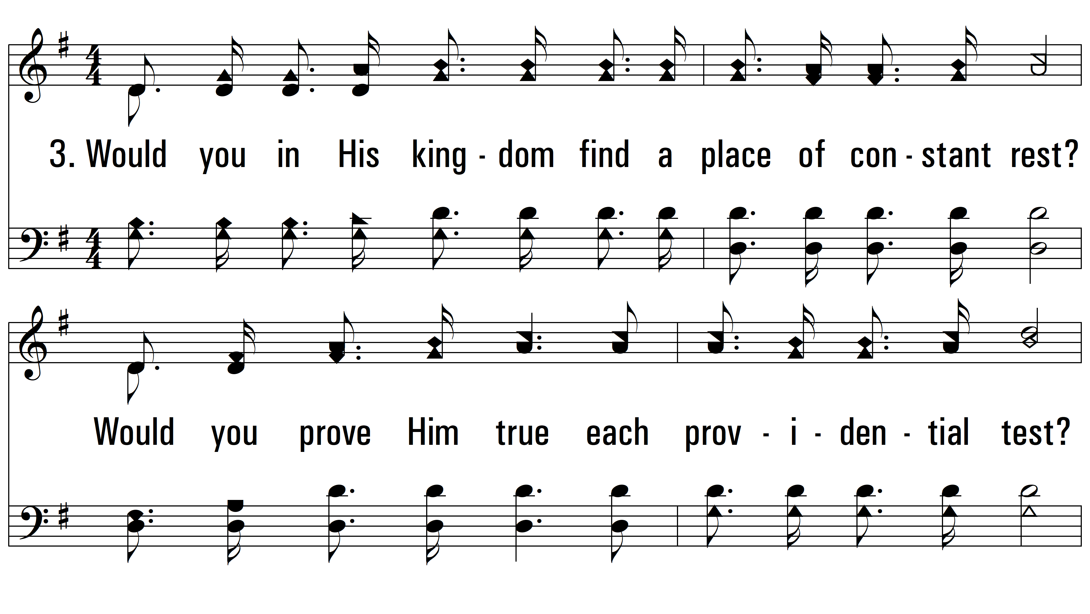
vs. 3 ~ Let Him Have His Way With Thee

Slide 11
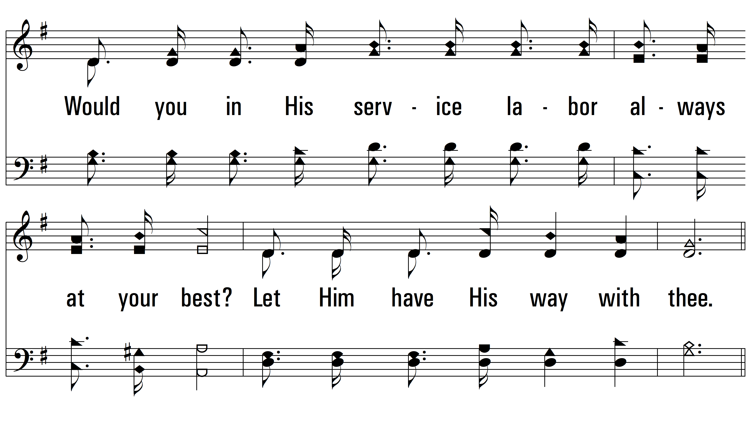
vs. 3

Slide 12
vs. 3

Slide 13
vs. 3
PDHymns.com
END

