Slide 1
Let Him In
(There’s A Stranger At The Door)
Words: | J. B. Atchinson (1881)
Music: | E. O. Excell (1881)
4/4
C/E - MI
Verses: 3
Lead - | MI
Alto - | DO
Tenor - | SOL
Bass - | DO
PDHymns.com

Slide 2
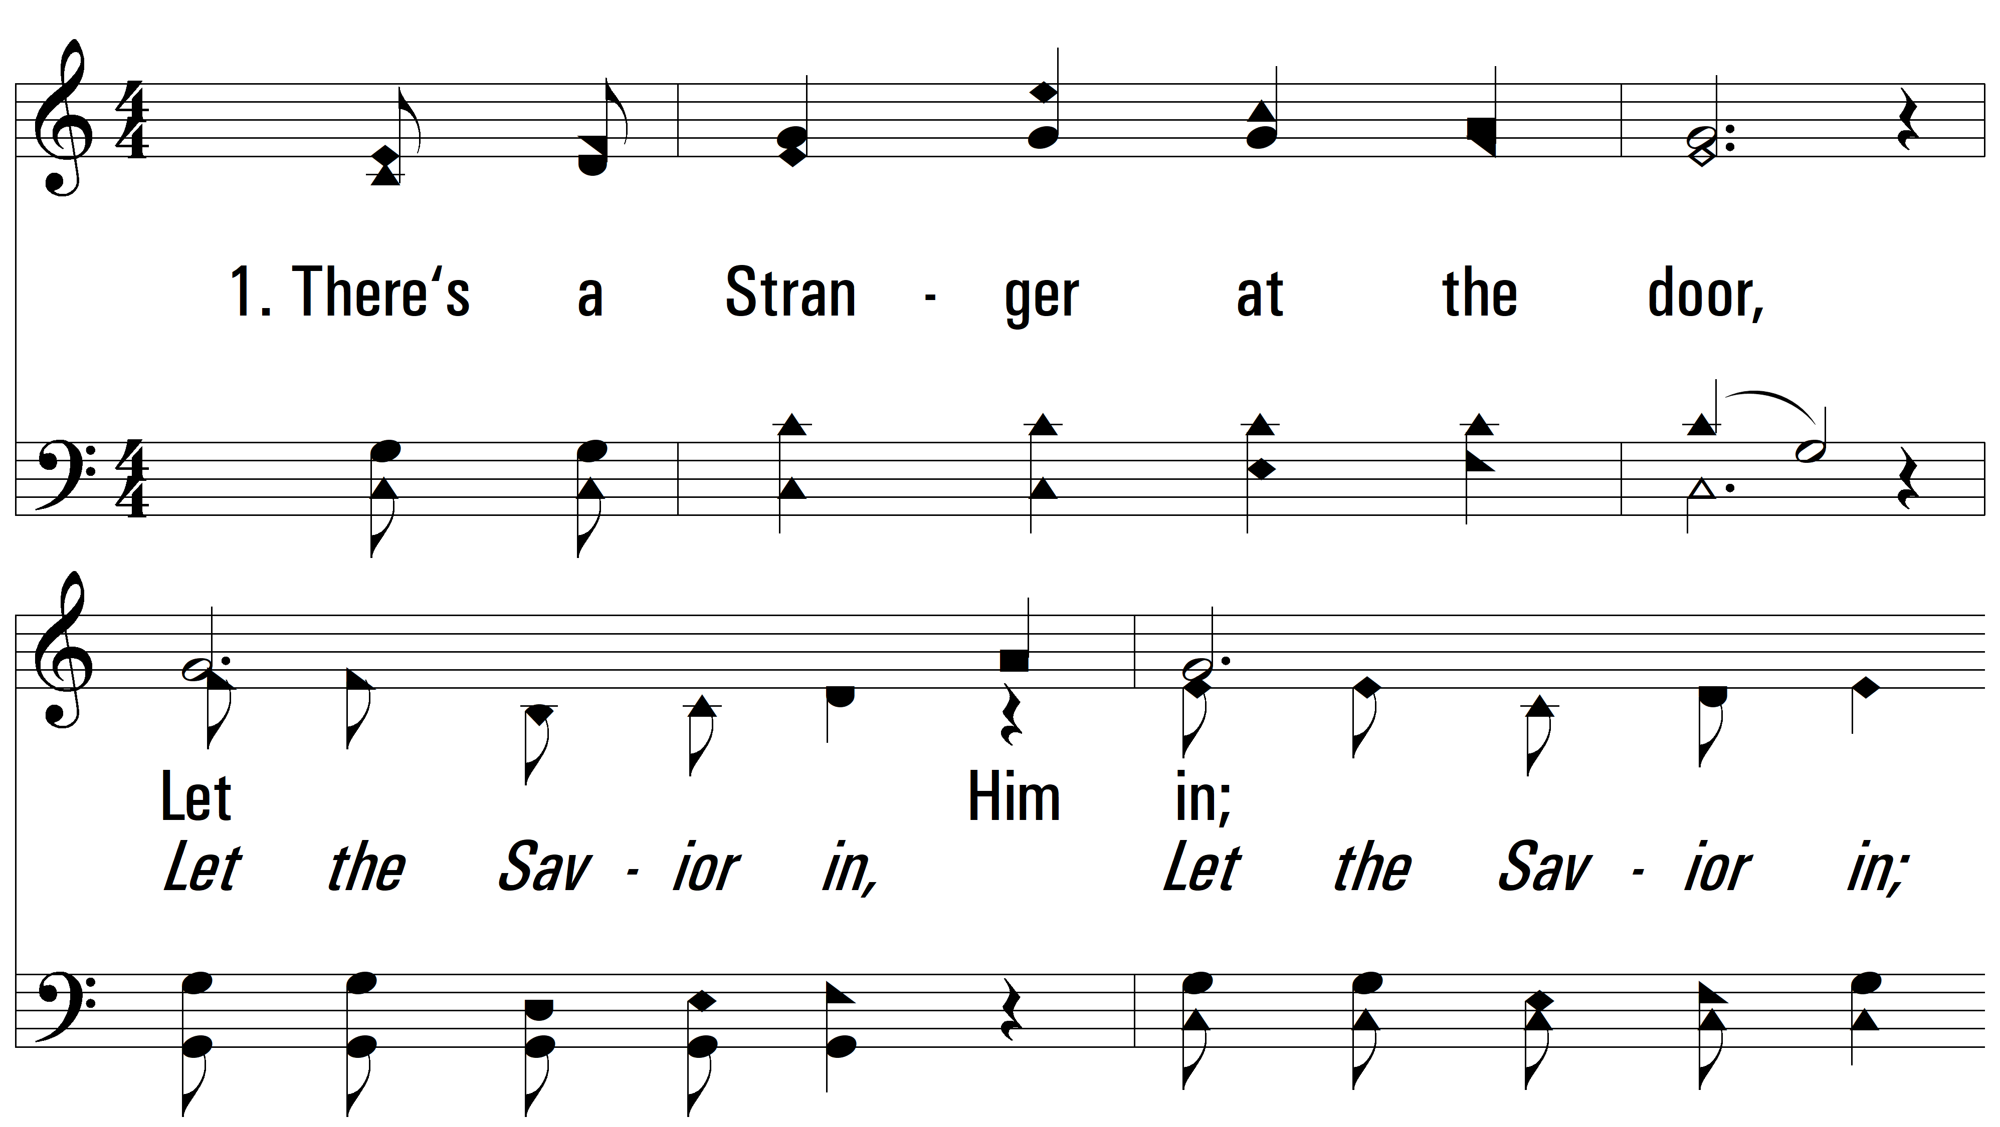
vs. 1 ~ Let Him In

Slide 3
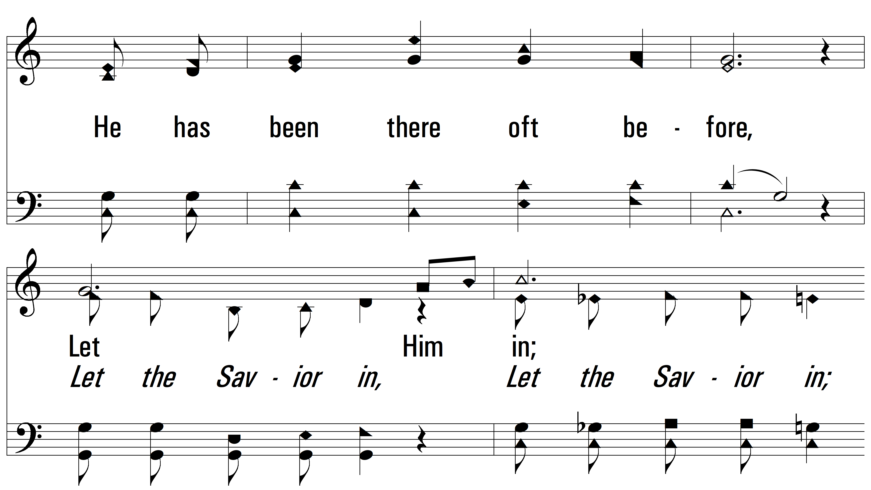
vs. 1

Slide 4
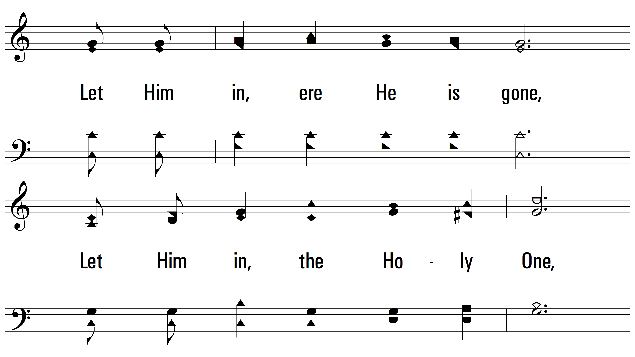
vs. 1

Slide 5
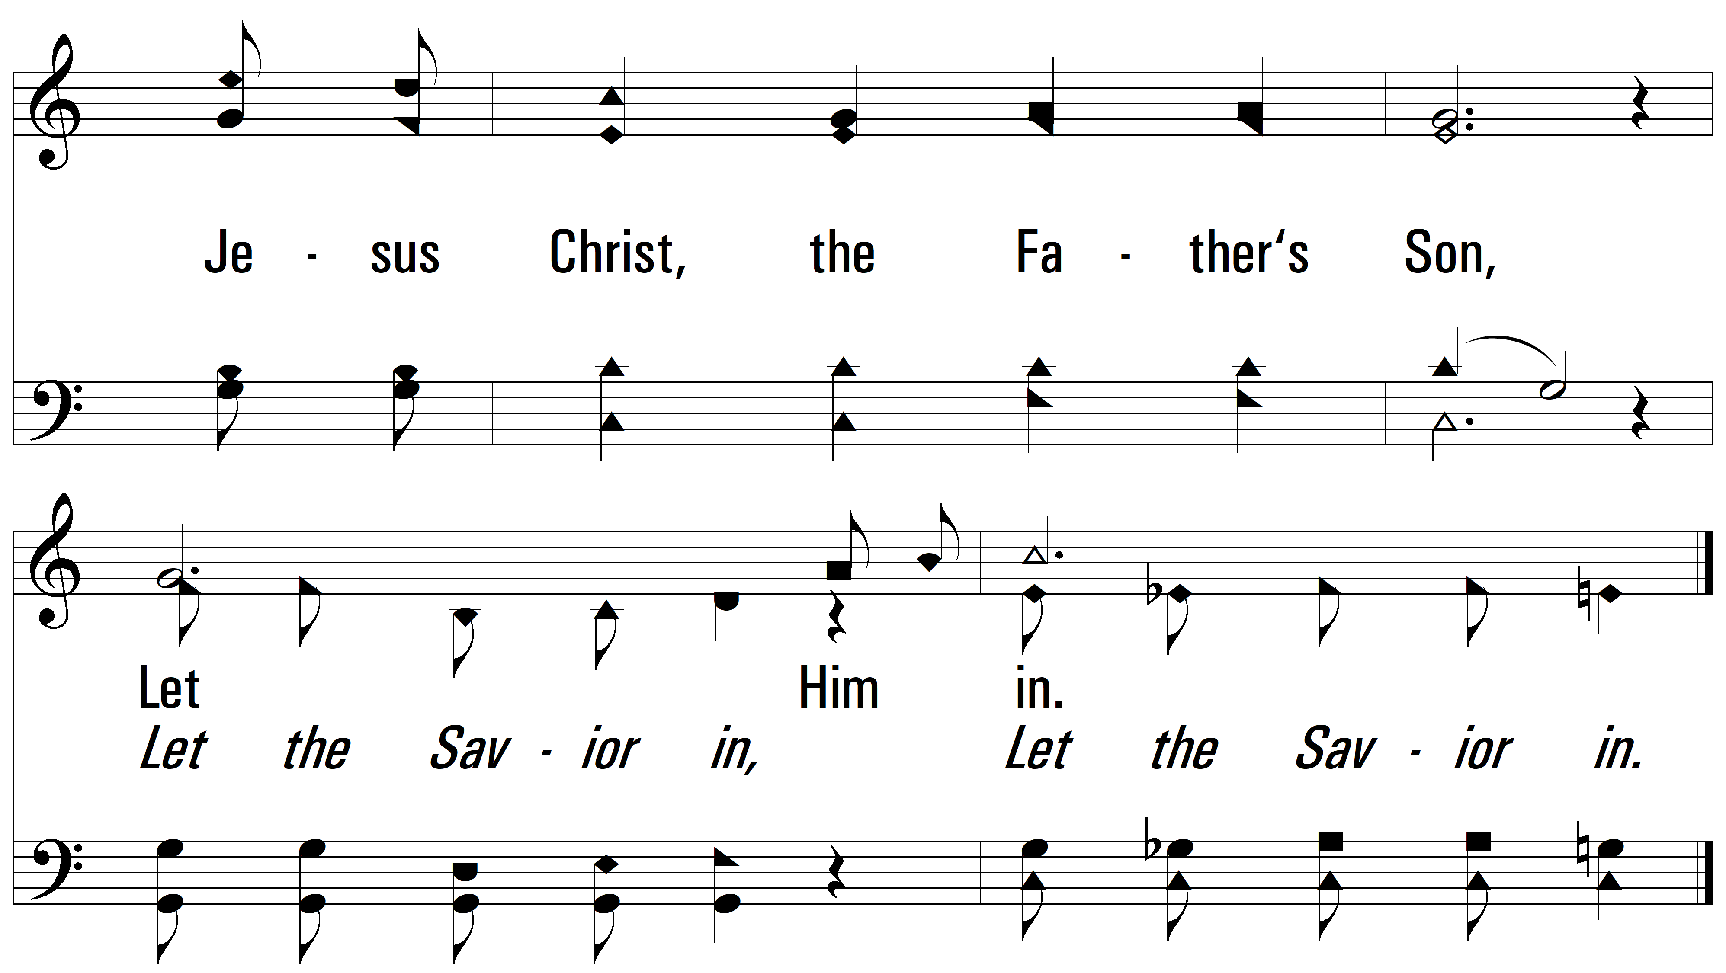
vs. 1

Slide 6
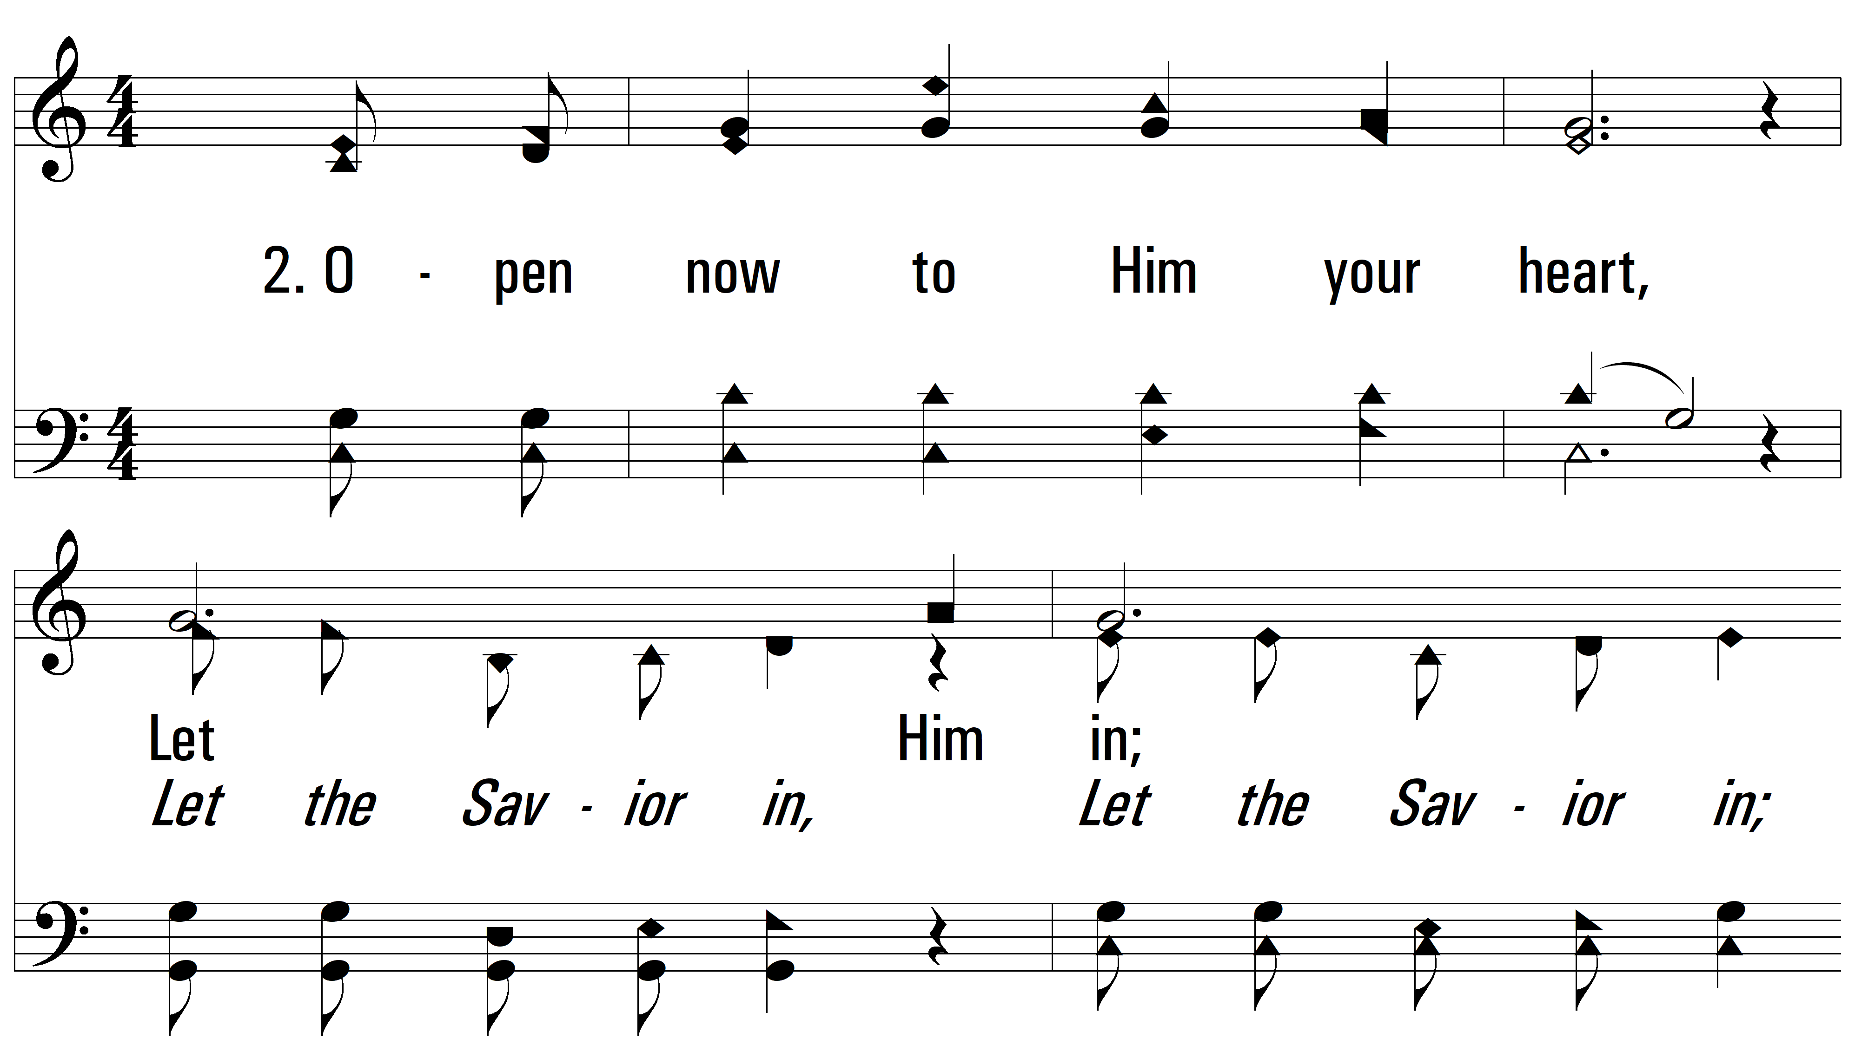
vs. 2 ~ Let Him In

Slide 7
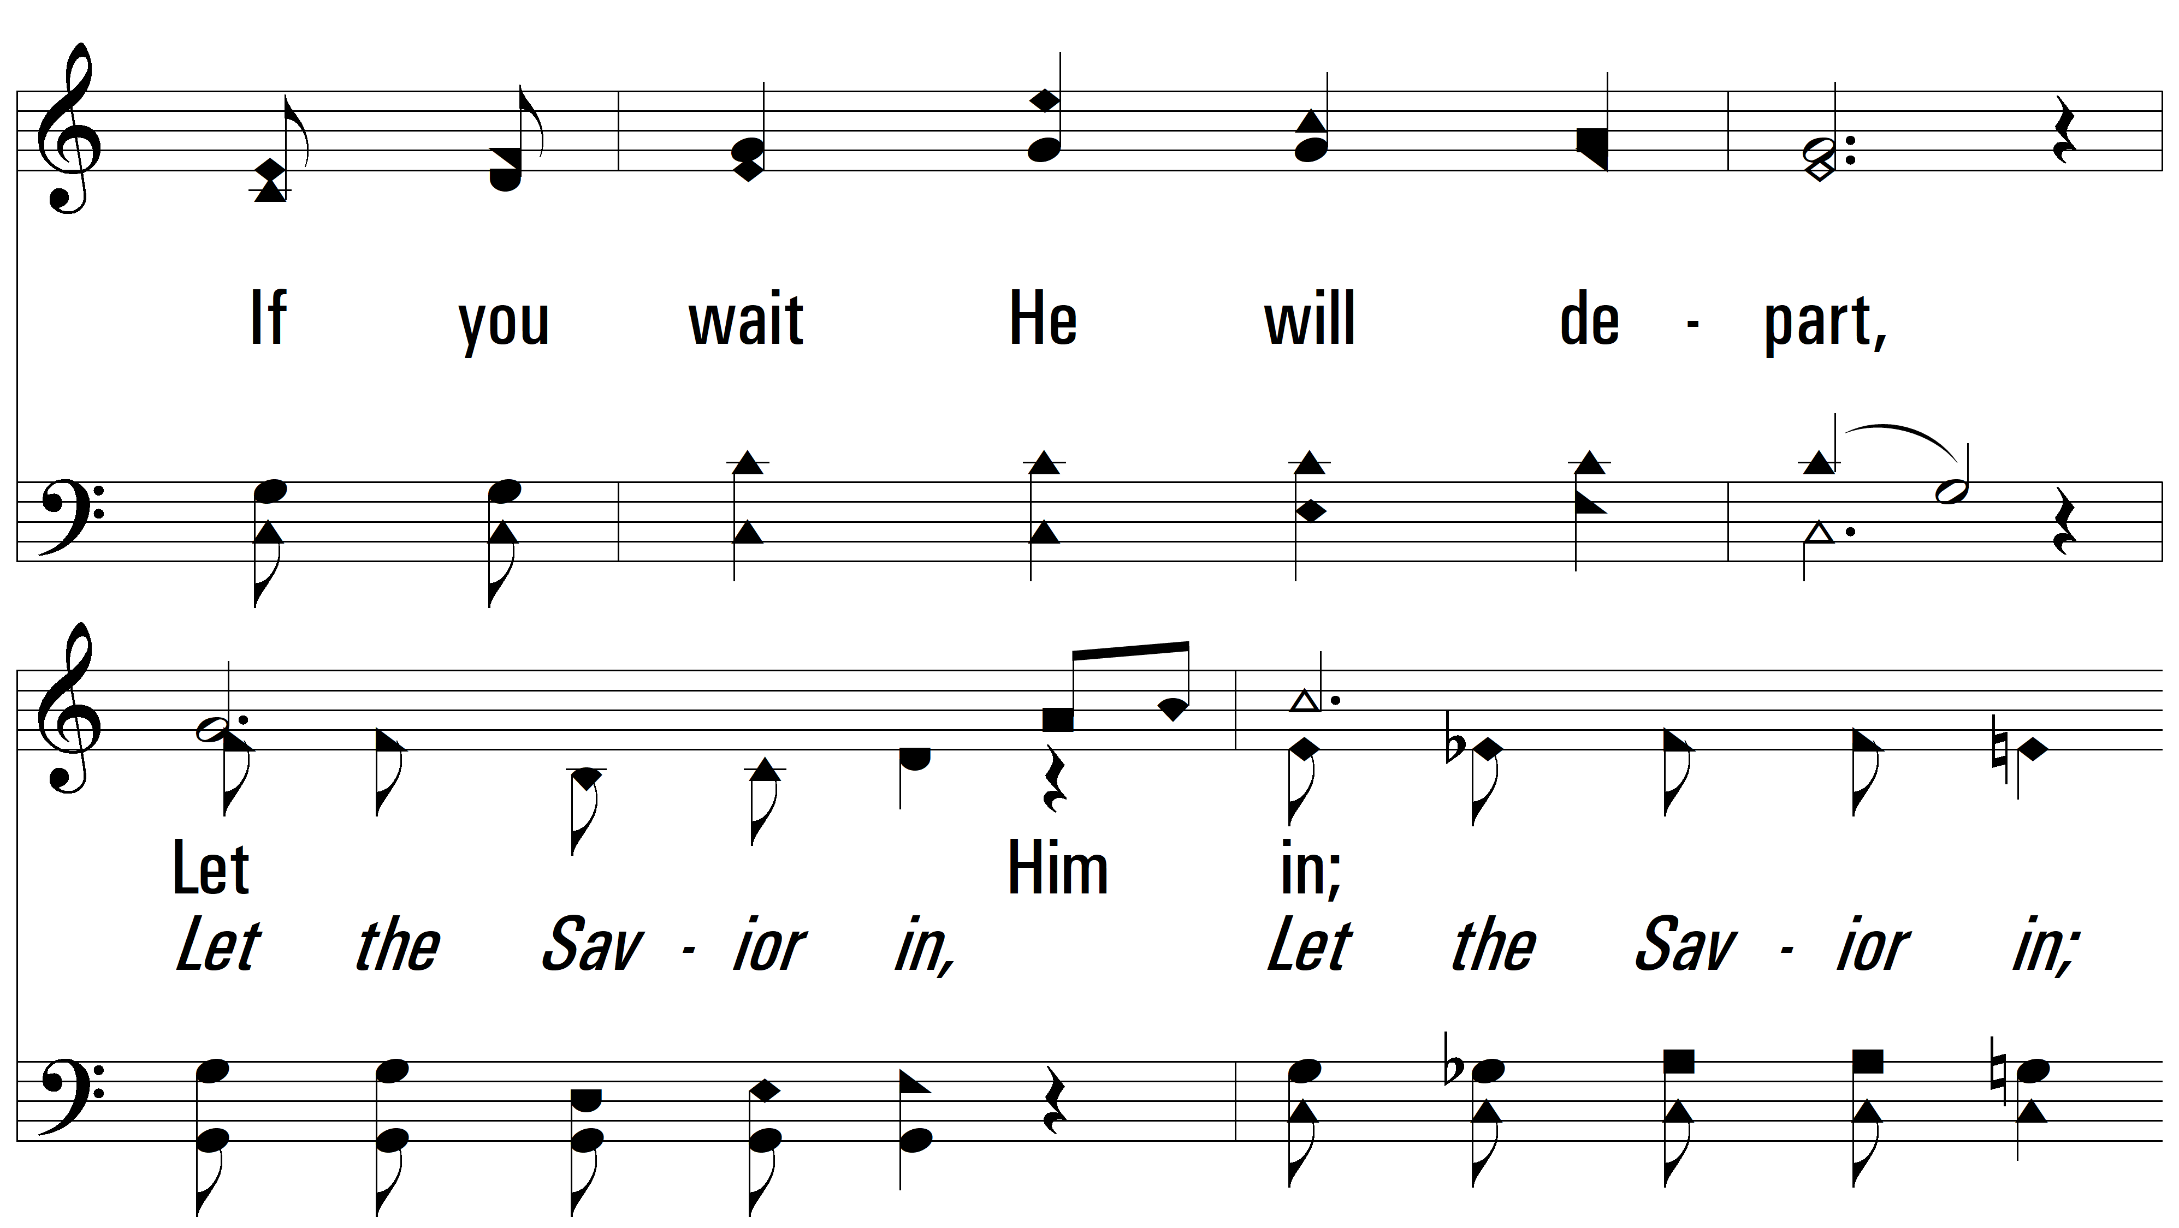
vs. 2

Slide 8
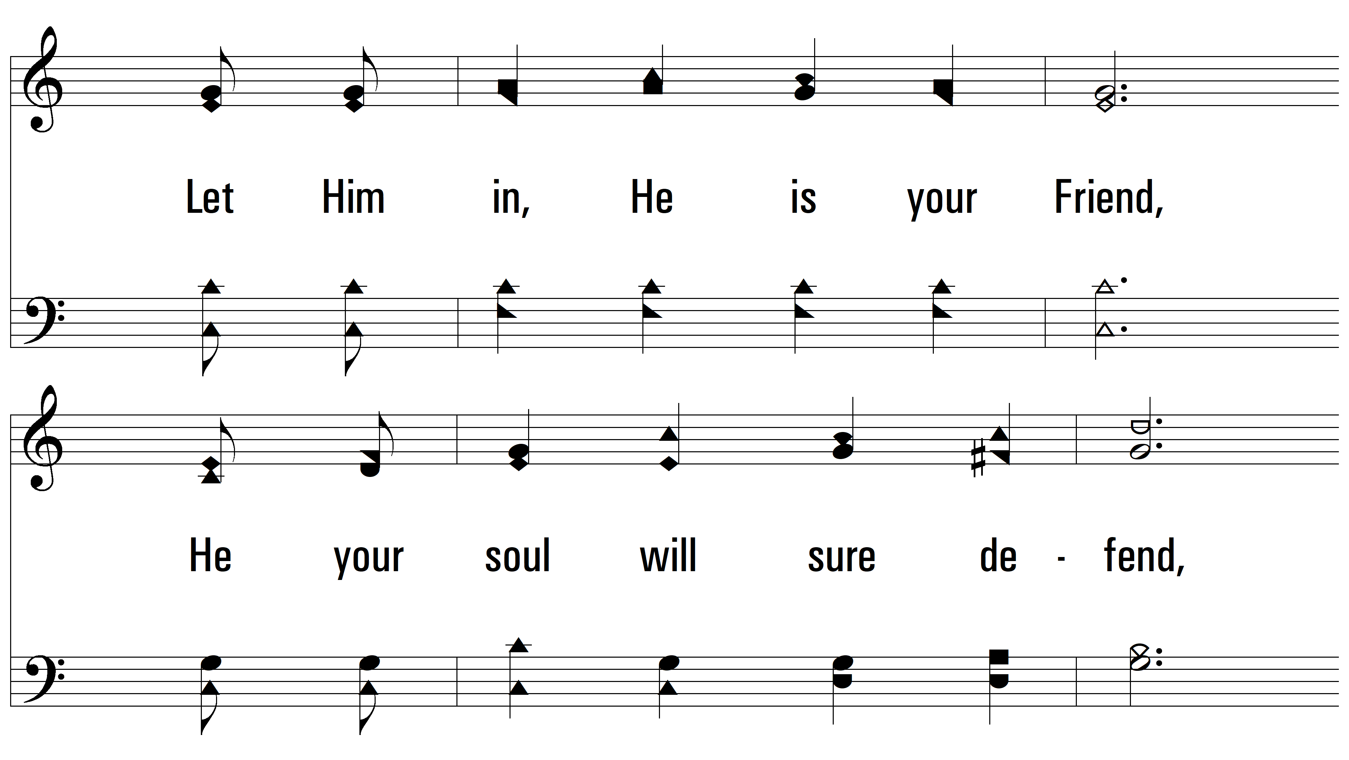
vs. 2

Slide 9
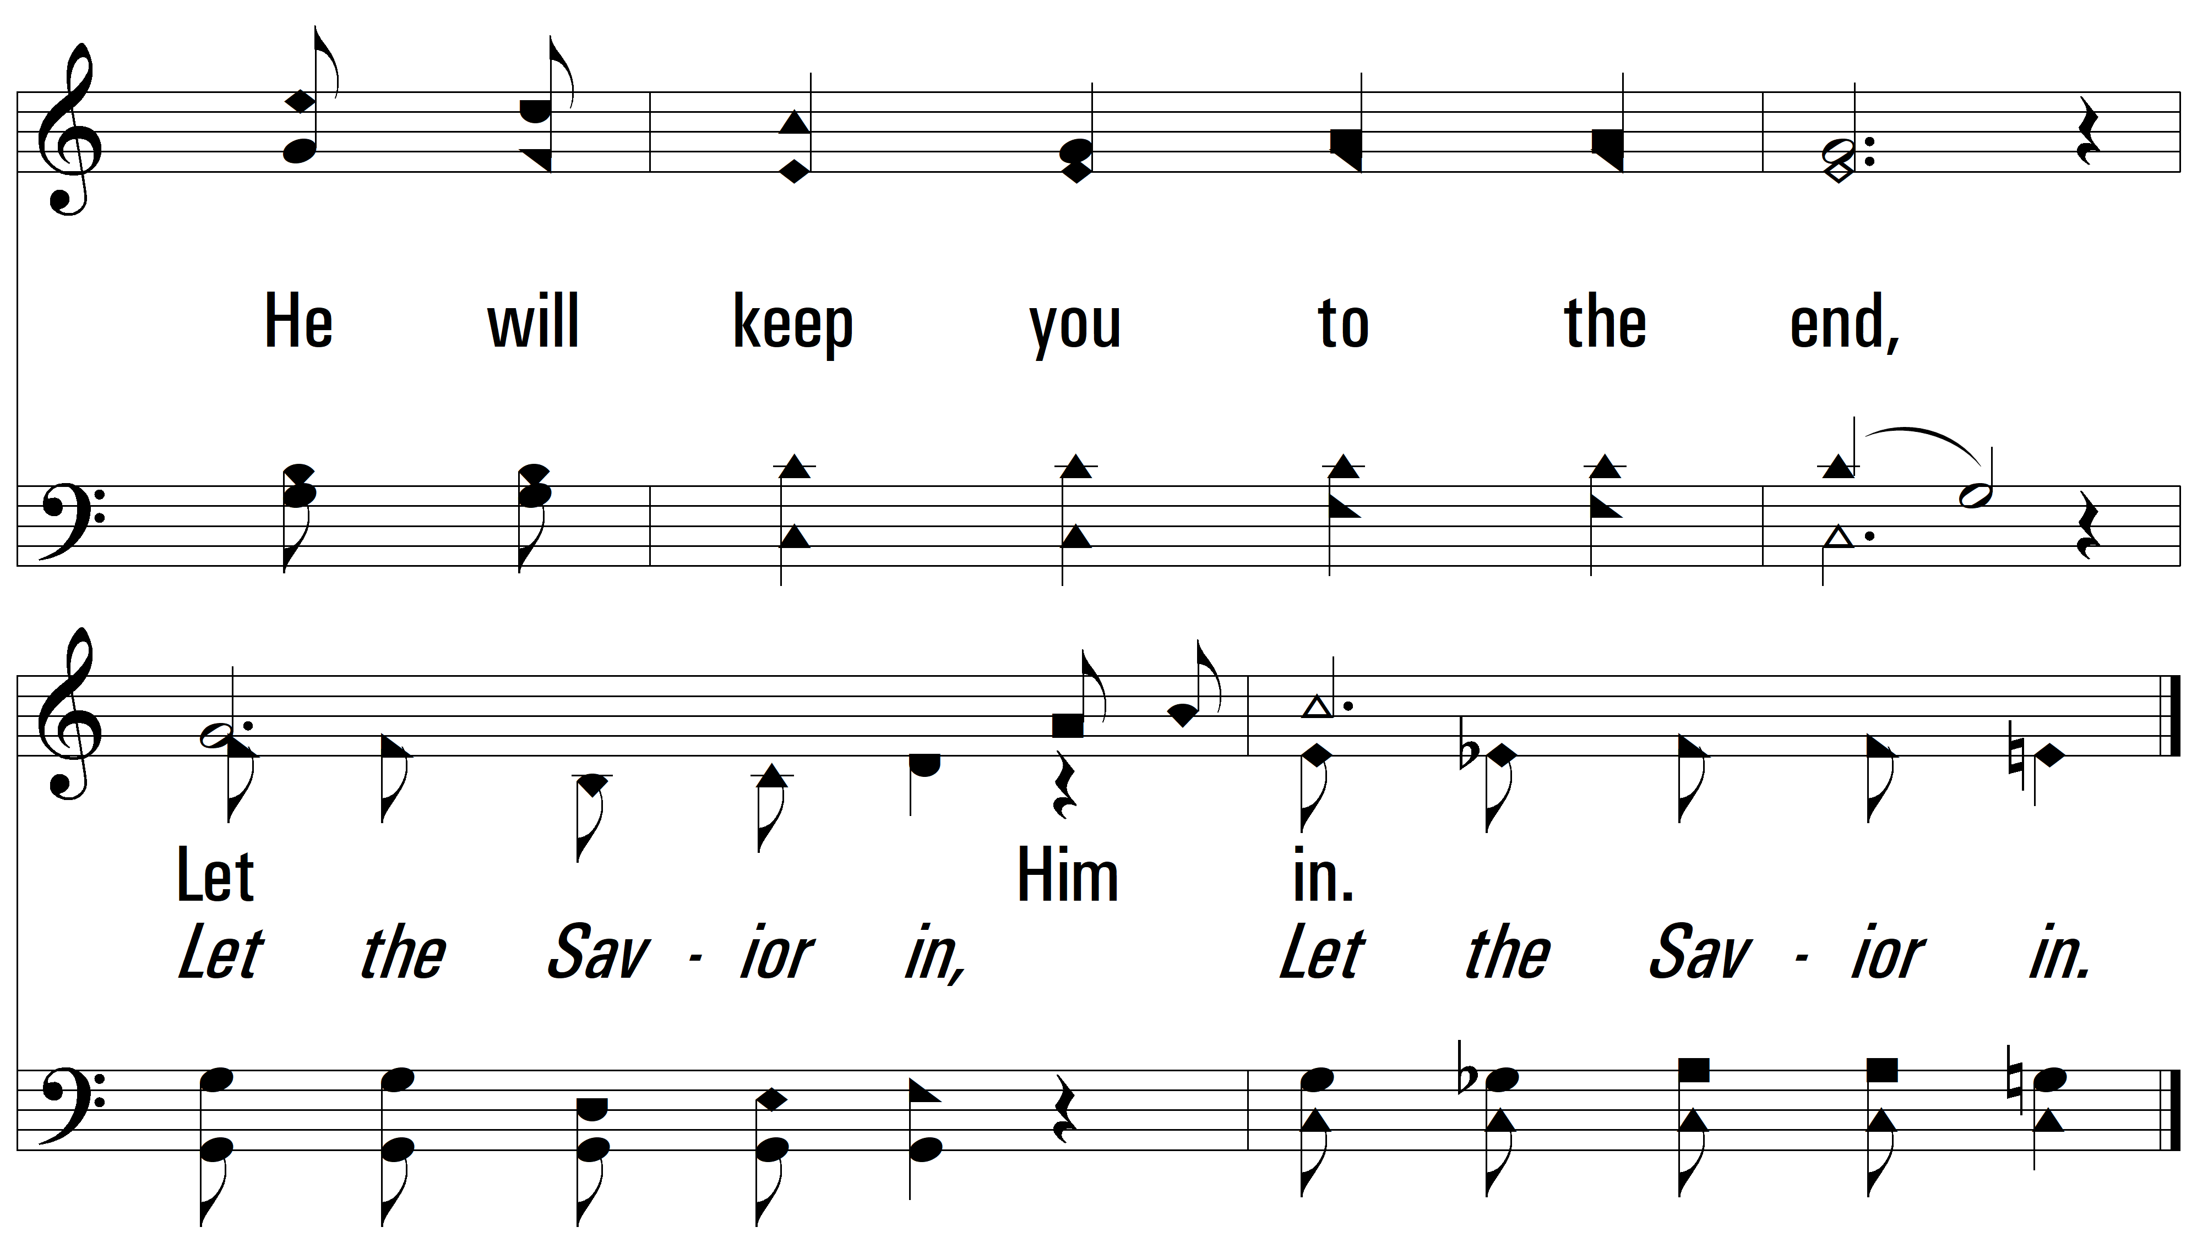
vs. 2

Slide 10
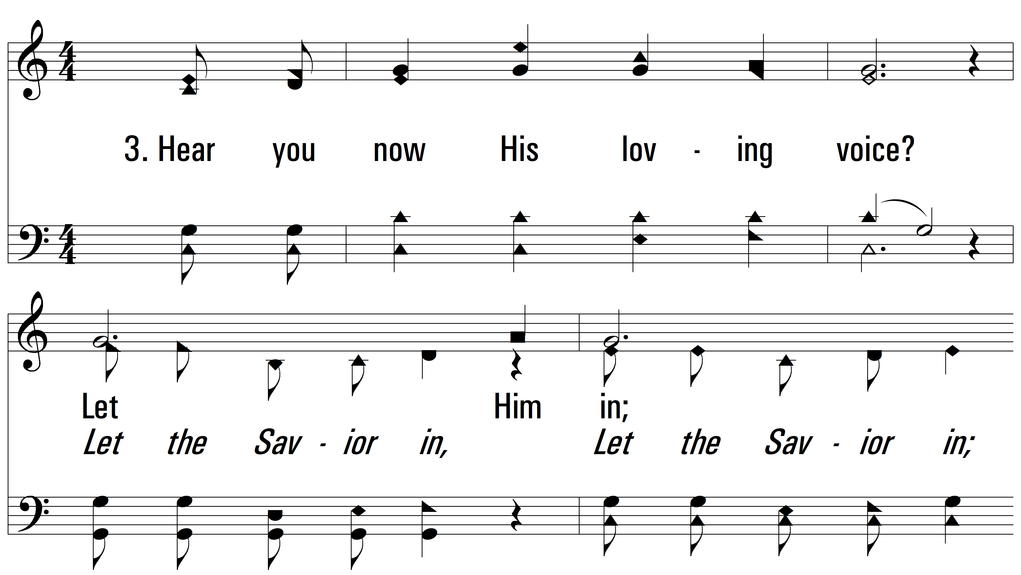
vs. 3 ~ Let Him In

Slide 11
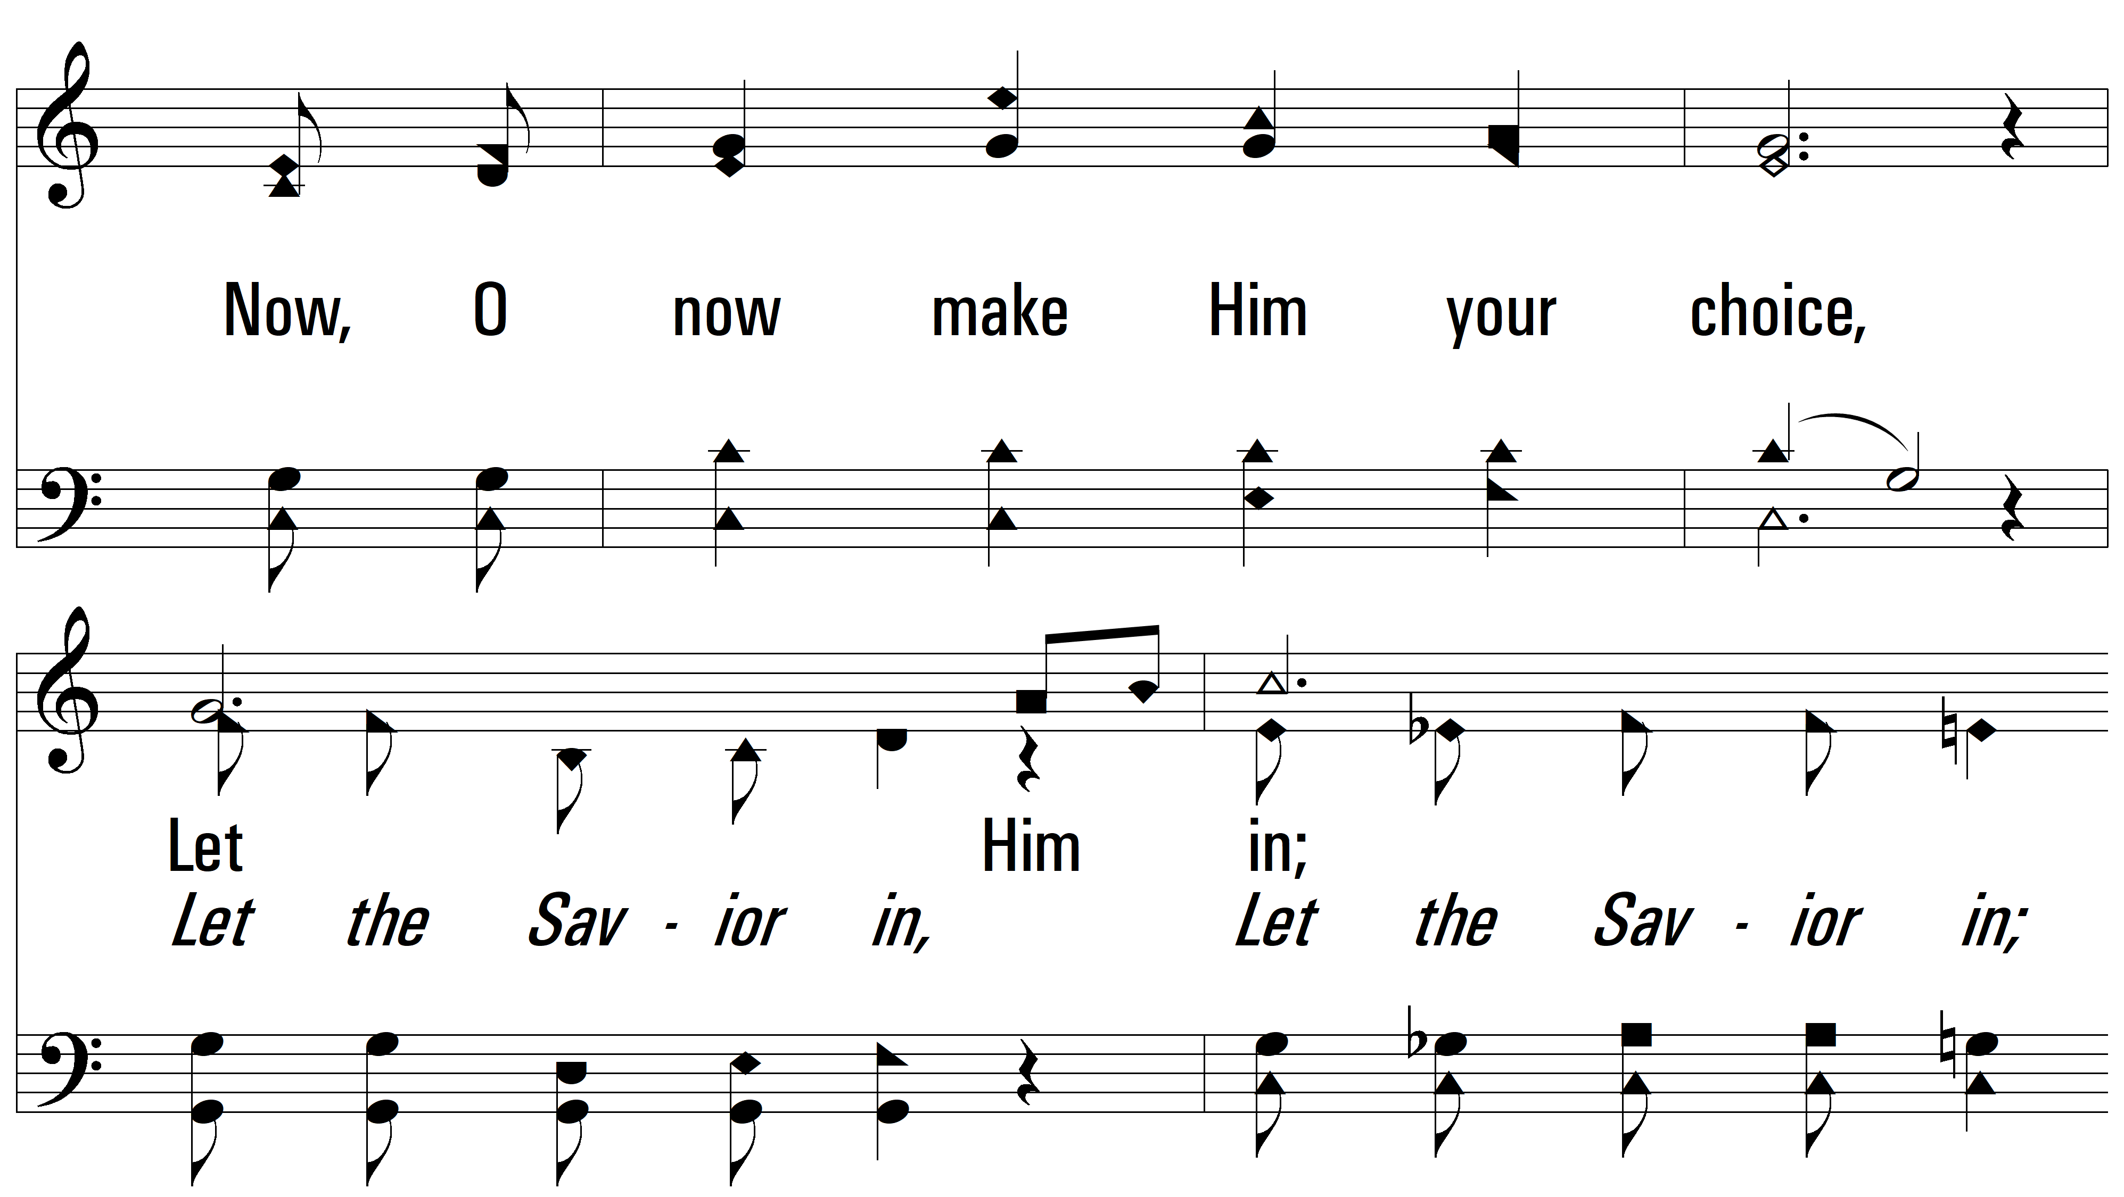
vs. 3

Slide 12
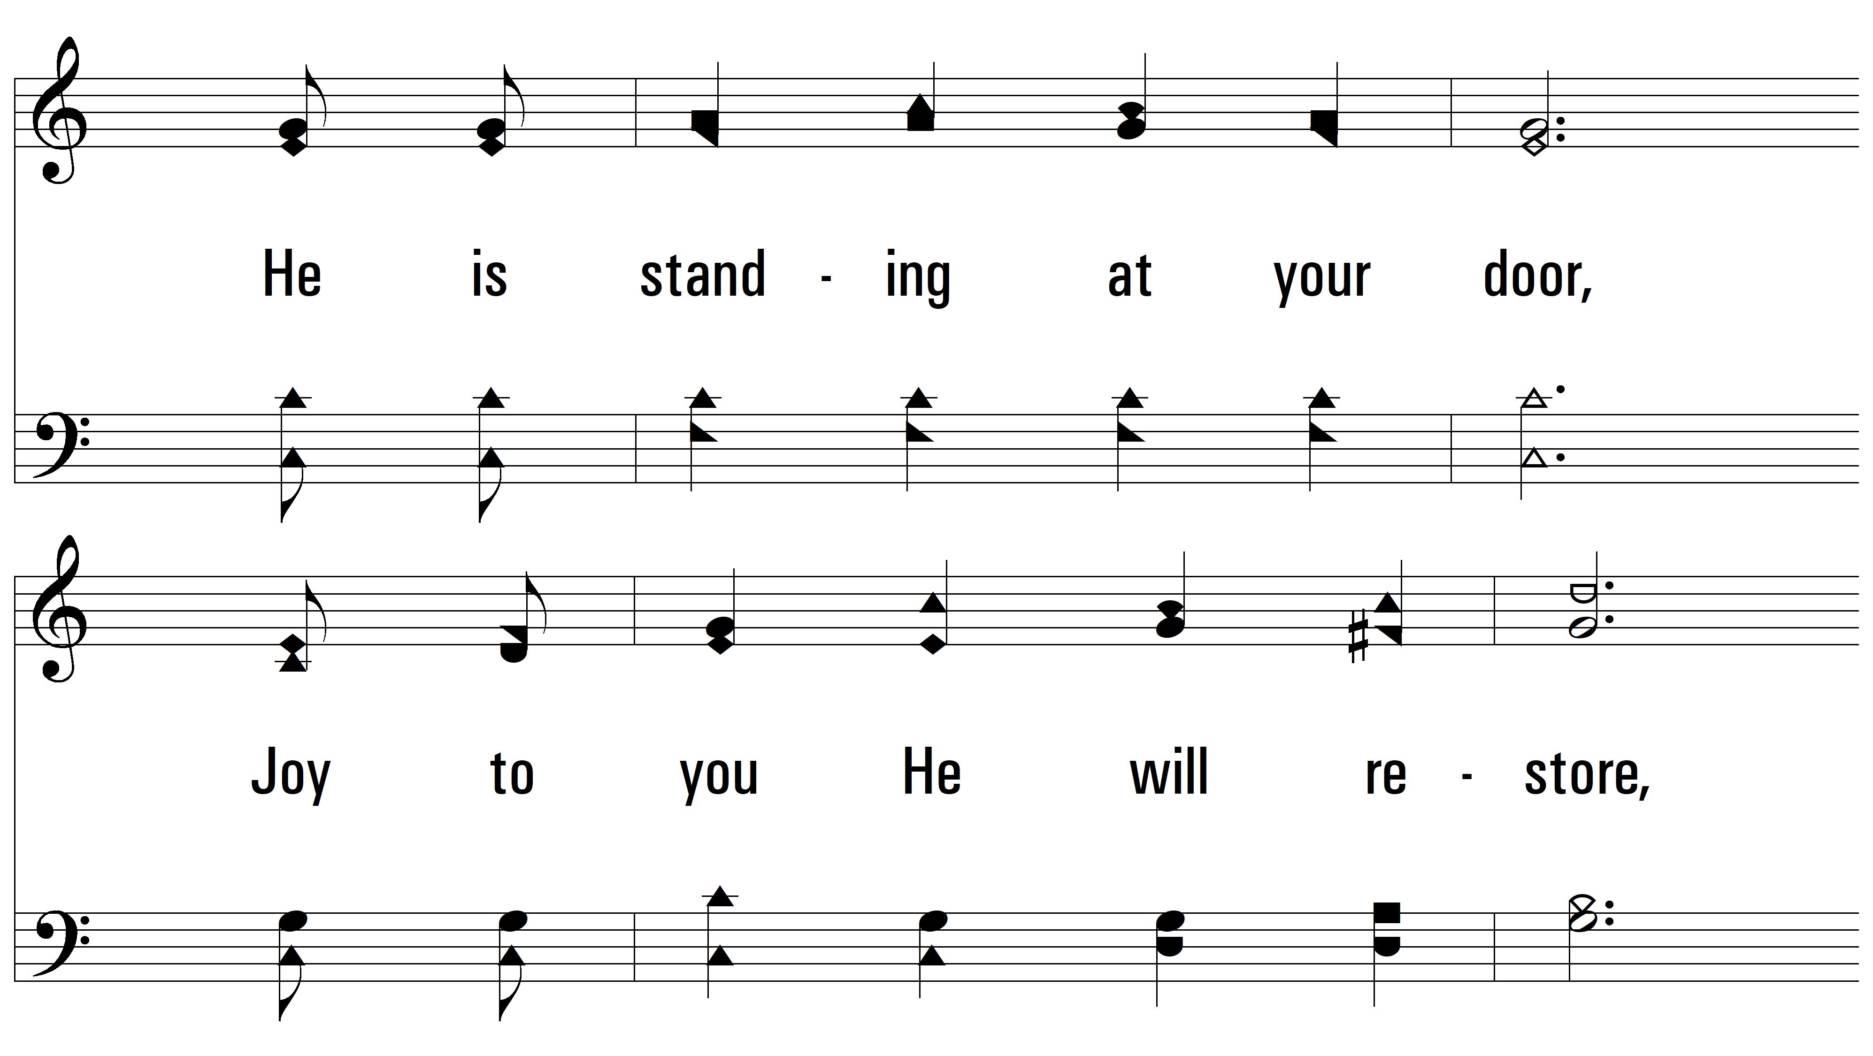
vs. 3

Slide 13
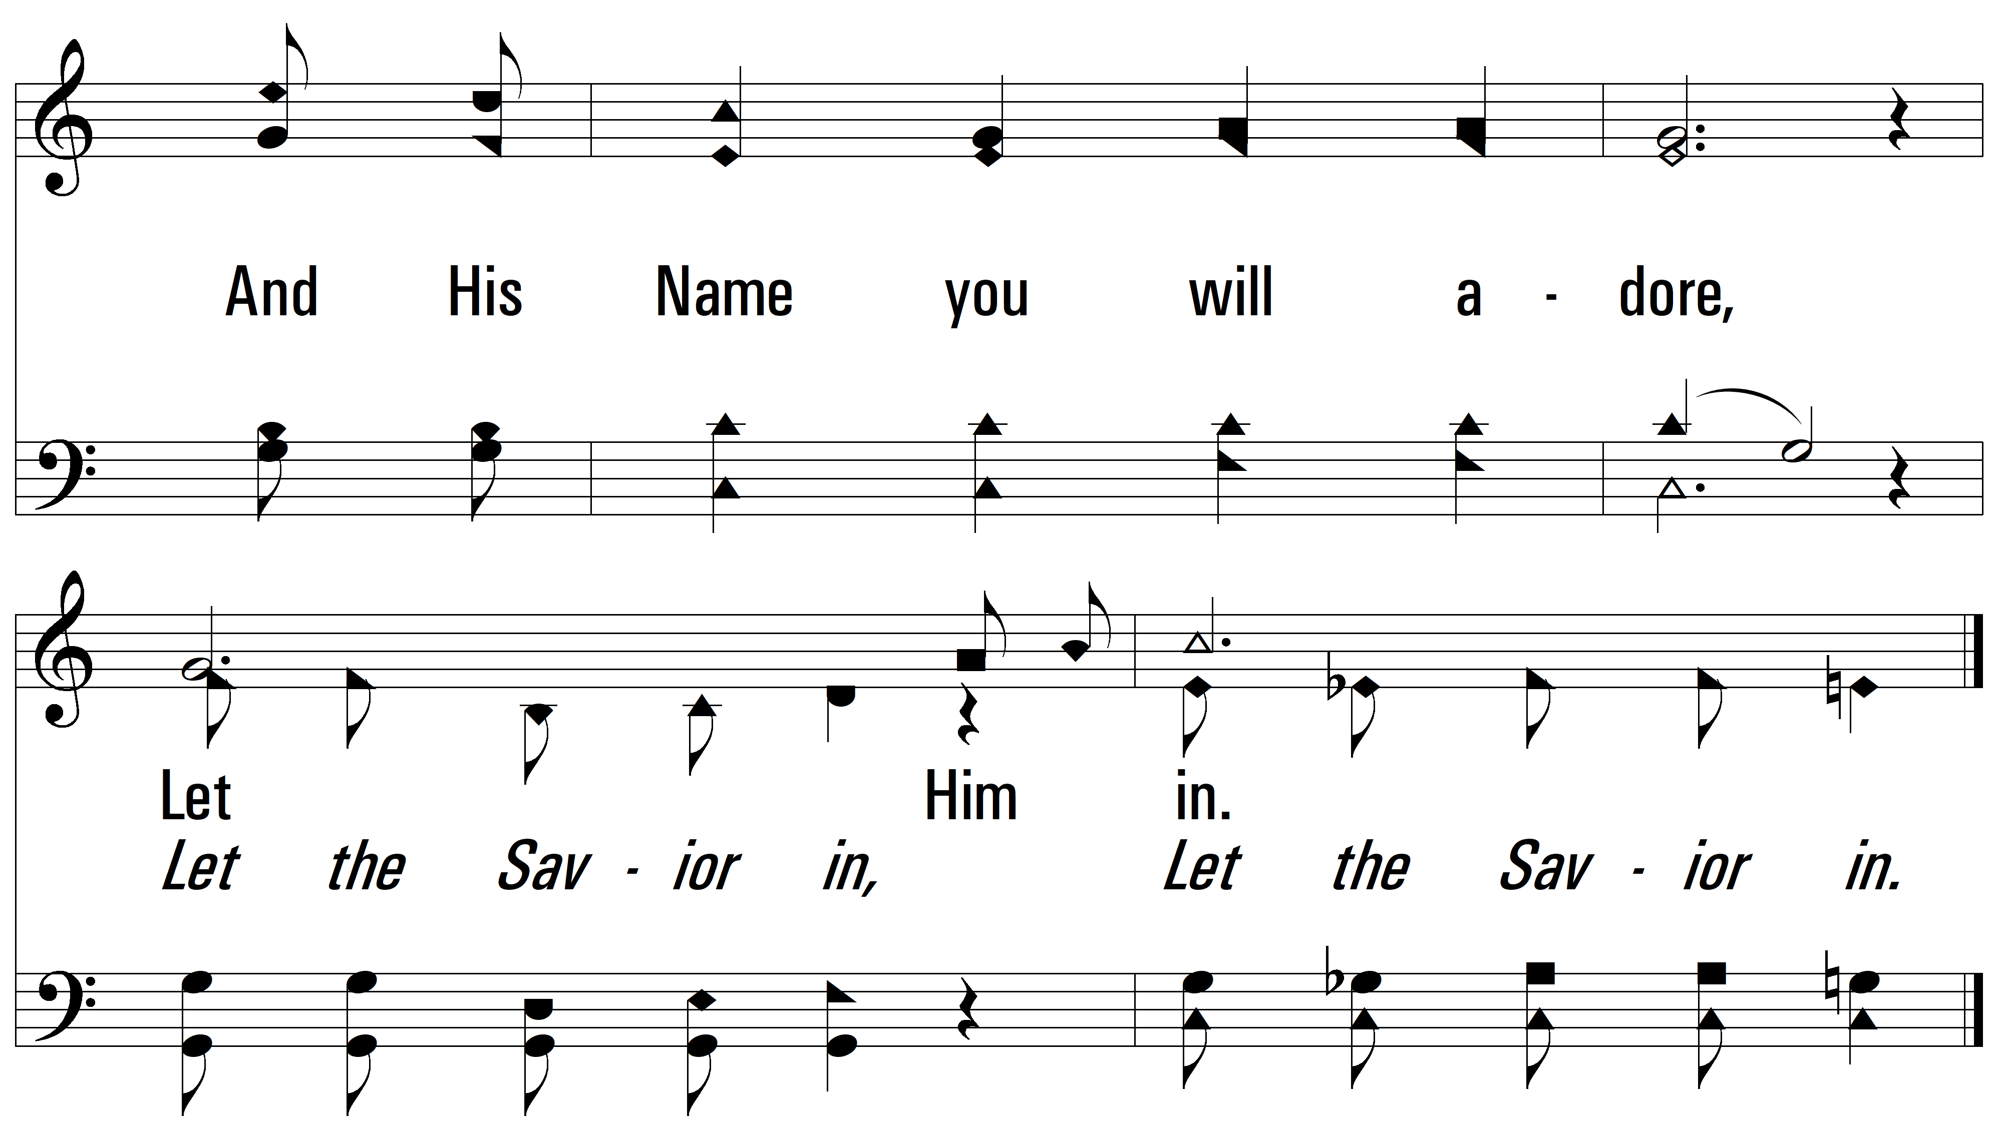
vs. 3
PDHymns.com
END

