Slide 1
Lift Every Voice And Sing
Words: | James Weldon Johnson (1921)
Music: | J. Rosamond Johnson (1921)
6/8
G/F# - TI
Verses: 3
Lead - | TI
Alto - | SOL
Tenor - | TI
Bass - | SOL
PDHymns.com

Slide 2
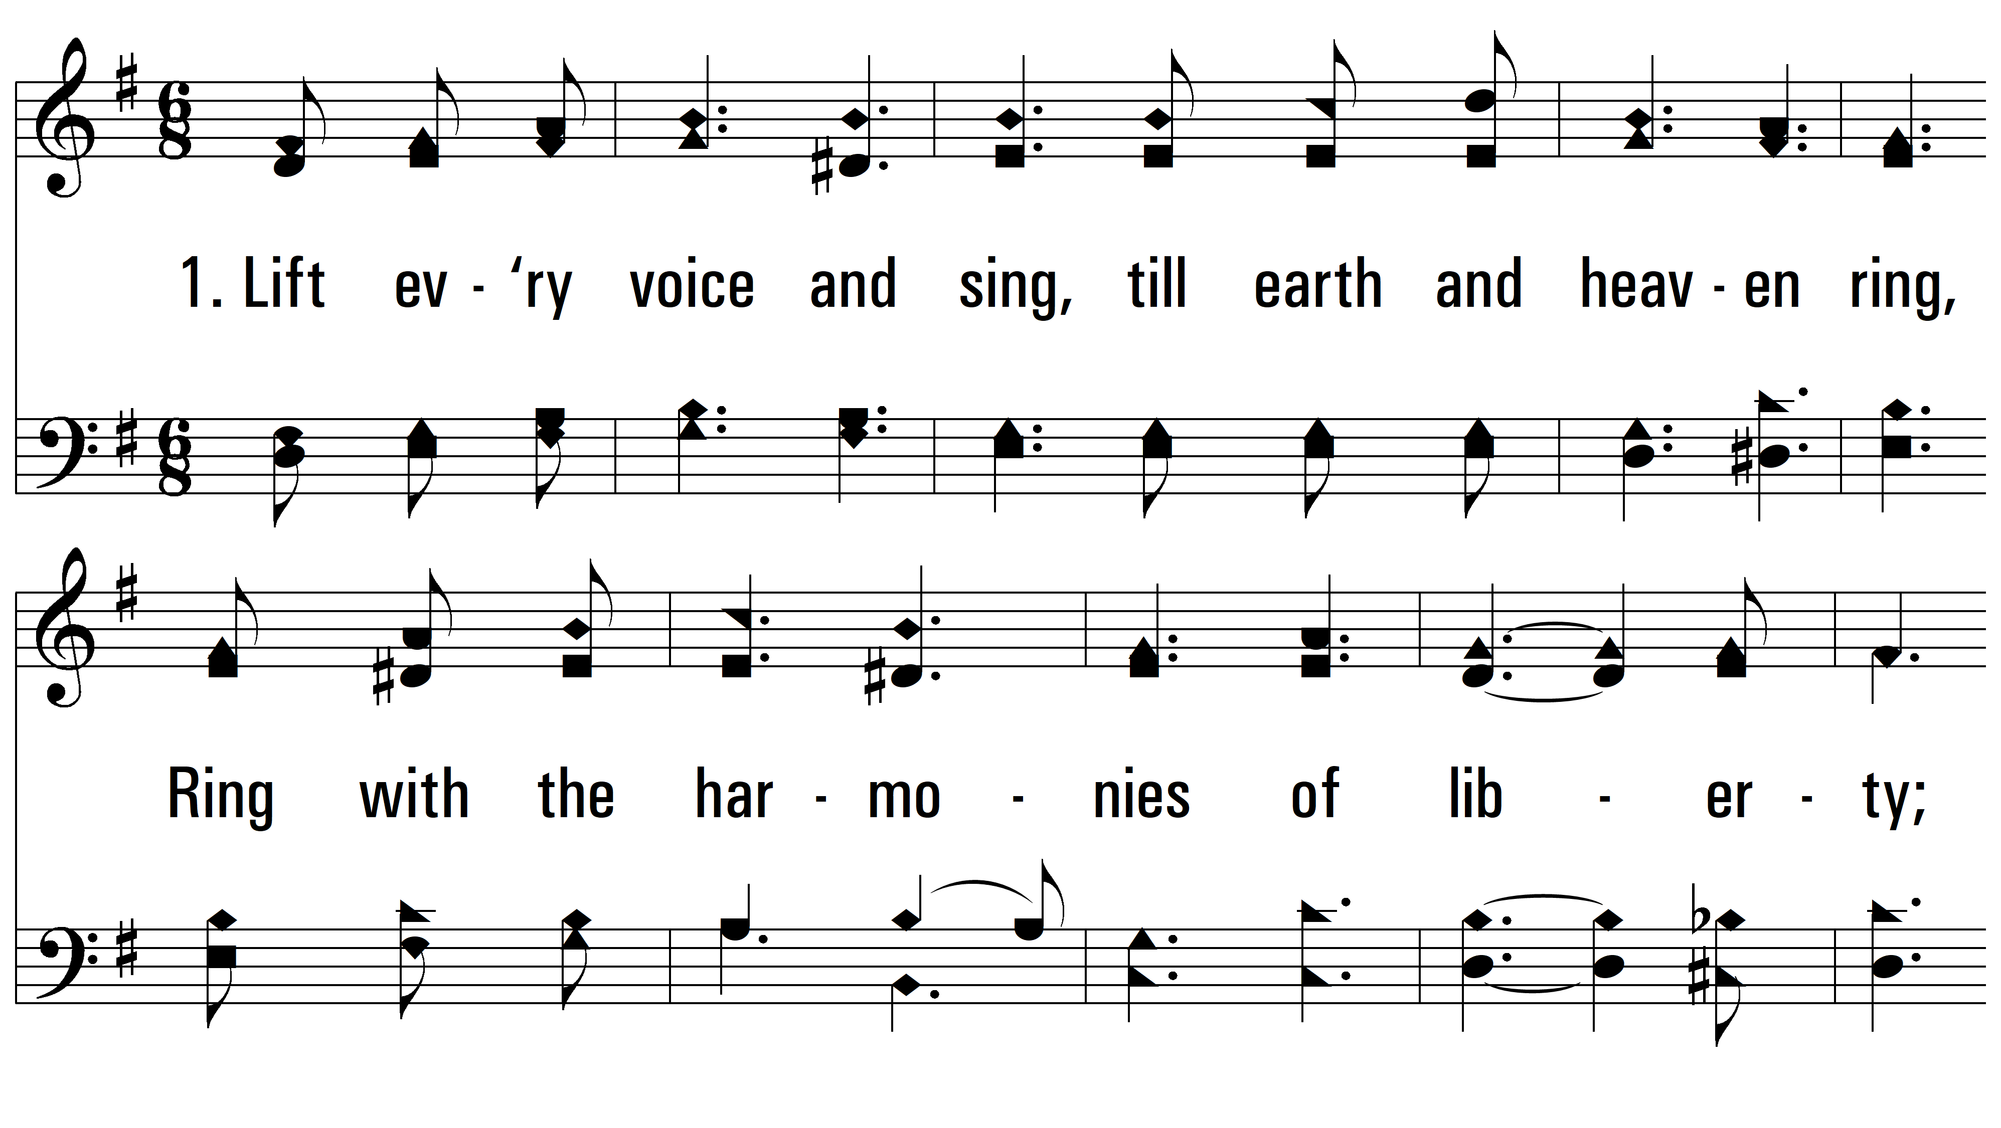
vs. 1 ~ Lift Every Voice And Sing

Slide 3
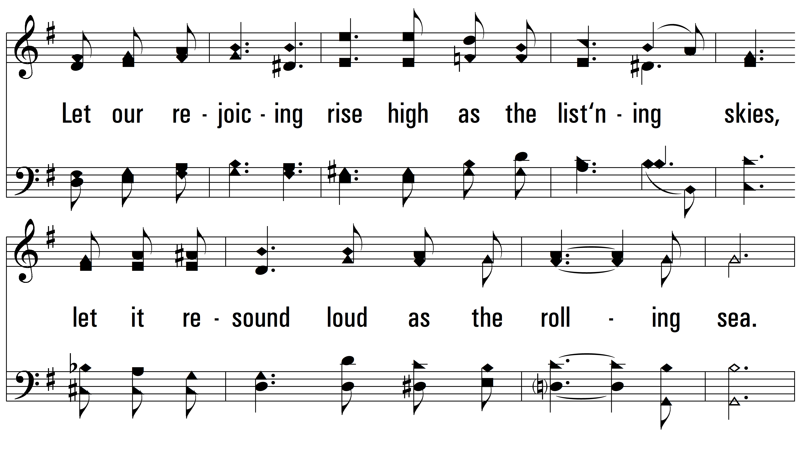
vs. 1

Slide 4
vs. 1

Slide 5
vs. 1

Slide 6
vs. 2 ~ Lift Every Voice And Sing

Slide 7
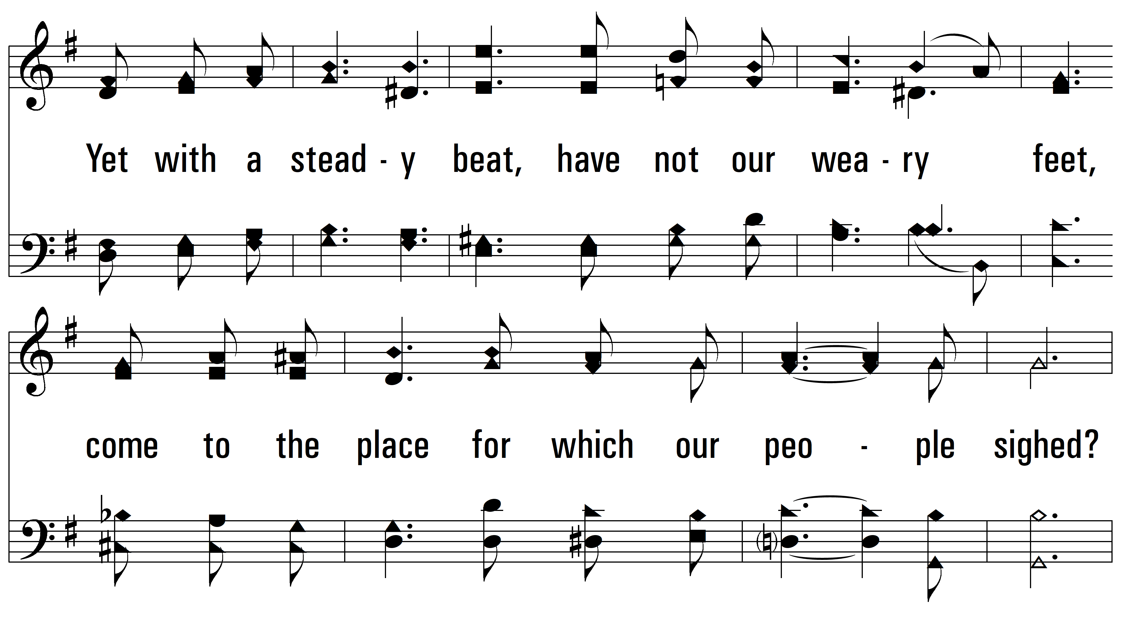
vs. 2

Slide 8
vs. 2

Slide 9
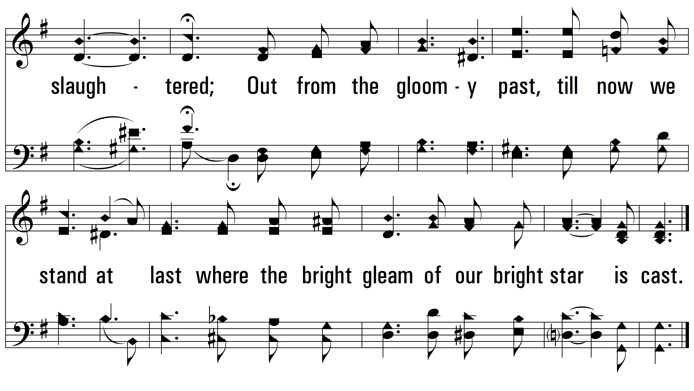
vs. 2

Slide 10
vs. 3 ~ Lift Every Voice And Sing

Slide 11
vs. 3

Slide 12
vs. 3

Slide 13
vs. 3
PDHymns.com
END

