Slide 1
Like A River Glorious
WYE VALLEY
6.5.6.5.D w/CHORUS
Words: | Frances R. Havengal (1874)
Music: | James Mountain (1876)
2/2
F/F - DO
Verses: 3/Chorus
Lead - | DO
Alto - | SOL
Tenor - | MI
Bass - | DO
PDHymns.com

Slide 2
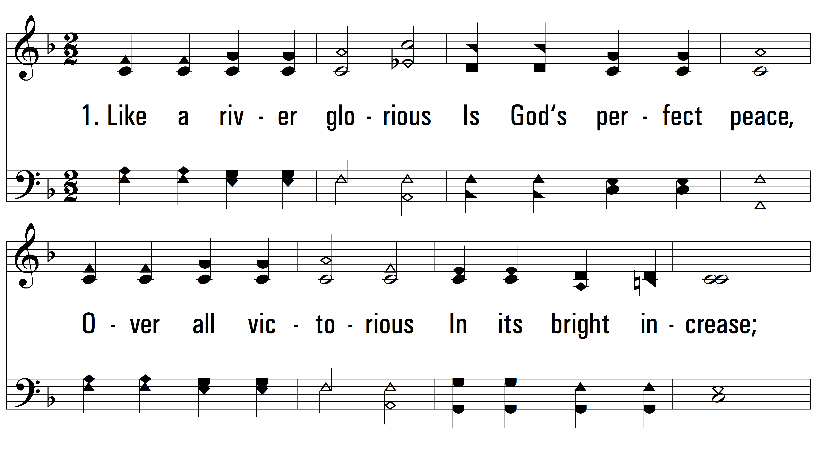
vs. 1 ~ Like A River Glorious

Slide 3
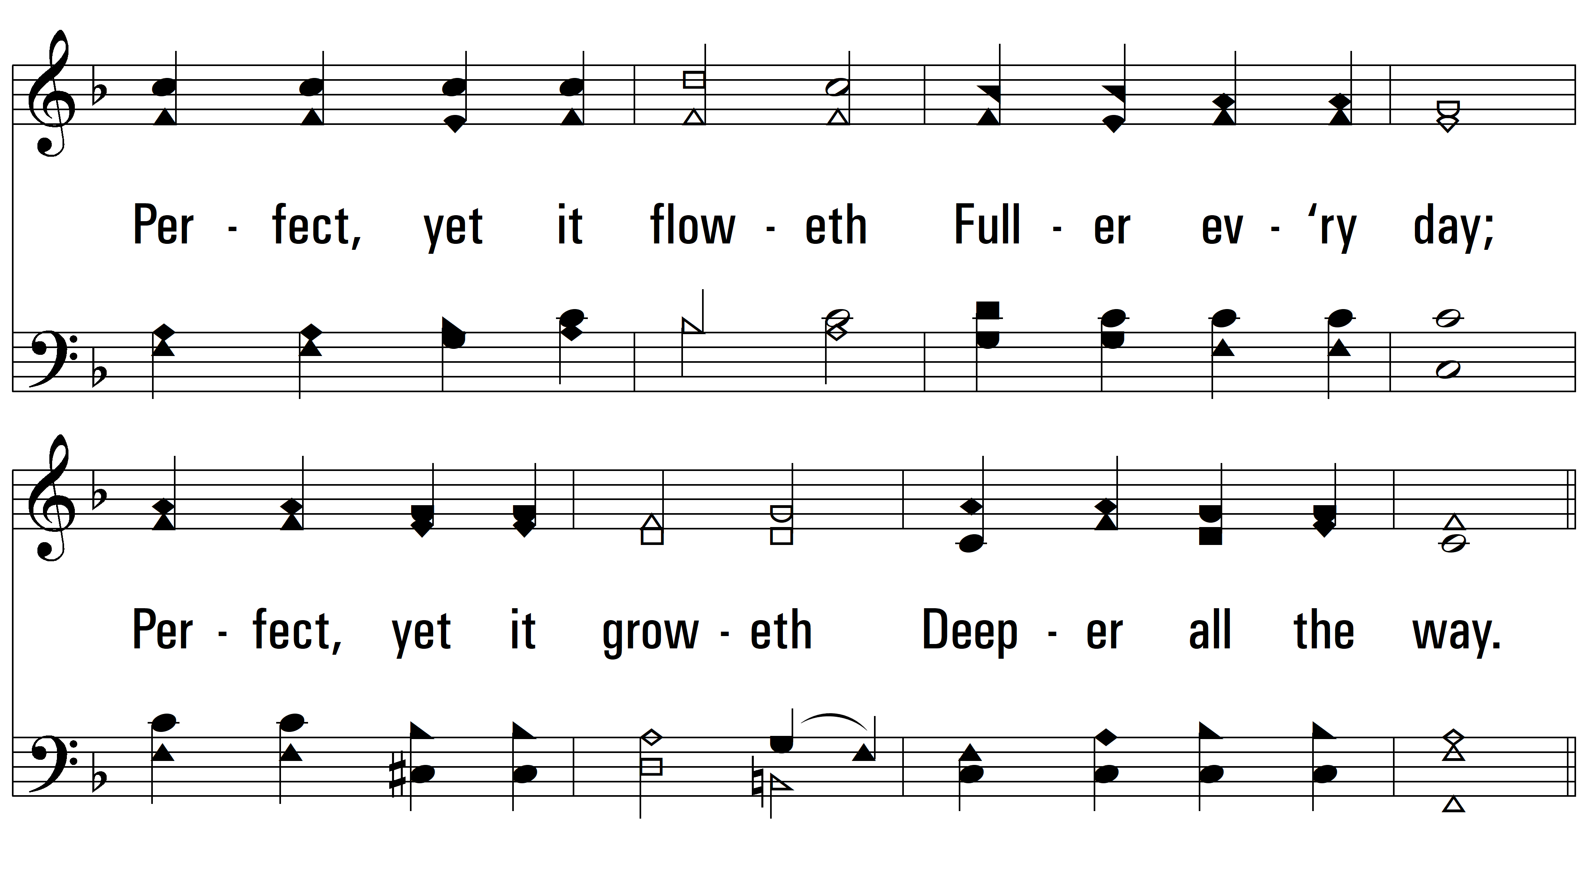
vs. 1

Slide 4
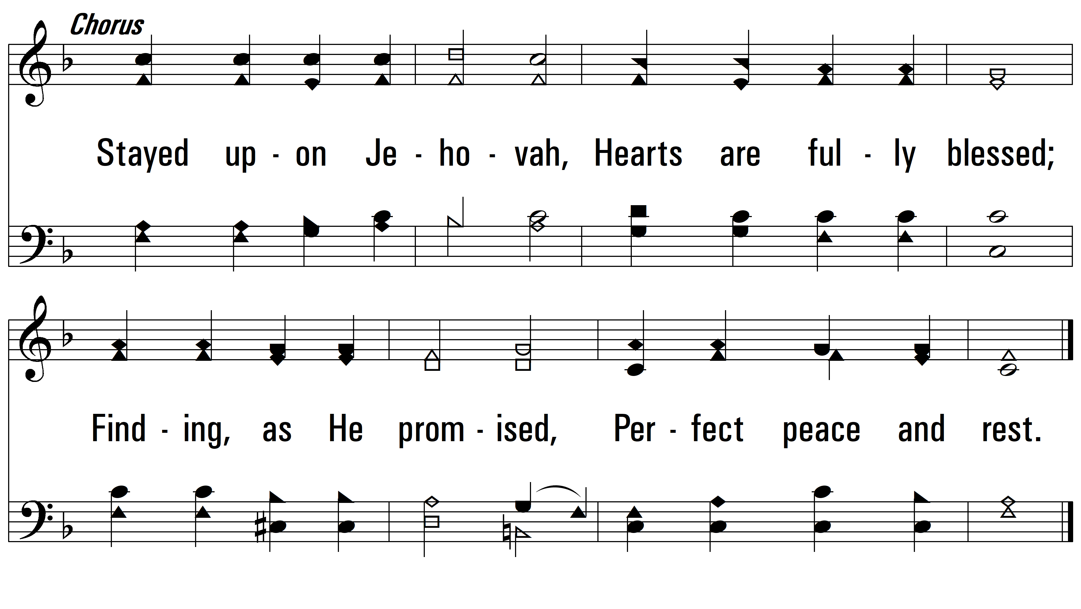
vs. 1

Slide 5
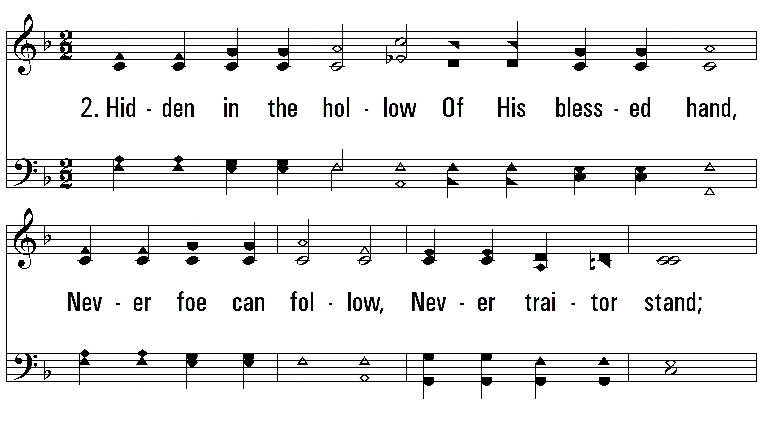
vs. 2 ~ Like A River Glorious

Slide 6
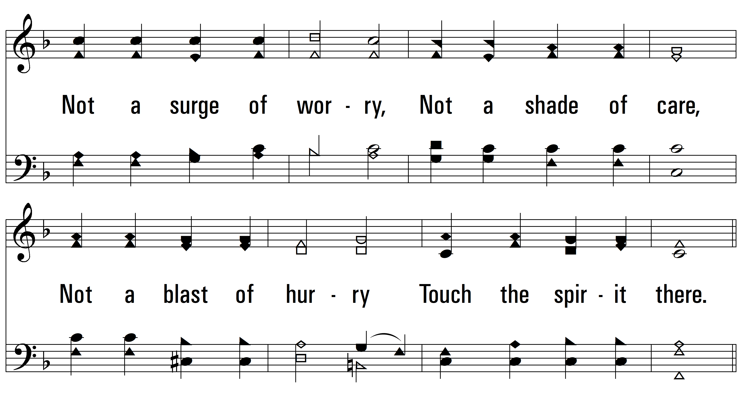
vs. 2

Slide 7
vs. 2

Slide 8
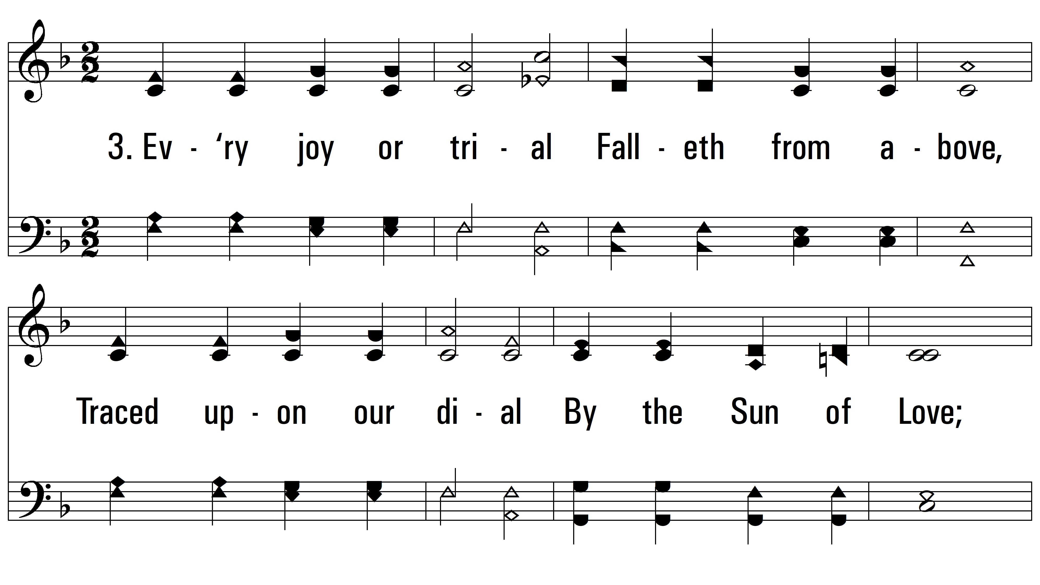
vs. 3 ~ Like A River Glorious

Slide 9
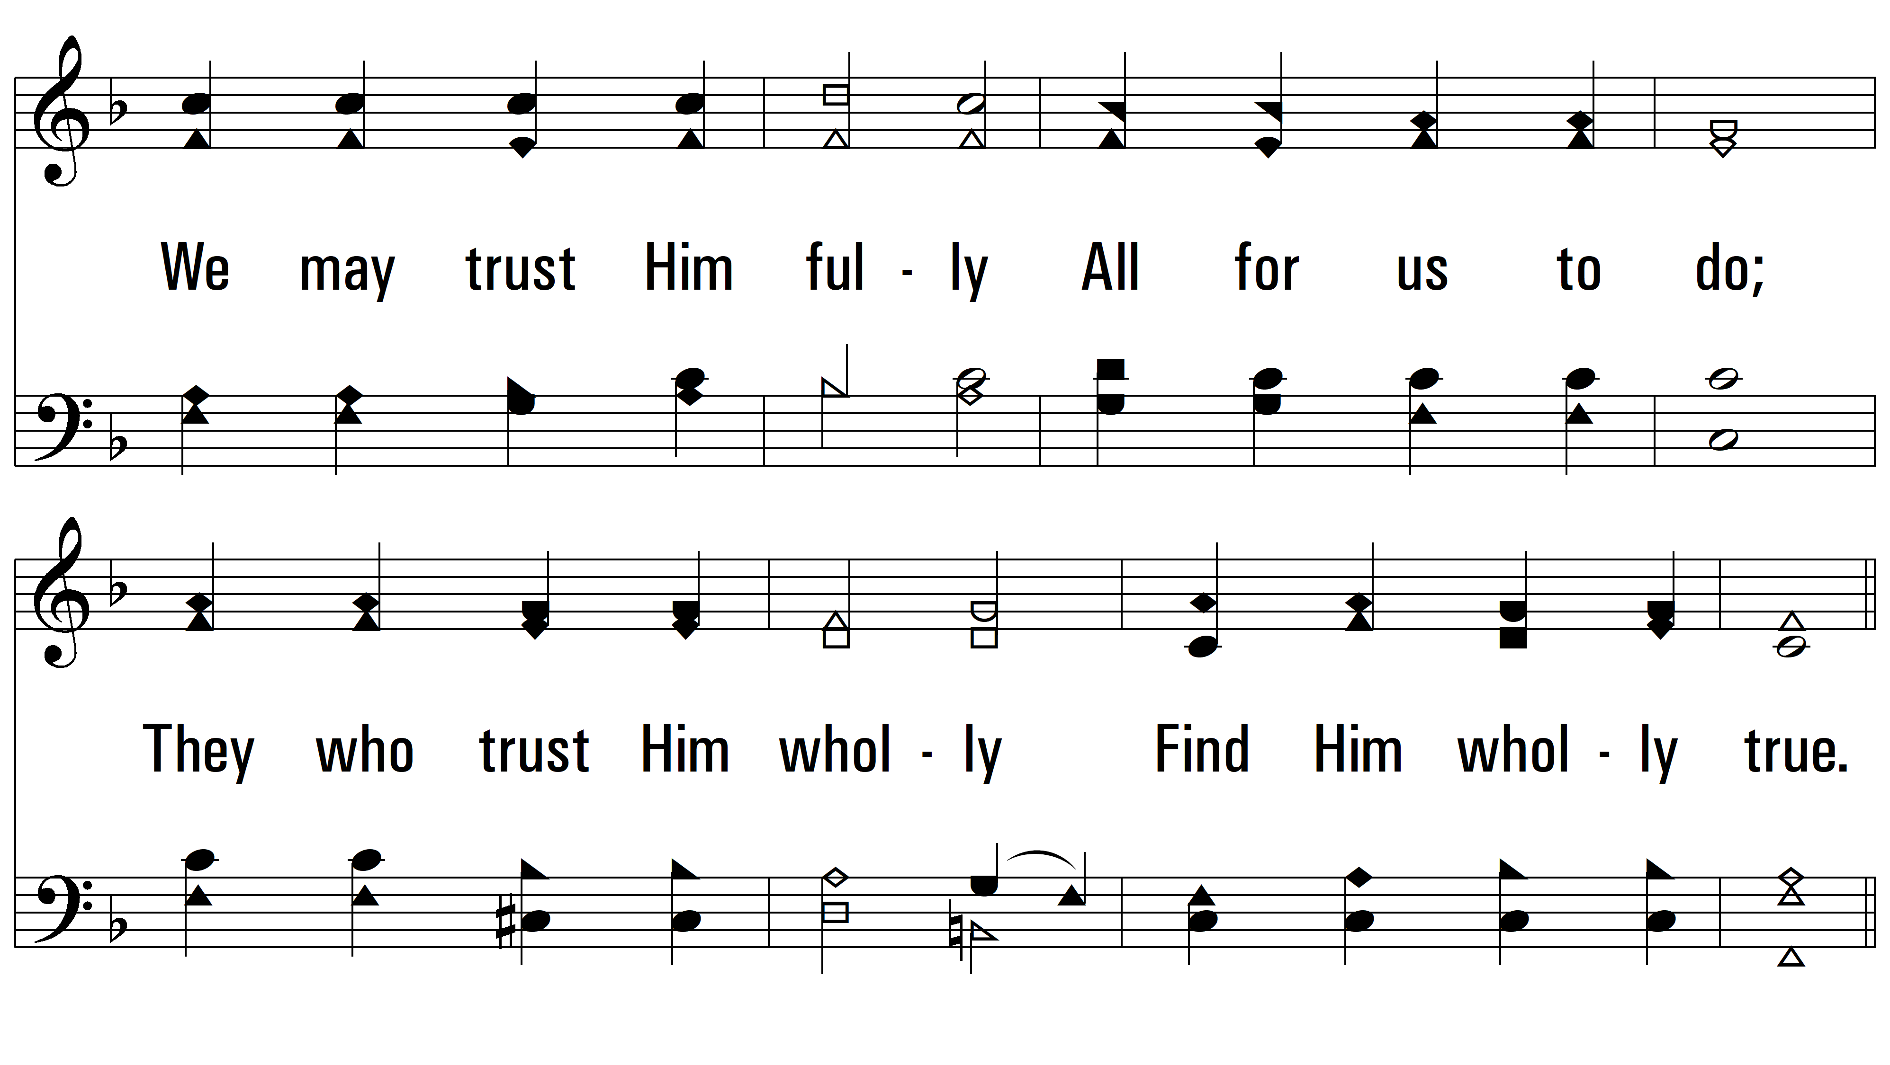
vs. 3

Slide 10
vs. 3
PDHymns.com
END

