Slide 1
Lord, We Come Before Thee Now
HENDON
7.7.7.7
Words: | W. Hammond (1745)
Music: | C. H. A. Malan (1823)
2/4
G/G - DO
Verses: 4
Lead - | DO
Alto - | SOL
Tenor - | MI
Bass - | DO
PDHymns.com

Slide 2
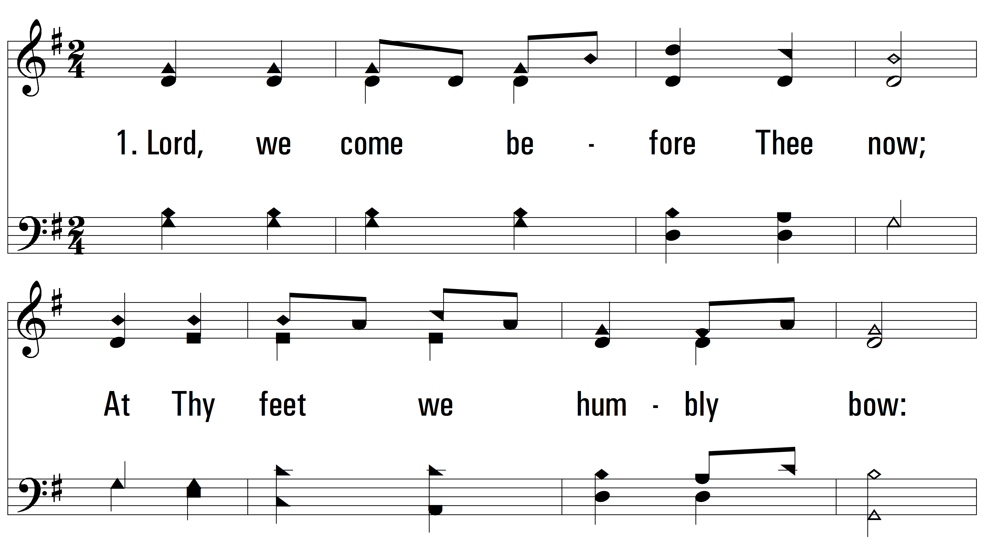
vs. 1 ~ Lord, We Come Before Thee Now

Slide 3
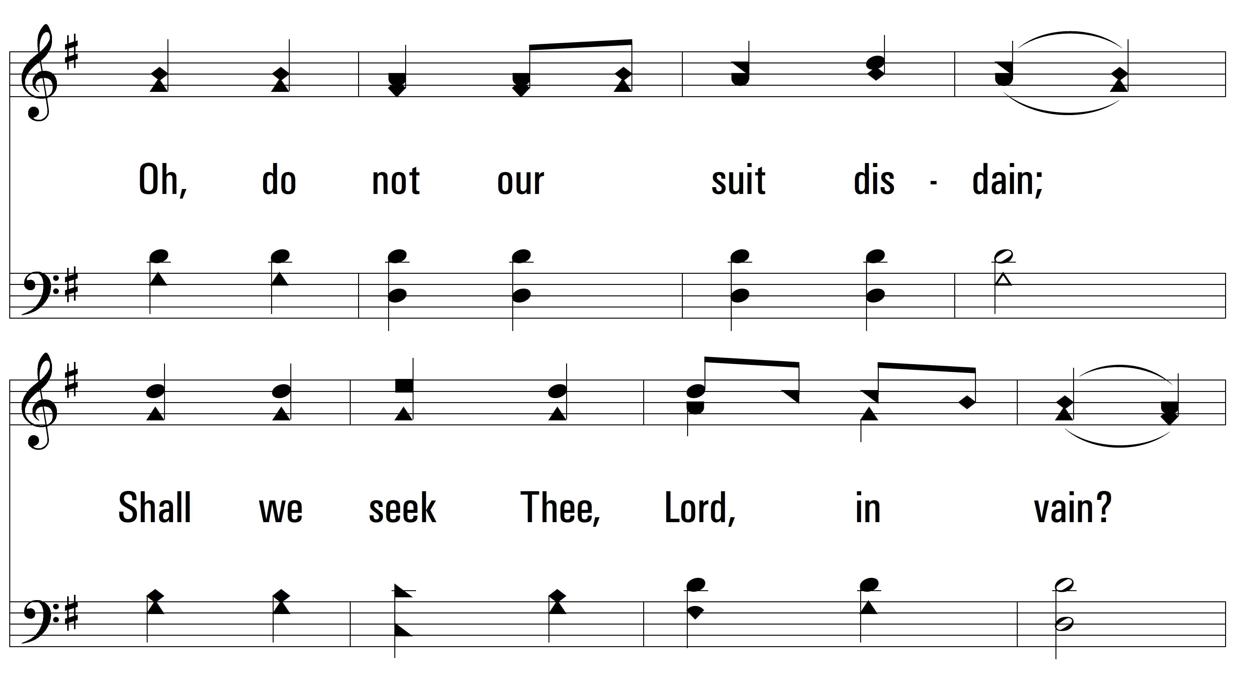
vs. 1

Slide 4
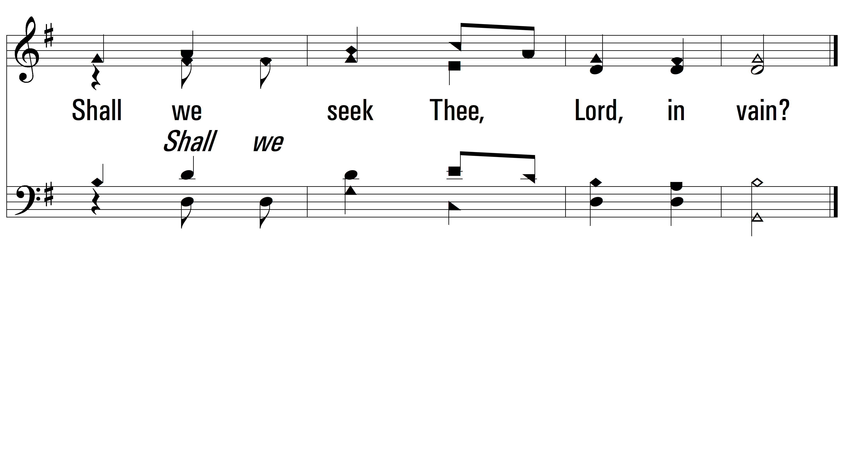
vs. 1

Slide 5
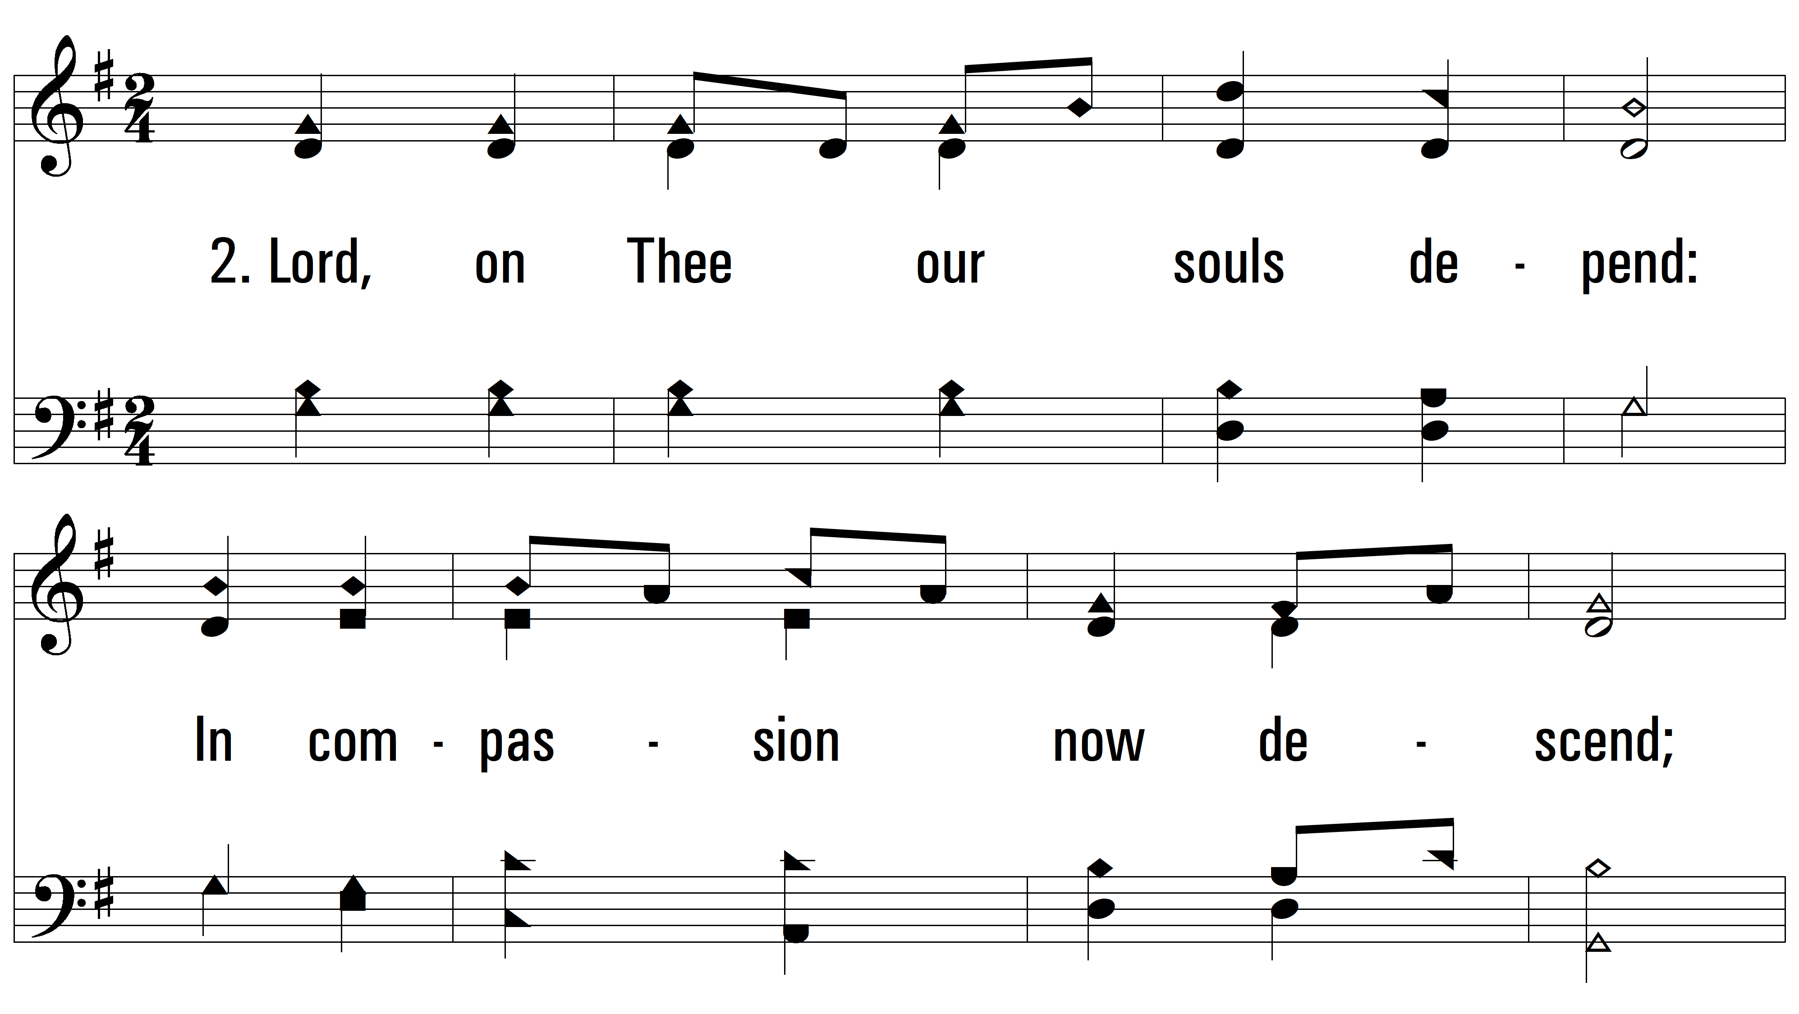
vs. 2 ~ Lord, We Come Before Thee Now

Slide 6
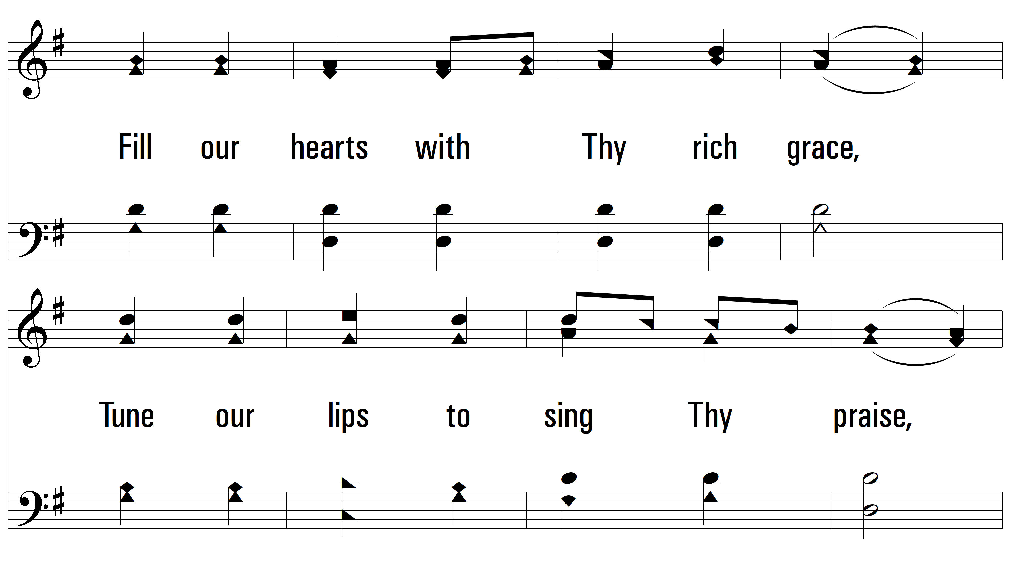
vs. 2

Slide 7
vs. 2

Slide 8
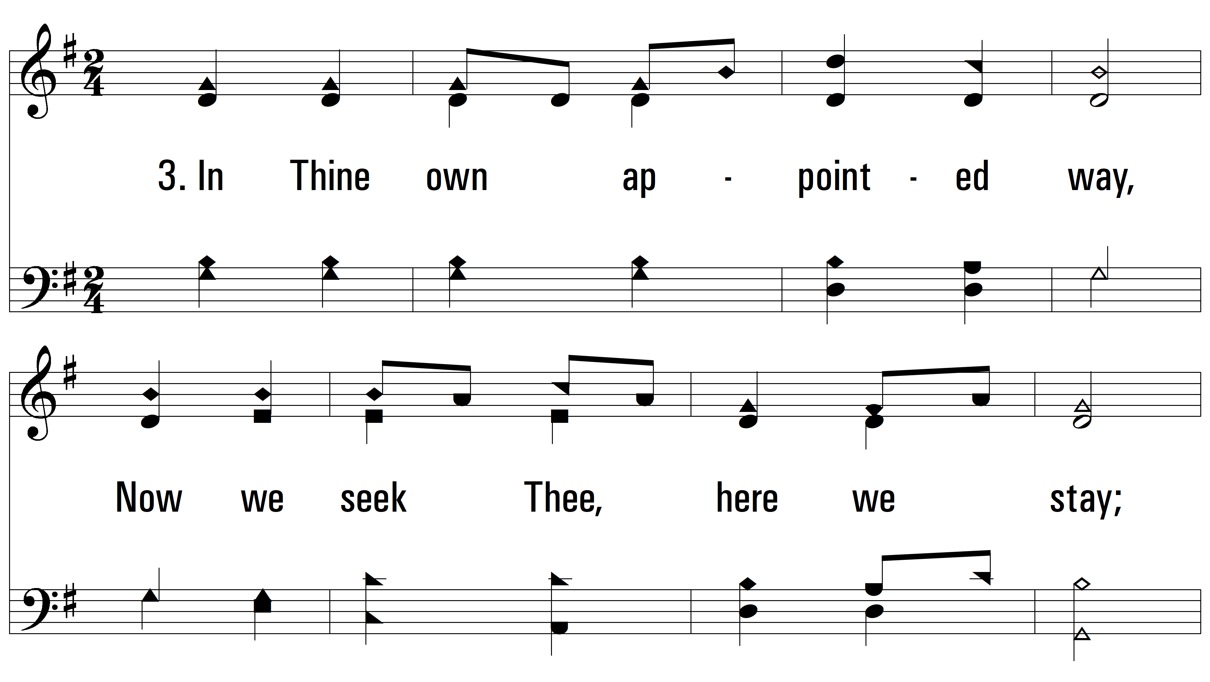
vs. 3 ~ Lord, We Come Before Thee Now

Slide 9
vs. 3

Slide 10
vs. 3

Slide 11
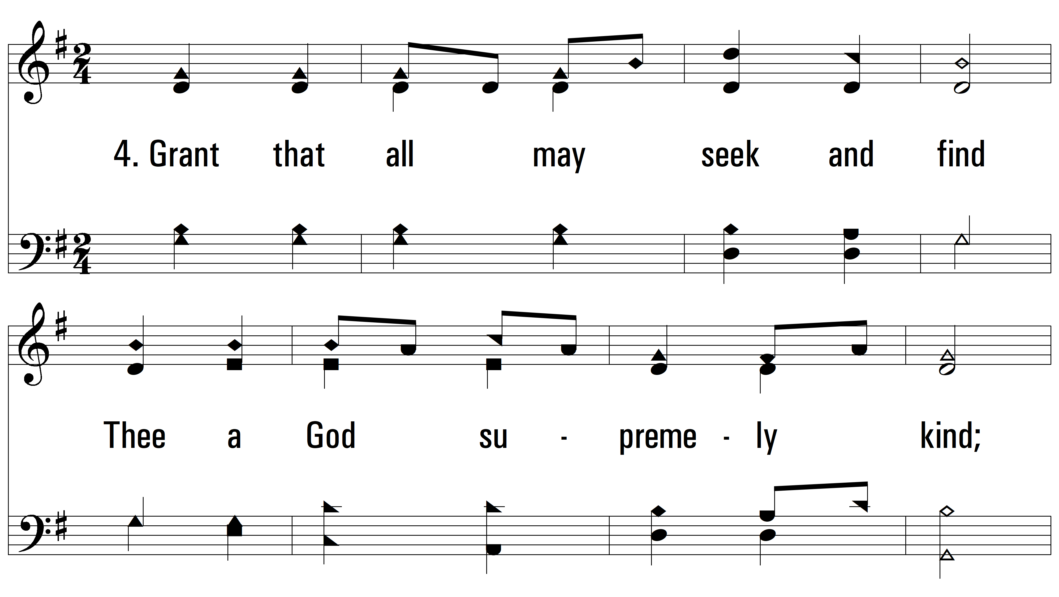
vs. 4 ~ Lord, We Come Before Thee Now

Slide 12
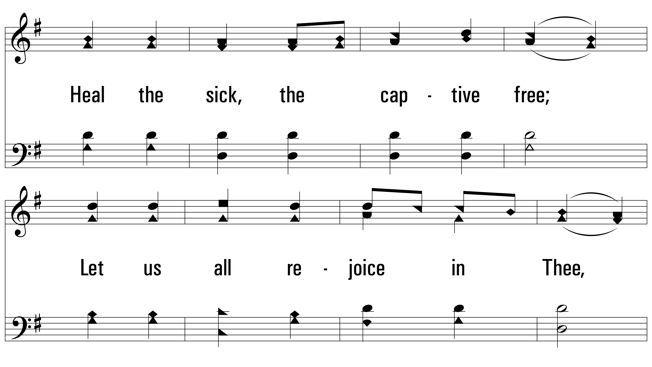
vs. 4

Slide 13
vs. 4
PDHymns.com
END

