Slide 1
Love Lifted Me
Words: | James Rowe (1912)
Music: | Howard E. Smith (1912)
6/8
B^{b}/F - SOL
Verses: 3/Chorus
Lead - | SOL
Alto - | MI
Tenor - | DO
Bass - | DO
PDHymns.com

Slide 2
vs. 1 ~ Love Lifted Me

Slide 3
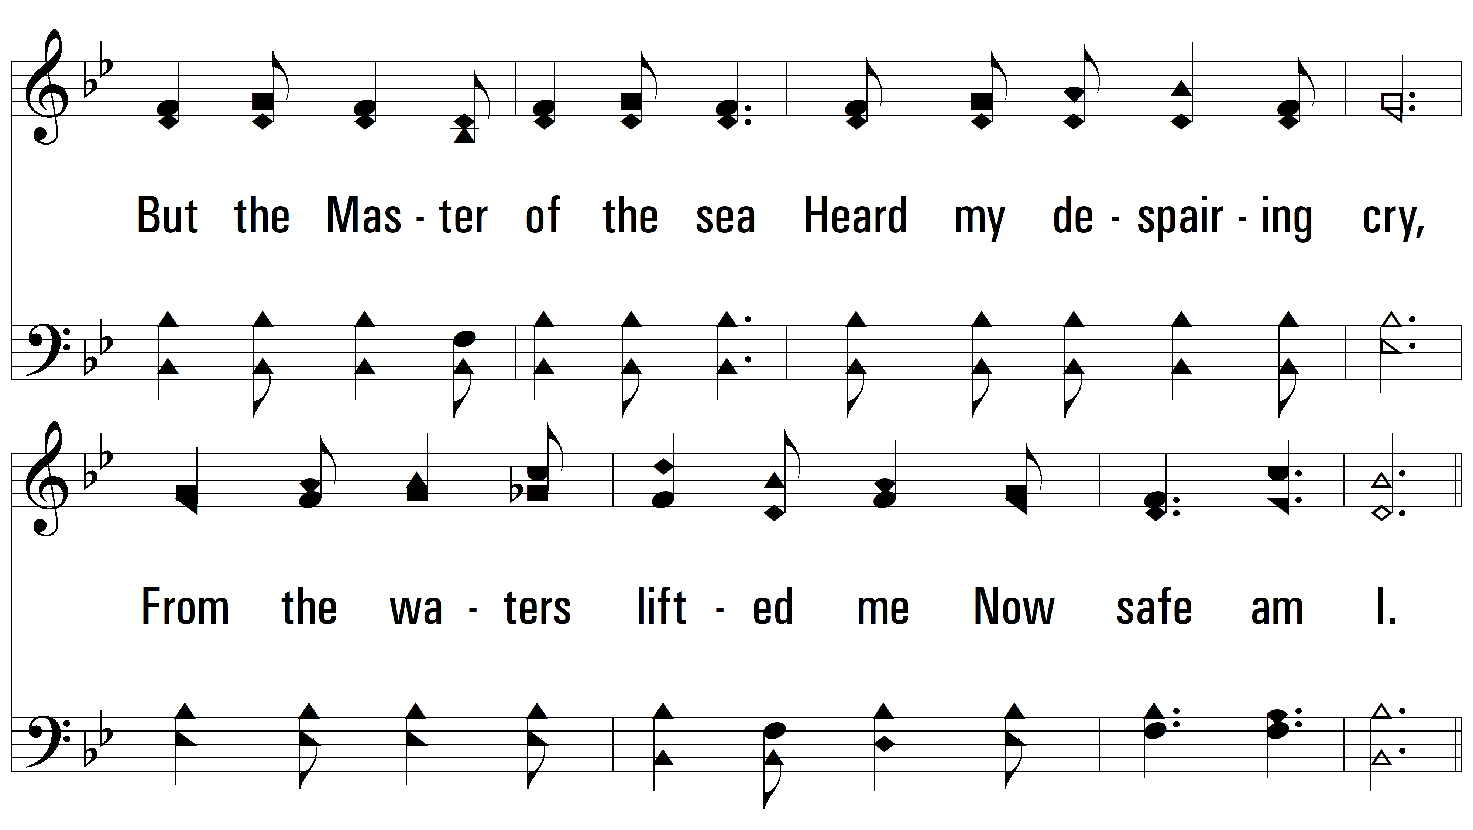
vs. 1

Slide 4
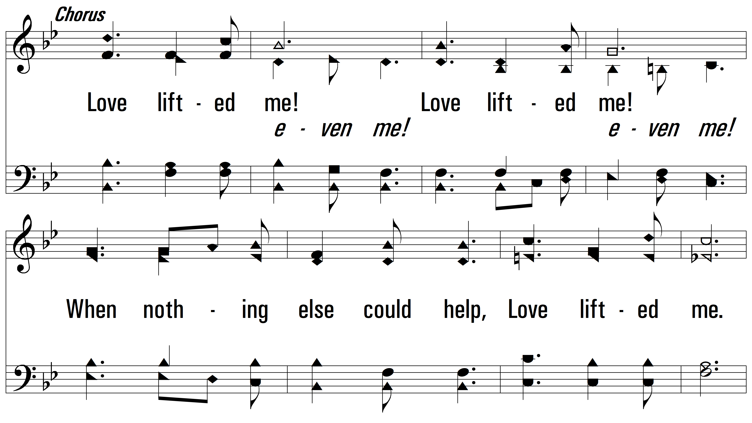
vs. 1

Slide 5
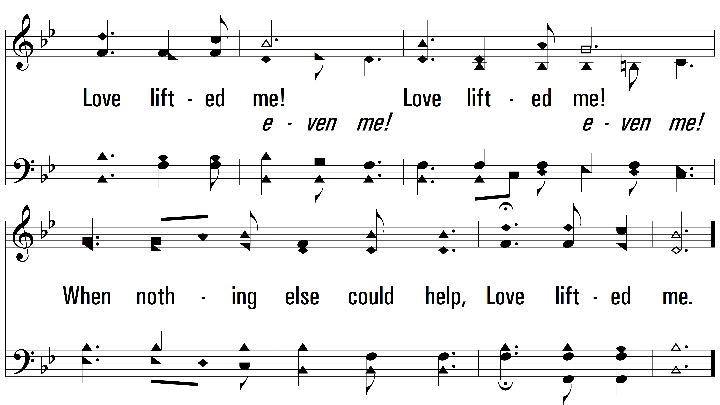
vs. 1

Slide 6
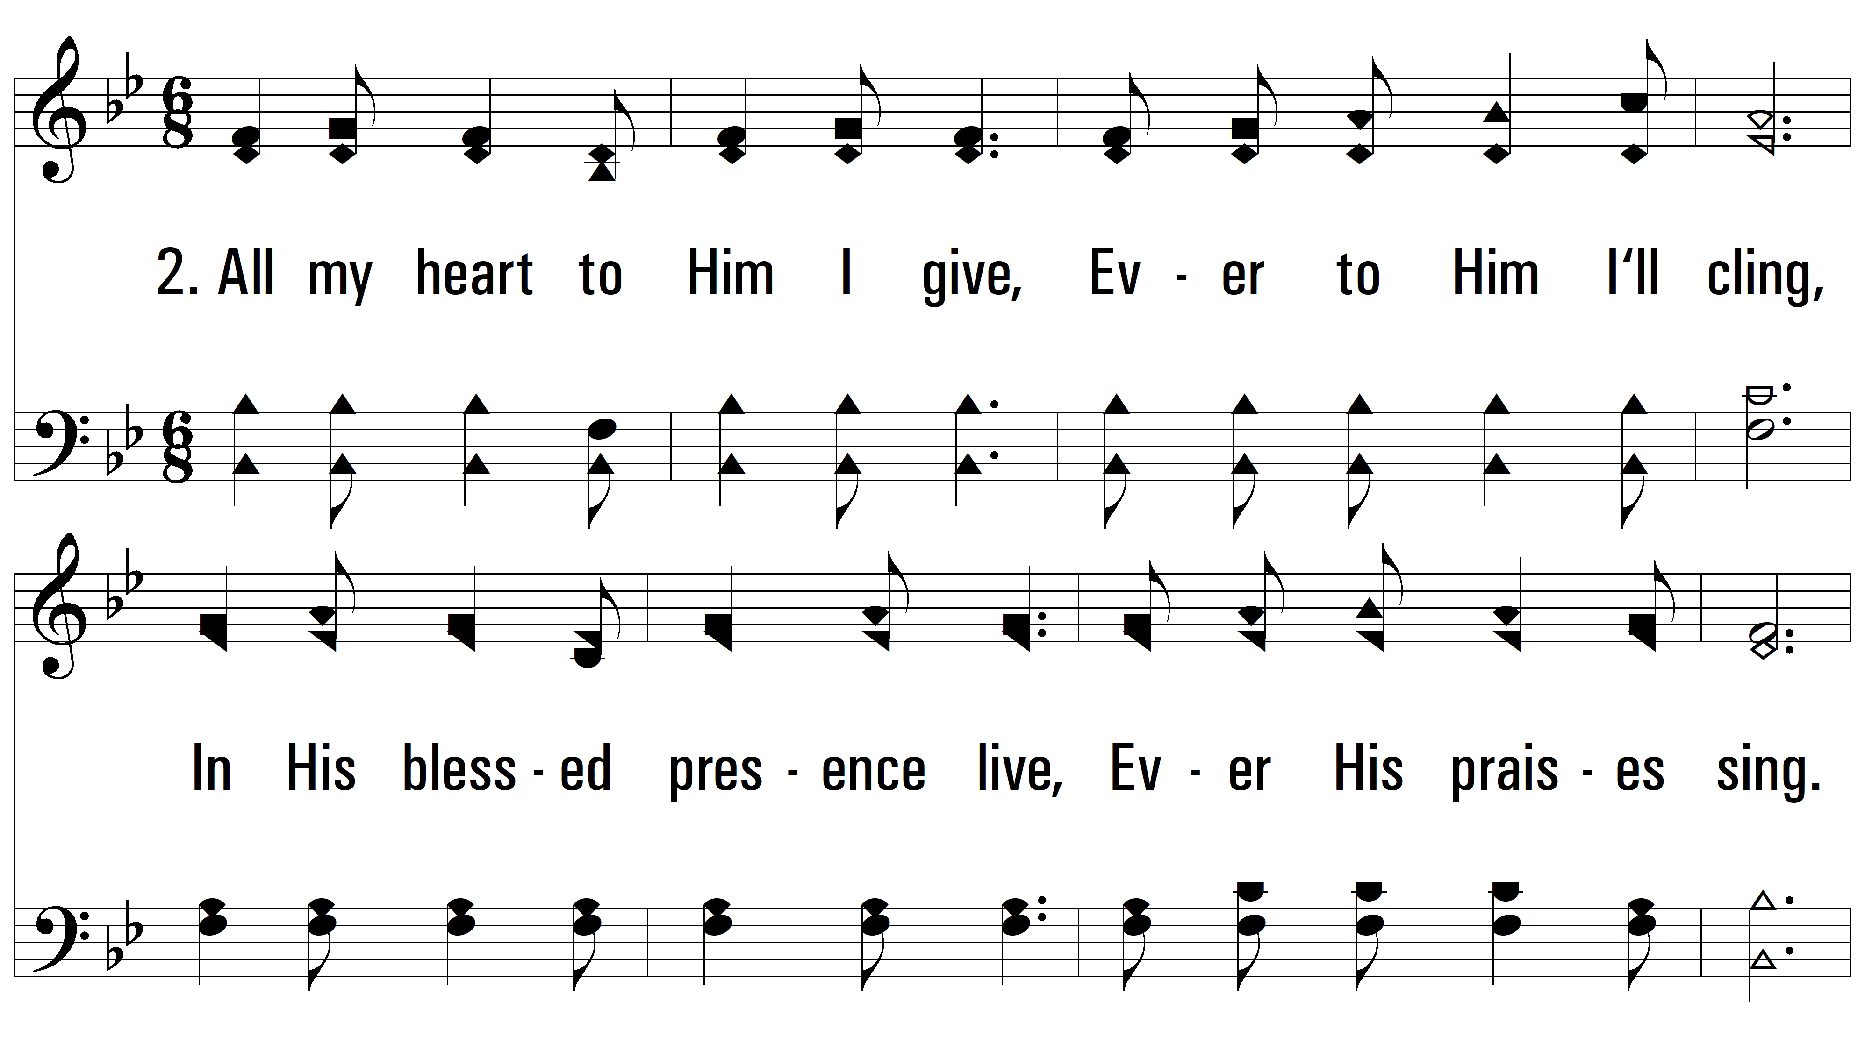
vs. 2 ~ Love Lifted Me

Slide 7
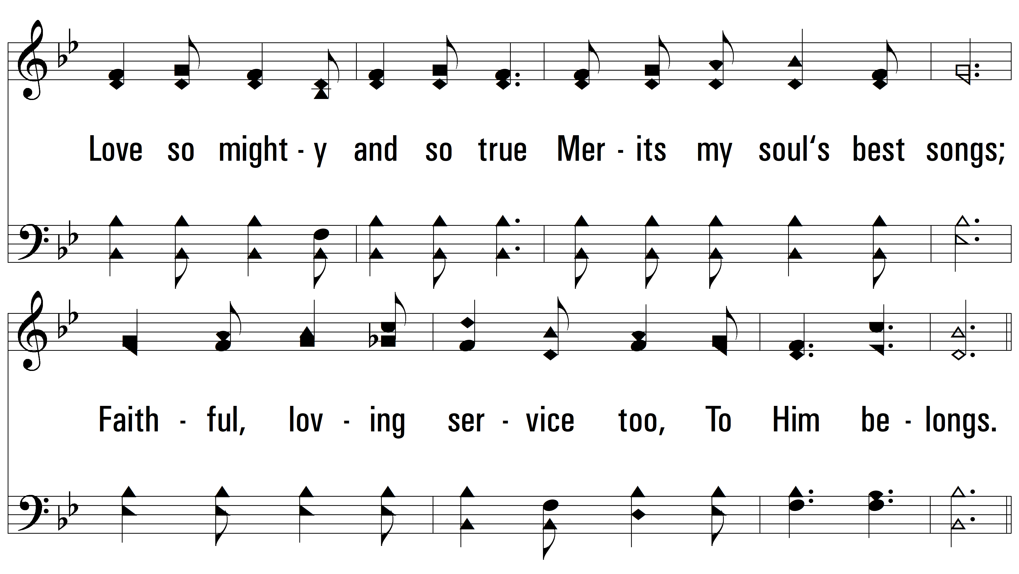
vs. 2

Slide 8
vs. 2

Slide 9
vs. 2

Slide 10
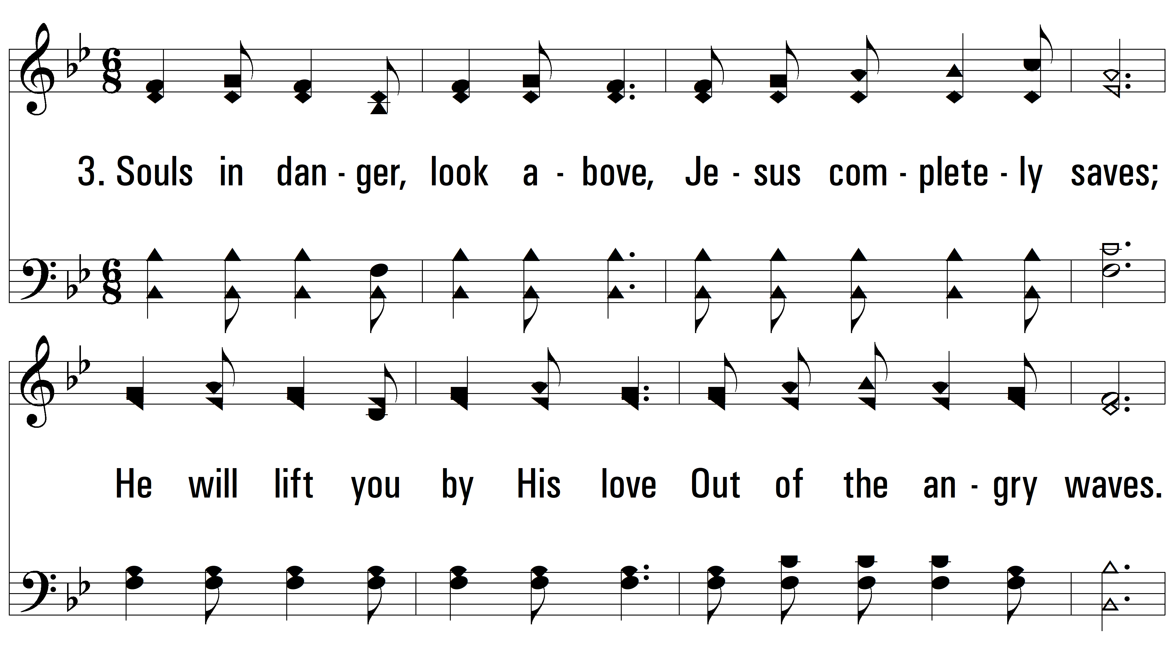
vs. 3 ~ Love Lifted Me

Slide 11
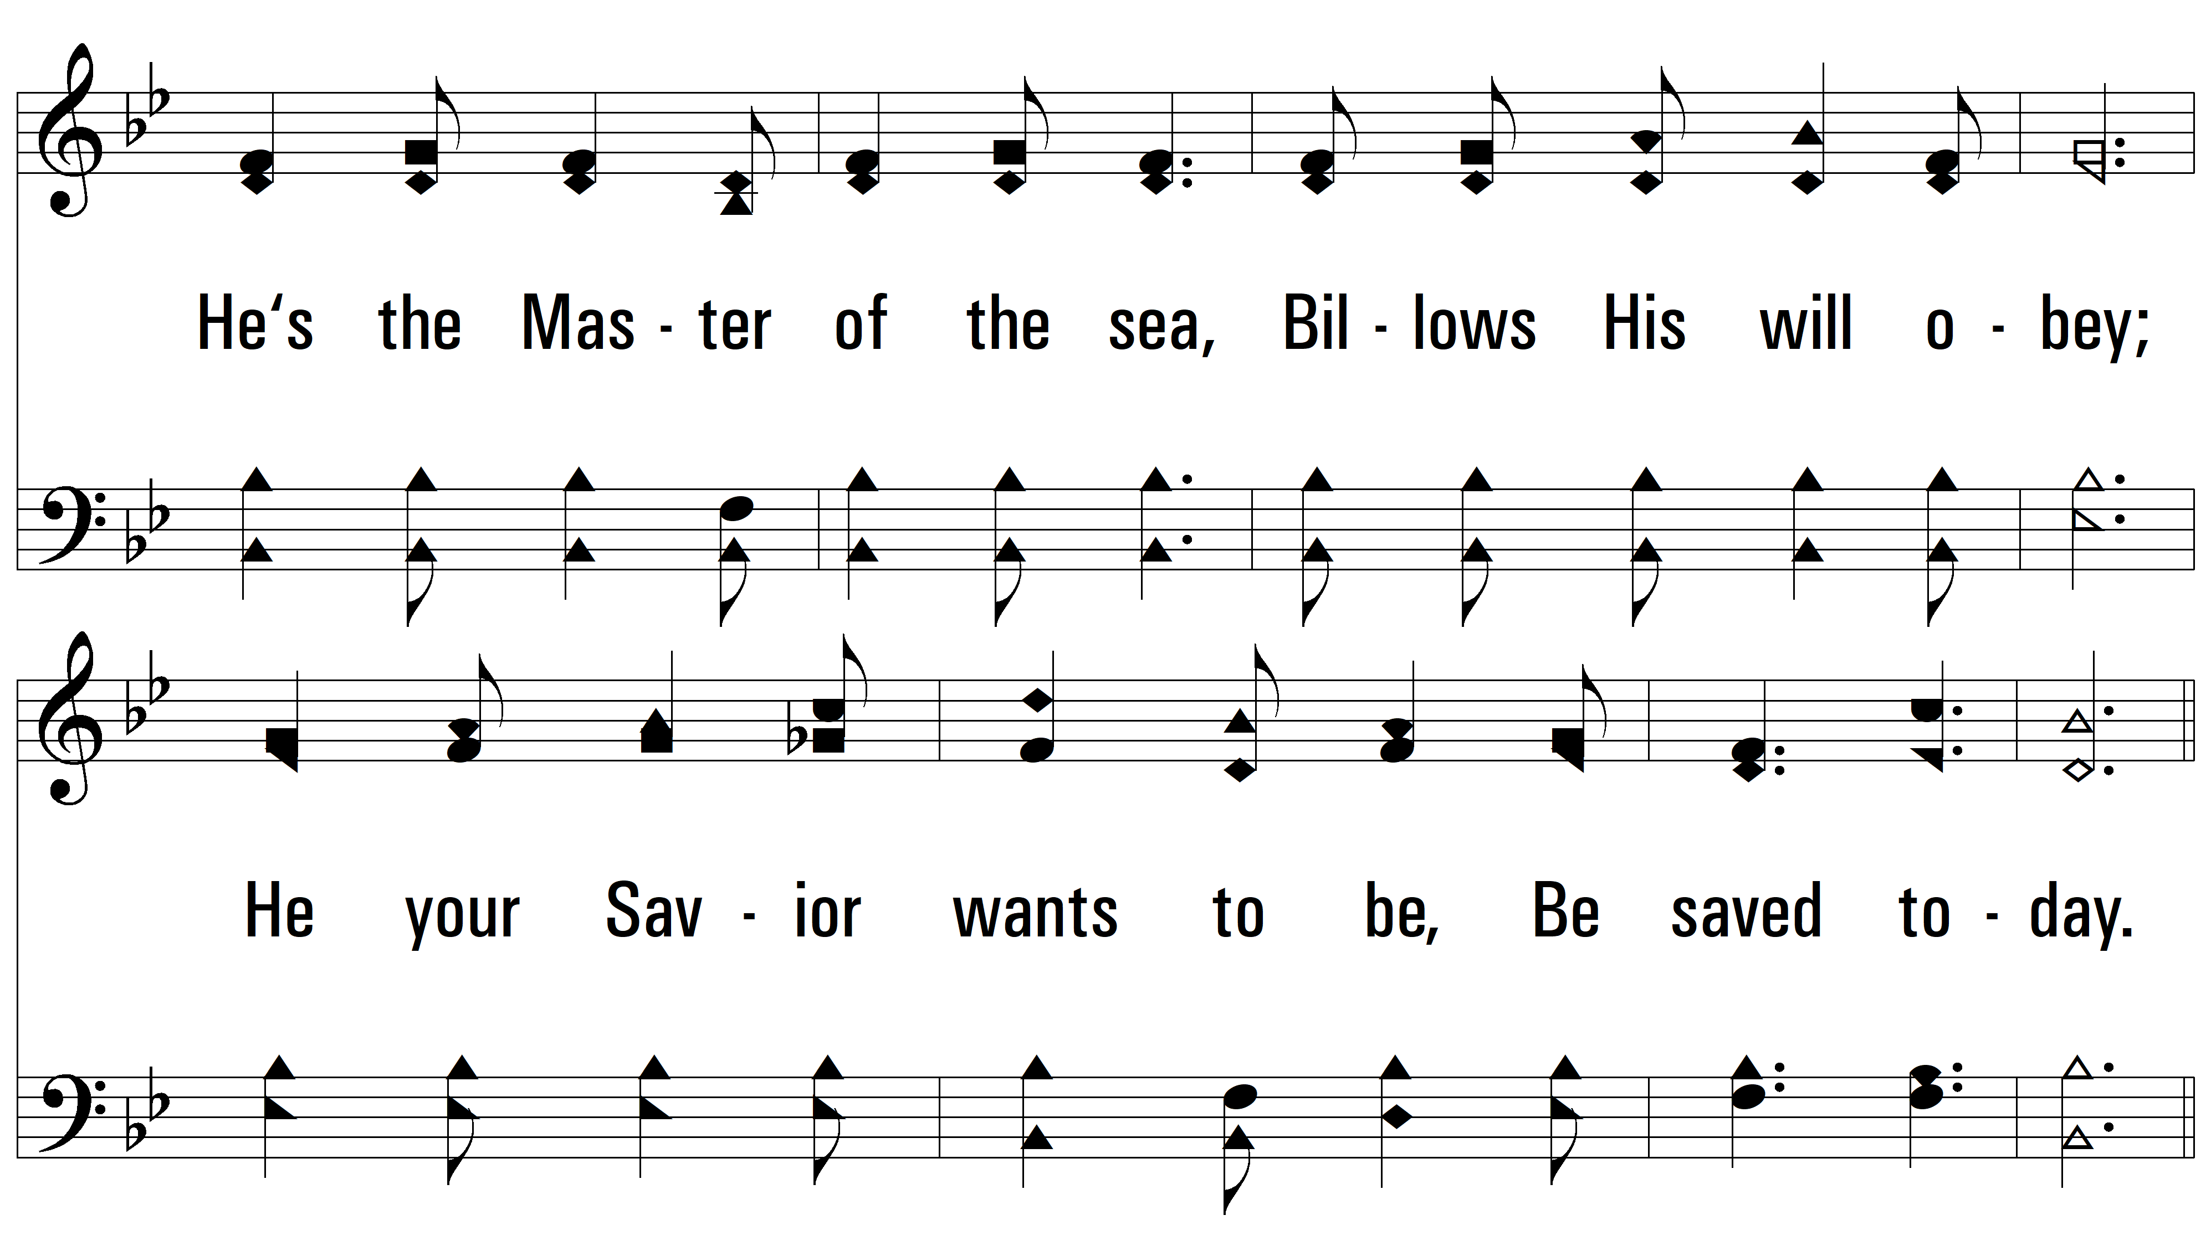
vs. 3

Slide 12
vs. 3

Slide 13
vs. 3
PDHymns.com
END

