Slide 1
Low In The Grave He Lay
(Christ Arose)
Words: | Robert Lowry (1874)
Music: | Robert Lowry (1874)
4/4
C/G - SOL
Verses: 3/Chorus
Lead - | SOL
Alto - | MI
Tenor - | DO
Bass - | DO
PDHymns.com

Slide 2
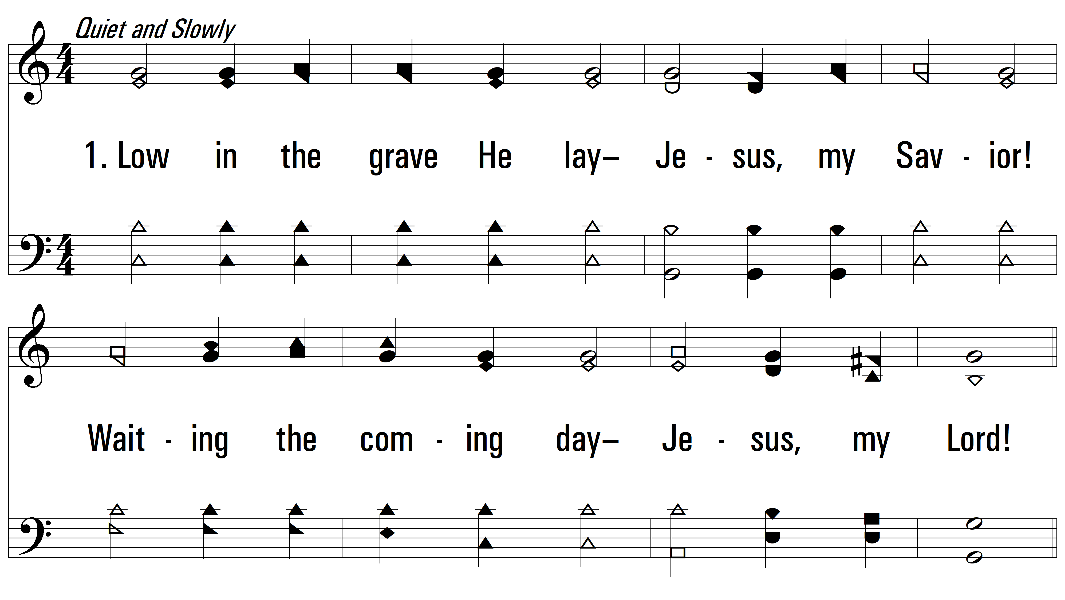
vs. 1 ~ Low In The Grave He Lay

Slide 3
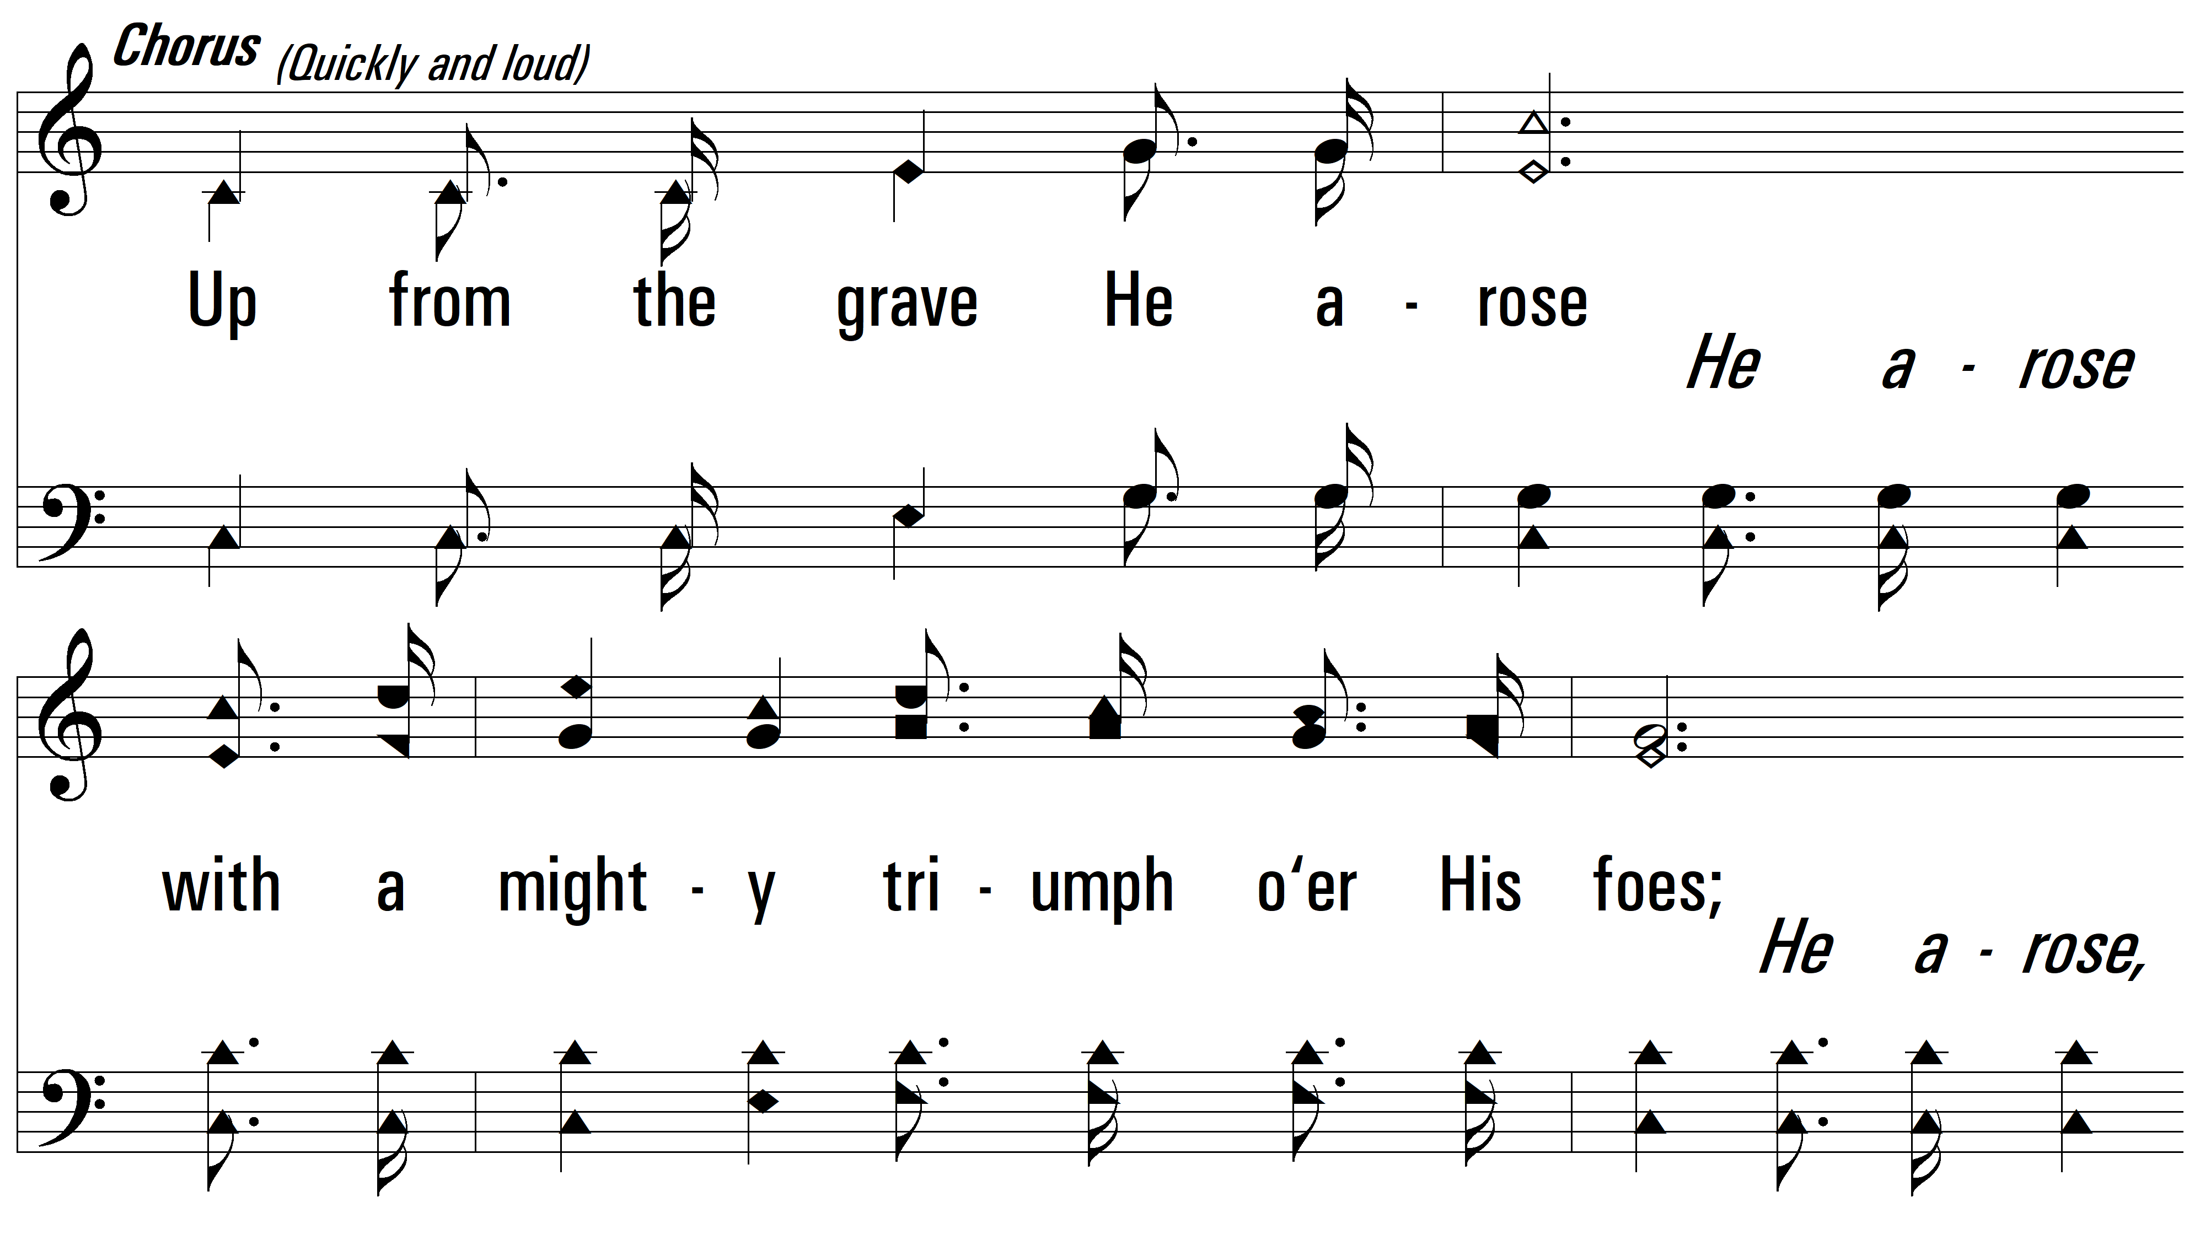
vs. 1

Slide 4
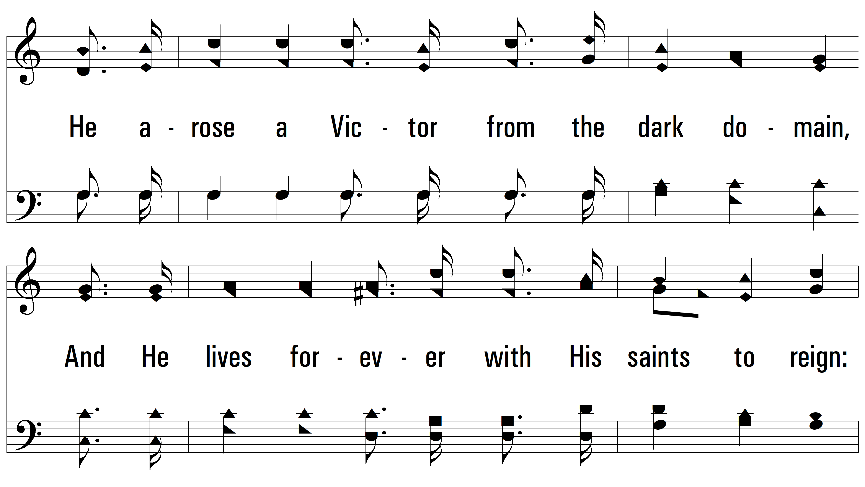
vs. 1

Slide 5
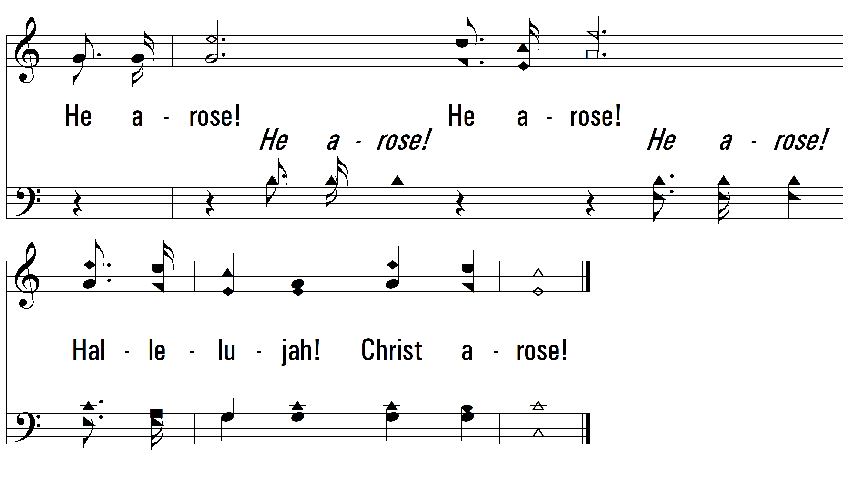
vs. 1

Slide 6
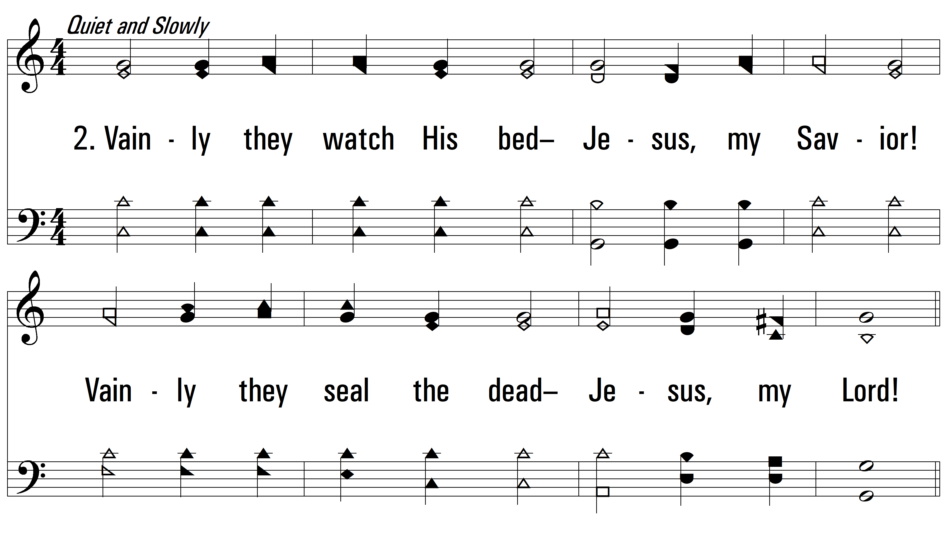
vs. 2 ~ Low In The Grave He Lay

Slide 7
vs. 2

Slide 8
vs. 2

Slide 9
vs. 2

Slide 10
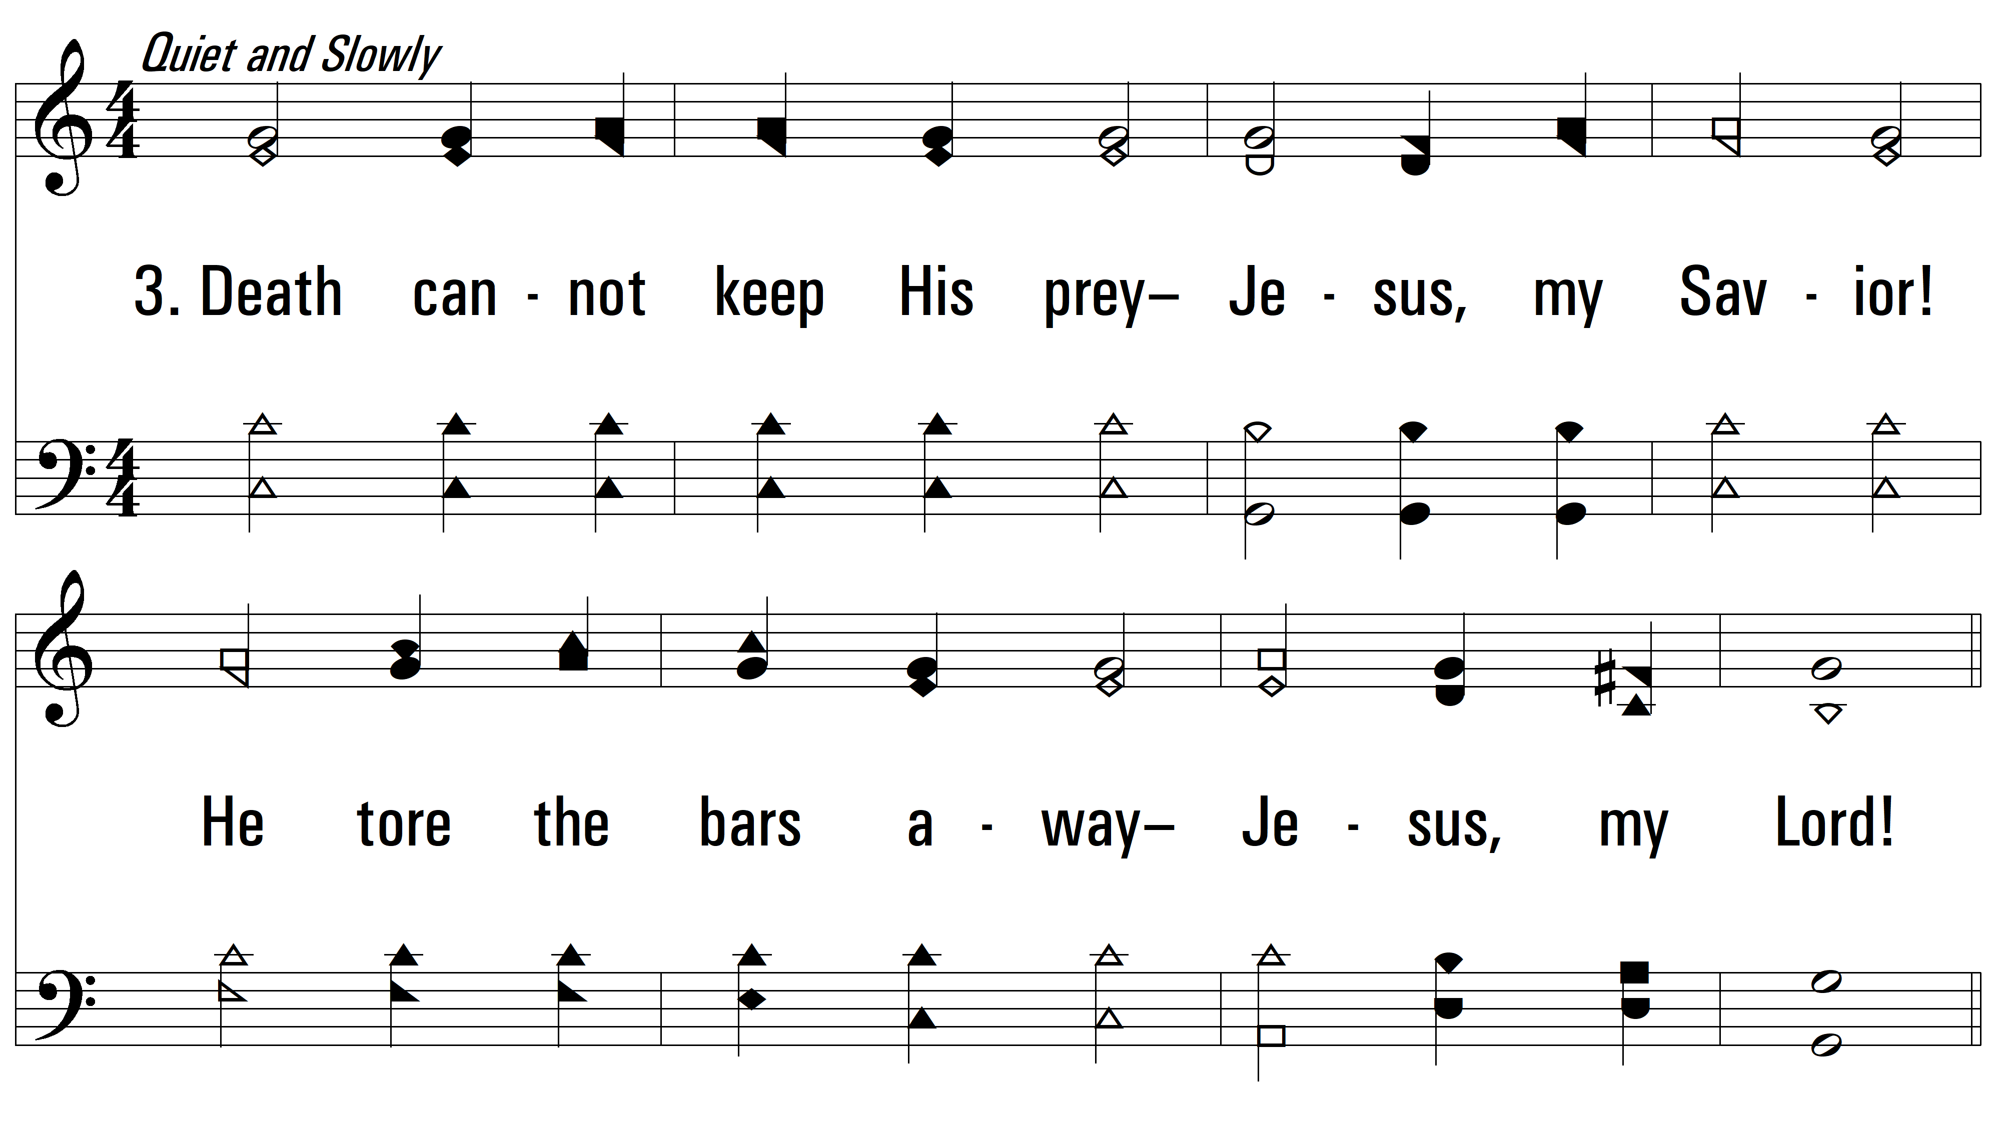
vs. 3 ~ Low In The Grave He Lay

Slide 11
vs. 3

Slide 12
vs. 3

Slide 13
vs. 3
PDHymns.com
END

