Slide 1
My Country, ‘Tis Of Thee
(America)
Words: | S. F. Smith (1831)
Music: | Henry Carey, Gentleman's Magazine (1745)
3/4
F/F - DO
Verses: 4
Lead - | DO
Alto - | SOL
Tenor - | MI
Bass - | DO
PDHymns.com

Slide 2
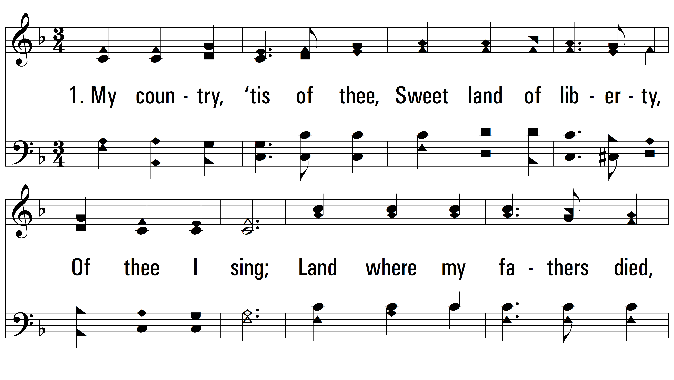
vs. 1 ~ My Country, ‘Tis Of Thee

Slide 3
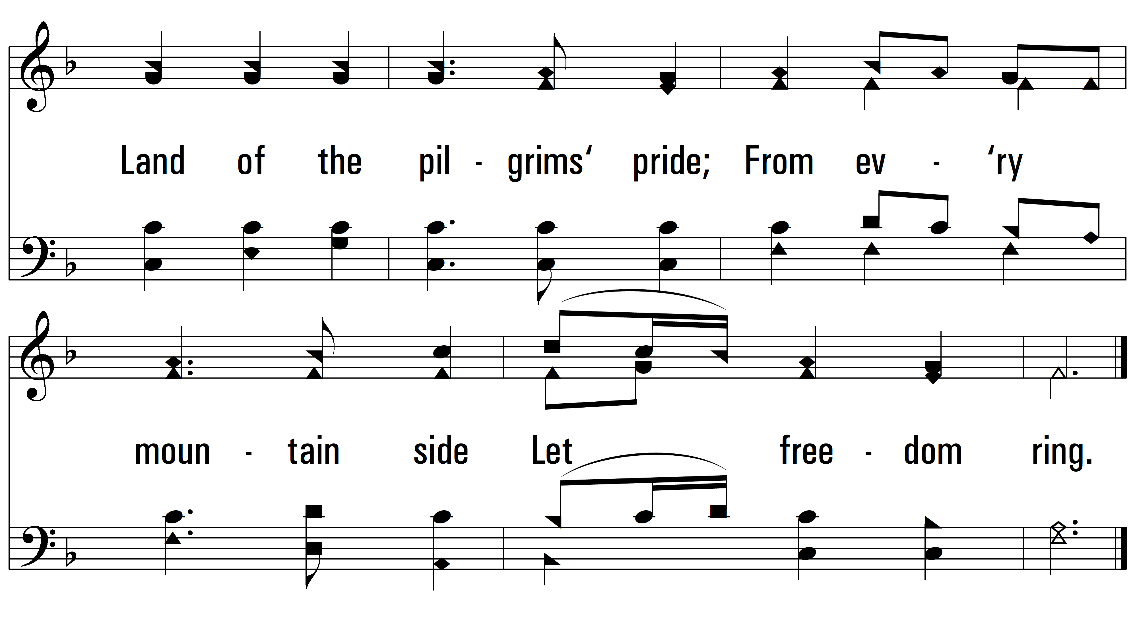
vs. 1

Slide 4
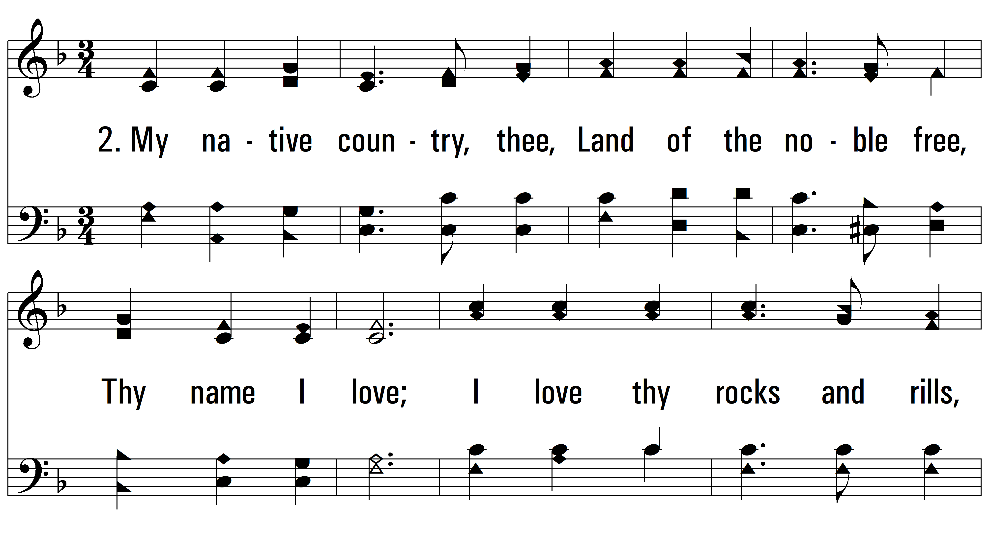
vs. 2 ~ My Country, ‘Tis Of Thee

Slide 5
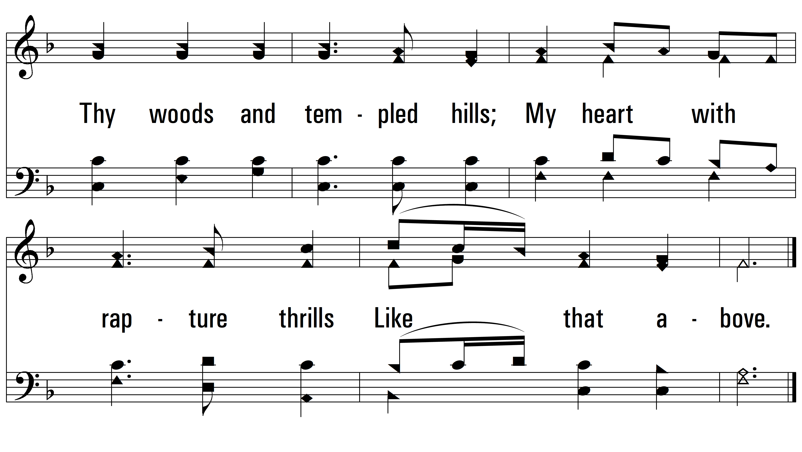
vs. 2

Slide 6
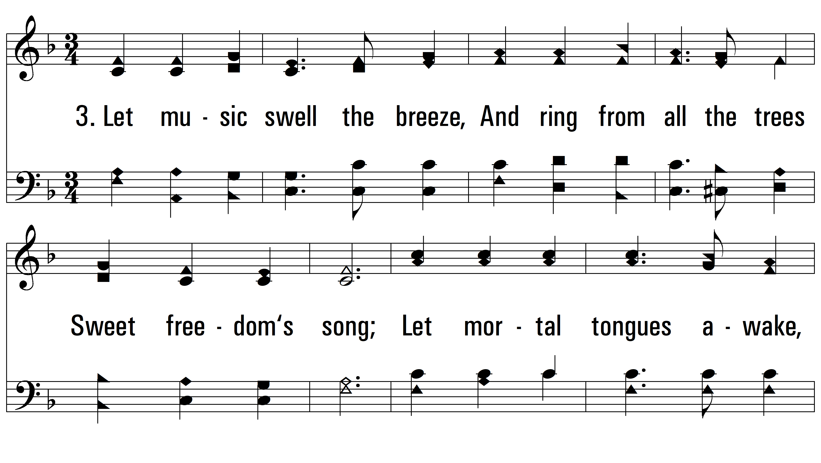
vs. 3 ~ My Country, ‘Tis Of Thee

Slide 7
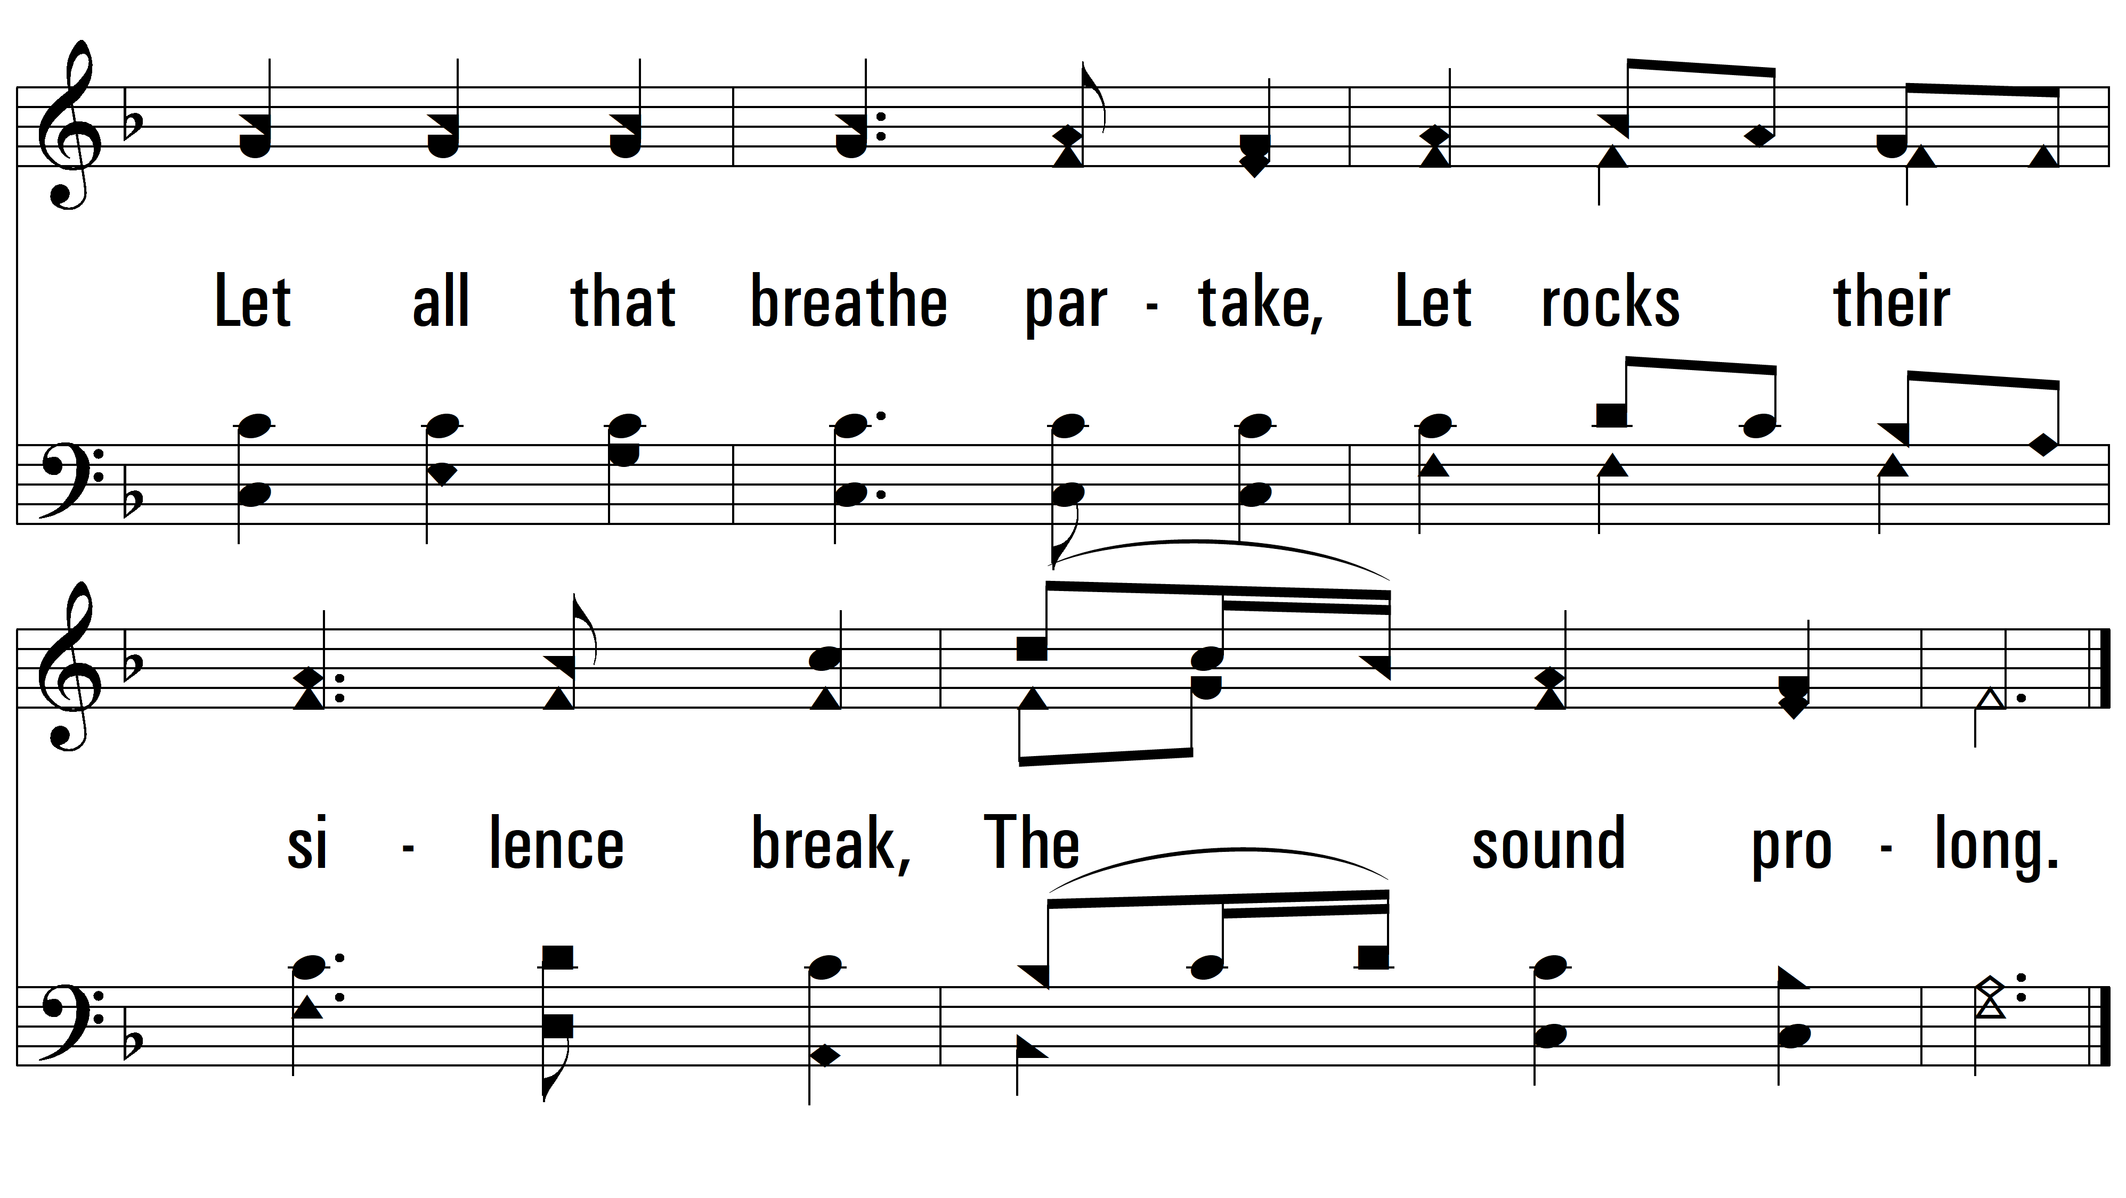
vs. 3

Slide 8
vs. 4 ~ My Country, ‘Tis Of Thee

Slide 9
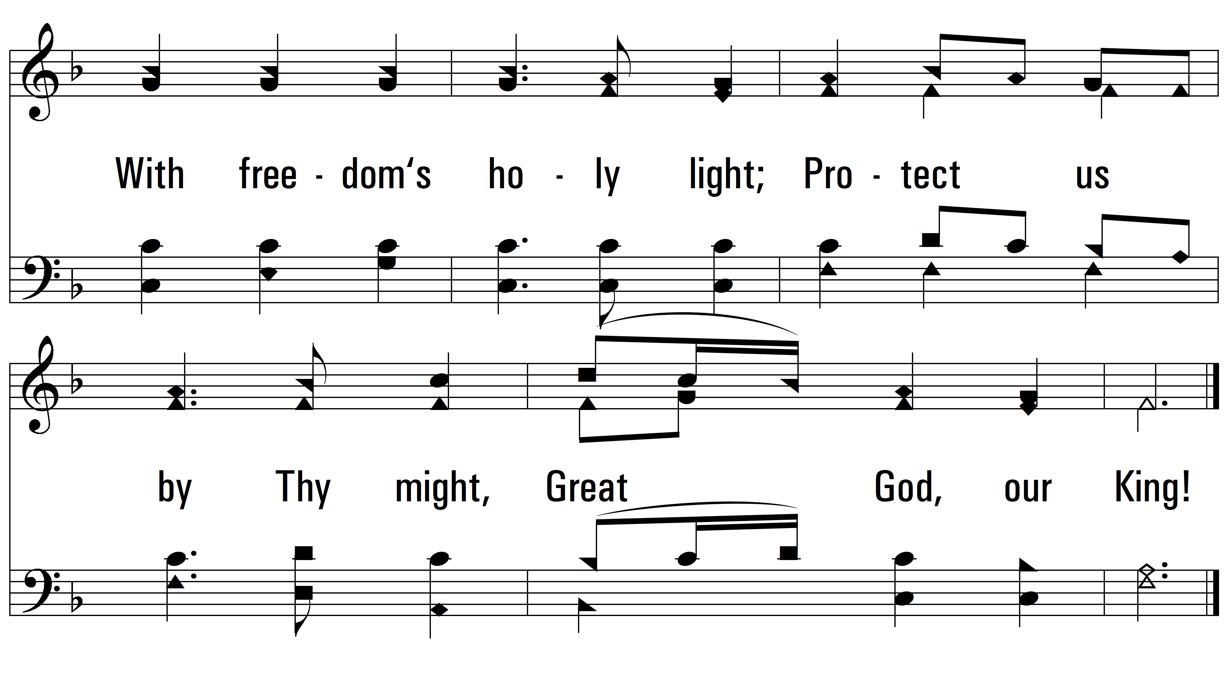
vs. 4
PDHymns.com
END

