Slide 1
My Jesus As Thou Wilt
JEWETT
6.6.6.6.D
Words: | Benjamin Schmolke (1704), Tr. Jane Borthwick (1854)
Music: | Carl von Weber (1820), Arr. Joseph P. Holbrook (1862)
4/4
D/A - SOL
Verses: 4
Lead - | SOL
Alto - | MI
Tenor - | DO
Bass - | DO
PDHymns.com

Slide 2
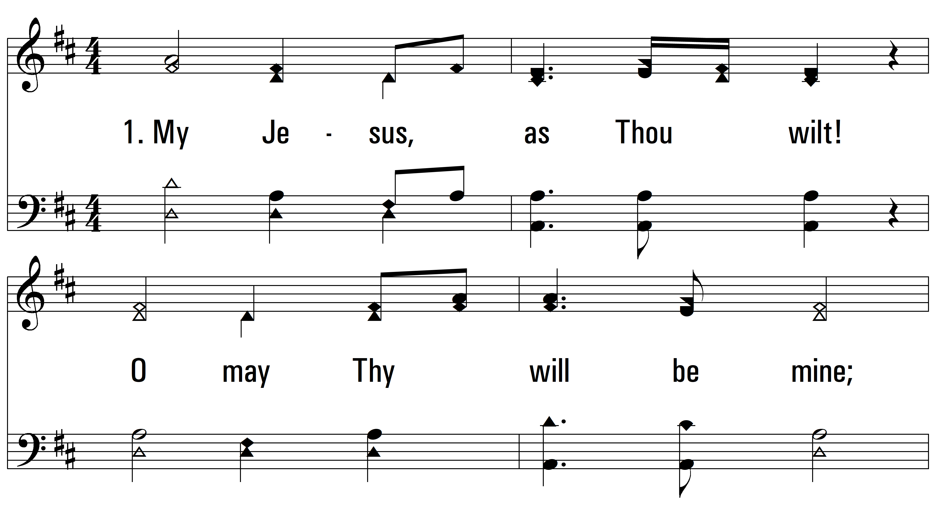
vs. 1 ~ My Jesus As Thou Wilt

Slide 3
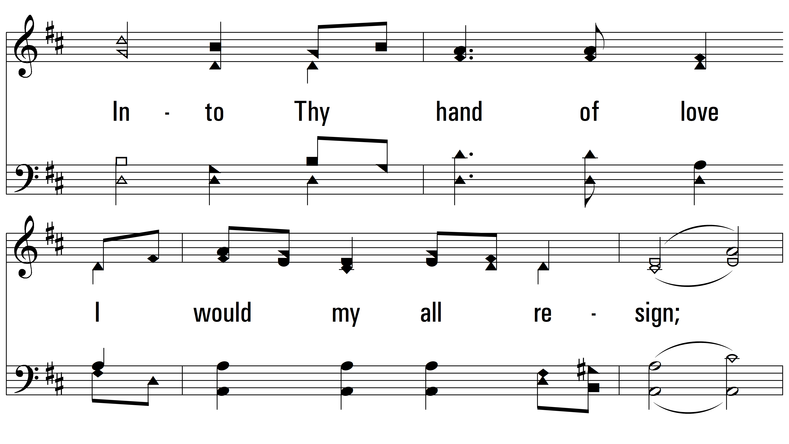
vs. 1

Slide 4
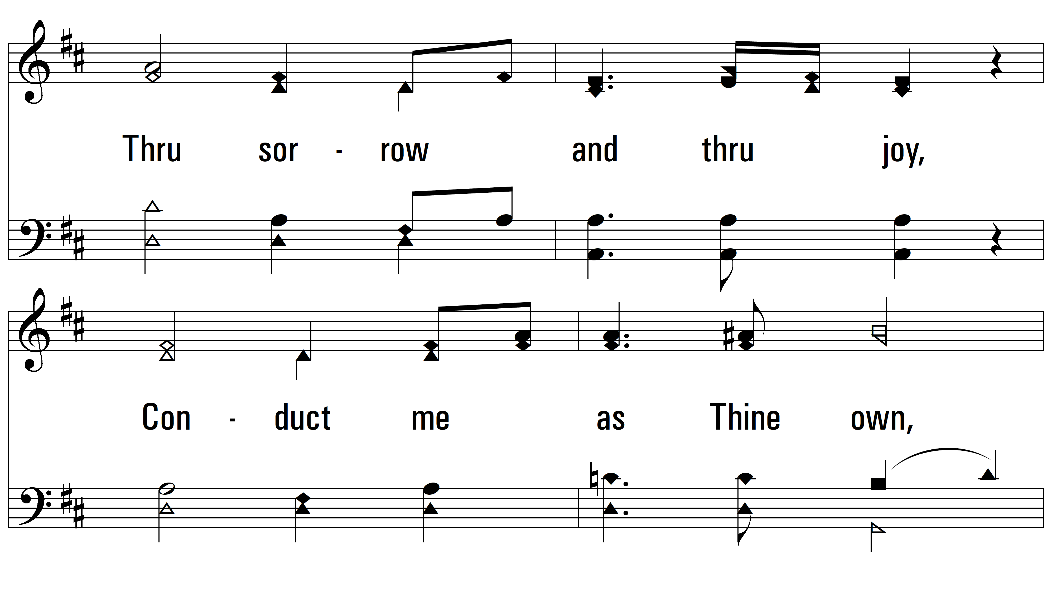
vs. 1

Slide 5
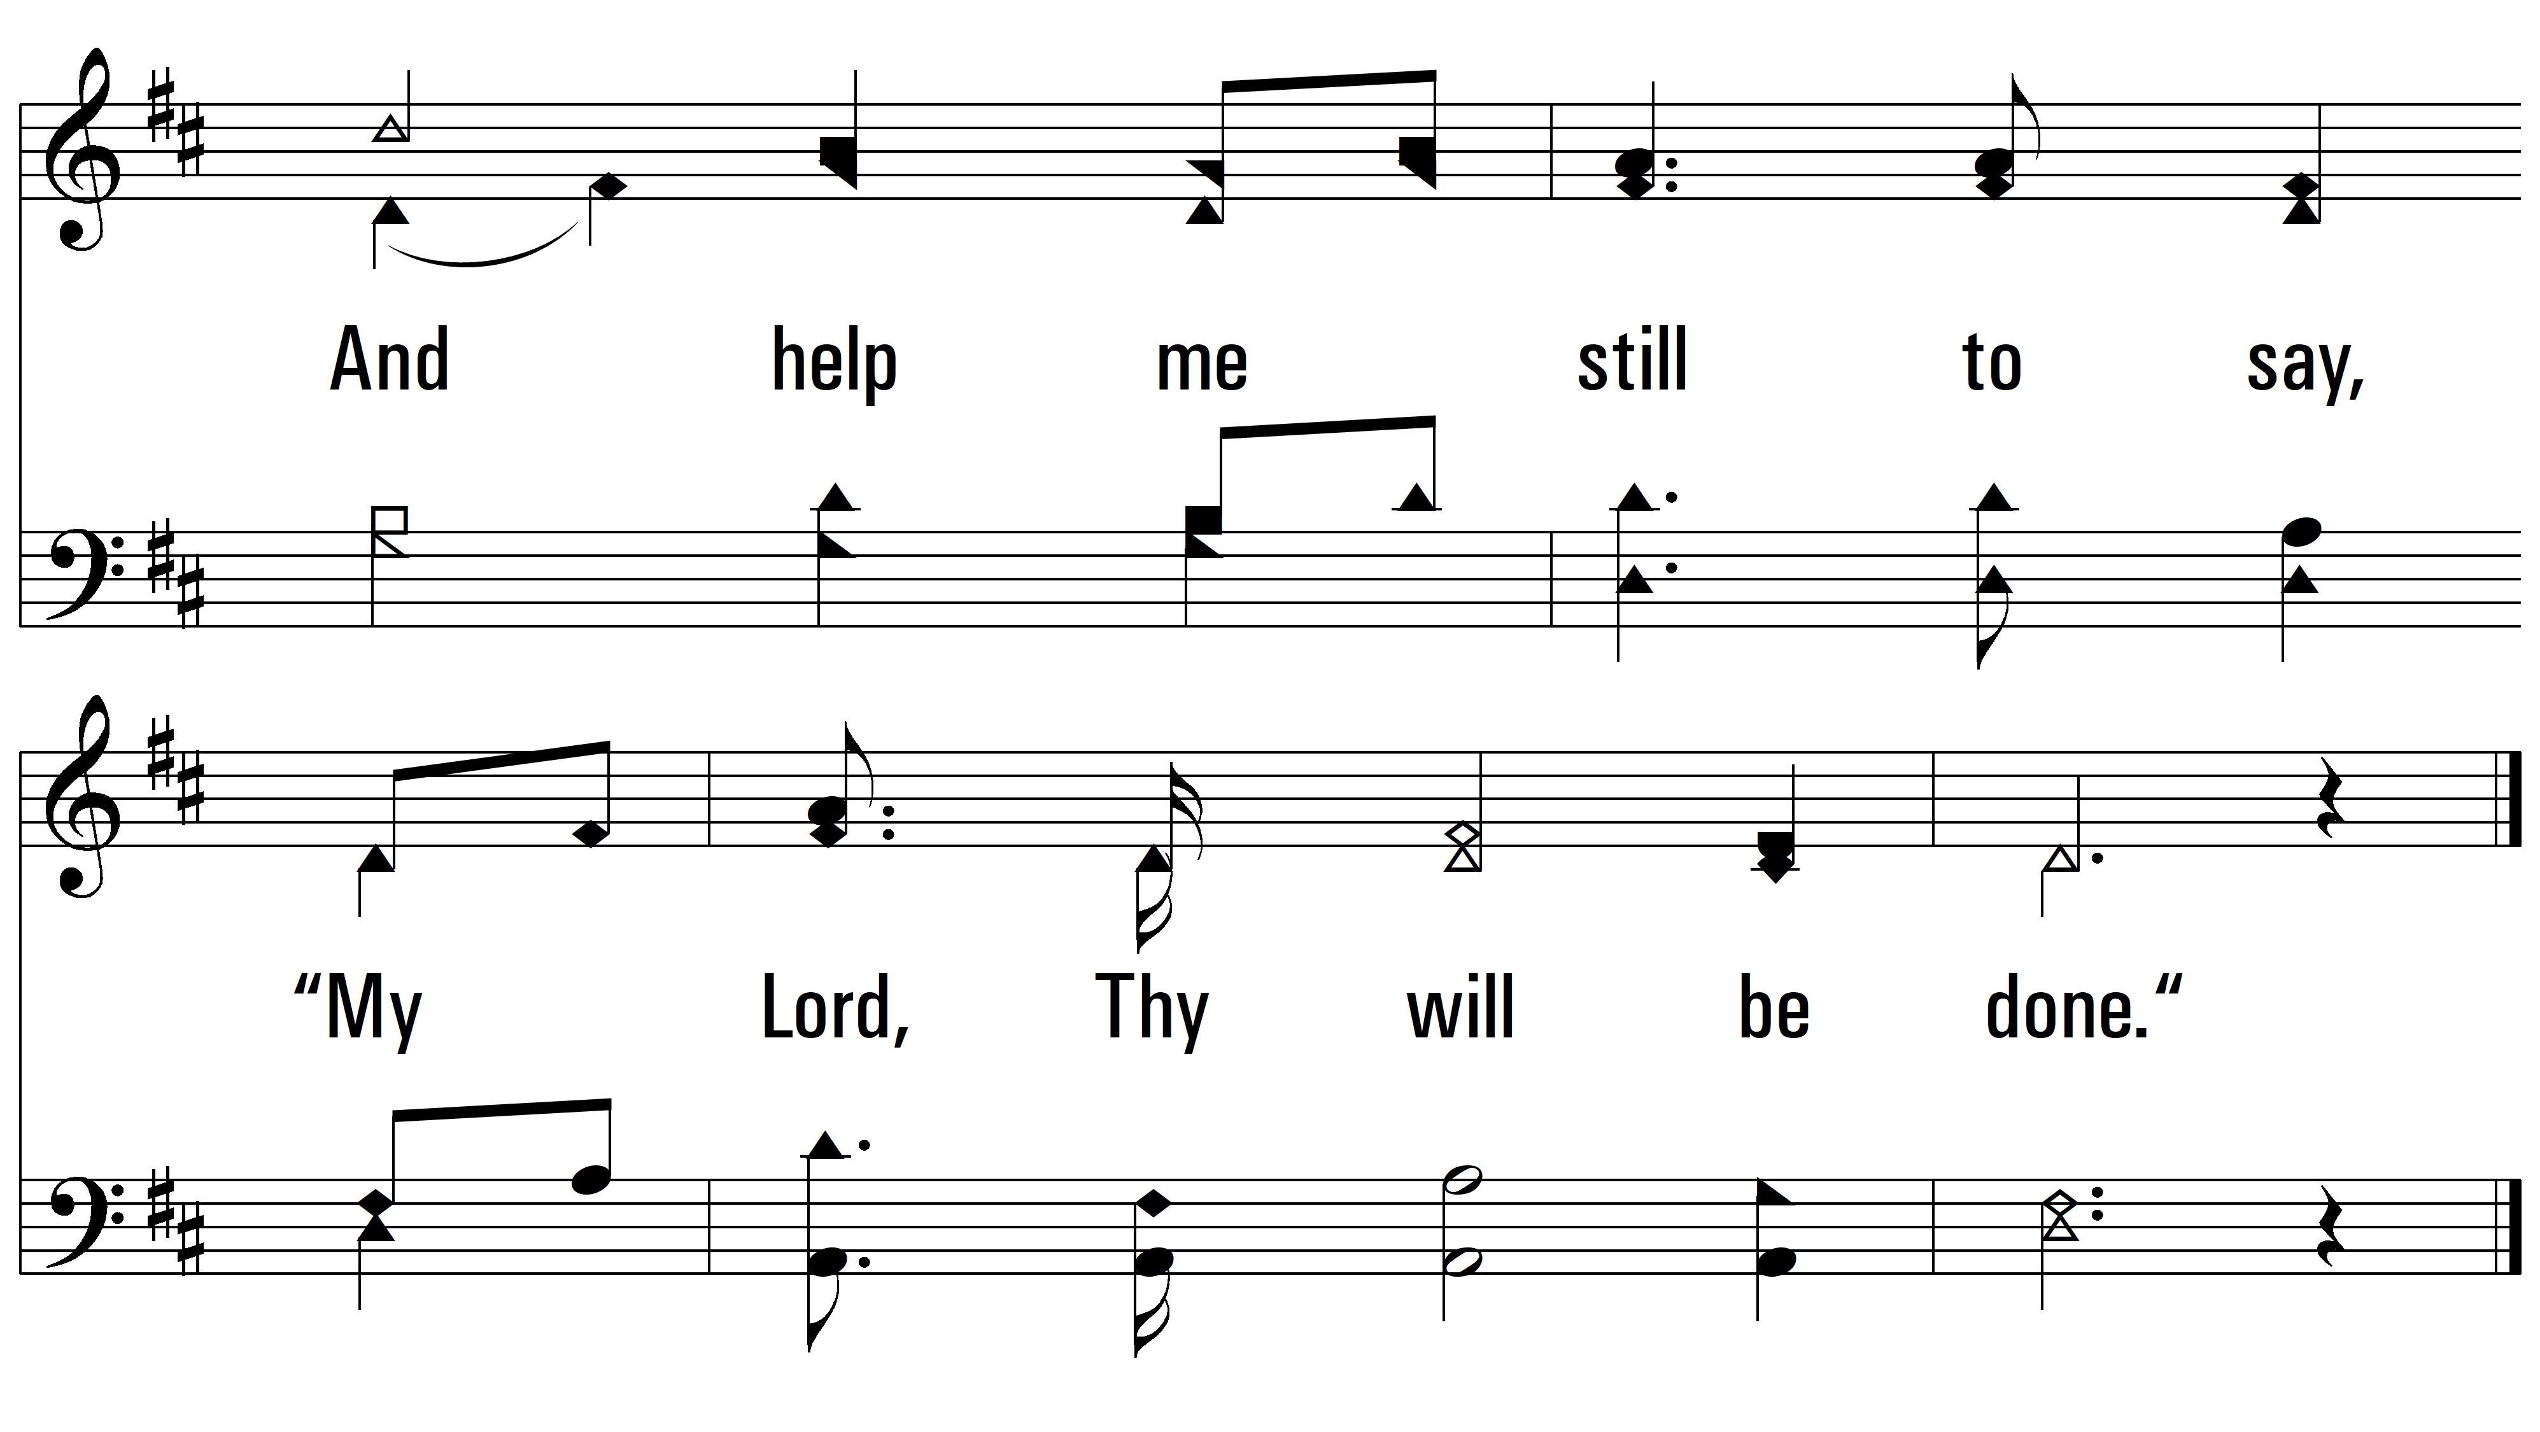
vs. 1

Slide 6
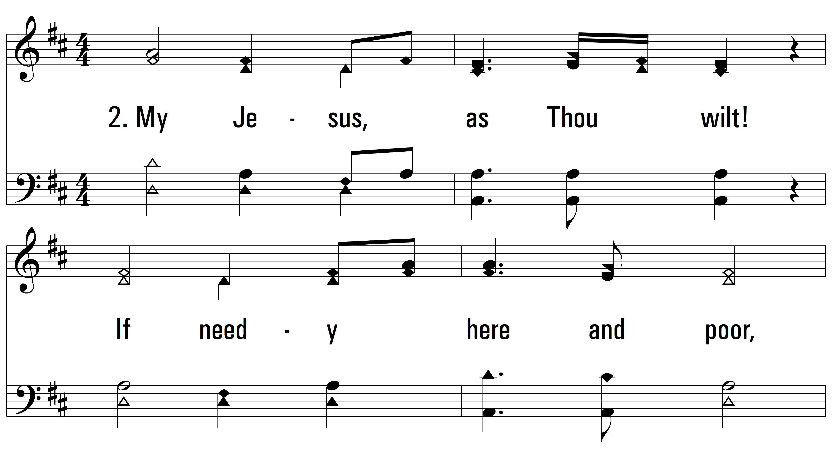
vs. 2 ~ My Jesus As Thou Wilt

Slide 7
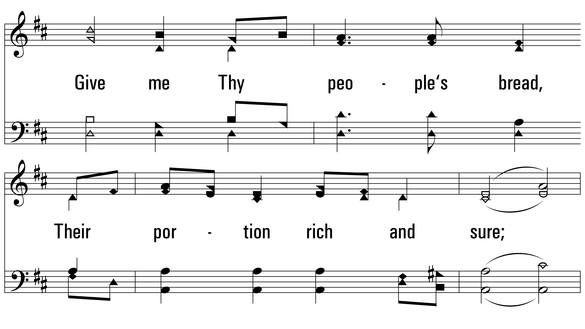
vs. 2

Slide 8
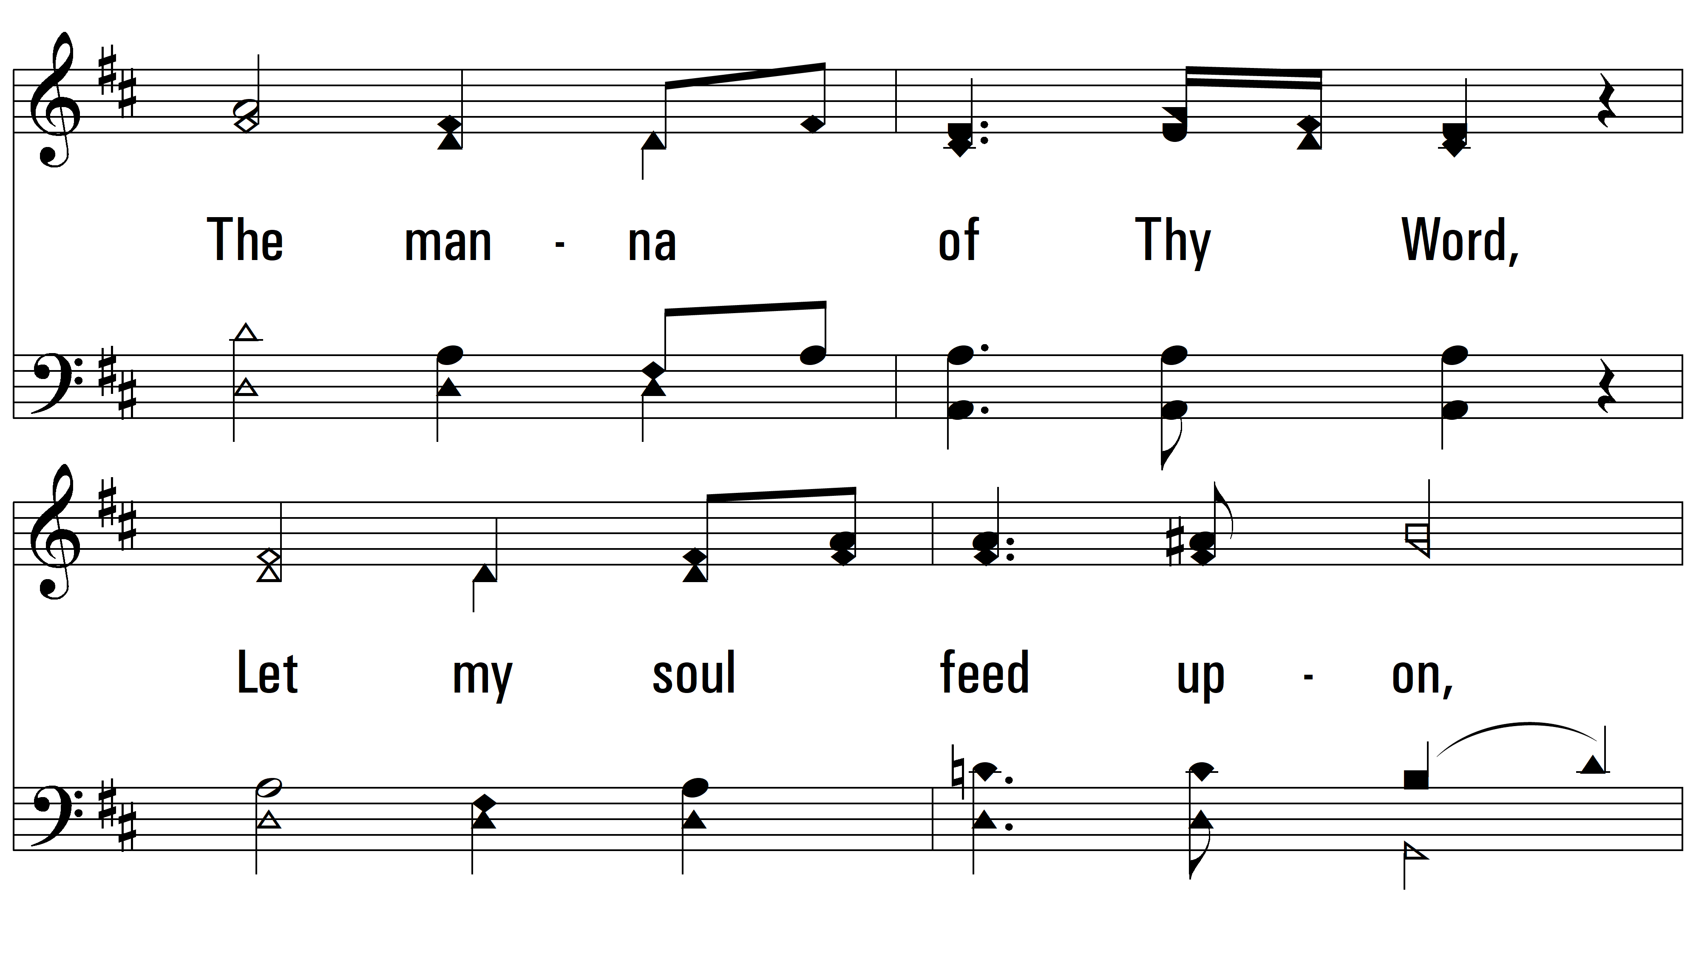
vs. 2

Slide 9
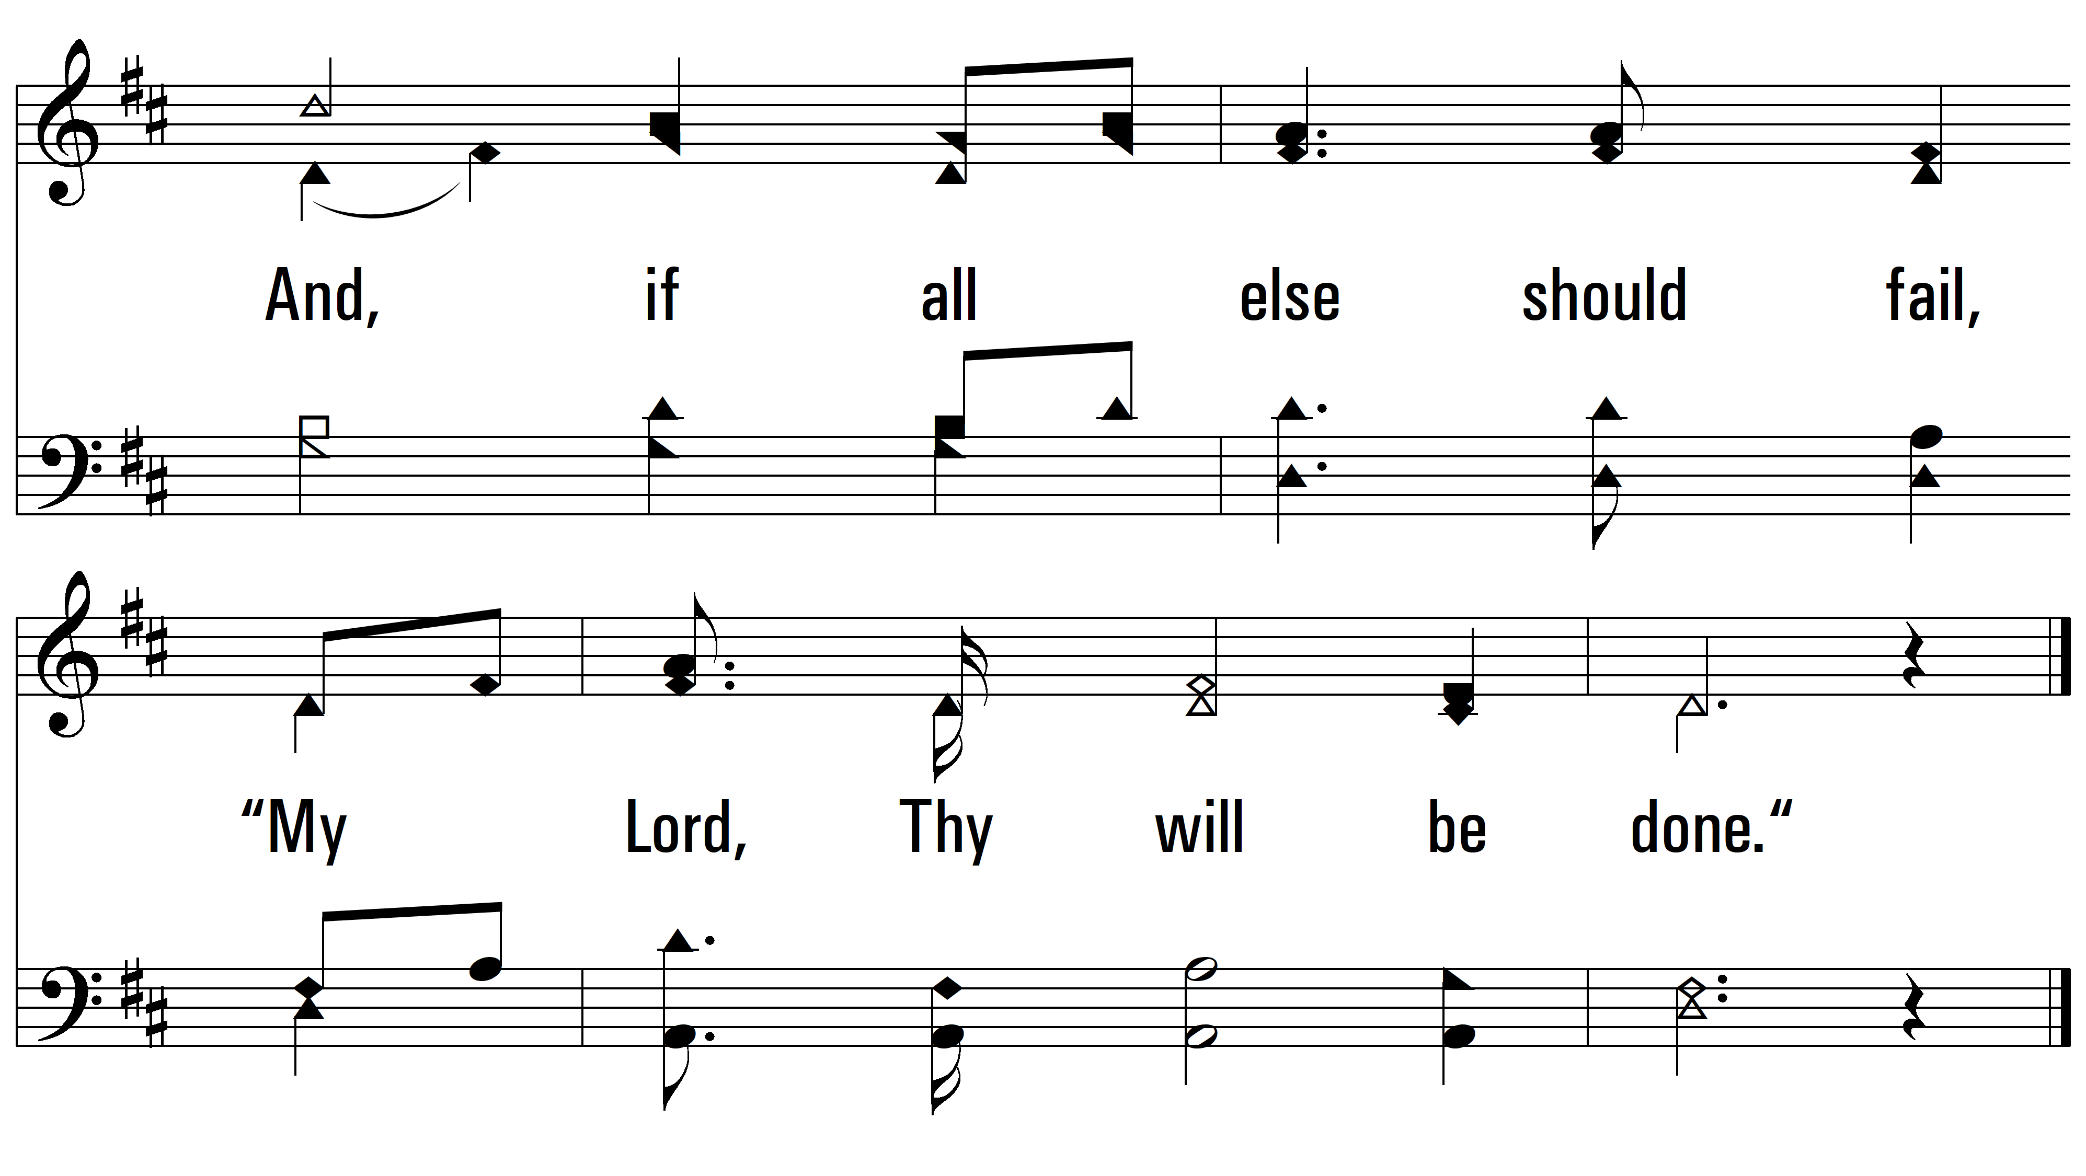
vs. 2

Slide 10
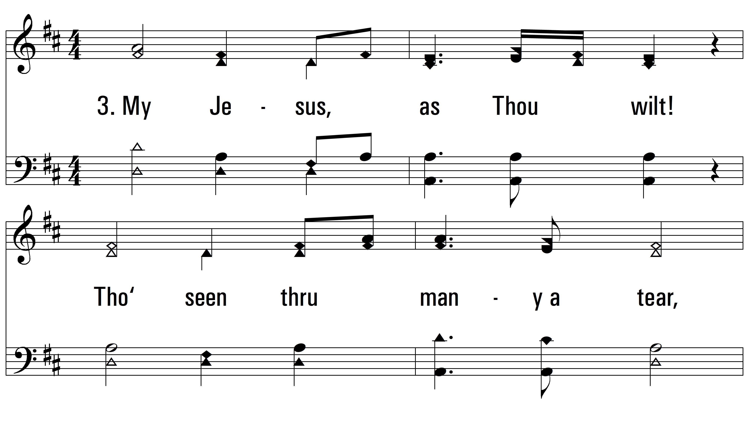
vs. 3 ~ My Jesus As Thou Wilt

Slide 11
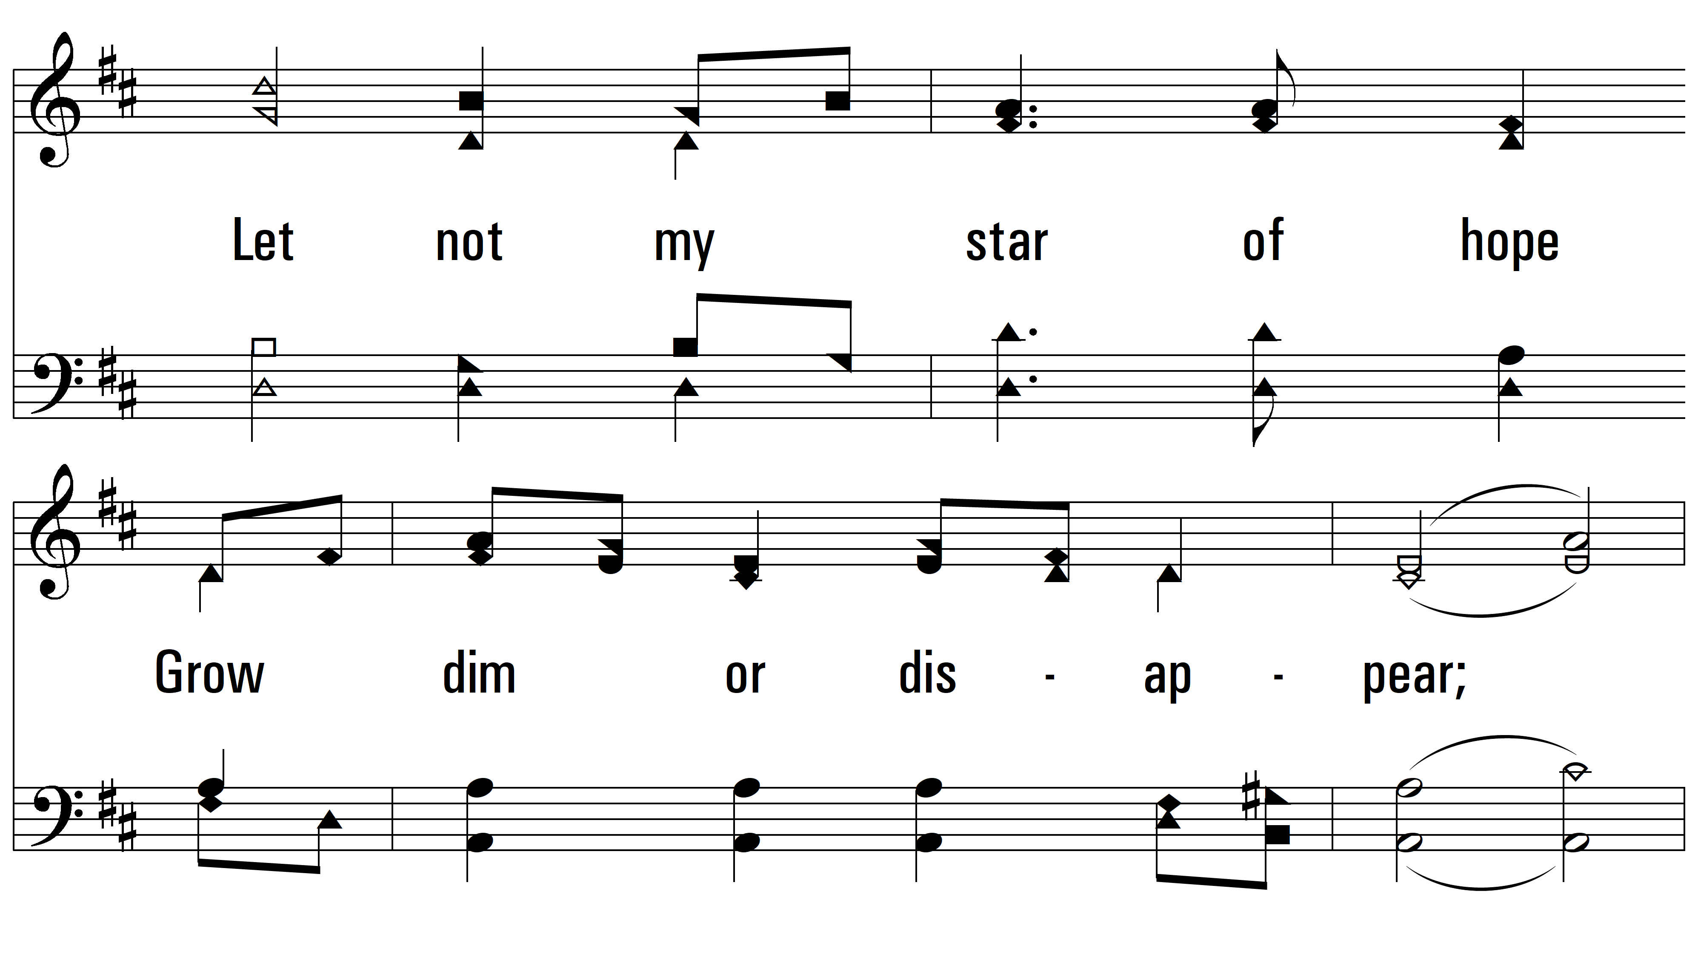
vs. 3

Slide 12
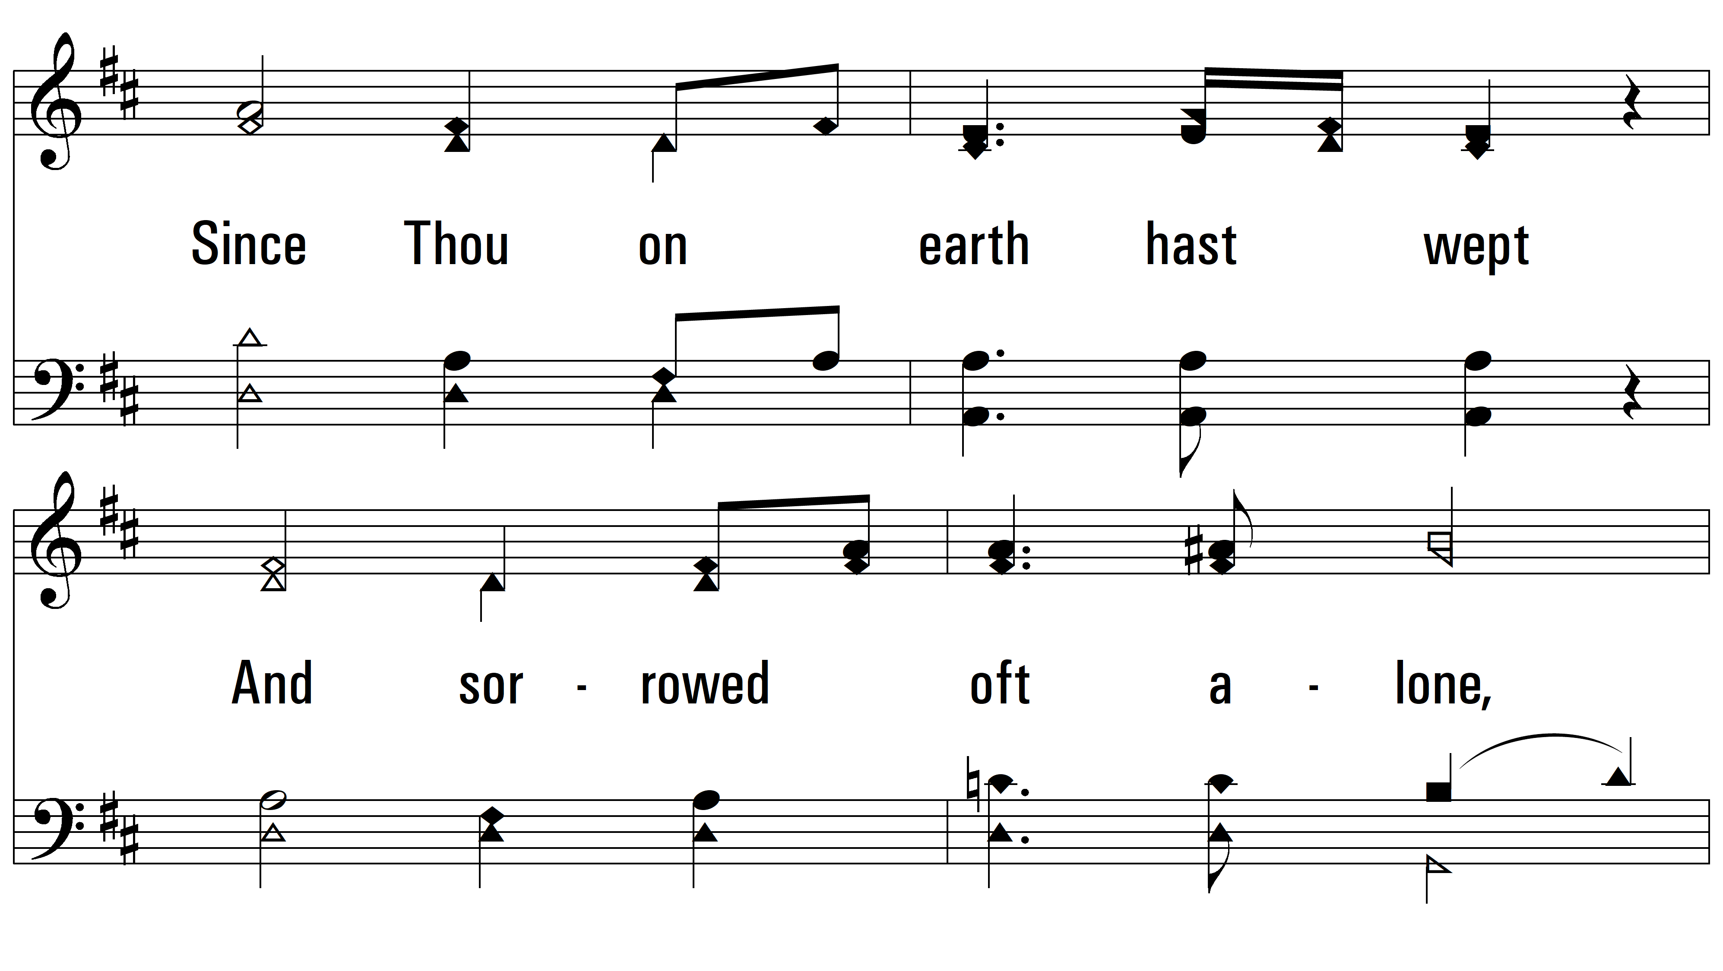
vs. 3

Slide 13
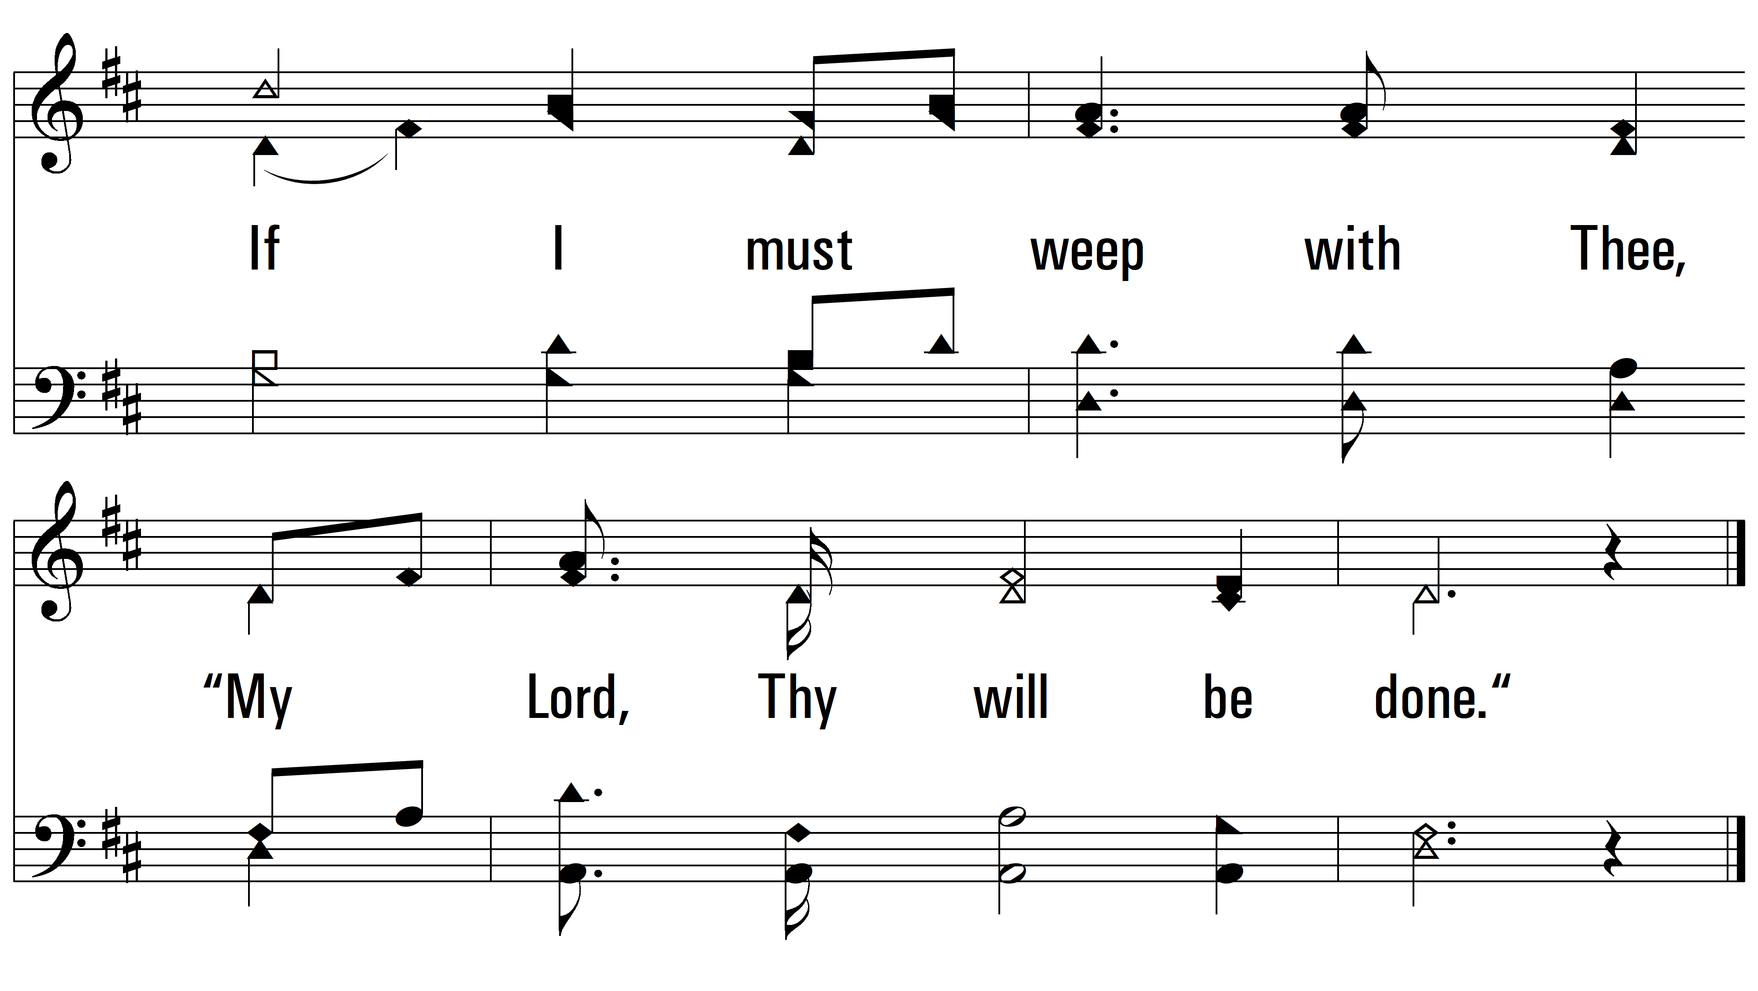
vs. 3

Slide 14
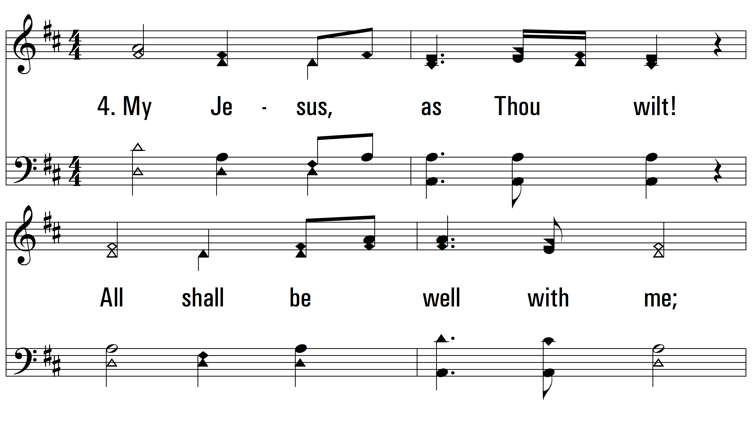
vs. 4 ~ My Jesus As Thou Wilt

Slide 15
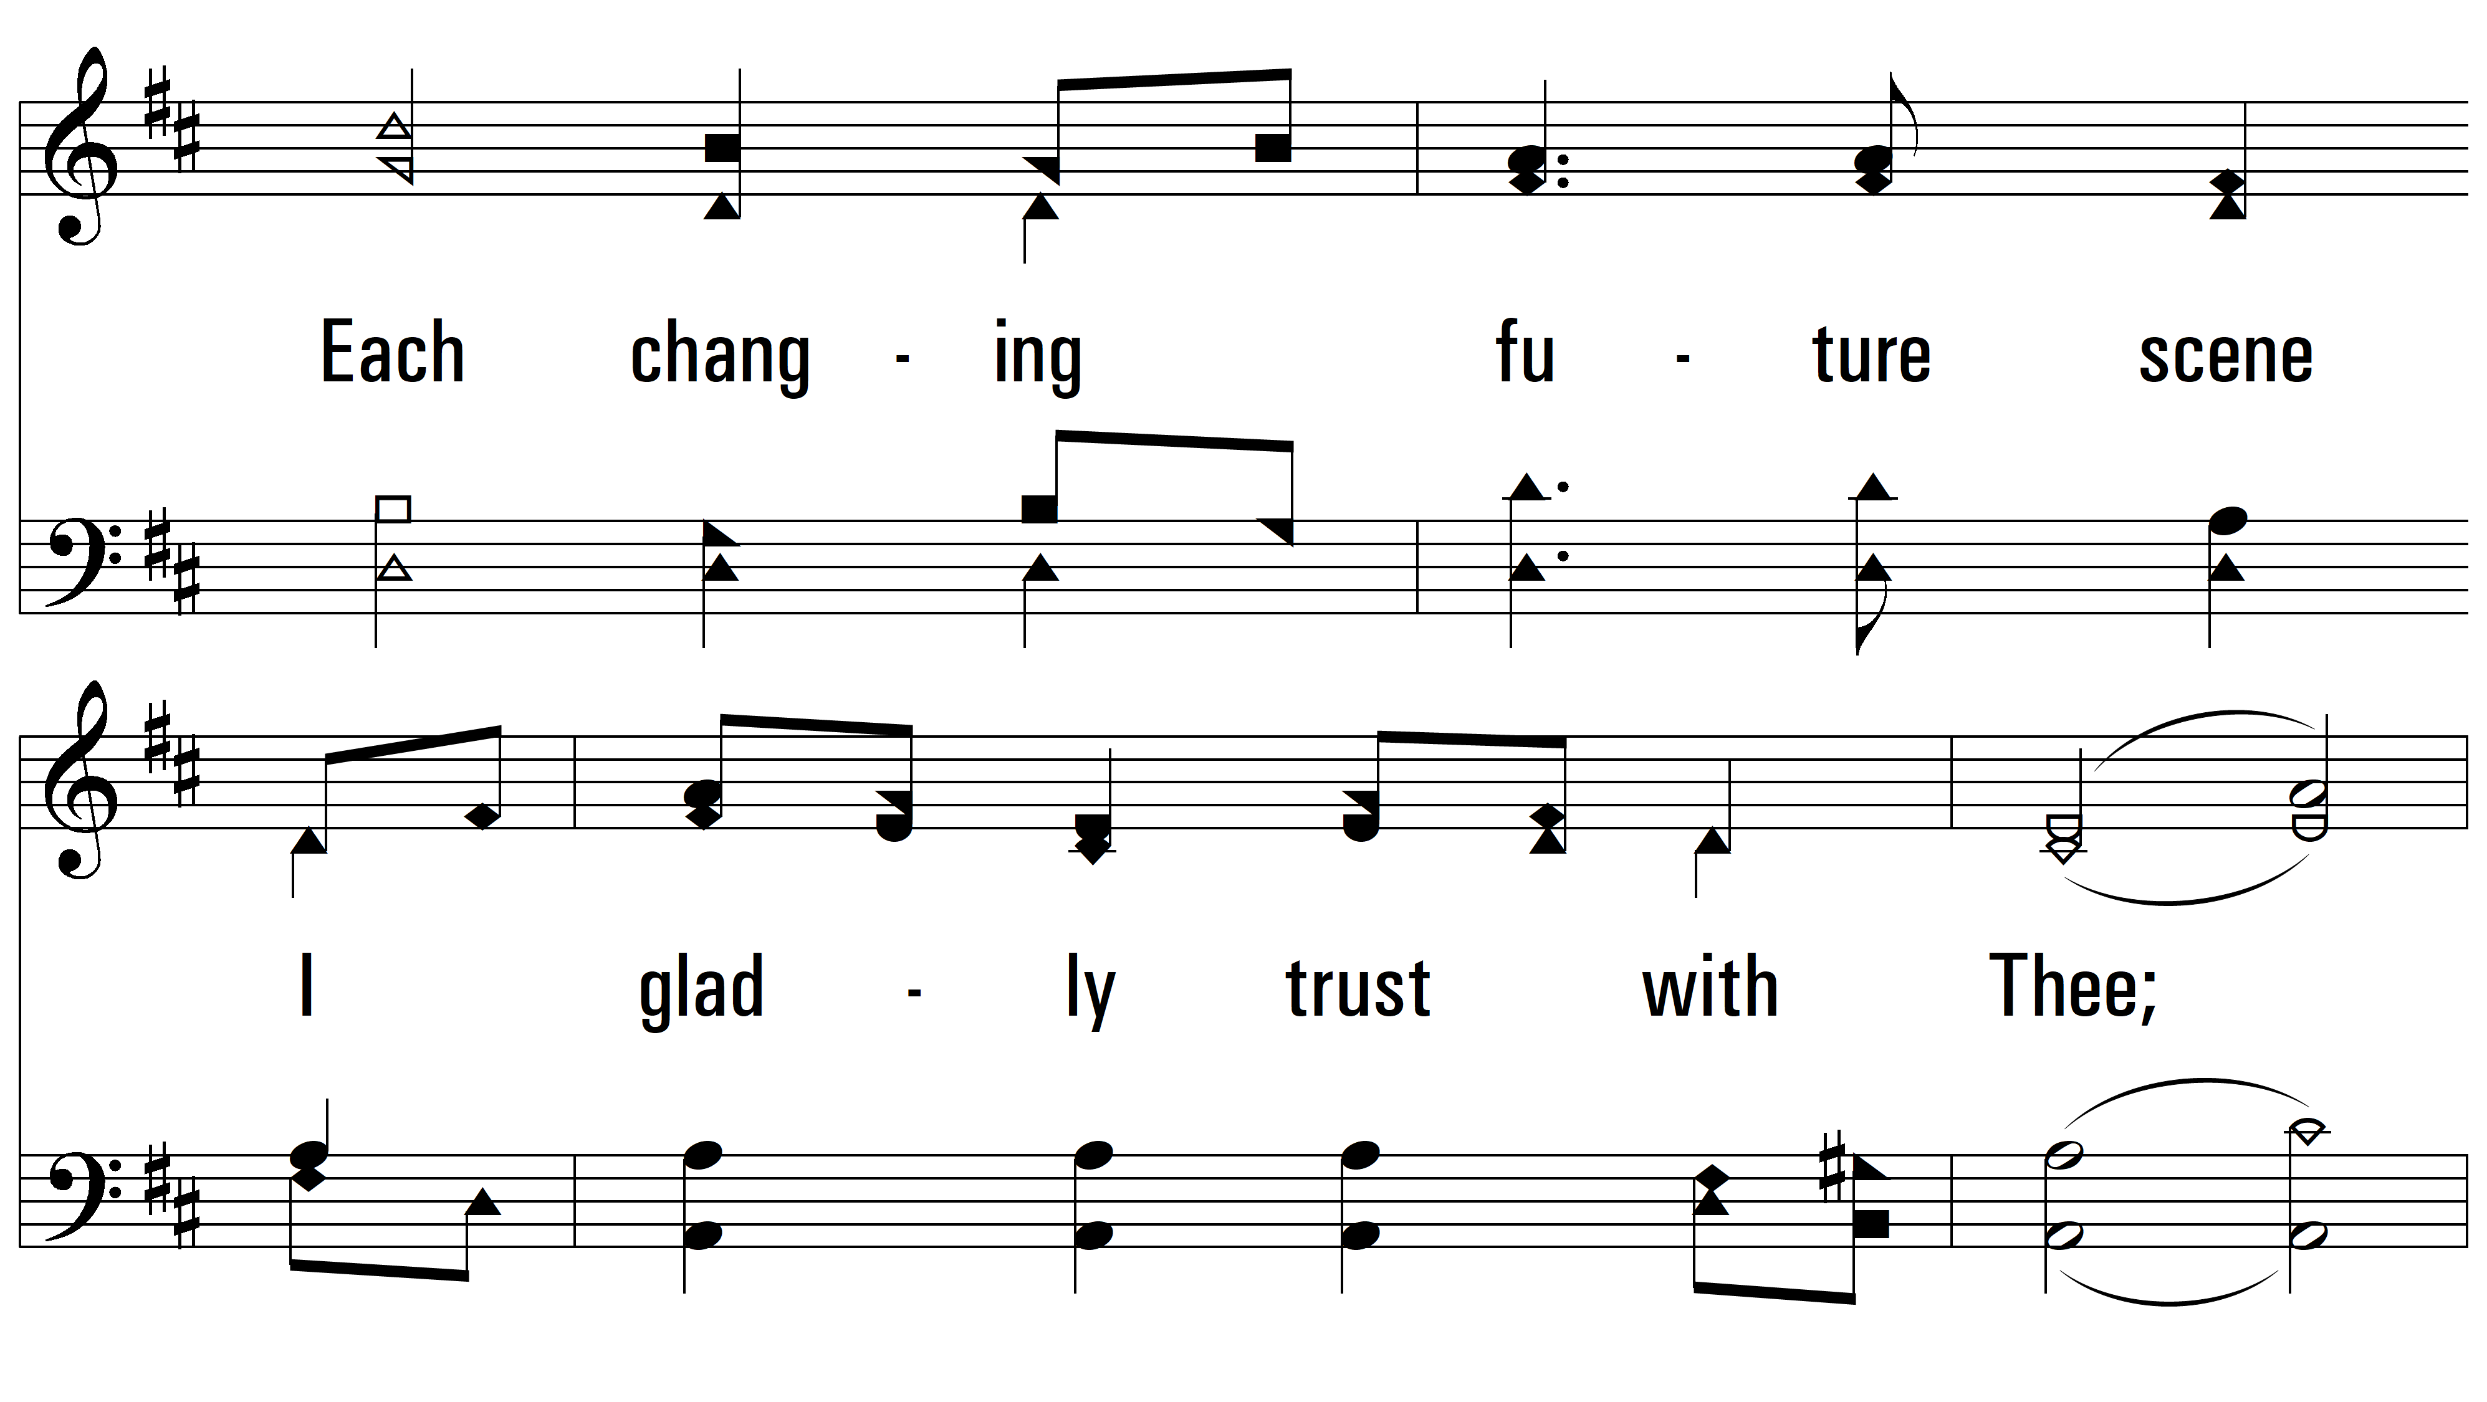
vs. 4

Slide 16
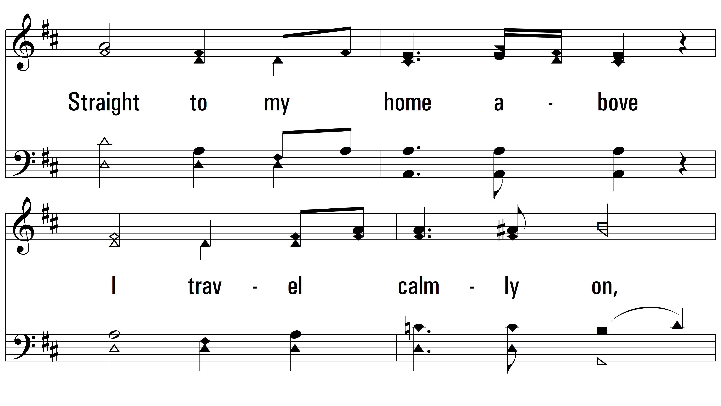
vs. 4

Slide 17
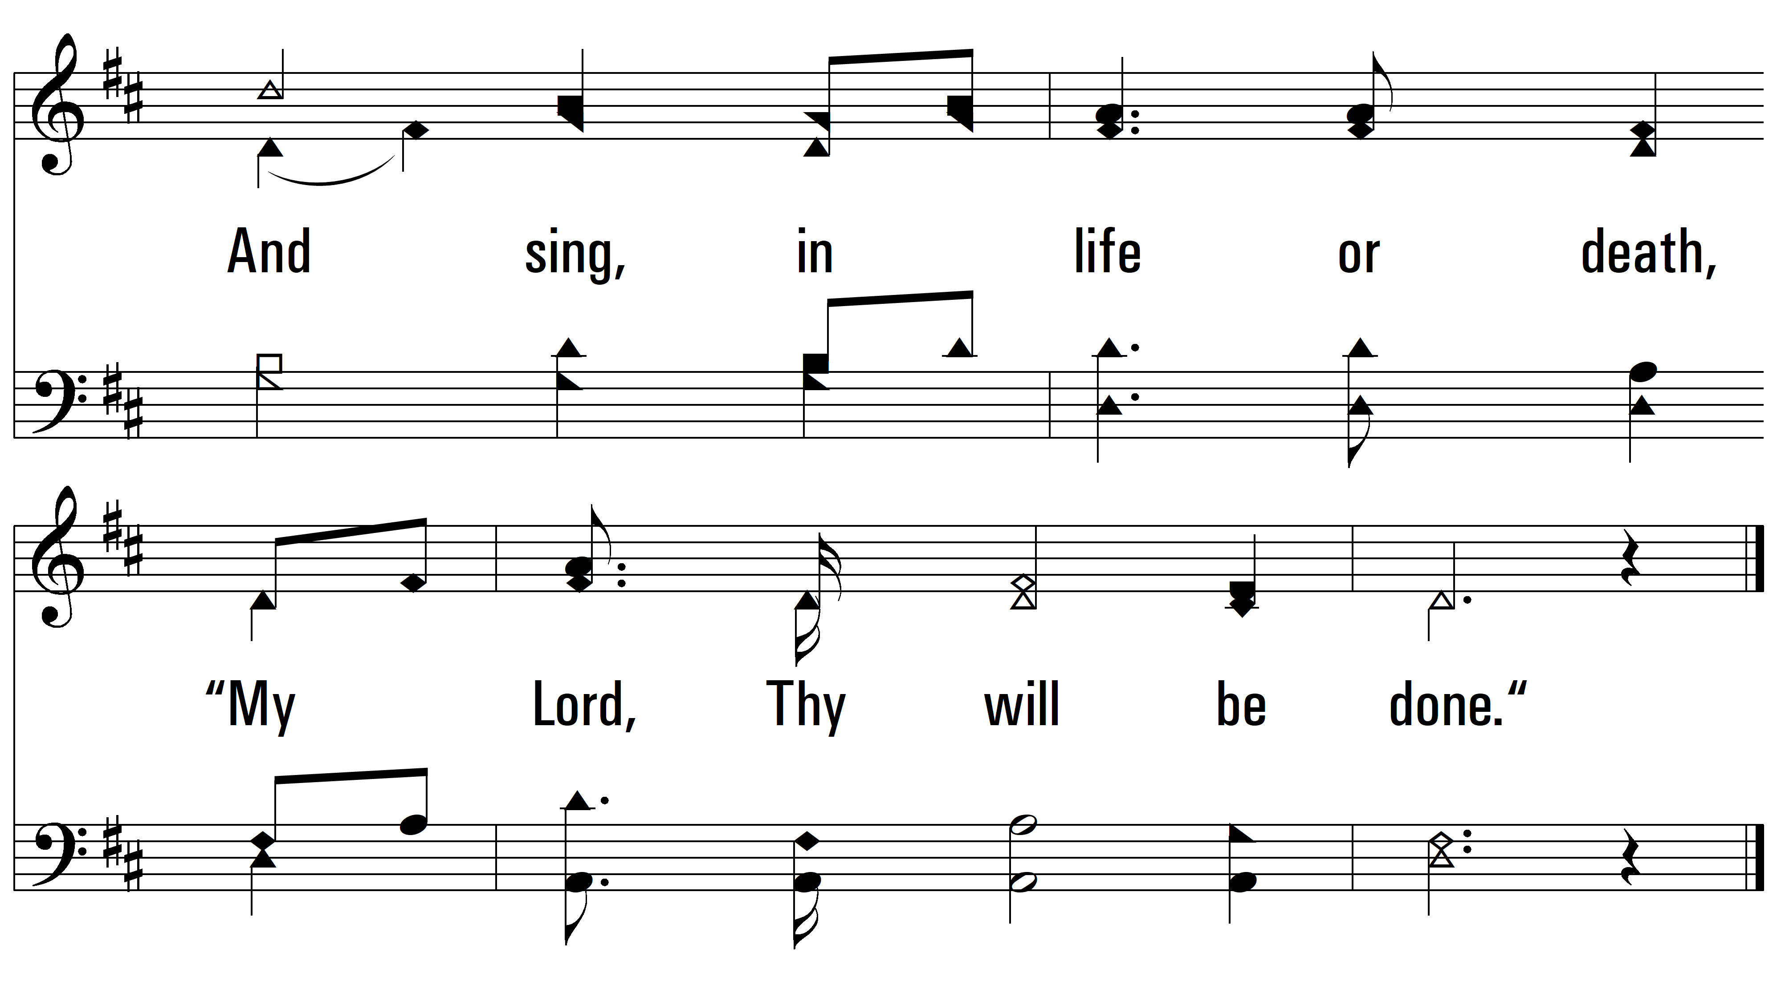
vs. 4
PDHymns.com
END

