Slide 1
Night, With Ebon Pinion
SORROWS
6.5.6.5.7.6.6.5
Words: | L. H. Jameson (1854)
Music: | J.P. Powell (1871)
6/8
E^{b}/G - MI
Verses: 3
Lead - | MI
Alto - | DO
Tenor - | SOL
Bass - | DO
PDHymns.com

Slide 2
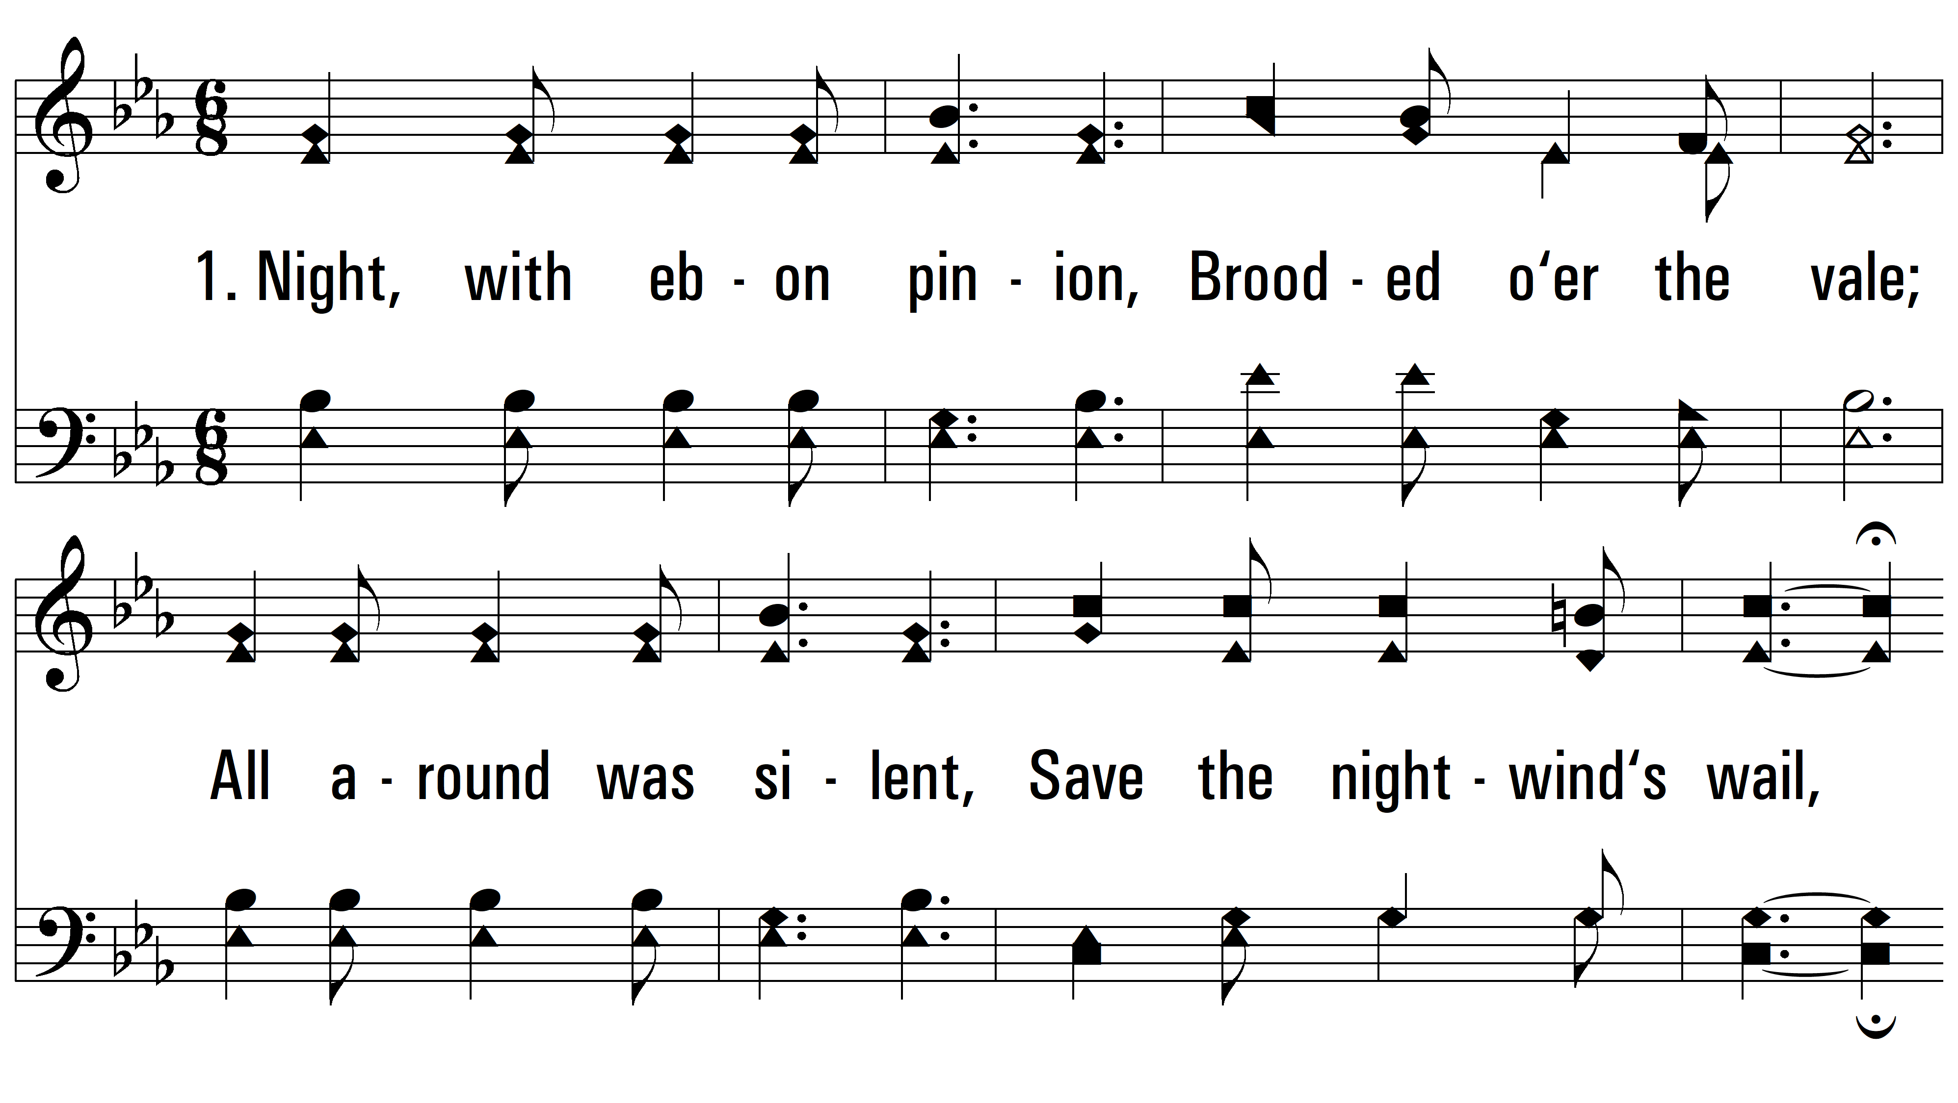
vs. 1 ~ Night, With Ebon Pinion

Slide 3
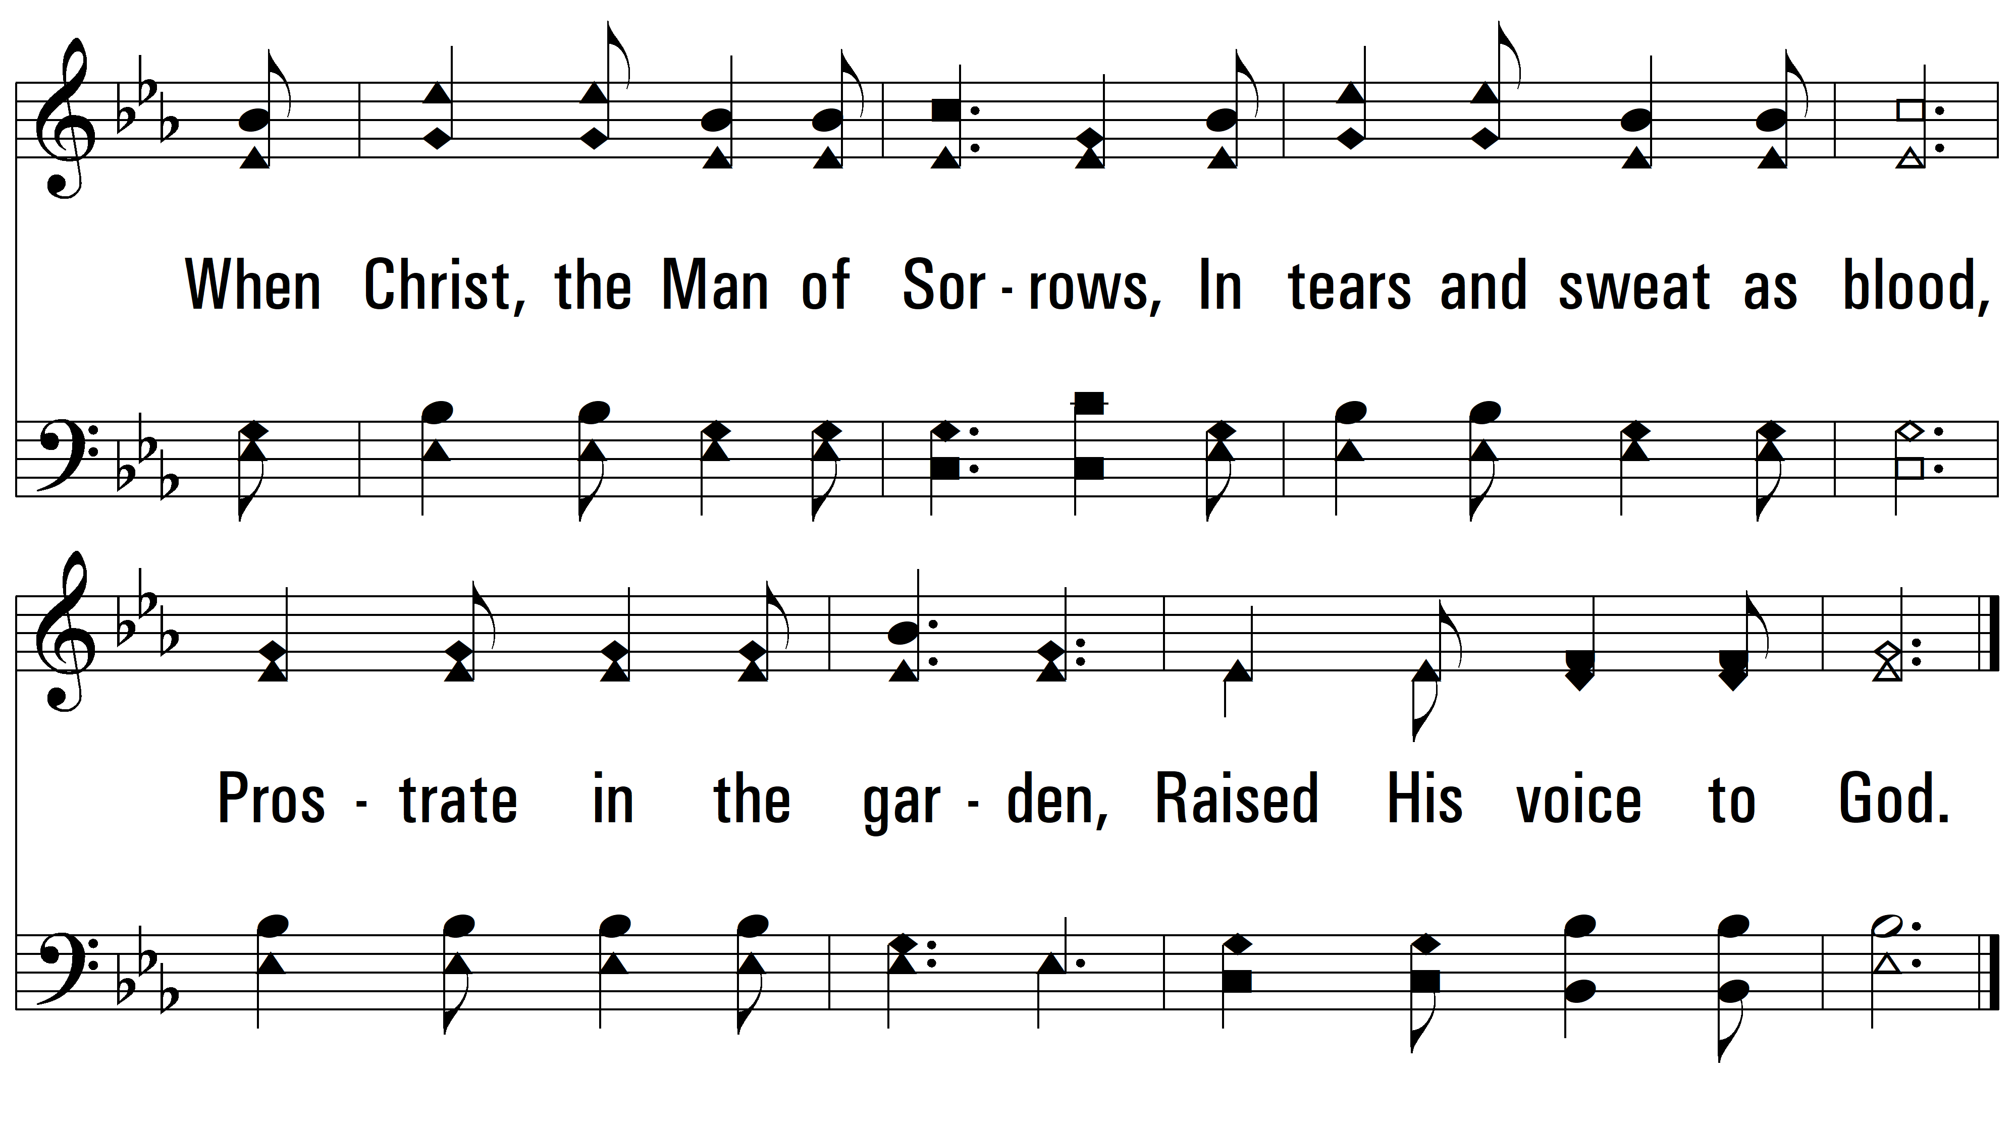
vs. 1

Slide 4
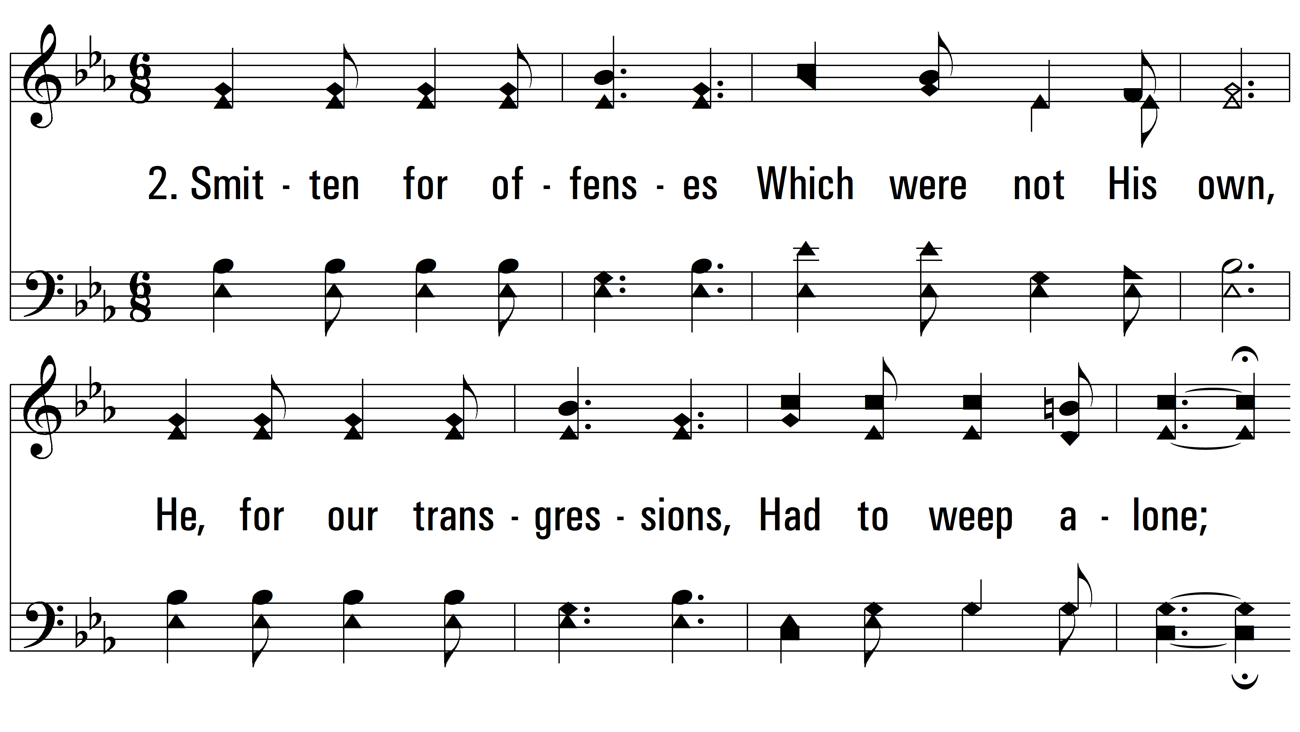
vs. 2 ~ Night, With Ebon Pinion

Slide 5
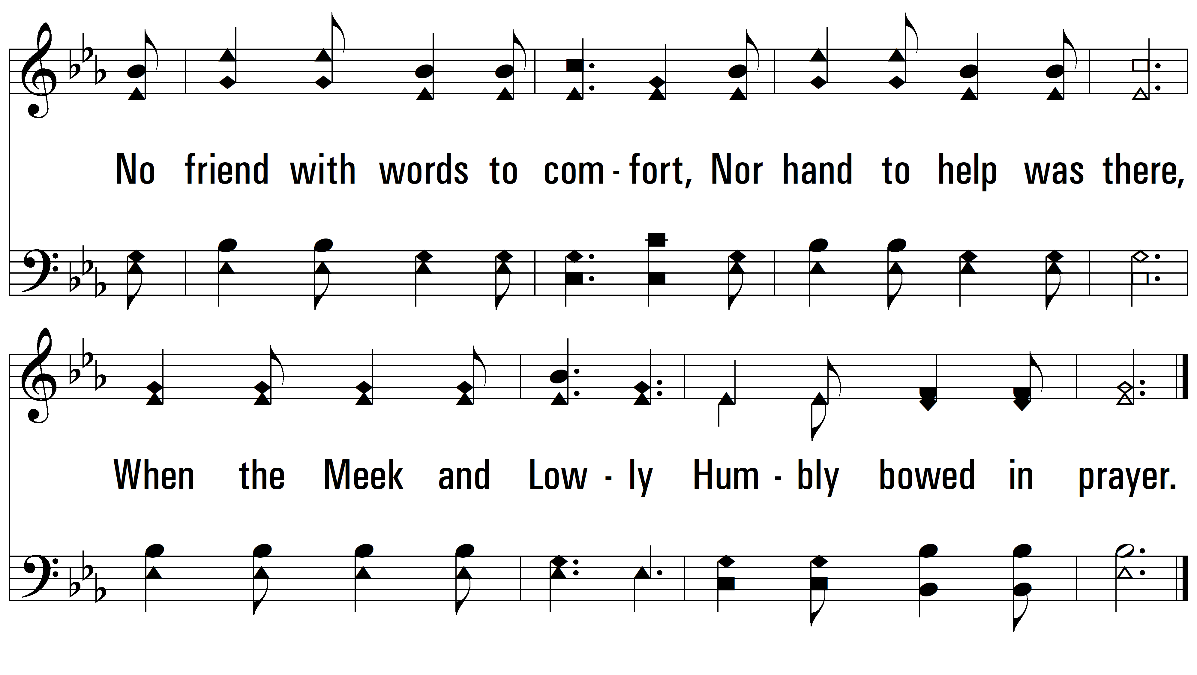
vs. 2

Slide 6
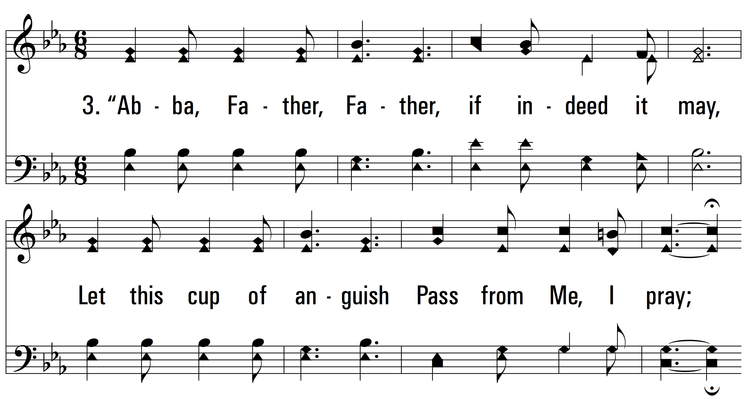
vs. 3 ~ Night, With Ebon Pinion

Slide 7
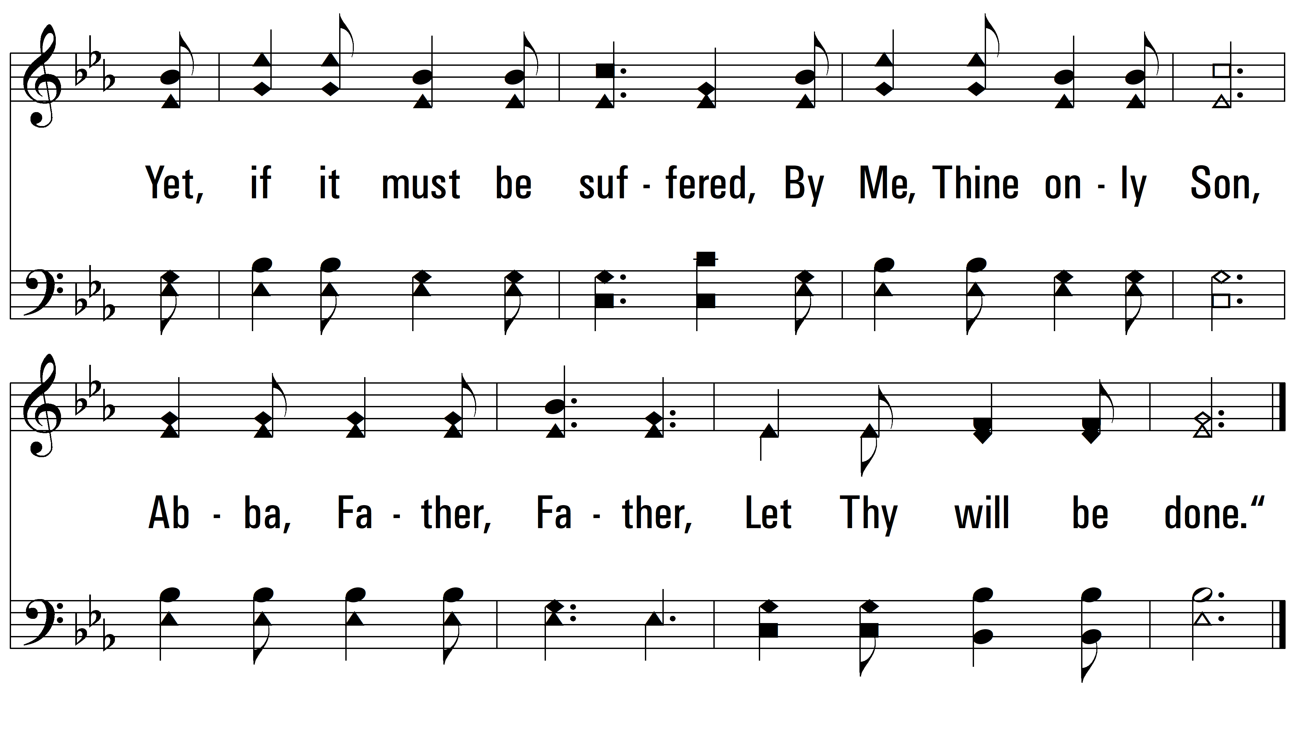
vs. 3
PDHymns.com
END

