Slide 1
O Fill My Cup
Words: | Unknown, vss. 2 & 3 John Newton (1779)
Music: | Unknown
4/4
B^{b}/F - SOL
Verses: 4
Lead - | MI
Alto - | MI
Tenor - | SOL
Bass - | SOL
PDHymns.com

Slide 2
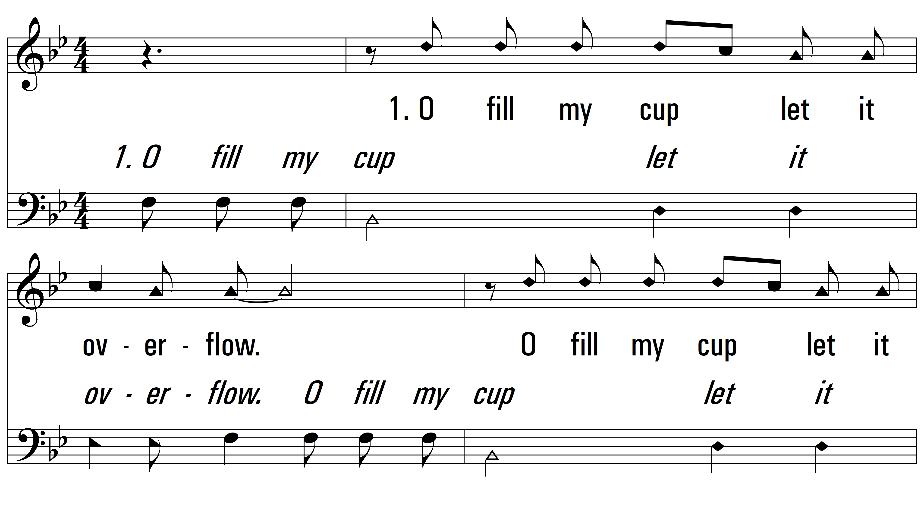
vs. 1 ~ O Fill My Cup

Slide 3
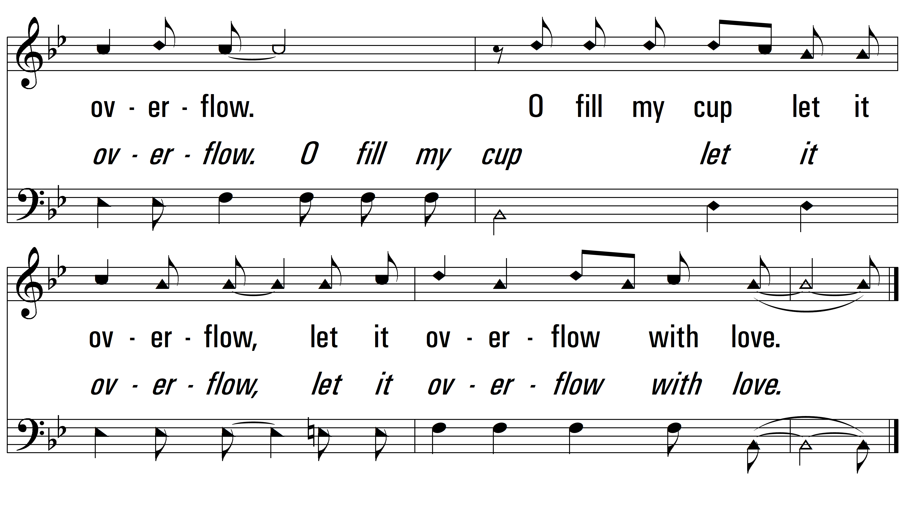
vs. 1

Slide 4
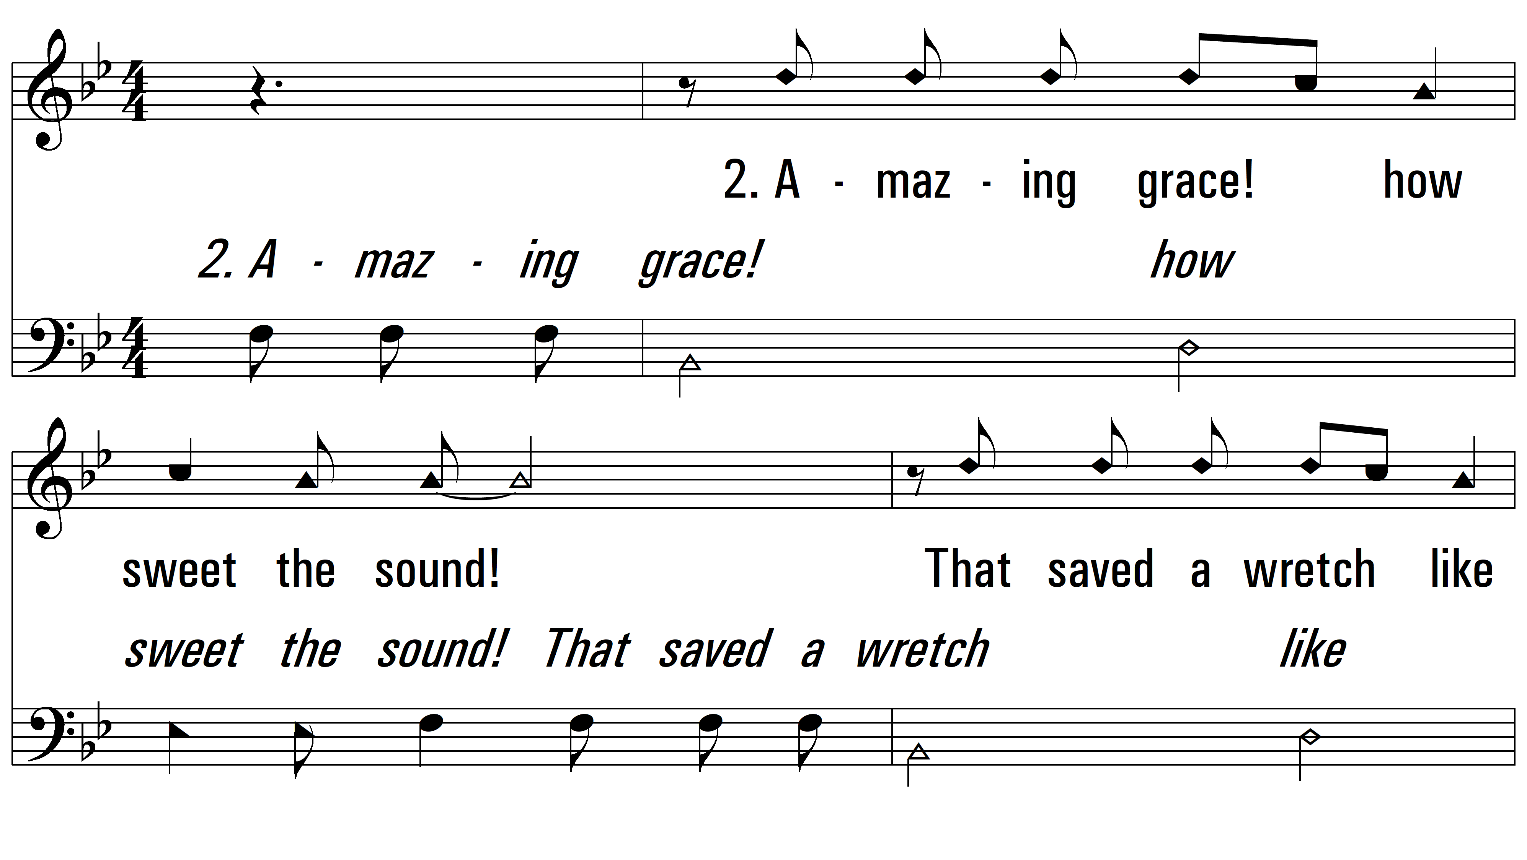
vs. 2 ~ O Fill My Cup

Slide 5
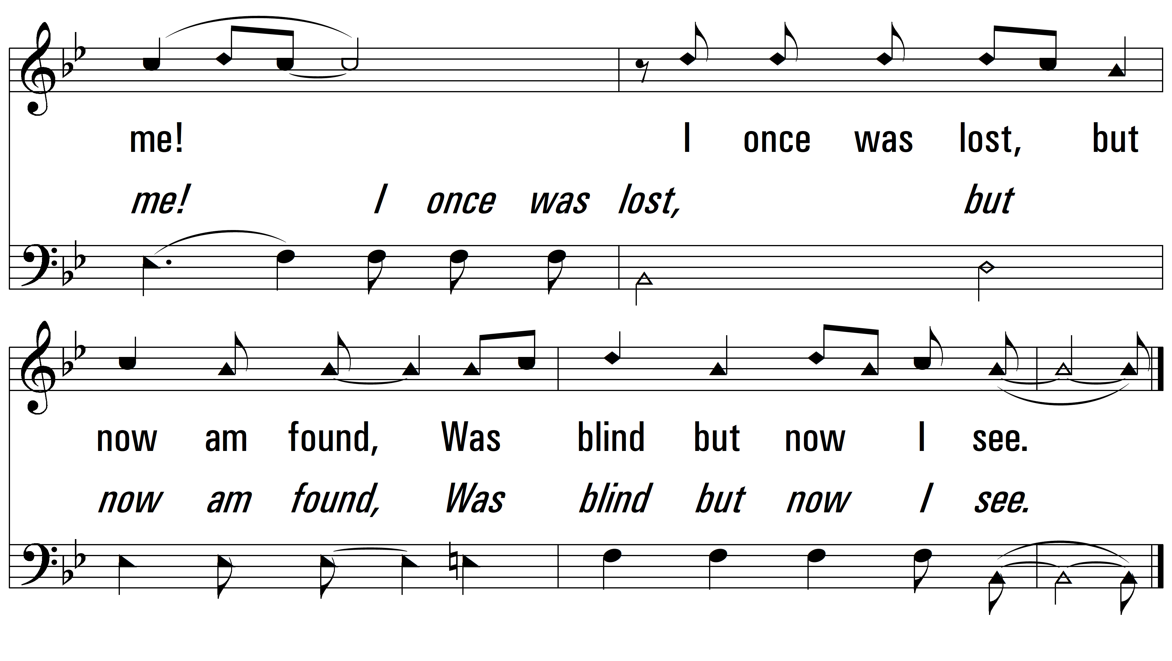
vs. 2

Slide 6
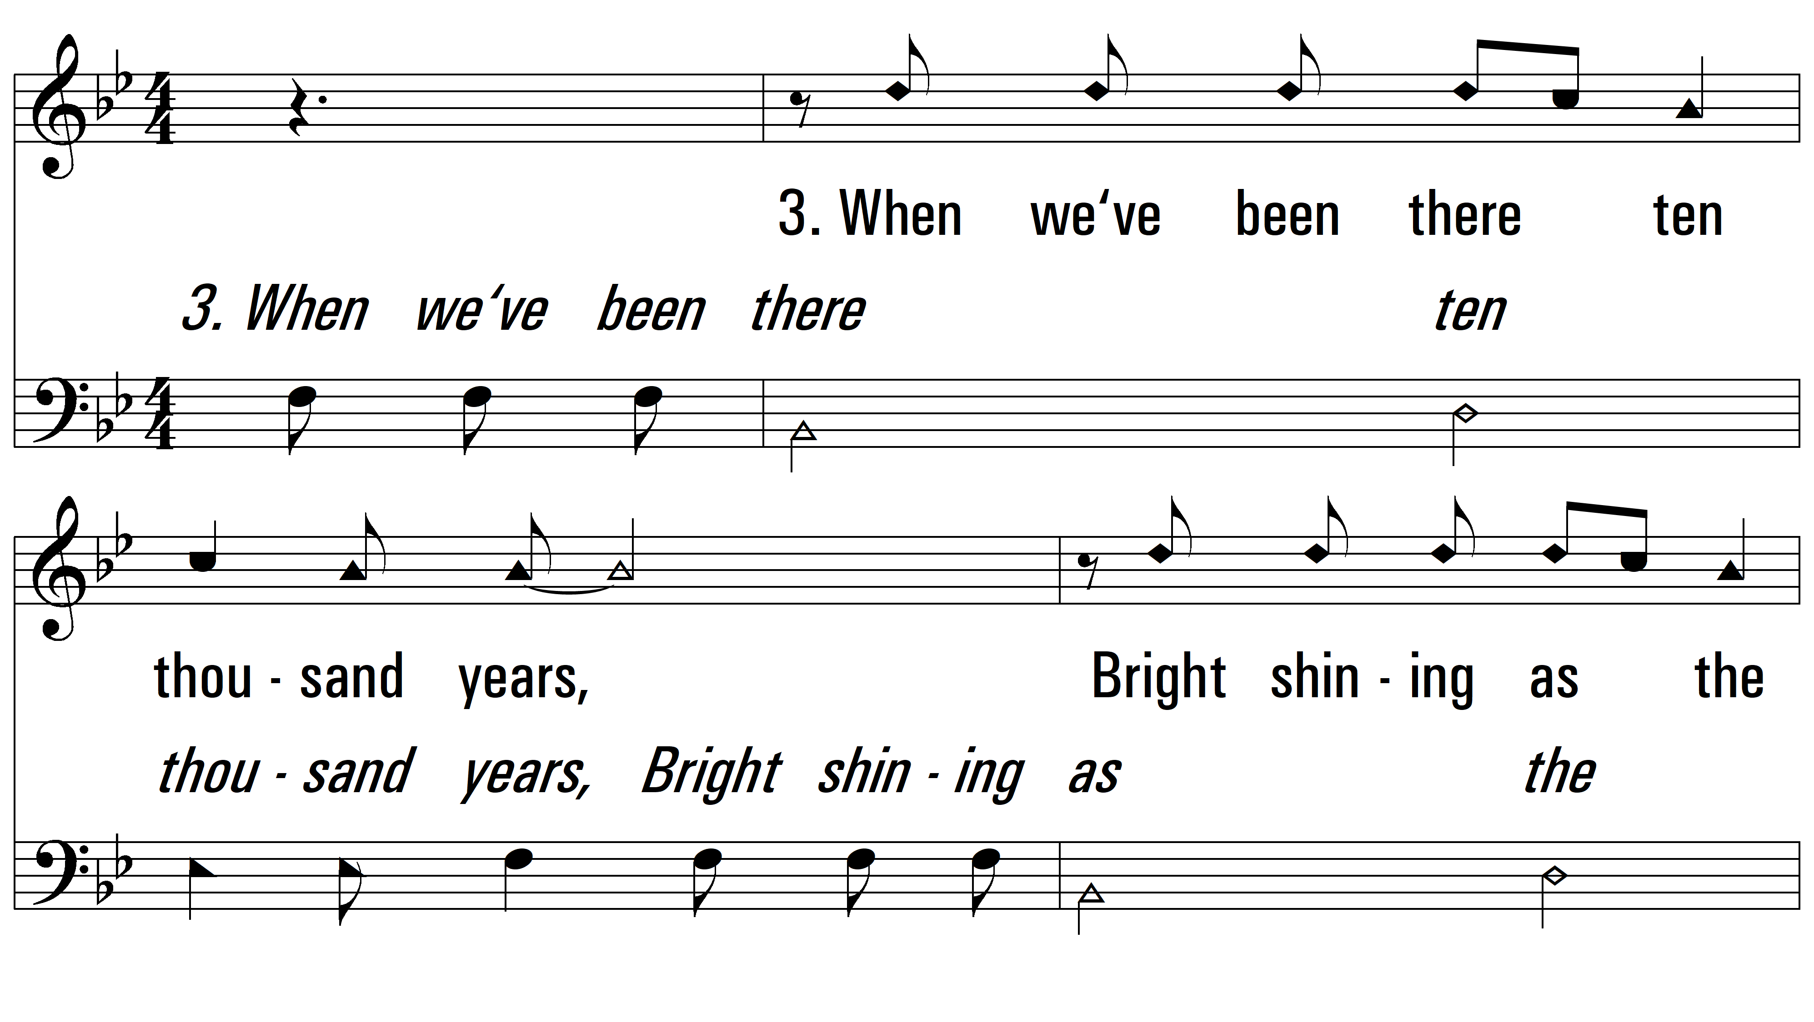
vs. 3 ~ O Fill My Cup

Slide 7
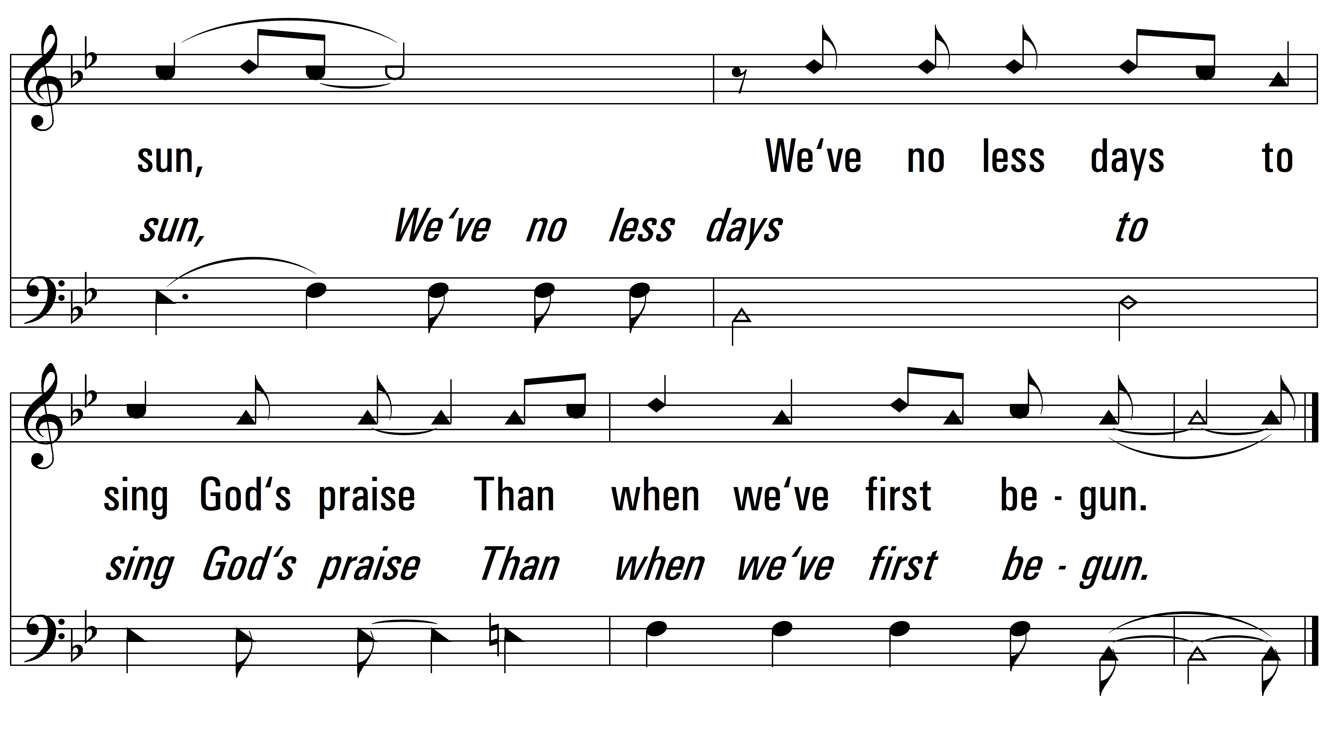
vs. 3

Slide 8
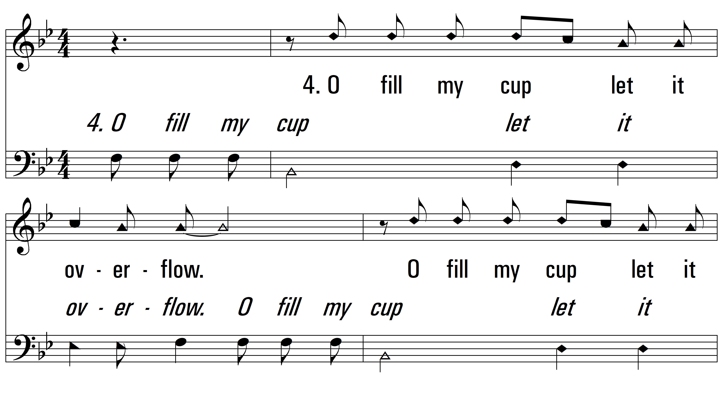
vs. 4 ~ O Fill My Cup

Slide 9
vs. 4
PDHymns.com
END

