Slide 1
Only A Step
Words: | Charles H. Gabriel (1890)
Music: | Charles H. Gabriel (1890)
9/8
E^{b}/G - MI
Verses: 3/Chorus
Lead - | MI
Alto - | DO
Tenor - | SOL
Bass - | DO
PDHymns.com

Slide 2
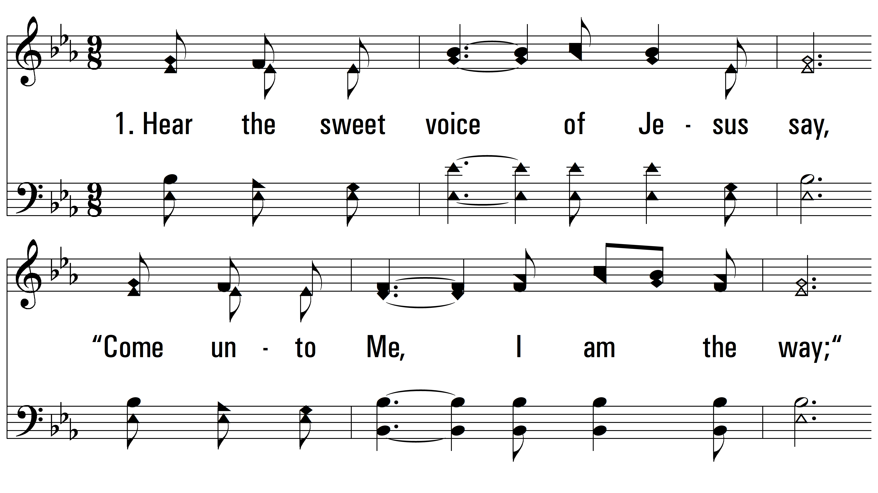
vs. 1 ~ Only A Step

Slide 3
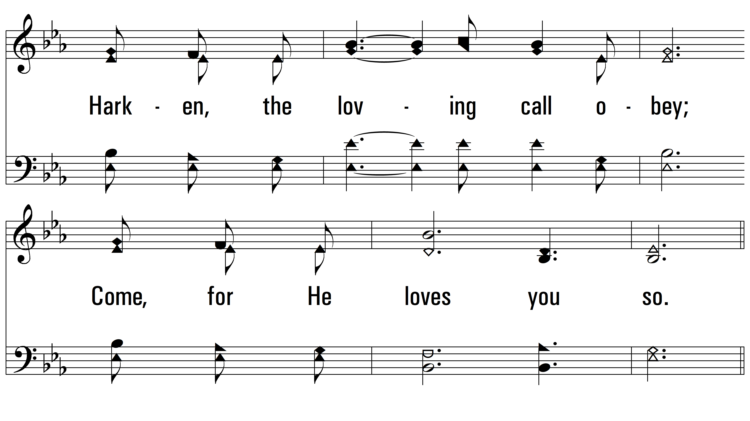
vs. 1

Slide 4
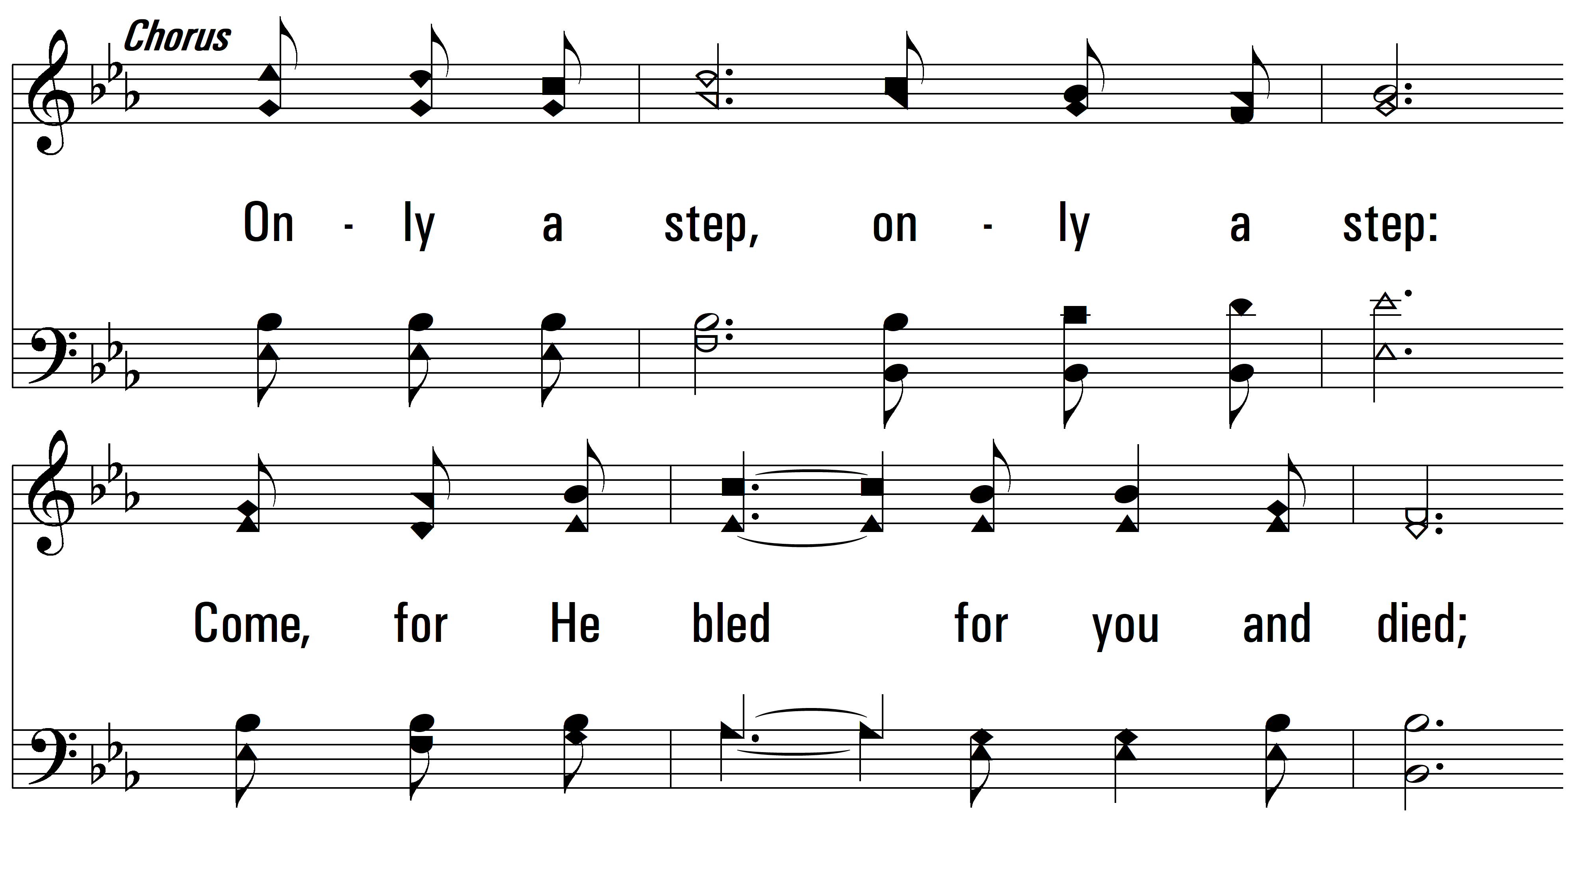
vs. 1

Slide 5
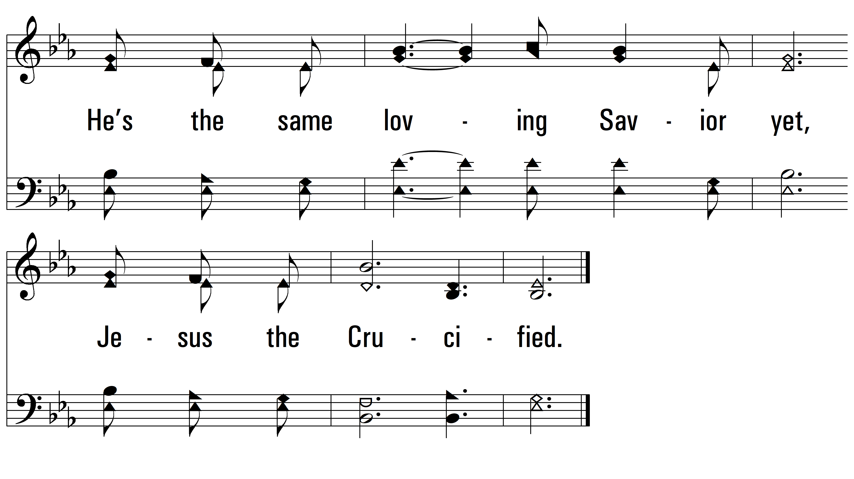
vs. 1

Slide 6
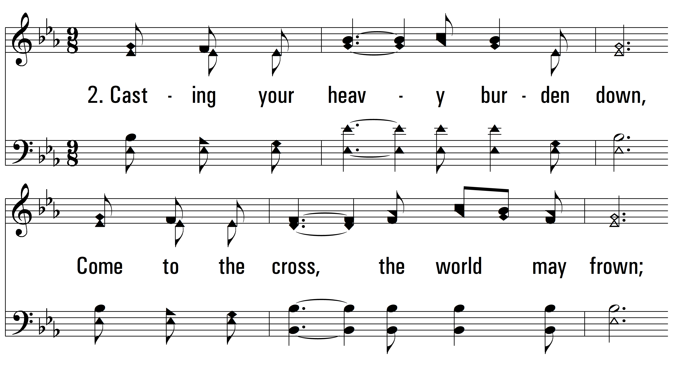
vs. 2 ~ Only A Step

Slide 7
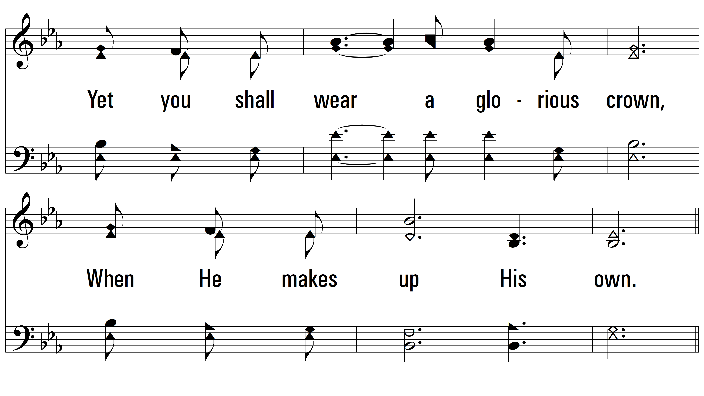
vs. 2

Slide 8
vs. 2

Slide 9
vs. 2

Slide 10
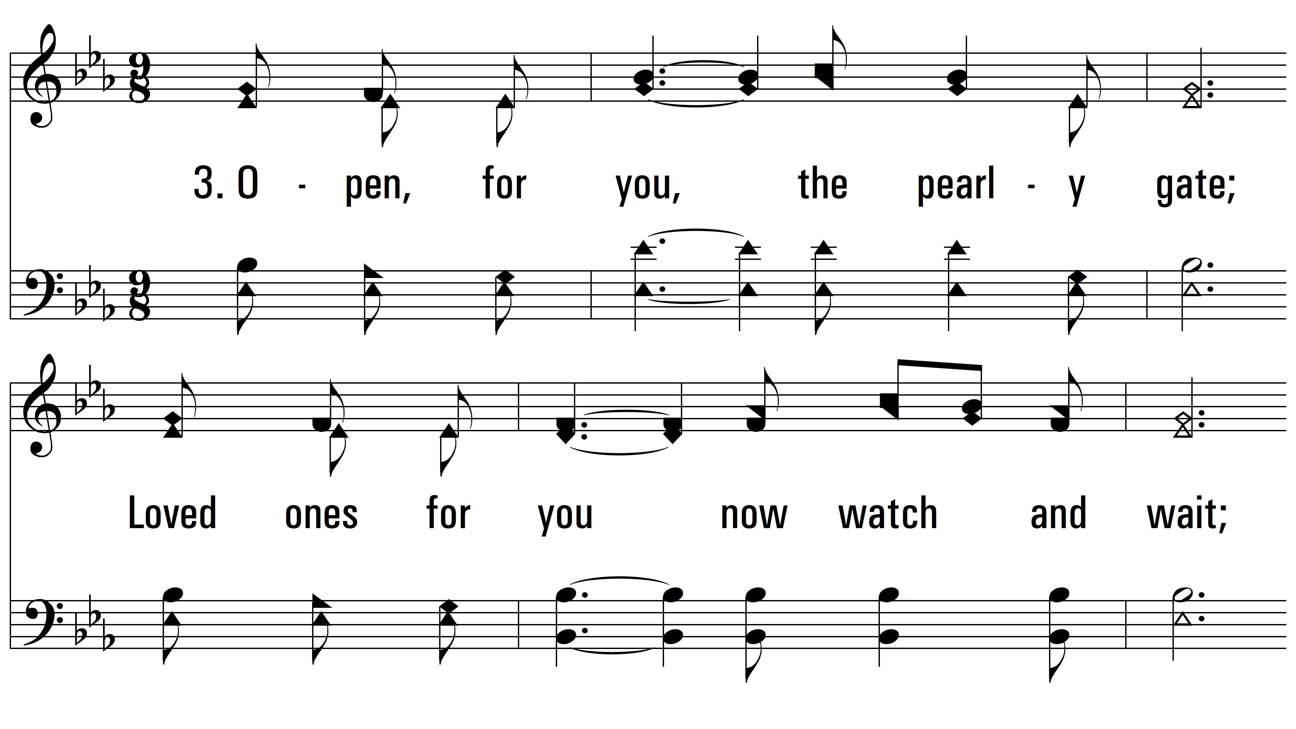
vs. 3 ~ Only A Step

Slide 11
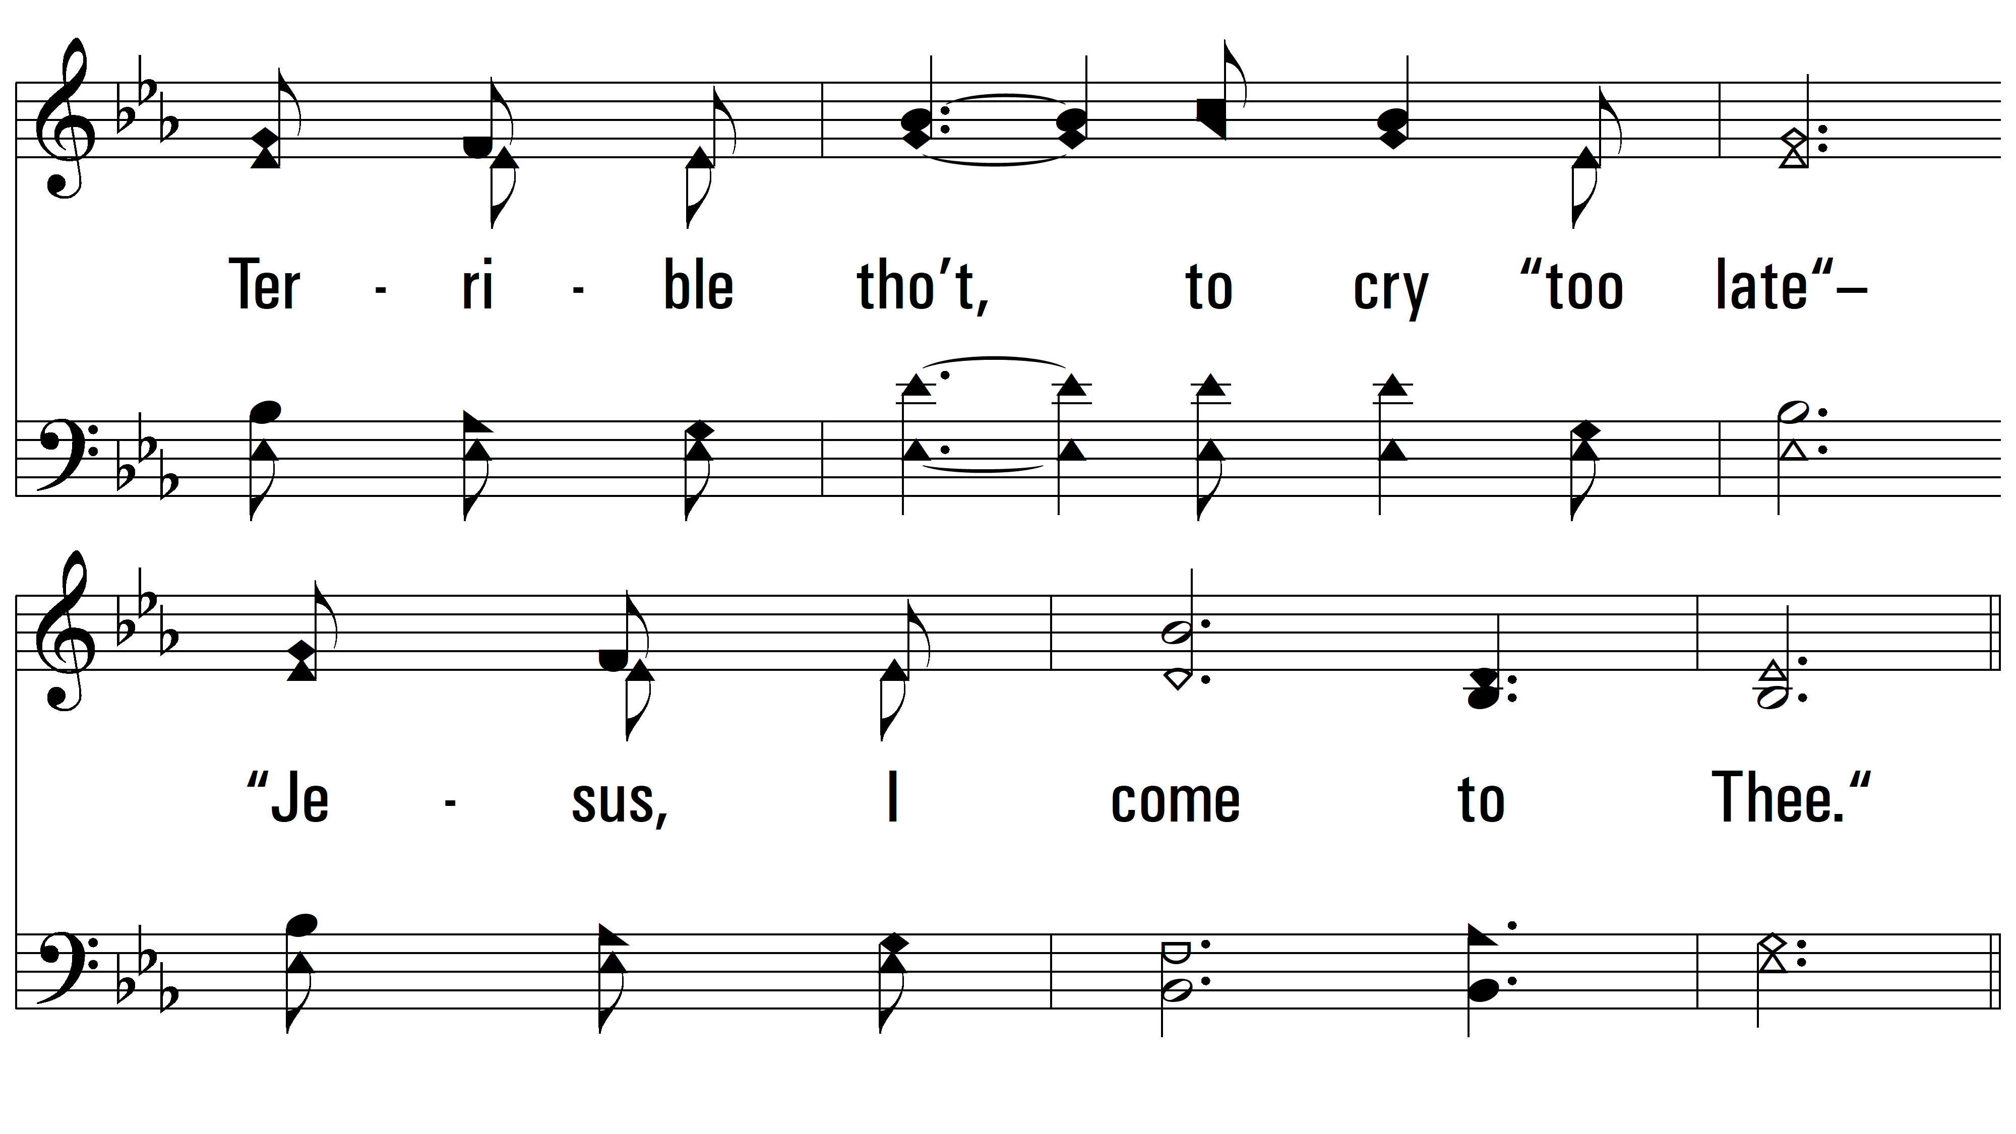
vs. 3

Slide 12
vs. 3

Slide 13
vs. 3
PDHymns.com
END

